Slide 1
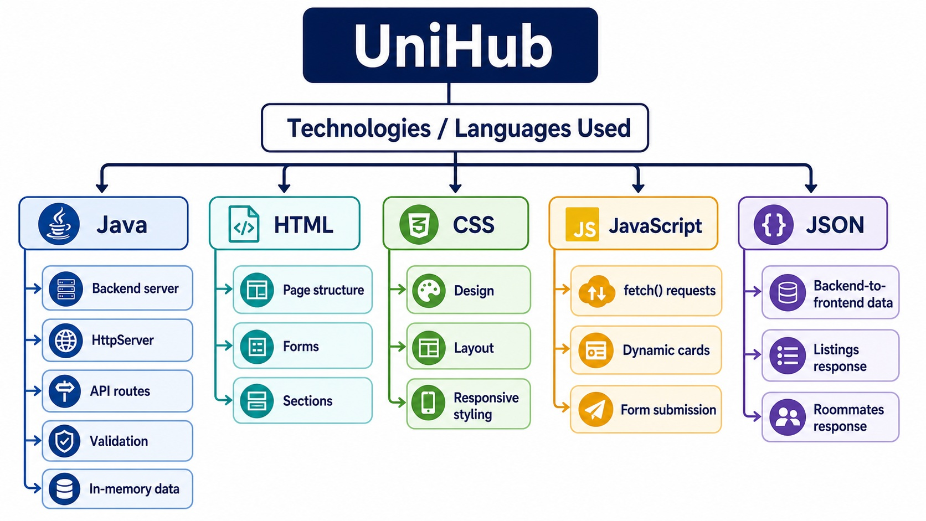
UniHub Technology Tree
Opening visual: languages, tools, and where they are used
UniHub | 1

Slide 2
Introduction
What Is UniHub?
A full stack student housing and roommate finder web app
UniHub helps students browse dorm listings and roommate profiles in one place.
Users can publish a new dorm listing or a roommate request through forms.
The page updates dynamically after data is submitted.
The project demonstrates frontend, backend, API communication, and a data layer.
Presentation goal
Show the app, explain how each part works, and defend the full stack flow clearly.
Core idea
Student dorm rental + roommate matching in one web application.
UniHub | 2

Slide 3
Problem
Why This Project Matters
The user problem and the project goal
Problem
Goal
Result
Students need dorms, rooms, and roommates, but information is usually scattered.
Provide one simple app where students can browse and post housing-related information.
A working local demo where data moves from the UI to the backend and back to the UI.
Dorm listings are sorted by price.
Roommate profiles are sorted by move-in date.
Forms make the app interactive instead of static.
UniHub | 3

Slide 4
Architecture
Full Stack Architecture
Frontend, backend, data, and API communication
Frontend
Backend
Data + API
HTML creates structure. CSS controls styling. JavaScript calls APIs and updates the page.
Java HttpServer serves files, handles routes, validates forms, and returns JSON.
In-memory Java lists store demo data. JSON is used to send responses to JavaScript.
Browser -> fetch() -> Java API route -> data layer -> JSON response -> updated cards
UniHub | 4

Slide 5
Frontend
Frontend Explanation
What the browser-side code does
HTML
CSS
JavaScript
Creates the page sections, forms, buttons, counters, and empty card containers.
Controls visual design, grids, spacing, colors, buttons, cards, and responsive layout.
Fetches API data, renders cards, submits forms, and reloads content after success.
Important HTML IDs: listingGrid, roommateGrid, listingForm, roommateForm.
CSS media query changes multi-column layouts into one column on small screens.
JavaScript uses fetch(), response.json(), FormData, and URLSearchParams.
UniHub | 5

Slide 6
Backend
Backend Explanation
What Java does in the project
Starts a local HTTP server on port 8080.
Serves static frontend files from the public folder.
Registers routes for /api/listings and /api/roommates.
Handles GET requests to read data.
Handles POST requests to create new data.
Validates required fields before saving.
Converts Java records into JSON strings.
HttpServer server = HttpServer.create(new InetSocketAddress(PORT), 0);
server.createContext("/api/listings", this::handleListings);
server.createContext("/api/roommates", this::handleRoommates);
server.createContext("/", new StaticHandler());
Backend language
Java is used for the backend server, route handling, validation, and data storage.
UniHub | 6

Slide 7
API
API Routes
How frontend and backend communicate
GET /api/listings
GET /api/roommates
Returns dorm listings sorted by price.
Returns roommate posts sorted by move-in date.
POST /api/listings
POST /api/roommates
Creates a new dorm listing from form data.
Creates a new roommate profile from form data.
GET = read existing data
POST = submit new data
JSON = response format
UniHub | 7

Slide 8
Data
Data Layer and Database Perspective
What stores the information
This project currently uses in-memory storage.
Data exists only while the Java server is running.
Submitted posts disappear when the server restarts.
For production, this would become MySQL, PostgreSQL, or SQLite.
The Java records map naturally to database tables.
CopyOnWriteArrayList<DormListing> listings
CopyOnWriteArrayList<RoommatePost> roommatePosts
AtomicInteger listingIds / roommateIds
Honest defense
The app has a data layer, but not persistent database storage. That is a clear future improvement.
UniHub | 8

Slide 9
JSON
JSON Communication
The message format used by the API
{
"listings": [
{
"id": 901,
"title": "Sunlit Studio Loft",
"price": 420
}
]
}
JSON is structured text, not a database.
Curly braces create an object.
Square brackets create a list.
Java builds JSON responses.
JavaScript reads JSON using response.json().
Then JavaScript renders the data as cards.
Simple explanation
JSON is the common language between the Java backend and JavaScript frontend.
UniHub | 9

Slide 10
Demo
Live Demo Flow
What to show during presentation
Compile: javac -d out src/DormMateServer.java
Run: java -cp out DormMateServer
Open: http://localhost:8080
Show dorm listings and roommate profiles.
Submit a new dorm listing.
Submit a new roommate request.
Explain that JavaScript sends POST requests and reloads data from the backend.
javac -d out src/DormMateServer.java
java -cp out DormMateServer
Demo point
Every submission proves the full stack loop from browser to Java and back.
UniHub | 10

Slide 11
Quality
Validation, Security, and Limits
What works and what can improve
Validation
Security
Limits
HTML uses required fields and input types. Java also checks required values and invalid data.
Static files are normalized to stay inside public. JSON strings are escaped before response.
No real database, no login, no edit/delete, and possible XSS risk from dynamic innerHTML.
Best next upgrades: persistent database, authentication, search filters, and stronger input sanitization.
This version focuses on proving the full stack request-response cycle.
UniHub | 11

Slide 12
Q&A
Expected Questions
Short answers to prepare
What makes it full stack? Frontend, backend, API, and data layer.
Where is the database? Currently in-memory; production would use SQL.
Why JSON? It sends structured data between Java and JavaScript.
What does GET do? Reads existing data.
What does POST do? Creates new data.
What would you improve? Database, login, search, edit/delete, security.
Final defense
UniHub demonstrates the complete flow: user input -> JavaScript -> Java backend -> data storage -> JSON -> updated UI.
UniHub | 12

Slide 13
Closing
Final Summary
End with confidence
"UniHub is a full stack Java web application for student dorm listings and roommate matching. HTML creates the structure, CSS styles the interface, JavaScript communicates with the backend, and Java handles server routes, validation, data storage, and JSON responses."
Memorize this
The project is a working full stack demo. Its main limitation is no persistent database yet.
UniHub | 13

