Slide 1
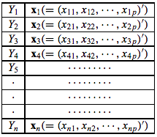
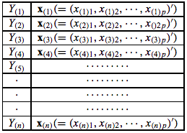
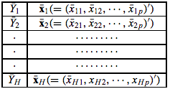
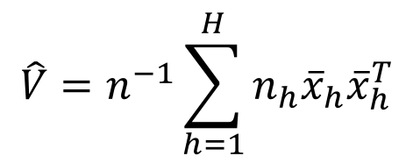
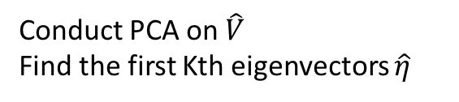

Original data
Sorted and sliced by y
Slice means of standardized data
$$\hat{V}=n^{−1}\sum_{h=1}^{H}{n_{h}{\overline{x}}_{h}{\overline{x}}_{h}^{T}}$$
Conduct PCA on $\hat{V}$
Find the first Kth eigenvectors $\hat{η}$
$${\hat{β}}_{k}={\hat{η}}_{k}Σ_{xx}^{−1/2}$$
Estimated Covariance matrix

