Slide 1


Car Showroom Web Application (MVC)
Team Members: Abobaker, Asem, Mohamed, Warda, Walaa

Slide 2

System Overview
A web-based car showroom for browsing, reviewing, and purchasing vehicles.
Key features include authentication, car catalog, wishlist, reviews, shopping cart, checkout, and admin control.

Slide 3

Team Roles
Abobaker: Authentication System, User Profile
Asem: Car Catalog (CRUD + Views)
Mohamed: Wishlist, Reviews
Warda: Cart, Order Flow, Checkout
Walaa: Promotions, Admin Dashboard

Slide 4
Functional Requirements
Account management (register/login/logout)
View and filter car listings
Add/remove from wishlist
Submit/read reviews for cars
Add to cart, checkout, and track orders
Admin dashboard to manage data

Slide 5
Non-Functional Requirements
Performance: Fast and responsive UI
Security: Encrypted passwords, session control
Scalability: Modular codebase using layers
Usability: Clean Bootstrap-based interface
Reliability: Stable database using Entity Framework

Slide 6
System Design
Architecture: N-Tier Architecture
- Presentation Layer (Views)
- Business Logic Layer (Controllers & Services)
- Data Access Layer (EF Repositories)
Design Pattern: MVC
Frameworks Used: ASP.NET MVC, Entity Framework (Code First), SQL Server, Bootstrap

Slide 7
Database Design
Main Tables: Users, Cars, WishlistItems, Reviews, Orders, OrderItems, Promotions
Entity Relationships:
- User → WishlistItems, Reviews, Orders (One-to-Many)
- Car → Reviews, OrderItems (One-to-Many)
- Order → OrderItems (One-to-Many)

Slide 8
Technology Stack
Backend: ASP.NET MVC, C#
Frontend: HTML, CSS, JavaScript, Bootstrap
Database: SQL Server
ORM: Entity Framework (Code First)
IDE: Visual Studio

Slide 9
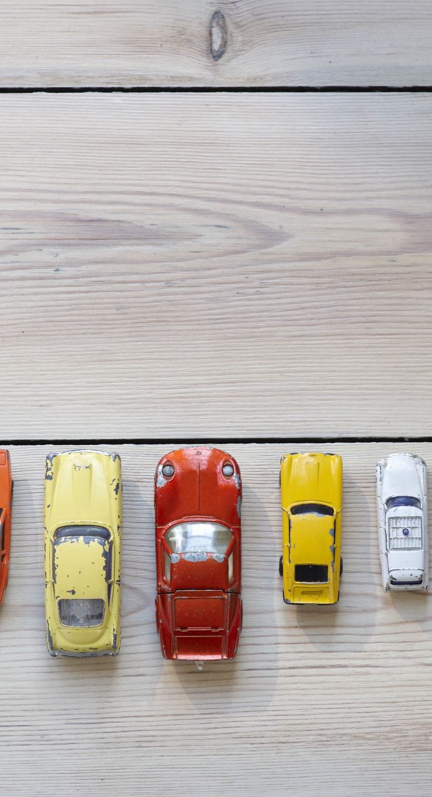
Code & Logic
Wishlist:
- Action method adds/removes cars to/from wishlist
- Data displayed via partial views in profile
Reviews:
- Review model includes Rating, Comment, Date, UserId, CarId
- Displayed under each car page with user details

Slide 10
Conclusion & Future Work
Achievements:
- Practical experience with ASP.NET MVC & Entity Framework
- Hands-on work with database modeling and real-world logic
Future Enhancements:
- Online payment integration
- Advanced admin analytics

Slide 11




Thank You
Questions and feedback welcome!

