Slide 1

Notes:
Official source: https://bcs.gov.ph/wp-content/uploads/2021/09/SONA-Speech-2019.pdf
Language: Filipino
Source PDF page: 1

Slide 2
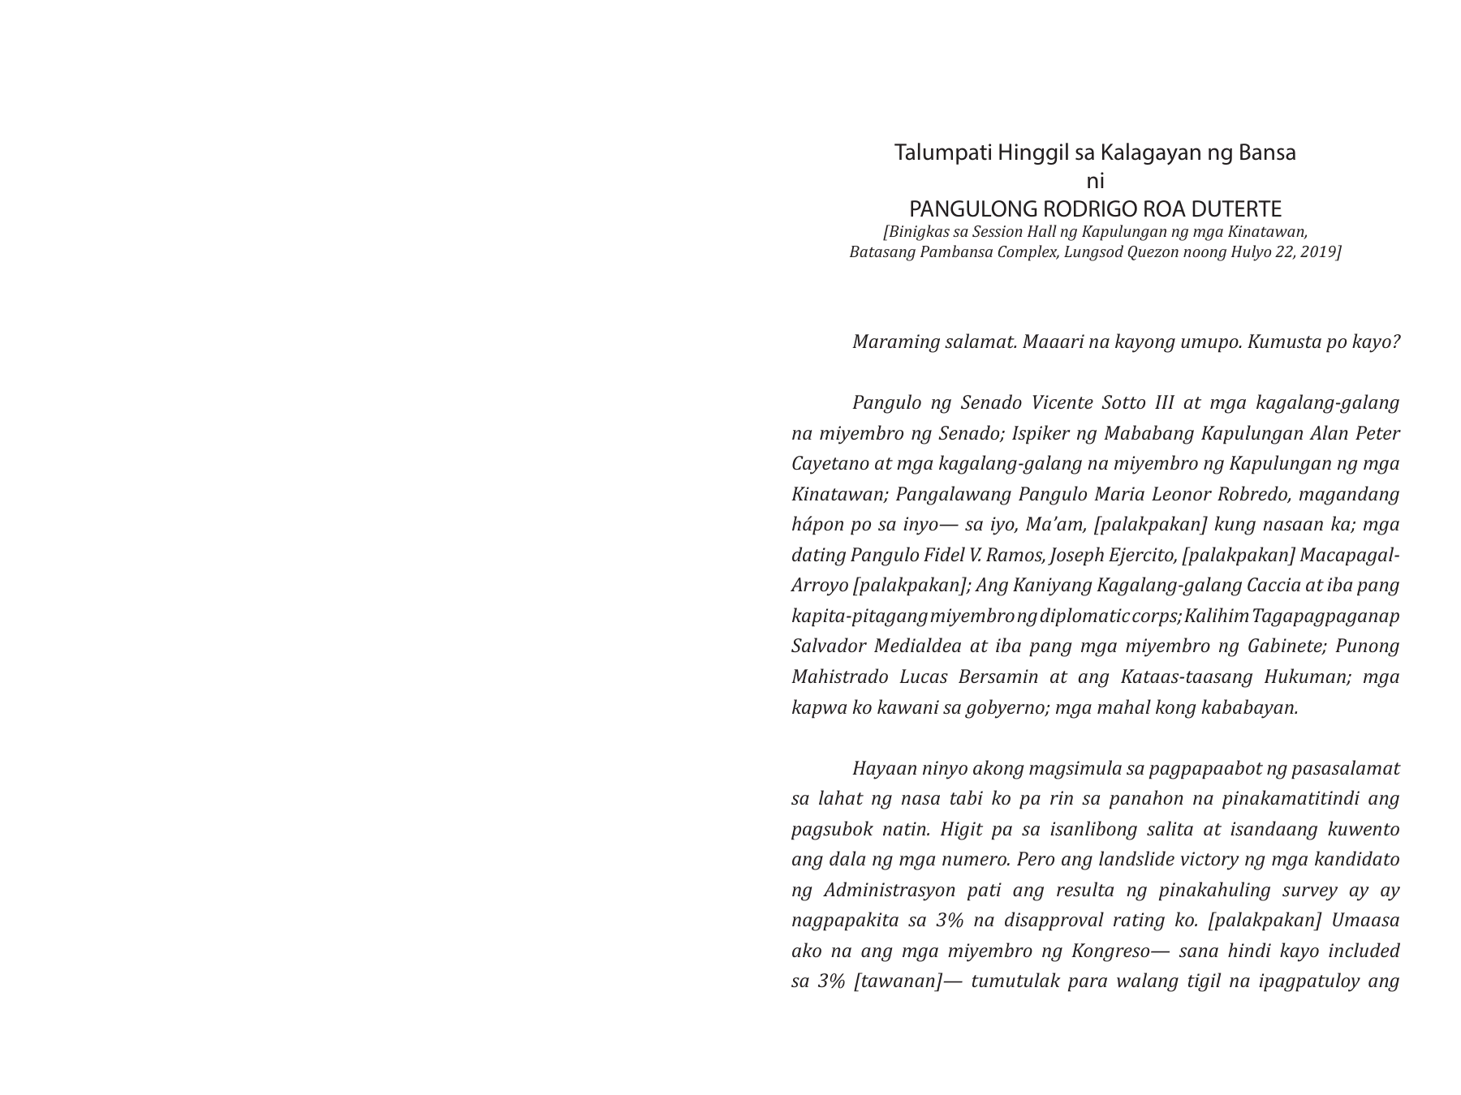
Notes:
Official source: https://bcs.gov.ph/wp-content/uploads/2021/09/SONA-Speech-2019.pdf
Language: Filipino
Source PDF page: 2

Slide 3
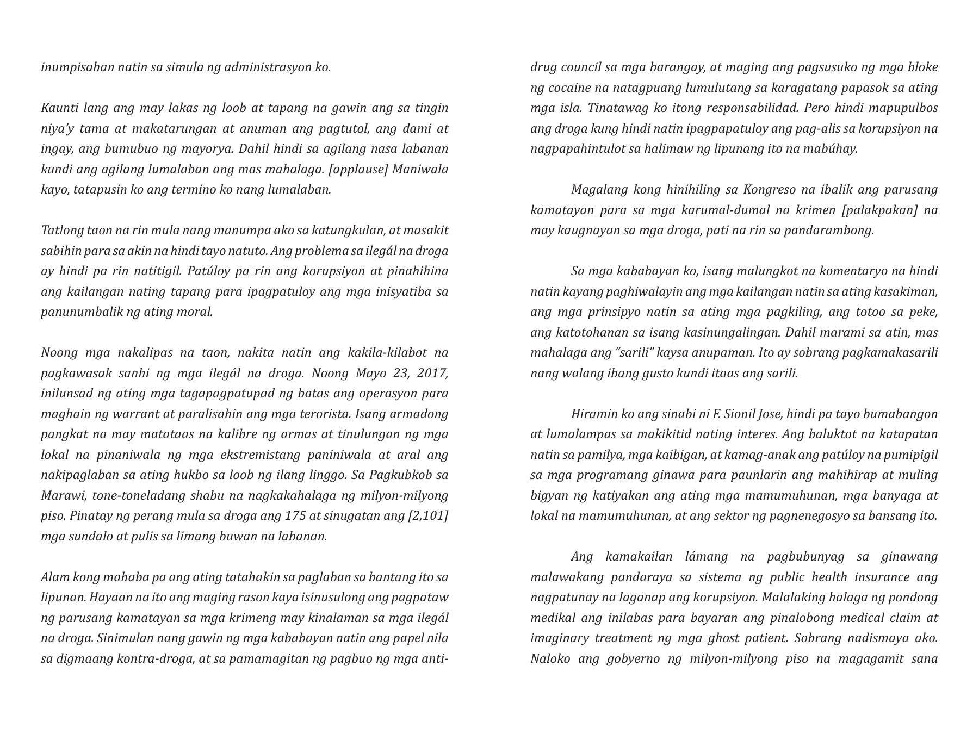
Notes:
Official source: https://bcs.gov.ph/wp-content/uploads/2021/09/SONA-Speech-2019.pdf
Language: Filipino
Source PDF page: 3

Slide 4
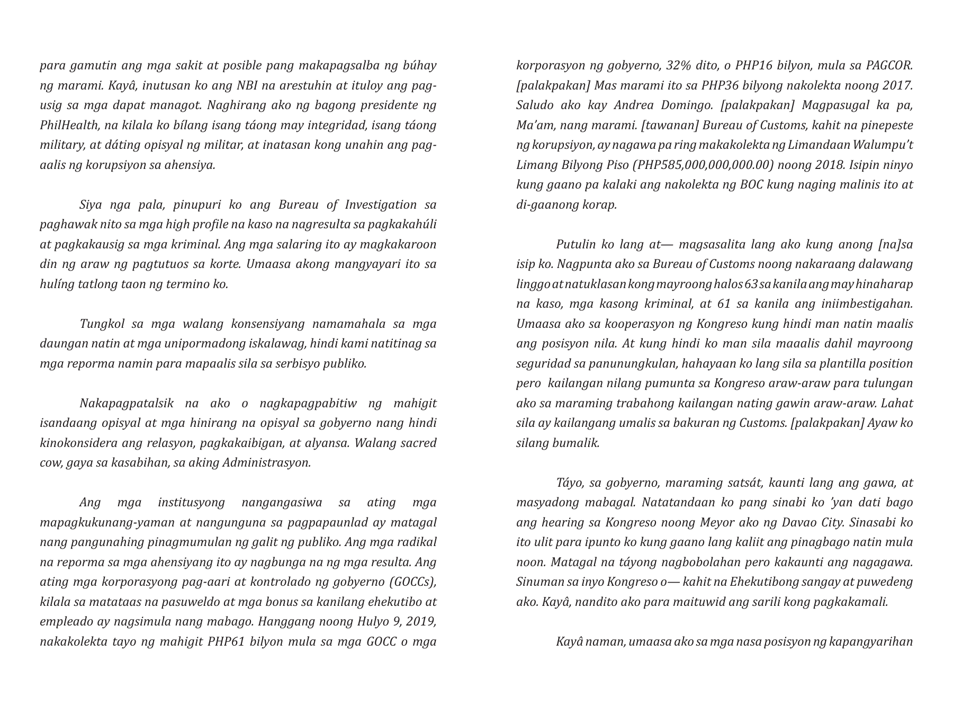
Notes:
Official source: https://bcs.gov.ph/wp-content/uploads/2021/09/SONA-Speech-2019.pdf
Language: Filipino
Source PDF page: 4

Slide 5
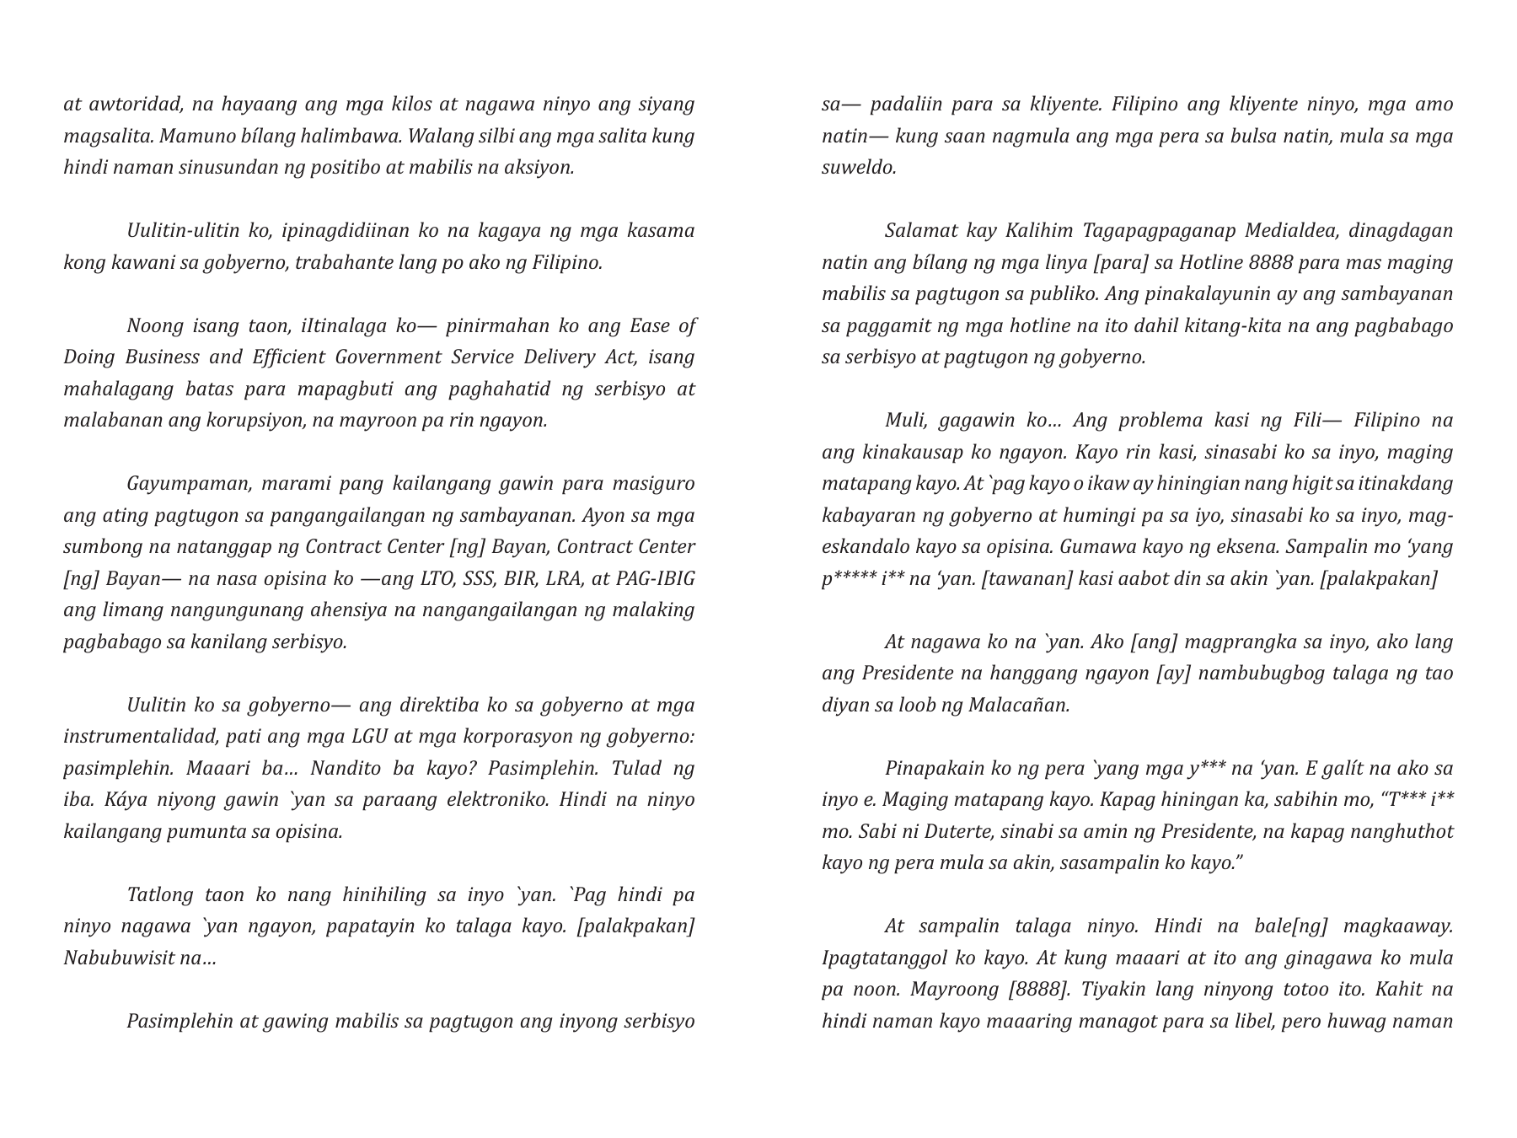
Notes:
Official source: https://bcs.gov.ph/wp-content/uploads/2021/09/SONA-Speech-2019.pdf
Language: Filipino
Source PDF page: 5

Slide 6
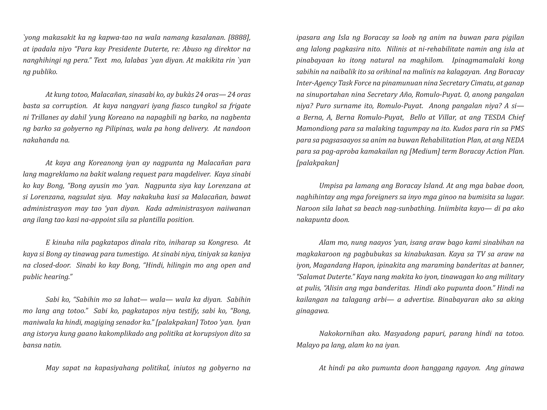
Notes:
Official source: https://bcs.gov.ph/wp-content/uploads/2021/09/SONA-Speech-2019.pdf
Language: Filipino
Source PDF page: 6

Slide 7
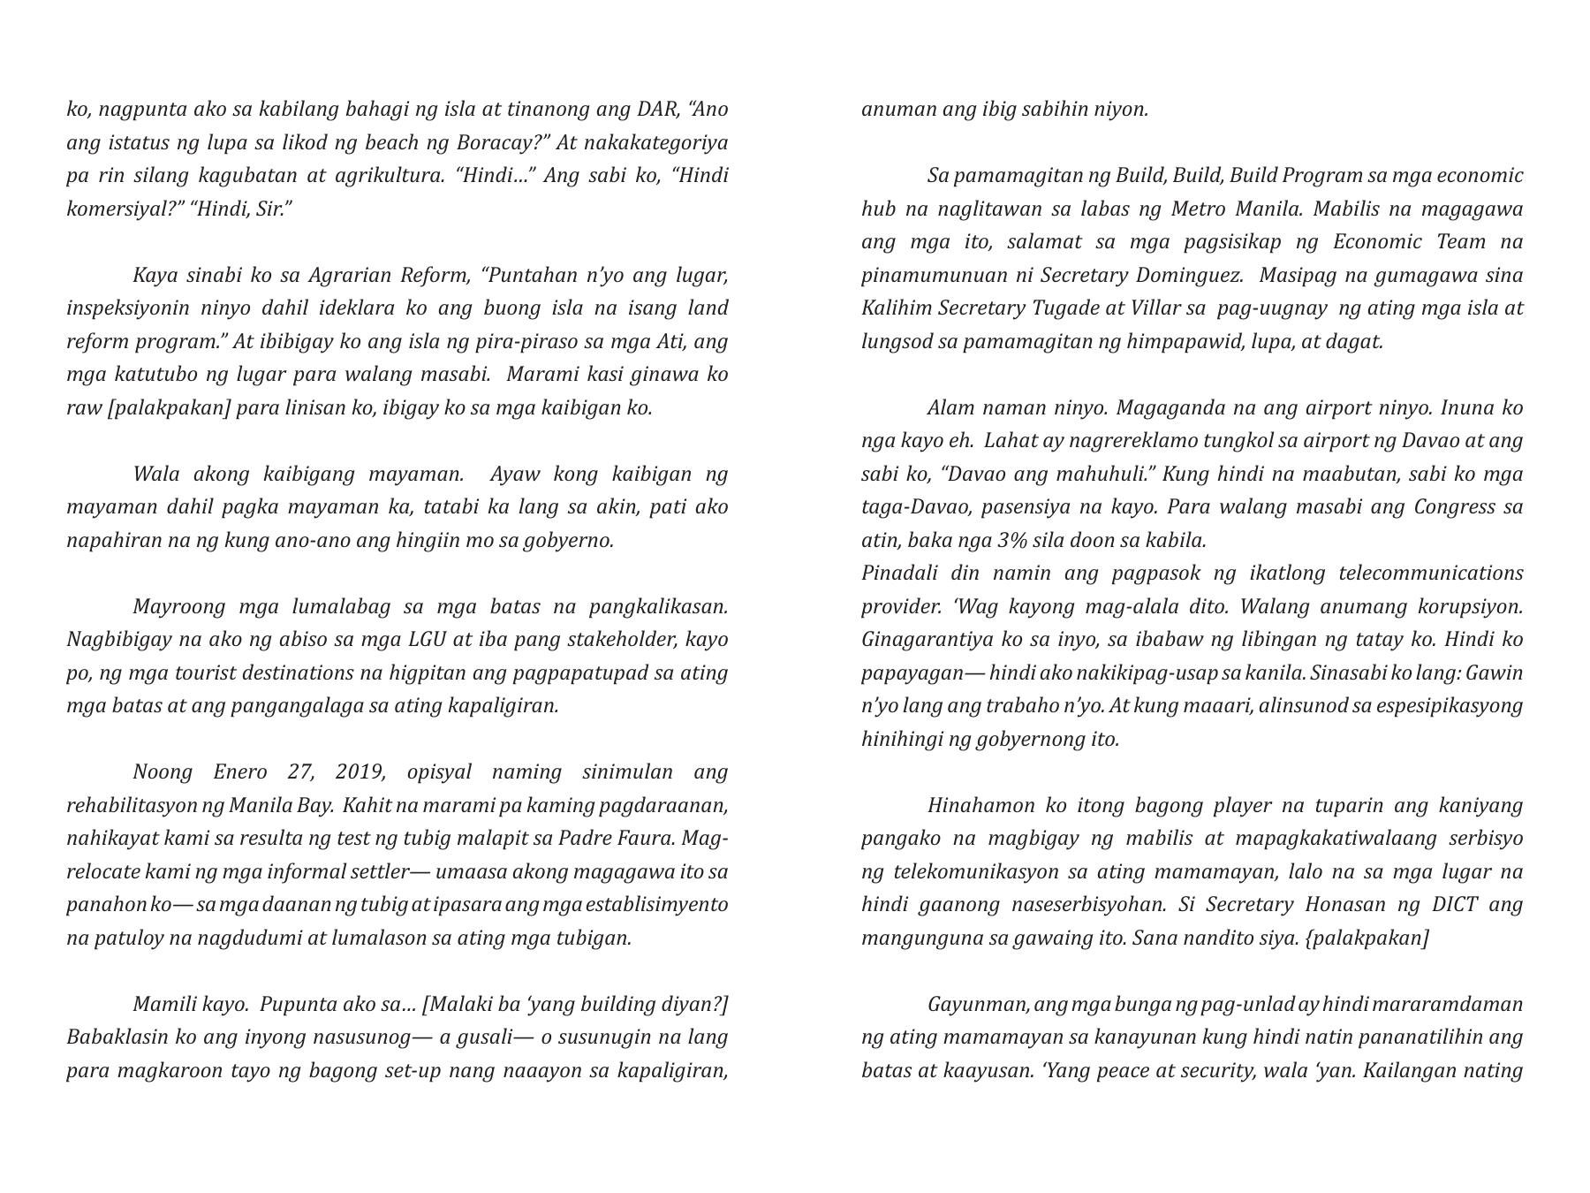
Notes:
Official source: https://bcs.gov.ph/wp-content/uploads/2021/09/SONA-Speech-2019.pdf
Language: Filipino
Source PDF page: 7

Slide 8
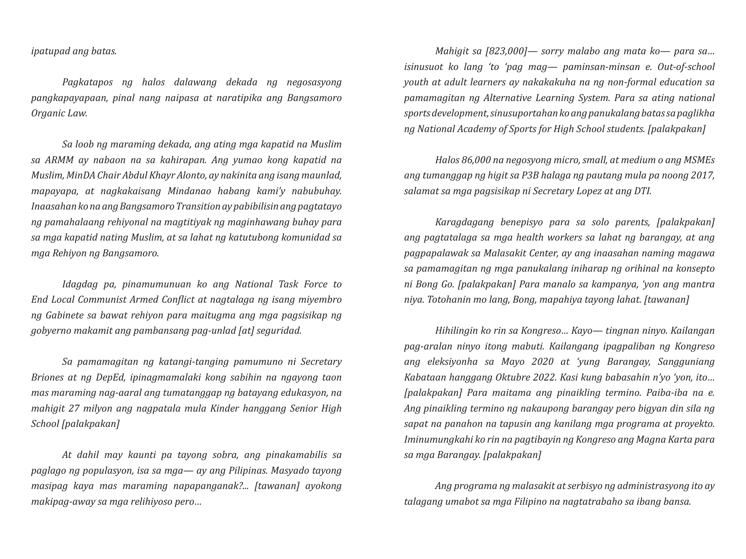
Notes:
Official source: https://bcs.gov.ph/wp-content/uploads/2021/09/SONA-Speech-2019.pdf
Language: Filipino
Source PDF page: 8

Slide 9
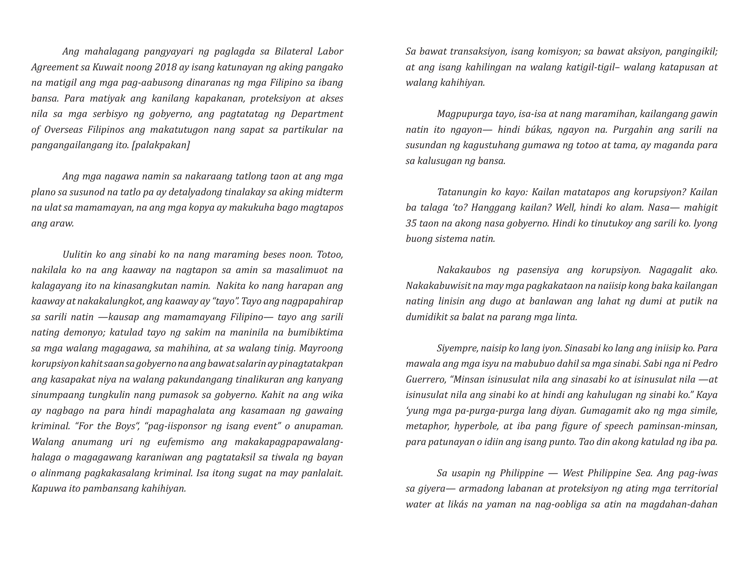
Notes:
Official source: https://bcs.gov.ph/wp-content/uploads/2021/09/SONA-Speech-2019.pdf
Language: Filipino
Source PDF page: 9

Slide 10
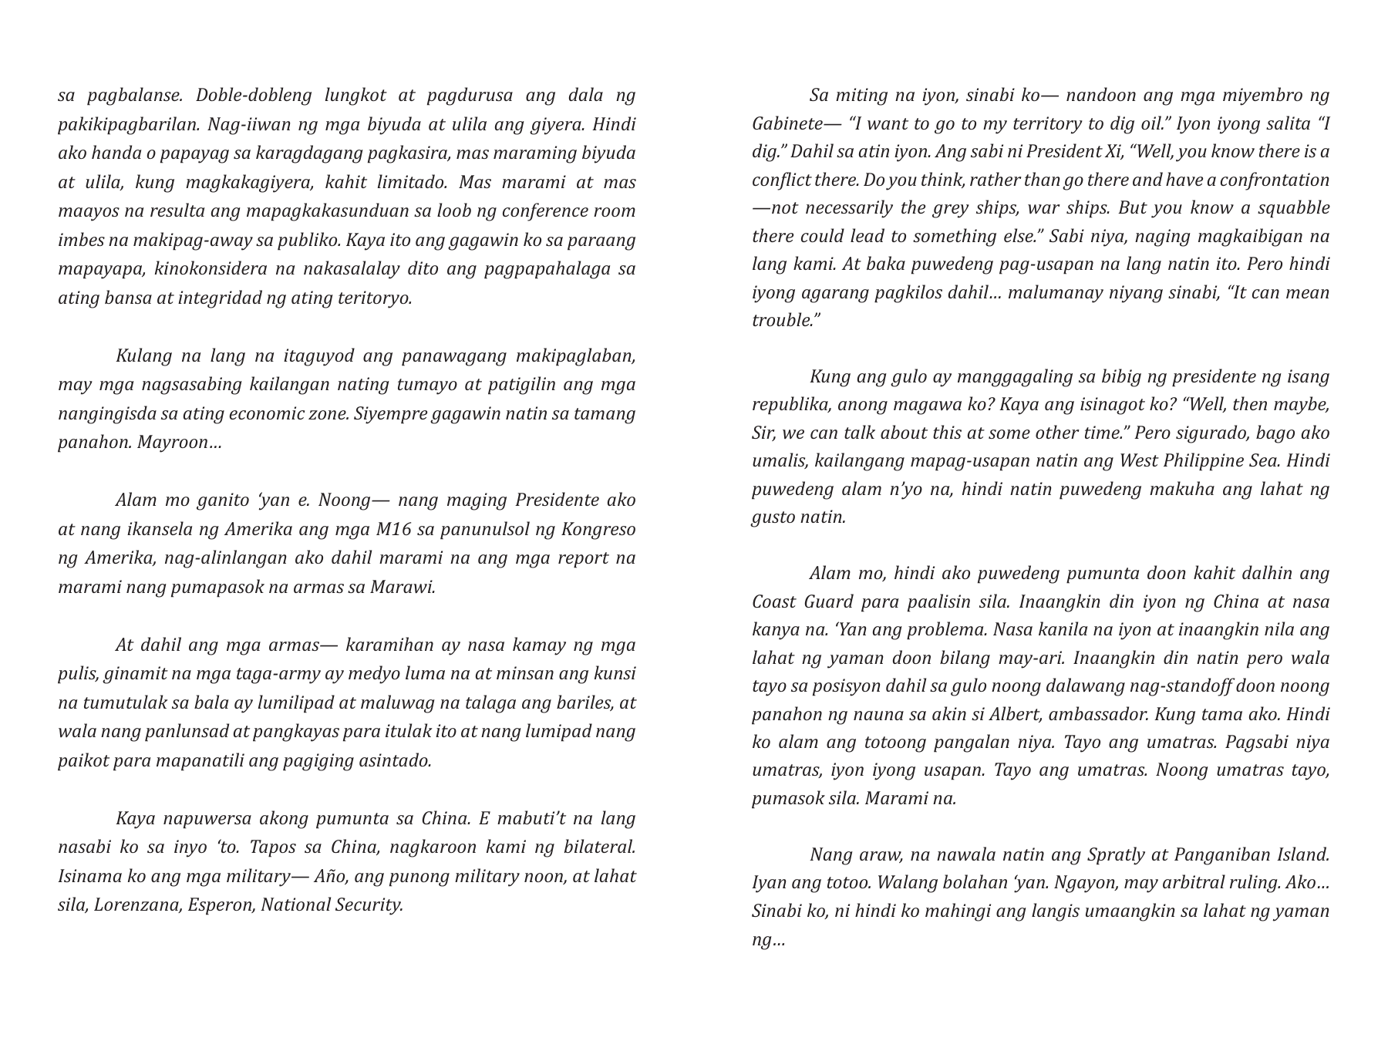
Notes:
Official source: https://bcs.gov.ph/wp-content/uploads/2021/09/SONA-Speech-2019.pdf
Language: Filipino
Source PDF page: 10

Slide 11
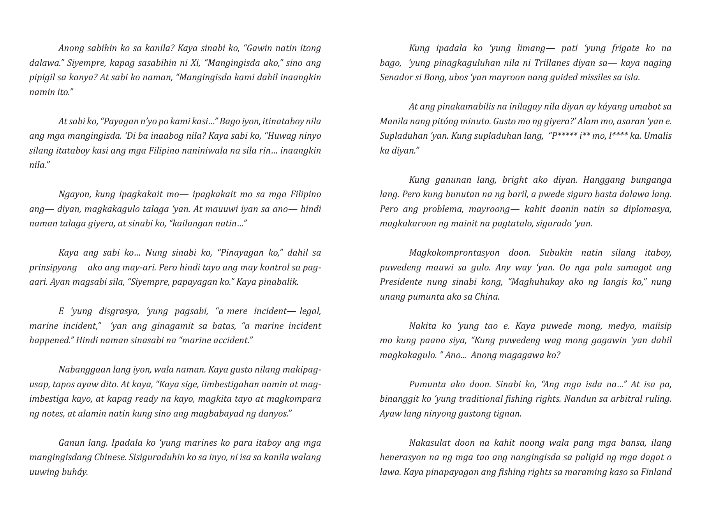
Notes:
Official source: https://bcs.gov.ph/wp-content/uploads/2021/09/SONA-Speech-2019.pdf
Language: Filipino
Source PDF page: 11

Slide 12
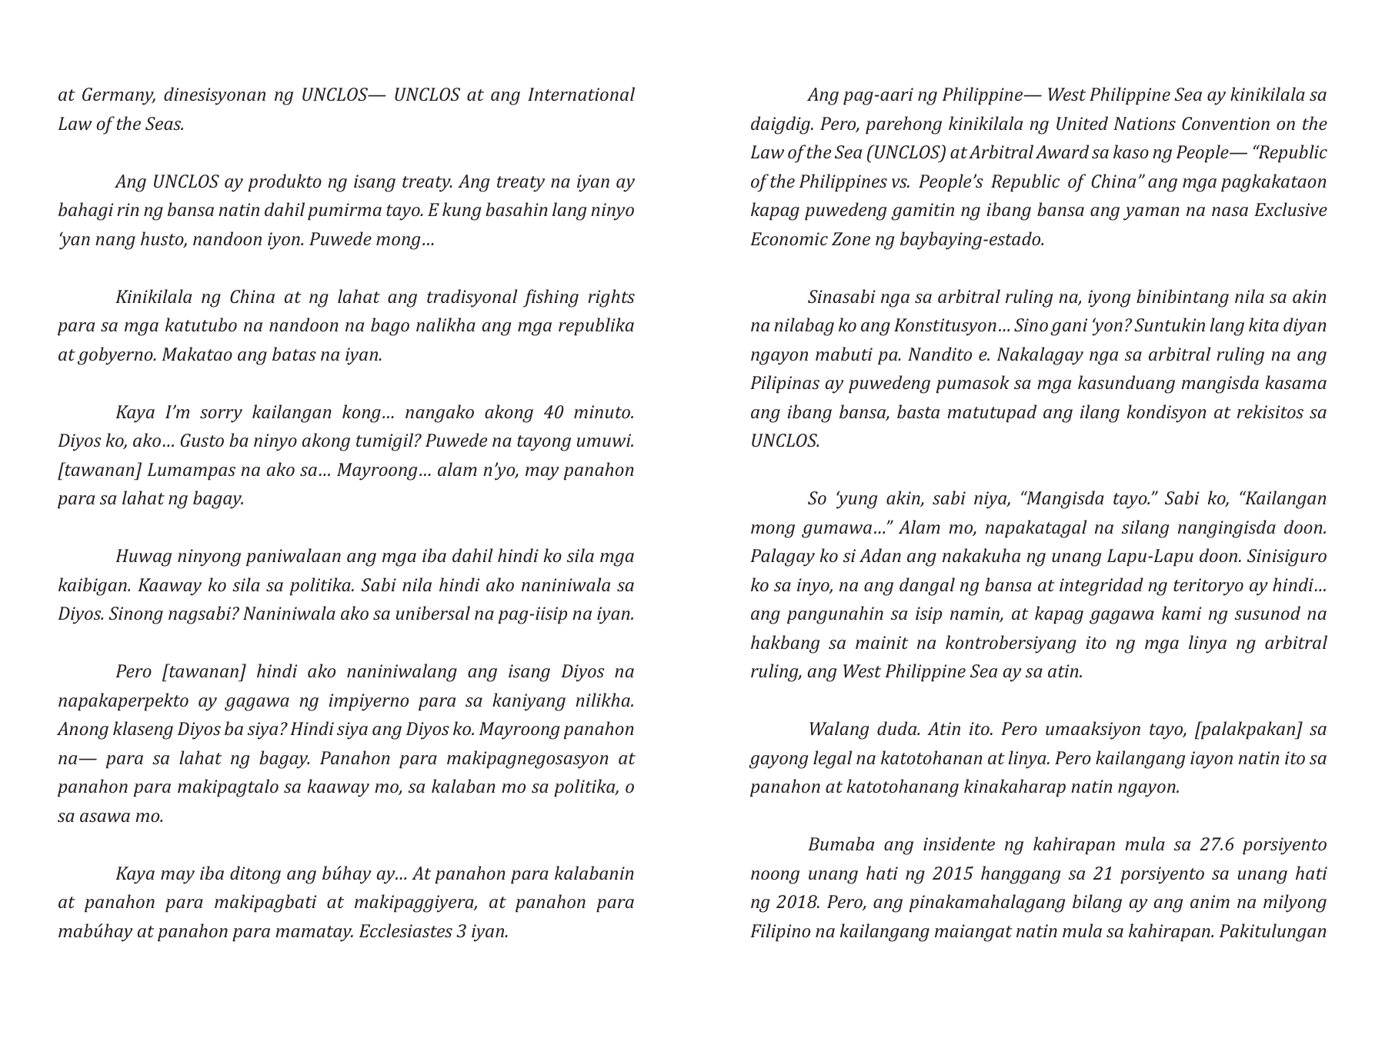
Notes:
Official source: https://bcs.gov.ph/wp-content/uploads/2021/09/SONA-Speech-2019.pdf
Language: Filipino
Source PDF page: 12

Slide 13
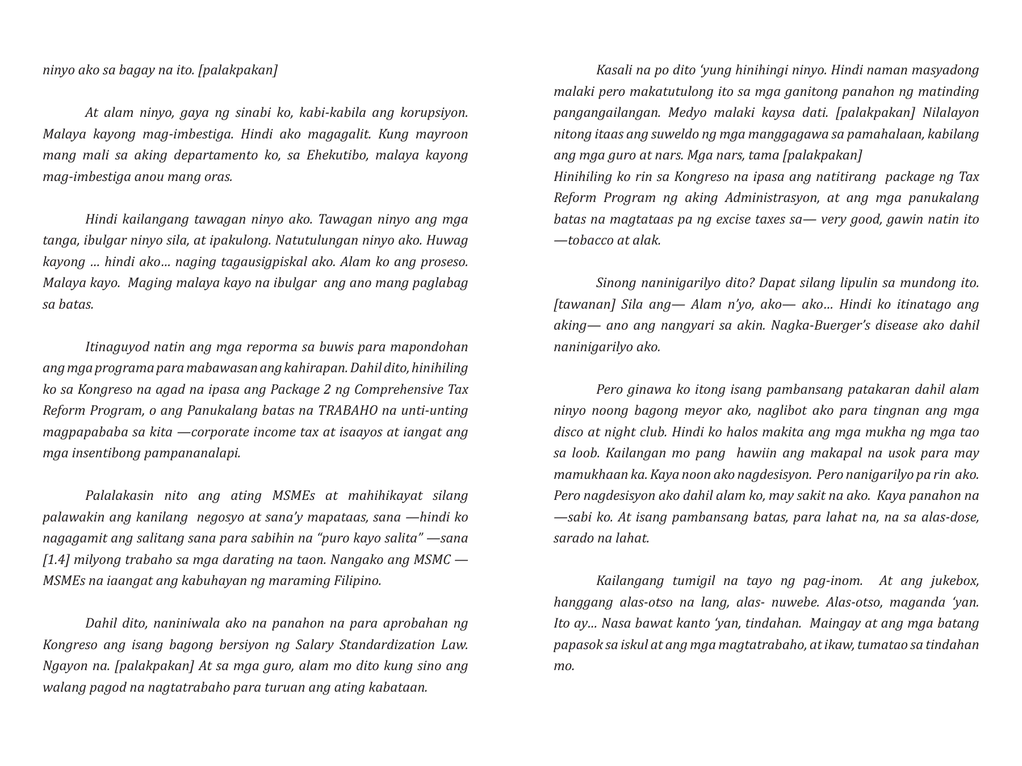
Notes:
Official source: https://bcs.gov.ph/wp-content/uploads/2021/09/SONA-Speech-2019.pdf
Language: Filipino
Source PDF page: 13

Slide 14
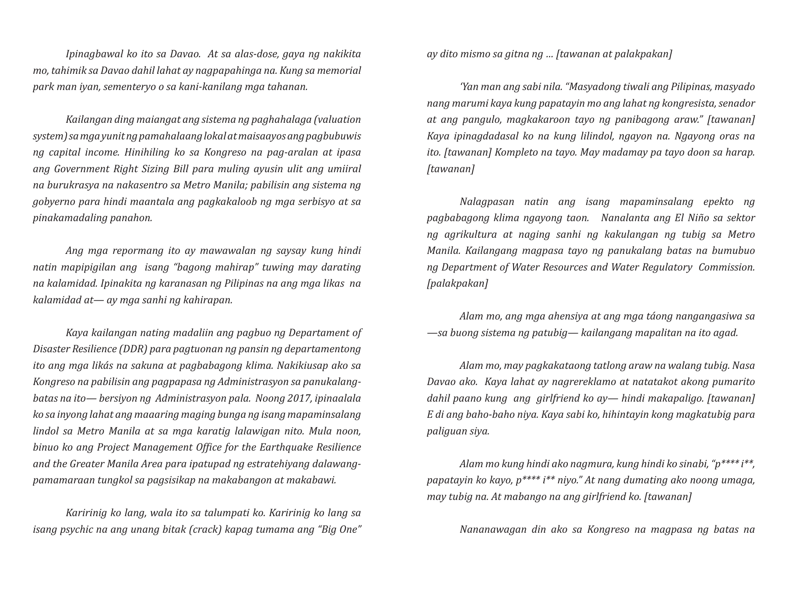
Notes:
Official source: https://bcs.gov.ph/wp-content/uploads/2021/09/SONA-Speech-2019.pdf
Language: Filipino
Source PDF page: 14

Slide 15
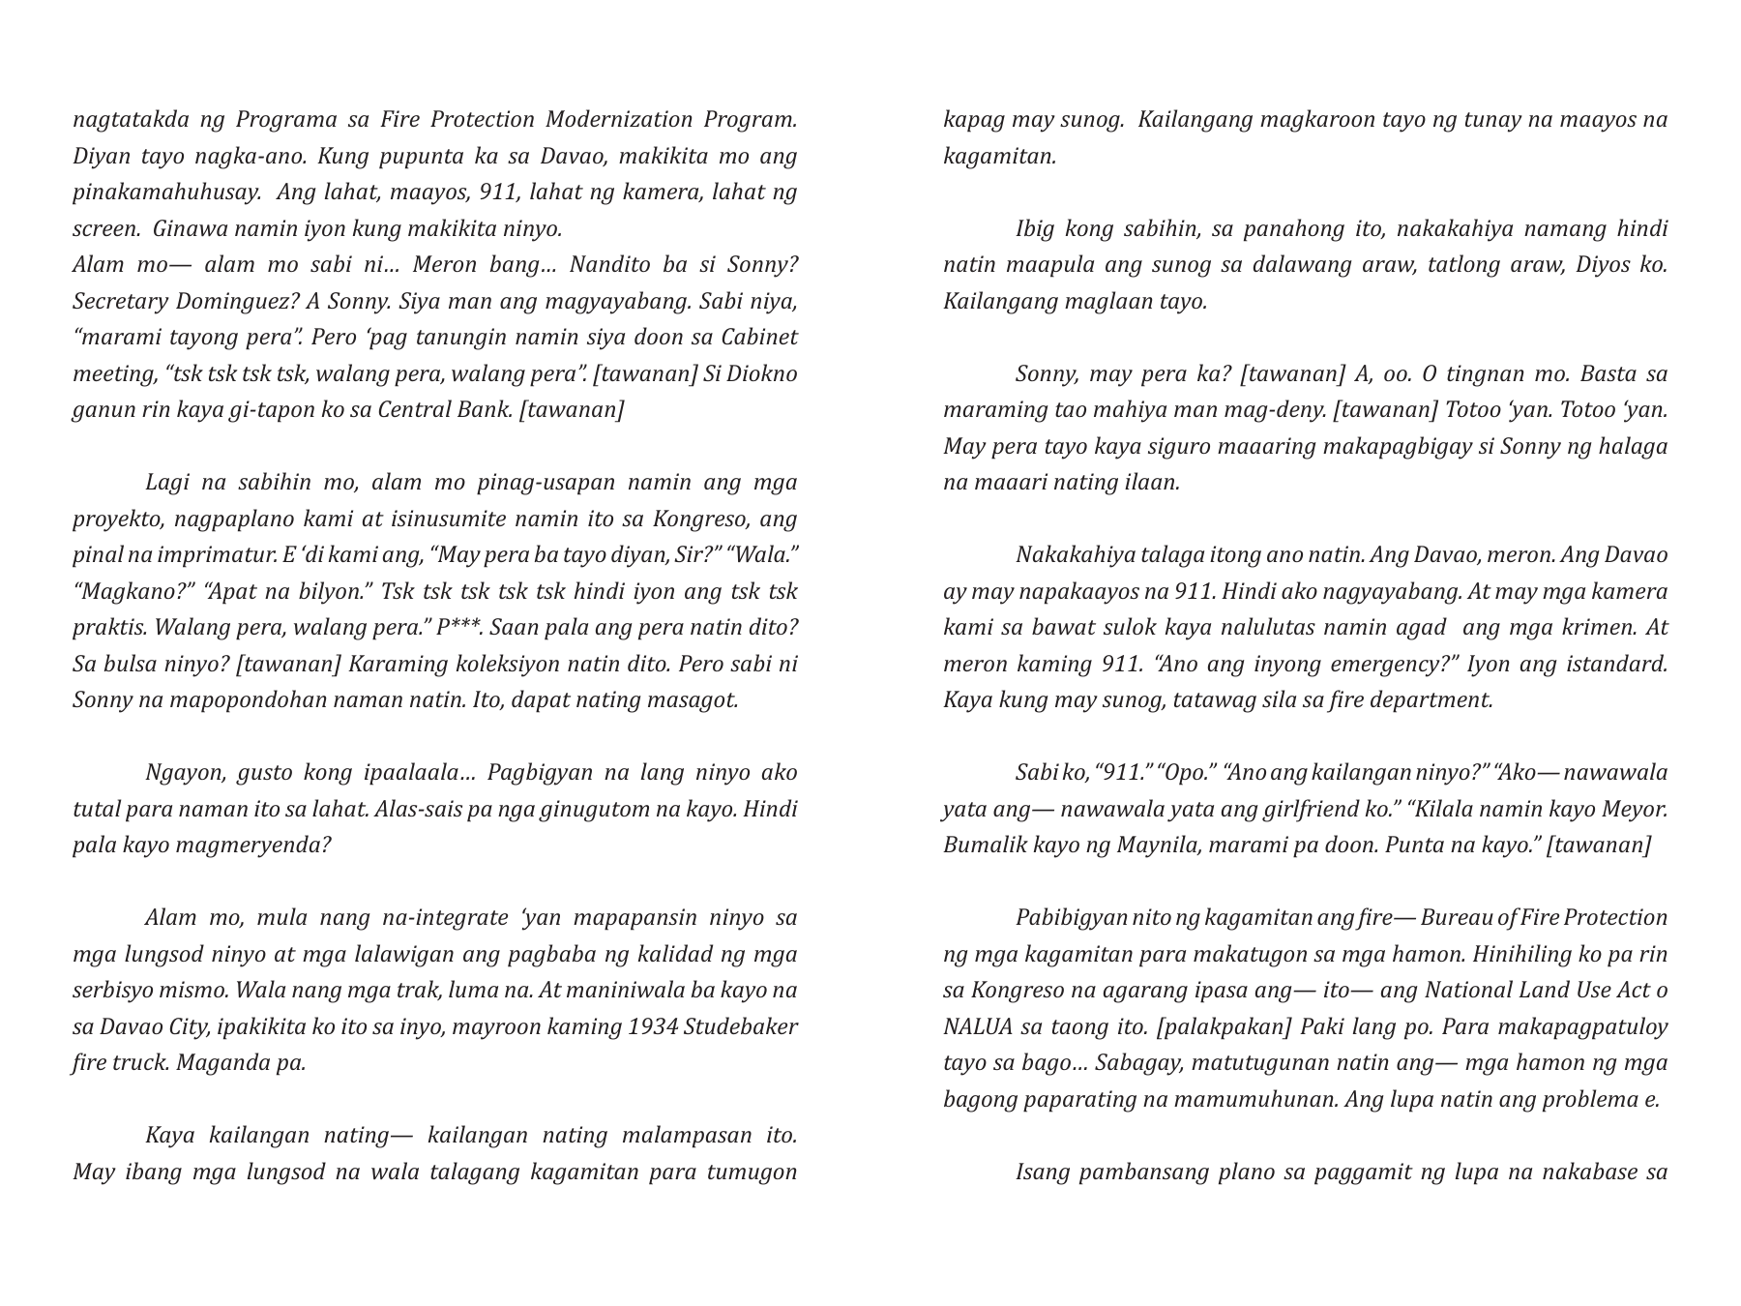
Notes:
Official source: https://bcs.gov.ph/wp-content/uploads/2021/09/SONA-Speech-2019.pdf
Language: Filipino
Source PDF page: 15

Slide 16
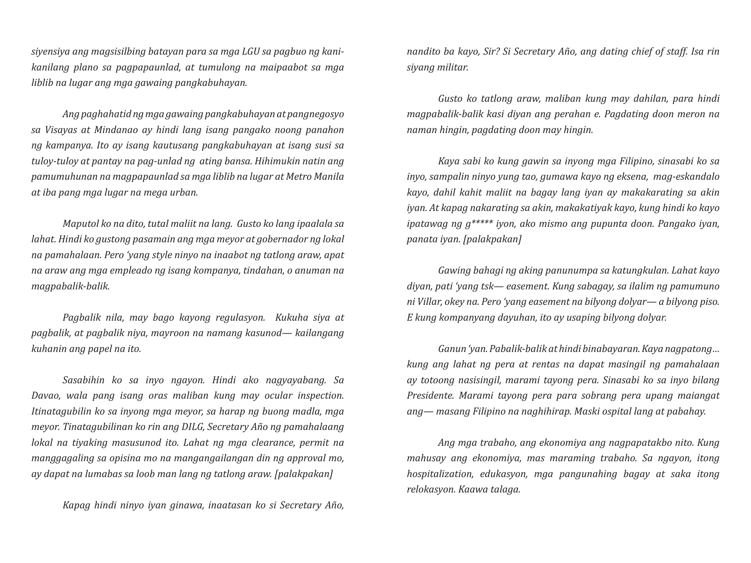
Notes:
Official source: https://bcs.gov.ph/wp-content/uploads/2021/09/SONA-Speech-2019.pdf
Language: Filipino
Source PDF page: 16

Slide 17
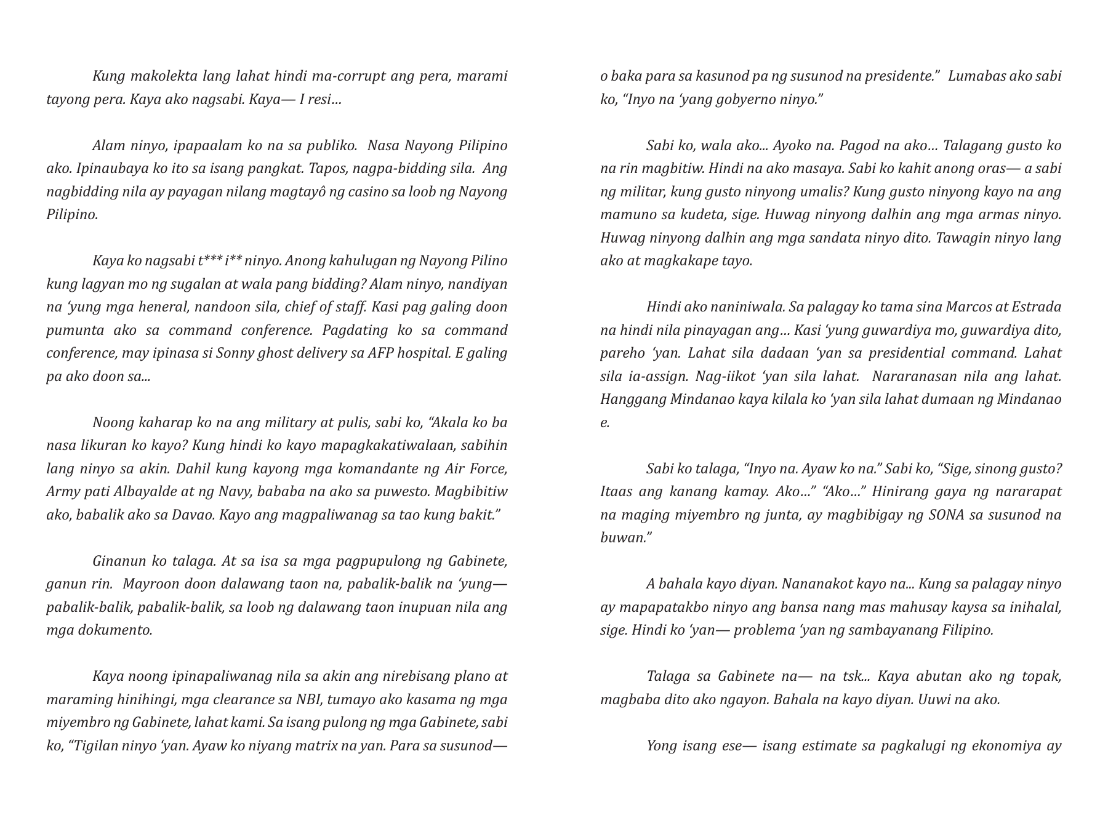
Notes:
Official source: https://bcs.gov.ph/wp-content/uploads/2021/09/SONA-Speech-2019.pdf
Language: Filipino
Source PDF page: 17

Slide 18
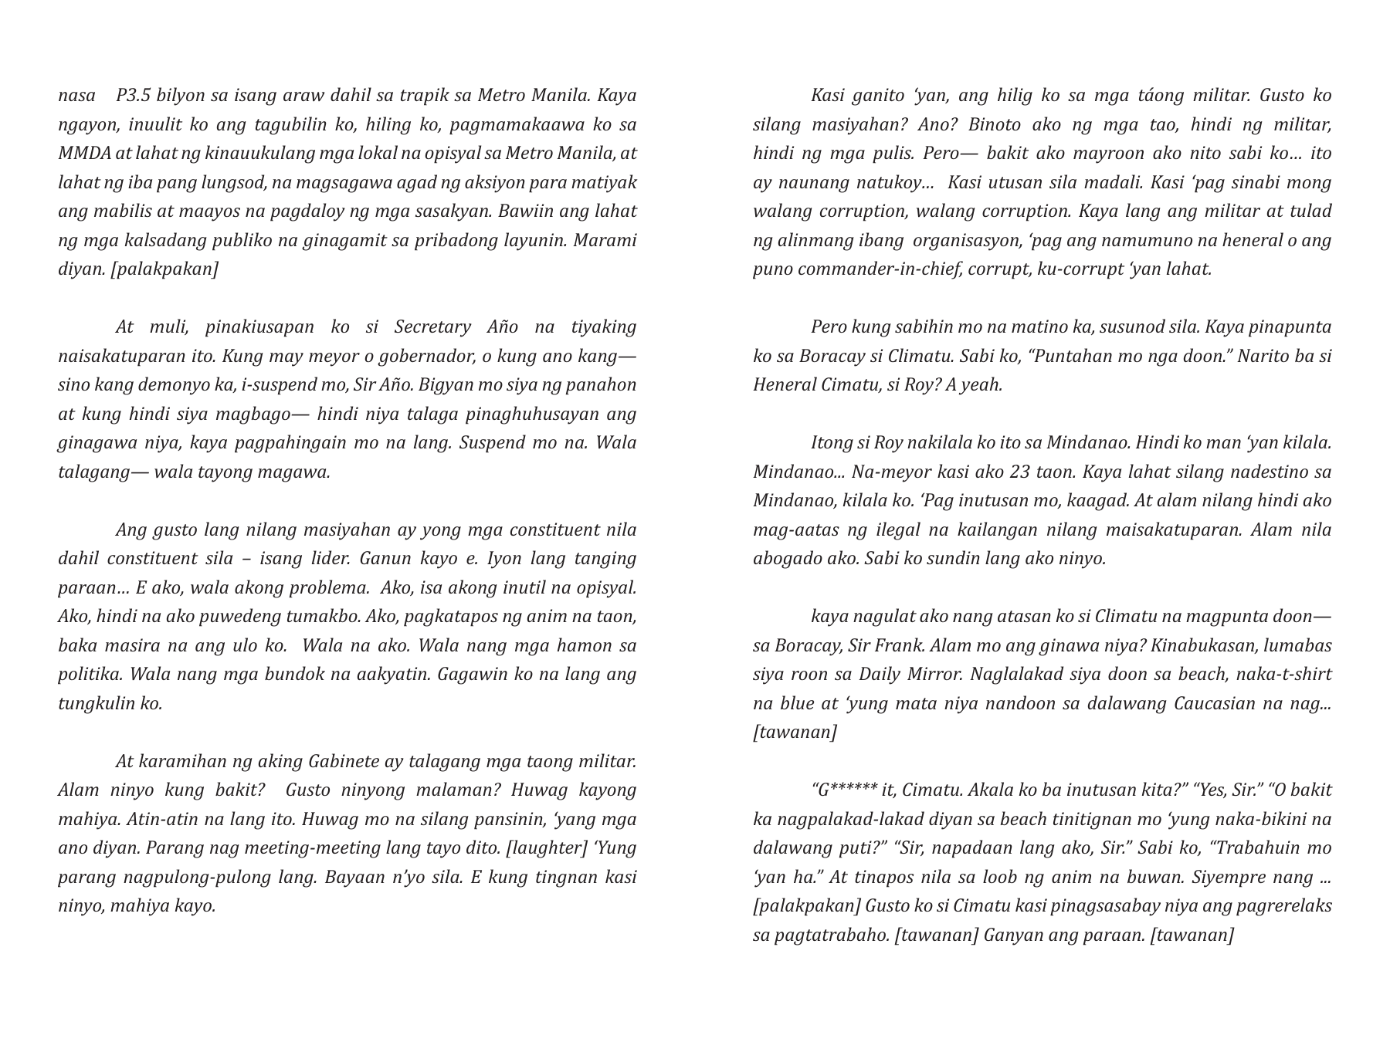
Notes:
Official source: https://bcs.gov.ph/wp-content/uploads/2021/09/SONA-Speech-2019.pdf
Language: Filipino
Source PDF page: 18

Slide 19
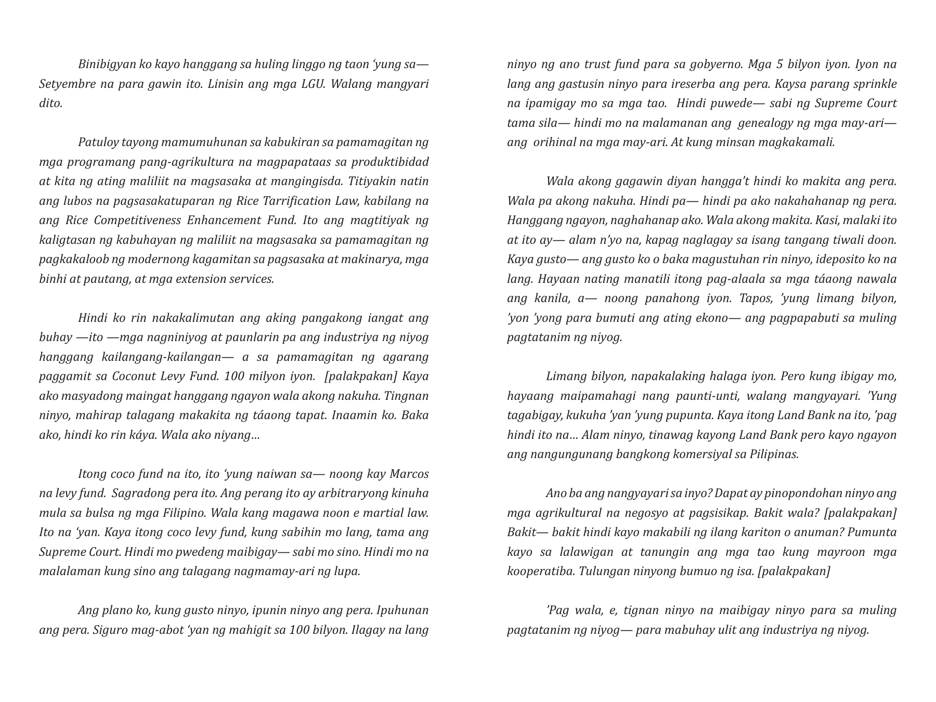
Notes:
Official source: https://bcs.gov.ph/wp-content/uploads/2021/09/SONA-Speech-2019.pdf
Language: Filipino
Source PDF page: 19

Slide 20
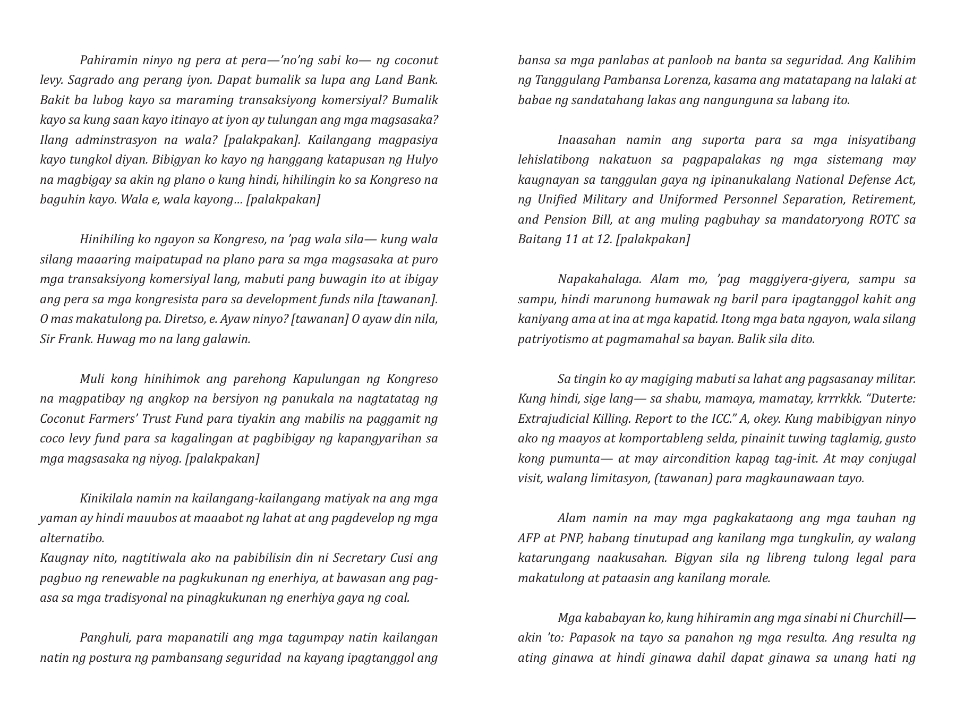
Notes:
Official source: https://bcs.gov.ph/wp-content/uploads/2021/09/SONA-Speech-2019.pdf
Language: Filipino
Source PDF page: 20

