Slide 1
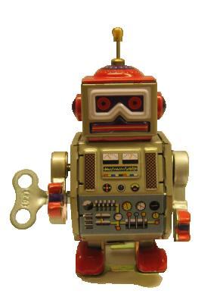
An introduction to
Robot Framework http://robotframework.org
© Copyright Nokia Siemens Networks
Creative Commons Attribution 3.0 License

Slide 2
Fast facts
Generic test automation framework
  Utilizes the keyword-driven testing approach
  Suitable for both “normal” test automation and ATDD
Implemented with Python
  Runs also on Jython (JVM) and IronPython (.NET)
  Can be extended natively using Python or Java
  Other languages supported via a remote interface
Open source
  Apache 2.0 license
  Sponsored by Nokia Siemens Networks
  Active development and growing community

Slide 3
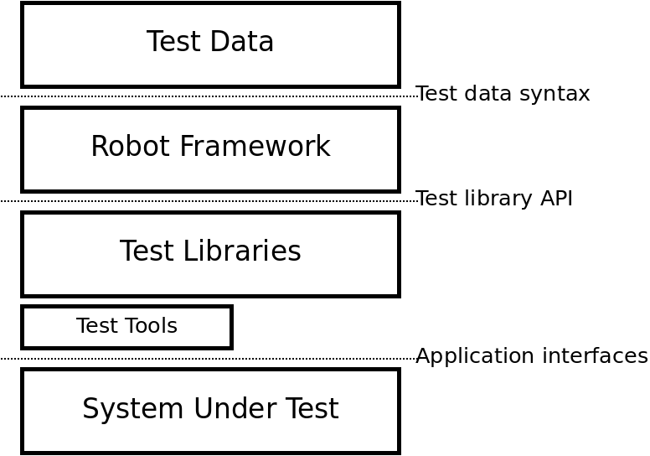
High level architecture

Slide 4
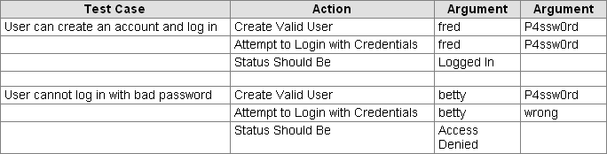
Simple tabular syntax

Slide 5
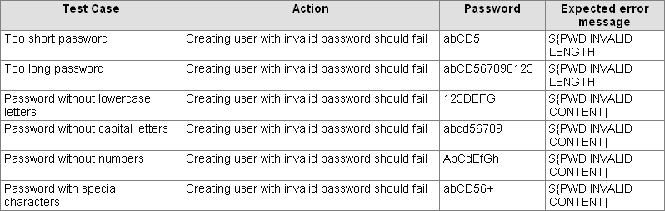
Data-driven test cases

Slide 6
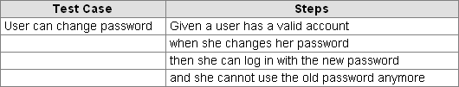
Executable specifications

Slide 7
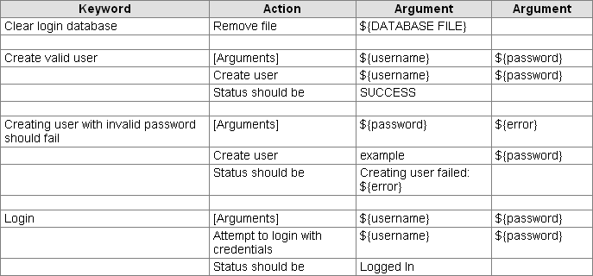
Higher level keywords

Slide 8
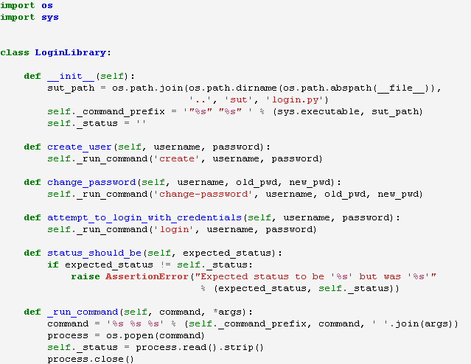
Straightforward test library API

Slide 9
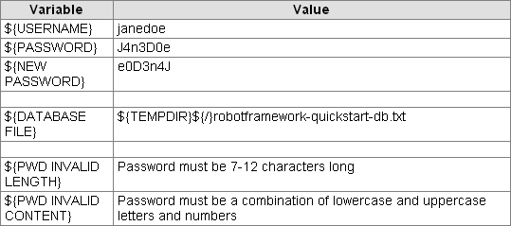
Variables
From command line:
$ pybot --variable USERNAME:johndoe --variable PASSWORD:J0hnD0e my_tests.html

Slide 10
Tagging
Free metadata to categorize test cases
Statistics by tags collected automatically
Select test cases to be executed
Specify which test cases are considered critical

Slide 11
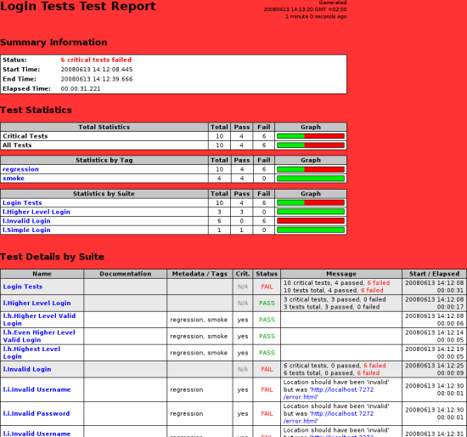
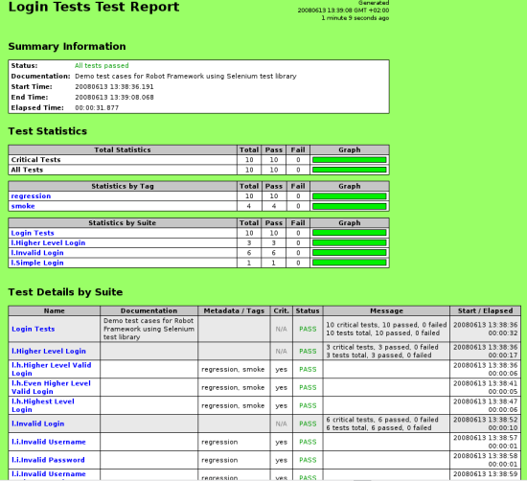
Clear reports

Slide 12
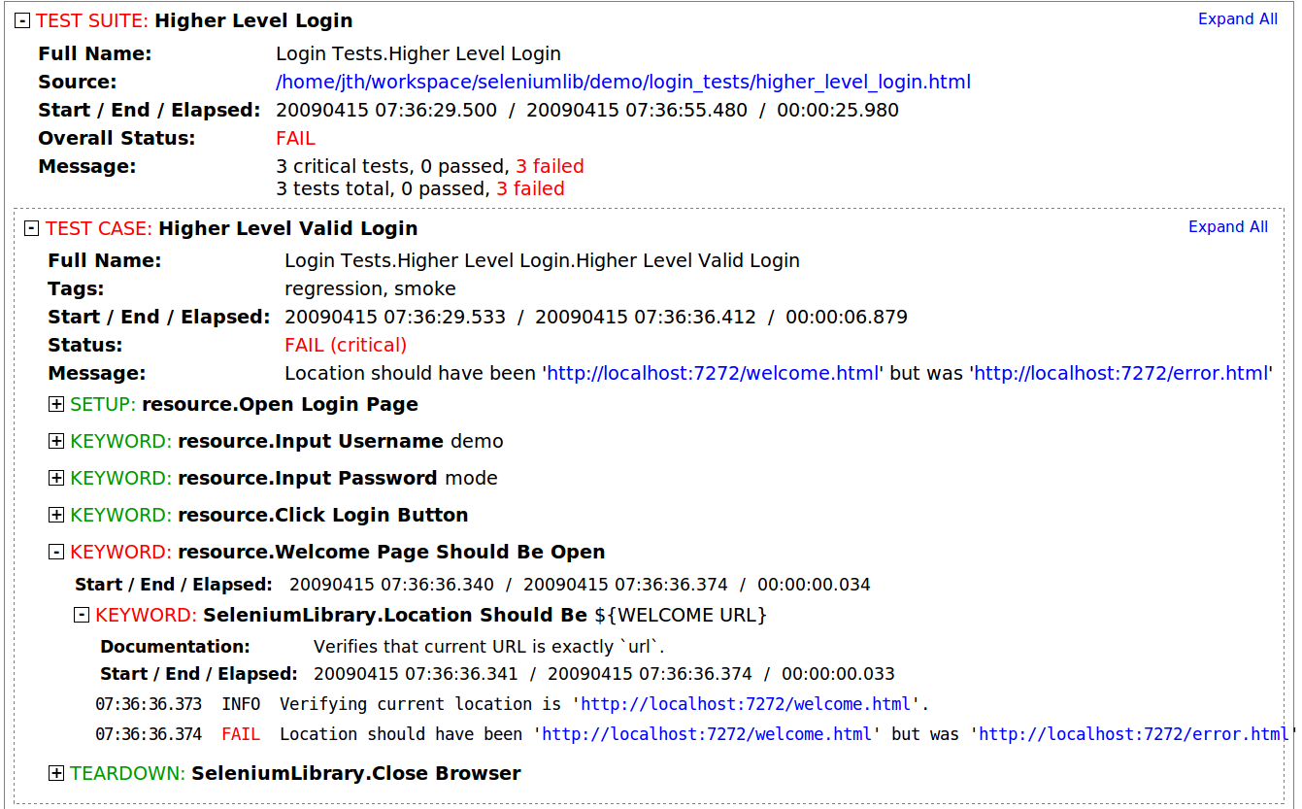
Detailed logs

Slide 13
Easy integration
Test suites are created from files and directories
  Trivial to store into any version control system
Simple command line interface
  Easy to start test execution from CI systems or other tools
Output also in XML format
  All information in machine readable format
  Outputs from different test runs can be combined
Plugins for common CI and build tools
  Jenkins/Hudson, Ant, Maven

Slide 14
Different test libraries
Standard libraries
  Included in normal installation
  OperatingSystem, Telnet, Screenshot, String, …
External libraries
  Must be installed separately
  SeleniumLibrary, SwingLibrary, DatabaseLibrary, AutoItLibrary, SSHLibrary, HTTPLibrary, …
Project and team specific libraries

Slide 15
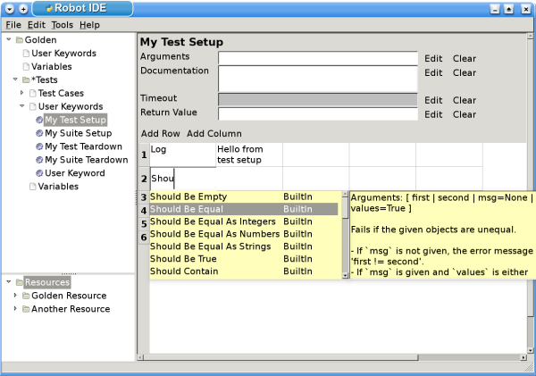
Separate test data editor (RIDE)

Slide 16
For more information
Project pages
  The main information hub
  http://robotframework.org
Quick Start Guide
  Executable guide demonstrating the key features
  http://code.google.com/p/robotframework/wiki/QuickStartGuide
User Guide
  Detailed information about all features of the framework
  http://code.google.com/p/robotframework/wiki/UserGuide
SeleniumLibrary demo
  Demonstrates web testing with Robot Framework
  http://code.google.com/p/robotframework-seleniumlibrary

