Slide 1
Real Time Path Planning for Multiple Robots and Multiple Goals
Waldez Junior

Slide 2
Problem definition
Inputs:
  Positions and velocities in a 2-D environment at any given time of
    Goals
    Robots
    Obstacles

Slide 3
Problem definition
Output
  Control law that defines a smooth path from the robot’s initial position to each one of the goals.
  Each goal must be visited at least once for at least one robot.

Slide 4
Applications
Cleaning mobile robots;
Soccer robots;
Robots in industrial environments.

Slide 5
Path planning for Multiple Robots
Main concern:
  How will the robots interact?
    Cooperatively?
    Concurrently?

Slide 6
My approach
Divide and conquer!
  Cluster the goals using a clustering algorithm;
  Send one robot to each cluster using a modified APF that makes smoother paths around obstacles;
  Every time a robot reaches one of the goals REPLAN the paths for every robot

Slide 7
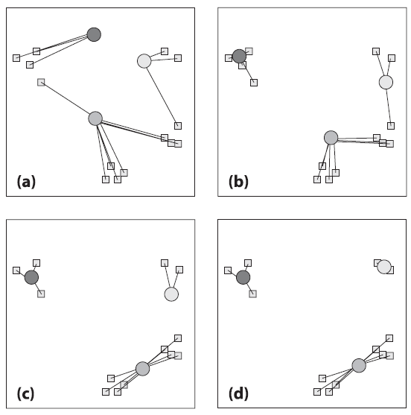
Clustering – K-Means

Slide 8
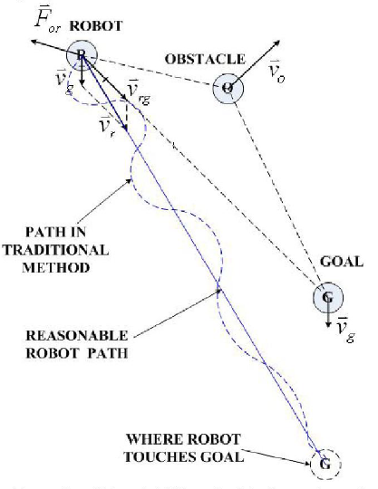
Problems with APF for moving obstacles

Slide 9
References
G. Bradski, A. Kaehler, “Learning OpenCv. Computer vision with the OpenCv Library” 1st edition.
C. Qixin, H. Yanwen, Z. Jingliang, “An evolutionary Artificial Potential Field Algorithm for Dynamic Path Planning of Mobile Robot”.

Slide 10

Live Demonstration

Slide 11

Q&A

