Slide 1
K-MEANS CLUSTERING

Slide 2

Partitioning Algorithms: Basic Concept
Partitioning method: Partitioning a database D of n objects into a set of k clusters, such that the sum of squared distances is minimized (where ci is the centroid or medoid of cluster Ci)
Given k, find a partition of k clusters that optimizes the chosen partitioning criterion
  Global optimal: examine all possible partitions
  Heuristic methods: k-means and k-medoids

Slide 3
What is clustering?
A grouping of data objects such that the objects within a group are similar (or related) to one another and different from (or unrelated to) the objects in other groups
Inter-cluster distances are maximized
Intra-cluster distances are minimized

Slide 4
Outliers
Outliers are objects that do not belong to any cluster or form clusters of very small cardinality
In some applications we are interested in discovering outliers, not clusters (outlier analysis)
cluster
outliers

Slide 5
Types of clustering
Partitioning method: Partitioning a database D of n objects into a set of k clusters, such that the sum of squared distances is minimized (where ci is the centroid or medoid of cluster Ci)
Given k, find a partition of k clusters that optimizes the chosen partitioning criterion
  Global optimal: examine all possible partitions
  Heuristic methods: k-means and variants

Slide 6
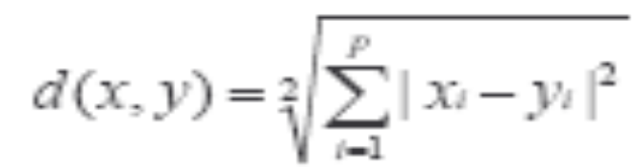

Common Distance measures
Distance measure will determine how the similarity of two elements is calculated and it will influence the shape of the clusters.
Euclidean distance (also called 2-norm distance) is given by:
Manhattan distance (also called norm or 1-norm) is given by:

Slide 7

K-means clustering
The k-means algorithm is an algorithm to cluster n objects based on attributes into k partitions, where k < n.
An algorithm for partitioning (or clustering) N data points into K disjoint subsets Sj containing data points so as to minimize the sum-of-squares criterion
  where xn is a vector representing the the nth data point and uj is the geometric centroid of the data points in Sj.
Distance measure is squared Euclidean
  Scale should be similar in all dimensions

Slide 8

How the K-Mean Clustering algorithm works?
Iterate:
  Calculate distance from objects to cluster centroids
  Assign objects to closest cluster
  Recalculate new centroids
Stop based on convergence criteria
  No (or minimum) re-assignments of data points to different clusters;
  No (or minimum) change of centroids;
  Minimum decrease in the sum of squared error;
  Max iterations.
O(tkn),
  where n is number of objects or points, k is number of clusters and t is number of iterations.

Slide 9
Step 1: Begin with a decision on the value of k = number of clusters .
Step 2: Put any initial partition that classifies the data into k clusters. You may assign the training samples randomly,or systematically as the following:
1.Take the first k training sample as single- element clusters
2. Assign each of the remaining (N-k) training sample to the cluster with the nearest centroid. After each assignment, recompute the centroid of the gaining cluster.

Slide 10
Step 3: Take each sample in sequence and compute its distance from the centroid of each of the clusters. If a sample is not currently in the cluster with the closest centroid, switch this sample to that cluster and update the centroid of the cluster gaining the new sample and the cluster losing the sample.
Step 4 . Repeat step 3 until convergence is achieved, that is until a pass through the training sample causes no new assignments.

Slide 11

A Simple example showing the implementation of k-means algorithm
(using K=2)

Slide 12


Step 1:
Initialization: Randomly we choose following two centroids (k=2) for two clusters.
In this case the 2 centroid are: m1=(1.0,1.0) and m2=(5.0,7.0).

Slide 13




Step 2:
Thus, we obtain two clusters containing:
{1,2,3} and {4,5,6,7}.
Their new centroids are:

Slide 14

Step 3:
Now using these centroids we compute the Euclidean distance of each object, as shown in table.
Therefore, the new clusters are:
{1,2} and {3,4,5,6,7}
Next centroids are: m1=(1.25,1.5) and m2 = (3.9,5.1)

Slide 15

Step 4 :
The clusters obtained are:
{1,2} and {3,4,5,6,7}
Therefore, there is no change in the cluster.
Thus, the algorithm comes to a halt here and final result consist of 2 clusters {1,2} and {3,4,5,6,7}.

Slide 16

PLOT

Slide 17
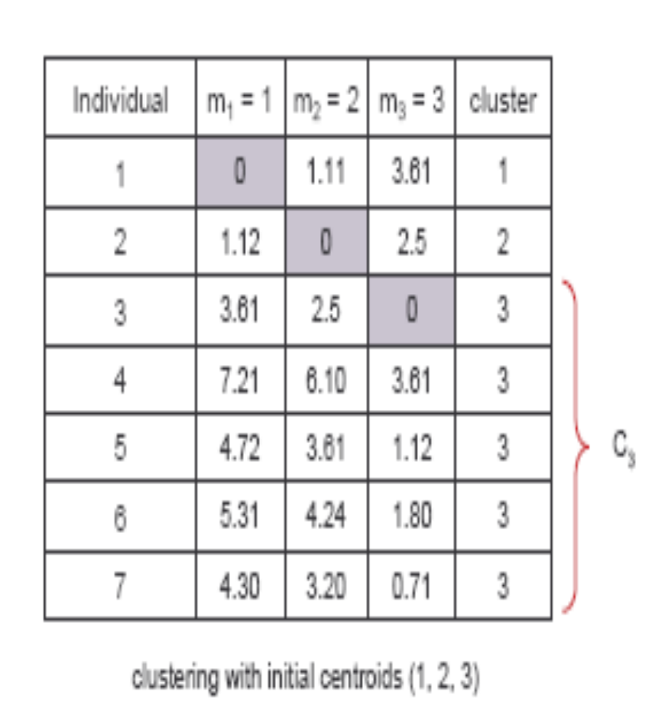
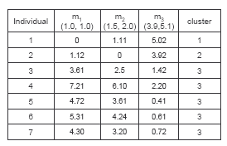
(with K=3)
Step 1
Step 2

Slide 18
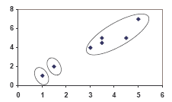
PLOT

Slide 19
Real-Life Numerical Example of K-Means Clustering
We have 4 medicines as our training data points object and each medicine has 2 attributes. Each attribute represents coordinate of the object. We have to determine which medicines belong to cluster 1 and which medicines belong to the other cluster.
Object | Attribute1 (X): weight index | Attribute 2 (Y): pH
Medicine A | 1 | 1
Medicine B | 2 | 1
Medicine C | 4 | 3
Medicine D | 5 | 4

Slide 20
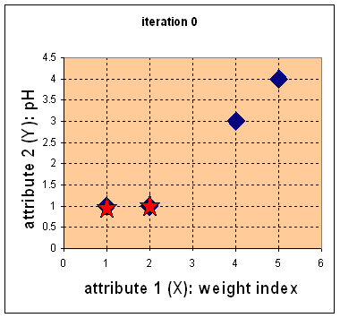
Step 1:
Initial value of centroids : Suppose we use medicine A and medicine B as the first centroids.
Let and c₁ and c₂ denote the coordinate of the centroids, then c₁=(1,1) and c₂=(2,1)

Slide 21
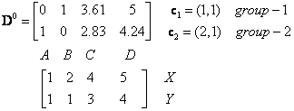
Objects-Centroids distance : we calculate the distance between cluster centroid to each object. Let us use Euclidean distance, then we have distance matrix at iteration 0 is
Each column in the distance matrix symbolizes the object.
The first row of the distance matrix corresponds to the distance of each object to the first centroid and the second row is the distance of each object to the second centroid.
For example, distance from medicine C = (4, 3) to the first centroid is , and its distance to the second centroid is , is etc.

Slide 22
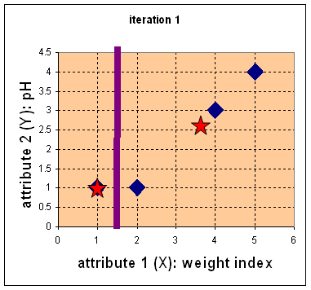

Step 2:
Objects clustering : We assign each object based on the minimum distance.
Medicine A is assigned to group 1, medicine B to group 2, medicine C to group 2 and medicine D to group 2.
The elements of Group matrix below is 1 if and only if the object is assigned to that group.

Slide 23
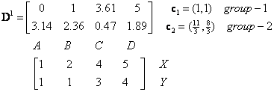
Iteration-1, Objects-Centroids distances : The next step is to compute the distance of all objects to the new centroids.
Similar to step 2, we have distance matrix at iteration 1 is

Slide 24
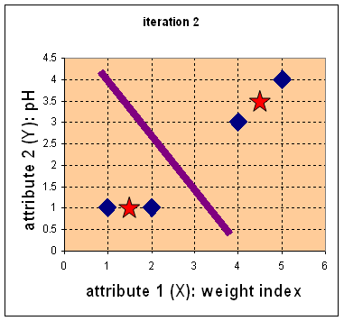



Iteration-1, Objects clustering:Based on the new distance matrix, we move the medicine B to Group 1 while all the other objects remain. The Group matrix is shown below
Iteration 2, determine centroids: Now we repeat step 4 to calculate the new centroids coordinate based on the clustering of previous iteration. Group1 and group 2 both has two members, thus the new centroids are
and

Slide 25
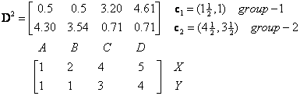
Iteration-2, Objects-Centroids distances : Repeat step 2 again, we have new distance matrix at iteration 2 as

Slide 26

Iteration-2, Objects clustering: Again, we assign each object based on the minimum distance.
We obtain result that . Comparing the grouping of last iteration and this iteration reveals that the objects does not move group anymore.
Thus, the computation of the k-mean clustering has reached its stability and no more iteration is needed..

Slide 27
We get the final grouping as the results as:
Object | Feature1(X): weight index | Feature2 (Y): pH | Group (result)
Medicine A | 1 | 1 | 1
Medicine B | 2 | 1 | 1
Medicine C | 4 | 3 | 2
Medicine D | 5 | 4 | 2

Slide 28
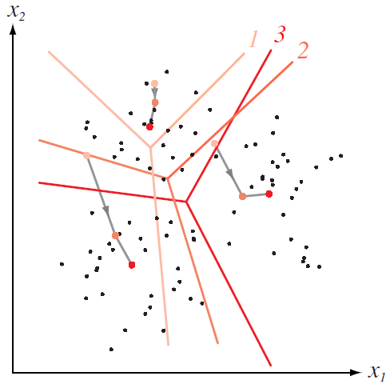
How K-means partitions?
When K centroids are set/fixed, they partition the whole data space into K mutually exclusive subspaces to form a partition;
A partition amounts to a Voroni Diagram;
Changing positions of centroids leads to a new partitioning.
Notes:
This implication is important for generalization in clustering analysis, e.g., clustering U.K. population survey.

Slide 29
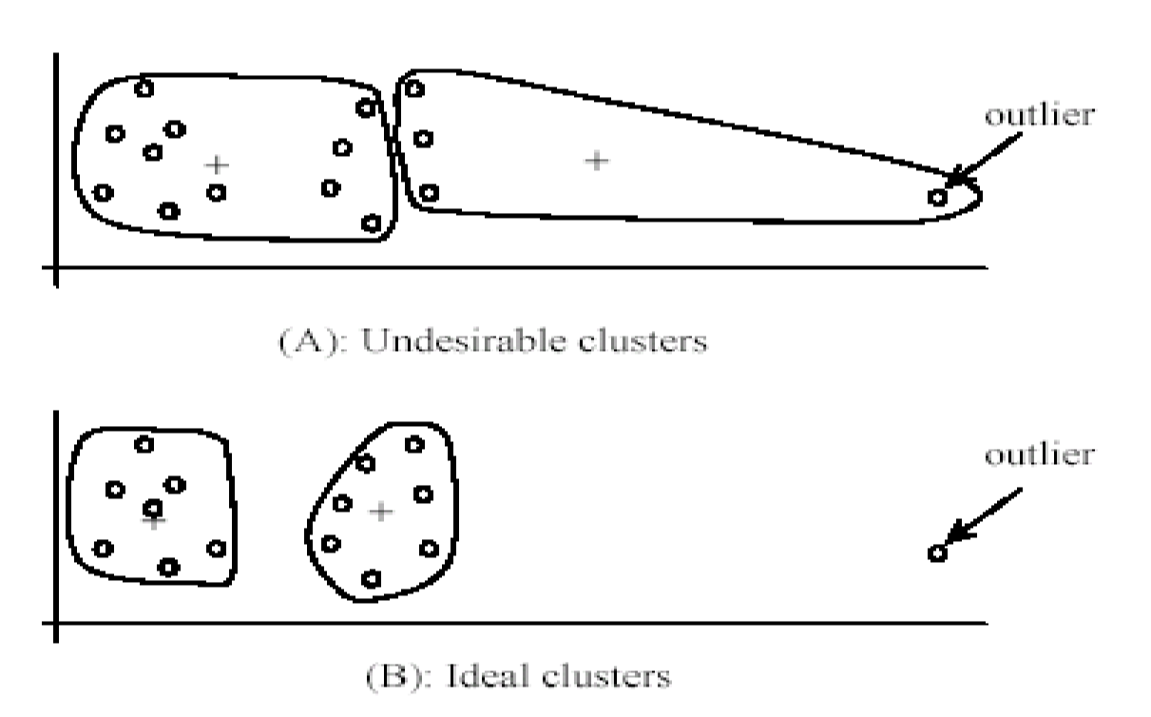
Weaknesses of K-Mean Clustering
Specify k, the number of clusters, in advance;
The algorithm is sensitive to outliers;
  Outliers could be errors in the data recording or some special data points with very different values.

Slide 30
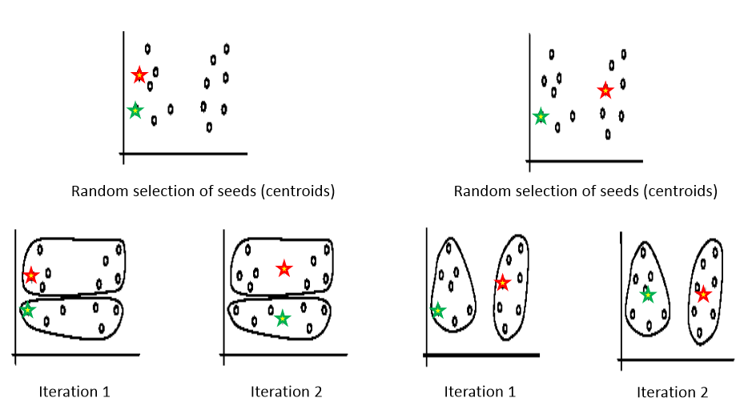
Weaknesses of K-Mean Clustering
It is sensitive to initial condition. Different initial condition may produce different result of cluster. The algorithm may be trapped in the local optimum.

Slide 31
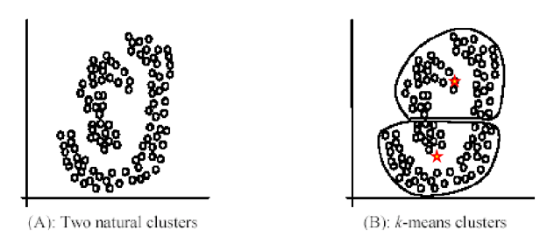
Weaknesses of K-Mean Clustering
Not suitable for discovering cluster that are not hyper-ellipsoids (or hyper-spheres)

Slide 32
Variants of K-means to overcome its weaknesses
K-Medians / K-Medoids: resistance to noise and/or outliers;
K-Modes: extension to categorical data clustering analysis;
Kernel K-means: suitable for discovering clusters with non-convex shapes

Slide 33
K-medians clustering
Instead of mean, use medians of each cluster
Not affected by extreme values
Works like K‐means
Data must be inserted in order
The mean is a measurement that is highly vulnerable to outliers. Even just one drastic outlier can pull the value of the mean away from the majority of the data set, which can be a high concern when operating on very large data sets. The median, on the other hand, is a statistic incredibly resistant to outliers, for in order to deter the median away from the bulk of the information, it requires at least 50% of the data to be contaminated.
D. Feldman and L. J. Schulman (2012) Data reduction for weighted and outlier-resistant clustering Proceedings of the twenty-third annual ACM-SIAM symposium on Discrete Algorithms (pp. 1342-1354)

Slide 34
K-medoids clustering
Use an actual data point as a cluster centroid;
More robust than K-means in the presence of noise and outliers;
PAM algorithm (Kaufman and Rousseeuw, 1987):
  Use real objects to represent clusters;
  Select k representative objects arbitrarily;
  For each medoid m;
  For each non‐medoid O;
  Swap m and O and compute cost of resulting configuration;
  Select configuration with the lowest cost;
  Repeat until there is no change;
  Works effectively for small data sets, but does not scale well for large data sets.

Slide 35
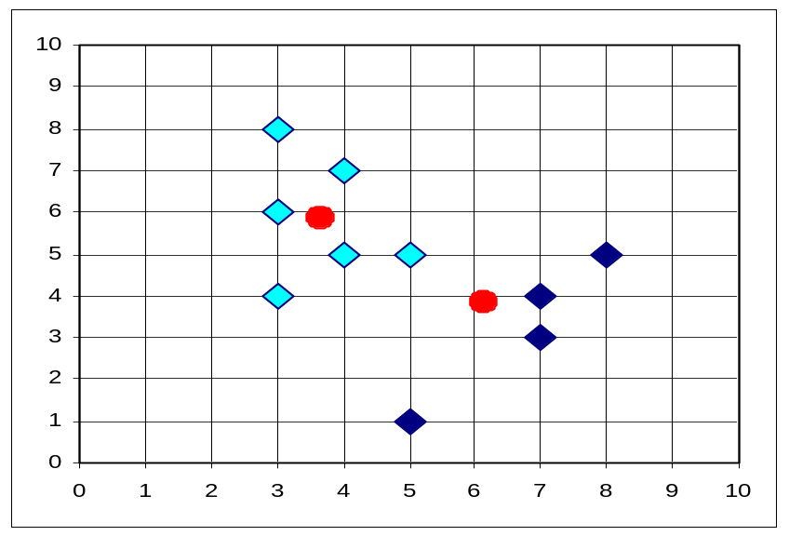
K-Medoids Clustering
PAM (Partitioning Around Medoids, 1987)
CLARA (Kaufmann & Rousseeuw, 1990)
CLARANS (Ng & Han, 1994): Randomized sampling
10
9
8
7
6
5
4
3
2
1
0
0
1
2
3
4
5
6
7
8
9
10
k-means
k-medoids

Slide 36
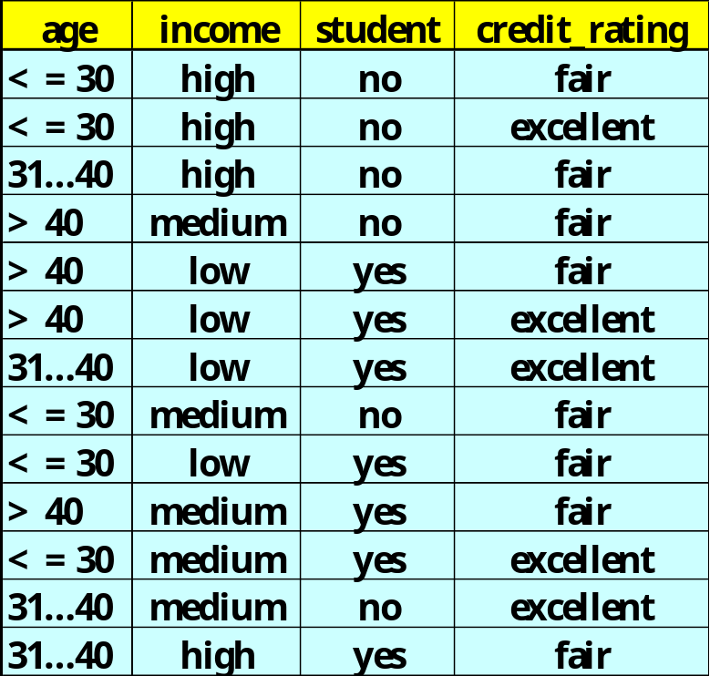
K-modes clustering
Handling categorical data: k-modes (Huang’98)
  Replacing means of clusters with modes
  Given n records in cluster, mode is record made up of most frequent attribute values
mode: (<=30, medium, yes, fair)

Slide 37
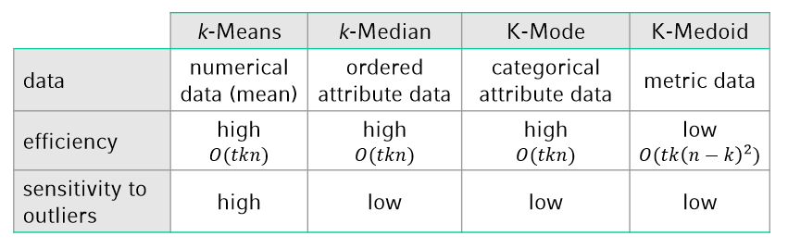
Comparison

Slide 38
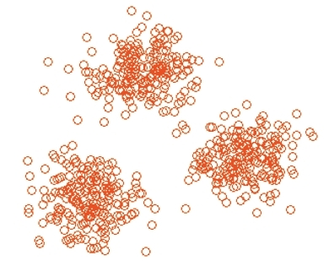
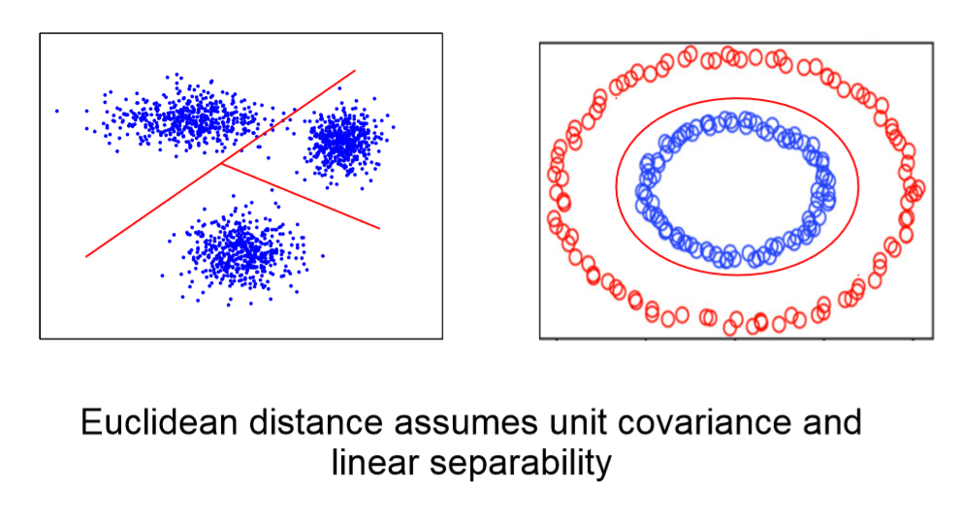
Kernel K-means
K-means works perfectly when clusters are “linearly separable”
Clusters are compact and well separated

Slide 39
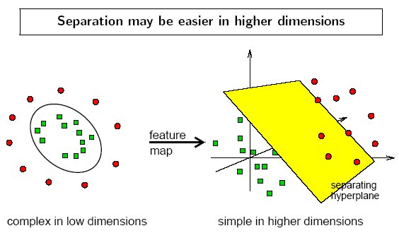
Kernel K-means
K-means applied in Kernel space;
Exploit the notion that a nonlinear data transformation into a higher dimensional feature space increases the probability of the linear separability of the transformed data.

Slide 40
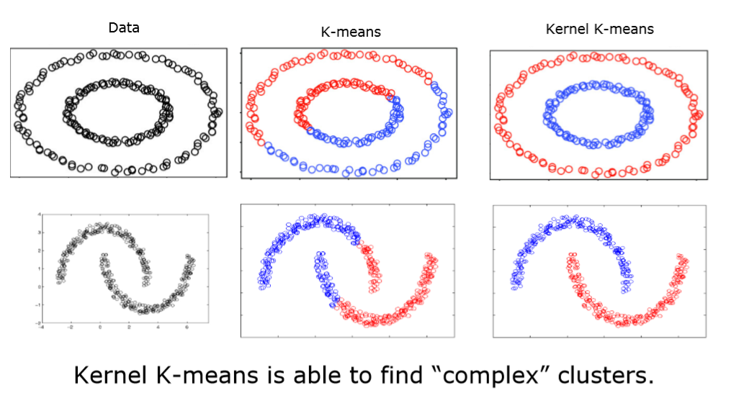
Kernel K-means

Slide 41
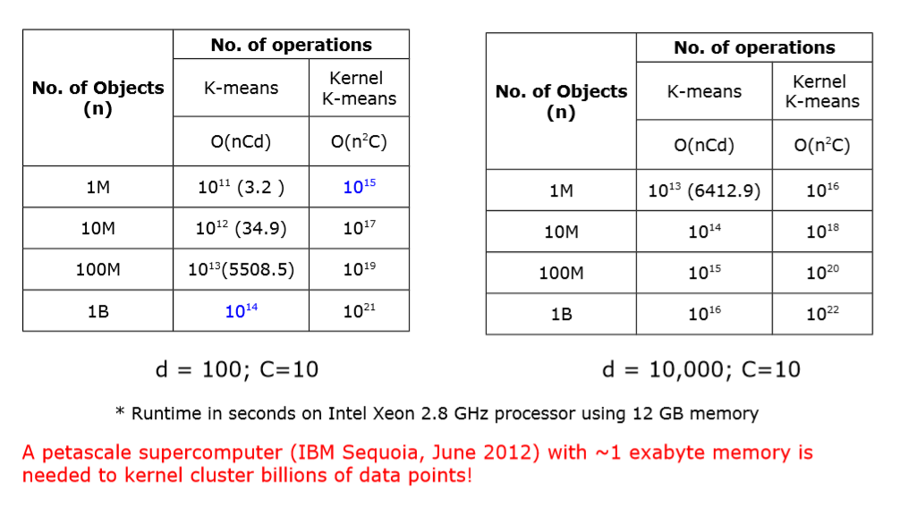
Kernel K-means

Slide 42
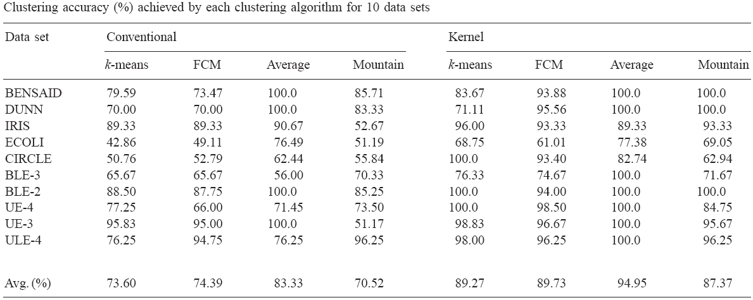
Performance of Kernel K-means
Evaluation of the performance of clustering algorithms in kernel-induced feature space, Pattern Recognition, 2005

Slide 43
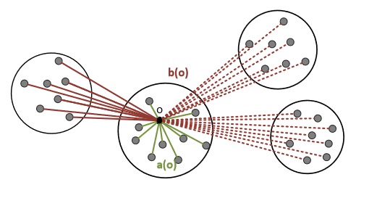
How good is a cluster?
Elements in cluster should be “similar“ to their representative: measure the average distance of objects to their representative: a(o)
Elements in different clusters should be “dissimilar“: measure the average distance of objects to alternative clusters (i.e. second closest cluster): b(o)

Slide 44


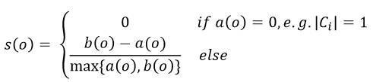
How good is a cluster?
𝑎(𝑜): average distance between object 𝑜 and the objects in its cluster A
𝑏(𝑜): for each other cluster 𝐶𝑖 compute the average distance between o and the objects in𝐶𝑖. Then take the smallest average distance
The silhouette of o is then defined as
The values of the silhouette coefficient range from –1 to +1

Slide 45
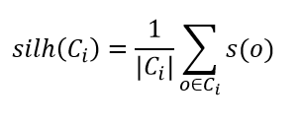
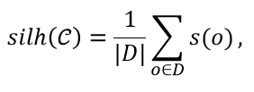
How good is a cluster?
The silhouette of a cluster 𝐶𝑖 is defined as:
The silhouette of a clustering 𝒞 = (𝐶1,…,𝐶𝑘) is defined as:
D represents the whole data set

Slide 46
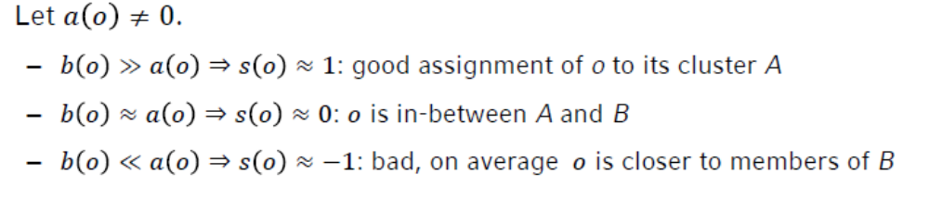
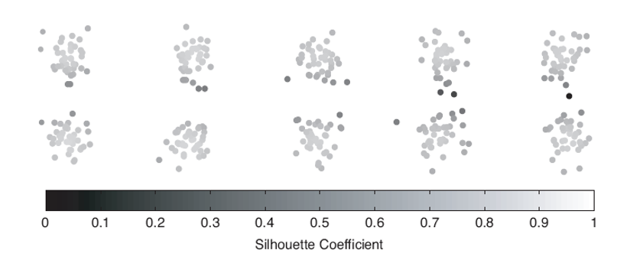
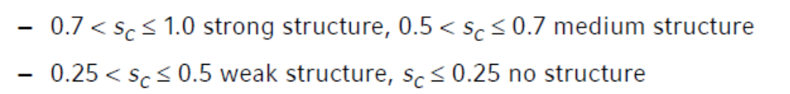
How good is a cluster?

