Slide 1
K-MEANS CLUSTERING
Allan Gaban
André Grigorio
Carlos José Nunes de Sousa
Waldir José Pereira Junior
PUC-Rio – Departamento de Informática
INF2979 – Tópicos de Otimização e Rac. Autom. II – Machine Learning
Professor Hélio Côrtes Vieira Lopes
Novembro/2019

Slide 2

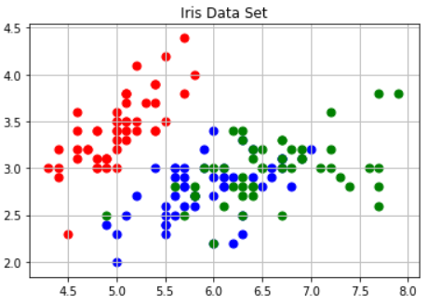

Data Set Information
Machine Learning Repository - UCI
The data set contains 3 classes of 50 instances;
Each class refers to a type of iris plant;
One class is linearly separable from the other 2;
The latter are NOT linearly separable from each other.
Attribute Information:
1. sepal length in cm
2. sepal width in cm
3. petal length in cm
4. petal width in cm
5. class:

Slide 3

K-means Clustering
The k-means algorithm is an algorithm to cluster n objects based on attributes into k partitions, where k < n.
An algorithm for partitioning (or clustering) N data points into K disjoint subsets Sj containing data points so as to minimize the sum-of-squares criterion
  where xn is a vector representing the the nth data point and uj is the geometric centroid of the data points in Sj.
Distance measure is squared Euclidean
  Scale should be similar in all dimensions

Slide 4

How the K-Mean Clustering algorithm works?
Iterate:
  Calculate distance from objects to cluster centroids
  Assign objects to closest cluster
  Recalculate new centroids
Stop based on convergence criteria
  No (or minimum) re-assignments of data points to different clusters;
  No (or minimum) change of centroids;
  Minimum decrease in the sum of squared error;
  Max iterations.
O(tkn),
  where n is number of objects or points, k is number of clusters and t is number of iterations.

Slide 5
K-means - Example
Step 1: Begin with a decision on the value of k = number of clusters
Step 2: Put any initial partition that classifies the data into k clusters as the following:
  You may assign the training samples randomly, or systematically
  Take the first k training sample as single-element clusters
  Assign each of the remaining (N-k) training sample to the cluster with the nearest centroid. After each assignment, recompute the centroid of the gaining cluster.

Slide 6
K-means - Example
Step 3: Take each sample in sequence and compute its distance from the centroid of each of the clusters. If a sample is not currently in the cluster with the closest centroid, switch this sample to that cluster and update the centroid of the cluster gaining the new sample and the cluster losing the sample
Step 4: Repeat step 3 until convergence is achieved, that is until a pass through the training sample causes no new assignments

Slide 7

K-means - Example
A Simple example showing the implementation of k-means algorithm (using K=2)

Slide 8

K-means - Example
Step 1 - Initialization:
Randomly we choose following two centroids (k=2) for two clusters
In this case the 2 centroids are: m1=(1.0,1.0) and m2=(5.0,7.0)

Slide 9
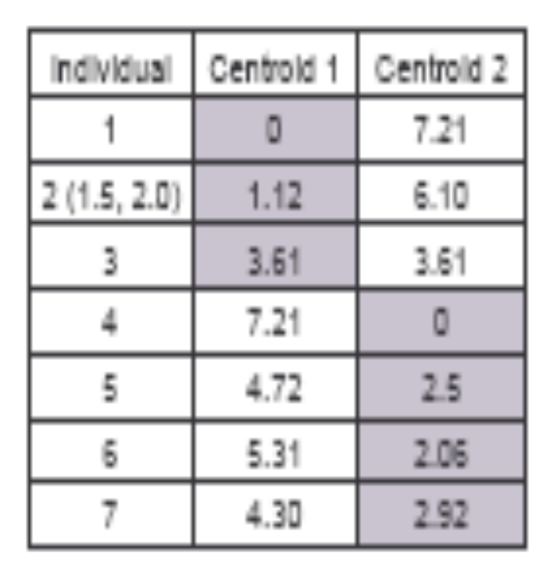



K-means - Example
Step 2:
Thus, we obtain two clusters containing: {1,2,3} and {4,5,6,7}
Their new centroids are:

Slide 10

K-means - Example
Step 3:
Now using these centroids we compute the Euclidean distance of each object, as shown in table
Therefore, the new clusters are: {1,2} and {3,4,5,6,7}
Next centroids are:
  m1= (1.25,1.5) and
  m2 = (3.9,5.1)

Slide 11

K-means - Example
Step 4:
The clusters obtained are:
{1,2} and {3,4,5,6,7}
Therefore, there is no change in the cluster
Thus, the algorithm comes to a halt here and final result consist of 2 clusters {1,2} and {3,4,5,6,7}

Slide 12

K-means - Example
Plot

Slide 13
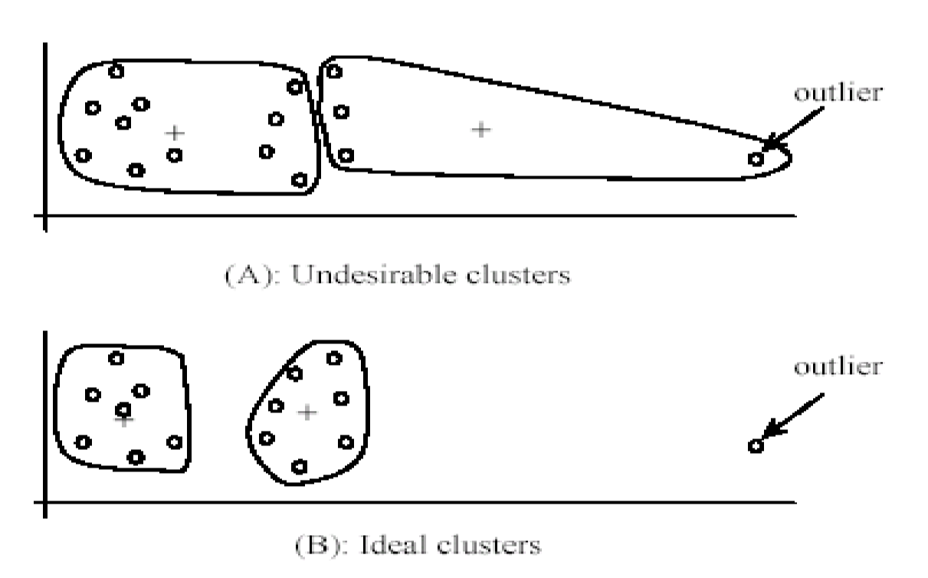
Weaknesses of K-Mean Clustering
Specify k, the number of clusters, in advance;
The algorithm is sensitive to outliers;
  Outliers could be errors in the data recording or some special data points with very different values.

Slide 14
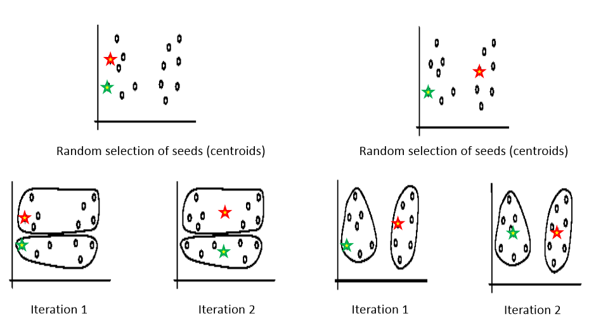
Weaknesses of K-Mean Clustering
It is sensitive to initial condition. Different initial condition may produce different result of cluster. The algorithm may be trapped in the local optimum.

Slide 15
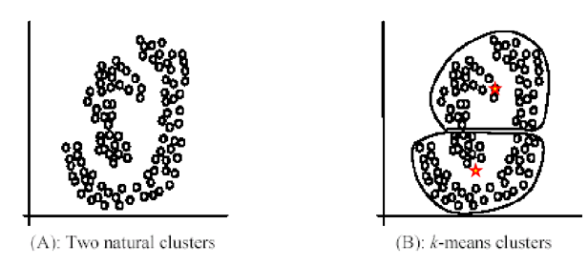
Weaknesses of K-Mean Clustering
Not suitable for discovering cluster that are not hyper-ellipsoids (or hyper-spheres)

Slide 16
Initialization – K-Means++
The initial values (or "seeds") for the k-means clustering algorithm
The algorithm:
  Choose one center uniformly at random from among the data points
  For each data point x, compute D(x), the distance between x and the nearest center that has already been chosen
  Choose one new data point at random as a new center, using a weighted probability distribution where a point x is chosen with probability proportional to D(x)²
  Repeat Steps 2 and 3 until k centers have been chosen.

Slide 17
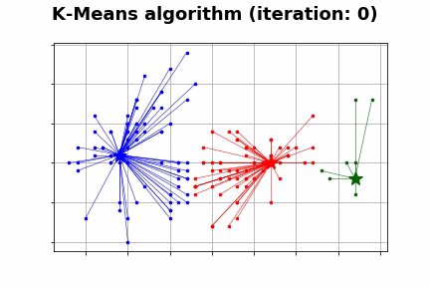
K-means – Animation

Slide 18
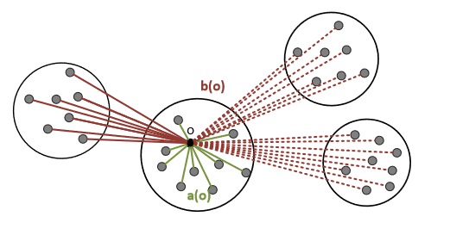
Silhouette
Elements in cluster should be “similar“ to their representative: measure the average distance of objects to their representative: a(o)
Elements in different clusters should be “dissimilar“: measure the average distance of objects to alternative clusters (i.e. second closest cluster): b(o)

Slide 19
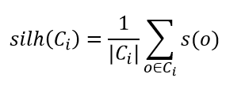
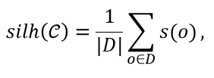
Silhouette
The silhouette of a cluster 𝐶𝑖 is defined as:
The silhouette of a clustering 𝒞 = (𝐶1,…,𝐶𝑘) is defined as:
D represents the whole data set

Slide 20


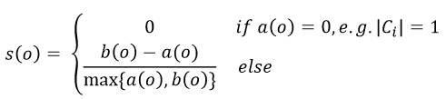
Silhouette
𝑎(𝑜): average distance between object 𝑜 and the objects in its cluster A
𝑏(𝑜): for each other cluster 𝐶𝑖 compute the average distance between o and the objects in 𝐶𝑖. Then take the smallest average distance
The silhouette of o is then defined as
The values of the silhouette coefficient range from –1 to +1

Slide 21
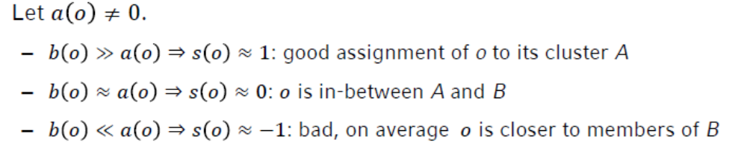
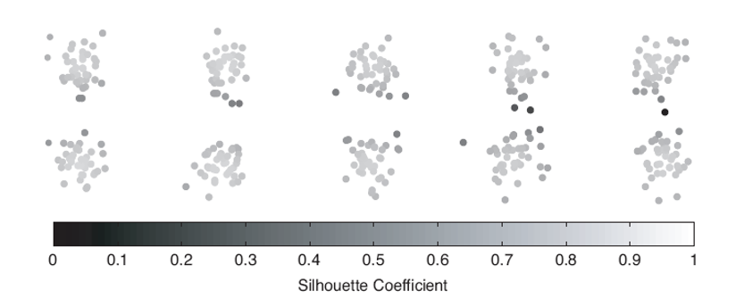
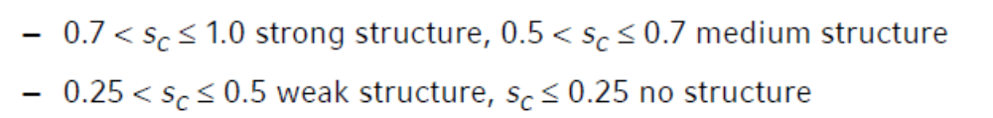
Silhouette

Slide 22
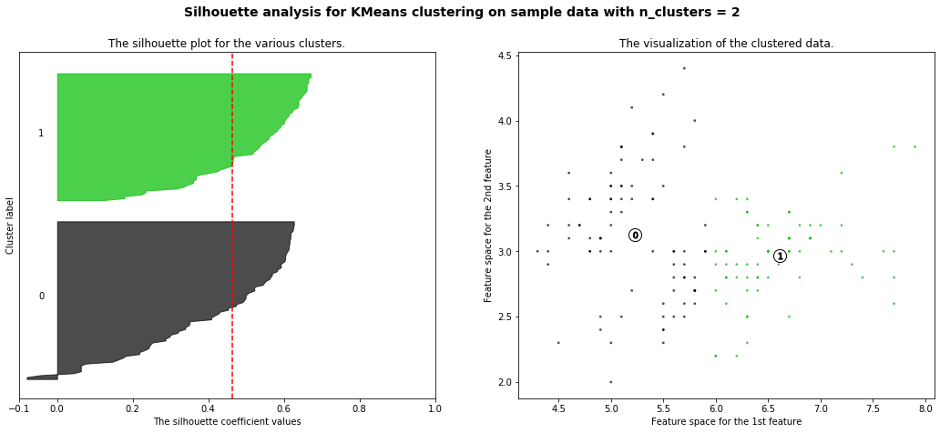
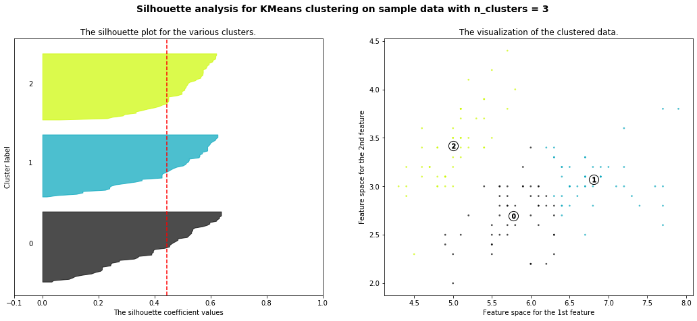
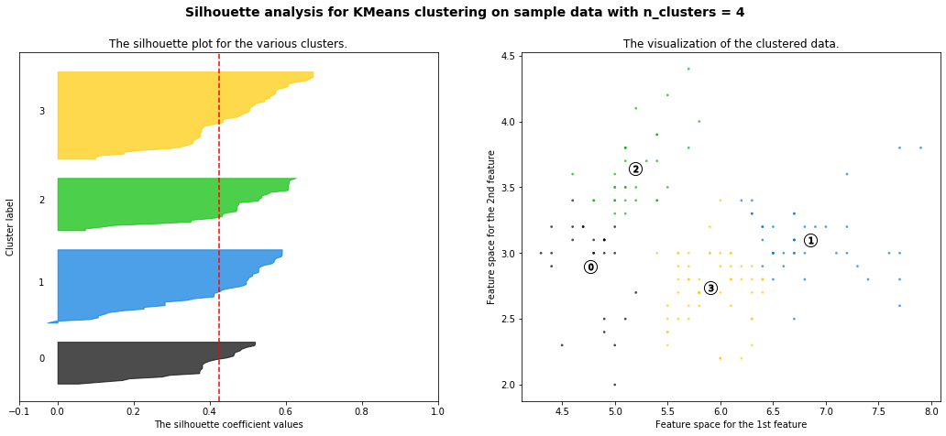
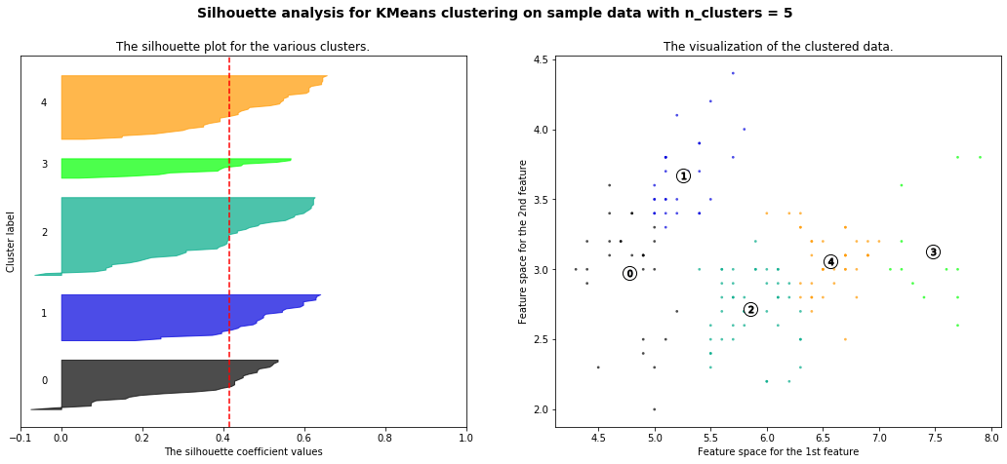
K-Means – Silhouette

Slide 23
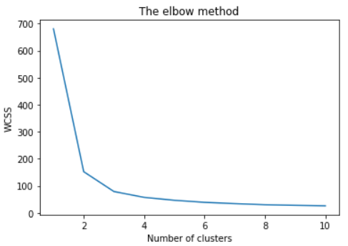
K-Means The Elbow Method
How K-means partitions?
It involves running the algorithm multiple times over a loop, with an increasing number of cluster choice and then plotting a clustering score as a function of the number of clusters.

Slide 24
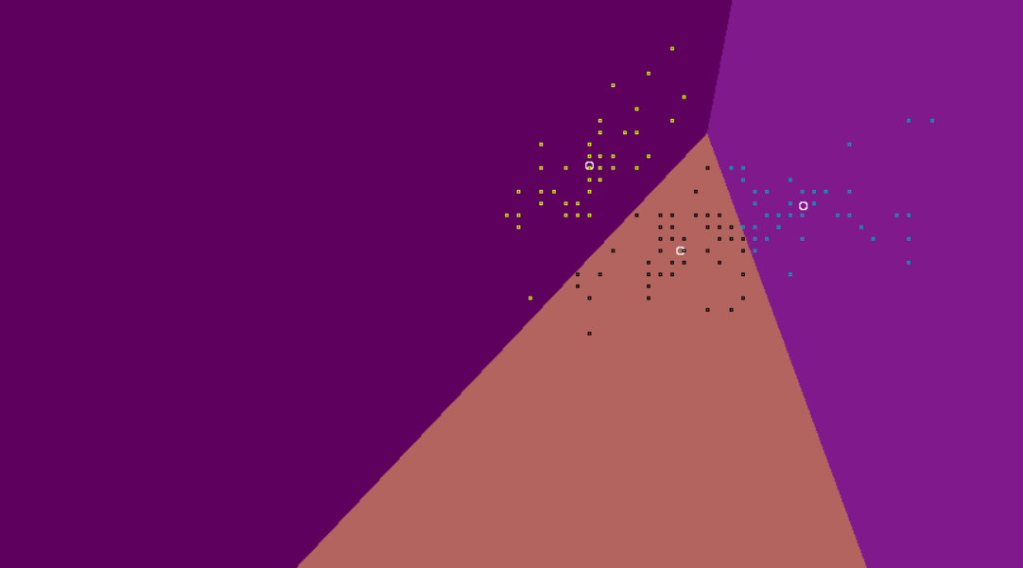
K-means – Voronoy Diagram
How K-means partitions?
When K centroids are set/fixed, they partition the whole data space into K mutually exclusive subspaces to form a partition
Changing positions of centroids leads to a new partitioning
Notes:
This implication is important for generalization in clustering analysis, e.g., clustering U.K. population survey.

Slide 25
Variants of K-means to overcome its weaknesses
K-Medians: resistance to noise and/or outliers;
K-Medoids: extension to categorical data clustering analysis;
Kernel K-means: suitable for discovering clusters with non-convex shapes

Slide 26
K-medians clustering
Instead of mean, use medians of each cluster
Not affected by extreme values
Works like K‐means
Data must be inserted in order
The mean is a measurement that is highly vulnerable to outliers. Even just one drastic outlier can pull the value of the mean away from the majority of the data set, which can be a high concern when operating on very large data sets. The median, on the other hand, is a statistic incredibly resistant to outliers, for in order to deter the median away from the bulk of the information, it requires at least 50% of the data to be contaminated.

Slide 27
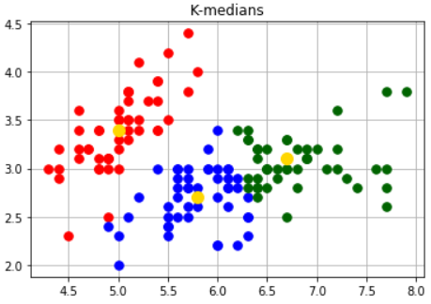
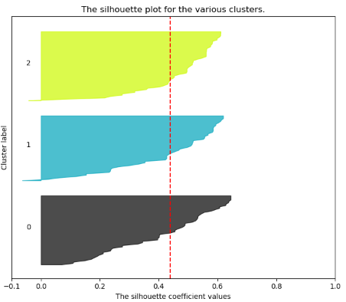
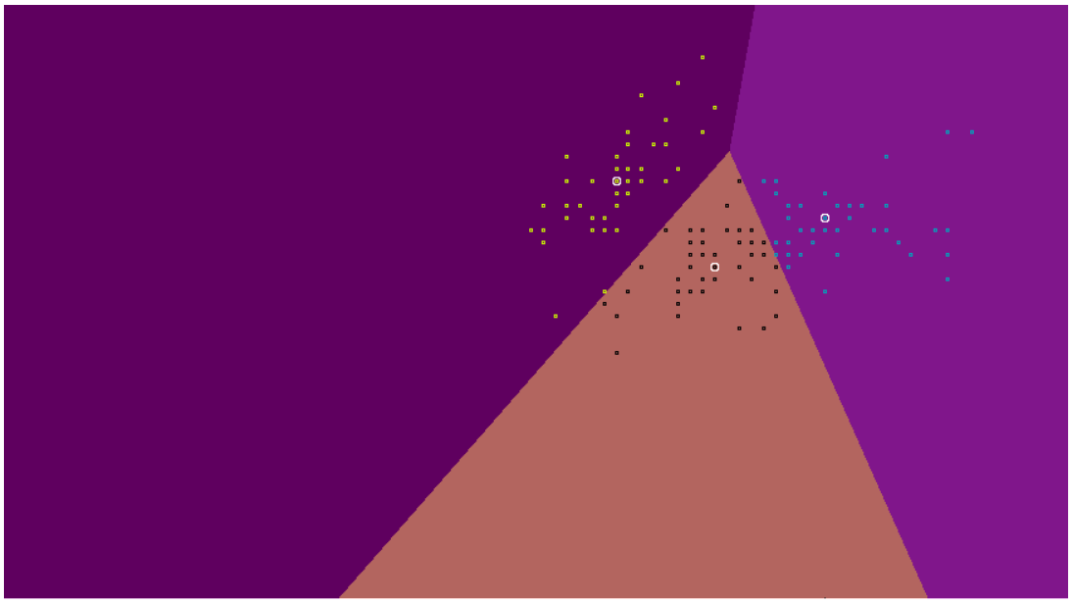
K-medians clustering

Slide 28
K-medoids Clustering
Use an actual data point as a cluster centroid;
More robust than K-means in the presence of noise and outliers;
PAM algorithm (Kaufman and Rousseeuw, 1987):
  Use real objects to represent clusters;
  Select k representative objects arbitrarily;
  For each medoid m;
  For each non‐medoid O;
  Swap m and O and compute cost of resulting configuration;
  Select configuration with the lowest cost;
  Repeat until there is no change;
  Works effectively for small data sets, but does not scale well for large data sets.

Slide 29
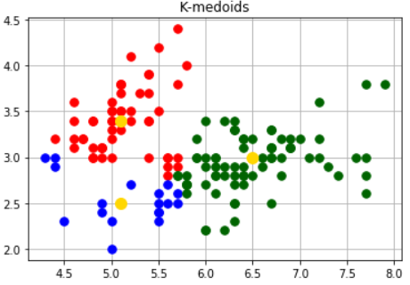
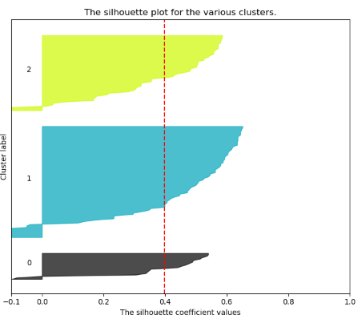
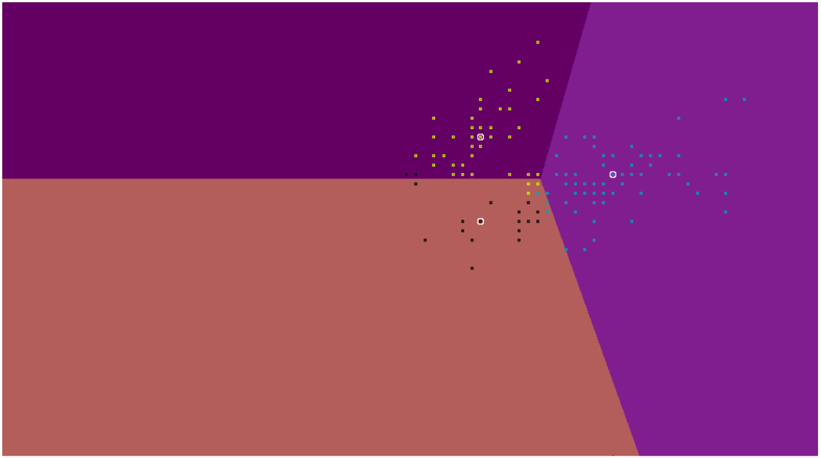
K-Medoids Clustering

Slide 30
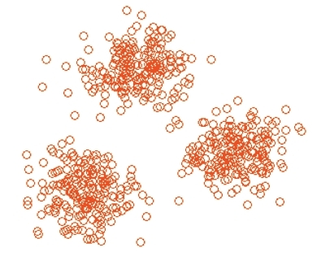
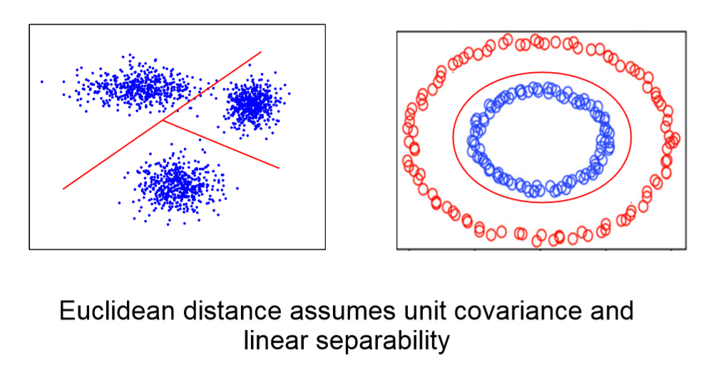
Kernel K-means
K-means works perfectly when clusters are “linearly separable”
Clusters are compact and well separated

Slide 31
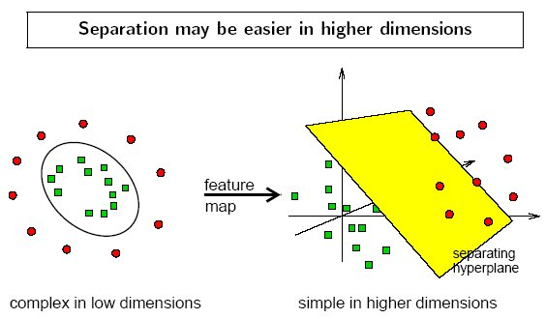
Kernel K-means
K-means applied in Kernel space;
Exploit the notion that a nonlinear data transformation into a higher dimensional feature space increases the probability of the linear separability of the transformed data.

Slide 32
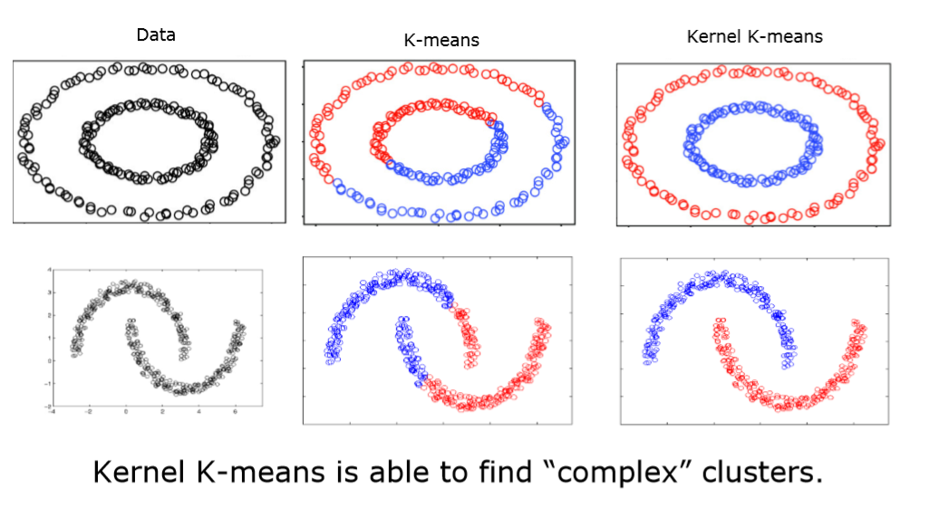
Kernel K-means

Slide 33
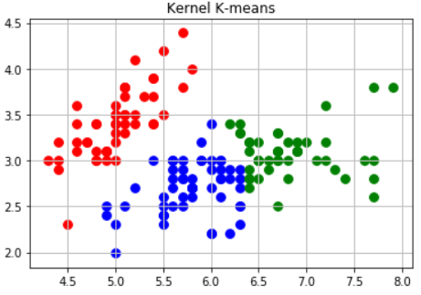
Kernel K-means

Slide 34
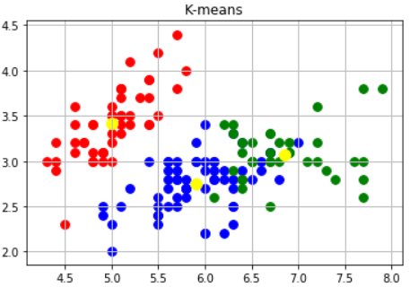
Results

