Slide 1
Analyst-friendly data in Bioconductor
curatedOvarianData
30 datasets, most annotated for OS, surgical debulking, histology
curatedCRCData
34 datasets, many annotated for MSS, gender, stage, age, N, M
curatedBladderData
12 datasets, many annotated for stage, grade, OS
curatedTCGAData + TCGAutils
The Cancer Genome Atlas as MultiAssayExperiment
cBioPortalData
150+ multi’omics cancer datasets as MultiAssayExperiment
HMP16SData
Simple access to The Human Microbiome Project
curatedMetagenomicData
~20K samples processed through bioBakery 3 with curated metadata
SingleCellMultiModal
Landmark datasets from new single-cell multimodal technologies
MicrobiomeBenchmarkData
Microbiome benchmarking with experimental ground truth

Slide 2
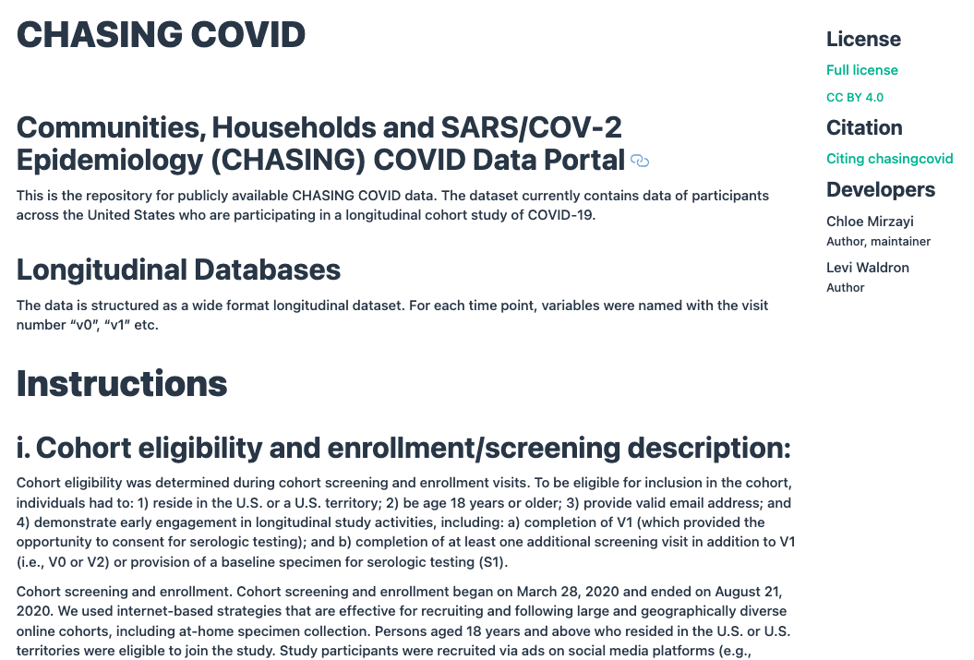
data.isph.org

Slide 3
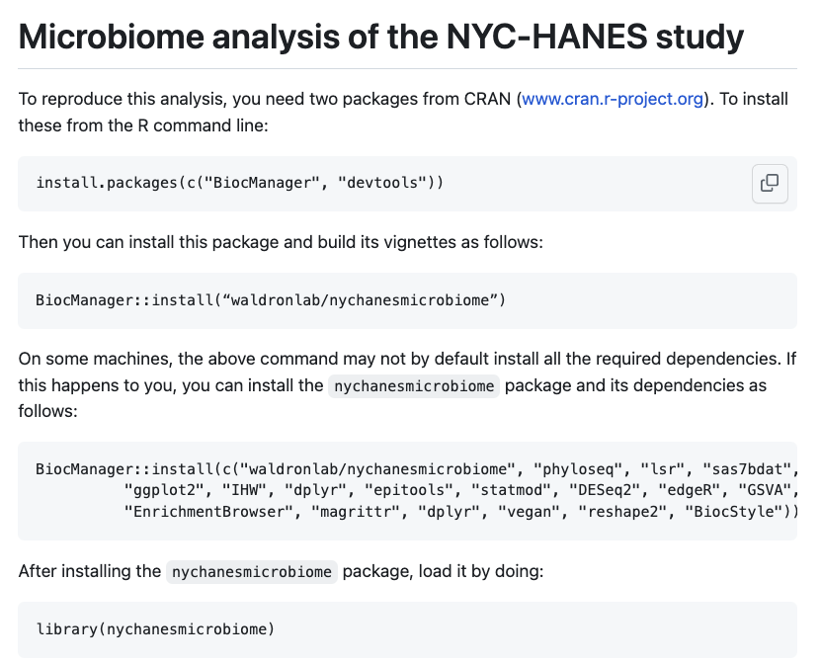
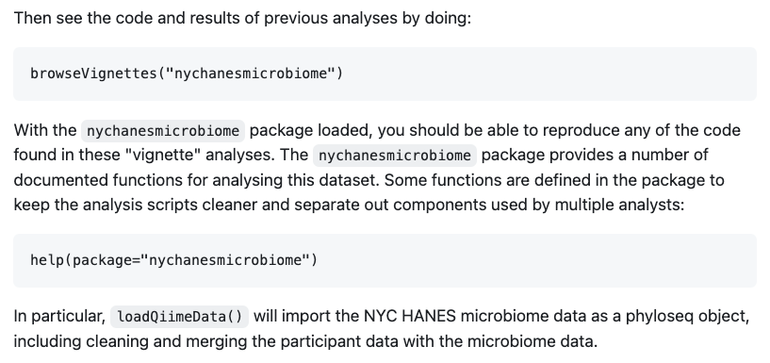
github.com/waldronlab/nychanesmicrobiome

Slide 4
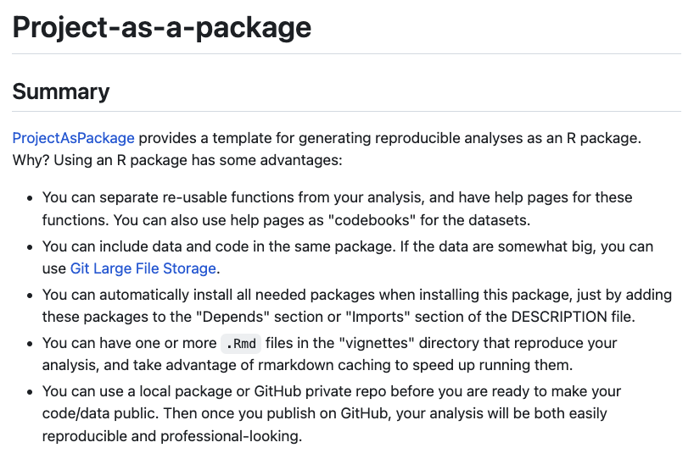
github.com/waldronlab/projectaspackage

Slide 5
BugSigDB
A Comprehensive Database of Published Microbial Signatures
Standardizes published microbiome signatures of human health conditions and exposures in a publicly editable Semantic MediaWiki
Records information including
Study design
Bioinformatic and statistical analysis
Diversity measures
Differentially abundant taxa
Bulk data export for high-throughput analysis, e.g. EnrichmentBrowser Bioconductor package
>2,900 microbial signatures >750 published papers >50 curators
medRxiv preprint https://doi.org/10.1101/2022.10.24.22281483
In Press at Nature Biotechnology

Slide 6
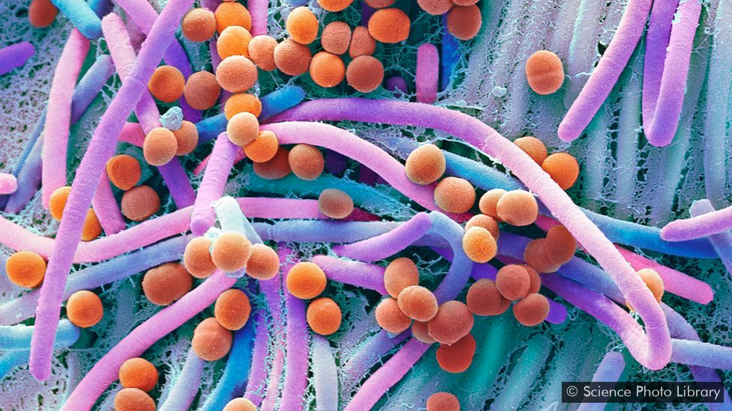
BugPhyzz: standardization of microbial physiology annotations
Cell shapes
Rods
Circles
Spirals
…
Oxygen utilization
Aerobic
Anaerobic
Obligate
Facultative
Gram Stain
(cell wall
composition)
Positive
Negative
Variable
Metabolism
Glucose
Lactose
Nitrate/Nitrite
Fermenter
…
Optimal pH
and temperature
Wide ranges
Motility
Yes
No
Leads: Kelly Eckenrode, Samuel Gamboa-Tuz

Slide 7

STORMS analytic sample size flowcharts (item 3.6)
Observational
Experimental
Expressions of interest n=xx
Expressions of interest n=xx
Assessment for eligibility:
xxxx n=xx
Assessment for eligibility:
xxxx n=xx
Screened n=xx
Screened n=xx
Excluded:
xxxx n=xx
Excluded:
xxxx n=xx
Recruited n=xx
Recruited and randomised n=xx
Drop out:
xxxx n=xx
n=xx Group 1
n=xx Group 2
Data available for analyses n=xx
Drop out:
xxxx n=xx
Excluded:
Lack of sequencing n=xx
Low number of reads n=xx
Completed trial n=xx
Total samples included in the analyses n=xx
Excluded:
Lack of sequencing n=xx
Low number of reads n=xx
Total samples included in the analyses n=xx
Mirzayi et al. Nat. Medicine 2021
www.stormsmicrobiome.org

Slide 8

A recurring bite-sized online alternative to multi-day microbiome conferences
regular short-format (~3 hours) conferences that provide all the key elements of a traditional conference
https://www.microbiome-vif.org

Slide 9



BioC2023 Boston, USA, Aug 2-4
fully hybrid
https://bioc2023.bioconductor.org/
EuroBioC2023 Ghent, Belgium, Sept 20-22
partially hybrid
https://eurobioc2023.bioconductor.org/

Slide 10
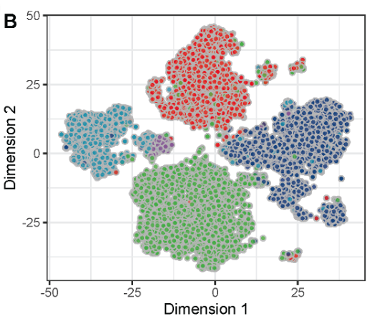
Pitfall 1: clustering & classification tools find clusters in continuous variation

Slide 11
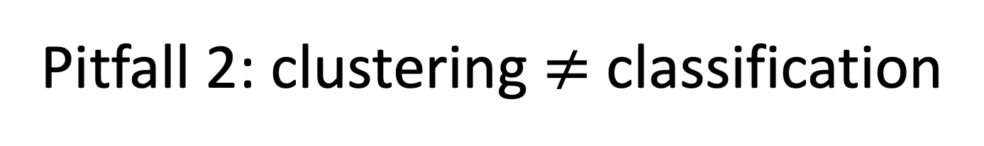
Pitfall 2: clustering $≠$ classification
Clustering: grouping similar observations together in a training dataset
good for exploration, discovery
Classification: assigning a single observation to a class or subtype
required for application

Slide 12
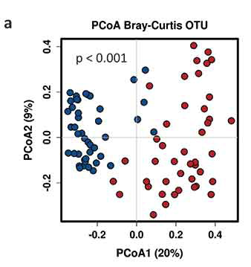
Pitfall 3: “double-dipping” [1]
Dip 1: define a separation between observations
Dip 2: test for a difference across the separation
García-Mantrana et al., Gut Microbes 2020
My simulated example
set.seed(1)
mat <- matrix(rnorm(1e6), ncol = 1000)
mdist <- dist(mat)
hc <- hclust(mdist)
cl <- cutree(hc, k = 20)
GUniFrac::PermanovaG(list(mdist) ~ cl)
...
#> Permutation: free
#> Number of permutations: 999
#>
#> Terms added sequentially (first to last)
#>
#> Df SumsOfSqs MeanSqs F.Model R2 Pr(>F)
#> cl 1 1235 1234.9 1.2346 0.00124 0.001 ***
#> Residuals 998 998182 1000.2 0.99876
#> Total 999 999417 1.00000
#> ---
#> Signif. codes: 0 '***' 0.001 '**' 0.01 '*' 0.05 '.' 0.1 ' ' 1
[1] Daniela Whitten “Double-dipping” in statistics
https://youtu.be/tiv--XjPl9M
https://arxiv.org/abs/2012.02936 and https://pubmed.ncbi.nlm.nih.gov/31521605

Slide 13

Pitfall 3: “double-dipping” [1]
Even applying a fully-specified classifier to a validation dataset does not protect against “double-dipping”
However, valid methods of statistical inference exist
[1] Daniela Whitten “Double-dipping” in statistics
https://youtu.be/tiv--XjPl9M
https://arxiv.org/abs/2012.02936 and https://pubmed.ncbi.nlm.nih.gov/31521605

Slide 14

Example of double-dipping
Subtype classifier
Elderly >70 yrs
Statistical test for:
age difference
survival difference
Unclassified
Children <18 yrs

