Slide 1


Increasing the value of ASAP-produced data
April 9, 2024
Levi Waldron
Microbiome Analytic Core

Slide 2
Outline
Background / self-introduction:
curatedMetagenomicData: standardized, curated human microbiome data for novel analyses
BugSigDB: A comprehensive database of published microbial signatures
STORMS: Strengthening the Organization and Reporting of Microbiome Studies
Roles for MAC in ASAP

Slide 3


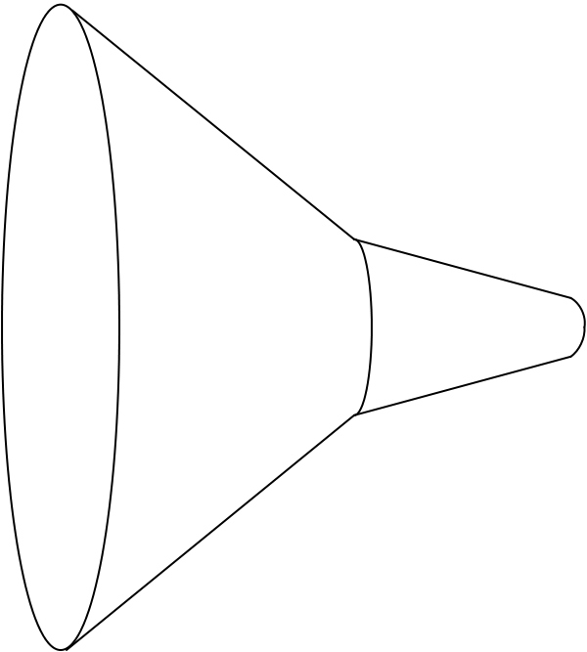
Background: curatedMetagenomicData
Raw data
41 datasets (2017)
7,152 samples
Study metadata
Age, body site, disease, etc…
Differential abundance
Diversity metrics
Clustering
Machine learning
Convenience download functions
Megabytes-sized datasets
Download fastq
ExperimentHub product
Amazon S3 cloud distribution
Tag-based searching
Dataset snapshot dates
Automatic local caching
Uniform processing
Manual curation
MetaPhlAn
HUMAnN
Automatic documentation
species abundance
metabolic pathway abundance
Integrated Bioconductor ExpressionSet objects
Per-patient microbiome data
Per-patient metadata
Experiment-wide metadata
marker
presence
metabolic pathway presence
standardized metadata
marker abundance
gene family abundance
Integration
Pasolli E and Schiffer L et al.: Accessible, curated metagenomic data through ExperimentHub. Nat. Methods 2017, 14:1023–1024.

Slide 4
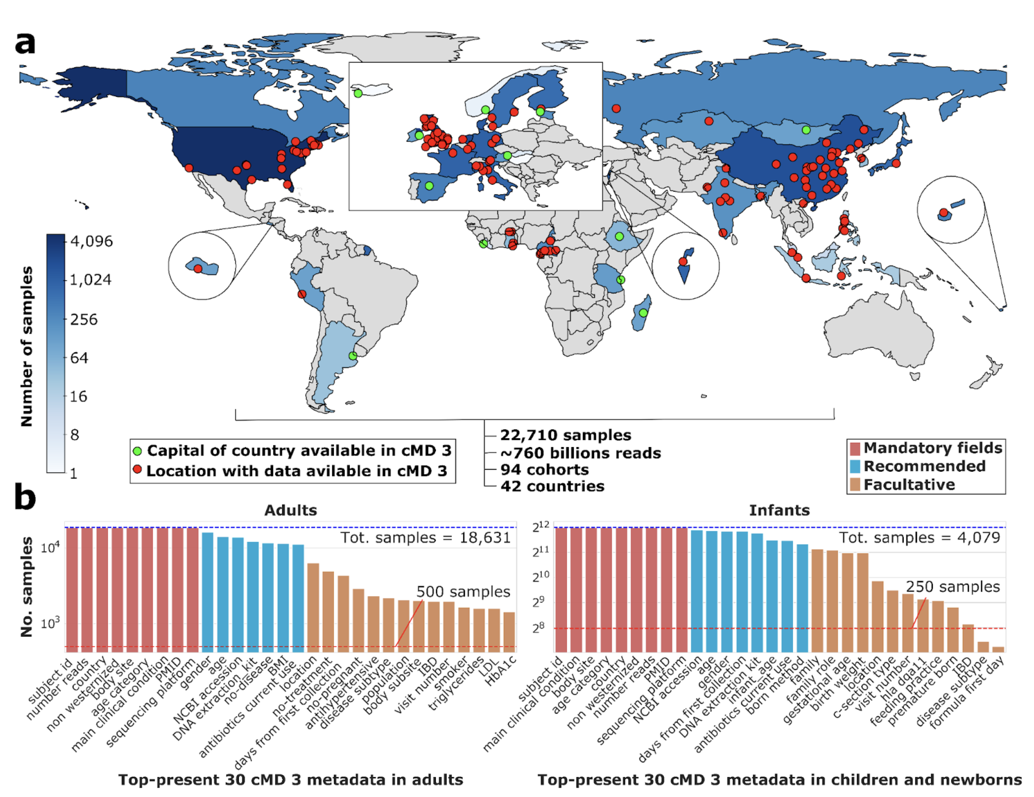
metadata

Slide 5
BugSigDB.org: A Comprehensive Database of Published Microbial Signatures
Standardizes key information from microbiome studies including:
Health condition of interest
Study design
Experimental and statistical methods
Diversity measures
Differentially abundant taxa
Geistlinger, L. et al. BugSigDB captures patterns of differential abundance across a broad range of host-associated microbial signatures. Nat. Biotechnol. (2023) doi:10.1038/s41587-023-01872-y

Slide 6
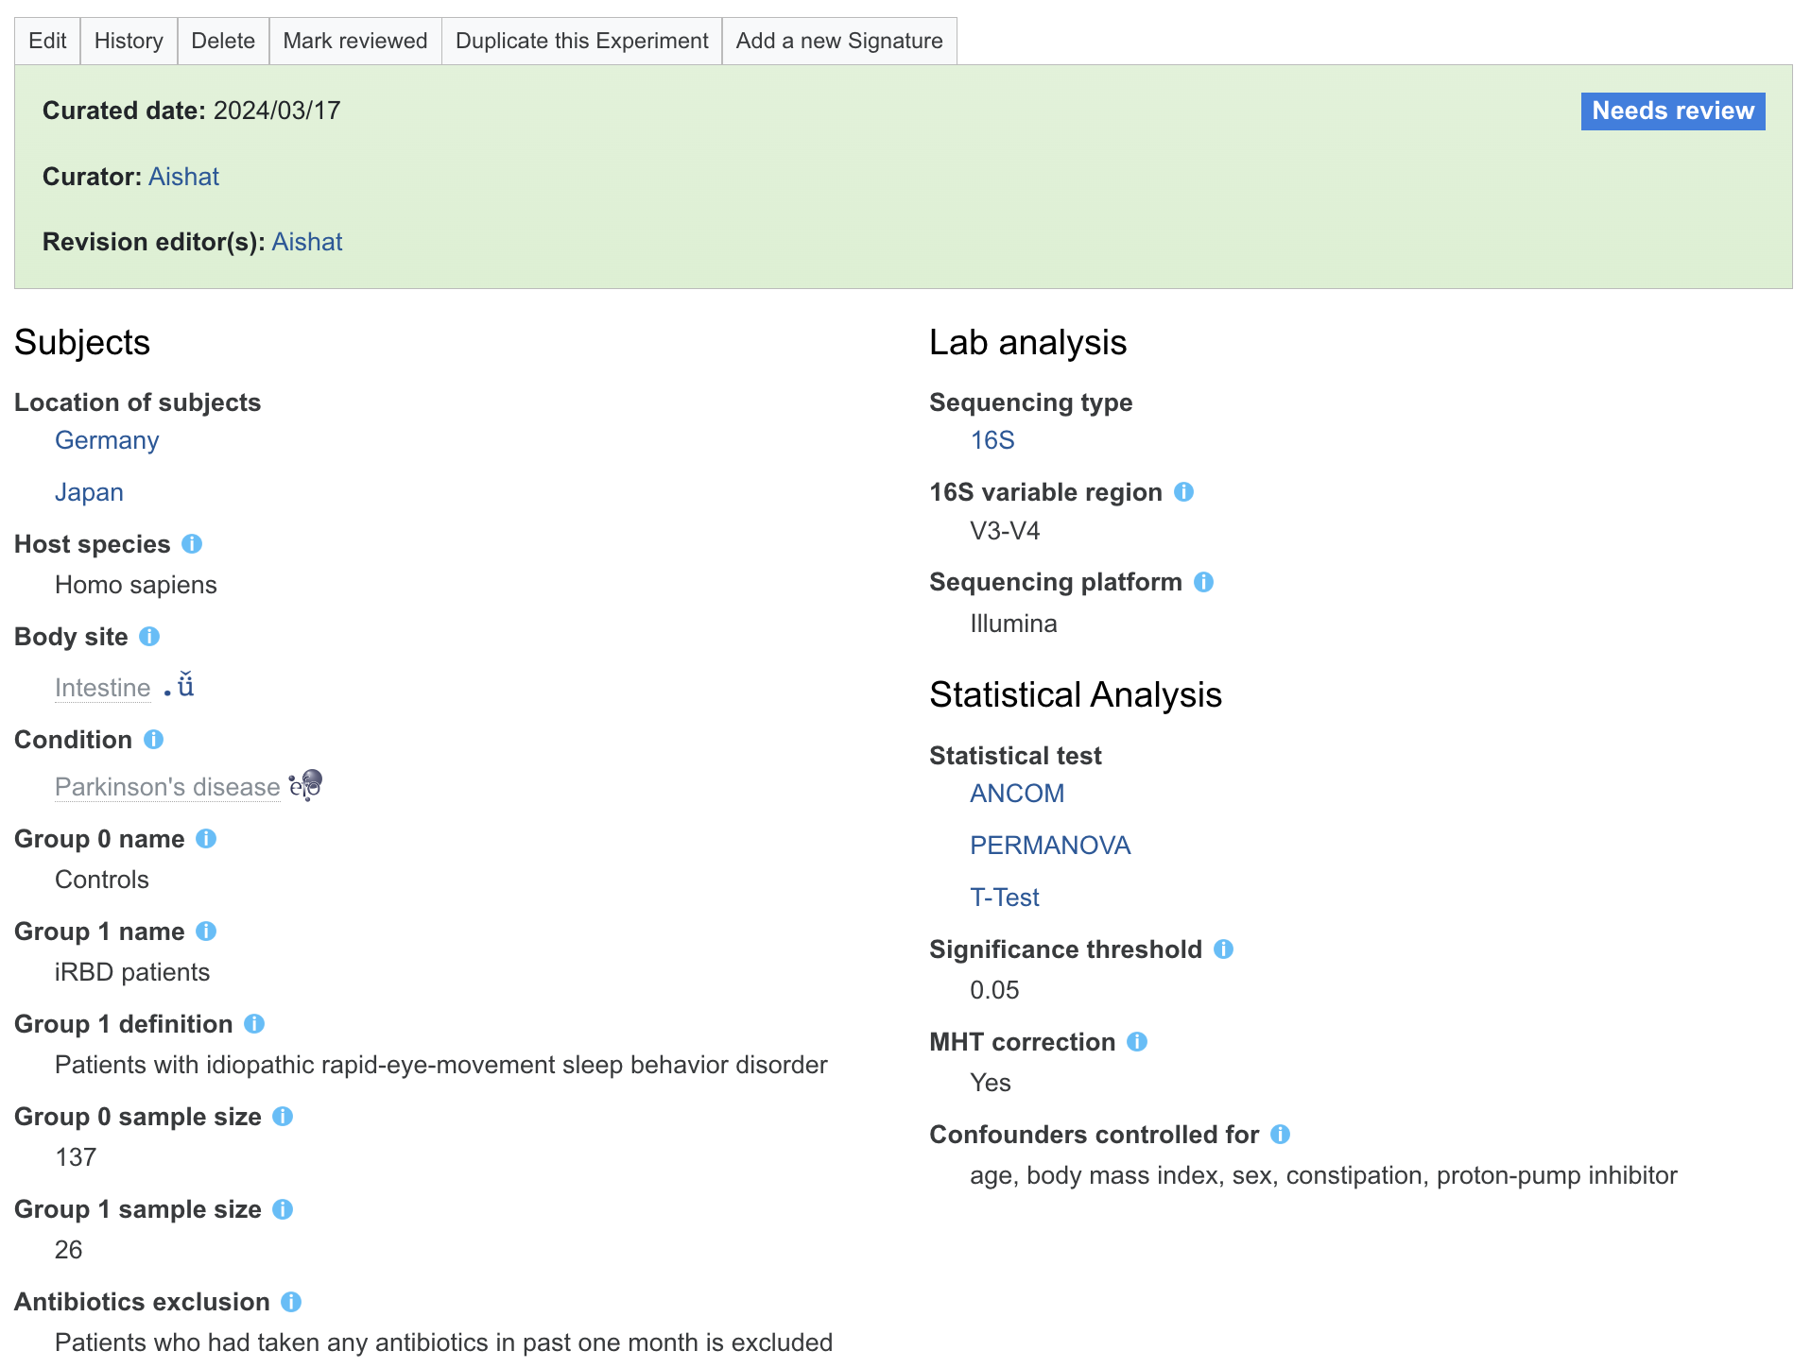
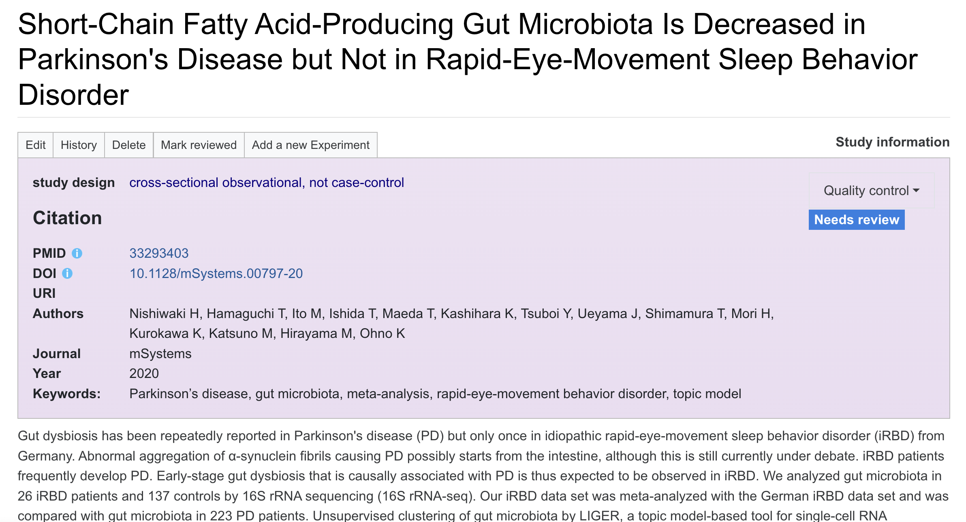
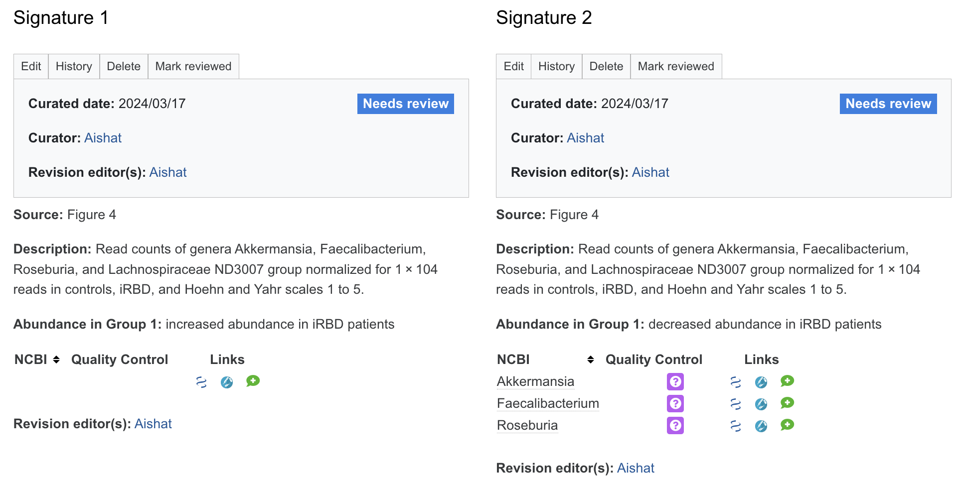
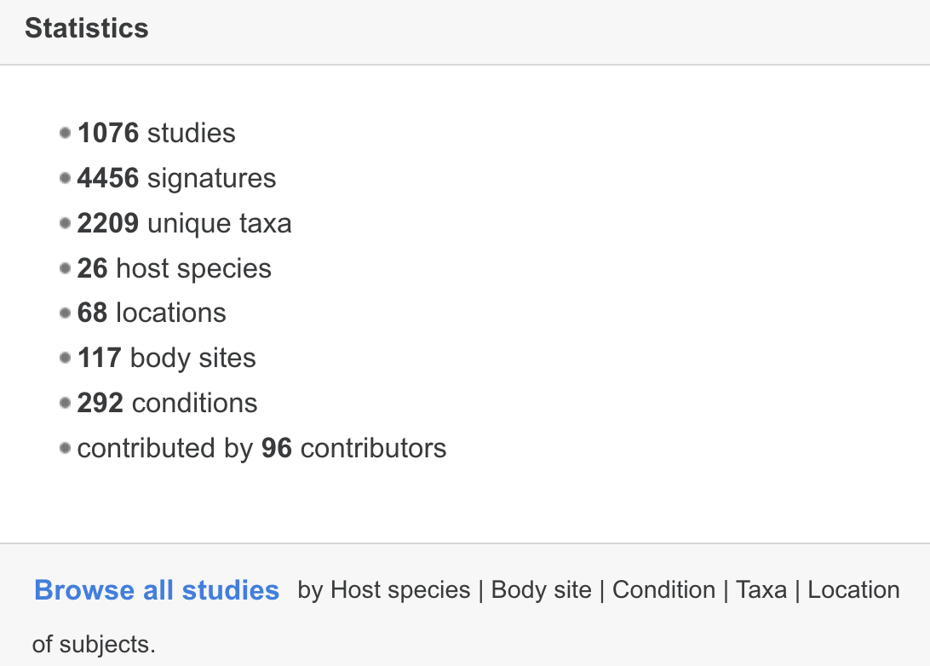
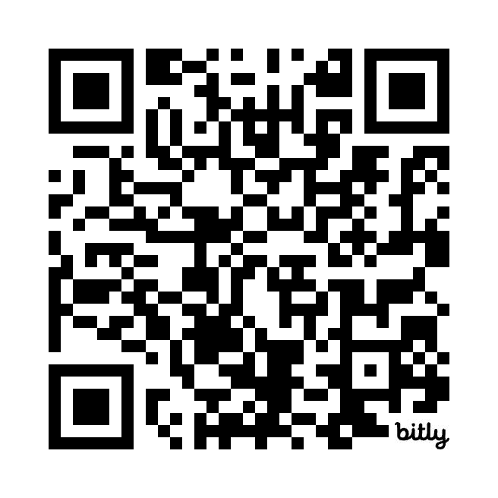
BugSigDB.org
~60 Parkinson’s Disease studies in BugSigDB.org
https://bit.ly/bugsigdb_pd
Notes:
https://bugsigdb.org/Special:RunQuery/Drill?Drill=Condition%2Blogic%3DAND%26Location%2Blogic%3DAND%26Site%2Blogic%3DAND&_run=1&title=Special%3ARunQuery%2FDrill&pfRunQueryFormName=Drill&Drill%5BTaxon%5D%5Bis_list%5D=1&Drill%5BLocation+of+subjects%5D%5Bis_list%5D=1&Drill%5BLocation+logic%5D=AND&Drill%5BHost+species%5D%5Bis_list%5D=1&Drill%5BBody+site%5D%5Bis_list%5D=1&Drill%5BSite+logic%5D=AND&Drill%5BCondition%5D%5B%5D=parkinson%27s+disease&Drill%5BCondition%5D%5Bis_list%5D=1&Drill%5BCondition+logic%5D=AND&Drill%5BNCBI%5D=&wpRunQuery=&pf_free_text=

Slide 7
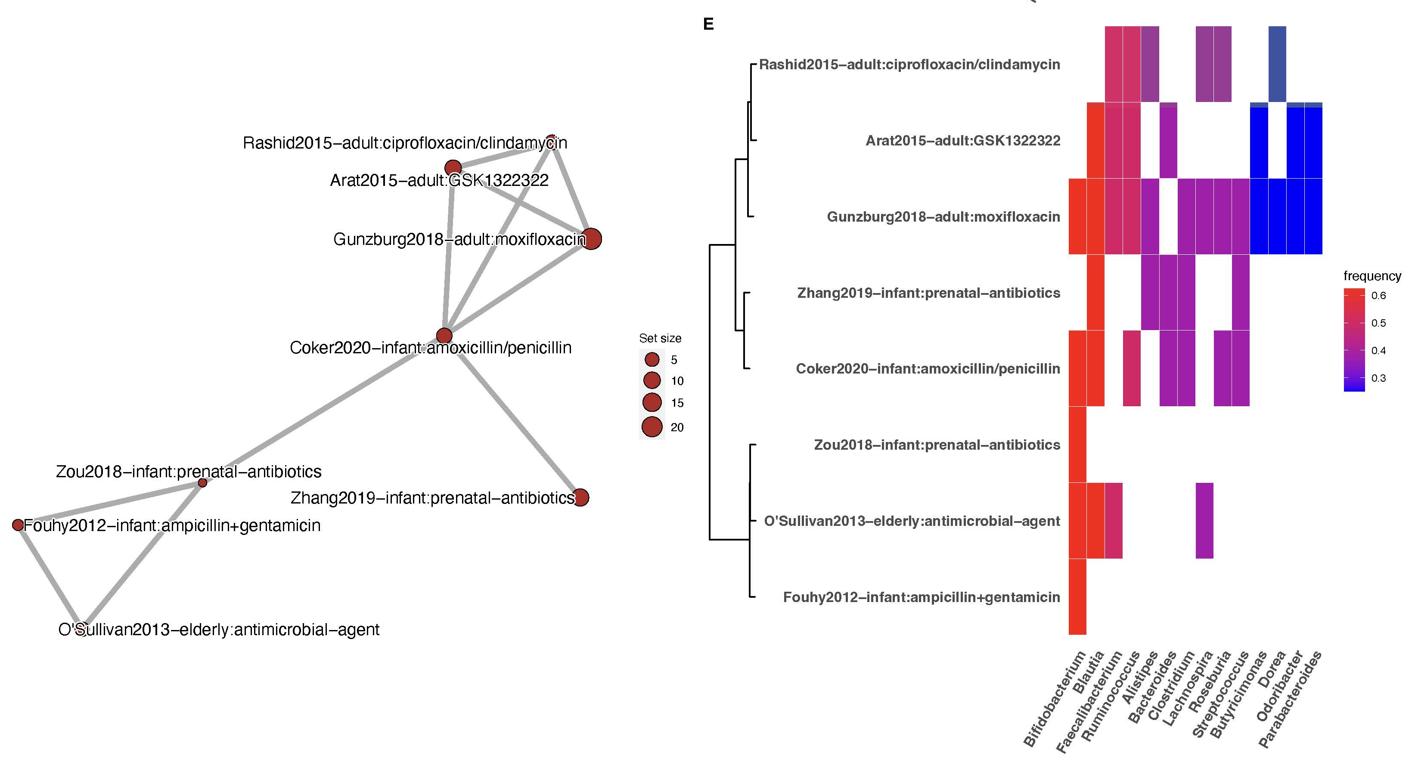
Reproducibility of microbiome research topics
antibiotics exposure HIV infection
Geistlinger, L. et al. BugSigDB captures patterns of differential abundance across a broad range of host-associated microbial signatures. Nat. Biotechnol. (2023) doi:10.1038/s41587-023-01872-y
Notes:
Figure 2. Analysis of signature similarity in BugSigDB identifies conditions with replicable microbiome changes across studies. (A) Signature similarity analysis for conditions with fecal samples from at least two studies. Signatures were stratified by direction of abundance change into signatures with decreased abundance (DOWN panel, left) and increased abundance (UP panel, right) in the study group. Shown is the p-value (x-axis, negative log scale) obtained from testing whether the semantic similarity of signatures for each condition (y-axis) exceeds the semantic similarity of randomly sampled signatures. The size of each dot corresponds to the number of studies investigating a condition. (B-E) Example exploration of two top ranked conditions in more detail: signatures of decreased abundance for patients with HIV infection (B,C), and signatures of decreased abundance for patients treated with antibiotics (D,E). (B,D) Semantic similarity between signatures. Each node corresponds to a signature. The size of each node is proportional to the number of taxa in a signature. More similar signatures are connected by shorter and thicker edges. (C,E) Microbial contents of the signatures shown in panels B and D (y-axis) delineating the genera contained in these signatures (x-axis). Signatures are clustered by semantic similarity and the relative frequency of each genus across signatures is indicated by a color scale. Display of contained taxa is restricted to genera occurring in at least two signatures (full signatures are shown in Supplementary Figure S5 and S6).

Slide 8
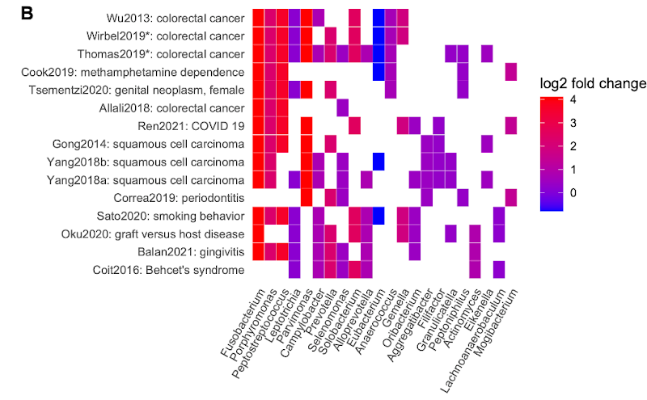
Similar signatures of different health outcomes
8
Notes:
Figure 3. Bug set enrichment analysis reveals established and novel associations of the human microbiome with colorectal cancer and other disease phenotypes. (A) Overrepresentation analysis (ORA) of BugSigDB signatures with differentially abundant genera between 662 colorectal cancer samples and 653 control samples pooled from 10 published metagenomic datasets. Each dot corresponds to an enriched published signature from BugSigDB (FDR < 0.05, Fisher’s exact test, color scale). The size of each dot corresponds to the number of differentially abundant genera in a signature, given as a proportion on the x-axis. * Prior meta-analytic signatures from Thomas et al., 2019⁵² and Wirbel et al., 2019⁵³ which reported differentially abundant species and genera from meta-analysis of 8 colorectal cancer datasets. These act as positive controls, as several of the datasets being tested for enrichment were included at the time these signatures were derived. (B) Differentially abundant genera (x-axis) in the top 15 enriched signatures (y-axis) from the overrepresentation analysis in (A). The x-axis is sorted by occurrence frequency of each genus in decreasing order, the y-axis is sorted by Jaccard similarity between signatures. (C) Percentile of ranks (y-axis) of both meta-analytic signatures for ORA, pathway analysis with down-weighting of overlapping genes (PADOG), and competitive balances for taxonomic enrichment analysis (CBEA) relative to all signatures when applied to the 10 published metagenomic datasets individually (x-axis). # Datasets not included as training sets in the meta-analyses of Thomas et al., 2019, and Wirbel et al., 2019. (D) Assessment of statistically significant differences of the percentile ranks shown in (C) between the three methods using Wilcoxon’s signed-rank test.

Slide 9
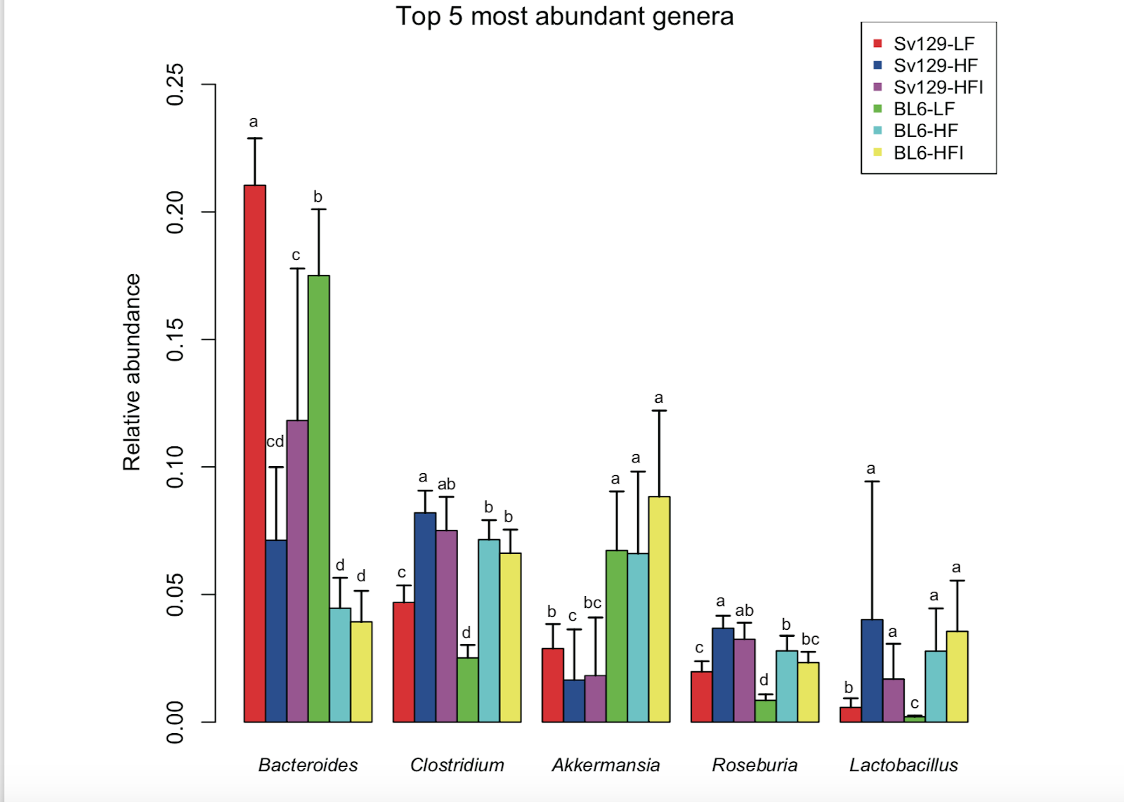
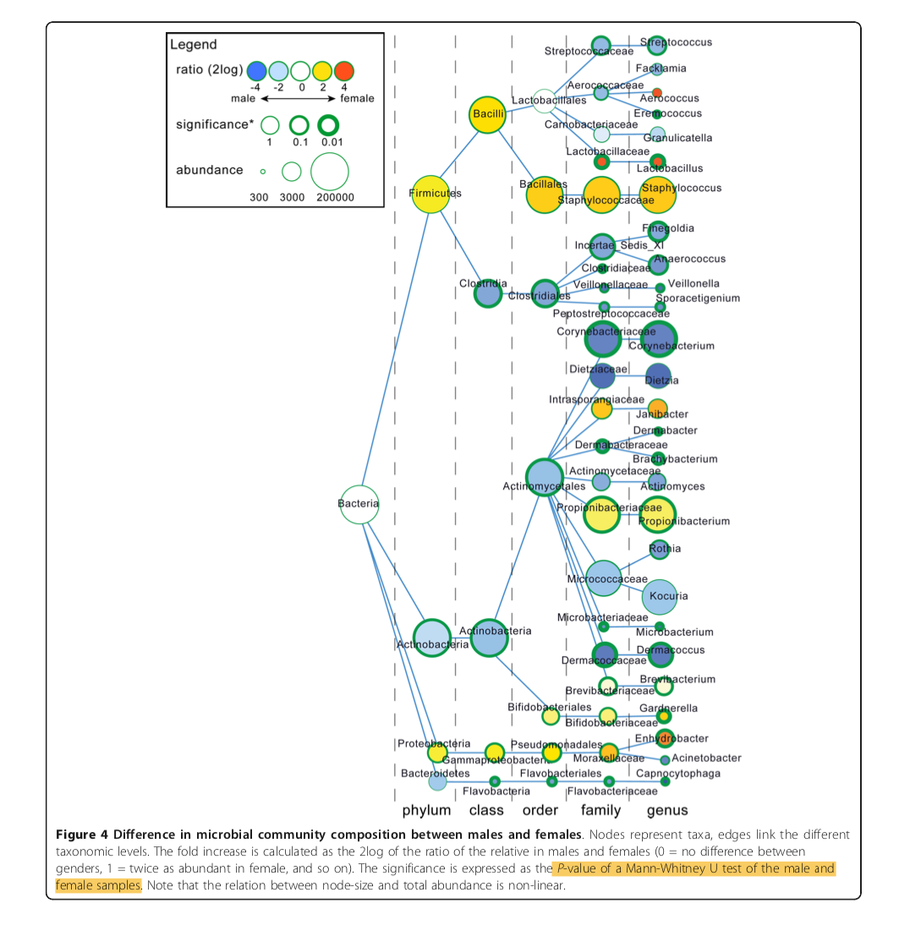
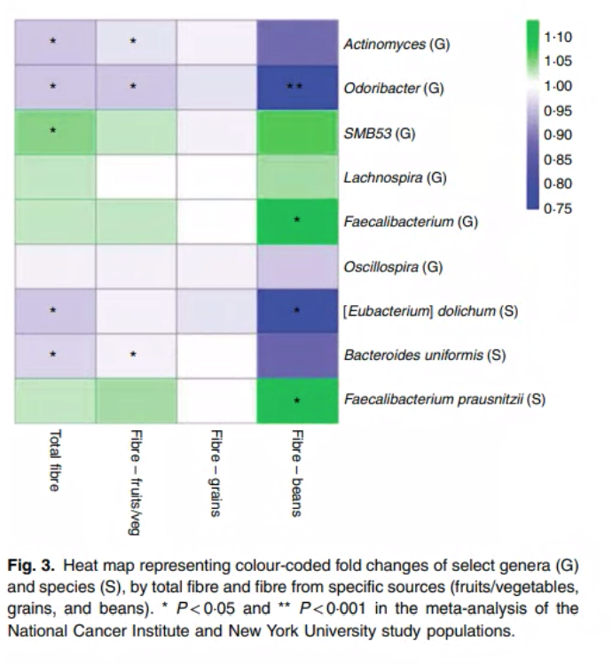
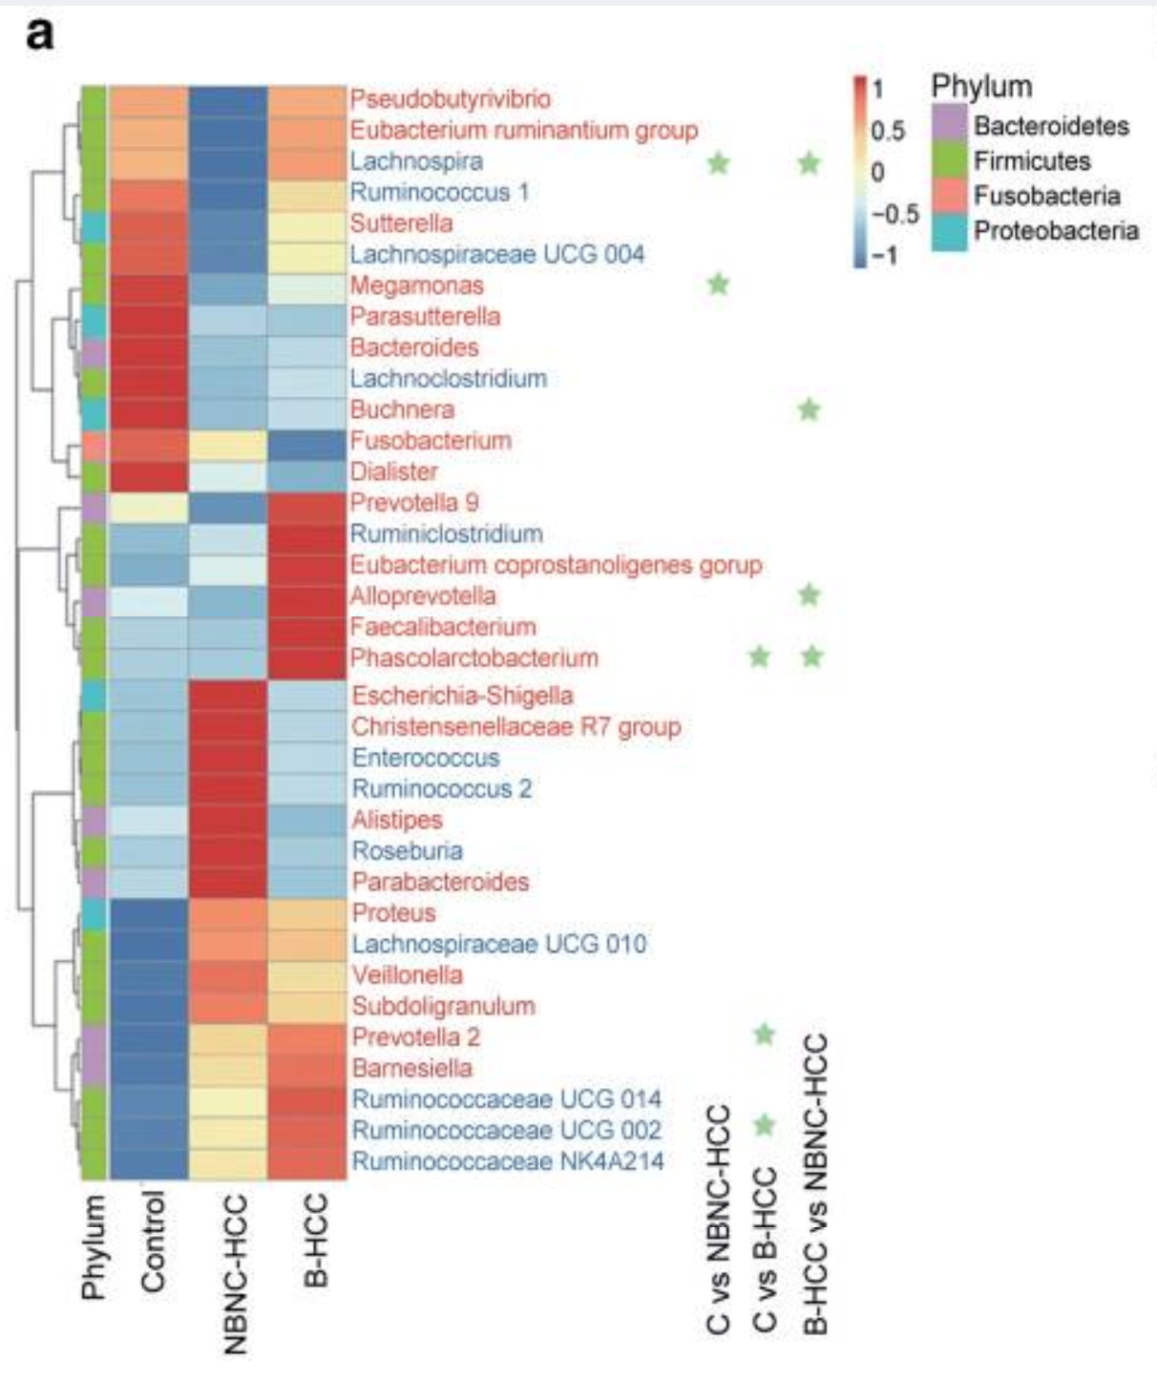
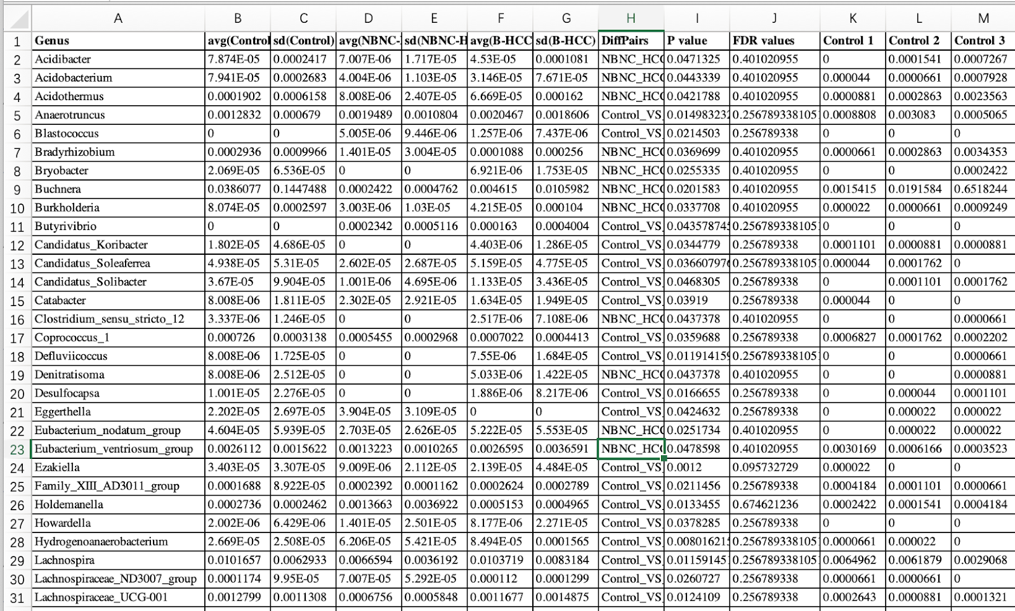
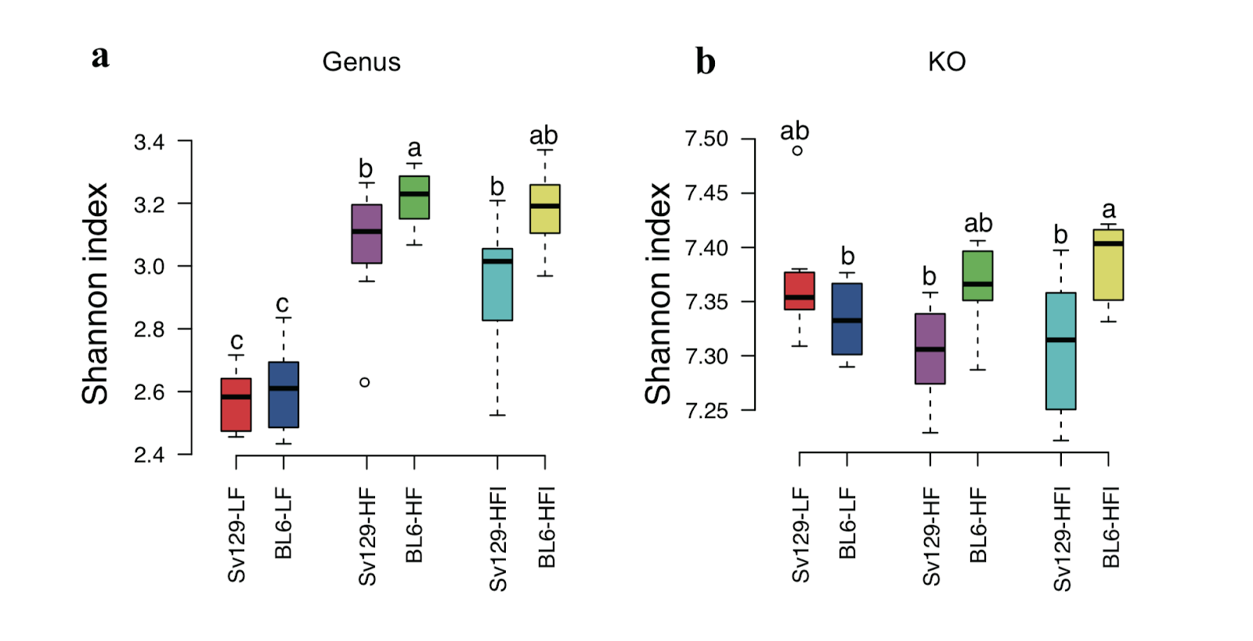
Difficult to: - compare results of two studies - compare or replicate methods

Slide 10




STORMS checklist objectives
Strengthening the Organization and Reporting of Microbiome Studies
Intuitive and straightforward
Help authors write well-organized microbiome papers
Easier comparison of study designs and results between papers
Method, database, and analysis-agnostic
www.stormsmicrobiome.org
Mirzayi, C. et al. Reporting guidelines for human microbiome research: the STORMS checklist. Nat. Med. 27, 1885–1892 (2021)

Slide 11
STORMS development process
Core team drafted initial checklist (Primarily Chloe Mirzayi, Heidi Jones, myself)
Emailed widely to the microbiome community to invite collaborators
Collected feedback via email + Google Doc
Synthesized as a “response to reviewers”
Repeat steps 2-4 until no further comments (Delphi process)
~50-page single-spaced response to consortium feedback letter, included in submission to journal
Mirzayi, C. et al. Reporting guidelines for human microbiome research: the STORMS checklist. Nat. Med. 27, 1885–1892 (2021)

Slide 12

The Checklist
Number | Item | Recommendation | Source | Additional Guidance | Yes/No/NA | Comments
4.0 | Laboratory methods | State the laboratory/center where laboratory work was done. | STORMS | (not shown)
4.1 | Specimen collection | State the body site sampled from and how specimens were collected. | STORMS
4.2 | Shipping | Describe how samples were stored and shipped to the laboratory | STORMS
4.3 | Storage | Describe how the laboratory stored samples, including time between collection and storage and any preservation buffers or refridgeration used. | STORMS
4.4 | DNA extraction | Provide DNA extraction method, including kit and version if relevant | STORMS
4.5 | Human DNA removal | Describe whether human DNA removal was performed | STORMS
4.6 | Primer selection | Provide primer selection and DNA amplification methods as well as variable region sequenced (if applicable). | STORMS
4.7 | Contaminant analysis | Provide any methods used to control for or identify microbiome contamination. | STORMS
4.8 | Controls | Describe any positive and negative controls, including their source and which steps were performed on them. | STORMS
17 items (57 subitems)
divided into 6 sections
Abstract
Introduction
Methods
Results
Discussion
Other Information
Follows a paper outline
Easy to use
Go to full checklist now: https://zenodo.org/record/5714305
https://zenodo.org/record/5714305
www.stormsmicrobiome.org

Slide 13
Roles for MAC in ASAP
Support for ASAP researchers – can start already:
Advise on experimental, study and analytical design
Provide SOP for microbiome sample collection, storage, and processing
Provide template for standardizing metadata, including required metadata
Manuscript scientific review and feedback
Work with Open Science Team to develop policies
Preprint review for adherence to ASAP open science policies
Support for ASAP researchers – pending hiring:
Uniform processing of raw data
Standardization of metadata
Statistical analysis and machine learning analysis
Depositing data in public repositories (SRA, Genomic Data Commons, curatedMetagenomicData)
Contribute methods and results to manuscript
Encourage:
Informed consent for General Research Use of data, e.g. TCGA template
STORMS to help organize manuscripts, with customization as needed

