Slide 1



Databases and methods for efficient learning from published data in cancer genomics BITS@Povo June 14, 2024
Levi Waldron
City University of New York
University of Trento, Department CIBIO
NCI: R01 CA230551 Exploiting public metagenomic data to uncover cancer-microbiome relationships
NCI: U24 CA180996 Cancer Genomics: Integrative and Scalable Solutions in R/Bioconductor
NHGRI: U24 HG010263 Implementing the genomic data science analysis, visualization, and informatics
lab-space (ANVIL)

Slide 2
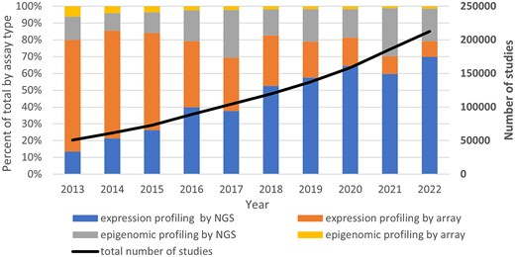
Accelerating growth of public ‘omics data
SRA
57.5 PB
Emily Clough et al. NCBI GEO: archive for gene expression and epigenomics data sets: 23-year update, Nucleic Acids Research, Volume 52, Issue D1, 5 January 2024, Pages D138–D144, https://doi.org/10.1093/nar/gkad965
Notes:
Figure 1. GEO growth and data type trends over the last decade. The stacked bars display the percentage of each of four broad data type categories from 2013–2022, using the left y-axis. The thick black line shows growth of the total number of studies from 2013–2022 and uses the right y-axis.

Slide 3
Barriers
Finding the right data
Missing metadata
Inconsistent data and metadata
Computational cost
Complexity of data

Slide 4

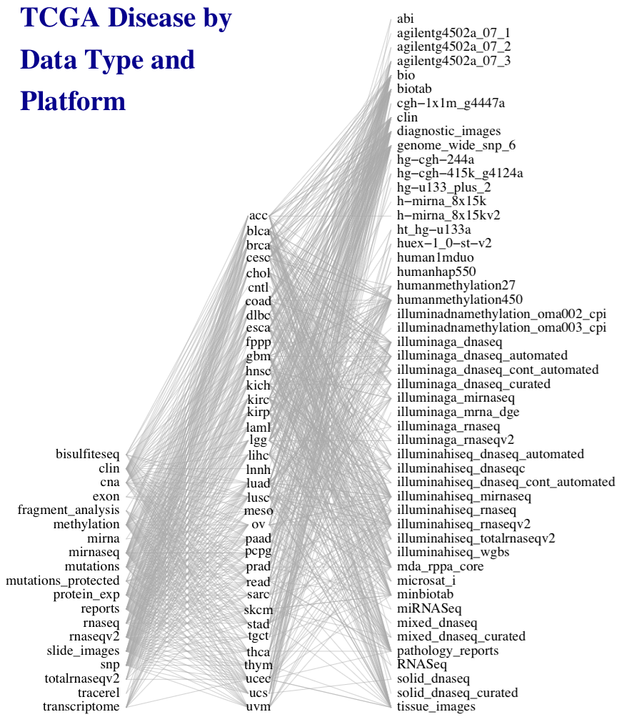
50 platforms
Multi’omic integration with MultiAssayExperiment
33 diseases
19 data types
Marcel Ramos
Ramos M et al.: Software for the Integration of Multiomics Experiments in Bioconductor. Cancer Res. 2017, 77:e39–e42.
Ramos M et al. Multiomic integration of public oncology databases in Bioconductor. JCO Clinical Cancer Informatics 2020:4, 958-971
Notes:
This work was motivated by the need to simplify general statistical analysis and development of bioinformatic tools for a study as complex as the Cancer Genome Atlas, where 33 cancers were assayed on many platforms to generate different types of data, but also to provide a simplified framework for more easily reproducible and less error-prone analysis of simpler experiments involving just a couple of complementary assays and clinical data.

Slide 5
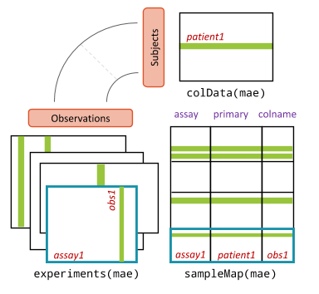
MultiAssayExperiment: the integrative Bioconductor container

Slide 6
> acc <- curatedTCGAData(diseaseCode = "ACC", assays="*", dry.run = FALSE)
> acc
A MultiAssayExperiment object of 9 listed
experiments with user-defined names and respective classes.
Containing an ExperimentList class object of length 9:
[1] ACC_CNASNP-20160128: RaggedExperiment with 79861 rows and 180 columns
[2] ACC_CNVSNP-20160128: RaggedExperiment with 21052 rows and 180 columns
[3] ACC_GISTIC_AllByGene-20160128: SummarizedExperiment with 24776 rows and 90 col$
[4] ACC_GISTIC_ThresholdedByGene-20160128: SummarizedExperiment with 24776 rows an$
[5] ACC_Methylation-20160128: SummarizedExperiment with 485577 rows and 80 columns
[6] ACC_miRNASeqGene-20160128: SummarizedExperiment with 1046 rows and 80 columns
[7] ACC_Mutation-20160128: RaggedExperiment with 20166 rows and 90 columns
[8] ACC_RNASeq2GeneNorm-20160128: SummarizedExperiment with 20501 rows and 79 colu$
[9] ACC_RPPAArray-20160128: SummarizedExperiment with 192 rows and 46 columns
Features:
experiments() - obtain the ExperimentList instance
colData() - the primary/phenotype DataFrame
sampleMap() - the sample availability DataFrame
`$`, `[`, `[[` - extract colData columns, subset, or experiment
*Format() - convert into a long or wide DataFrame
assays() - convert ExperimentList to a SimpleList of matrices
Ramos M et al. Multiomic integration of public oncology databases in Bioconductor. JCO Clinical Cancer Informatics 2020:4, 958-971

Slide 7
Analyst-friendly data in Bioconductor
curatedOvarianData
30 datasets, most annotated for OS, surgical debulking, histology
curatedCRCData
34 datasets, many annotated for MSS, gender, stage, age, N, M
curatedBladderData
12 datasets, many annotated for stage, grade, OS
curatedTCGAData + TCGAutils
The Cancer Genome Atlas as MultiAssayExperiment
cBioPortalData
150+ multi’omics cancer datasets as MultiAssayExperiment
HMP16SData
Simple access to The Human Microbiome Project
curatedMetagenomicData
~20K samples processed through bioBakery 3 with curated metadata
MicrobiomeBenchmarkData
Microbiome benchmarking with experimental ground truth
SingleCellMultiModal
Landmark datasets from new single-cell multimodal technologies

Slide 8
SingleCellMultiModal landmark datasets on select single-cell multimodal technologies for benchmarking and methods development
DataType | Technology | Modalities (Ref.No.)
cord_blood | CITE-seq | Cell surface marker + mRNA (1)
peripheral_blood | ECCITE-seq | Cell surface marker + mRNA + CRISPR perturbations (2)
mouse_gastrulation | scNMT | Epigenetic markers (chromatin accessibility, methylation) + mRNA (3)
mouse_visual_cortex | seqFISH | mRNA in spatial context, in situ (4, 5)
macrophage_differentiation | SCoPE2 | Peptides + mRNA (6)
mouse_embryo_8_cell | G&T-seq | Genome + mRNA (7)
pbmc_10x | 10X Multiome ATAC-seq | Chromatin accessibility + mRNA (8)

Slide 9
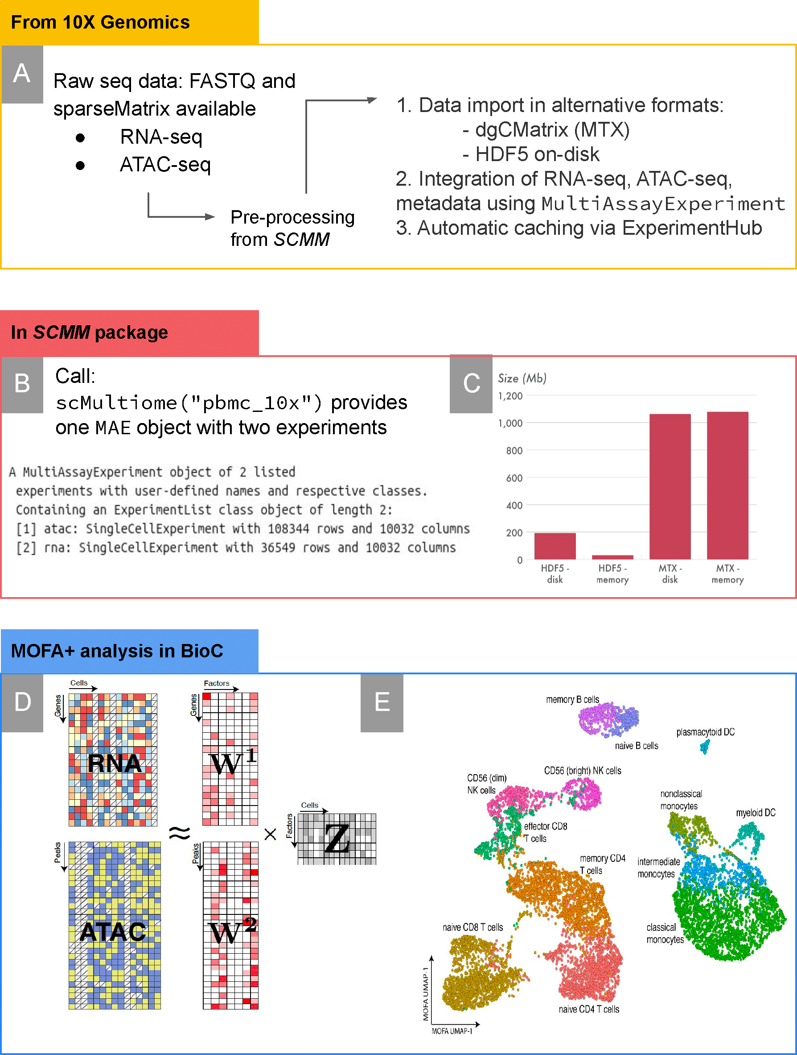
SingleCellMultiModal usage
Eckenrode et al. Curated single cell multimodal landmark datasets for R/Bioconductor. PLoS Comput. Biol. 19, e1011324 (2023)
https://www.bioconductor.org/packages/SingleCellMultiModal/

Slide 10
SingleCellMultiModal usage
Eckenrode et al. Curated single cell multimodal landmark datasets for R/Bioconductor. PLoS Comput. Biol. 19, e1011324 (2023)
https://www.bioconductor.org/packages/SingleCellMultiModal/

Slide 11
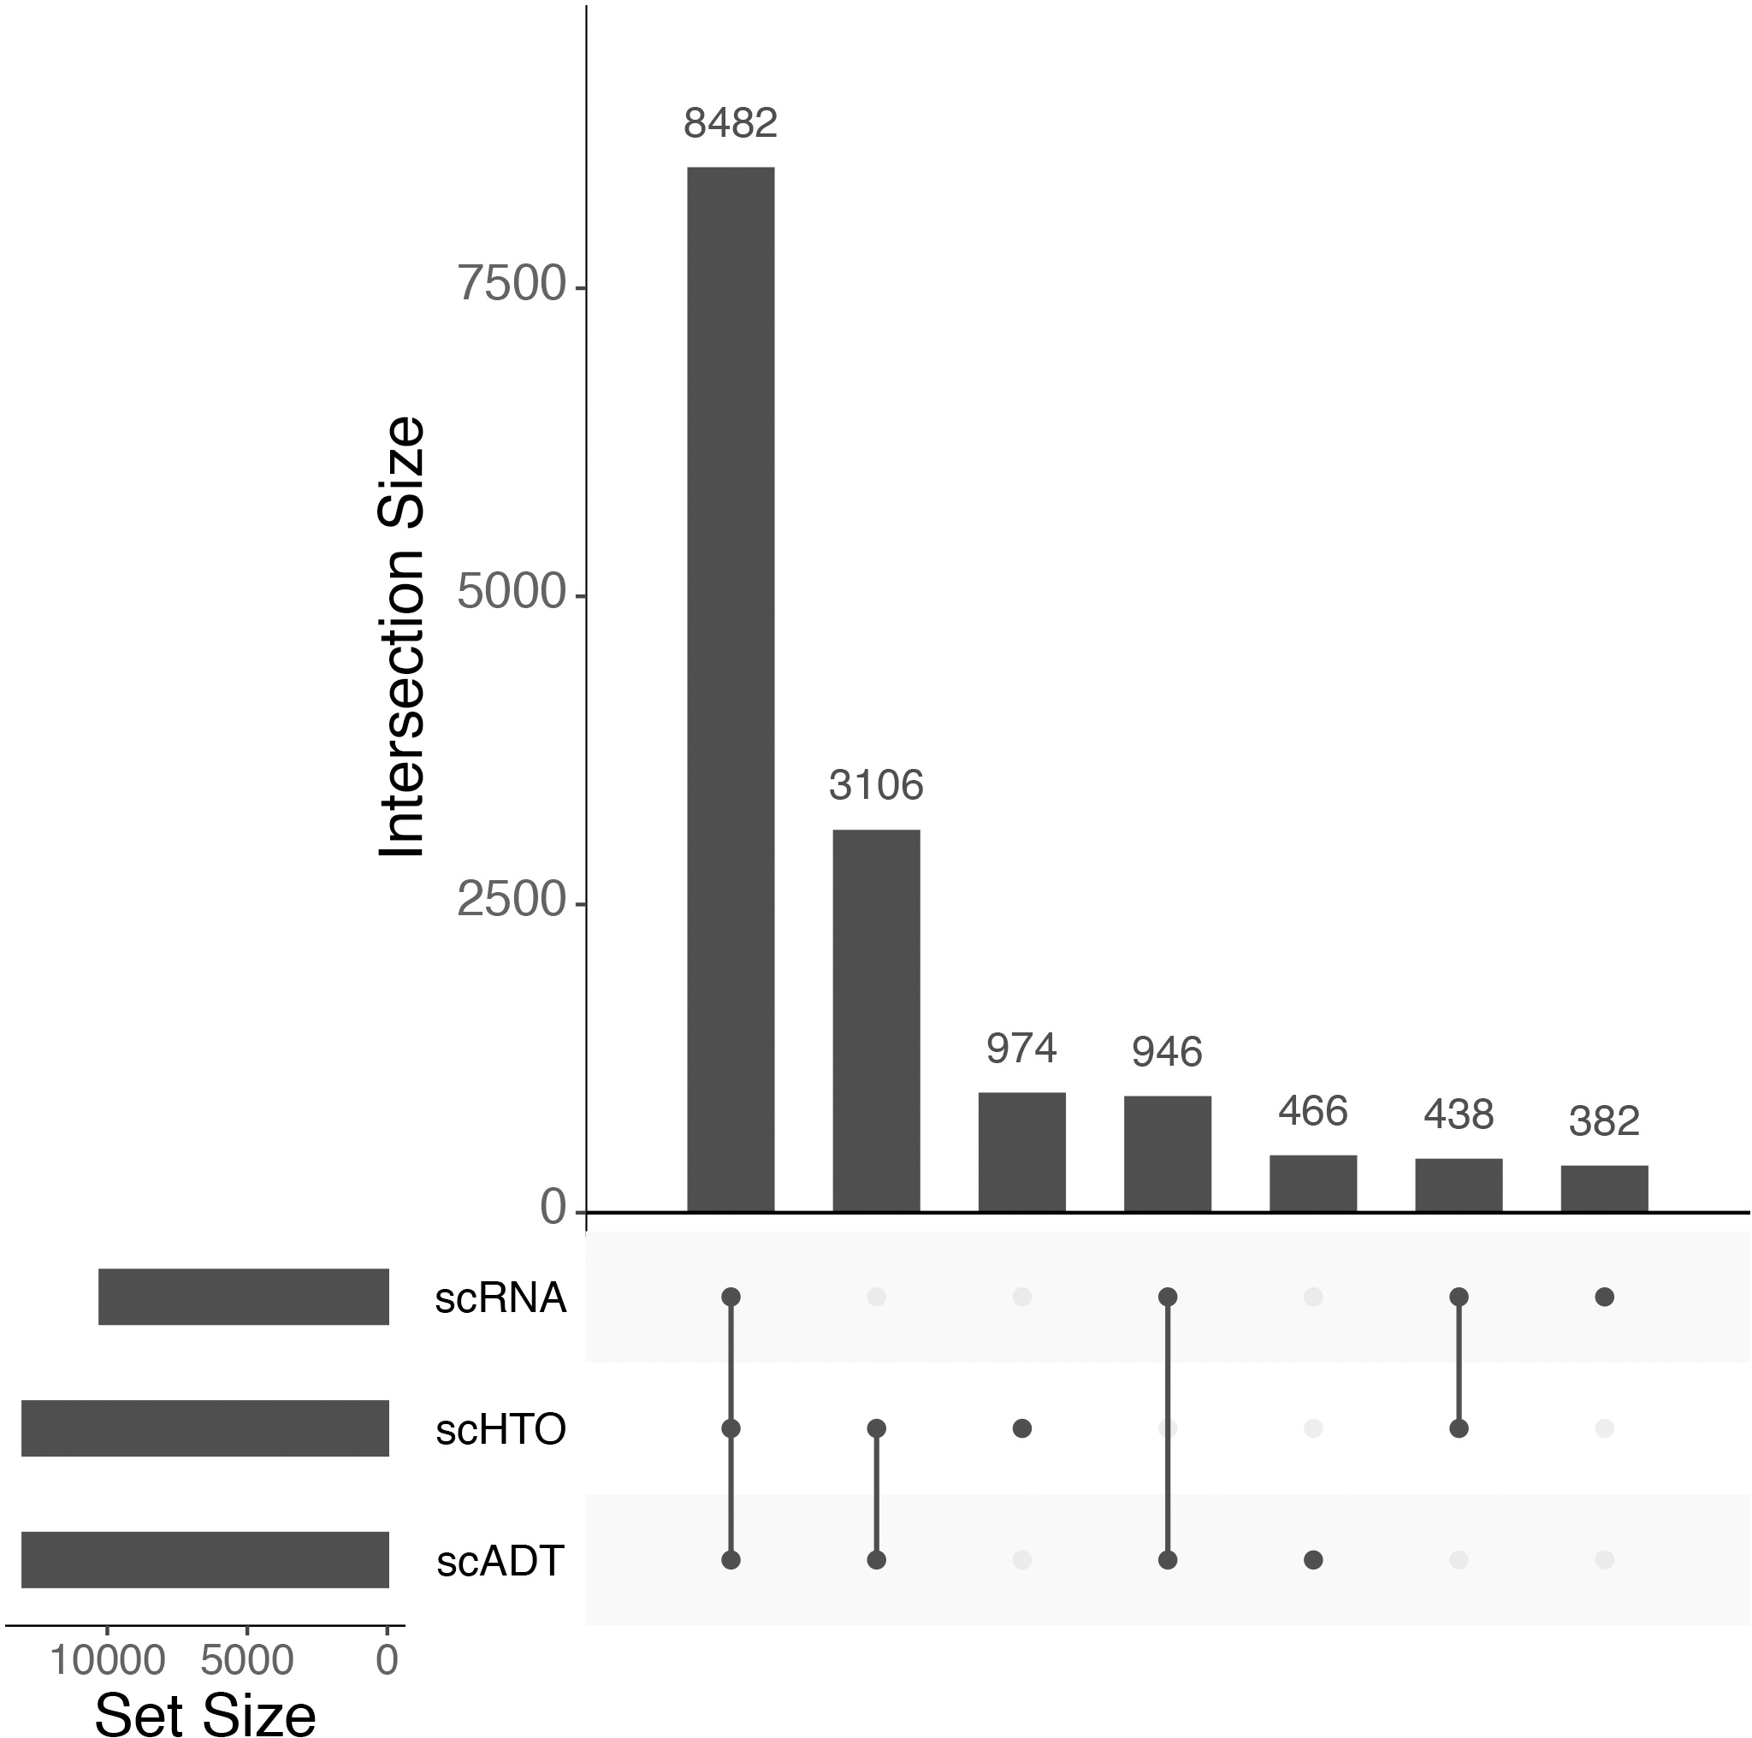
SingleCellMultiModal usage
upsetSamples(ECCITEseq)
Eckenrode et al. Curated single cell multimodal landmark datasets for R/Bioconductor. PLoS Comput. Biol. 19, e1011324 (2023)
https://www.bioconductor.org/packages/SingleCellMultiModal/

Slide 12
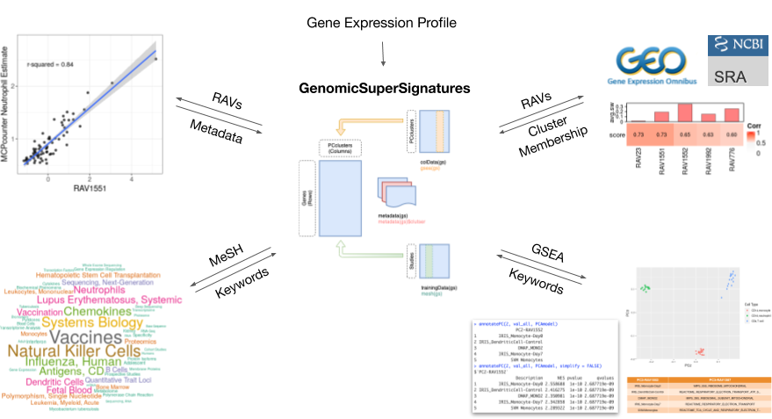
GenomicSuperSignature
Oh, S. et al. GenomicSuperSignature facilitates interpretation of RNA-seq experiments through robust, efficient comparison to public databases. Nat. Commun. 13, 3695 (2022)
https://www.bioconductor.org/packages/GenomicSuperSignature/

Slide 13
GenomicSuperSignature Interpretation of RNA-seq experiments through robust, efficient comparison to public databases
Source Data: RNA-seq Sample Compendium from refine.bio (https://www.refine.bio/)
536 studies (44,890 samples) for model building:
50 – 1000 samples per study
Intersection of top 90% varying genes from each study
Top 20 PCs from each study
Hierarchical clustering of 10,720 PCs (= 20 PCs x 536 studies) into 4,764 clusters including singletons
Average PCs in each cluster → RAV (Replicable Axes of Variation)
Oh, S. et al. GenomicSuperSignature facilitates interpretation of RNA-seq experiments through robust, efficient comparison to public databases. Nat. Commun. 13, 3695 (2022)
https://www.bioconductor.org/packages/GenomicSuperSignature/

Slide 14
Annotation - MeSH Terms
What are MeSH terms?
MeSH (Medical Subject Headings) terms are labels assigned to each article in Medline in order to describe what the article is about. The National Library of Medicine employees with training as ‘indexers’ look at each new article added to Medline and assign to it about 10–12 labels. (N. Baumann, IJCP 2016)
Collect MeSH terms assigned to the studies for model building
Each term is weighted by
Frequency of the term
Variance explained by PC
Oh, S. et al. GenomicSuperSignature facilitates interpretation of RNA-seq experiments through robust, efficient comparison to public databases. Nat. Commun. 13, 3695 (2022)
https://www.bioconductor.org/packages/GenomicSuperSignature/
Notes:
Our index stays directly connected to the training datasets. Additionally, we annotated newly created signatures with two aspects: MeSH terms and GSEA.
For MeSH term annotation, we collect all the MeSH terms assigned to the 536 studies and reverse-weighted them by the frequency. And at the cluster level, we weighted them again based on the variance explained by each PC in the clusters.

Slide 15
Annotation - GSEA
Create a pre-ranked gene list from each RAV (based on the average loading)
GSEA on pre-ranked gene list
multiPLIER gene sets
mSigDB C2 gene sets
any user-defined gene set on gene symbols
Model contains enriched pathways with minimum q-value
Association strength of the enriched pathways ranked by normalized enrichment score (NES)
Notes:
For GSEA-based annotation, we created a pre-ranked gene list from each PCcluster. PCAGenomicSignatures object contains the enriched pathways with the minimum q-value.

Slide 16
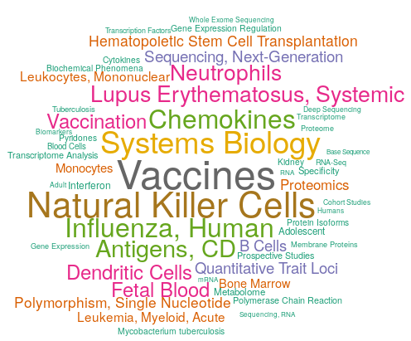
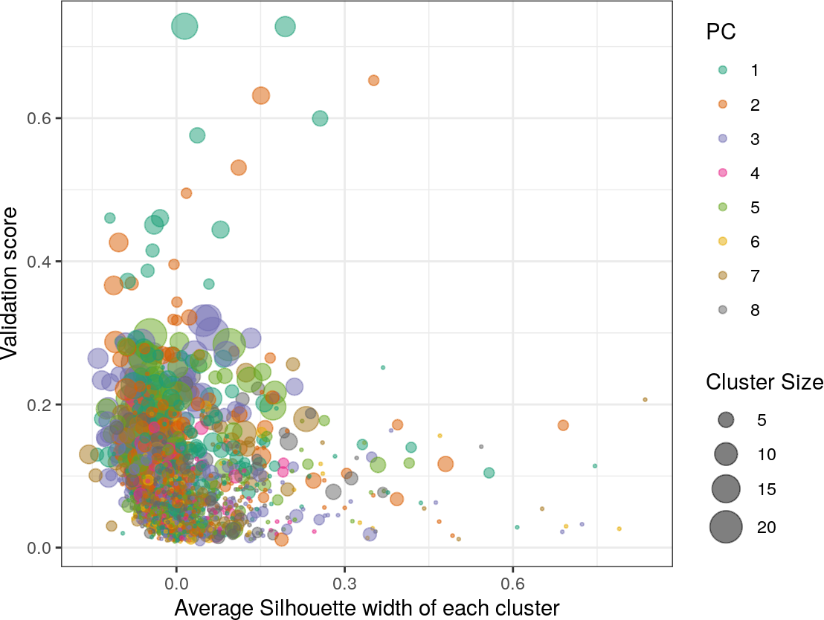
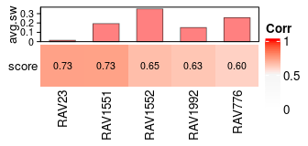
1. Find the major signal of your data
E- MTAB-2452 (McKinney et al., 2015), a dataset comprised of isolated immune subsets (CD4+ T cells, CD14+ monocytes, and CD16+ neutrophils) from patients with autoimmune diseases.
Find validating RAVs
> val_all <- validate(dataset, RAVmodel)
> heatmapTable(val_all, swCutoff=0)
MeSH term of RAV1551
> drawWordcloud(RAVmodel, 1551)
Interactive plot for RAVs
> val_all <- validate(dataset, RAVmodel)
> plotValidate(val_all)
Notes:
Alignment. GTEx and public SRA samples were selected by searching the SRA website as discussed in selecting GTEx, SRA and TCGA samples subsection. Samples that could not be downloaded using fastq-dump were eliminated as described in incomplete and invalid input data. Samples were aligned in a spliced fashion to the hg38 assembly of the human genome using Rail-RNA. Alignments were performed in batches on computer clusters rented from the Amazon Web Services Elastic MapReduce service. The alignment pipeline was divided into two phases, where the first phase (“preprocessing”) downloads and reformats the data and the second phase performs spliced alignment. Outputs of the pipeline include, for each sample, a junction coverage file (similar to a TopHat “junctions.bed” file) and a BigWig file37 containing a genome-wide coverage vector. Further details are presented in alignment with Rail-RNA section below and the Rail-RNA study21. Gene and exon counts were compiled using the BigWig files output by Rail-RNA and the Gencode v25 annotation38. For exon counts, we first obtained a set of non-overlapping “unioned” exons. Gene and exon counts were compiled into per-project tables and RangedSummarizedExperiment objects. We expanded the tables with several metadata columns containing, for example, read count, paired-end status, GEO accession, and the tissue type as predicted by the SHARQ beta resource (http://www.cs.cmu.edu/~ckingsf/sharq/). For GTEx and TCGA we included metadata provided by the respective projects as detailed in the counting genes and exons.

Slide 17
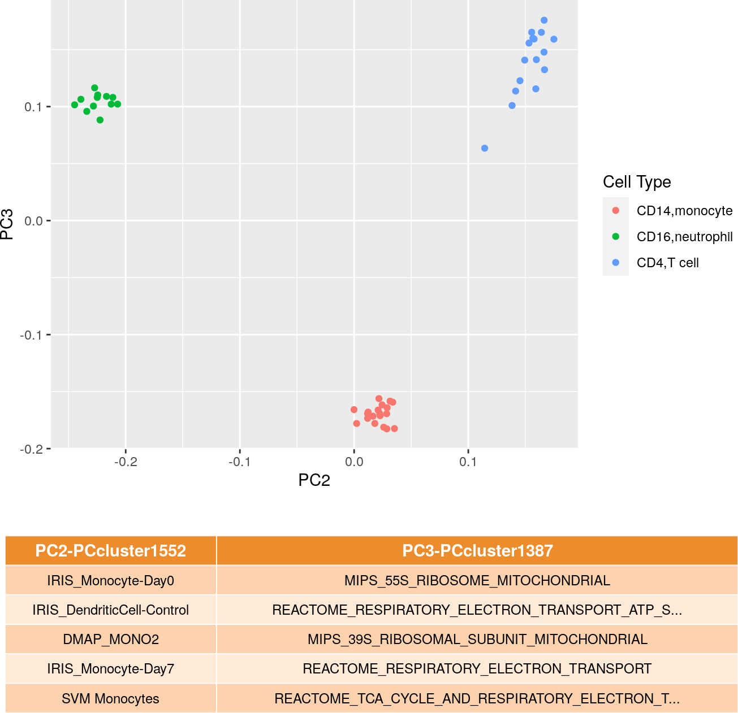
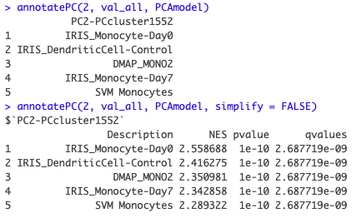
2. Interpret top PCs of your own data
E- MTAB-2452 (McKinney et al., 2015), a dataset comprised of isolated immune subsets (CD4+ T cells, CD14+ monocytes, and CD16+ neutrophils) from patients with autoimmune diseases.

Slide 18
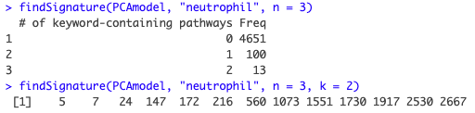
3. Calculate a known signature in your data
Identify principal components associated with neutrophil count
1. Keyword search in enriched pathways of RAVs
2. Correlation with dataset metadata
PCclusters with high R² with neutrophil count:
#> [1] "PCcluster1551" "PCcluster776" "PCcluster23"
#> [4] "PCcluster2671" "PCcluster1830"
PCclusters with high R² with neutrophil estimate:
#> [1] "PCcluster1551" "PCcluster7" "PCcluster1073"
#> [4] "PCcluster2632" "PCcluster23" "PCcluster2671"
https://www.bioconductor.org/packages/GenomicSuperSignature/

Slide 19
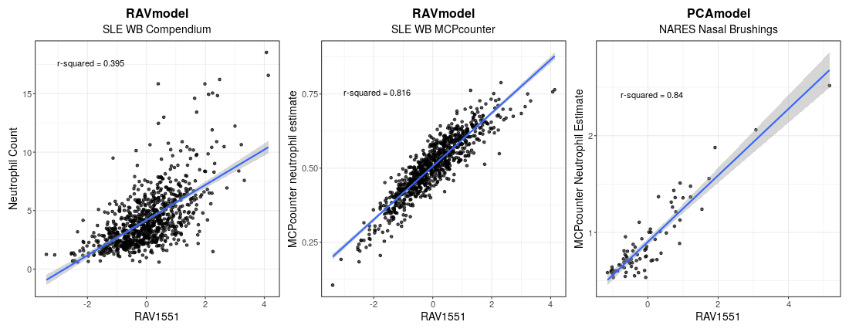
Comparing estimated neutrophil count with known count
Neutrophil count of Systemic lupus erythematosus (SLE) whole blood (WB) Compendium is from the metadata (B and E)
Neutrophil estimate of SLE-WB by MCPcounter (C and F)
Neutrophil estimate of nasal brushings microarray dataset (NARES) by MCPcounter (D and G)
Neutrophil-associated signature RAV1551
> findSignature(RAVmodel, "neutrophil", k=2)
[1] 7 1551
SLE WB Compendium
SLE WB MCPcounter
NARES Nasal Brushings
Dataset from MCPcounter: Becht, E. et al. (2016). Estimating the population abundance of tissue-infiltrating immune and stromal cell populations using gene expression. Genome Biology, 17(1), 218. https://doi.org/10.1186/s13059-016-1070-5
https://www.bioconductor.org/packages/GenomicSuperSignature/

Slide 20

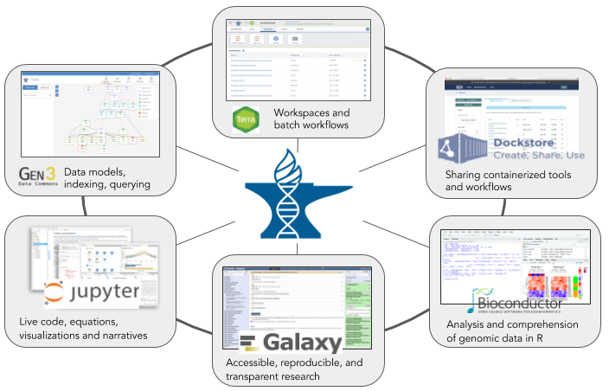
(Analysis, Visualization, and Informatics Lab-Space)
Problems
The traditional model of genomic data sharing (i.e., researchers download data to analyze locally) :
transfer/download cost
long transfer time
redundant compute infrastructure
security of protected data
Solutions
AnVIL provides a unified environment for data management and compute
no need for data movement
better security handling
provide elastic, shared computing resources
Compute
Data
Workflow
Interactive analysis
https://anvilproject.org // https://anvil.terra.bio
https://anvilproject.org/overview

Slide 21
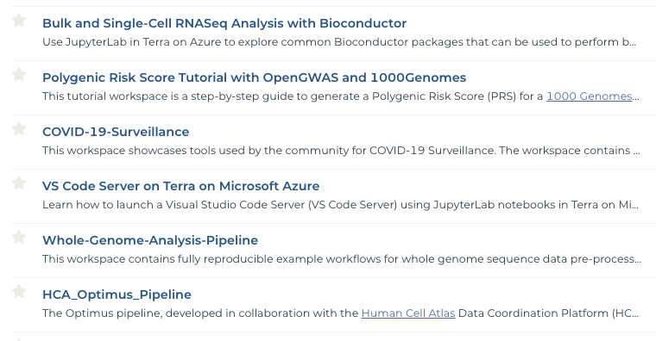
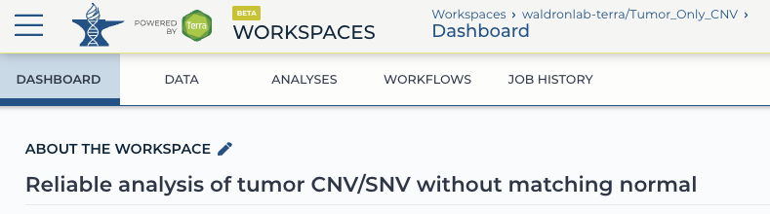
Workspace in AnVIL
Workflow in Workspace
Workspace is the main building block of AnVIL
Workflows are a series of steps performed by an external compute engine - often used for automated, bulk analysis, such as aligning genomic reads.
Example list of available workspaces
https://anvilproject.org // https://anvil.terra.bio
Notes:
Workspace is the main building block of AnVIL - delivers data, workflows, and interactive analysis interfaces, or some/all of them. This list here is some of the workspaces available in AnVIL.
As I just mentioned, workflow is one of the main components of workspace. Workflows are a series of…

Slide 22
AnVILWorkflow Bioconductor package
Run AnVIL-implemented workflows from a local R session
Interpretable and actionable function calls and error messaging
Option to incorporate non-R-based tools into Rmarkdown for improved reproducibility
https://www.bioconductor.org/packages/AnVILWorkflow/
Notes:
Even though AnVIL offers a lot of benefit supporting data and resource sharing, there are a few weaknesses, and we are motivated to create AnVILWorkflow package to improve those weaknesses and provide additional R-user-friendly features.
AnVIL’s GUI is potentially intuitive, but still require some learning. Also, GUI tends to be less efficient and slower than a command line interface, especially for bulk analyses.
AnVILWorkflow package enables to run AnVIL-implemented workflows from a local R session, provides interpretable and actionable error messaging, and make it possible to incorporate upstream batch analysis using non-R-based tools into a rmarkdown file for improved reproducibility.

Slide 23






CUNY Student curators
Marianthi Thomatos
Utsav Patel
Valentina Pineda
Yaseen Javaid
Lora Kasselman
Philippe Lutete
Aboud Ezzeddine
Afroza Parvin
Victoria Goulbourne
William Lam
Zyaijah Bailey
Lucy Mellor
Mst Afroza Parvin
William Lam
Cynthia Anderson
Phyu Han
Nadine Ulysse
Tahiya Begum
Christina Brown
Aboud Eby
Yu Wang
Joyessa Dey
Frans Cuevas
Martha Marin
Clare Grieve
Kweku Amoo
Samara Khan
Tangirul Islam
Mary Bearkland
Thank you
Jennifer Wokaty, BA
Ludwig Geistlinger, PhD
Marcel Ramos, MPH
Sehyun Oh, PhD
Kelly Eckenrode, PhD
Chloe Mirzayi, MPH

Slide 24
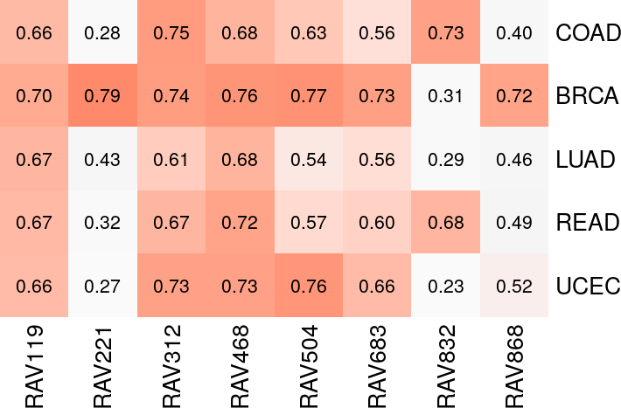
Feature differentiation between datasets
Find validating PCclusters
> val_all <- validate(datasets, RAVmodel)
> heatmapTable(val_all)
Five TCGA datasets : COAD (colon), BRCA (breast), LUAD (lung), READ (rectal), UCEC (uterine)
Based on the validation table:
RAV221 is associated with BRCA?
RAV832 is associated with COAD/READ?

Slide 25
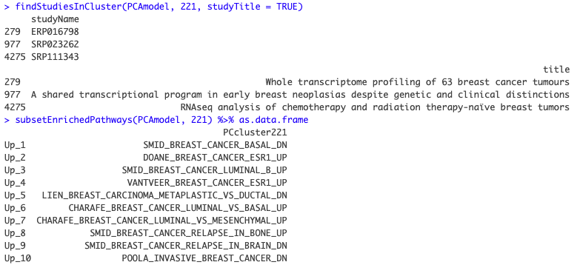
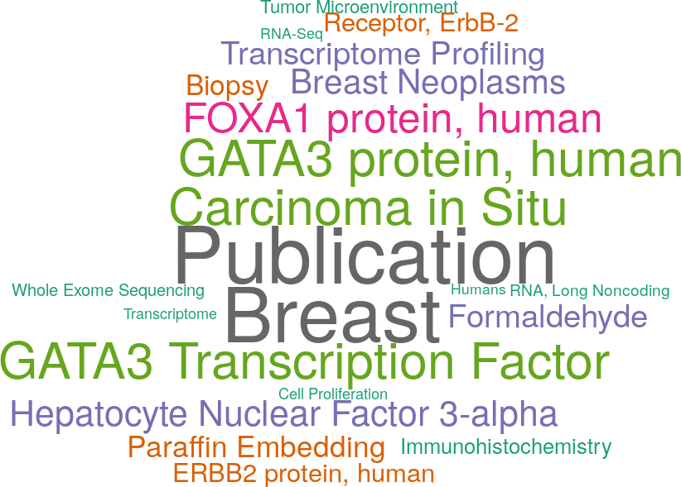
RAV221 : associated with BRCA?
↓ Studies associated with this cluster
↓↓ Enriched pathways
↓ MeSH terms
MeSH term of RAV221
> drawWordcloud(RAVmodel, 221)

