Slide 1
Metal Detector
IMT Final Project

Slide 2
Waleed Ebrahem Mohamed
Mohamed Osama Saleh
Group Members

Slide 3
01
The Idea of the project

Slide 4
What is Metal Detector?
Metals distributed on the earth: in our desert, roads and in our soil .
Sometimes this places not safe that gave us first hint to create robot car which can look for metals or explore it ,then we got idea why not make the robot car move and learn without interaction with humans.

Slide 5
Metal Components
We divided our project to two main parts:
-Software Layers
-Hardware Components

Slide 6
02
Software Layers

Slide 7
Software Architecture
MCAL
HAL
APP
LIB

Slide 8
MCAL
DIO
ADC
GIE
UART
EXI
TIMER2

Slide 9
HAL
SIM808
DC_MOTOR
ULTRASONIC

Slide 10
Software Block Diagram
Q_Learning
Main
APP
LIB
STD_TYPES
HAL
DC_Motor
ULTRASONIC
Bluetooth
BIT_MATH
ADC
DIO
GIE
MCAL
UART
EXI
TIMER2

Slide 11
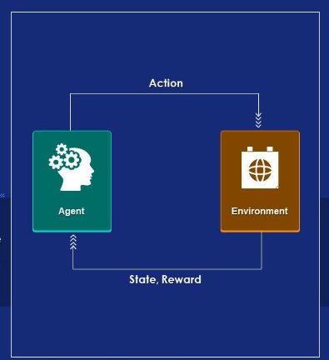
Reinforcement
Reinforcement Learning uses rewards and punishment to train computing models to perform a sequence of selections.in our project the car take random action (trial and error) for training, then testing to use learning knowledge.

Slide 12
03
Hardware Components

Slide 13
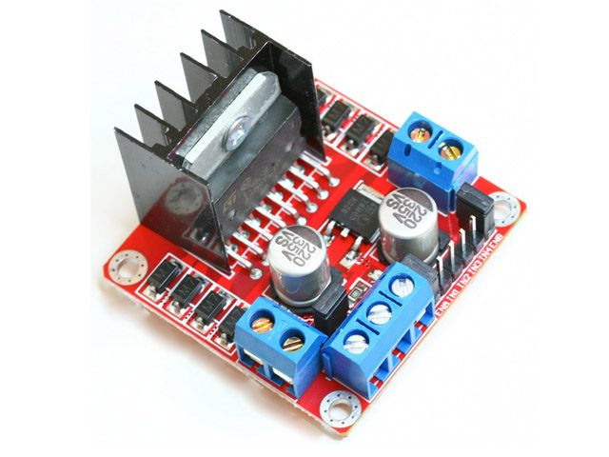
H-Bridge
The H-bridge arrangement is generally used to reverse the polarity/direction of the motor, but can also be used to 'brake' the motor, where the motor comes to a sudden stop, as the motor's terminals are shorted.

Slide 14
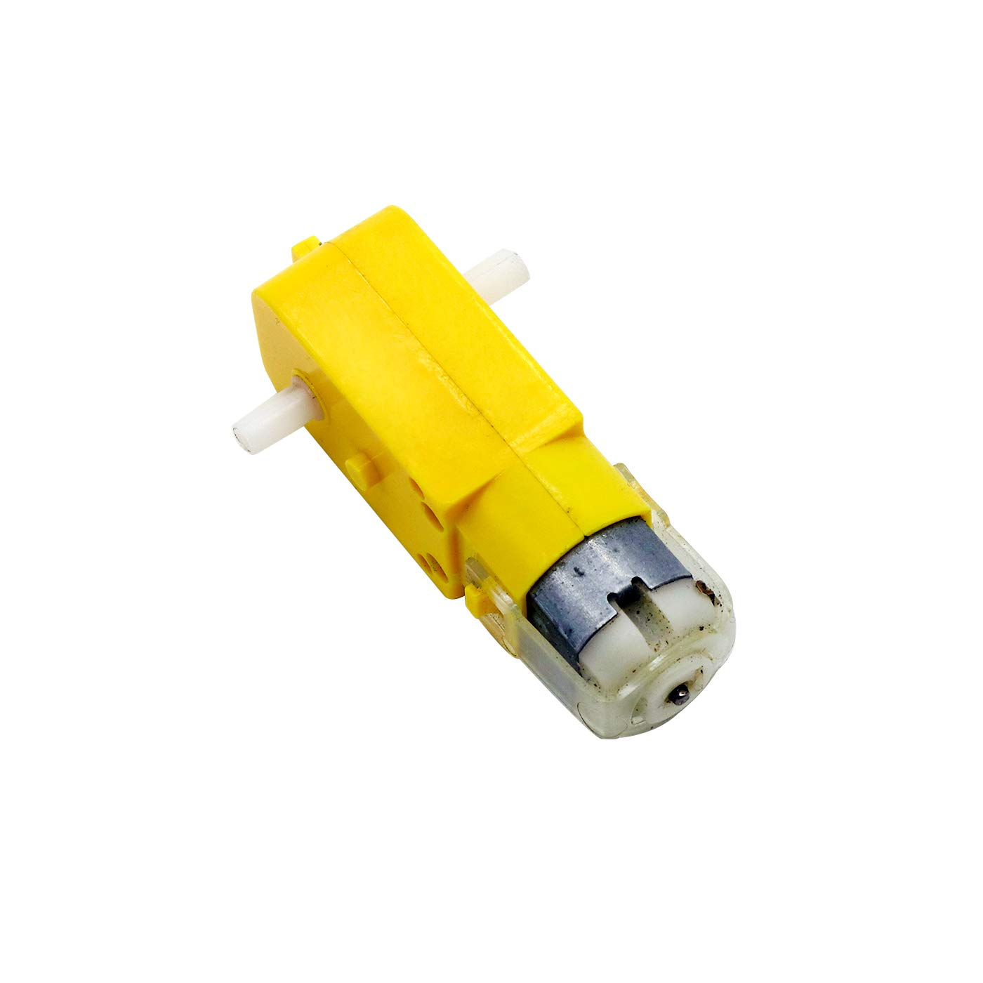
DC_Motor
A DC motor is any of a class of rotary electrical motors that converts direct current (DC) electrical energy into mechanical energy.
It is used in movement of our car.

Slide 15
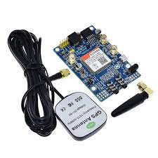
SIM808_Module
SIM808 module is a GSM,GPRS and GPS three-in-one function module. It is based on the latest GSM/GPS module SIM808 from SIMCOM, supports GSM/GPRS Quad-Band network and combines GPS technology for satellite navigation.
It is used to provide location of our car.

Slide 16
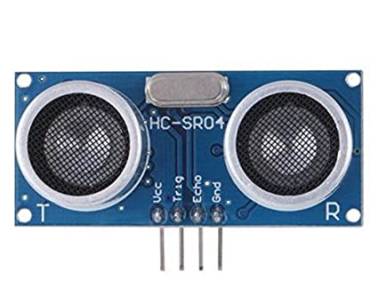
Ultrasonic
This is the HC-SR04 ultrasonic distance sensor. This economical sensor provides 2cm to 400cm of non-contact measurement functionality with a ranging accuracy that can reach up to 3mm. Each HC-SR04 module includes an ultrasonic transmitter, a receiver and a control circuit.
There are only four pins that you need to worry about on the HC-SR04: VCC (Power), Trig (Trigger), Echo (Receive), and GND (Ground).
It is used in calculating distance.

Slide 17
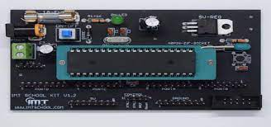
Microcntroller
We use Microcontroller Atemaga 32. the kit in figure is IMT kit

Slide 18
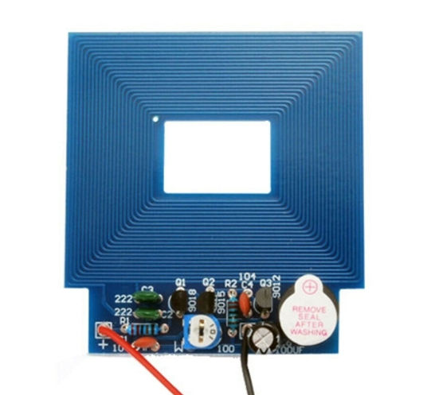
Metal Detector
We use Metal Detector to detect metal and Buzzer works when metal be under metal detector

Slide 19
SO
How the System Work

Slide 20
How is our project work?
Firstly,we connect battaries then enable Sim808 (by using button in Sim808), then
Leave car to train (maybe hit obstcales) then car move to test mode and will try to avoid the obstcale and if it find metal by using metal detector it will send sms message to phone number I put it as destination before and tha sms contain location where is the metal thing figures below will illustrate that.

Slide 21

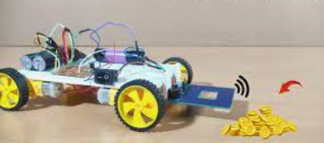
Main Feachers

Slide 22

THANK YOU

