Slide 1

Application:Restaurant Name of App: Ristorante amici

Slide 2
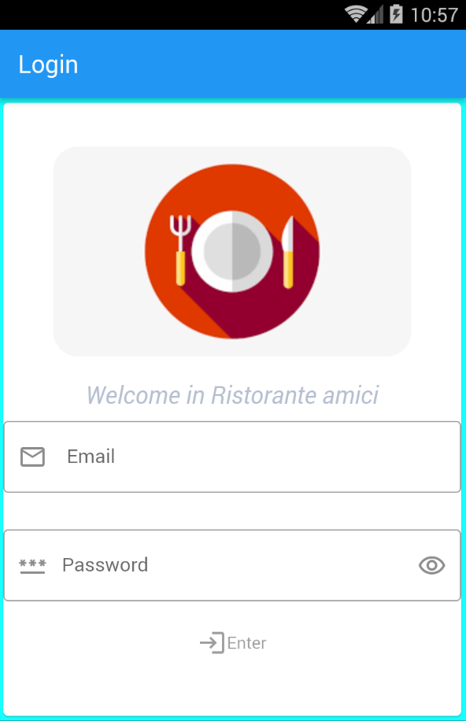
Application pages:
First Page: Login
User click on Enter to enter home page

Slide 3
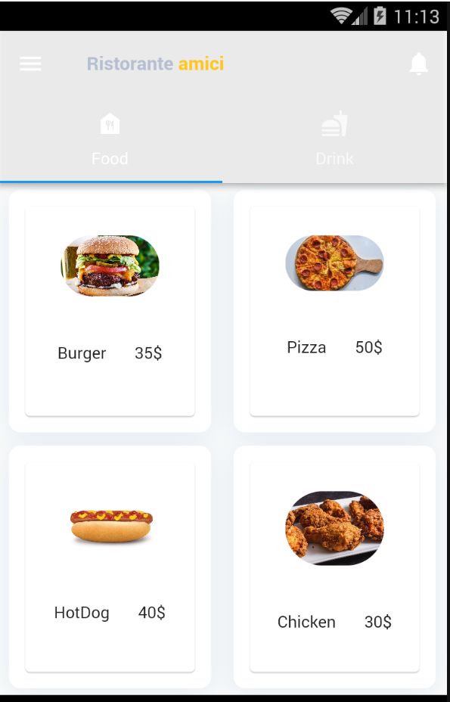
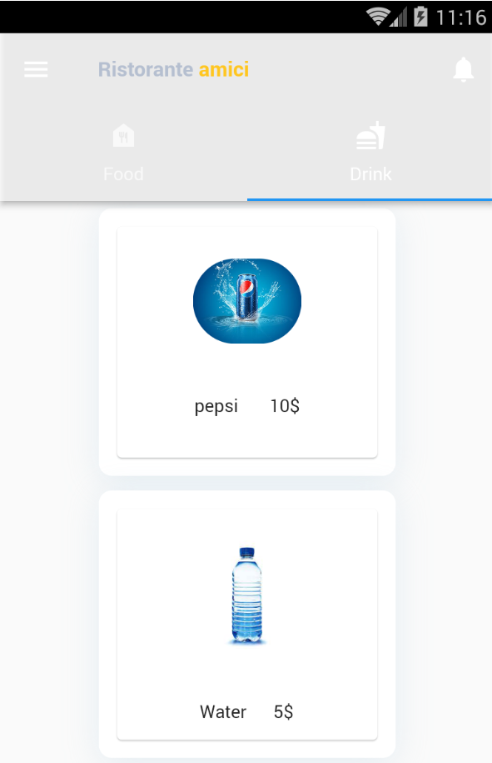
Second Page: Home page It is the main page contain 2 taps one for Food and one for Drink . customer choose what he wants

Slide 4
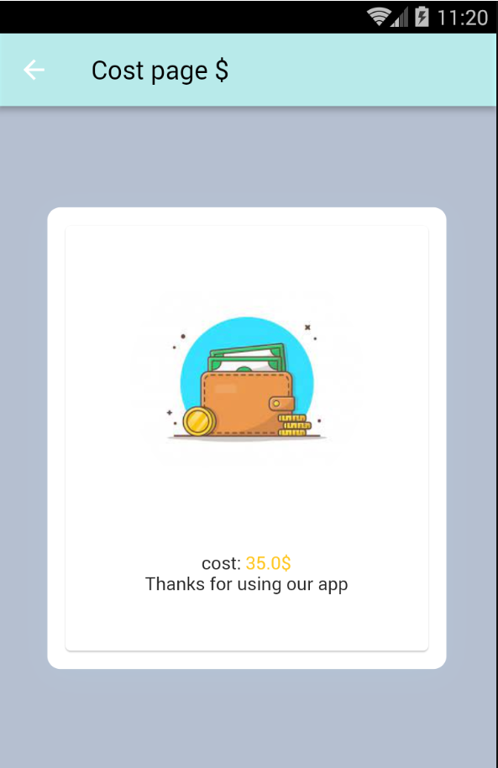

Third Page: Cost page It show the cost of item

Slide 5

END

