Slide 1
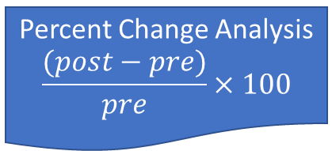
Pre
Raster
Calculate Statistics
(min & max)
Raster Normalization
(0-1)
Masked Values
(<1000) to 0
Percent Change Analysis
$$\frac{(post−pre)}{pre}×100$$
Post
Raster
Calculate Statistics
(min & max)
Raster Normalization
(0-1)

