Slide 1
AI-Powered Silent Speech Recognition System
Final Year Project (FYP)
Muhammad Waleed Wazir
Mohammad Adil
Supervisor:
MS. Sadia Zar

Slide 2
Introduction
1
Silent Speech Recognition is an emerging area of Artificial Intelligence that focuses on converting lip movements into textual output without using audio signals.
2
This project presents an AI-powered mobile application that allows users to upload silent videos and receive predicted text using lip-reading technology.
3
The system is developed using Flutter for the mobile application and integrates a pre-trained deep learning model via Replicate API through a Flask backend.

Slide 3
Project Overview
This project focuses on silent speech recognition using lip-reading.
A pre-trained deep learning model is accessed via Replicate API.
The system converts silent lip movements into readable text.

Slide 4

Project Objectives
Assist speech-impaired individuals
Enable communication without audio
Integrate AI using cloud-based APIs
Develop a practical mobile application

Slide 5
Problem Statement
01
02
03
Speech-impaired individuals face challenges in verbal communication.
Conventional speech recognition systems depend on audio input.
There is a need for a vision-based system that understands speech using lip movements.

Slide 6
Methodology
01
02
03
Video Input (User Side)
Backend Processing (Flask)
AI Prediction
User selects or records a silent video from mobile gallery
Video uploaded from mobile to Flask backend
Backend sends video to API for prediction
Video is stored in Supabase cloud storage
API returns predicted text
04
05
Result Display
History & Storage
Predicted text is displayed on app
Predicted results and video link saved in Supabase
User can view results instantly
User can access previous predictions from History screen

Slide 7

Project Scope
Focuses on lip-reading technology to interpret speech using visual cues only
Aims to assist deaf and hearing-impaired individuals in understanding spoken content
Enables speech interpretation from silent or muted video sources where audio is unavailable
Can be applied to scenarios such as muted surveillance or recorded video footage

Slide 8

System Architecture
Cloud Storage
Mobile Application
Video storage
History storage
User interface
AIPSSRS-System
AI Model Service
Backend Server
Flask API handling uploads
Pre-Trained Model

Slide 9
Model & API Usage
Pre-trained silent speech recognition model
Model hosted on Replicate platform
Accessed via REST API calls
No local training or GPU dependency

Slide 10




Input Processing
Short silent video clips
Lip movement focused videos
Uploaded from mobile gallery
Sent to API for inference

Slide 11
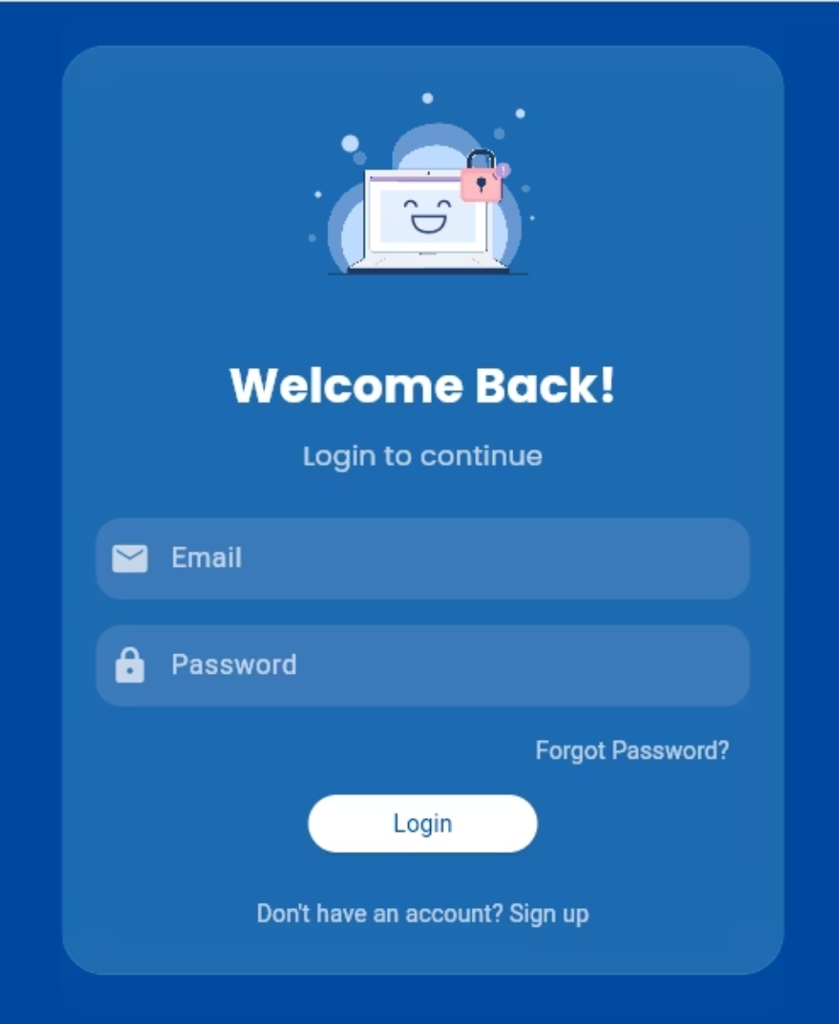
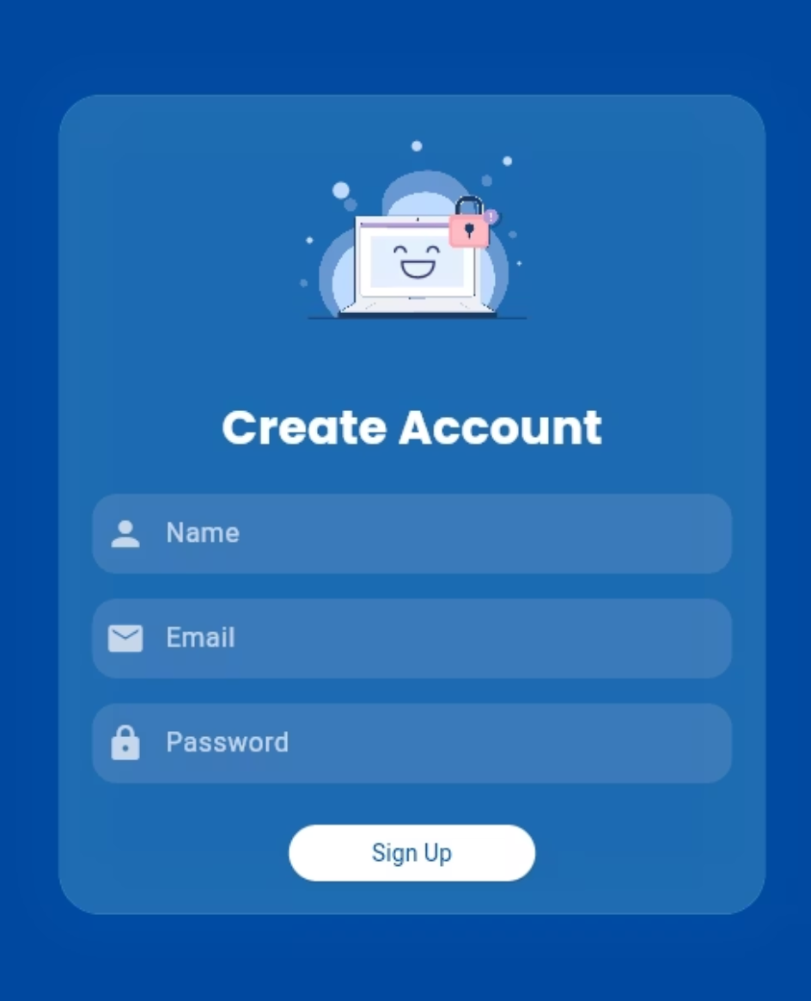
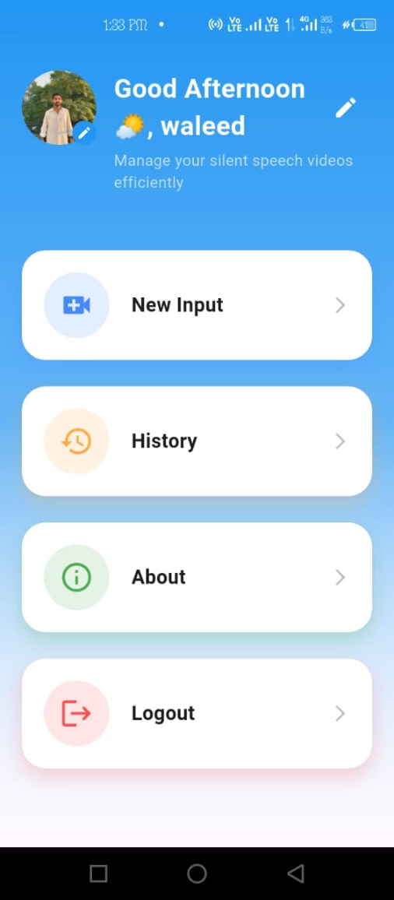
Application Screens
Login
Sign Up
Dashboard

Slide 12
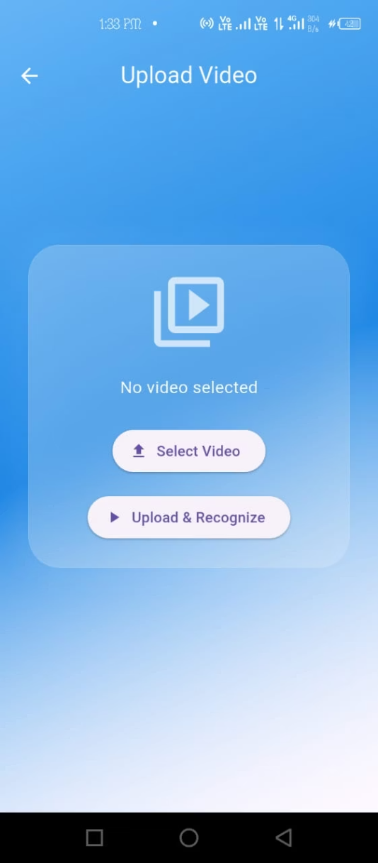
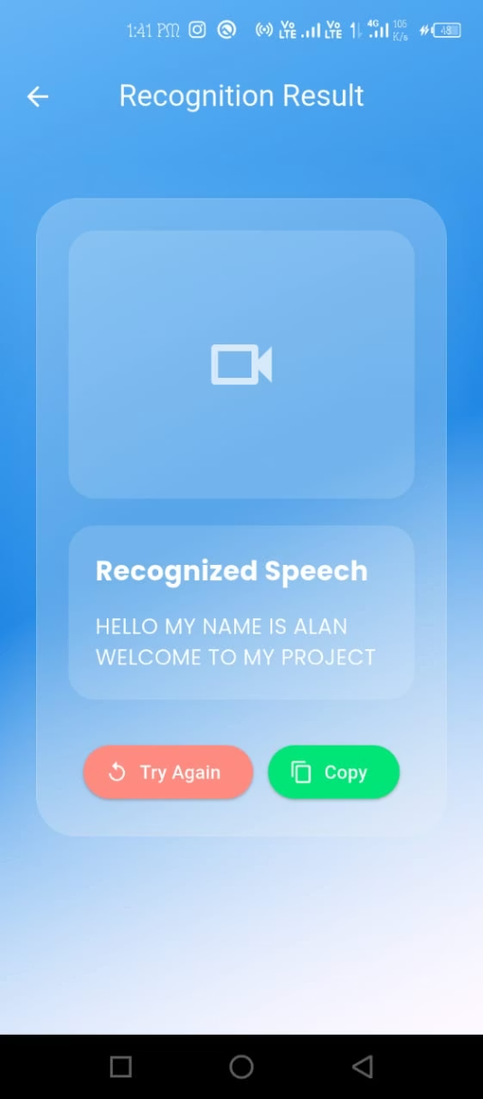
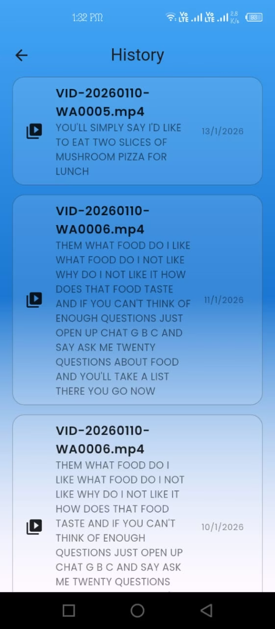
Video Upload
Recognition Result
History

Slide 13
Strengths & Limitations
Strengths
Limitations
Fast implementation with reliable AI inference
Requires internet for AI predictions (Replicate API)
Mobile-based solution for easy accessibility
Not real-time (processes pre-recorded videos only)
Cloud storage integration for history and backup
Accuracy depends on video quality and lighting
Helps hearing-impaired users by converting lip movements to text
Limited language support (English only)
Dependent on third-party API availability
Scalable system due to cloud-based processing
No live camera lip-reading in this phase

Slide 14
Results & Evaluation
Accurate recognition for short silent videos
Fast response time using cloud inference
Stable performance without local processing

Slide 15
Conclusion & Future Work
Conclusion
Future Work
Developed an AI-powered Silent Speech Recognition System (AIPSRS)
Add real-time lip-reading using live camera feed
Improve accuracy using custom model training
Successfully integrated a pre-trained lip-reading model via Replicate API
Add multi-language support (Urdu, Arabic, etc.)
Implement offline prediction
Built a mobile application (Flutter) with user-friendly interface
Implemented Flask backend and Supabase cloud storage
voice output for predicted text (Text-to-Speech)

Slide 16
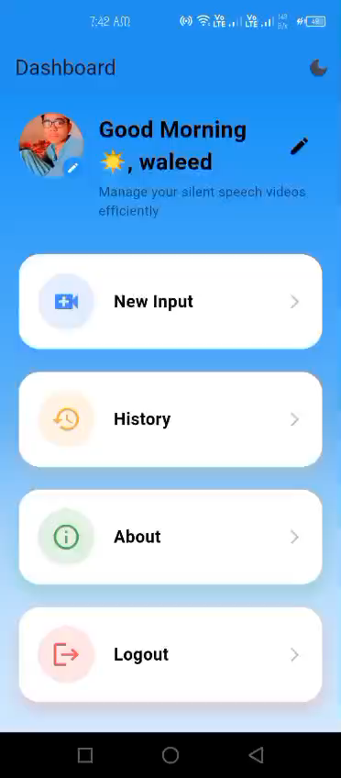
Demo Video:

