Slide 1
Mapping from Data Model (ERD) to Relational Model
Yong Choi
School of Business
CSUB

Slide 2
Objectives of logical design...
Transform the conceptual database design (ERD) into a logical database design (our choice: relational database) that can be implemented on a chosen DBMS later
  Input: conceptual model (ERD)
  Output: relational schema, normalized relations
Resulting database must meet user needs for:
  Optimal data sharing
  Ease of access
  Flexibility

Slide 3
Why do I need to know this?
CASE tools can perform many of the transformation steps automatically, but..
  Often CASE tools cannot model complexity of data and relationship (Ternary relationships, supertype/subtypes, i.e..)
  You must be able to perform a quality check on CASE tool results
* Mapping a conceptual model to a relational schema is a straight-forward process…

Slide 4
Basics
A conceptual model MUST NOT include FK information *
  Example on the next slide
An entity turns into a table.
Each attribute turns into a column in the table.
The (unique) identifier of the entity turns into a PK of the table.

Slide 5
Example
Team
Team ID
Speciality
Customer
Customer ID
Customer name
Customer address
Customer activity
Customer telephone
Customer fax
Employee
Employee ID
First name
Last name
Employee function
Employee salary
Project
Project ID
Project name
Dependent
Project label
Dep ID
Start date
Dep Name
End date

Slide 6
Basics (con’t)
There is no such thing as a multi-valued attribute (phone #) in a relational database.
  If you have a multi-valued attribute, take the attribute and turn it into a new entity of its own thru the normalization process (see later slide..).

Slide 7
Some rules...
* Remember! The Relational database does not like any type of redundancy.
Every table must have a unique name.
Attributes in tables must have unique names.
Every attribute value is atomic.
The order of the columns is irrelevant.
The order of the rows is irrelevant.

Slide 8
The key...
Relational database uses primary keys and foreign keys to maintain relationships
Primary keys are typically the (unique) identifier noted on the conceptual model

Slide 9
The key... (con’t)
Foreign keys are the PK of another entity to which an entity has a relationship
  Example: “PK as FK” & “Referential integrity”
Composite primary keys are keys that are made of more than one attribute
  Weak entities
  Bridge entities (M:N relationship)

Slide 10
Constraints…
Entity integrity constraints
  A PK attribute must not be null.
Referential integrity constraints
  Matching of primary and foreign keys
    Cascade delete and update (only Access)
    Assign default value (e.g., 999)
    Set to null

Slide 11
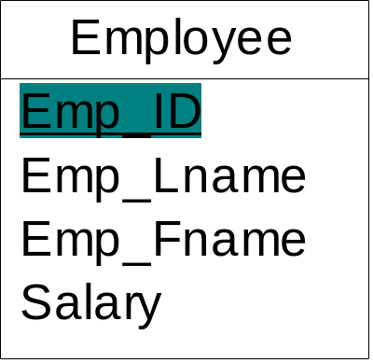
Mapping an entity into a relation
An Entity name: Employee
Attributes:
  Emp_ID, Emp_Lname, Emp_Fname, Salary
Identifier: Emp_ID
Employee
Emp_Id
PK
Emp_Lname
Emp_Fname
Salary

Slide 12
Mapping an entity into a relation
Movies
Movies
title
year
length
filmType
Title
Year
Length
Film Type
Star Wars
1977
124
color
Mighty
Ducks
1991
104
color
Wayne’s
World
1992
95
color

Slide 13
Mapping binary relationships
One-to-one: if there is no indication of optional relationship, then it needs to be decided.
  one-to-one mandatory relationship
  Restaurant DB: BillingAddress and Customer
One-to-many: PK on the one side becomes a FK on the many side
Many-to-many - create a new relation (bridge entity) with the PKs of the two entities as its composite PK

Slide 14
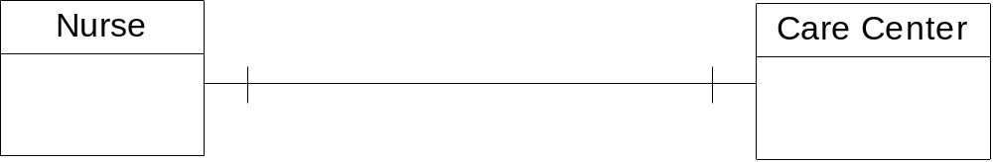
Mapping a 1:1 relationship with optional on the one side
Nurse:
  Nurse_ID, Name, Date_of_Birth
Care Center
  Center_Name, Location, Date_Assigned

Slide 15
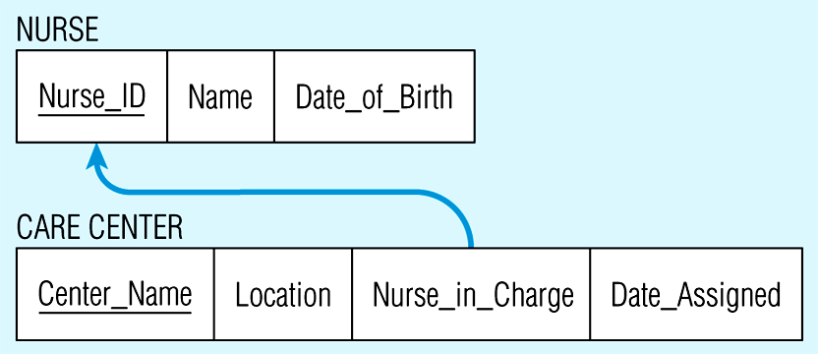
Mapping a 1:1 relationship
OK to use Nurse_ID
Access:
- Name must be matched
FK: Nurse_ID

Slide 16
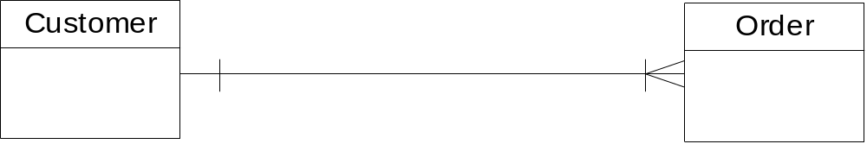
Mapping a 1:M relationship
Customer:
  Customer_ID, Customer_Name, Customer_Address
Order:
  Order_ID, Order_Date

Slide 17
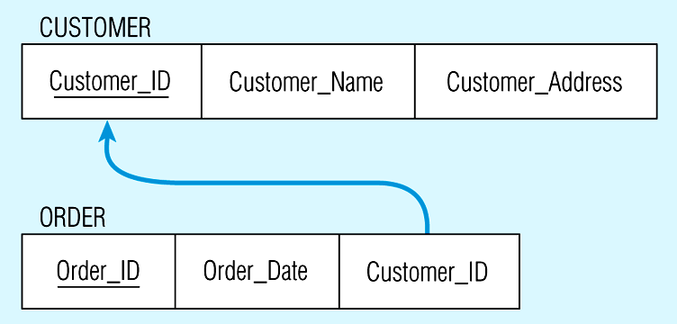
Mapping a 1:M relationship
FK

Slide 18
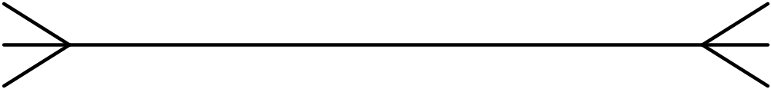
Mapping M:N relationship
Each student takes many classes, and a class must be taken by many students.
CLASS
STUDENT
IS_TAKEN_BY
TAKE

Slide 19
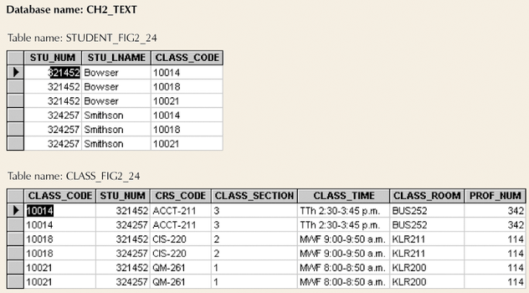
Example M:N Relationship
Table to represent Entity
3 to 3
30 to 30
300 to 300
3000 to 3000
30,000 to 30,000
300, 000 to 300, 000

Slide 20
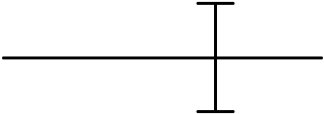
Transformation of M:N
When transform to relational model, many redundancies can be generated.
  The relational operations become very complex and are likely to cause system efficiency errors and output errors.
  Break the M:N down into 1:N and N:1 relationships using bridge entity (weak entity).
CLASS
ENROLL
STUDENT

Slide 21
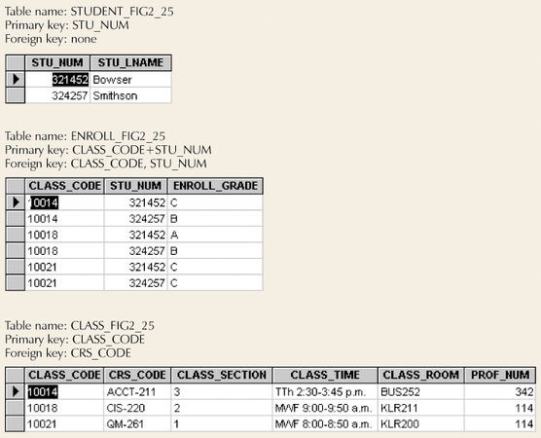
Converting M:N Relationship to Two 1:M Relationships
Bridge Entity

Slide 22
Mapping an M:N relationship
Student
STU_NUM | STU_LNAME
Enroll
CLASS CODE | STU_NUM | ENROLL_GRADE
Class
CLASS CODE | CRS_CODE | CLASS_SECTION | CLASS_TIME

Slide 23
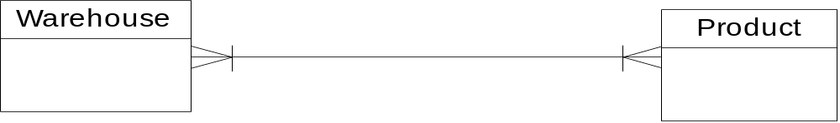
Mapping an M:N relationship 2
WH_ID
WH_Name
Area
P_ID
P_Name
P_Price

Slide 24
Mapping an M:N relationship 2 (con’t)
Warehouse
WH_ID | WH_Name | Area
A component of composite PK is a FK of other relations
StockInfo
WH_ID | P_ID | Quantity (new)
Product
P_ID | P_Name | Price

Slide 25
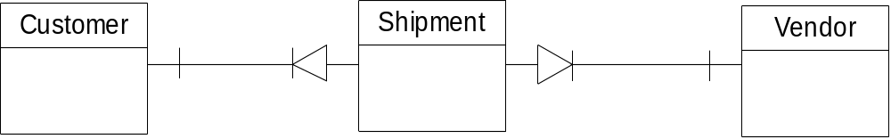
Mapping a bridge entity with its own identifier
Customer_ID
Name
Other Attributes
Shipment_NO
Customer_ID
Vendor_ID
Date
Amount
Vendor_ID
Address
Other Attributes

Slide 26
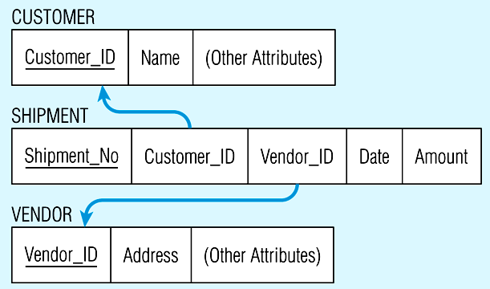
Mapping a bridge entity with its own identifier (con’t)

Slide 27
Mapping composite and Multi-valued attributes to relations
Composite attributes: use only their simple, component attributes – divide into atomic and separate attribute.
Multi-valued attributes: become a separate relation with a FK taken from the superior entity.

Slide 28
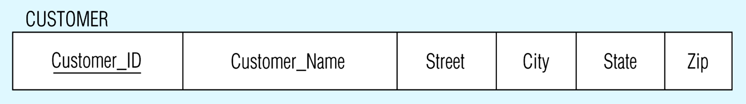
Mapping composite attributes to relations
Customer
Composite attribute
Customer_ID
Customer_Name
Customer_Address

Slide 29
Mapping a multi-valued attribute
Employee
Employee
SSN | Name
E101 | Johnson
E102 | Smith
E103 | Conley
E104 | Roberts
Phone
SSN | Phone#
E101 | 312 …
E102 | 708 …
E102 | 312 …
E104 | 603 …
SSN
Name
Phone #
Notes:
24

Slide 30
Mapping a weak entity
Becomes a separate relation with a FK taken from the superior entity
Primary key composed of:
  Partial identifier of weak entity
  Primary key of identifying relation

Slide 31
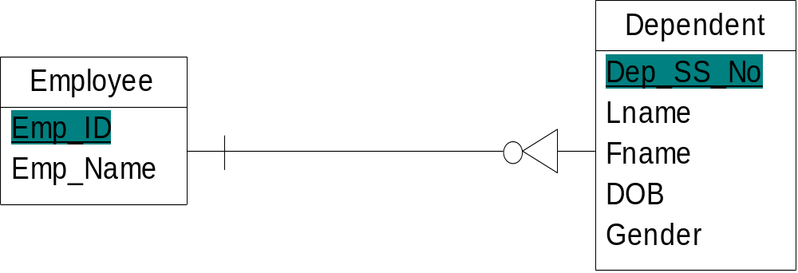
Mapping a weak entity

Slide 32
Mapping a weak entity
Employee
NOTE: The FK of DEPENDENT should NOT allow null value if DEPENDENT is a weak entity
Emp_ID | Emp_name
Dependent
FK
Dep_SS_No | Emp_ID | Lname | Fname | DOB | Gender

Slide 33
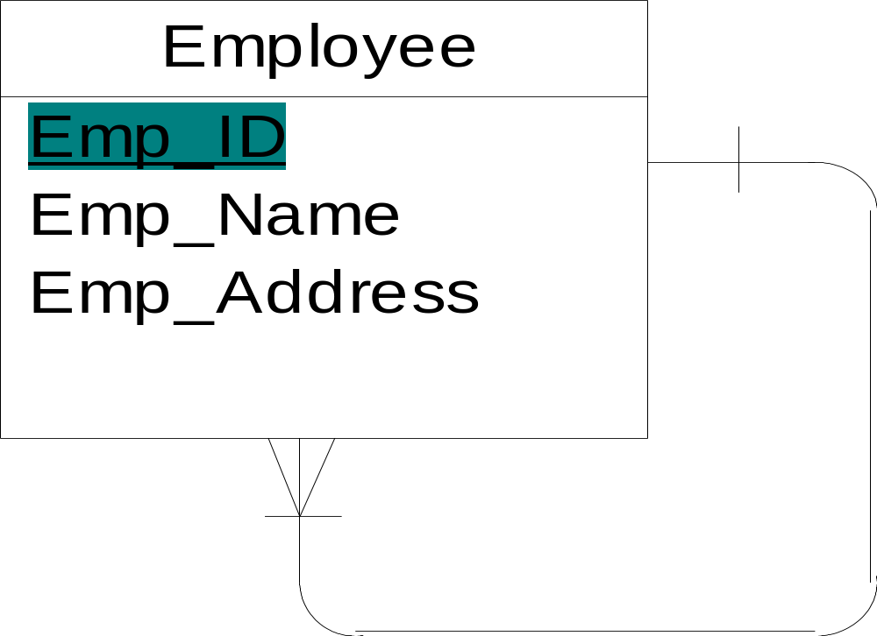
Mapping 1:M recursive (or unary) relationships

Slide 34
Mapping 1:M recursive (or unary) relationships
Employee
FK
Emp_ID | Emp_Name | Emp_Address | Manager_ID
Manager_ID references Emp_ID

Slide 35
Mapping M:N recursive (or unary) relationships
In manufacturing assembly line, several items consist of multiple items as components.
  One item can be used to create other items.
  Associations among items are M:N.
the associations among items are M:N. That is, there is a M:N unary relationship.

Slide 36
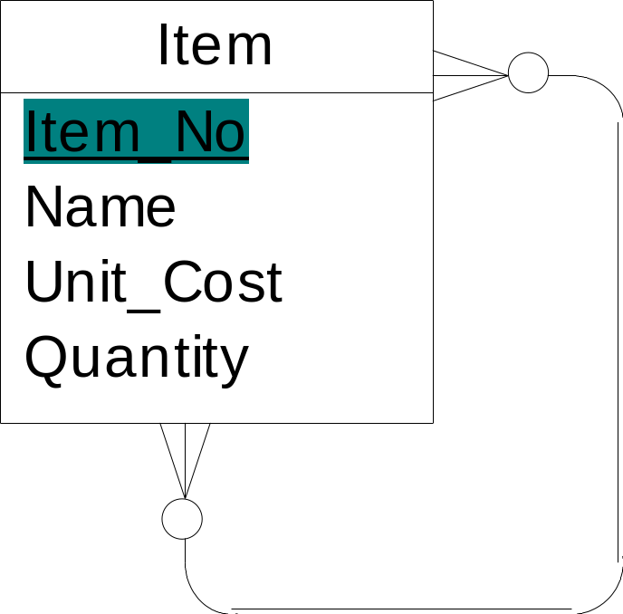

Mapping M:N recursive (or unary) relationships
Has_components
(a) Bill-of-materials relationships (M:N)
Used_by
(b) ITEM and COMPONENT relations

Slide 37
Mapping Supertype/subtype relationships
Create a separate relation for the supertype and each of the subtypes
Assign common attributes to supertype
Assign PK and unique attributes to each subtype
Assign an attribute of the supertype to act as subtype discriminator

Slide 38
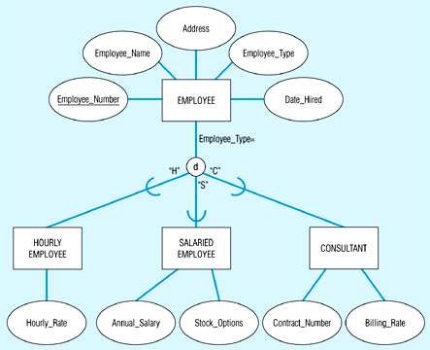
Mapping Supertype/subtype relationships
Sub symbol

Slide 39
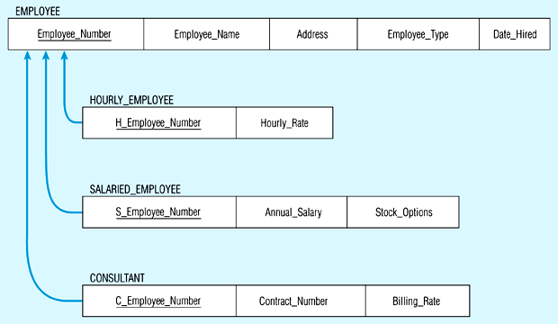
Mapping Supertype/subtype relationships

Slide 40
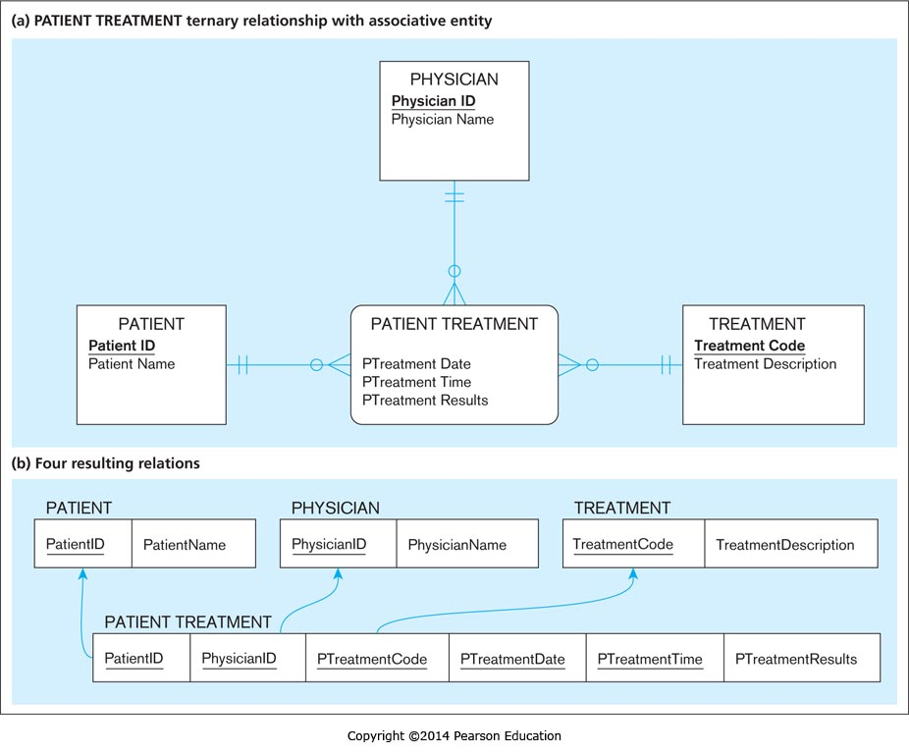
Mapping ternary relationship with bridge (associative) entity

