Slide 1
ERD Mapping to Tables
Presented by:
Eng. Ahmed Mamdouh
Intake 36

Slide 2
ER-to-Relational Mapping
Step 1: Mapping of Regular Entity Types
Step 2: Mapping of Weak Entity Types
Step 3: Mapping of Binary 1:1 Relation Types
Step 4: Mapping of Binary 1:N Relationship Types.
Step 5: Mapping of Binary M:N Relationship Types.
Step 6: Mapping of Multi-valued attributes.
Step 7: Mapping of N-ary Relationship Types.

Slide 3
Step 1: Mapping of Regular Entity Types
Create table for each entity type
Choose one of key attributes to be the primary key

Slide 4
Step 2: Mapping of Weak Entity Types
Create table for each weak entity.
Add foreign key that correspond to the owner entity type.
Choose the primary key : ( FK + weak entity Partial PK if any)

Slide 5
Step 3: Mapping of Binary 1:1 Relation Types
Merged two tables if both sides are Mandatory.
Add FK into table with the total participation relationship to represent optional side.
Create third table if both sides are optional.

Slide 6
Step 4: Mapping of Binary 1:N Relationship Types.
Add FK to N-side table
Add any simple attributes of relationship as column to N-side table.

Slide 7
Step 5: Mapping of Binary M:N Relationship Types.
Create a new third table
Add FKs to the new table for both parent tables
Add simple attributes of relationship to the new table if any .
M
N

Slide 8
Step 6: Mapping of Multi-valued attributes.
Create new table for each multi-valued attribute
Table will include two columns.
one for multi-valued attribute + FK column.

Slide 9
Step 7: Mapping of N-ary Relationship Types.
If n > 2 then :
Create a new third table
Add FKs to the new table for all parent tables
Add simple attributes of relationship to the new table if any .

Slide 10
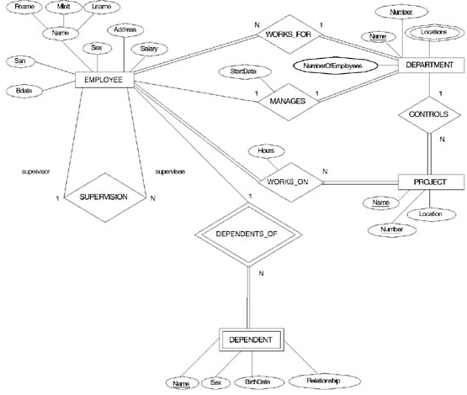

Slide 11

Mapping Result

Slide 12
ERD Case Study
An organization makes many models of cars, where a model is characterized by a unique name and a suffix (such as GL or XL) and an engine size.
Each model is made up from many parts and Each part has a description , an id code, production year, and many images.
each part may be used in the manufacturing of more than one model

Slide 13
ERD Case Study
Each model must be produced at just one of the firm's factories, which are located in London, Birmingham, Bristol, Wolverhampton and Manchester - one in each city. Each factory has number of machines, capacity, and computer system used ( OS , DBMS, Internet).
A factory produces many models of cars and many types of parts. Although the parts and model produced in the same factory.
Notes:
although each type of part is produced at one factory only and the model is produced in the same factory.
Discuss Ternary relationship.

Slide 14

Ternary Relationship

