Slide 1
Stock Market Prediction Using Deep Learning
Chair in Business Administration
Deutsches Forschungszentrum für Künstliche Intelligenz
Presented by: Waleed Ahmed

Slide 2
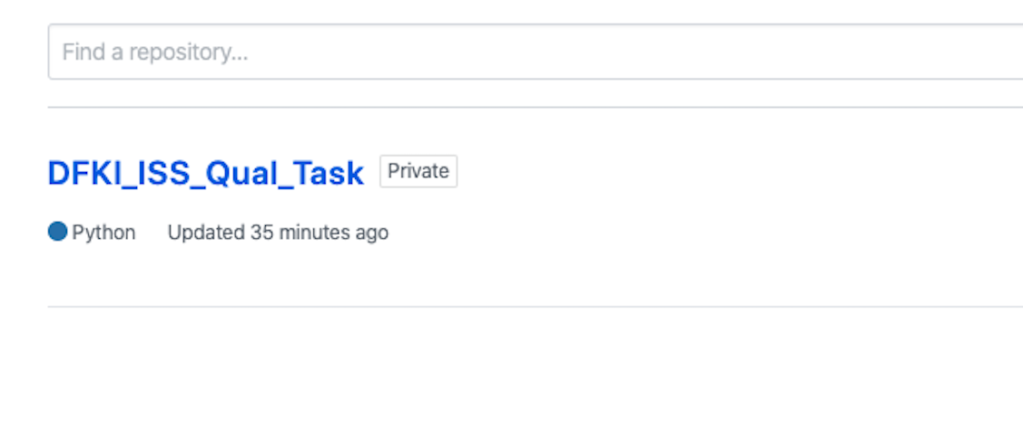
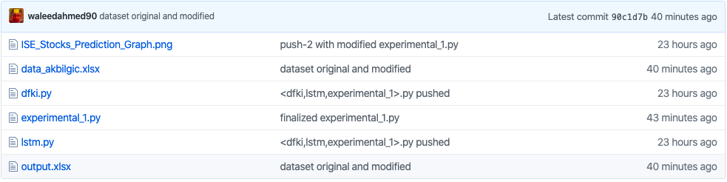
Task Description (Step-1) Creation of a GitHub Repository

Slide 3
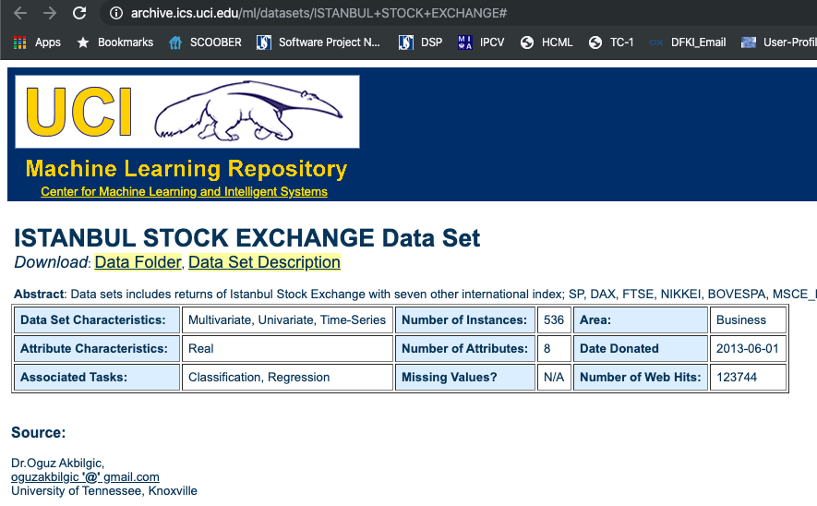
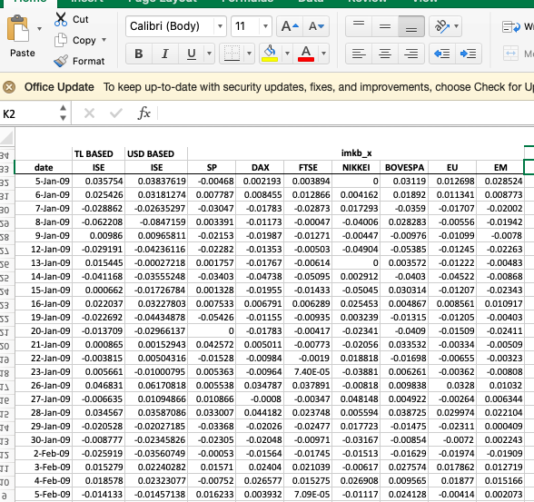
Task Description (Step-2) The Dataset

Slide 4


Reading the data
“pandas” library for reading the excel file
Reading the dataset in “xlsx” format

Slide 5
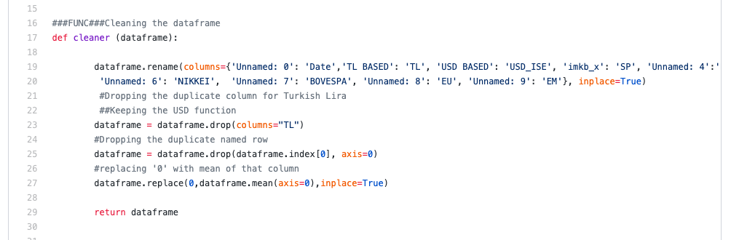
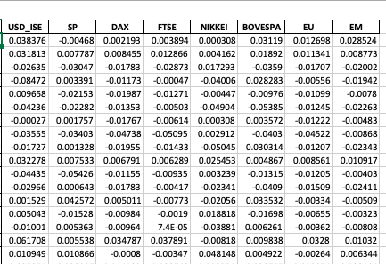
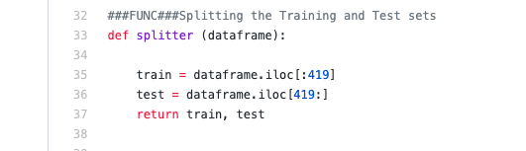
(Step-3&4) Preprocessing/Noise Removal/Feature Engineering
Notes:
Renaming the columns
Dropping the TL column
Removing the top row which is unnecessary
Handling the zeros
Splitting the data between training and test sets
(Jan 5th, 2009) to (Aug 31st, 2009) Training
(Sep 1st, 2010) to (Feb 22nd, 2011) Test

Slide 6
(Step-5) Training the Neural Network
Which Neural Network to use?
The dataset = A Time Series
RNN Category
Tracking Long term dependencies (from input)
LSTM (Long Short Term Memory) NN

Slide 7
LSTM Basics
A Cell
(memory to keep track of dependencies between the sequence of the inputs)
Input gate
Takes care of the extent to which a new value flows to a cell
Output gate
Controls the extent to which the value in the cell is used to compute the output activation of the LSTM unit
Forget gate
Controls the extent to which a value remains in the cell

Slide 8
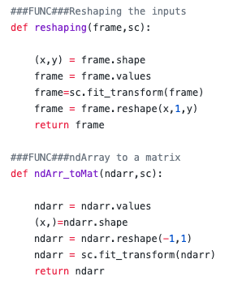

(Step-5…continued) Training the Neural Network (Changing the shape of training/test sets+Normalizing)
Library:
Inputs
Reshaping and Transformation
Outputs

Slide 9
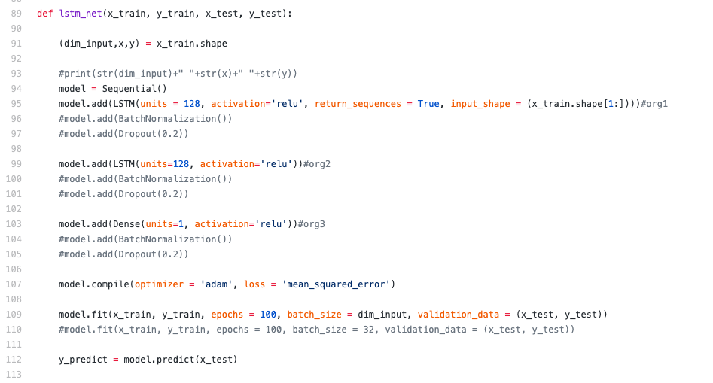

(Step-5…continued) Training the Neural Network (LSTM)

Slide 10
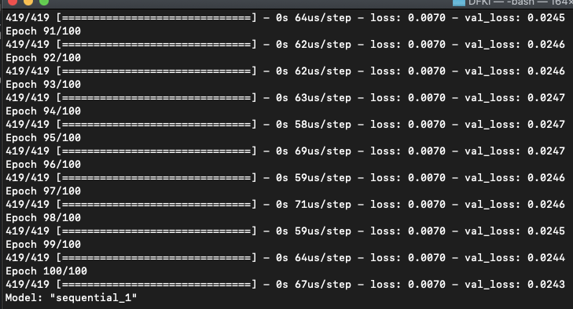
(Step-6) Testing
Notes:
MSE: 0.0070

Slide 11
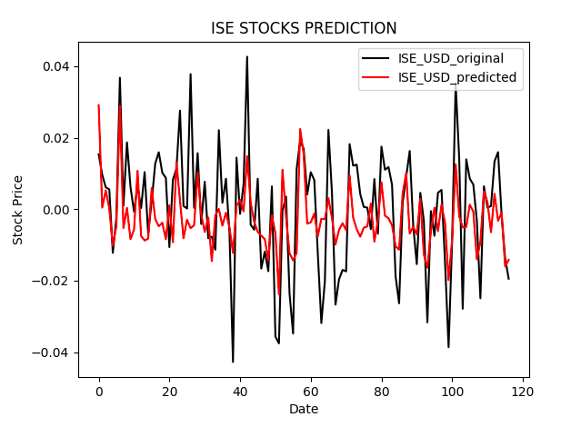
(Step-6) Plot
Notes:
Training Loss << Validation Loss => The model is slightly underfitted

