Slide 1
Fake News Detection
Student Name: Waleed Asghar

Slide 2
Contents
Problem Statement
Dataset Overview
Proposed Methodology
Results
Analysis
Conclusion
References

Slide 3
Problem Statement
In today’s digital era ,the widespread problem of fake news is very difficult to tackle.
Thousands of information sharing platforms are propagating fake news or misinformation.
The increase in artificial bots are source of spreading fake news due to advancements in Artificial Intelligence[1].
People believe everything they read on the internet specifically those new to digital technology.
Needs to acknowledge this situation to control crime rates, and thwart the spread of fake news.

Slide 4

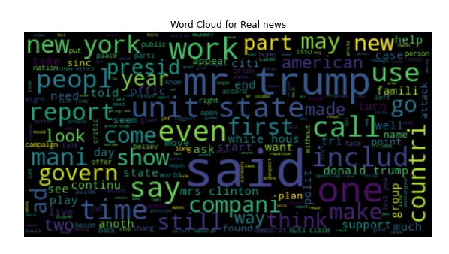
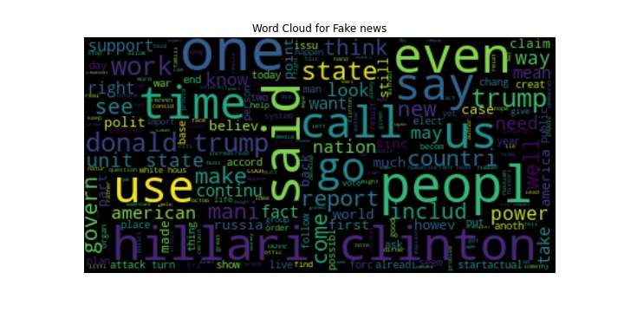
Dataset Overview
The whole fake news detection will be based on word clouds. There will be two-word clouds.
A reliable word cloud having real words
And unreliable world cloud containing fake words.
Fig 1: Word Cloud for Real news
Fig 2: Word Cloud for Fake news

Slide 5
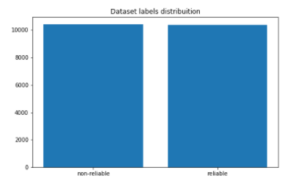
Dataset Processing (Word Cloud Preprocessing)
The classification of fake news will be based on these clouds.
These word clouds have been first preprocessed.
Processes like stop words, stemming and punctuation removal have been applied.
The figure shows the balanced distribution of reliable and non-reliable word clouds after processing.
Fig 3: Reliable & Non-Reliable Word Clouds Graphic Representation

Slide 6
Training Dataset
The training dataset is taken from Kaggle[3]. Particulars of the dataset have been stated below:
Id: unique id for a news article
Title: the title of a news article
Author: author of the news article
Text: the text of the article; could be incomplete
Label: label that marks the article as potentially reliable or unreliable

Slide 7
Proposed Methodology
Pre-Processing of Data
Stage - I
Selection Of DL Techniques
Stage II
Implementation of DL Techniques
Stage III
Result Analysis
Stage IV
Fig 4: Stages of Methodology

Slide 8
Stage 1: Pre-Processing
The first step is pre-processing of dataset as it needs to be converted into vector form before feeding into neural networks.
The dataset is converted into vector form using word2vec.
Skip gram model is used for word2vec conversion.
The skip gram model learns the vector representation based on similarity between words.

Slide 9
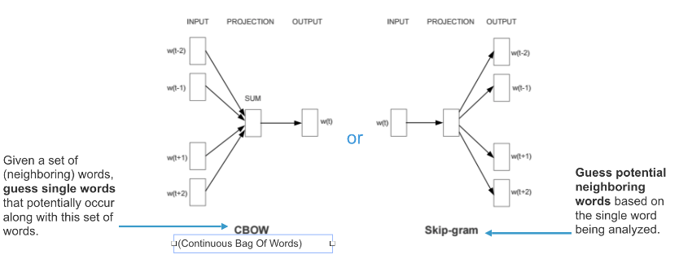
Continue..
The figure shows two models offered by word2vec. One is Continuous Bag-of-word model and other is Skip-gram. We have chosen skip-gram model as this model maximizes the average log probability for a given set of sentences or words.

Slide 10
Stage 2:
Selected neural networks:
RCNN (Recurrent Based Convolutional Neural Network)
LSTM (Long Short-Term Memory Neural Network)
Bi-LSTM (Bi-directional Long Short-Term Memory)

Slide 11
Stage 3: Implementation
Implementation of all of three DL techniques.
Helps in analysis of techniques giving more accurate and validated results.

Slide 12

Experiment Results

Slide 13
LSTM Results
LSTM
Learning Rate | 0.005 | 0.0005
Validation Accuracy | 94 | 84
Training Accuracy | 97 | 85
Valid Loss | 0.029 | 0.39
Train Loss | 0.091 | 0.2999

Slide 14
RCNN Results
RCNN
Learning Rate | 0.05 | 0.005
Validation Accuracy | 95.6 | 94.7
Training Accuracy | 97 | 94
Valid Loss | 0.05 | 0.09
Train Loss | 0.088 | 0.109

Slide 15
Bi-LSTM Results
Bi - LSTM
Learning Rate | 0.005 | 0.0005
Validation Accuracy | 94.5 | 85
Training Accuracy | 98 | 86
Valid Loss | 0.023 | 0.379
Train Loss | 0.098 | 0.362

Slide 16
Accuracy Results

Slide 17
Loss Results

Slide 18
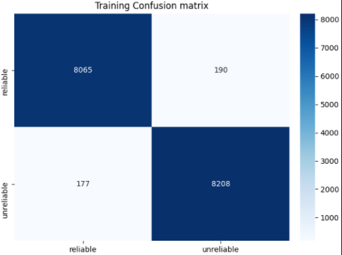
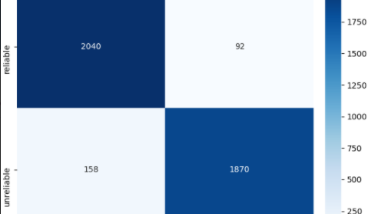
Results Analysis
The validation confusion matrix results also are very much in alignment with the conclusion results. The true positive result makes it pretty much clear.
Considering Bi – LSTM is the appropriate choice since it provides almost same validation accuracy but in addition to that it results in giving least validity loss which is also an extremely important aspect to look into.
Fig 6 Confusion Matrix of Validation (Bi-LSTM)
Fig 7 Confusion Matrix of Training (Bi-LSTM)

Slide 19
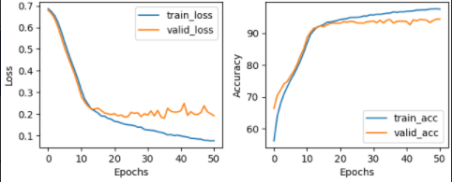
Stage 4: Analysis
The curve plot for Bi-LSTM at learning rate of 0.005 shows significant decrease in the validation loss and similarly substantial increase in the validation accuracy that justifies our conclusion.
Fig 5 Curve Plot For Bi-LSTM Accuracy And Loss results (Epochs)

Slide 20
Conclusion
Considering all of aspects, we have concluded that since validation accuracy is prime suspect to declare the best DL technique for the fake news detection, After analysis of results we come to conclusion that RCNN provides the most validation accuracy results but similarly it also provide most validation loss. On the other hand, Bi-LSTM provides almost same validation accuracy as RCNN with less validation loss as compared to RCNN so Bi-LSTM would be the suitable choice.

Slide 21
References
[1] Shao, C., Ciampaglia, G. L., Varol, O., Flammini, A., &Menczer, F. (2017). The spread of fake news by social bots. arXiv preprint arXiv:1707.07592, 96-104.
[2] S. Marsland, Machine learning: an algorithmic perspective. CRC press, 2015.
[3] https://www.kaggle.com/c/fake-news/data

Slide 22
Any Questions?

