Slide 1
Graphing EEG Brain Data
Waleed Asif
Maeusz Zmijewski
Patri Basavaraja

Slide 2
Overview
A person was hooked up to an EEG reader
Was shown 140 images for 2 seconds each
Subject was asked to try and remember the image
If an image currently being displayed was similar to another she had seen before, there should be brain activity in 1 part of the brain.
If not, then there is brain activity in another part.

Slide 3
The data
We have data for 30 minutes of the experiment
1GB
Was able to convert the binary file to be read in by python, we now have a 2D array [0:64][0:1830000]

Slide 4
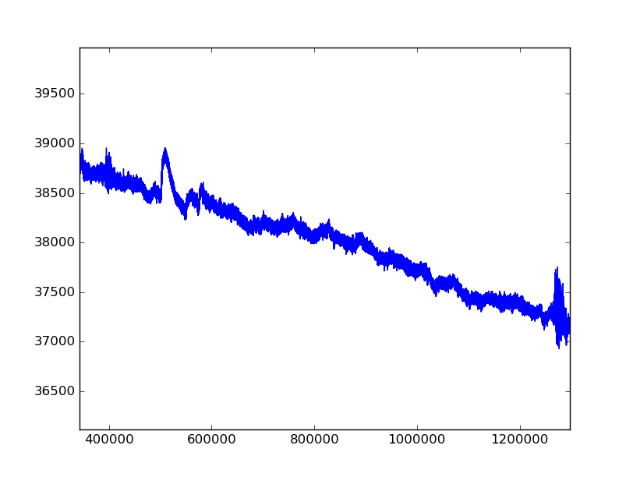
Using Matplotlib
We can see the average values of every node over time on this graph:

Slide 5
Next Step
Since data is huge, we need to find a way to break up the data so we can compute the correlation coefficient from one channel to another.

Slide 6
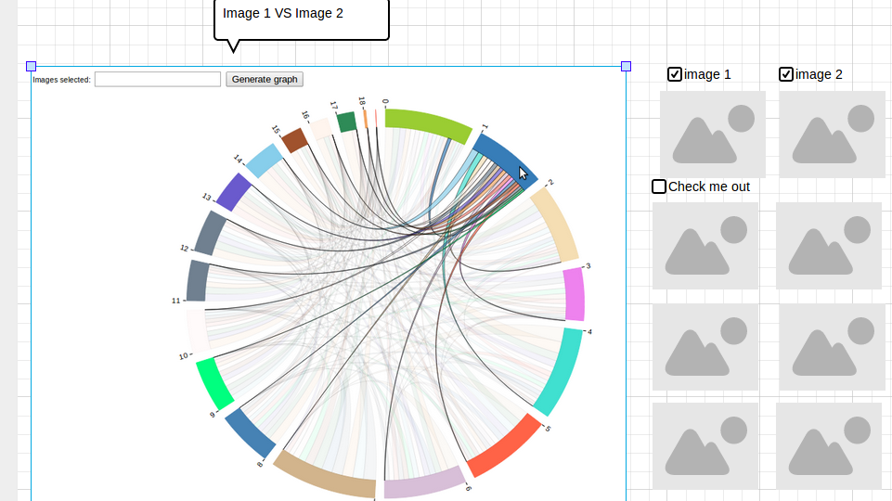
How we will visualize our data
We will be using a chord diagram

Slide 7
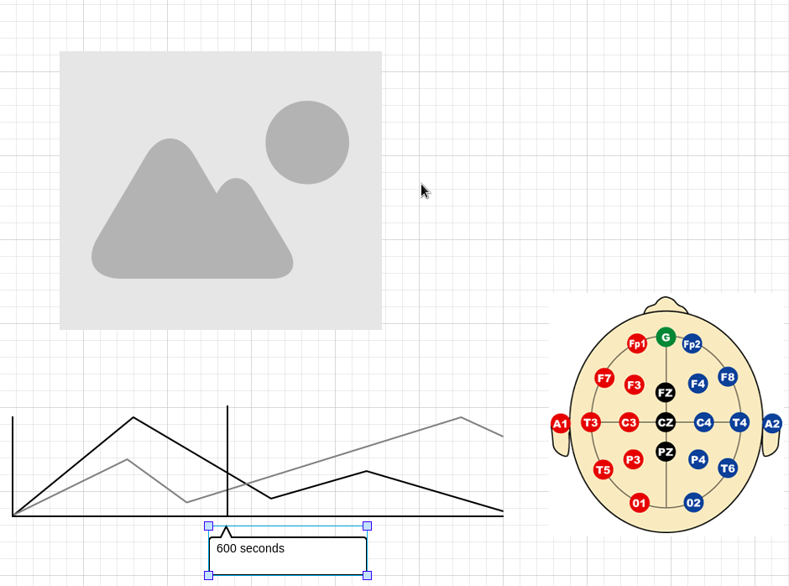
Showing data as time-series

Slide 8
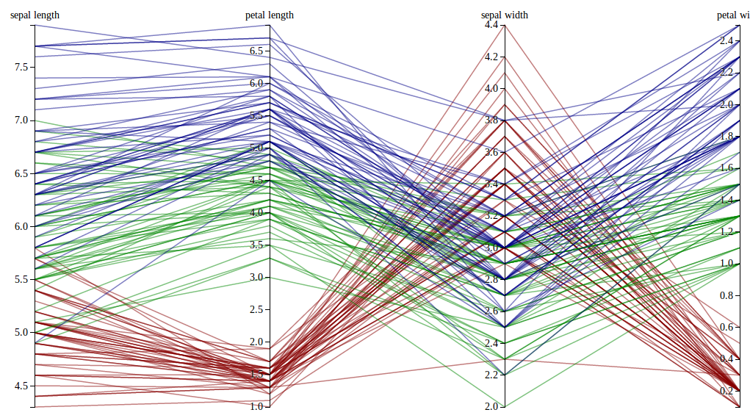
Alternative Graph

