Slide 1
World Risk Index
Database / Application

Slide 2
Functioning of application
Update
Insert
Delete
Search

Slide 3
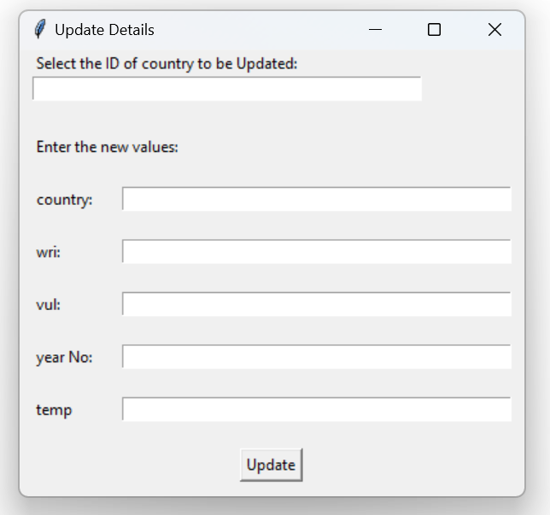
Update

Slide 4
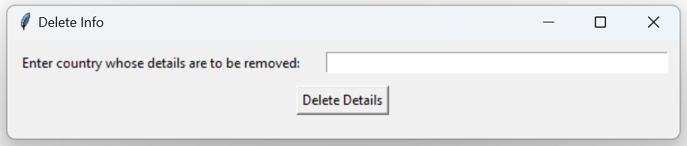
Delete

Slide 5
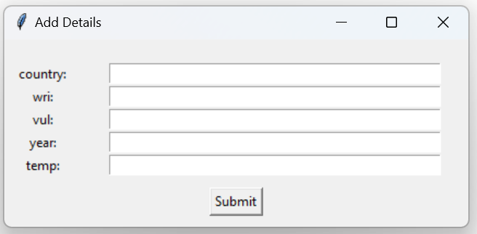
Insert

Slide 6
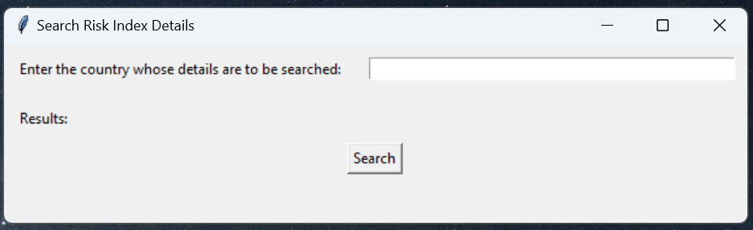
Search

