Slide 1
Predicting Lap Time Degradation in Formula 1 Using Machine Learning Models
Presented By:
Waleed Hussain University of Hertfordshire
MSc in Data Science

Slide 2
Introduction
Gradual increase in lap time as the race progresses
Caused by tyre wear, fuel consumption, track evolution, driver strategy, and pit stops
Why is Lap Time Degradation Important in Formula 1?
Directly affects race pace
Determines optimal pit-stop strategy
Impacts tyre selection and stint length
Helps teams predict performance and overtake windows
Critical for race engineers and strategists

Slide 3
Introduction
Project Aim
To develop a machine learning model that can accurately predict lap time degradation using:
Lap-level telemetry data
Pit-stop information
Driver/team statistics
Circuit characteristics
Research Goal
To build a predictive model comparable to published studies and extract strategic insights from historical race data.

Slide 4
Dataset Overview
Dataset Source
Kaggle: Formula 1 World Championship (1950–2020)
Contains 70+ years of historical race data
Suitable for time-series, performance, and predictive modelling
Why This Dataset Works for Our Project
Large-scale lap-level dataset
Includes all key indicators affecting lap time
Covers multiple circuits, seasons, drivers, and strategies
Allows detailed analysis of:
Lap progression
Pit stop effects
Driver/team performance
Circuit characteristics

Slide 5
Data Preprocessing
Data Loading & Merging
Loaded multiple CSV files from the dataset
Merged them using relational keys:
raceId, driverId, constructorId, circuitId
Created a unified Data Frame containing all lap-level information:
Driver
Team
Circuit
Pit stops
Race metadata
Lap times

Slide 6
Data Preprocessing
Data Cleaning
Converted lap time from milliseconds → seconds
Renamed columns for clarity
Removed irrelevant or duplicate columns
Ensured consistent data types (numeric/categorical)
Categorical Encoding
Used Label Encoding to convert non-numeric fields into numeric form:
Driver name → driver_encoded
Constructor/team → constructor_encoded
Circuit ID → circuit_encoded
This makes data usable for ML models.

Slide 7
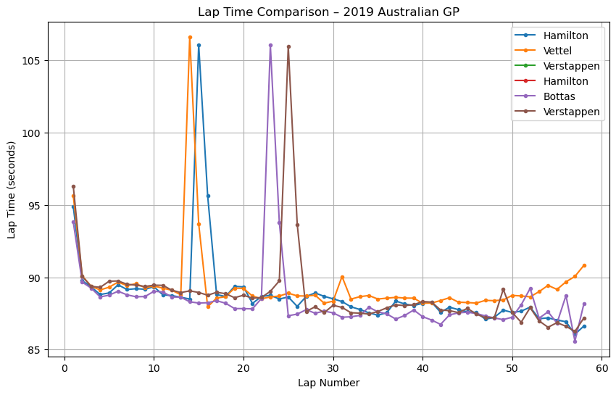
Exploratory Data Analysis (EDA)
Lap Time Trends
Analysed lap-by-lap time progression for drivers
Observed natural degradation (lap times increase over laps)
Identified pit-stop resets (lap time drops after pit stop)
Example: Hamilton, Bottas, Vettel, Verstappen (2019 Australian GP)
Pit Stop Impact
Clear spike in lap time on pit-stop lap
Sharp decrease immediately after pit stop
Statistically measured before vs after pit stop:
Before pit stop → stronger degradation
After pit stop → performance reset

Slide 8
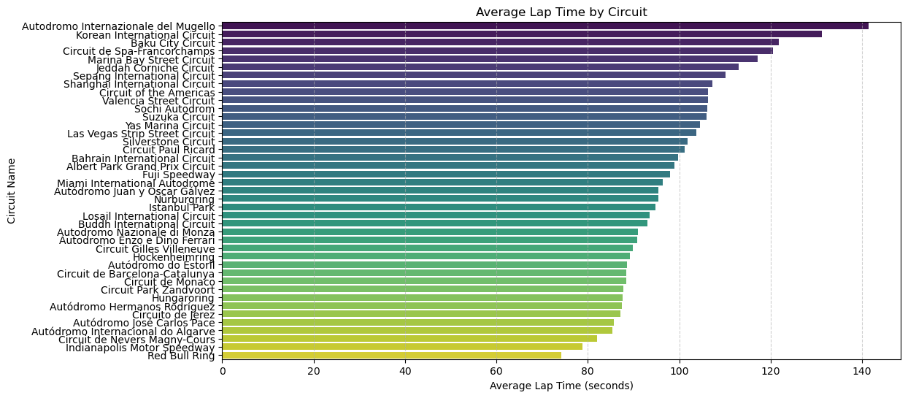
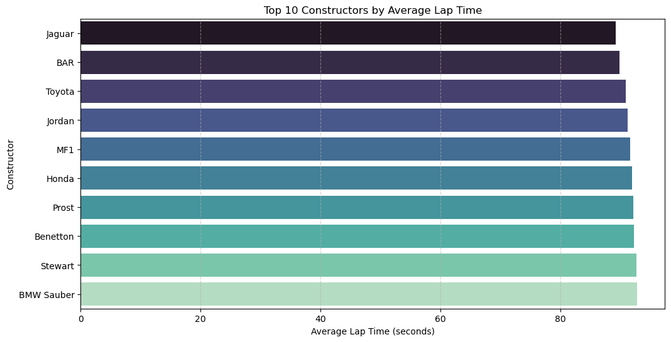
Circuit-Level Analysis
Compared average lap times across all circuits
Found significant differences due to:
Track length
Sector complexity
Weather and country characteristics
Confirmed circuit type is an important feature

Slide 9
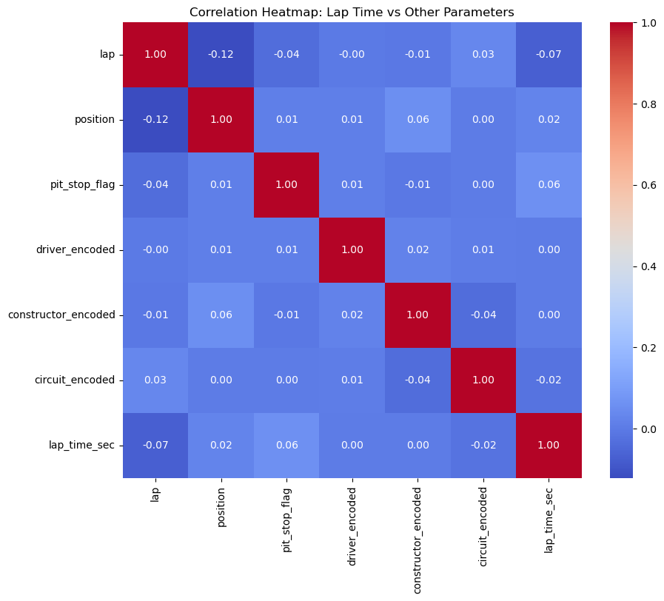
Exploratory Data Analysis (EDA)
Statistical Tests
Correlation Heatmap
Lap time correlates strongly with:
Lap number
Pit-stop flag
Previous lap time
Race progress percentage
ANOVA Test
Driver p-value = 0.00000
Constructor p-value = 0.00000
Circuit p-value = 0.00000
All effects are statistically significant

Slide 10
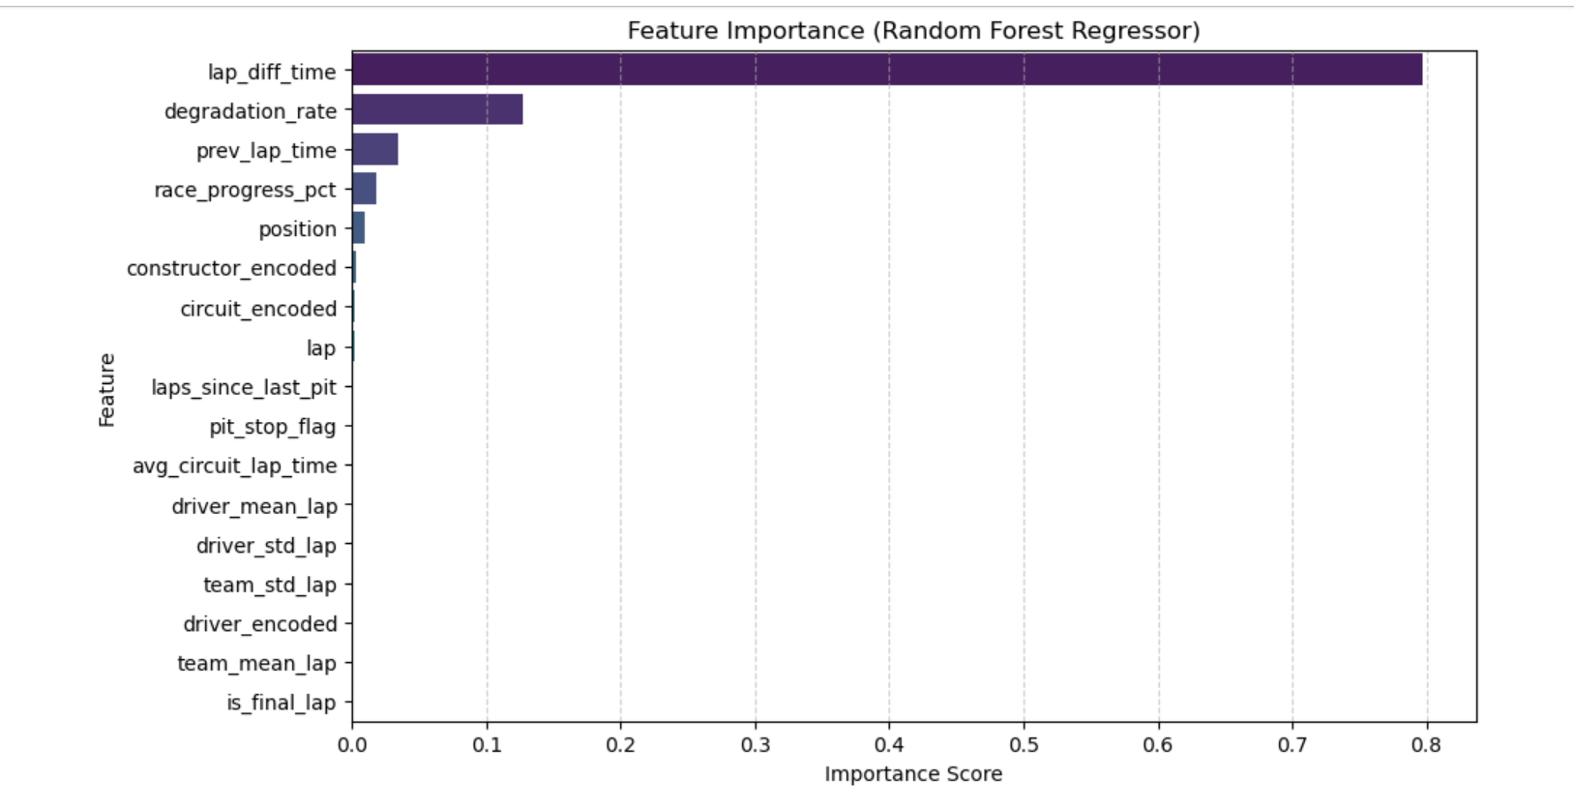
Feature Importance
Lap difference time is the most important.
The degradation rate and the previous lap time follow it.

Slide 11
Feature Engineering
Lap-Time Derived Features
Created new features to better capture race dynamics:
Lap Time (sec) = milliseconds / 1000
Lap Time Difference = current lap time – previous lap time
Rolling Average Lap Time (3-lap, 5-lap windows)
Rolling Standard Deviation to capture consistency
Cumulative Race Time to monitor total progress

Slide 12
Feature Engineering
Pit Stop Features
Extracted insights from pit-stop events:
Pit Stop Flag (1 if pit stop on that lap, else 0)
Pit Stop Duration (in ms)
Time Since Last Pit Stop (laps)
Performance Before vs After Pit Stop (used in correlation analysis)
Driver & Constructor Encoding
Converted categorical variables into numerical form:
Driver Encoded
Constructor Encoded
Circuit Encoded

Slide 13
Feature Engineering
Target Variable
Our main prediction target:
Lap Time (seconds)
Used as the output variable for all machine learning models.

Slide 14
Machine Learning Models
This project evaluates three supervised regression models for predicting F1 lap times.
Linear Regression
Random Forest Regressor
Gradient Boosting Regressor

Slide 15
Machine Learning Models
Linear Regression
Purpose:
Baseline model to measure linear relationships between features and lap time.
Why Used:
Simple, interpretable
Helps understand how each feature influences lap time
Acts as a benchmark for comparison
Observed Behaviour:
Captures general trends
Struggles with non-linear race dynamics (tyre wear, pit stops, position changes)

Slide 16
Machine Learning Models
Random Forest Regressor
Purpose:
Tree-based ensemble model for handling complex patterns.
Why Used:
Captures non-linear relationships
Handles categorical encodings well
Robust to outliers and unbalanced data
Observed Behaviour:
Strong performance with low MAE
Learns interactions between lap number, pit stop flags, and position

Slide 17
Machine Learning Models
Gradient Boosting Regressor
Purpose:
Boosting technique that builds trees sequentially to minimise prediction error.
Why Used:
Excellent for tabular race data
Great at modelling subtle effects like:
tyre degradation
race progression
driver consistency
Often the top performer in structured datasets
Observed Behaviour:
Highest predictive accuracy
Low error metrics similar to existing research
Very sensitive to engineered features → improves as feature set grows

Slide 18
Initial Results
Model | R² Score | RMSE | MAE
Linear Regression | 0.9541 | 16.82 | 5.60
Random Forest Regressor | 0.9941 | 6.01 | 0.3169
Gradient Boosting Regressor | 0.9942 | 5.96 | 0.9051

Slide 19
Future work
Hyperparameter tuning
Add one more model
Report writing and submission

