Slide 1
Requirements Engineering
Chapter 4: Software Requirements Definition & Specifications

Slide 2
What are requirements?
Requirements represent a need that a software system should fulfill.
Requirements can be:
Functional (what the software or component should do, a functionality or system service)
Non-functional (how the system will do, that is, constraints or qualities)

Slide 3
Requirements definition versus specification
Requirement definitions are customer-oriented.
– Written using natural language and simple diagrams.
Requirement specifications are oriented towards the software developer.
– More precise description of functionality and constraints.

Slide 4
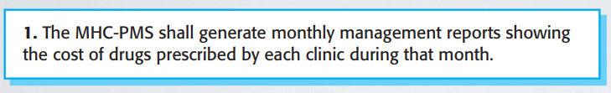
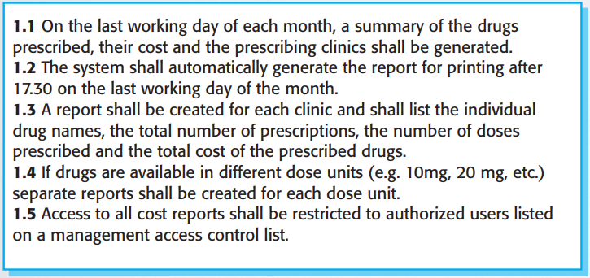
Example
Requirement definition (end user)
Requirement specifications (designer & developer)

Slide 5
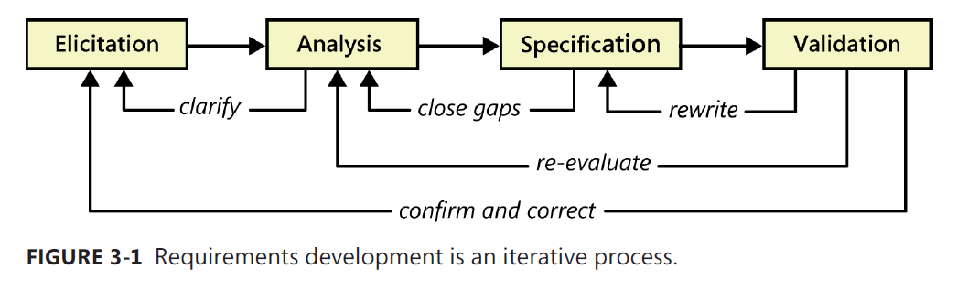
Requirements Engineering Process

Slide 6
Requirements Engineering Process Stages
Software engineers work with a range of system stakeholders to find out more about the application environment, services that the system should provide to end users, the required system performance indicators, hardware constraints, other systems, etc.
RE Stages are:
Requirements Elicitation (Discovery)
Requirements Analysis
Requirements Specification → SRS
Requirements Validation → Validated SRS

Slide 7
Software Requirements Specification (SRS) Document
The SRS document is the official statement of what is required of the system developers.
Should include both a definition and a specification of requirements.
It is NOT a design document. As far as possible, it should set of WHAT the system should do rather than HOW it should do it.

Slide 8
SRS Document Structure
Introduction
Describe need for the system and how it fits with business objectives
Glossary
Define technical terms used
Functional requirements definition
Describe the end-user services to be provided
Non-functional requirements definition
Define constraints on the system and the development process
Requirements specification
Detailed specification of functional requirements

Slide 9
SRS Document Structure
System models
Define models from different perspectives, such as contextual, interaction, structural and behavioral, showing system components and relationships.
System evolution
Define fundamental assumptions on which the system is based and anticipated changes.
Appendices
System hardware platform description
Database requirements (as an ER model perhaps)
Index

Slide 10
Checklists for Requirements Validity
Functionality. Does the system provide the functions which best support the customer’s needs?
Consistency. Are there any requirements conflicts?
Completeness. Are all functions required by the customer included?
Applicability. Can the requirements be implemented given available budget and technology (feasible)?
Verifiability. Can the requirements be checked (measurable)?

Slide 11
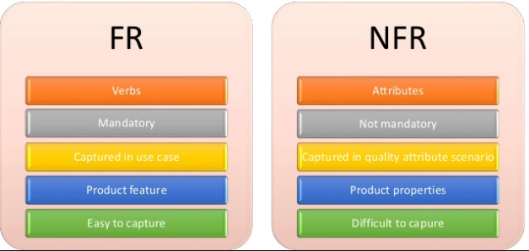
Types of Requirements
Functional requirements (FR).
Non-functional requirements (NFR).

Slide 12
Functional Requirements for the Mental Health Care Patient Management System (MHC-PMS) (Examples)
A user shall be able to search the appointments lists for all clinics.
The system shall generate each day, for each clinic, a list of patients who are expected to attend appointments that day.
Clinicians shall be able create records for patients, edit the information in the system, and view patient history.

Slide 13
Requirements Imprecision
Problems arise when requirements are not precisely stated.
Ambiguous requirements may be interpreted in different ways by developers and users.
Consider the term ‘search’ in requirement R1
User intention – R1: search for a patient name across all appointments in all clinics;
Developer interpretation – search for a patient name in an individual clinic. User chooses clinic then search.

Slide 14
Non-Functional Requirements
These define system properties and constraints.
Non-functional requirements may be more critical than functional requirements. If these are not met, the system may be useless.

Slide 15
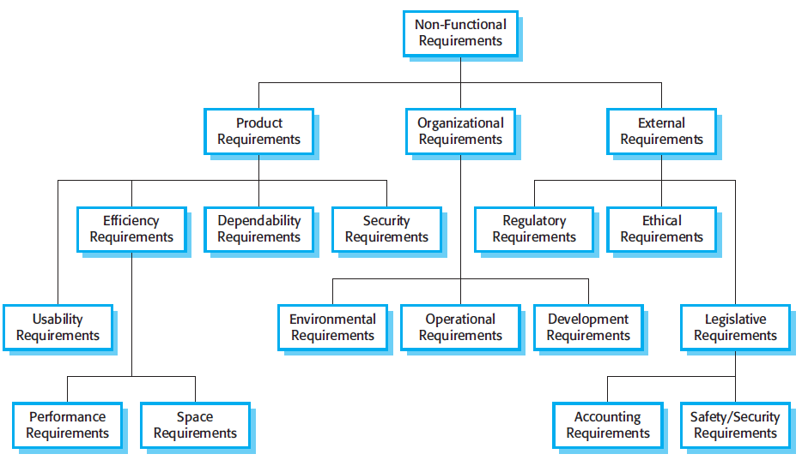
Types of Non-Functional Requirements

Slide 16
Non-Functional Classifications
Product requirements
Requirements which specify that the delivered product must behave in a particular way e.g. execution speed, usability, reliability, etc.
Organisational requirements
Requirements which are a consequence of organisational policies and procedures e.g. process standards used, implementation requirements, etc.
External requirements
Requirements which arise from factors which are external to the system and its development process e.g. interoperability requirements, legislative requirements, etc.

Slide 17
Non-Functional Requirements for the Mental Health Care Patient Management System (MHC-PMS) (Examples)
Product requirement The MHC-PMS shall be available to all clinics during normal working hours (Mon–Fri, 0830–17.30). Downtime within normal working hours shall not exceed five seconds in any one day. Organizational requirement Users of the MHC-PMS system shall authenticate themselves using their health authority identity card. External requirement The system shall implement patient privacy provisions as set out in HStan-03-2006-priv.

Slide 18
NFR Requirements (Examples)
The system should be easy to use by medical staff and should be organized in such a way that user errors are minimized. (Usability)
Medical staff shall be able to use all the system functions after four hours of training. (Usability)
Average number of errors made by experienced users shall not exceed two errors per hour of system use. (Reliability)

Slide 19
Metrics for Specifying Non-Functional Requirements
Property | Measure
Speed | Processed transactions/second User/event response time Screen refresh time
Size | Mbytes Number of ROM chips
Ease of use | Training time Number of help frames
Reliability | Mean time to failure Probability of unavailability Rate of failure occurrence Availability
Robustness | Time to restart after failure Percentage of events causing failure Probability of data corruption on failure
Portability | Percentage of target dependent statements Number of target systems

Slide 20
Domain Requirements (Environmental Constraints)
The system’s operational environment imposes constraints on the system.
For example, a train control system has to take into account the braking characteristics in different weather conditions.
Domain requirements are considered as new functional requirements, constraints on existing requirements or define specific computations.
If domain requirements are not satisfied, the system may be unworkable.

Slide 21
Problems with the Domain Requirements
Understandability
Requirements are expressed in the language of the application domain;
This is often not understood by software engineers developing the system.
Implicitness
Environment specialists understand the area so well that they do not think of making the environment constraints explicit.

Slide 22
Problems with Requirements Elicitation & Analysis
Stakeholders don’t know what they really want.
Stakeholders express requirements in their own terms.
Different stakeholders may have conflicting requirements.
Organisational and political factors may influence the system requirements.
The requirements may change during the analysis process. New stakeholders may emerge, and the business environment may change.

Slide 23
Requirements Elicitation Methods
Interviews.
Observe the user using similar systems.
Questionnaires.
Requirements workshops.
Brainstorming and idea reduction.
Storyboarding.
Analyze similar products & relevant documents.
Focus group.
Prototyping.
User Interface analysis.

