Slide 1
HeatShift
Tomorrow’s temperature,
with evidence you can check
Karachi, Lahore and Multan
A 24-hour airport temperature prototype
Waleed Irfan
Syed Mateen Ali
Aman Khan Lodhi
Notes:
WALEED | 15 seconds | 0:00-0:15
Hello, we are the HeatShift team. Our project helps people understand tomorrow’s temperature and the evidence behind it. We combine a prediction model with two agents in one dashboard. Our current scope covers three airport stations.
Sources:
https://github.com/waleedirfan2006-arch/Heat-Shift-/blob/main/TEAM_CONTRIBUTIONS.md
https://github.com/waleedirfan2006-arch/Heat-Shift-/blob/main/README.md

Slide 2
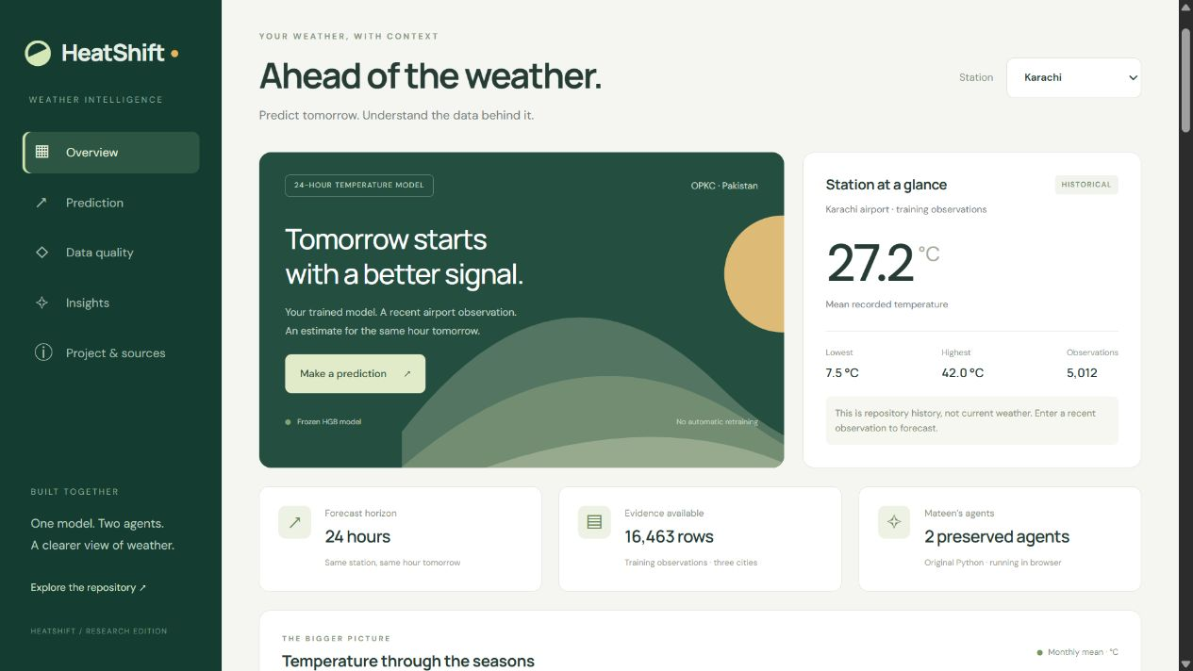
The problem and our solution
A forecast number leaves questions
How reliable are the inputs?
How uncertain is the estimate?
Where did the explanation come from?
Prediction, data checks and
traceable answers in one view
Public responsive dashboard
HeatShift / HackInsight 26
02
Notes:
WALEED | 25 seconds | 0:15-0:40
We focused on making a forecast easier to judge. A number alone does not show whether its data is complete or where an explanation came from. HeatShift puts the prediction, quality checks and evidence references together. Everyday users are our intended audience. We have not yet measured the impact on their decisions.
Sources:
https://huggingface.co/spaces/Waleed-1234/HeatShift-Dashboard
https://github.com/waleedirfan2006-arch/Heat-Shift-/blob/main/Business_Model.md

Slide 3
The data warehouse
Original records stay separate from cleaned and processed data
01 Acquire
NOAA station observations and archived weather inputs
02 Preserve
Raw snapshots and manifest.csv with source receipts
03 Prepare
Cleaned tables, exact 24-hour targets and time-based splits
04 Rebuild
One make data command and 14 warehouse checks
16,463 training rows 1,783 validation rows 755 calibration rows
HeatShift / HackInsight 26
03
Notes:
AMAN | 35 seconds | 0:40-1:15
I handled data cleaning and warehouse management. We keep original files, cleaned data and processed tables separate. A manifest records where files came from and their fingerprints. We use time-based splits because future weather must not leak into training. The single make data command rebuilds the warehouse. The final audit passed fourteen checks. Some original collection receipts remain unavailable.
Live METAR data supplies current inference inputs, not historical model training. Open-Meteo historical comparison snapshots are distinct from JMA previous-runs features.
Sources:
https://github.com/waleedirfan2006-arch/Heat-Shift-/blob/main/submission/datasetpropsal.pdf
https://github.com/waleedirfan2006-arch/Heat-Shift-/blob/main/evidence/final_audit/warehouse_rebuild_receipt.json
https://www.ncei.noaa.gov/products/land-based-station/integrated-surface-database
https://open-meteo.com/en/docs/previous-runs-api

Slide 4
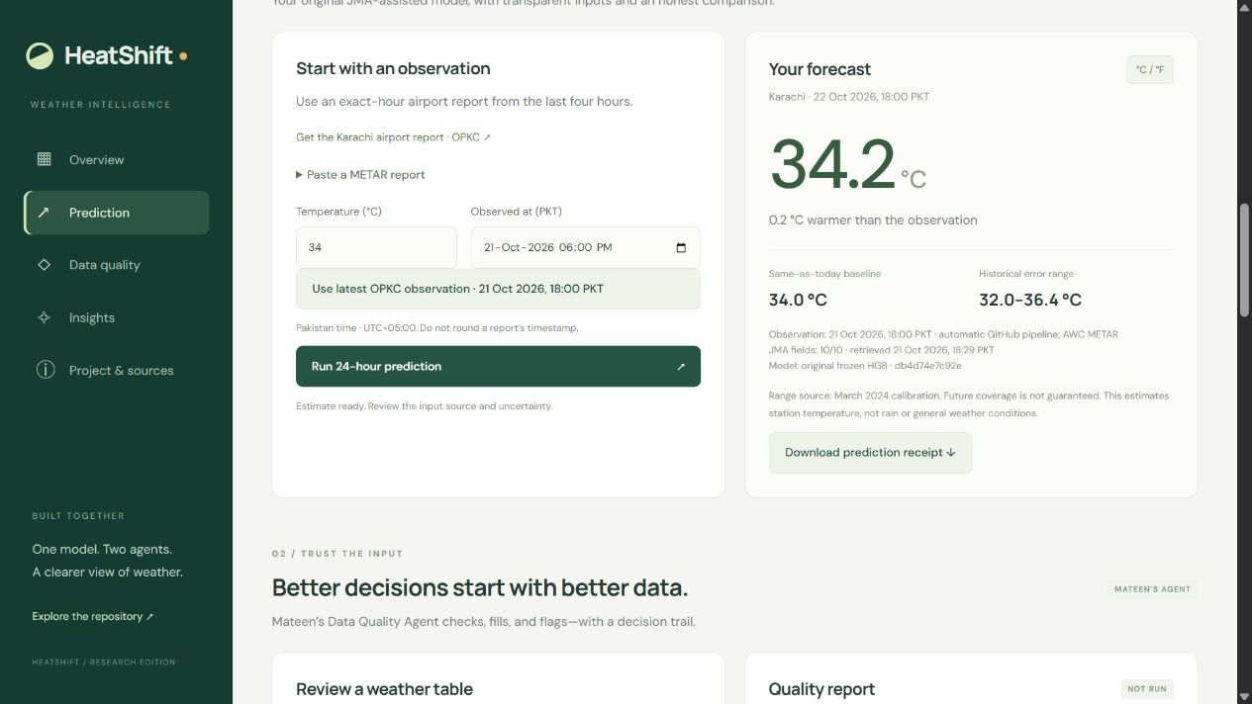
The prediction model
Frozen HistGradientBoosting
Recent station temperature
JMA weather forecast fields
Station and calendar features
Output
Station temperature
24 hours later
Example captured on 21 October 2026. The model does not retrain on each request.
HeatShift / HackInsight 26
04
Notes:
WALEED | 35 seconds | 1:15-1:50
I developed the model and worked on improving it. The deployed model is HistGradientBoosting, which combines small decision trees to correct prediction errors. It uses the current station temperature, JMA forecast fields and calendar information. It predicts a correction to the current temperature for the same hour tomorrow. We compare it with a simple rule: tomorrow equals today. This audit preserved the existing model parameters.
The earlier Ridge and station-only alternatives did not beat persistence. Original JMA fitting-feature and search records remain unavailable. Do not claim full training reproducibility.
Sources:
https://github.com/waleedirfan2006-arch/Heat-Shift-/blob/main/HeatShift_Web/core.js
https://github.com/waleedirfan2006-arch/Heat-Shift-/blob/main/HeatShift_Web/model.json
https://github.com/waleedirfan2006-arch/Heat-Shift-/blob/main/OPTIMIZATION_LOG.md

Slide 5
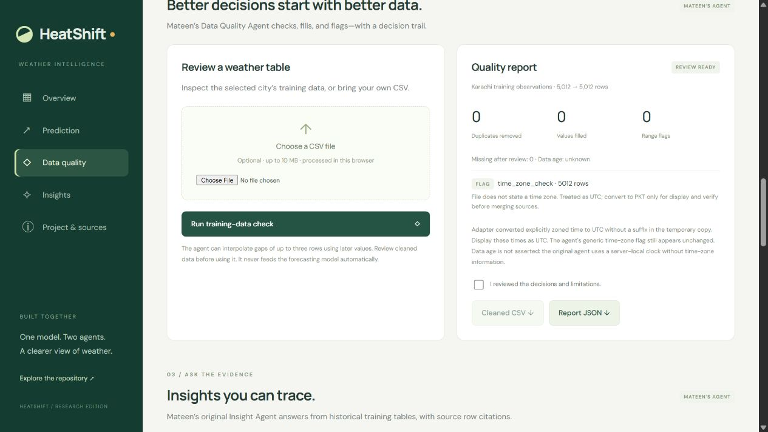
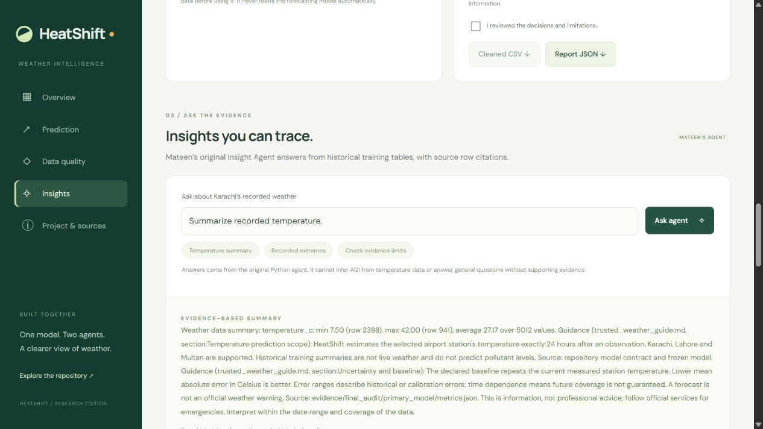
Mateen’s two agents
Data Quality Agent
Insight Agent
Removes duplicates, fills small gaps
and flags suspect values with a log
Retrieves trusted notes and computes
table summaries with row or section citations
HeatShift / HackInsight 26
05
Notes:
MATEEN | 40 seconds | 1:50-2:30
I developed, managed and maintained both agents. The quality agent reviews missing values, duplicates and unusual weather readings, then records its decisions. Its short-gap interpolation can use later rows, so we review cleaned data before modeling. The insight agent retrieves trusted notes and calculates statistics from the training tables. It gives row or section citations. This is lightweight deterministic RAG. It refuses questions when the data does not support an answer.
Both original vendor files retain their source fingerprints. Browser adapters verify them before execution. This is not a general LLM chatbot.
Sources:
https://github.com/waleedirfan2006-arch/Heat-Shift-/blob/main/TEAM_CONTRIBUTIONS.md
https://github.com/waleedirfan2006-arch/Heat-Shift-/tree/main/HeatShift_Unified_Space/vendor
https://github.com/waleedirfan2006-arch/Heat-Shift-/blob/main/HeatShift_Web/trusted_weather_guide.md

Slide 6
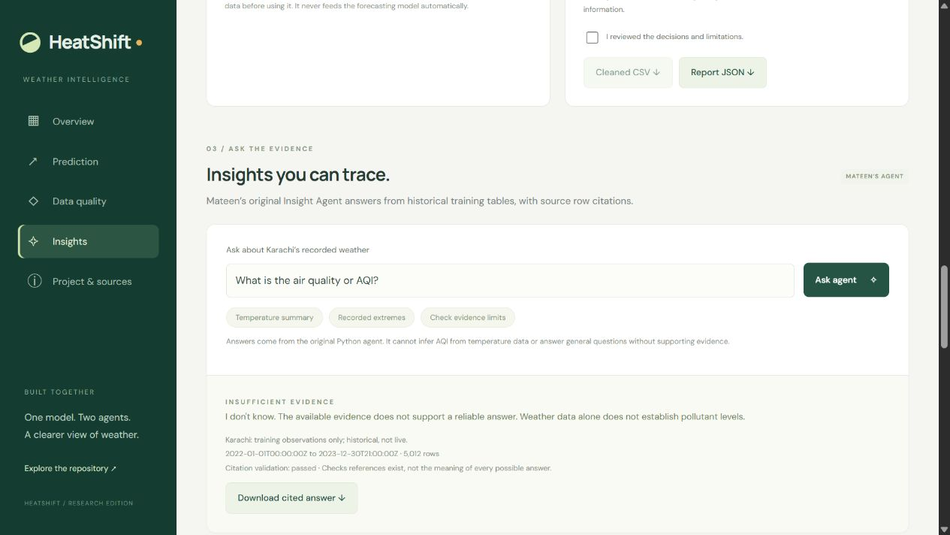
Live demonstration
1 Prediction and uncertainty
2 Quality decisions and downloadable log
3 A cited temperature summary
4 An unsupported AQI question
Open the public dashboard
Offline backup: the 2 min 24 sec demo video
HeatShift / HackInsight 26
06
Notes:
TEAM | 120 seconds | 2:30-4:30
Switch to the already-open dashboard. Do not play the full backup video as well as a live demo.
0-30 seconds, Waleed: select a city, use the latest automatic observation and run a prediction. Point to the timestamp, baseline and calibrated range. If no fresh observation is available, show the saved example and say it is historical.
30-60 seconds, Aman: show the hourly status and its timestamp, then open data quality. Mateen runs or shows the completed check and explains one decision.
60-90 seconds, Mateen: ask for a temperature summary and point to the row and section references.
90-120 seconds, Mateen: ask about AQI and show the refusal. Return to the slides.
Preload Python agents before your turn. If the network fails, use HeatShift_Demo.mp4 or the screenshots in this deck and identify their capture date. Never imply a saved example is current weather.
Sources:
https://huggingface.co/spaces/Waleed-1234/HeatShift-Dashboard
https://github.com/waleedirfan2006-arch/Heat-Shift-/blob/main/submission/DEMO_README.md

Slide 7
Lower average validation error
10.8%
observed reduction
in average absolute error
1,783 identical validation rows
Lower MAE is better
January performed worse than baseline. The improvement interval includes zero.
These reused validation results do not prove future performance.
HeatShift / HackInsight 26
07
Notes:
WALEED | 55 seconds | 4:30-5:25
MAE means average absolute error in Celsius. Across the same 1,783 validation examples, the model had about 1.10 degrees of error compared with 1.24 for repeating today’s temperature. That is 10.8 percent less average error. It is not a percentage accuracy score. January was worse, and the bootstrap interval includes no improvement. We show March-calibrated uncertainty ranges, but future coverage is not guaranteed. These are reused validation results, not a fresh independent final test.
Declared unrounded baseline MAE: 1.2351654514862591 C. Rounded deployment baseline: 1.2439147504206394 C. Model: 1.1019464086208355 C. Seven-day block bootstrap 95% improvement interval: [-0.0416937705, 0.2706989324] C. No new locked-test, replay or reserve scoring in the audit.
Sources:
https://github.com/waleedirfan2006-arch/Heat-Shift-/blob/main/evidence/final_audit/primary_model/metrics.json
https://github.com/waleedirfan2006-arch/Heat-Shift-/blob/main/evidence/final_audit/primary_model/row_predictions.csv

Slide 8
Feasibility and business model
Who could benefit?
What would it cost?
Everyday planners and students
Potential institutional payers:
campuses, event teams and logistics firms
Current free static prototype
Hourly GitHub pipeline
Commercial weather-data rights
Maintenance and support
Basic public view, with paid reporting
and support as a future hypothesis
No verified paying customers or measured impact yet
HeatShift / HackInsight 26
08
Notes:
WALEED | 35 seconds | 5:25-6:00
The basic dashboard serves everyday users. Institutions could eventually pay for reporting and support. That is a business proposal, not existing sales. The current prototype uses a free static Space and public GitHub Actions, subject to their terms. A commercial service would need appropriate weather API rights and a maintenance budget. We want to measure whether users understand forecasts better before claiming real-world impact.
Commercial previous-runs access needs the appropriate Open-Meteo plan. No price or paying customer has been validated. The existing final audit records a successful push-triggered hourly-workflow run; schedule delays remain possible.
Sources:
https://github.com/waleedirfan2006-arch/Heat-Shift-/blob/main/Business_Model.md
https://open-meteo.com/en/pricing
https://github.com/waleedirfan2006-arch/Heat-Shift-/blob/main/evidence/final_audit/first_actions_run.json

Slide 9
Team contributions and questions
Waleed Irfan
Prediction model development and improvement
Syed Mateen Ali
Development, management and maintenance
of both AI agents
Aman Khan Lodhi
Data cleaning, warehouse management
and related preparation
Next: recover missing provenance and test future seasons independently
HeatShift / HackInsight 26
09
Notes:
QUESTIONS | 6:00-10:00
Stop the main presentation at six minutes. Leave this slide visible for judges’ questions. Roles come from Waleed’s explicit team allocation. Explain substantial AI assistance honestly using the cumulative AI log. Each member should answer questions about their work.
The following three slides are backup material. Use them only when relevant.
Before evaluation, have the submitted Devpost project link ready separately. The team has not supplied that link in this conversation. Do not claim that the GitHub or Hugging Face link replaces it.
Sources:
https://github.com/waleedirfan2006-arch/Heat-Shift-/blob/main/TEAM_CONTRIBUTIONS.md
https://github.com/waleedirfan2006-arch/Heat-Shift-/blob/main/AI_Use_Log.md

Slide 10
Backup: errors by group and uncertainty
Group | Rows | Model MAE | Baseline MAE
Karachi | 419 | 1.031°C | 1.368°C
Lahore | 963 | 1.082°C | 1.129°C
Multan | 401 | 1.226°C | 1.352°C
January | 775 | 1.165°C | 1.074°C
February | 1,008 | 1.053°C | 1.359°C
March calibration bands
Karachi ±2.22°C
Lahore ±3.08°C
Multan ±2.27°C
Nominal 90% ranges
Future coverage unknown
Baseline repeats the raw current NOAA temperature on the same scored rows.
HeatShift / HackInsight 26
10
Notes:
BACKUP ONLY
All scores use mean absolute error in Celsius. January is the group where the model loses to persistence. March calibration uses 183 Karachi, 398 Lahore and 174 Multan examples, separate from the Jan-Feb validation. Calibration coverage is approximately 90% on the calibration rows themselves. It is not independent future coverage. Time dependence limits a simple coverage interpretation.
Do not read the chart/table as percent accuracy.
Sources:
https://github.com/waleedirfan2006-arch/Heat-Shift-/blob/main/evidence/final_audit/primary_model/metrics.json

Slide 11
Backup: effort, speed and memory
Measurement | Recorded result | Practical limit
Warm model inference | 80.4 ms / 2,538 rows | Excludes loading and network
Node heap snapshot | 11.0 MiB | Not total browser memory
Quality / insight runtime | 0.238 s / 0.103 s | Local warm runs, 5,012 rows
Browser startup | About 25 MB download | First use can take a minute
Human effort | Exact hours not recorded | AI assistance disclosed
Earlier Ridge and station-only HGB attempts did not beat the baseline.
The final audit preserved the existing JMA-assisted model.
HeatShift / HackInsight 26
11
Notes:
BACKUP ONLY
These are context-specific benchmarks, not service-level guarantees. The quality and insight values are medians over five warm runs on 5,012 Karachi rows. Traced Python allocation peaks were 2,933,053 and 1,970,584 bytes, excluding native allocations. Original training peak memory and training speed were not verified. The exported model JSON is about 0.74 MiB. Browser startup and external requests dominate first use.
Educational outcomes include source receipts, time-based splits, baseline comparison, uncertainty, citation checks and honest refusals.
Sources:
https://github.com/waleedirfan2006-arch/Heat-Shift-/blob/main/OPTIMIZATION_LOG.md
https://github.com/waleedirfan2006-arch/Heat-Shift-/blob/main/evidence/final_audit/agent_benchmarks.json
https://github.com/waleedirfan2006-arch/Heat-Shift-/blob/main/AI_Use_Log.md

Slide 12
Backup: project links and evidence
Public HeatShift dashboard
GitHub source and submission documents
Public demo video
Evaluation metrics and row-level evidence
Primary data services
NOAA Integrated Surface Database
Open-Meteo previous-runs API
Aviation Weather Center METAR API
HeatShift / HackInsight 26
12
Notes:
BACKUP ONLY
Primary source documentation and project records are linked below. The exact original Open-Meteo collection URL/model/fetch time and original JMA fitting-feature/search records remain incomplete. Fresh archive receipts prove the audit reproduction, not the original data arrival.
Submission reminder: the latest organizer notice requires slides, project demonstration and the submitted Devpost link. Every team member must attend and understand their part. This deck provides approximately six minutes of presentation/demo plus four minutes of questions. Check team slot and reporting time separately.
AI disclosure: Codex substantially assisted with integration, evaluation, automation and documents. User-reported team roles remain distinct from file-by-file authorship verification.
Sources:
https://www.ncei.noaa.gov/products/land-based-station/integrated-surface-database
https://open-meteo.com/en/docs/previous-runs-api
https://aviationweather.gov/data/api/
https://github.com/waleedirfan2006-arch/Heat-Shift-/blob/main/AI_Use_Log.md
https://github.com/waleedirfan2006-arch/Heat-Shift-/blob/main/TEAM_CONTRIBUTIONS.md

