Slide 1
Week 5 AWS Identity Access Management
Dr Zhi Zhang

Slide 2
Mid-sem test (4:30pm-5:30pm on 27/08/24 )
Student Number | Venues
20000000 - 23816000 | MATH: [ G40] (Mathematics Building)
23816001 - 23959800 | WTLTS: [ G106] (Wilsmore & Tattersall Lecture Theatres Building)
23959801 - 24700000 | WTLTS: [ G108] (Wilsmore & Tattersall Lecture Theatres Building)
students with UAAP | ENCM: [ 105] (Engineering – Civil &Mechanical Building)
If a student is 30 minutes late to the test, they are not allowed to sit for it

Slide 3
Mid-sem test (4:30pm-5:30pm on 27/08/24 )
Part 1: Multi-choice questions (15 marks)
15 questions
Part 2: Multi-answer questions (15 marks)
5 questions
Part 3: Short answer questions including reading code (30 marks)
5 themed questions
A themed question is about specific concepts from lectures, based on which, a few sub-questions will be asked.
Practice

Slide 4
Part 1
How does virtualization contribute to the benefits of cloud computing?
A. Virtualization eliminates the need for internet connectivity.
B. Virtualization increases hardware resource costs.
C. Virtualization enables efficient utilization of physical hardware by creating multiple virtual instances on a single server.
D. Virtualization limits the scalability of cloud services.

Slide 5
Part 1
How does virtualization contribute to the benefits of cloud computing?
A. Virtualization eliminates the need for internet connectivity.
B. Virtualization increases hardware resource costs.
C. Virtualization enables efficient utilization of physical hardware by creating multiple virtual instances on a single server.
D. Virtualization limits the scalability of cloud services.
Answer: C
What is Amazon EC2 used for in AWS?
A. Managing DNS records for domains.
B. Storing and managing relational databases.
C. Scaling compute capacity and launching virtual servers in the cloud.
D. Sending and receiving emails.

Slide 6
Part 1
How does virtualization contribute to the benefits of cloud computing?
A. Virtualization eliminates the need for internet connectivity.
B. Virtualization increases hardware resource costs.
C. Virtualization enables efficient utilization of physical hardware by creating multiple virtual instances on a single server.
D. Virtualization limits the scalability of cloud services.
Answer: C
What is Amazon EC2 used for in AWS?
A. Managing DNS records for domains.
B. Storing and managing relational databases.
C. Scaling compute capacity and launching virtual servers in the cloud.
D. Sending and receiving emails.
Answer: C

Slide 7
Part 1
Which of the following is NOT correct about cloud computing?
A. On-demand self service
B. Broad network access
C. Resource pooling
D. Slow elasticity

Slide 8
Part 1
Which of the following is NOT correct about cloud computing?
A. On-demand self service
B. Broad network access
C. Resource pooling
D. Slow elasticity
Answer: D
Which of the following best describes ARN?
A. a unique ID for AWS S3 buckets
B. a unique ID for AWS EC2 instances
C. a unique ID for AWS IAM users
D. a unique ID for any AWS resources

Slide 9
Part 1
Which of the following is NOT correct about cloud computing?
A. On-demand self service
B. Broad network access
C. Resource pooling
D. Slow elasticity
Answer: D
Which of the following best describes ARN?
A. a unique ID for AWS S3 buckets
B. a unique ID for AWS EC2 instances
C. a unique ID for AWS IAM users
D. a unique ID for any AWS resources
Answer: D

Slide 10
Part 1
Which of the following is the main feature of EBS?
A. A cloud-based email service for sending and receiving messages.
B. A service for launching and managing virtual servers in the cloud.
C. A block storage service that provides persistent storage.
D. A service that manages domain names and translates them to IP addresses.

Slide 11
Part 1
Which of the following is the main feature of EBS?
A. A cloud-based email service for sending and receiving messages.
B. A service for launching and managing virtual servers in the cloud.
C. A block storage service that provides persistent storage.
D. A service that manages domain names and translates them to IP addresses.
Answer: C
Part 2
Which of the following statements are correct in cloud computing? (Select all that apply)
A. Cloud providers allow users to pay as they go.
B. Data centers are usually distributed globally.
C. Cloud computing is built upon data centers.
D. Cooling may not be needed for data centers.

Slide 12
Part 1
Which of the following is the main feature of EBS?
A. A cloud-based email service for sending and receiving messages.
B. A service for launching and managing virtual servers in the cloud.
C. A block storage service that provides persistent storage.
D. A service that manages domain names and translates them to IP addresses.
Answer: C
Part 2
Which of the following statements are correct in cloud computing? (Select all that apply)
A. Cloud providers allow users to pay as they go.
B. Data centers are usually distributed globally.
C. Cloud computing is built upon data centers.
D. Cooling may not be needed for data centers.
Answer: ABC

Slide 13
Part 2
Which of the following are the main types of application architecture? (Select all that apply)
A. Monolithic architecture.
B. Client/Server architecture.
C. Three-tier architecture.
D. Cloud-based serverless architecture.

Slide 14
Part 2
Which of the following are the main types of application architecture? (Select all that apply)
A. Monolithic architecture.
B. Client/Server architecture.
C. Three-tier architecture.
D. Cloud-based serverless architecture.
Answer: ABCD
Which of the following statements are correct? (Select all that apply)
A. Page tables translate virtual memory into physical memory in modern OS.
B. When translating a 32-bit virtual address, two levels of page tables are needed.
C. Ring 0 is the least privileged and Ring 3 is the most privileged.
D. The number of processes is much smaller than the number of physical CPUs.

Slide 15
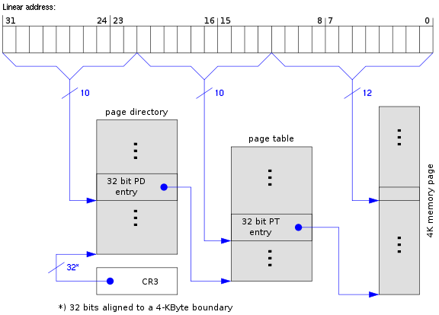
Page table:
A modern OS uses a set of page tables to map virtual memory within a process to their corresponding physical memory in main memory.
https://www.cs.virginia.edu/~bjc8c/class/cs6456-s20/slides/01-intro.pptx

Slide 16
Part 2
Which of the following are the main types of application architecture? (Select all that apply)
A. Monolithic architecture.
B. Client/Server architecture.
C. Three-tier architecture.
D. Cloud-based serverless architecture.
Answer: ABCD
Which of the following statements are correct? (Select all that apply)
A. Page tables translate virtual memory into physical memory in modern OS.
B. When translating a 32-bit virtual address, two levels of page tables are needed.
C. Ring 0 is the least privileged and Ring 3 is the most privileged.
D. The number of processes is much smaller than the number of physical CPUs.
Answer: AB

Slide 17
Part 3
1 import boto3
2 s3_resource = boto3.resource('s3’)
3 s3_resource.Object('bucket-mst', 'A2.txt').copy_from(CopySource ='bucket-mst/A1.txt’)
4 s3_resource.Object('bucket-mst', 'A1.txt').delete()
Read the python code snippet above. Explain Line 3 and Line4 and conclude what essential file operation has been performed.

Slide 18
Part 3
1 import boto3
2 s3_resource = boto3.resource('s3’)
3 s3_resource.Object('bucket-mst', 'A2.txt').copy_from(CopySource ='bucket-mst/A1.txt’)
4 s3_resource.Object('bucket-mst', 'A1.txt').delete()
Answer
Line 3 copies the object named 'A1.txt' from the 'bucket-mst' bucket to a new object named 'A2.txt' within the same bucket.
Line 4 deletes 'A1.txt' from the 'bucket-mst' bucket.
The operation is to rename the object from A1.txt to A2.txt.

Slide 19
Part 3
A DynamoDB table called MusicAlbum
Artist | Song
Tom | Call me today
Tom | Treat you better
Henry | Flowers
Jerry | Happy day
Read the code snippet below and show its table output.
1
2
3
4
aws dynamodb query \
--table-name MusicAlbum \
--key-condition-expression "Artist = :A1 or Artist = :A2" \
--expression-attribute-values ‘{":A1":{"S":"Tom"}, ":A2":{"S":"Jerry"}}’

Slide 20
Part 3
1
2
3
4
aws dynamodb query \
--table-name MusicAlbum \
--key-condition-expression "Artist = :A1 or Artist = :A2" \
--expression-attribute-values ‘{":A1":{"S":"Tom"}, ":A2":{"S":"Jerry"}}’
Answer
Artist | Song
Tom | Call me today
Tom | Treat you better
Jerry | Happy day

Slide 21
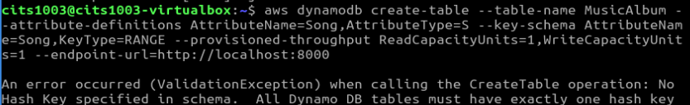
When the hash key is NOT given:

Slide 22
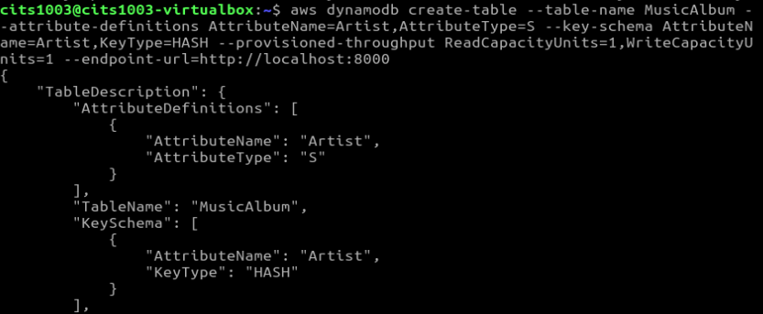
When the hash key is NOT given:
When the range key is NOT given:

Slide 23
A dynamodb table
Artist | Song
Jerry | Happy Day
What will the table be like if we create an item by adding a value of “Tom” to the “Artist” key?

Slide 24
A dynamodb table
Artist | Song
Jerry | Happy Day
Tom
What will the table be like if we create an item by adding a value of “Poker Face” to the “Song” key?

Slide 25


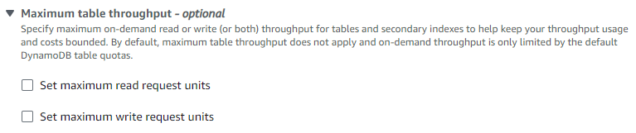
Core Components
Amazon DynamoDB

Slide 26
Overview
Cryptography
IAM (Identity Access Management)

Slide 27
Cybersecurity
It is about the protection of digital information from unauthorised access, harm or misuse.
This is done by preserving the CIA triad of the information, i.e., Confidentiality, Integrity and Availability.
Confidentiality: keeps sensitive information private and ensures that only authorized individuals or entities have access to it.
Integrity: maintains the accuracy, consistency, and reliability of information.
Availability: ensures that information such as services and data are accessible and operational for authorized users.

Slide 28
Cybersecurity
CIA can be extended to include such as Authentication, Authorization Non-Repudiation, etc.
Authentication: verifies the identity of a user, system, or entity trying to access a resource or system.
Authorization: determines what actions or resources an authenticated user or system is allowed to perform or access.
Non-Repudiation: prevents individuals or entities from denying their involvement in a particular digital transaction.

Slide 29



Cryptography
It is the practice and study of techniques for secure communication in the presence of adversaries or potential threats.
Insecure Channel
Alice
Bob
Attacker

Slide 30
Cryptography
It is the practice and study of techniques for secure communication in the presence of adversaries or potential threats.
It is mainly about the use of mathematical algorithms to transform plain, readable data (i.e., plaintext) into an unintelligible data (i.e., ciphertext) and vise versa

Slide 31
Cryptography
It is the practice and study of techniques for secure communication in the presence of adversaries or potential threats.
It is mainly about the use of mathematical algorithms to transform plain, readable data (i.e., plaintext) into an unintelligible data (i.e., ciphertext) and vise versa
Caesar cipher: an old-fashion substitution cipher where each letter in the plaintext is shifted a certain number of positions down the alphabet.
ROT3
plaintext : HELLO
ciphertext : KHOOR
H becomes K (H → I → J → K)
E becomes H (E → F → G → H)
L becomes O (L →M → N → O)
L becomes O (L → M → N → O)
O becomes R (O → P → Q → R)

Slide 32
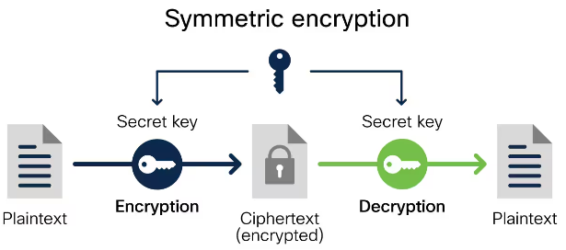
Cryptography today
Symmetric key cryptography: the same key is used for data transformation.
The transformation involve encryption and decryption.
Encryption: takes plaintext and converts it into ciphertext
Decryption: reverses the encryption process
Examples?

Slide 33
Cryptography today
Symmetric key cryptography: the same key is used for data transformation.
Examples: DES (insecure), 3DES (insecure), AES (AES-128, AES-192, AES-256).
Applications: data (file, network packets) encryption (AES-256 used by S3)
https://www.cisco.com/c/en/us/products/security/encryption-explained.html#~encryption-algorithms

Slide 34
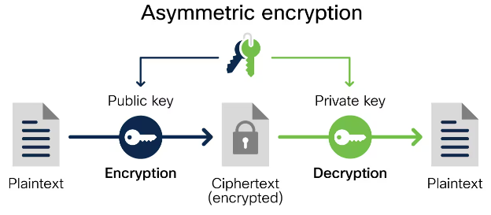
Cryptography today
Symmetric key cryptography: the same key is used for encryption and decryption of data.
Asymmetric key cryptography (public key cryptography): a pair of distinct keys is used for encryption and decryption.
Examples?
https://www.cisco.com/c/en/us/products/security/encryption-explained.html#~encryption-algorithms

Slide 35
Cryptography today
Symmetric key cryptography: the same key is used for encryption and decryption of data.
Asymmetric key cryptography (public key cryptography): a pair of distinct keys is used for encryption and decryption.
Examples: ECC, RSA
Application: remote authentication (SSH communication)
https://www.cisco.com/c/en/us/products/security/encryption-explained.html#~encryption-algorithms

Slide 36
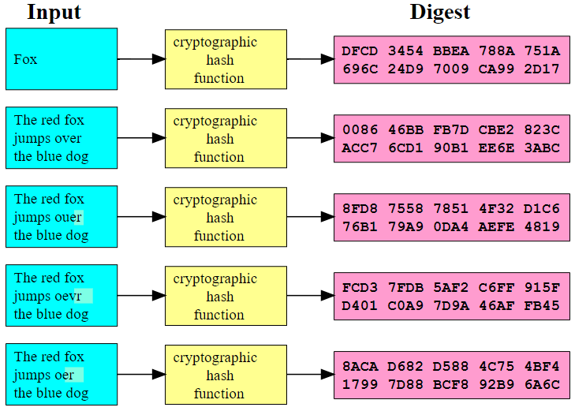
Cryptography today
Symmetric key cryptography, Asymmetric key cryptography,
Hash functions: take an input (e.g., a large block of text) and transform it into a fixed-size value (i.e., hash digest/checksum). The hash value serves as a ‘fingerprint’ of the input.
Examples: ?
https://upload.wikimedia.org/wikipedia/commons/2/2b/Cryptographic_Hash_Function.svg

Slide 37
Cryptography today
Symmetric key cryptography, Asymmetric key cryptography,
Hash functions: take an input (e.g., a large block of text) and transform it into a fixed-size value (i.e., hash digest/checksum). The hash value serves as a ‘fingerprint’ of the input.
Examples: MD5 (insecure), SHA-1 (insecure), SHA-2 (e.g., SHA-256)
https://upload.wikimedia.org/wikipedia/commons/2/2b/Cryptographic_Hash_Function.svg

Slide 38
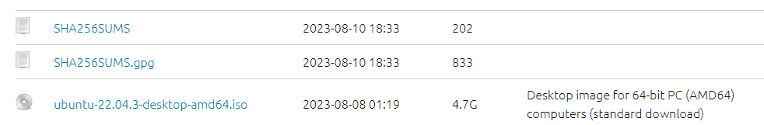
SHA256
A real-world example: verifying file integrity
SHA256SUMS: contains a checksum/hash digest for the iso image to verify the image’s integrity.
SHA256SUMS.gpg: contains a signature for the SHA256SUMS file to verify the image’s authenticity.

Slide 39
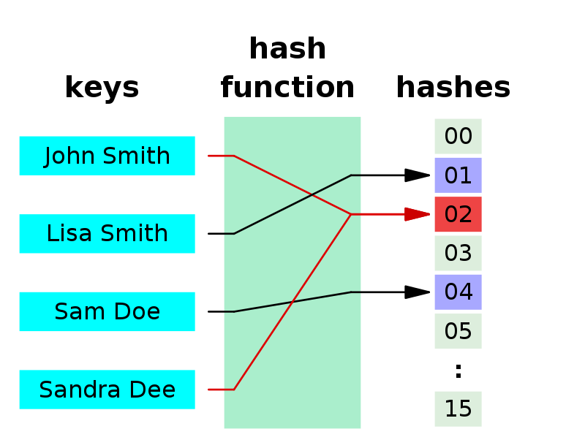
Properties of hash functions
The same message results in the same hash digest
Small changes to a message result in large changes to its hash digest
Hash collision
While two different messages are very unlikely to generate the same hash, such a possibility still exists, so-called hash collision (e.g., MD5 and SHA-1)
Why?
https://en.wikipedia.org/wiki/Hash_collision

Slide 40
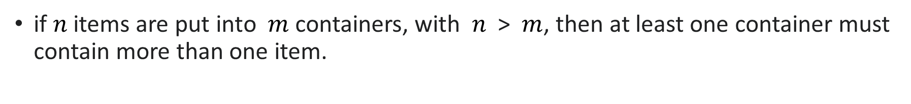
Pigeonhole principle
if $n$items are put into $m$ containers, with $n$ > $m$, then at least one container must contain more than one item.
https://en.wikipedia.org/wiki/Pigeonhole_principle

Slide 41
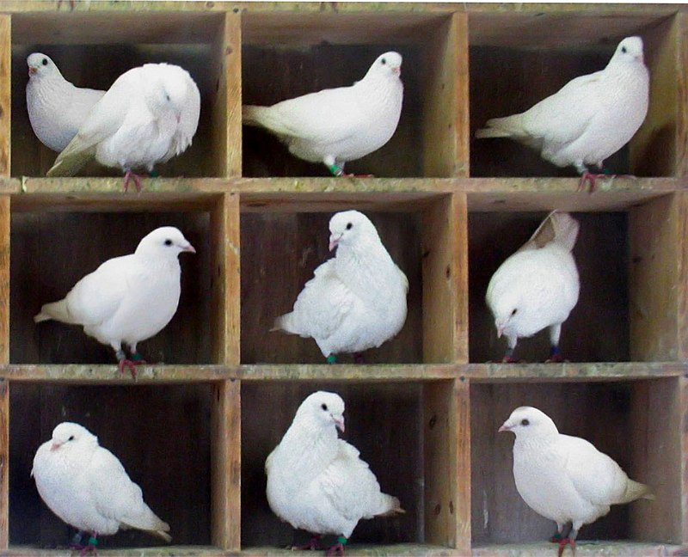
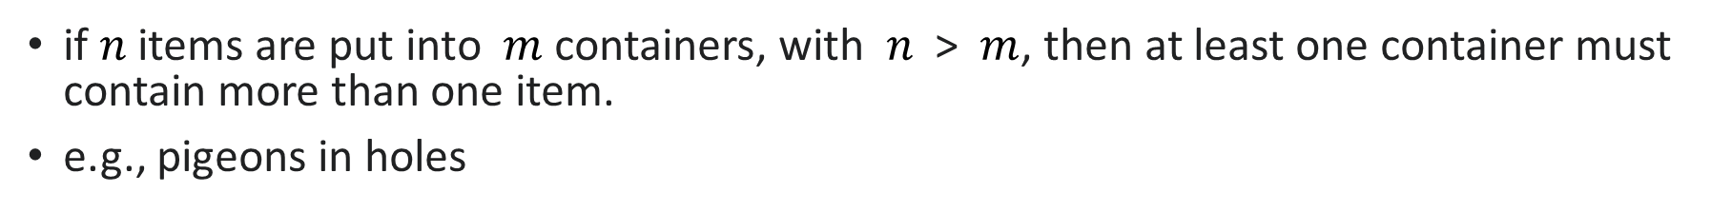
Pigeonhole principle
if $n$items are put into $m$ containers, with $n$ > $m$, then at least one container must contain more than one item.
e.g., pigeons in holes
https://en.wikipedia.org/wiki/Pigeonhole_principle

Slide 42
Cryptography today
Symmetric key cryptography
Asymmetric key cryptography
Hash functions
Which aspect of the CIA triad do the cryptography techniques above protect?

Slide 43
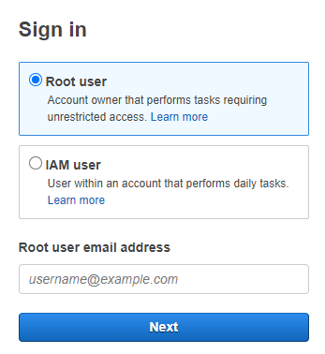
What is IAM (identity access management)?
It is a web service that helps us securely control access to AWS resources.
It is used to control who is authenticated (signed in) and authorized (has permissions) to use AWS resources.
Root user: complete access to all AWS services and resources in the account

Slide 44
IAM identity
IAM user: an identity within a root user account that has specific permissions for a single person or application:
Each user has an ARN:
e.g., arn:aws:iam::489389878001:user/12345678@student.uwa.edu.au
IAM user group: an identity that specifies a set of IAM users:
Users within the same group are given the same set of permissions.
Users can belong to different groups.
Each group has an ARN, e.g., arn:aws:iam::489389878001:group/admins
IAM role: an identity that has specific permissions, similar to IAM user but not relevant to a specific person/application.
Any users/applications can assume a role to complete a specific task.
User case: an IAM role grants permissions to applications running on EC2 instances
Each role has an ARN, e.g., arn:aws:iam:: 489389878001 :role/apps4ec2

Slide 45
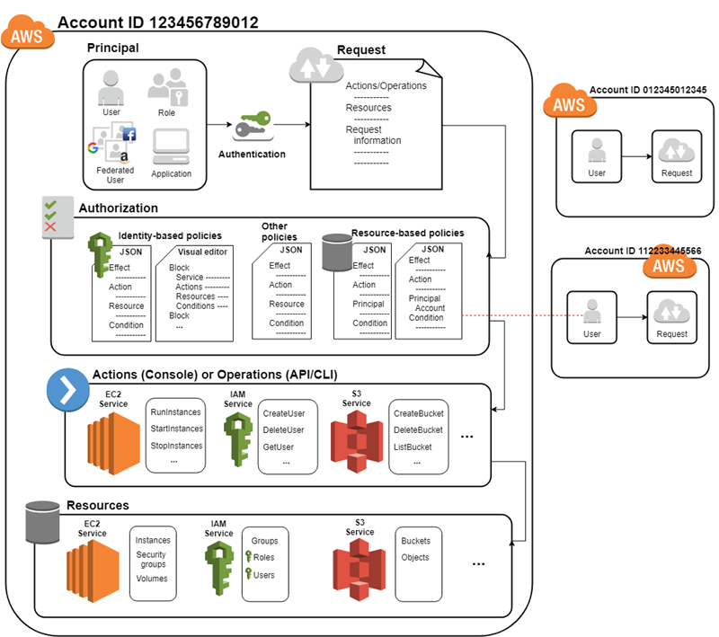
How IAM works
Step 1: Authenticate a principal.
Principal: a person or application that uses an IAM user, a root user, or an IAM role to sign in and make requests to AWS.

Slide 46
How IAM works
Step 1: Authenticate a principal.
Step 2: Authorize a principal.

Slide 47
How IAM works
Step 1: Authenticate a principal.
Step 2: Authorize a principal.
Step 3: Take actions/operations on AWS resources.

Slide 48
Main features of IAM
Shared access to AWS root user account
Grant other people permission to use resources in our root user account without having to share our password or access key.
Granular permissions
Grant varying permissions to different individuals for specific resources.
e.g., some users have complete access to specified EC2 instances while some have read-only access to specific S3 buckets.

Slide 49
Policies and permissions
Access permissions (authorization) are managed by creating policies and attaching them to IAM identities (users, groups of users, or roles) or AWS resources.
Note: IAM policies only define permissions for an action regardless of the method that we use to perform the action
e.g., if a policy allows the GetUser action, then a user with that policy can get user information with all three methods.

Slide 50
Policies and permissions
Access permissions (authorization) are managed by creating policies and attaching them to IAM identities (users, groups of users, or roles) or AWS resources.
Note: IAM policies only define permissions for an action regardless of the method that we use to perform the action
e.g., if a policy allows the GetUser action, then a user with that policy can get user information with all three methods.
Policy types (most frequently used):
Identity-based policy
Resource-based policy
permissions boundary

Slide 51
Identity-based policy
It controls what actions an identity can perform.
Managed policy: standalone identity-based policy that we can attach to multiple users, groups, and roles.
AWS managed policy: created and managed by AWS
Customer managed policy: created and managed by AWS users.
Inline policy

Slide 52
Identity-based policy
It controls what actions an identity can perform.
Managed policy: standalone identity-based policy that we can attach to multiple users, groups, and roles.
AWS managed policy: created and managed by AWS
Customer managed policy: created and managed by AWS users.
Inline policy: it maintains a strict one-to-one relationship between a policy and an identity. If the identity is deleted, the policy is deleted as well.

Slide 53
AWS managed policy
full-access managed policy: defines permissions for administrators by granting full access to services.
power-user managed policy: provides full access to services and resources, but disallows managing users and groups, i.e., a subset of full-access managed policy.
partial-user managed policy: provides varying access to specific services, i.e., a subset of power-user managed policy.

Slide 54
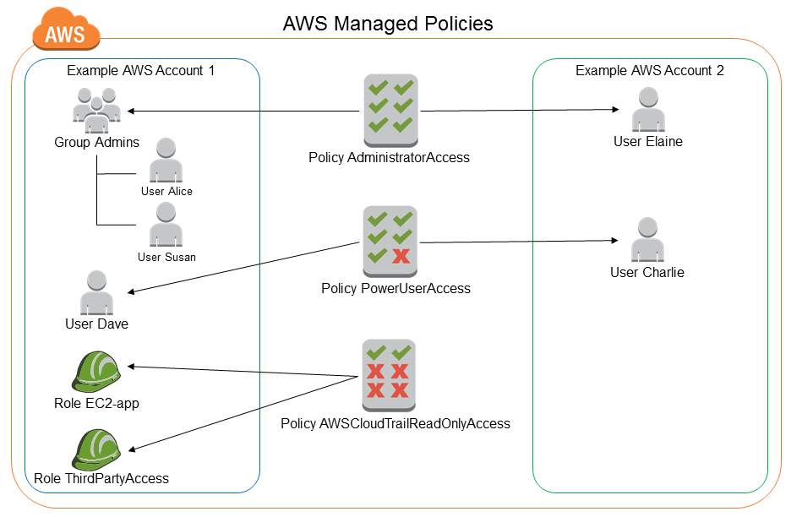
AWS managed policy
https://docs.aws.amazon.com/IAM/latest/UserGuide/access_policies_managed-vs-inline.html#aws-managed-policies

Slide 55
AdministratorAccess
Version: indicates the language version of the policy language.
Statement: represents a permission rule.
Effect: what the effect will be when a user requests the specific action—this can be either ’Allow’ or ’Deny’.
Action: defines a set of resource operations a user/application is allowed (or denied) to perform.
Resource: specifies AWS resources for which a user is allowed or denied to take actions. ARN is often used.
{
"Version": "2012-10-17",
"Statement": [
{
"Effect": "Allow",
"Action": "*",
"Resource": "*"
}
]
}

Slide 56
PowerUserAccess
{
"Version": "2012-10-17",
"Statement": [
{ "Effect": "Allow",
"NotAction": [
"iam:*",
"organizations:*",
"account:*"
],
"Resource": "*"
},
{ "Effect": "Allow",
"Action": [
"iam:ListRoles",
"organizations:DescribeOrganization",
"account:GetAccountInformation"
],
"Resource": "*"
}
]
}
Organizations: are a service that allows us to consolidate multiple AWS accounts into an organizational structure.

Slide 57
PowerUserAccess
{
"Version": "2012-10-17",
"Statement": [
{ "Effect": "Allow",
"NotAction": [
"iam:*",
"organizations:*",
"account:*"
],
"Resource": "*"
},
{ "Effect": "Allow",
"Action": [
"iam:ListRoles",
"organizations:DescribeOrganization",
"account:GetAccountInformation"
],
"Resource": "*"
}
]
}
Organizations: are a service that allows us to consolidate multiple AWS accounts into an organizational structure.
This policy allows all actions on all resources except those related to IAM, Organizations, and Account management. However, it explicitly allows three actions of ListRoles, DescribeOrganization and GetAccountInformation, providing limited access to any resource.

Slide 58
AWSCloudTrail_ReadOnlyAccess
{
"Version": "2012-10-17",
"Statement": [
{
"Effect": "Allow",
"Action": [
"cloudtrail:Get*",
"cloudtrail:Describe*",
"cloudtrail:List*",
],
"Resource": "*"
}
]
}
CloudTrail is a service that provides visibility into user activity and resource usage.
https://docs.aws.amazon.com/awscloudtrail/latest/APIReference/API_Operations.html

Slide 59
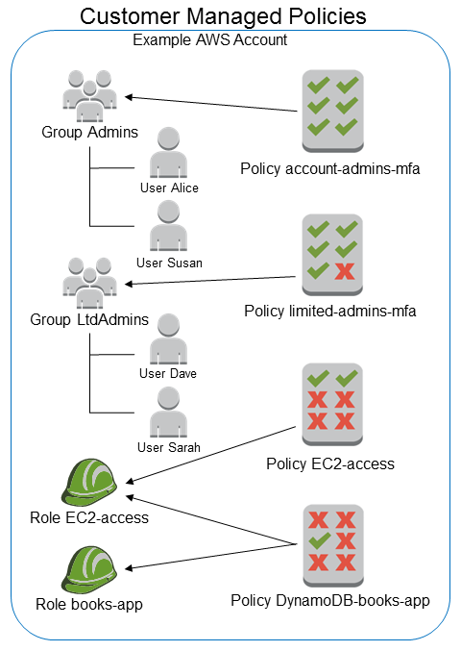
Customer managed policy
https://docs.aws.amazon.com/IAM/latest/UserGuide/access_policies_managed-vs-inline.html#aws-managed-policies

Slide 60
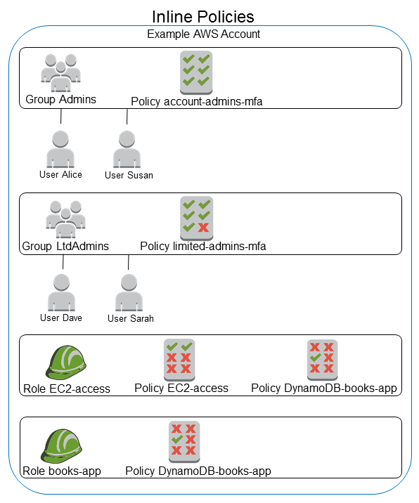
Inline policy
The DynamoDB-books-app policy is used by both roles. Is it shared?
https://docs.aws.amazon.com/IAM/latest/UserGuide/access_policies_managed-vs-inline.html#aws-managed-policies

Slide 61
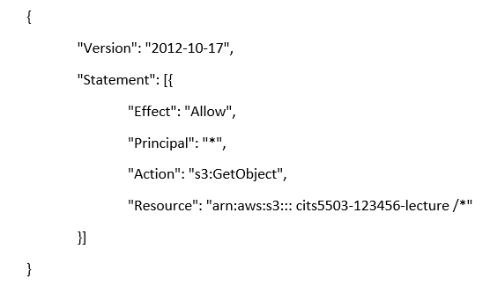
Resource-based policy
It specifies which principal has access to the resource and what actions they can perform on it, e.g., bucket policy.
Note: it is an inline policy.

Slide 62
Permissions boundary
It sets the maximum permissions that an identity-based policy can grant.
e.g., The permissions boundary is attached to an IAM user named Alice.
{
"Version": "2012-10-17",
"Statement": [
{
"Effect": "Allow",
"Action": [
"s3:*",
"ec2:*"
],
"Resource": "*"
}
]
}

Slide 63
Permissions boundary
identity-based policy
Permissions boundary
{
"Version": "2012-10-17",
"Statement": {
"Effect": "Allow",
"Action": "iam:CreateUser",
"Resource": "*"
}
}
{
"Version": "2012-10-17",
"Statement": [
{
"Effect": "Allow",
"Action": [
"s3:*",
"ec2:*"
],
"Resource": "*"
}
]
}
Both policies are attached to Alice.
Can Alice create a user?
Can Alice create S3 buckets and EC2 instances?

Slide 64
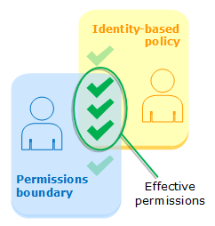
Permissions boundary
Both answers are NO.
Effective permissions are in the intersection of Identity-based policies and permissions boundaries.

Slide 65
Practice Questions
[6 marks] Q1: Name 3 of the keys in a Policy. Explain their role. An example of a key is “Version” that specifies the version of the policy syntax and is normally “Version”: “2012-10-17”

Slide 66
Practice Questions
[6 marks] Q1: Name 3 of the keys in a Policy. Explain their role. An example of a key is “Version” that specifies the version of the policy syntax and is normally “Version”: “2012-10-17”
[2 marks] Statement: represents a permission rule.
[2 marks] Effect: what the effect will be when a user requests the specific action—this can be either Allow or Deny.
[2 marks] Action: defines a set of resource operations a user/application is allowed (or denied) to perform.
[2 marks] Resource: specifies AWS resources for which a user is allowed or denied to take actions.

