Slide 1
Predicting Student Performance
Waleed Rimawi (24290818)
Notes:
Welcome. Today, we’ll be presenting our research on student performance prediction using classification and regression.

Slide 2
What factors most influence student performance?
Investigation of academic, demographic, and behavioral factors
Notes:
We want to find the key drivers impacting final outcomes (grades/overall performance).

Slide 3
The Problem
Educators rely heavily on early performance metrics
Biased or incomplete data might miss at-risk students
Notes:
Early intervention is crucial; missing at-risk students can lead to dropouts or failing grades. Data-driven methods help identify them earlier, enabling better resource allocation.

Slide 4
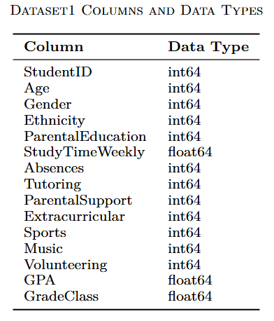
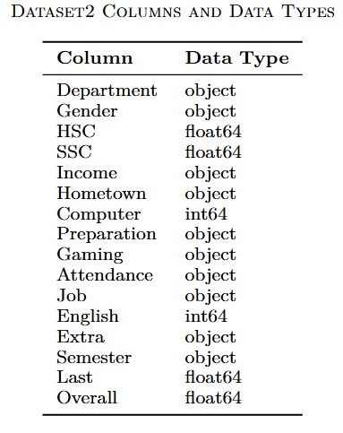
The Datasets
Dataset1 (Classification):
2,392 student records
15 columns (demographic, academic, extracurricular)
Dataset2 (Regression):
493 student records
16 columns (HSC, SSC, prior GPA, attendance, etc.)
Notes:
Dataset1 focuses on discrete grades (A–E), while Dataset2 has a continuous ‘Overall’ score. Each includes academic, demographic, and behavioral features.

Slide 5
Our Approach
Data Preprocessing & Cleaning
Remove irrelevant columns (e.g., IDs), handle null values, encode categorical features, scale numeric columns
Classification (Dataset1)
Goal: Predict discrete grade classes (A–E)
Models: SVM, Random Forest, Gradient Boosting, etc.
Main Metric: Accuracy, Confusion Matrix
Regression (Dataset2)
Goal: Predict continuous “Overall” performance score
Models: Random Forest Regressor, Linear Regression, etc.
Main Metrics: R2 score, Mean Squared Error (MSE)
Notes:
We dropped irrelevant columns like IDs, dealt with missing values by removing or imputing them, and encoded categorical variables—label encoding so that our ML algorithms can handle them numerically. Then we scaled numeric features to prevent any one feature from dominating the model.

Slide 6
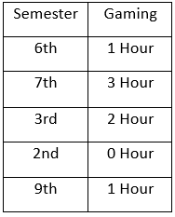
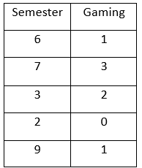
Data cleaning
Removing letters and symbols from numerical data
Notes:
lets talk about data cleaning, we started by removing the letters and symbols from numerical data. It is best to remove these symbols because they might introduce noise to the dataset

Slide 7
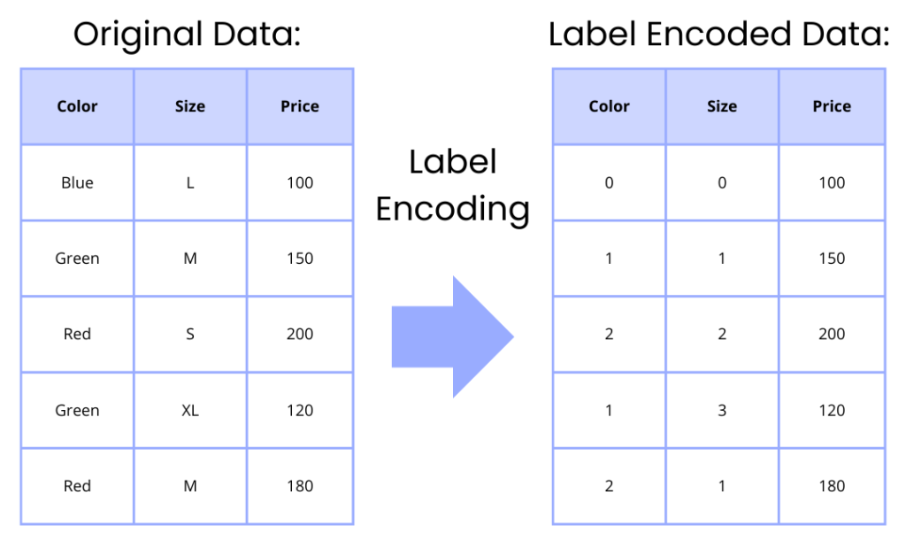
Data cleaning
Removing irrelevant or missing data
Encoding categorical features (LabelEncoder)
Scaling numeric data (StandardScaler)
Notes:
Encoding categorical features is crucial so that algorithms can interpret them numerically.
Scaling prevents large-value features from dominating the model.

Slide 8
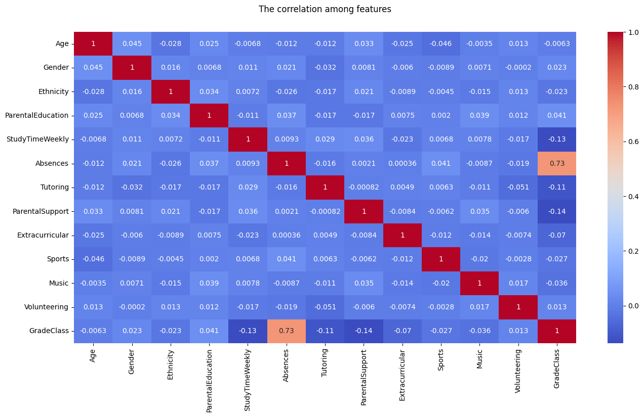
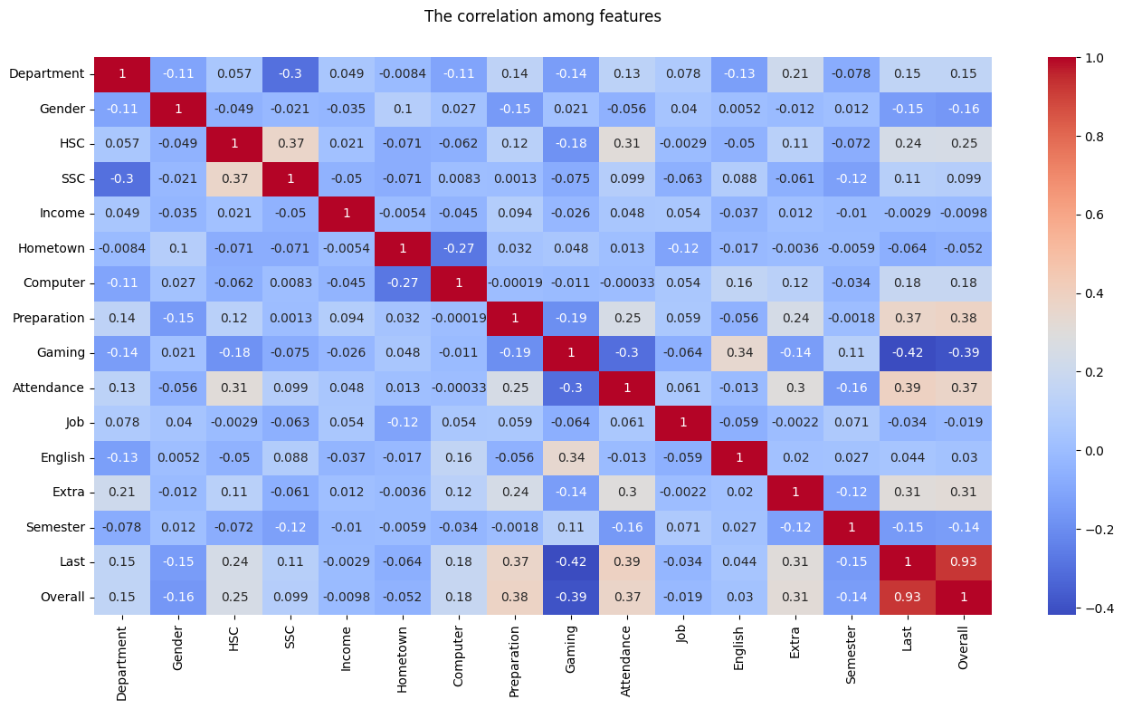
Feature Correlation
Notes:
For Dataset1, we found ‘Absences’ is highly correlated with grade class (around 0.73). This suggests that frequent absenteeism is a strong indicator of lower performance. For Dataset2, ‘Last semester GPA’ correlated at 0.93 with ‘Overall’, indicating academic consistency is crucial.

Slide 9
Classification Models (Dataset1)
Models used:
- Decision Tree, Random Forest, Gradient Boosting, KNN, SVM, Logistic Regression, XGBoost, CatBoost, AdaBoost
Accuracy was primary metric; confusion matrix to address class imbalance
Notes:
All nine classification algorithms were tested. We highlight final accuracies and look at a confusion matrix focusing on grade distribution.

Slide 10
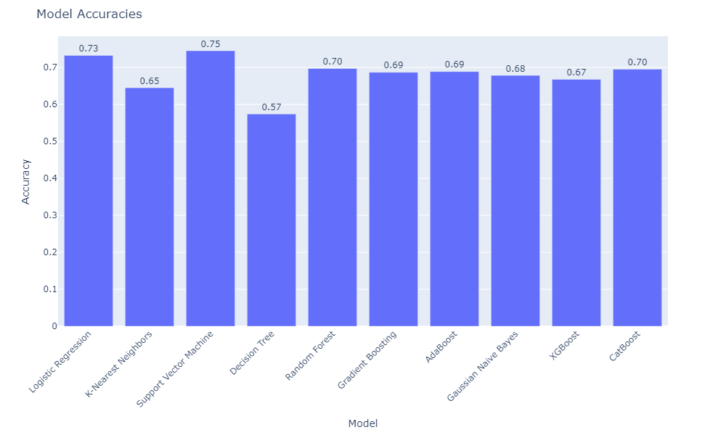
Classification Results
SVM: 0.75, Random Forest: 0.70, LR: 0.73, etc.
Notes:
SVM gave the best accuracy at 0.75. Logistic Regression came close at 0.73.

Slide 11
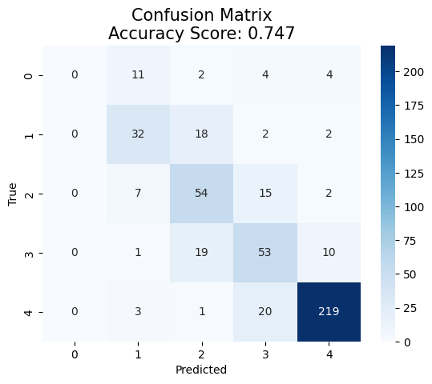
Confusion Matrix (Dataset1)
Majority class 'E' ~50%
Minor classes => lower recall
Notes:
We see from the confusion matrix that class ‘E’ (50% of dataset) was predicted best due to the imbalance

Slide 12
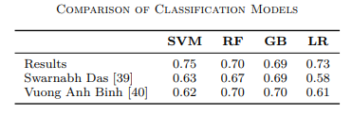
Comparison with Other Results
Our SVM: 0.75 vs. older references ~0.63–0.70
Table: Comparison of classification accuracies
Notes:
We also compared with older works, e.g., references achieving 0.63–0.70, so our approach shows improvement.

Slide 13
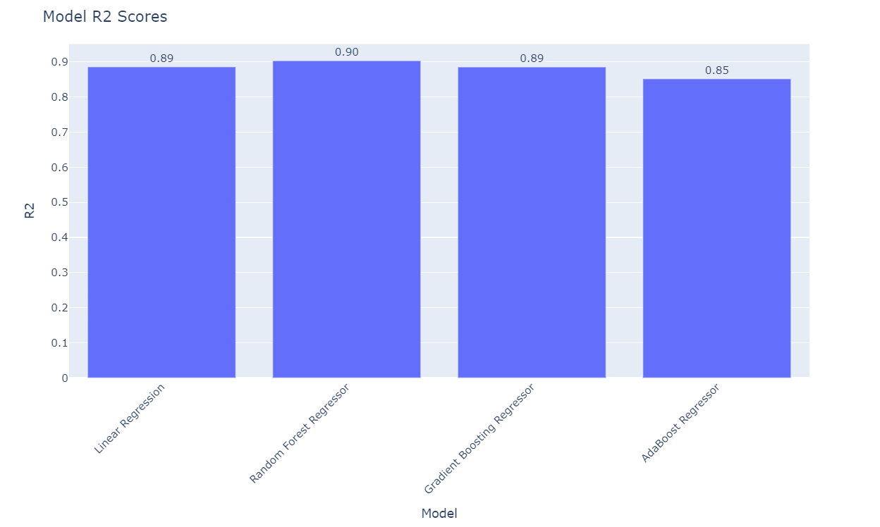
Regression Models (Dataset2)
Random Forest Regressor = 0.90 R², MSE = 0.11
Notes:
Random Forest Regressor led at 0.90 R², slightly outperforming Linear Regression and Gradient Boosting. This suggests ensemble methods capture non-linearities well in the data.

Slide 14
Pros & Cons
Advantages: Good accuracy, robust ensemble methods, interpretability of correlation.
Disadvantages: Class imbalance in Dataset1, smaller sample size in Dataset2
Notes:
While we got strong results, we must address the class imbalance in Dataset1. Also, Dataset2 has only 493 entries, so further data collection could improve generalization.

Slide 15
Future Work
Resampling methods (SMOTE, class weighting) to address imbalance.
Larger or more diverse datasets.
Incorporating text features or other advanced data sources.
Notes:
In the future, we’d like to integrate real-time data streams from e-learning platforms, adopt data augmentation for underrepresented classes, and explore advanced neural approaches or transfer learning.

Slide 16
Summary
Data cleaning & encoding are essential.
SVM is best for discrete grade classification.
Random Forest Regressor is best for continuous performance.
Notes:
In a nutshell, after cleaning and feature engineering, we tested multiple algorithms. We found SVM and Random Forest to be top performers. Key features like absences and prior GPA stand out as strong indicators of performance.

Slide 17
Conclusion
Our approach effectively predicts student performance under two paradigms. With more data and careful balancing, we could further refine these models
Notes:
End of presentation. Thank you for your time!

