Slide 1
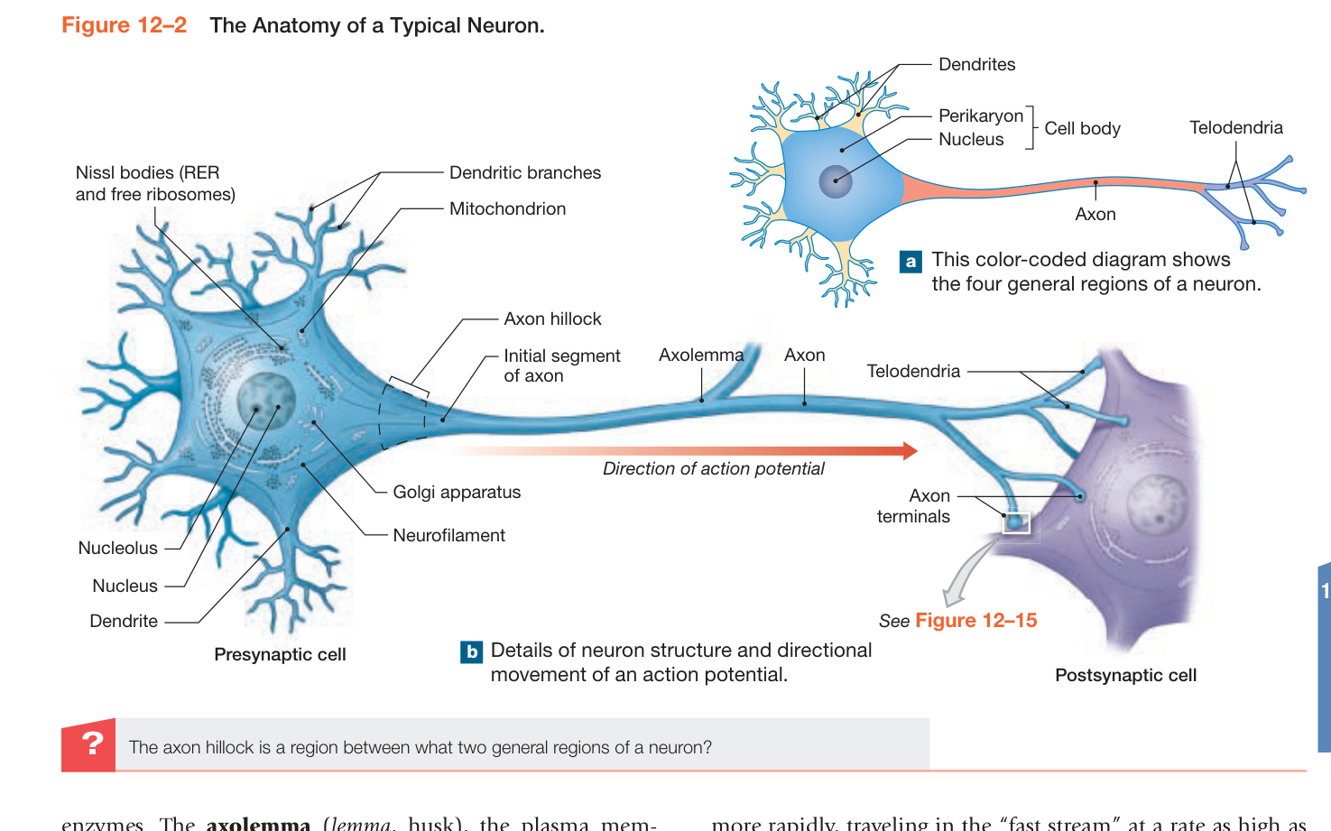
STUDY TOGETHER • TEACH IT BACK
BIO 233
Chapters 12 + 13
Nervous tissue. Spinal pathways.
Reflexes that protect and coordinate.
Detailed visual review • Memory cues
Partner checks • Source cautions
Separate one-sided, text-only exam sheet
Prepared for Waleed and a classmate
117 slides
Notes:
SOURCE BASIS
Your six lecture handouts, four transcript files, and textbook pp. 389–464.
TEACH-BACK
Nervous tissue • Spinal cord • Spinal nerves • Reflexes
A detailed, source-based review for Waleed and a classmate
Memory cues and practice questions are review aids created for this deck, not quotations or actual exam questions. Consult the provided source where a caution is marked.

Slide 2
START HERE
CORE
Use this deck as a conversation, not a script
EXPLAIN
RECALL
One person teaches the slide in their
own words; the other asks “why?” and
“what happens if it fails?”
Cover the labels. Name the structure,
its location, its function, and the
direction of information flow.
CHECK
PRIORITIZE
Work the original practice questions
before viewing their answers. Use the
glossary and source notes for weak spots.
LECTURE PRIORITY identifies explicit or
repeated emphasis. BOOK DETAIL adds
assigned reading; it is not a prediction of
the exam.
REMEMBER
Recognize it → name it → explain it → predict a change.
Study method created for this review; content priorities from T-A–T-D.
002
Notes:
SOURCE BASIS
Study method created for this review; content priorities from T-A–T-D.
TEACH-BACK
Recognize it → name it → explain it → predict a change.
EXPLAIN: One person teaches the slide in their own words; the other asks “why?” and “what happens if it fails?”
RECALL: Cover the labels. Name the structure, its location, its function, and the direction of information flow.
CHECK: Work the original practice questions before viewing their answers. Use the glossary and source notes for weak spots.
PRIORITIZE: LECTURE PRIORITY identifies explicit or repeated emphasis. BOOK DETAIL adds assigned reading; it is not a prediction of the exam.
Memory cues and practice questions are review aids created for this deck, not quotations or actual exam questions. Consult the provided source where a caution is marked.

Slide 3
START HERE
CORE
What this review can—and cannot—promise
COVERAGE
RECORDING LIMIT
All 16 chapter learning-outcome sections,
all six supplied handouts, and the four
available transcript files are represented.
The recordings are incomplete. The later
Chapter 13 reflex material is included from
the handout and textbook even where no
recording is available.
SOURCE CAUTION
EXAM RULE
Speech recognition and some lecture/book
statements disagree. Marked cautions
preserve the distinction instead of silently
treating everything as fact.
The recorded instruction allows one side of
a standard sheet, typed or handwritten
text. Any image must be drawn by
hand—not printed or photocopied.
REMEMBER
Comprehensive source coverage is not a guarantee of the exact questions your professor will choose.
C12/C13 learning outcomes; T-C exam instructions.
003
Notes:
SOURCE BASIS
C12/C13 learning outcomes; T-C exam instructions.
TEACH-BACK
Comprehensive source coverage is not a guarantee of the exact questions your professor will choose.
COVERAGE: All 16 chapter learning-outcome sections, all six supplied handouts, and the four available transcript files are represented.
RECORDING LIMIT: The recordings are incomplete. The later Chapter 13 reflex material is included from the handout and textbook even where no recording is available.
SOURCE CAUTION: Speech recognition and some lecture/book statements disagree. Marked cautions preserve the distinction instead of silently treating everything as fact.
EXAM RULE: The recorded instruction allows one side of a standard sheet, typed or handwritten text. Any image must be drawn by hand—not printed or photocopied.
Memory cues and practice questions are review aids created for this deck, not quotations or actual exam questions. Consult the provided source where a caution is marked.

Slide 4
01 • FOUNDATIONS
1
Organize the nervous system
Start with the map, then identify the cells and the structures that support them.
Use the memory cues, then explain the mechanism without reading.
004
Notes:
SOURCE BASIS
TEACH-BACK
Start with the map, then identify the cells and the structures that support them.
Memory cues and practice questions are review aids created for this deck, not quotations or actual exam questions. Consult the provided source where a caution is marked.

Slide 5
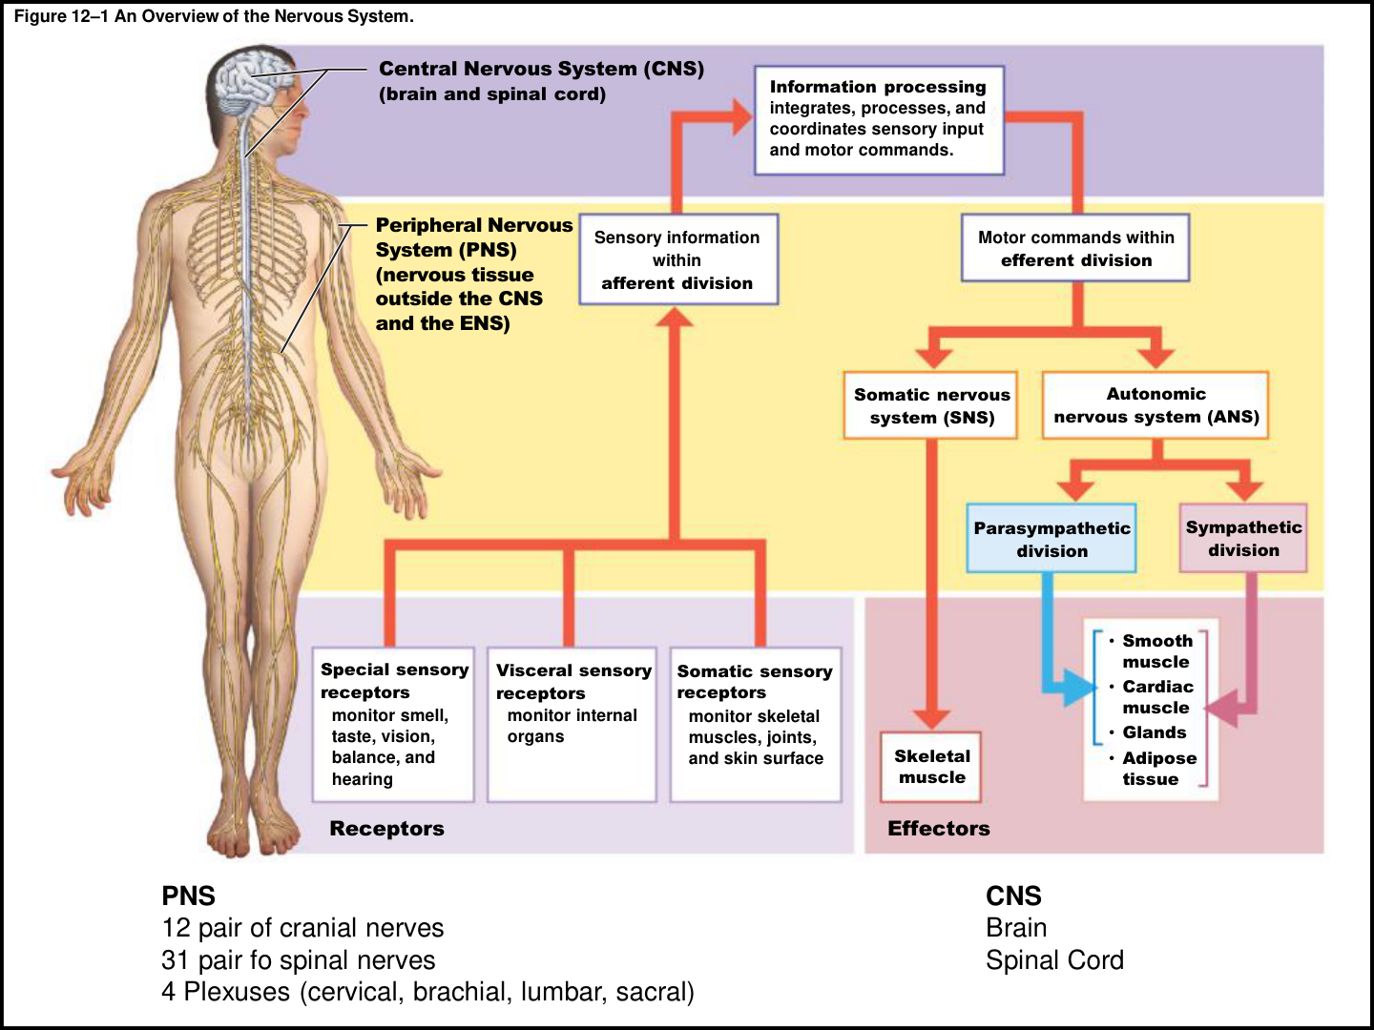
01 • FOUNDATIONS
CORE
The anatomical map: CNS, PNS, and ENS
CNS
Brain and spinal cord: integrate sensory input,
process information, and coordinate motor
commands.
PNS
Nervous tissue outside the CNS and ENS in this
textbook’s framing. Cranial and spinal nerves
connect the CNS with peripheral tissues.
ENS
Neuronal networks in the digestive-tract walls.
Can coordinate local visceral reflexes; sympathetic
and parasympathetic activity influence them.
BIG DISTINCTION
Anatomical divisions describe structures.
Functional divisions describe what information
travels through those structures.
REMEMBER
Central = control center. Peripheral = connecting paths. Enteric = intestine.
Book pp. 390–392; C12 L1 slide 2; T-D.
005
Notes:
SOURCE BASIS
Book pp. 390–392; C12 L1 slide 2; T-D.
The lecture often simplifies to central versus peripheral. The assigned book explicitly includes the ENS as a third anatomical division. Retain that textbook distinction when a question asks for all three.
TEACH-BACK
Central = control center. Peripheral = connecting paths. Enteric = intestine.
CNS: Brain and spinal cord: integrate sensory input, process information, and coordinate motor commands.
PNS: Nervous tissue outside the CNS and ENS in this textbook’s framing. Cranial and spinal nerves connect the CNS with peripheral tissues.
ENS: Neuronal networks in the digestive-tract walls. Can coordinate local visceral reflexes; sympathetic and parasympathetic activity influence them.
BIG DISTINCTION: Anatomical divisions describe structures. Functional divisions describe what information travels through those structures.
Memory cues and practice questions are review aids created for this deck, not quotations or actual exam questions. Consult the provided source where a caution is marked.

Slide 6
01 • FOUNDATIONS
LECTURE PRIORITY
Afferent arrives; efferent exits
AFFERENT / SENSORY
Receptors send information toward the CNS:
special senses, somatic sensation, and visceral
sensation.
EFFERENT / MOTOR
Commands leave the CNS for effectors. “Motor”
includes muscles and glands—not just visible
movement.
SOMATIC MOTOR
Targets skeletal muscle. Includes voluntary
movement and involuntary somatic reflexes.
AUTONOMIC MOTOR
Targets smooth muscle, cardiac muscle, glands,
and adipose tissue. Sympathetic and
parasympathetic are its major divisions.
REMEMBER
SAME: Sensory–Afferent; Motor–Efferent. “A arrives, E exits.”
Book pp. 390–391, 395; C12 L1 slide 2; T-B/T-C.
006
Notes:
SOURCE BASIS
Book pp. 390–391, 395; C12 L1 slide 2; T-B/T-C.
Do not equate somatic with always voluntary. A patellar reflex still uses skeletal muscle and therefore is somatic. Both sympathetic and parasympathetic divisions belong on the motor side of this introductory map.
TEACH-BACK
SAME: Sensory–Afferent; Motor–Efferent. “A arrives, E exits.”
AFFERENT / SENSORY: Receptors send information toward the CNS: special senses, somatic sensation, and visceral sensation.
EFFERENT / MOTOR: Commands leave the CNS for effectors. “Motor” includes muscles and glands—not just visible movement.
SOMATIC MOTOR: Targets skeletal muscle. Includes voluntary movement and involuntary somatic reflexes.
AUTONOMIC MOTOR: Targets smooth muscle, cardiac muscle, glands, and adipose tissue. Sympathetic and parasympathetic are its major divisions.
Memory cues and practice questions are review aids created for this deck, not quotations or actual exam questions. Consult the provided source where a caution is marked.

Slide 7
01 • FOUNDATIONS
CORE
Three receptor groups: where is the information from?
Term
What it monitors
Think of…
Exteroceptor
External environment; touch, temperature,
pressure and special senses
A hand touching a cold desk
Interoceptor
Internal organs; stretch, deep pressure,
internal conditions
Distension of a visceral organ
Proprioceptor
Position and movement of skeletal muscles
and joints
Touching your nose with your
eyes closed
REMEMBER
EXTERO = exterior; INTERO = interior; PROPRIO = your own position.
Book p. 395; C12 L1 slide 2; T-D.
007
Notes:
SOURCE BASIS
Book p. 395; C12 L1 slide 2; T-D.
Special sensory receptors monitor smell, taste, vision, hearing and equilibrium. The lecture’s proprioception examples are useful because they test the concept, not merely the spelling.
TEACH-BACK
EXTERO = exterior; INTERO = interior; PROPRIO = your own position.
Exteroceptor | External environment; touch, temperature, pressure and special senses | A hand touching a cold desk
Interoceptor | Internal organs; stretch, deep pressure, internal conditions | Distension of a visceral organ
Proprioceptor | Position and movement of skeletal muscles and joints | Touching your nose with your eyes closed
Memory cues and practice questions are review aids created for this deck, not quotations or actual exam questions. Consult the provided source where a caution is marked.

Slide 8
01 • FOUNDATIONS
LECTURE PRIORITY
Do not confuse these building blocks
Term
Meaning
Location or scale
Neuron
A single signaling cell
One cell with processes
Nerve
Axon bundles with connective tissue and
vessels
PNS
Tract
Axon bundle carrying related information
CNS
Ganglion / ganglia
Collection of neuron cell bodies
PNS
Nucleus / nuclei
Functionally organized collection of neuron
cell bodies
CNS
REMEMBER
A nerve is not a neuron. A ganglion is not a CNS nucleus.
Book pp. 390, 394–395, 440, 442; T-A/T-C.
008
Notes:
SOURCE BASIS
Book pp. 390, 394–395, 440, 442; T-A/T-C.
A nucleus in this context is a collection of neurons, not the DNA-containing organelle inside a single neuron. Singular/plural: ganglion/ganglia; nucleus/nuclei; ramus/rami; sulcus/sulci; gyrus/gyri.
TEACH-BACK
A nerve is not a neuron. A ganglion is not a CNS nucleus.
Neuron | A single signaling cell | One cell with processes
Nerve | Axon bundles with connective tissue and vessels | PNS
Tract | Axon bundle carrying related information | CNS
Ganglion / ganglia | Collection of neuron cell bodies | PNS
Nucleus / nuclei | Functionally organized collection of neuron cell bodies | CNS
Memory cues and practice questions are review aids created for this deck, not quotations or actual exam questions. Consult the provided source where a caution is marked.

Slide 9
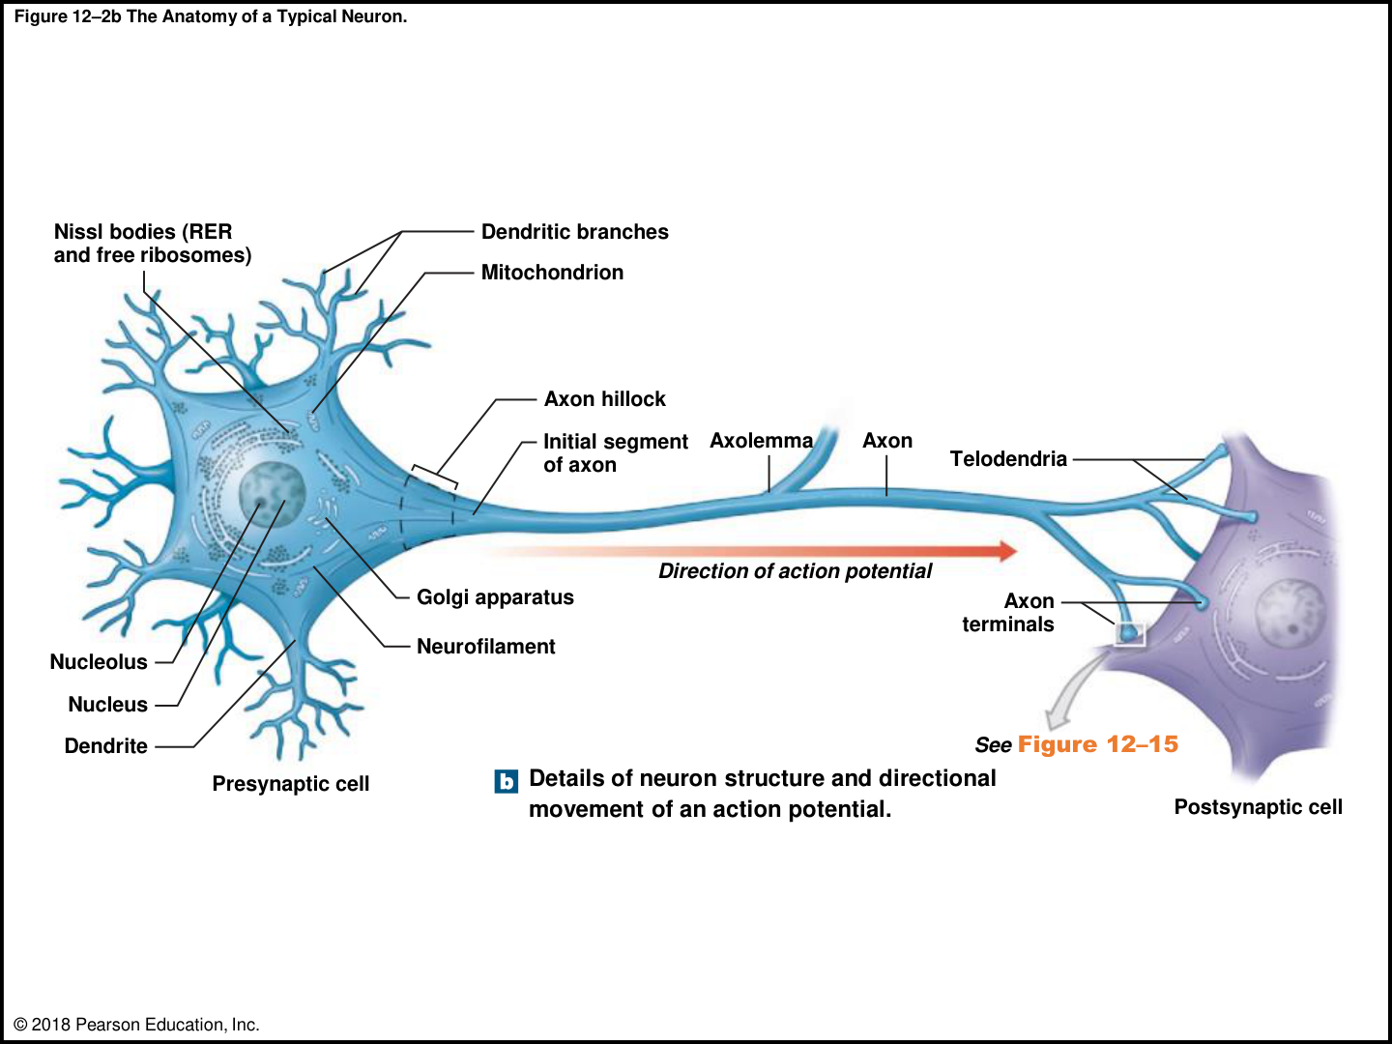
01 • FOUNDATIONS
LECTURE PRIORITY
Neuron anatomy: trace the signal
INPUT REGION
Dendrites receive information. The cell body is
the soma; the perikaryon is its cytoplasm around
the nucleus.
TRIGGER REGION
Axon hillock is the transition from soma to axon.
The initial segment is the key action-potential
initiation region in the chapter’s model.
CONDUCTING REGION
Axon carries the action potential. Axolemma =
axon membrane; axoplasm = axon cytoplasm.
OUTPUT REGION
Collaterals branch along an axon. Telodendria are
fine terminal branches ending in synaptic
terminals.
REMEMBER
Dendrites receive; axon carries; terminals communicate.
Book pp. 392–393, 409; C12 L1 slides 3–4; T-C.
009
Notes:
SOURCE BASIS
Book pp. 392–393, 409; C12 L1 slides 3–4; T-C.
Nissl bodies are clusters of rough endoplasmic reticulum and free ribosomes, involved in protein synthesis. Mitochondria supply ATP. Neurofilaments and neurotubules support the cell. Mature CNS neurons are generally long-lived and have high metabolic demand; the book notes limited neural stem-cell exceptions to the usual inability to divide.
TEACH-BACK
Dendrites receive; axon carries; terminals communicate.
INPUT REGION: Dendrites receive information. The cell body is the soma; the perikaryon is its cytoplasm around the nucleus.
TRIGGER REGION: Axon hillock is the transition from soma to axon. The initial segment is the key action-potential initiation region in the chapter’s model.
CONDUCTING REGION: Axon carries the action potential. Axolemma = axon membrane; axoplasm = axon cytoplasm.
OUTPUT REGION: Collaterals branch along an axon. Telodendria are fine terminal branches ending in synaptic terminals.
Memory cues and practice questions are review aids created for this deck, not quotations or actual exam questions. Consult the provided source where a caution is marked.

Slide 10
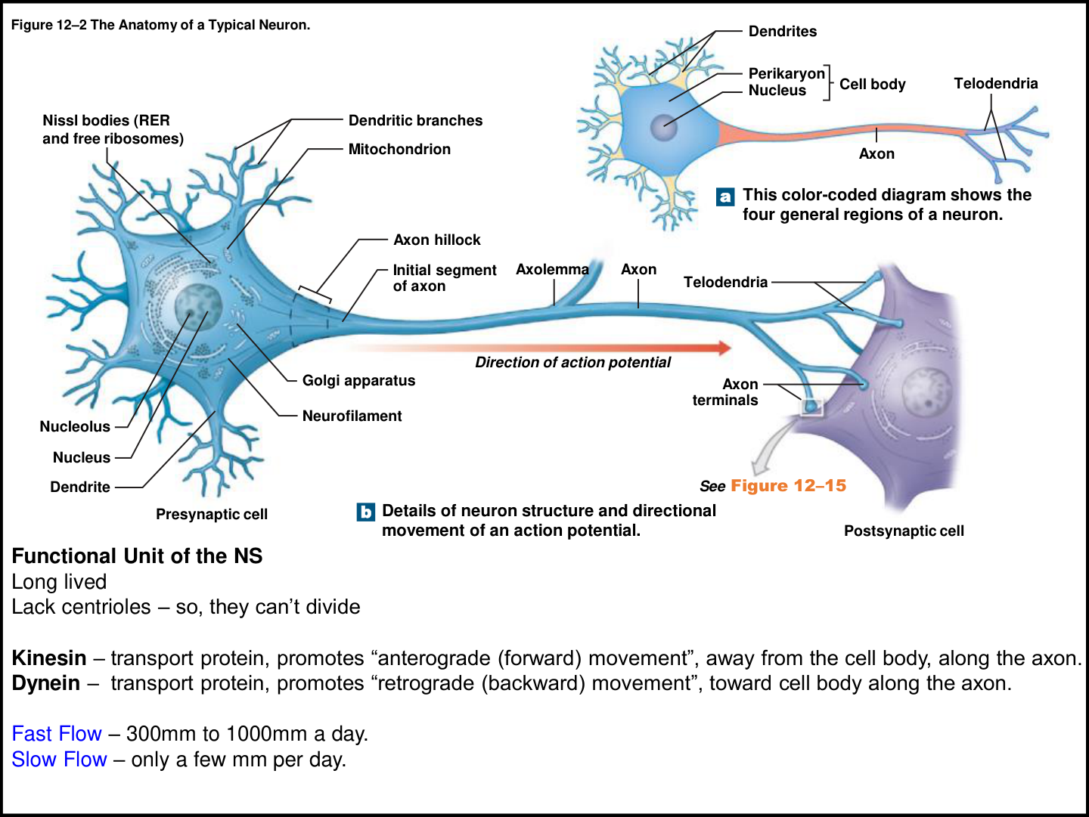
01 • FOUNDATIONS
CORE
Axonal transport: supply line and return route
ANTEROGRADE
Kinesin carries material away from the cell body
toward terminals along neurotubules.
RETROGRADE
Dynein carries material from terminals back
toward the cell body.
ENERGY + SPEED
Transport uses ATP. The book gives fast
transport up to 1,000 mm/day, averaging about
300; slow transport is a few mm/day.
WHY IT MATTERS
Terminals need proteins, enzymes and vesicle
materials. Retrograde transport also returns
debris and can carry harmful material toward the
CNS.
REMEMBER
Kinesin keeps going out; dynein delivers back.
Book p. 393; C12 L1 slide 3.
010
Notes:
SOURCE BASIS
Book p. 393; C12 L1 slide 3.
The rabies clinical note uses retrograde axonal transport to explain how material entering peripheral terminals can reach the CNS. Transport of cellular cargo is not the same thing as propagation of an action potential.
TEACH-BACK
Kinesin keeps going out; dynein delivers back.
ANTEROGRADE: Kinesin carries material away from the cell body toward terminals along neurotubules.
RETROGRADE: Dynein carries material from terminals back toward the cell body.
ENERGY + SPEED: Transport uses ATP. The book gives fast transport up to 1,000 mm/day, averaging about 300; slow transport is a few mm/day.
WHY IT MATTERS: Terminals need proteins, enzymes and vesicle materials. Retrograde transport also returns debris and can carry harmful material toward the CNS.
Memory cues and practice questions are review aids created for this deck, not quotations or actual exam questions. Consult the provided source where a caution is marked.

Slide 11
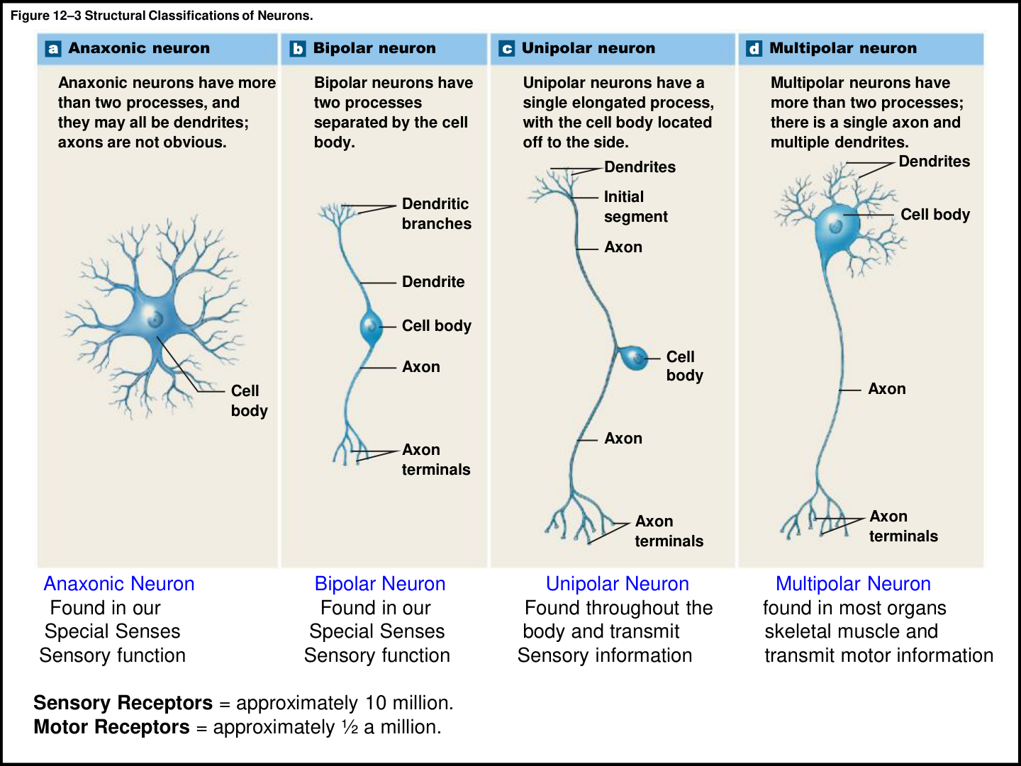
01 • FOUNDATIONS
LECTURE PRIORITY
Four neuron shapes
ANAXONIC
Many processes but no obvious axon; found in
the brain and special sense organs in the
textbook.
BIPOLAR
One dendrite and one axon, with the soma
between them; associated with special senses.
UNIPOLAR
A single process with the soma off to the side;
typical sensory neurons of the PNS.
MULTIPOLAR
Many dendrites and one axon. Includes skeletal
motor neurons and many CNS neurons; shape
alone does not prove a motor function.
REMEMBER
BI = two processes. MULTI = many dendrites. UNI = one main process.
Book pp. 394–395; C12 L1 slide 5; T-B/T-C.
011
Notes:
SOURCE BASIS
Book pp. 394–395; C12 L1 slide 5; T-B/T-C.
Source caution: the lecture groups three examples as sensory and multipolar as motor, while also acknowledging interneurons can look multipolar. Use the example classification for the lecture diagram, but do not memorize “every multipolar neuron is motor.”
TEACH-BACK
BI = two processes. MULTI = many dendrites. UNI = one main process.
ANAXONIC: Many processes but no obvious axon; found in the brain and special sense organs in the textbook.
BIPOLAR: One dendrite and one axon, with the soma between them; associated with special senses.
UNIPOLAR: A single process with the soma off to the side; typical sensory neurons of the PNS.
MULTIPOLAR: Many dendrites and one axon. Includes skeletal motor neurons and many CNS neurons; shape alone does not prove a motor function.
Memory cues and practice questions are review aids created for this deck, not quotations or actual exam questions. Consult the provided source where a caution is marked.

Slide 12
01 • FOUNDATIONS
CORE
Functional classes answer a different question
Class
Direction / role
Key detail
Sensory neuron
Peripheral receptor toward CNS
Cell bodies commonly in
sensory ganglia
Motor neuron
CNS toward a peripheral effector
Somatic targets skeletal muscle;
visceral targets other effectors
Interneuron
Integrates, distributes and coordinates
signals
The chapter emphasizes
interconnected CNS neurons
REMEMBER
Structure asks “what shape?” Function asks “what job?”
Book pp. 394–395, 452; C12 L1 slide 5; T-B/T-C.
012
Notes:
SOURCE BASIS
Book pp. 394–395, 452; C12 L1 slide 5; T-B/T-C.
The book gives approximate counts of 10 million sensory neurons, half a million motor neurons and 20 billion interneurons in its body/CNS discussion. Do not transfer that last number to the spinal cord alone; the transcript sometimes does.
TEACH-BACK
Structure asks “what shape?” Function asks “what job?”
Sensory neuron | Peripheral receptor toward CNS | Cell bodies commonly in sensory ganglia
Motor neuron | CNS toward a peripheral effector | Somatic targets skeletal muscle; visceral targets other effectors
Interneuron | Integrates, distributes and coordinates signals | The chapter emphasizes interconnected CNS neurons
Memory cues and practice questions are review aids created for this deck, not quotations or actual exam questions. Consult the provided source where a caution is marked.

Slide 13
01 • FOUNDATIONS
LECTURE PRIORITY
The four CNS glial cells
Cell
Main jobs
Memory cue
Astrocyte
Structural support; regulates local
ions/nutrients; supports BBB;
neurotransmitter recycling; repair/scar
response
Astro = star-shaped support
Ependymal cell
Lines ventricles and central canal; helps
produce, monitor and circulate CSF
Ependymal = lining
Oligodendrocyte
Myelinates CNS axon segments; supports
organization
Oligo = CNS insulation
Microglial cell
Phagocytosis of debris, wastes and
pathogens
Microglia = cleanup crew
REMEMBER
A–E–O–M: Astrocytes, Ependymal cells, Oligodendrocytes, Microglia.
Book pp. 395–399; C12 L1 slides 6–8; T-A/T-B/T-C.
013
Notes:
SOURCE BASIS
Book pp. 395–399; C12 L1 slides 6–8; T-A/T-B/T-C.
Lecture shorthand: “neurons conduct; glia do not.” For this course, the intended contrast is action-potential signaling versus support functions, not that glial cells do nothing. The book describes astrocytes maintaining capillary permeability characteristics of the BBB.
TEACH-BACK
A–E–O–M: Astrocytes, Ependymal cells, Oligodendrocytes, Microglia.
Astrocyte | Structural support; regulates local ions/nutrients; supports BBB; neurotransmitter recycling; repair/scar response | Astro = star-shaped support
Ependymal cell | Lines ventricles and central canal; helps produce, monitor and circulate CSF | Ependymal = lining
Oligodendrocyte | Myelinates CNS axon segments; supports organization | Oligo = CNS insulation
Microglial cell | Phagocytosis of debris, wastes and pathogens | Microglia = cleanup crew
Memory cues and practice questions are review aids created for this deck, not quotations or actual exam questions. Consult the provided source where a caution is marked.

Slide 14
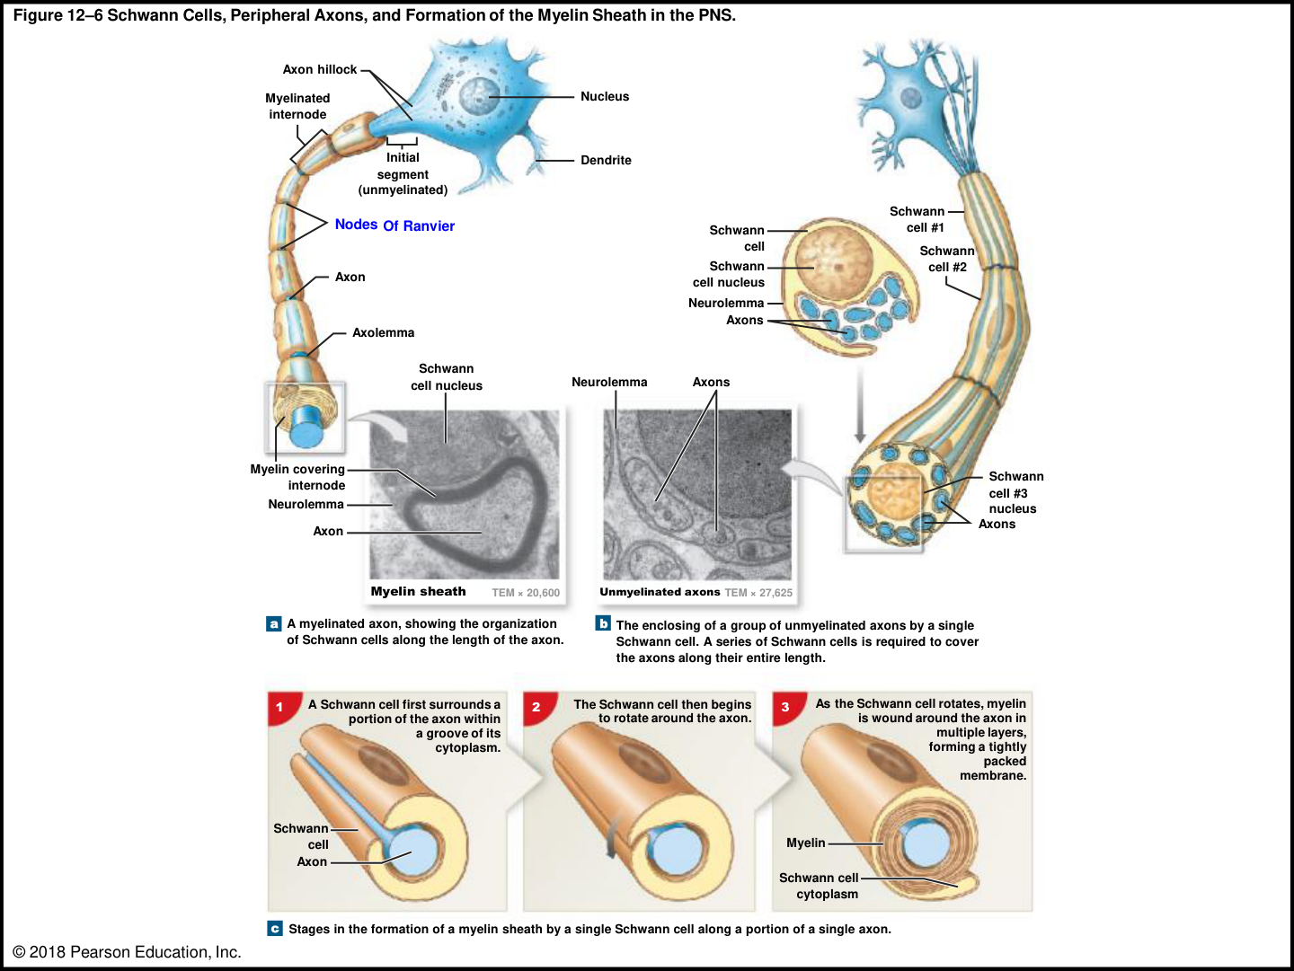
01 • FOUNDATIONS
LECTURE PRIORITY
The two PNS glia—and the myelin comparison
SATELLITE CELLS
Surround neuron cell bodies in ganglia and
regulate their local chemical environment.
SCHWANN CELLS
Enclose peripheral axons. A myelinating
Schwann cell forms one internode on one
axon; many cells cover the full length.
OLIGODENDROCYTES
A CNS oligodendrocyte sends processes to
myelinate segments of multiple axons.
UNMYELINATED ≠ UNPROTECTED
A Schwann cell can enclose several
unmyelinated axons without winding a thick
myelin sheath around them.
REMEMBER
Schwann = peripheral sheath; oligodendrocyte = central, multiple segments.
Book pp. 398–400; C12 L1 slides 6, 9; T-A/T-C.
014
Notes:
SOURCE BASIS
Book pp. 398–400; C12 L1 slides 6, 9; T-A/T-C.
TEACH-BACK
Schwann = peripheral sheath; oligodendrocyte = central, multiple segments.
SATELLITE CELLS: Surround neuron cell bodies in ganglia and regulate their local chemical environment.
SCHWANN CELLS: Enclose peripheral axons. A myelinating Schwann cell forms one internode on one axon; many cells cover the full length.
OLIGODENDROCYTES: A CNS oligodendrocyte sends processes to myelinate segments of multiple axons.
UNMYELINATED ≠ UNPROTECTED: A Schwann cell can enclose several unmyelinated axons without winding a thick myelin sheath around them.
Memory cues and practice questions are review aids created for this deck, not quotations or actual exam questions. Consult the provided source where a caution is marked.

Slide 15
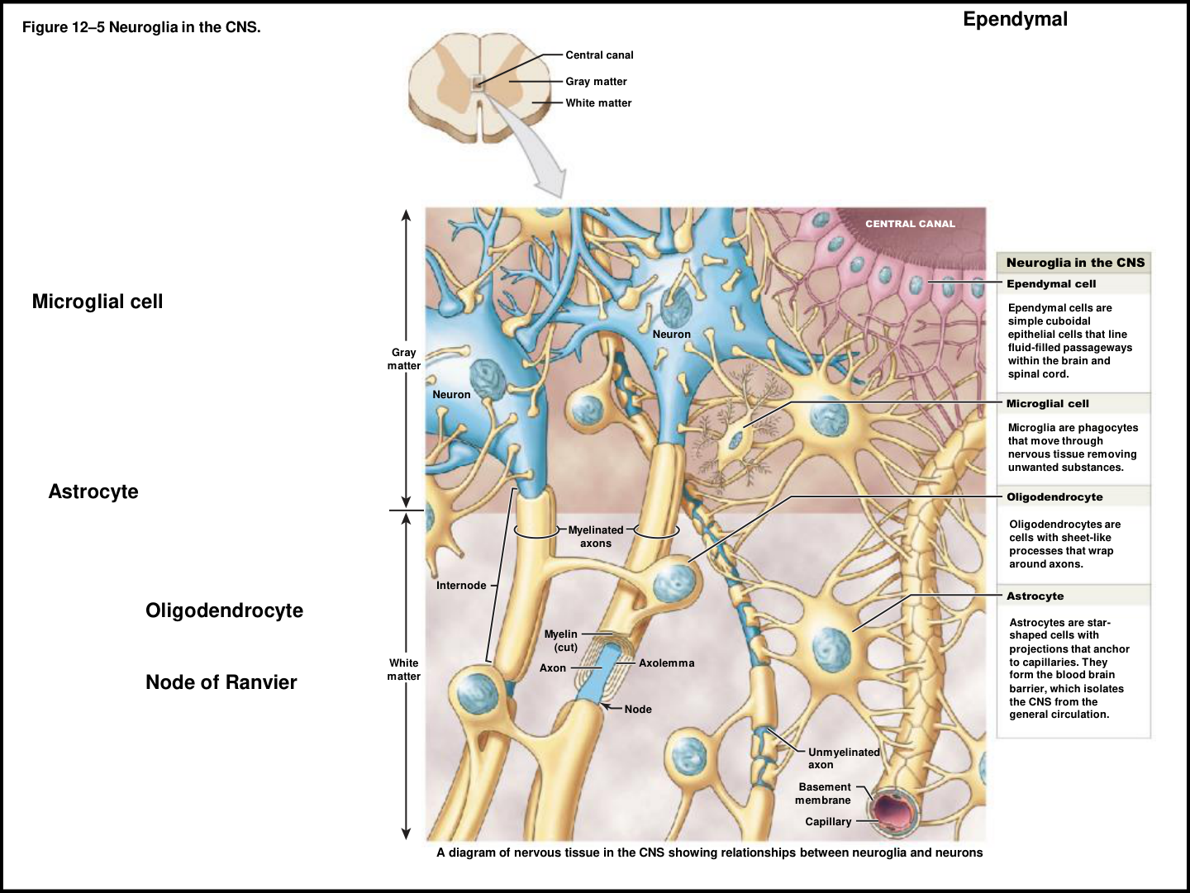
01 • FOUNDATIONS
CORE
Myelin, nodes, gray matter and white matter
MYELIN
Lipid-rich membrane wrapping that electrically
insulates axon segments and increases
propagation speed.
INTERNODE / NODE
Internode = myelinated segment. Node of
Ranvier = gap between internodes where action
potentials are regenerated.
WHITE MATTER
Rich in myelinated axons; organized mainly for
moving information between locations.
GRAY MATTER
Rich in cell bodies, dendrites and unmyelinated
processes; important for integration. In the cord
it forms the central butterfly.
REMEMBER
White = wires; gray = processing groups. These are helpful summaries, not exclusive contents.
Book pp. 398–400, 440; C12 L1 slides 7–9; T-A.
015
Notes:
SOURCE BASIS
Book pp. 398–400, 440; C12 L1 slides 7–9; T-A.
Neurolemma is the outer Schwann-cell surface around a peripheral axon. Gray and white matter also contain neuroglia; neither is literally only one component.
TEACH-BACK
White = wires; gray = processing groups. These are helpful summaries, not exclusive contents.
MYELIN: Lipid-rich membrane wrapping that electrically insulates axon segments and increases propagation speed.
INTERNODE / NODE: Internode = myelinated segment. Node of Ranvier = gap between internodes where action potentials are regenerated.
WHITE MATTER: Rich in myelinated axons; organized mainly for moving information between locations.
GRAY MATTER: Rich in cell bodies, dendrites and unmyelinated processes; important for integration. In the cord it forms the central butterfly.
Memory cues and practice questions are review aids created for this deck, not quotations or actual exam questions. Consult the provided source where a caution is marked.

Slide 16
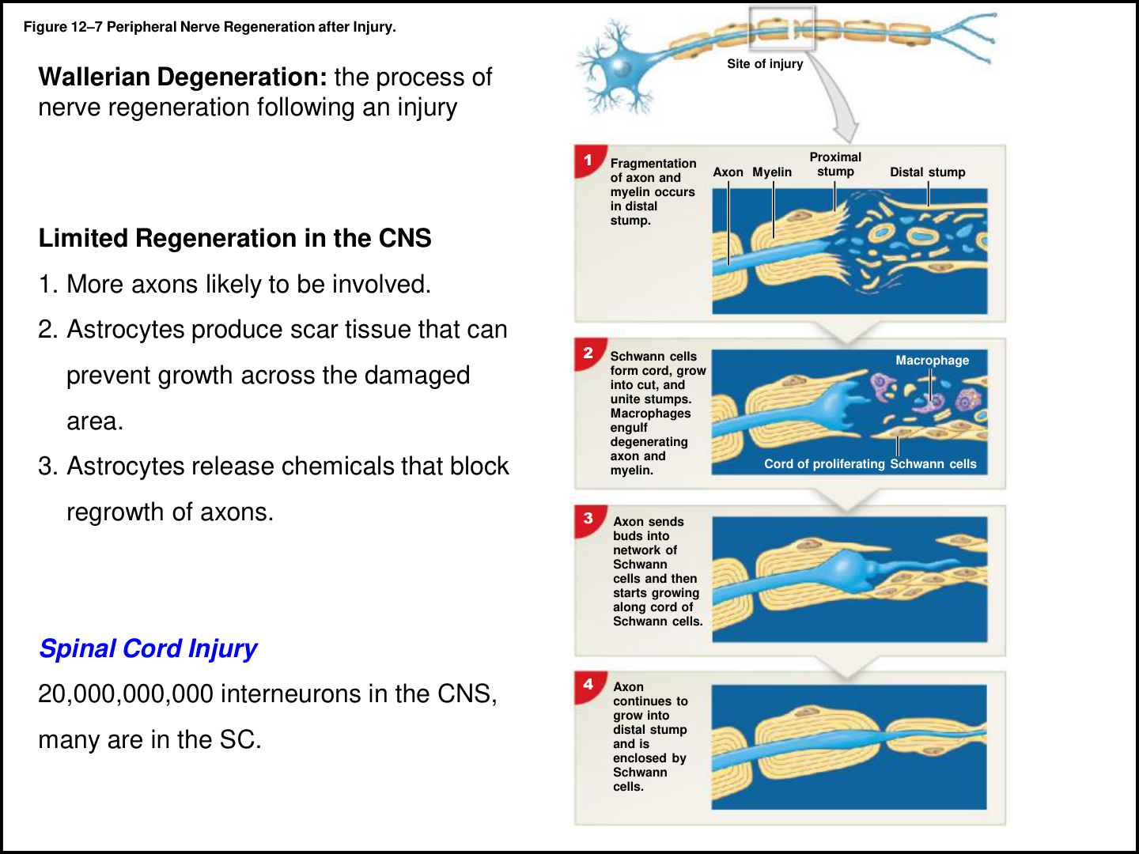
01 • FOUNDATIONS
CORE
Peripheral repair: degeneration comes before regrowth
1 | DISTAL BREAKDOWN
After severe axon injury, the disconnected distal
axon and its myelin degenerate: Wallerian
degeneration.
2 | CLEANUP + GUIDE
Macrophages remove debris. Schwann cells
proliferate and form a guiding cord.
3 | AXON REGROWTH
The surviving neuron can send sprouts into that
pathway; Schwann cells enclose the regrowing
axon.
4 | FUNCTIONAL OUTCOME
Recovery depends on regrowth reaching the
correct target. Misalignment, a large gap or
failure to reconnect can prevent recovery.
REMEMBER
Break down → clean up → guide → regrow → reconnect.
Book pp. 399–401, 442; C12 L1 slide 10; T-A.
016
Notes:
SOURCE BASIS
Book pp. 399–401, 442; C12 L1 slide 10; T-A.
Source caution: the handout loosely labels Wallerian degeneration as the regeneration process. The book distinguishes degeneration of the distal segment from subsequent repair. CNS repair is much more limited: many axons are involved, astrocytic scar tissue can obstruct growth, and inhibitory chemicals can impede regrowth.
TEACH-BACK
Break down → clean up → guide → regrow → reconnect.
1 | DISTAL BREAKDOWN: After severe axon injury, the disconnected distal axon and its myelin degenerate: Wallerian degeneration.
2 | CLEANUP + GUIDE: Macrophages remove debris. Schwann cells proliferate and form a guiding cord.
3 | AXON REGROWTH: The surviving neuron can send sprouts into that pathway; Schwann cells enclose the regrowing axon.
4 | FUNCTIONAL OUTCOME: Recovery depends on regrowth reaching the correct target. Misalignment, a large gap or failure to reconnect can prevent recovery.
Memory cues and practice questions are review aids created for this deck, not quotations or actual exam questions. Consult the provided source where a caution is marked.

Slide 17
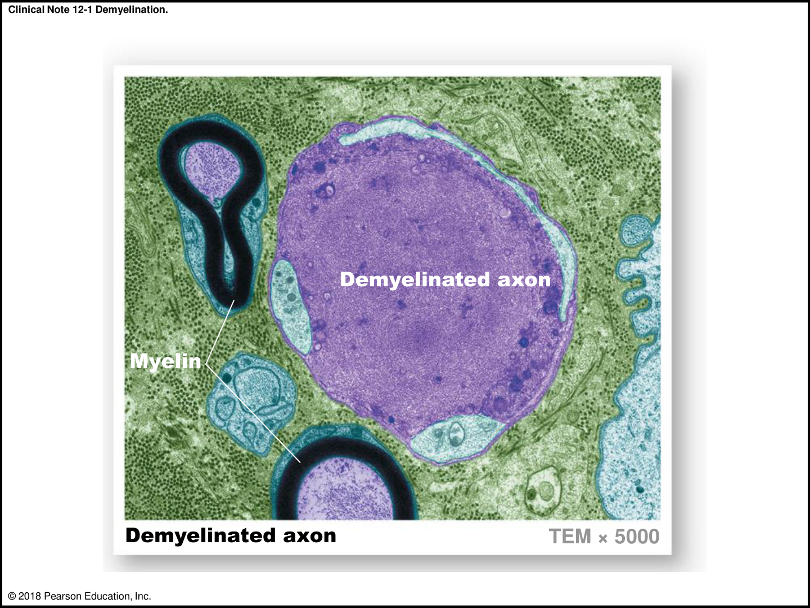
01 • FOUNDATIONS
BOOK DETAIL
Clinical connections: apply the cell biology
DEMYELINATION
Loss of myelin disrupts effective signaling. The
chapter links this to sensory and motor deficits.
CNS VERSUS PNS
The book’s main clinical note describes multiple
sclerosis in the optic nerve, brain and spinal cord;
it describes peripheral demyelination in
Guillain–Barré syndrome.
CELL BODY SURVIVAL
A severed distal axon loses its normal connection
to the soma’s maintenance machinery.
SOURCE CHECK
One end-of-chapter question describes MS as
peripheral. That conflicts with the chapter’s own
clinical note; use the note’s CNS description.
REMEMBER
Ask: which cell, which compartment, and which signal is disrupted?
Book pp. 399–401, 431; C12 L1 slide 11; T-A.
017
Notes:
SOURCE BASIS
Book pp. 399–401, 431; C12 L1 slide 11; T-A.
This is course review, not diagnosis or treatment guidance. The book’s Roosevelt case discusses uncertainty between historical polio and Guillain–Barré interpretations; it does not establish a definitive retrospective diagnosis.
TEACH-BACK
Ask: which cell, which compartment, and which signal is disrupted?
DEMYELINATION: Loss of myelin disrupts effective signaling. The chapter links this to sensory and motor deficits.
CNS VERSUS PNS: The book’s main clinical note describes multiple sclerosis in the optic nerve, brain and spinal cord; it describes peripheral demyelination in Guillain–Barré syndrome.
CELL BODY SURVIVAL: A severed distal axon loses its normal connection to the soma’s maintenance machinery.
SOURCE CHECK: One end-of-chapter question describes MS as peripheral. That conflicts with the chapter’s own clinical note; use the note’s CNS description.
Memory cues and practice questions are review aids created for this deck, not quotations or actual exam questions. Consult the provided source where a caution is marked.

Slide 18
01 • FOUNDATIONS
PARTNER CHECK
Checkpoint 1 | foundations
1. Is a dorsal root ganglion a CNS nucleus? Explain both parts of your
answer.
2. Which glia make myelin in the CNS and PNS? How does one cell’s
wrapping differ?
3. A neuron has one axon and many dendrites. Does that prove it is a
motor neuron?
4. Why can a peripheral axon sometimes regain function after injury?
REMEMBER
Take turns: answer without looking, explain why, then reveal the next slide.
Book pp. 394–401; C12 L1; T-A–T-C. Original practice questions.
018
Notes:
SOURCE BASIS
Book pp. 394–401; C12 L1; T-A–T-C. Original practice questions.
TEACH-BACK
Take turns: answer without looking, explain why, then reveal the next slide.
1. Is a dorsal root ganglion a CNS nucleus? Explain both parts of your answer.
2. Which glia make myelin in the CNS and PNS? How does one cell’s wrapping differ?
3. A neuron has one axon and many dendrites. Does that prove it is a motor neuron?
4. Why can a peripheral axon sometimes regain function after injury?
Memory cues and practice questions are review aids created for this deck, not quotations or actual exam questions. Consult the provided source where a caution is marked.

Slide 19
01 • FOUNDATIONS
ANSWER KEY
Checkpoint 1 | foundations | answers
1. No. A ganglion is a collection of neuronal cell bodies in the PNS; a nucleus is a
comparable CNS collection.
2. Oligodendrocytes in CNS: segments of several axons. Schwann cells in PNS:
one myelinated internode on one axon.
3. It is multipolar structurally. The book and lecture also recognize multipolar
interneurons.
4. A surviving soma can support axon regrowth along Schwann-cell guides,
provided the correct target is reconnected.
REMEMBER
A correct label is only half the job. Explain the structure, mechanism, or consequence.
Book pp. 394–401; C12 L1; T-A–T-C. Original practice questions.
019
Notes:
SOURCE BASIS
Book pp. 394–401; C12 L1; T-A–T-C. Original practice questions.
TEACH-BACK
A correct label is only half the job. Explain the structure, mechanism, or consequence.
1. No. A ganglion is a collection of neuronal cell bodies in the PNS; a nucleus is a comparable CNS collection.
2. Oligodendrocytes in CNS: segments of several axons. Schwann cells in PNS: one myelinated internode on one axon.
3. It is multipolar structurally. The book and lecture also recognize multipolar interneurons.
4. A surviving soma can support axon regrowth along Schwann-cell guides, provided the correct target is reconnected.
Memory cues and practice questions are review aids created for this deck, not quotations or actual exam questions. Consult the provided source where a caution is marked.

Slide 20
02 • MEMBRANE SIGNALS
2
Turn ion gradients into signals
Separate resting conditions, graded changes, action potentials, and propagation.
Use the memory cues, then explain the mechanism without reading.
020
Notes:
SOURCE BASIS
TEACH-BACK
Separate resting conditions, graded changes, action potentials, and propagation.
Memory cues and practice questions are review aids created for this deck, not quotations or actual exam questions. Consult the provided source where a caution is marked.

Slide 21
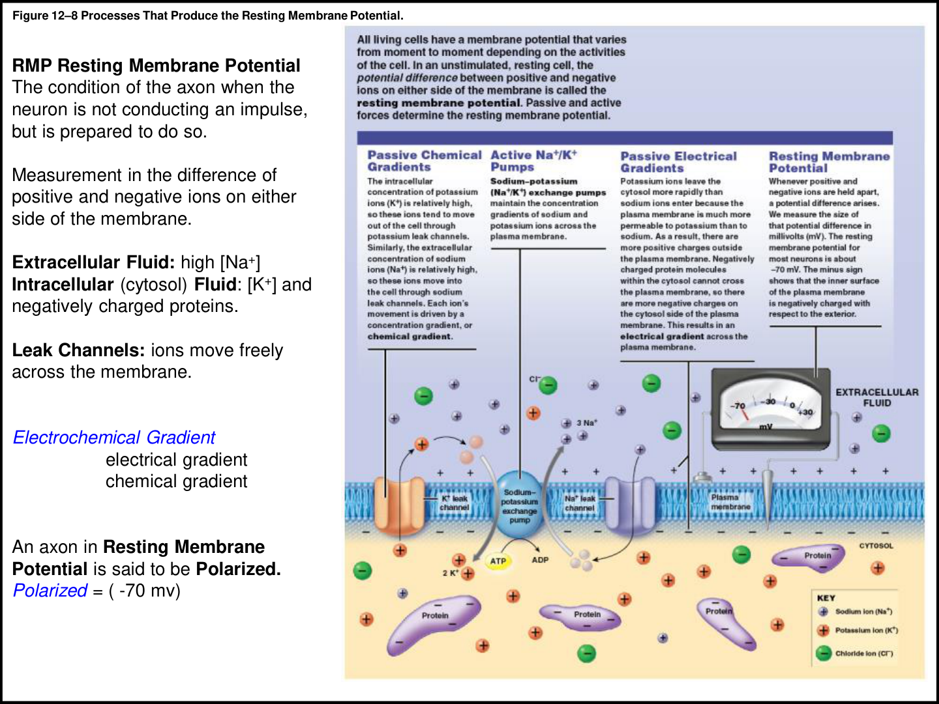
02 • MEMBRANE SIGNALS
LECTURE PRIORITY
Resting membrane potential: start at about −70 mV
WHAT IS MEASURED?
The voltage inside the cell relative to
outside—not an absolute amount of electricity in
the cell.
ION DISTRIBUTION
Na+ is high outside; K+ is high inside. Intracellular
negatively charged proteins also matter.
SELECTIVE PERMEABILITY
At rest, the membrane is more permeable to K+
than Na+. Leak channels remain open.
POLARIZED
A resting neuron has a charge separation and can
respond to a stimulus; it is not currently firing an
action potential.
REMEMBER
Na+ mainly outside; K+ mainly inside; inside is negative at rest.
Book pp. 402–405; C12 L2 slides 1–5; T-A/T-B.
021
Notes:
SOURCE BASIS
Book pp. 402–405; C12 L2 slides 1–5; T-A/T-B.
TEACH-BACK
Na+ mainly outside; K+ mainly inside; inside is negative at rest.
WHAT IS MEASURED?: The voltage inside the cell relative to outside—not an absolute amount of electricity in the cell.
ION DISTRIBUTION: Na+ is high outside; K+ is high inside. Intracellular negatively charged proteins also matter.
SELECTIVE PERMEABILITY: At rest, the membrane is more permeable to K+ than Na+. Leak channels remain open.
POLARIZED: A resting neuron has a charge separation and can respond to a stimulus; it is not currently firing an action potential.
Memory cues and practice questions are review aids created for this deck, not quotations or actual exam questions. Consult the provided source where a caution is marked.

Slide 22
02 • MEMBRANE SIGNALS
LECTURE PRIORITY
The sodium–potassium pump: 3 out, 2 in, 1 ATP
TRANSPORT RULE
EXTRACELLULAR FLUID
For one ATP used, the pump moves 3 Na+ out and
2 K+ in, against their concentration gradients.
Na+ is concentrated outside
WHY KEEP PUMPING?
3 Na+ OUT
Na+ leaks inward and K+ tends to leak outward.
Pumping maintains the gradients that signaling
requires.
Na+/K+
pump
NOT THE AP SWITCH
2 K+ IN
Rapid action-potential depolarization and
repolarization occur through ion channels, not by
the pump instantly moving the voltage up and
down.
CYTOSOL
K+ is concentrated inside
OVER TIME
The pump restores/maintains ion concentrations.
Only a small fraction of ions moves during one
action potential.
1 ATP per transport cycle
REMEMBER
“3 Na out, 2 K in, 1 ATP.” Say the direction every time.
Book pp. 403, 405, 412; C12 L2 slides 1–5; T-A–T-D.
022
Notes:
SOURCE BASIS
Book pp. 403, 405, 412; C12 L2 slides 1–5; T-A–T-D.
The book explicitly says many action potentials can occur before bulk ion concentrations change substantially. The pump is essential for sustained gradients, not the immediate mechanism for each falling phase of an action potential.
TEACH-BACK
“3 Na out, 2 K in, 1 ATP.” Say the direction every time.
TRANSPORT RULE: For one ATP used, the pump moves 3 Na+ out and 2 K+ in, against their concentration gradients.
WHY KEEP PUMPING?: Na+ leaks inward and K+ tends to leak outward. Pumping maintains the gradients that signaling requires.
NOT THE AP SWITCH: Rapid action-potential depolarization and repolarization occur through ion channels, not by the pump instantly moving the voltage up and down.
OVER TIME: The pump restores/maintains ion concentrations. Only a small fraction of ions moves during one action potential.
Memory cues and practice questions are review aids created for this deck, not quotations or actual exam questions. Consult the provided source where a caution is marked.

Slide 23
02 • MEMBRANE SIGNALS
LECTURE PRIORITY
Electrochemical gradients: two forces, one net movement
Ion at rest
Chemical gradient
Electrical gradient
Net tendency
K+
Out: concentration is
higher inside
In: negative interior
attracts it
Outward tendency, weakened by
electrical pull
Na+
In: concentration is
higher outside
In: negative interior
attracts it
Strong inward tendency
REMEMBER
K+ has a tug-of-war. Na+ gets two pushes in the same direction.
Book pp. 402–405; C12 L2 slide 4; T-A/T-B/T-D.
023
Notes:
SOURCE BASIS
Book pp. 402–405; C12 L2 slide 4; T-A/T-B/T-D.
A concentration gradient is also called a chemical gradient. The electrochemical gradient combines chemical and electrical forces. An ion can have a strong driving force yet little movement if its channels are closed.
TEACH-BACK
K+ has a tug-of-war. Na+ gets two pushes in the same direction.
K+ | Out: concentration is higher inside | In: negative interior attracts it | Outward tendency, weakened by electrical pull
Na+ | In: concentration is higher outside | In: negative interior attracts it | Strong inward tendency
Memory cues and practice questions are review aids created for this deck, not quotations or actual exam questions. Consult the provided source where a caution is marked.

Slide 24
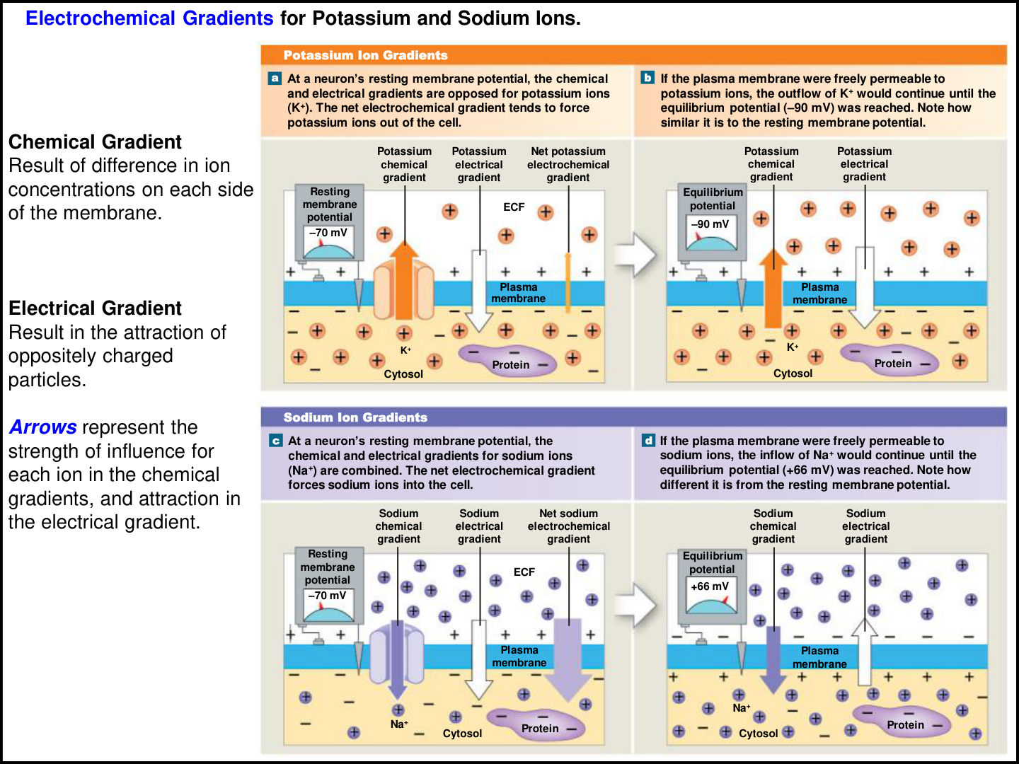
02 • MEMBRANE SIGNALS
SOURCE CAUTION
Equilibrium potential is not resting potential
K+ EQUILIBRIUM
The book’s K+-selective thought experiment
reaches approximately −90 mV, where the inward
electrical force balances outward diffusion.
Na+ EQUILIBRIUM
In the Na+-permeable thought experiment,
equilibrium is approximately +66 mV.
REAL RESTING MEMBRANE
The resting value is about −70 mV because real
membranes have more than one ion pathway plus
active maintenance.
IMPORTANT CAUTION
Do not learn “turn the pump off and the cell must
become −90 mV” as a general rule. The textbook’s
example assumes specific permeability conditions.
REMEMBER
−90 = K+ equilibrium; −70 = typical rest; +66 = Na+ equilibrium.
Book pp. 402–405; C12 L2 slide 4; T-A/T-B.
024
Notes:
SOURCE BASIS
Book pp. 402–405; C12 L2 slide 4; T-A/T-B.
TEACH-BACK
−90 = K+ equilibrium; −70 = typical rest; +66 = Na+ equilibrium.
K+ EQUILIBRIUM: The book’s K+-selective thought experiment reaches approximately −90 mV, where the inward electrical force balances outward diffusion.
Na+ EQUILIBRIUM: In the Na+-permeable thought experiment, equilibrium is approximately +66 mV.
REAL RESTING MEMBRANE: The resting value is about −70 mV because real membranes have more than one ion pathway plus active maintenance.
IMPORTANT CAUTION: Do not learn “turn the pump off and the cell must become −90 mV” as a general rule. The textbook’s example assumes specific permeability conditions.
Memory cues and practice questions are review aids created for this deck, not quotations or actual exam questions. Consult the provided source where a caution is marked.

Slide 25
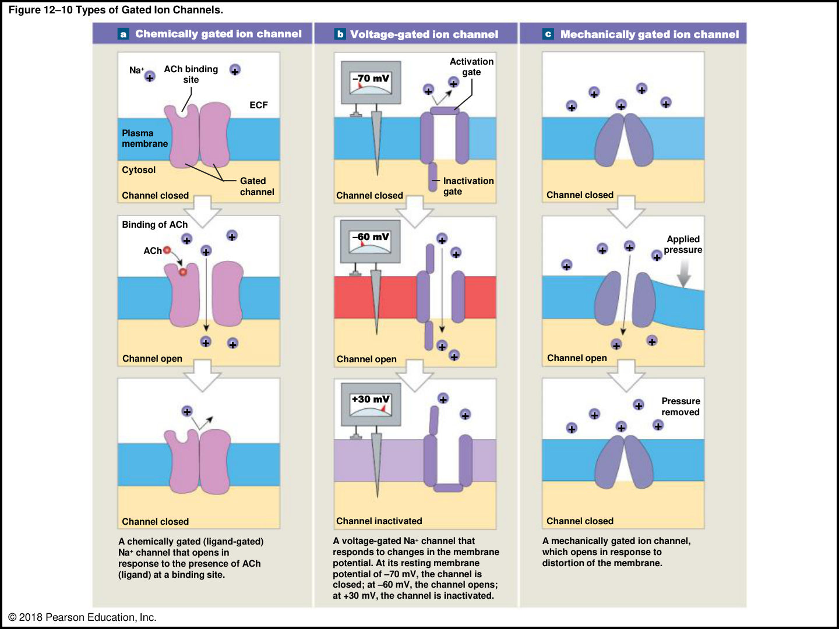
02 • MEMBRANE SIGNALS
LECTURE PRIORITY
Three ways to open an ion channel
CHEMICALLY GATED
A ligand binds a receptor/channel. Example: ACh
at the neuromuscular junction or a cholinergic
synapse.
VOLTAGE GATED
A change in membrane potential alters the
channel. Na+ and K+ channels support axonal
action potentials; Ca2+ channels matter at
terminals.
MECHANICALLY GATED
Physical deformation opens a channel, as in touch,
pressure or vibration receptors.
LEAK CHANNEL
Different from the three gated categories: it is
open at rest and contributes to resting conditions.
REMEMBER
Chemical = key; voltage = charge; mechanical = stretch or push.
Book pp. 405–407; C12 L2 slide 6; T-A/T-B.
025
Notes:
SOURCE BASIS
Book pp. 405–407; C12 L2 slide 6; T-A/T-B.
TEACH-BACK
Chemical = key; voltage = charge; mechanical = stretch or push.
CHEMICALLY GATED: A ligand binds a receptor/channel. Example: ACh at the neuromuscular junction or a cholinergic synapse.
VOLTAGE GATED: A change in membrane potential alters the channel. Na+ and K+ channels support axonal action potentials; Ca2+ channels matter at terminals.
MECHANICALLY GATED: Physical deformation opens a channel, as in touch, pressure or vibration receptors.
LEAK CHANNEL: Different from the three gated categories: it is open at rest and contributes to resting conditions.
Memory cues and practice questions are review aids created for this deck, not quotations or actual exam questions. Consult the provided source where a caution is marked.

Slide 26
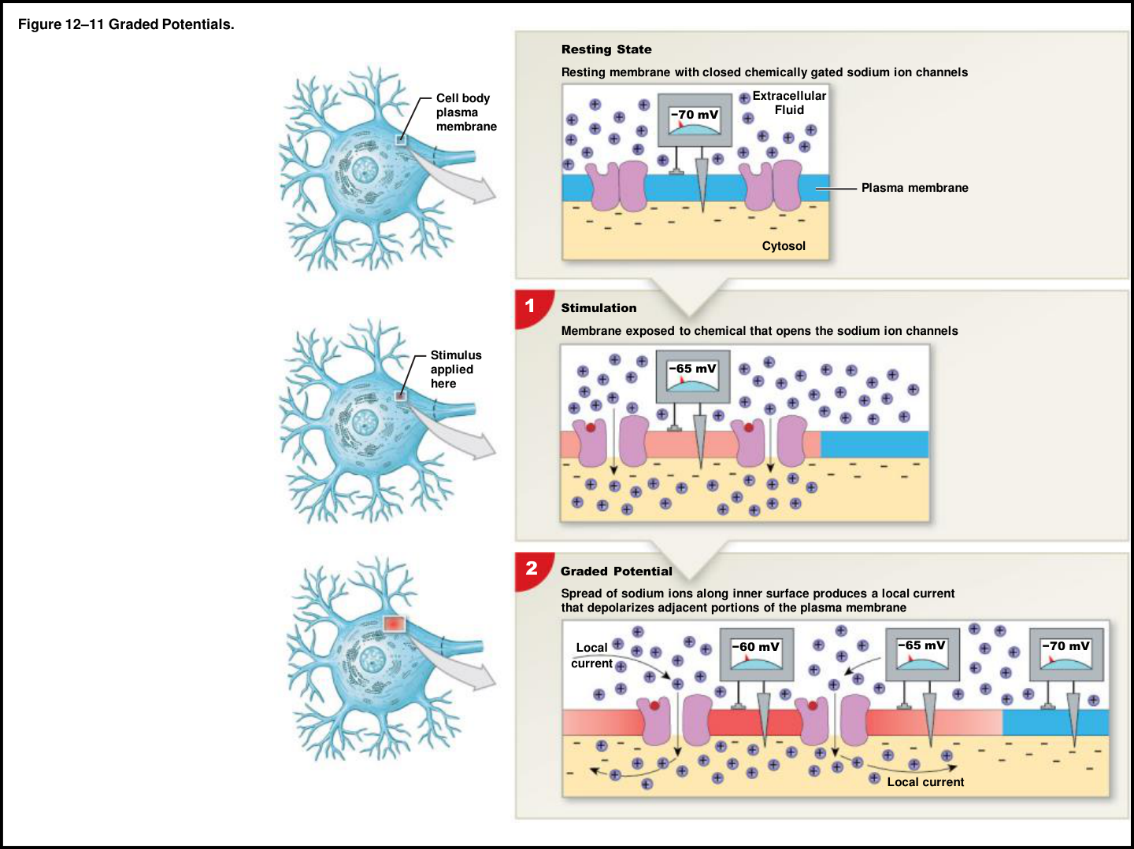
02 • MEMBRANE SIGNALS
LECTURE PRIORITY
Graded potentials: local and variable
LOCATION
Common on dendrites and soma in the neuronal
examples; the book also describes graded
potentials in other cell types.
AMPLITUDE
A stronger stimulus produces a larger local change.
There is no all-or-none threshold for the graded
potential itself.
DISTANCE
The effect decreases as it spreads because of
resistance and charge loss/spread; local current is
passive.
DIRECTION
A graded potential can depolarize or hyperpolarize.
It may or may not bring the axon’s initial segment
to threshold.
REMEMBER
GRADED = gets smaller with distance; size is graded to the stimulus.
Book pp. 407–409; C12 L2 slides 7–10; T-A/T-B.
026
Notes:
SOURCE BASIS
Book pp. 407–409; C12 L2 slides 7–10; T-A/T-B.
TEACH-BACK
GRADED = gets smaller with distance; size is graded to the stimulus.
LOCATION: Common on dendrites and soma in the neuronal examples; the book also describes graded potentials in other cell types.
AMPLITUDE: A stronger stimulus produces a larger local change. There is no all-or-none threshold for the graded potential itself.
DISTANCE: The effect decreases as it spreads because of resistance and charge loss/spread; local current is passive.
DIRECTION: A graded potential can depolarize or hyperpolarize. It may or may not bring the axon’s initial segment to threshold.
Memory cues and practice questions are review aids created for this deck, not quotations or actual exam questions. Consult the provided source where a caution is marked.

Slide 27
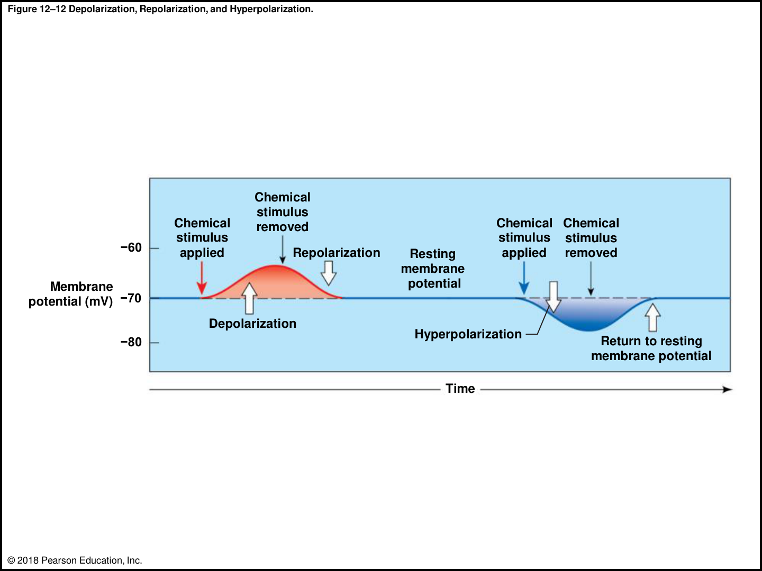
02 • MEMBRANE SIGNALS
LECTURE PRIORITY
Know the three voltage words
DEPOLARIZATION
The membrane becomes less negative / more
positive. −70 to −65 mV is depolarization even
without an action potential.
REPOLARIZATION
Movement back toward the resting membrane
potential after depolarization.
HYPERPOLARIZATION
The membrane becomes more negative than
its resting value, such as −70 to −85 mV.
THRESHOLD
Your professor emphasizes approximately −55
mV at the initial segment. The book gives −60
to −55 mV and some figures use −60.
REMEMBER
Depolarization is a direction of change—not a guarantee that a neuron fired.
Book pp. 407–409; C12 L2 slides 7, 10–14; T-A/T-B.
027
Notes:
SOURCE BASIS
Book pp. 407–409; C12 L2 slides 7, 10–14; T-A/T-B.
TEACH-BACK
Depolarization is a direction of change—not a guarantee that a neuron fired.
DEPOLARIZATION: The membrane becomes less negative / more positive. −70 to −65 mV is depolarization even without an action potential.
REPOLARIZATION: Movement back toward the resting membrane potential after depolarization.
HYPERPOLARIZATION: The membrane becomes more negative than its resting value, such as −70 to −85 mV.
THRESHOLD: Your professor emphasizes approximately −55 mV at the initial segment. The book gives −60 to −55 mV and some figures use −60.
Memory cues and practice questions are review aids created for this deck, not quotations or actual exam questions. Consult the provided source where a caution is marked.

Slide 28
02 • MEMBRANE SIGNALS
LECTURE PRIORITY
The action potential: one event, four phases
1 | REACH THRESHOLD
Membrane potential (mV)
A graded depolarization brings the trigger
region to about −55 mV in the lecture example.
30
Na+ IN
K+ OUT
2 | Na+ ENTRY
Voltage-gated Na+ channels activate; rapid Na+
influx produces the rising phase and a peak
around +30 mV.
0
3 | K+ EXIT
Threshold −55
Na+ channels inactivate; voltage-gated K+
channels allow outward K+ movement,
repolarizing the membrane.
-55
-70
-90
4 | AFTER-HYPERPOLARIZATION
Rest
Delayed closure of K+ channels allows a brief
undershoot before return toward −70 mV.
Undershoot
Time (schematic)
Course threshold shown; book figures may use −60 mV.
REMEMBER
Na+ IN brings voltage UP. K+ OUT brings voltage DOWN.
Book pp. 409–412; C12 L2 slides 11–14; T-A/T-B.
028
Notes:
SOURCE BASIS
Book pp. 409–412; C12 L2 slides 11–14; T-A/T-B.
The visual is a schematic redrawn for study using the lecturer’s −55 mV threshold. The handout’s original Pearson graph uses −60 mV. The book gives a threshold range, so neither number should be treated as a universal constant for all neurons.
TEACH-BACK
Na+ IN brings voltage UP. K+ OUT brings voltage DOWN.
1 | REACH THRESHOLD: A graded depolarization brings the trigger region to about −55 mV in the lecture example.
2 | Na+ ENTRY: Voltage-gated Na+ channels activate; rapid Na+ influx produces the rising phase and a peak around +30 mV.
3 | K+ EXIT: Na+ channels inactivate; voltage-gated K+ channels allow outward K+ movement, repolarizing the membrane.
4 | AFTER-HYPERPOLARIZATION: Delayed closure of K+ channels allows a brief undershoot before return toward −70 mV.
Memory cues and practice questions are review aids created for this deck, not quotations or actual exam questions. Consult the provided source where a caution is marked.

Slide 29
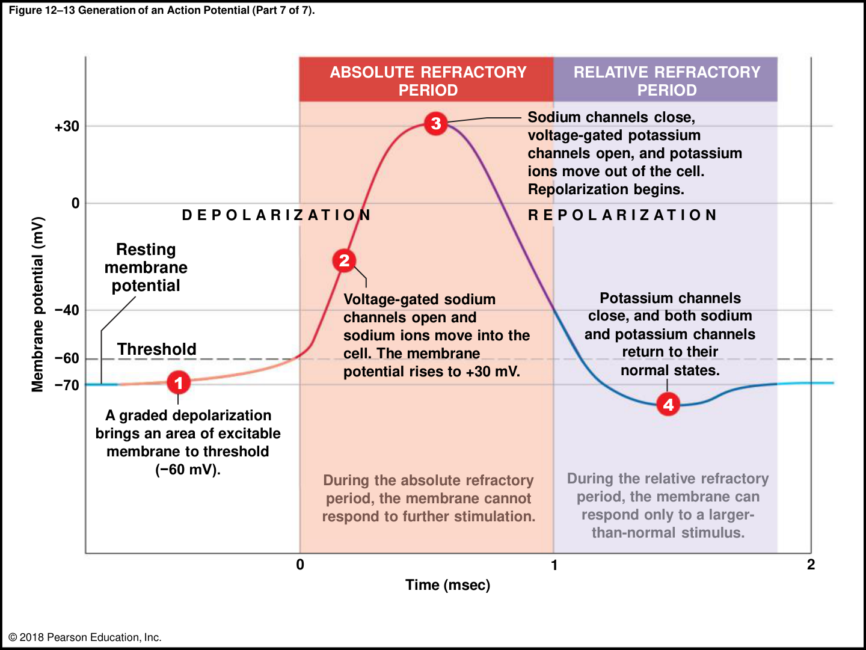
02 • MEMBRANE SIGNALS
CORE
Refractory periods explain recovery and direction
ABSOLUTE
From Na+ channel activation until recovery from
inactivation: another action potential cannot be
triggered in that membrane region.
RELATIVE
Some Na+ channels have recovered, but K+
conductance/hyperpolarization makes another
action potential require a stronger-than-normal
stimulus.
DIRECTION
The recently active membrane is refractory,
helping the normal impulse travel toward excitable
membrane ahead.
MAXIMUM FREQUENCY
The absolute refractory period limits how rapidly a
neuron can fire again.
REMEMBER
Absolute = absolutely not. Relative = requires more.
Book pp. 411–413, 428; C12 L2 slides 13–15; T-A.
029
Notes:
SOURCE BASIS
Book pp. 411–413, 428; C12 L2 slides 13–15; T-A.
Book detail: the absolute refractory period is approximately 0.4–1.0 ms in its example. This is distinct from the whole duration of the action potential. The waveform is an example, not a universal timing rule.
TEACH-BACK
Absolute = absolutely not. Relative = requires more.
ABSOLUTE: From Na+ channel activation until recovery from inactivation: another action potential cannot be triggered in that membrane region.
RELATIVE: Some Na+ channels have recovered, but K+ conductance/hyperpolarization makes another action potential require a stronger-than-normal stimulus.
DIRECTION: The recently active membrane is refractory, helping the normal impulse travel toward excitable membrane ahead.
MAXIMUM FREQUENCY: The absolute refractory period limits how rapidly a neuron can fire again.
Memory cues and practice questions are review aids created for this deck, not quotations or actual exam questions. Consult the provided source where a caution is marked.

Slide 30
02 • MEMBRANE SIGNALS
LECTURE PRIORITY
Graded versus action potential: the exam comparison
Feature
Graded potential
Action potential
Where in the neuron?
Usually dendrites / soma
Initial segment and axon
Size
Varies with stimulus
All-or-none once threshold is
reached
Distance
Decreases with distance
Regenerated without decreasing
amplitude
Sign
Depolarizing or hyperpolarizing
Depolarizing event followed by
recovery
Summation
Can add together
Individual AP amplitudes do not sum
Threshold /
refractory
No fixed AP threshold; no refractory period
Threshold and refractory periods
REMEMBER
Graded signals add; action potentials repeat.
Book pp. 407–412, Table 12–3; C12 L2 slide 15; T-A/T-B.
030
Notes:
SOURCE BASIS
Book pp. 407–412, Table 12–3; C12 L2 slide 15; T-A/T-B.
TEACH-BACK
Graded signals add; action potentials repeat.
Where in the neuron? | Usually dendrites / soma | Initial segment and axon
Size | Varies with stimulus | All-or-none once threshold is reached
Distance | Decreases with distance | Regenerated without decreasing amplitude
Sign | Depolarizing or hyperpolarizing | Depolarizing event followed by recovery
Summation | Can add together | Individual AP amplitudes do not sum
Threshold / refractory | No fixed AP threshold; no refractory period | Threshold and refractory periods
Memory cues and practice questions are review aids created for this deck, not quotations or actual exam questions. Consult the provided source where a caution is marked.

Slide 31
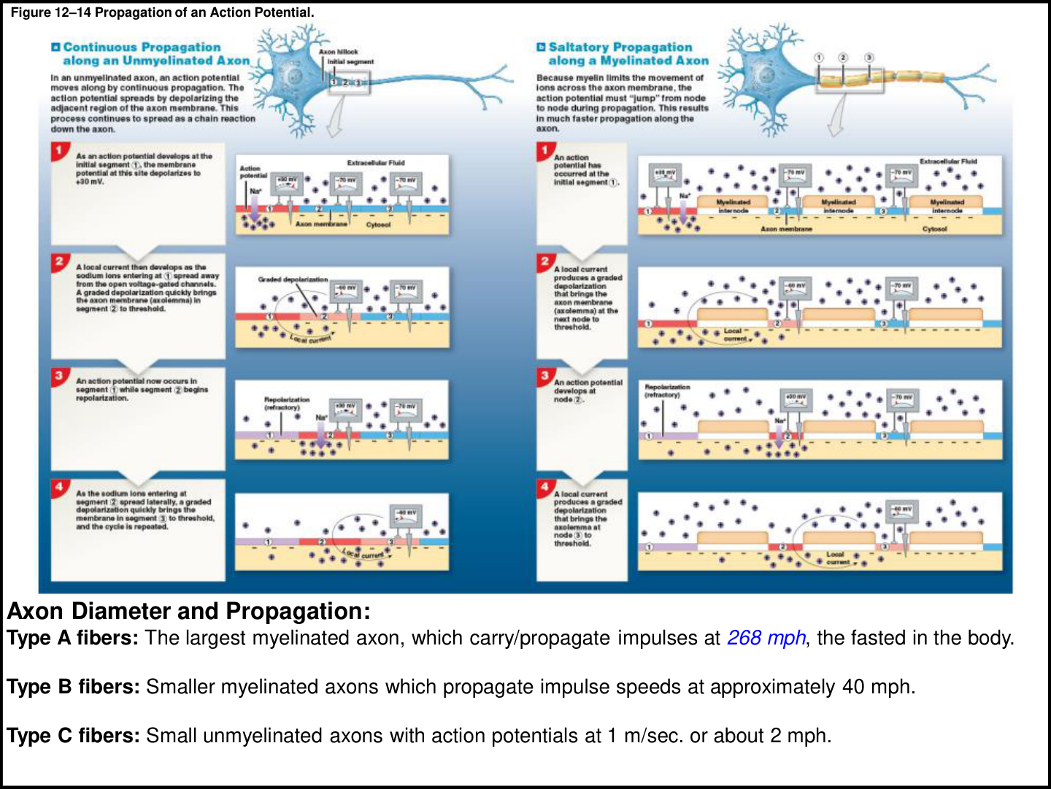
02 • MEMBRANE SIGNALS
CORE
Continuous propagation: every adjacent region
UNMYELINATED AXON
Local current from one active region depolarizes
the next region of excitable membrane.
CHAIN REACTION
The next region reaches threshold, opens its
voltage-gated Na+ channels, and generates
another action potential.
NO FADING
Unlike a graded potential alone, the action
potential is renewed along the axon.
ANALOGY
Each person in a line repeats the complete
message to the next person; the message stays
intact, but each relay takes time.
REMEMBER
Continuous = neighboring membrane sections take turns.
Book pp. 412–414; C12 L3 slide 1; T-A/T-C.
031
Notes:
SOURCE BASIS
Book pp. 412–414; C12 L3 slide 1; T-A/T-C.
The source figure compares continuous propagation on the left with saltatory propagation on the right. The individual ions do not travel from the cell body to the terminal at the impulse’s propagation speed.
TEACH-BACK
Continuous = neighboring membrane sections take turns.
UNMYELINATED AXON: Local current from one active region depolarizes the next region of excitable membrane.
CHAIN REACTION: The next region reaches threshold, opens its voltage-gated Na+ channels, and generates another action potential.
NO FADING: Unlike a graded potential alone, the action potential is renewed along the axon.
ANALOGY: Each person in a line repeats the complete message to the next person; the message stays intact, but each relay takes time.
Memory cues and practice questions are review aids created for this deck, not quotations or actual exam questions. Consult the provided source where a caution is marked.

Slide 32
02 • MEMBRANE SIGNALS
LECTURE PRIORITY
Saltatory propagation: regenerate at the nodes
MYELINATED AXON
Myelin limits ion movement across internodal
membrane.
NODE TO NODE
Local current travels beneath myelin and
depolarizes the next node to threshold; the
action potential is regenerated there.
FASTER + EFFICIENT
Fewer membrane regions need active
regeneration; proportionately less ion movement
requires restoration afterward.
TWO SPEED FACTORS
Myelination and larger axon diameter increase
conduction speed. The transcript emphasizes
these—not simply the neuron’s length.
REMEMBER
Saltatory = skip the insulated stretches; fire at the gaps.
Book pp. 413–416; C12 L3 slide 1; T-A/T-C.
032
Notes:
SOURCE BASIS
Book pp. 413–416; C12 L3 slide 1; T-A/T-C.
TEACH-BACK
Saltatory = skip the insulated stretches; fire at the gaps.
MYELINATED AXON: Myelin limits ion movement across internodal membrane.
NODE TO NODE: Local current travels beneath myelin and depolarizes the next node to threshold; the action potential is regenerated there.
FASTER + EFFICIENT: Fewer membrane regions need active regeneration; proportionately less ion movement requires restoration afterward.
TWO SPEED FACTORS: Myelination and larger axon diameter increase conduction speed. The transcript emphasizes these—not simply the neuron’s length.
Memory cues and practice questions are review aids created for this deck, not quotations or actual exam questions. Consult the provided source where a caution is marked.

Slide 33
02 • MEMBRANE SIGNALS
CORE
Fiber types: learn the class and the pattern
Fiber
Diameter / insulation
Book example speed
Typical roles in this chapter
A
Largest; myelinated;
4–20 μm
Up to 120 m/s (268
mph)
Fast position/touch information;
skeletal motor commands
B
Smaller; myelinated;
2–4 μm
About 18 m/s (40
mph)
Some sensory and visceral pathways
C
Small; unmyelinated;
under 2 μm
About 1 m/s (2 mph)
Slower sensory and visceral pathways
REMEMBER
A = accelerated; B = between; C = crawling. Speeds are the supplied book’s examples.
Book p. 416; C12 L3 slide 1; T-A/T-C.
033
Notes:
SOURCE BASIS
Book p. 416; C12 L3 slide 1; T-A/T-C.
The transcript includes variable verbal speed estimates. The table follows the provided handout and textbook so the study values are consistent. Know the diameter/myelination relationship rather than assuming every fiber of a class has one fixed speed.
TEACH-BACK
A = accelerated; B = between; C = crawling. Speeds are the supplied book’s examples.
A | Largest; myelinated; 4–20 μm | Up to 120 m/s (268 mph) | Fast position/touch information; skeletal motor commands
B | Smaller; myelinated; 2–4 μm | About 18 m/s (40 mph) | Some sensory and visceral pathways
C | Small; unmyelinated; under 2 μm | About 1 m/s (2 mph) | Slower sensory and visceral pathways
Memory cues and practice questions are review aids created for this deck, not quotations or actual exam questions. Consult the provided source where a caution is marked.

Slide 34
02 • MEMBRANE SIGNALS
LECTURE PRIORITY
A stronger signal usually means more APs, not taller APs
ALL-OR-NONE
FREQUENCY CODE
Once threshold is reached, increasing
stimulus strength does not create a
larger action potential in the same axon.
Stronger sustained depolarization can
increase the number of action
potentials generated per unit time.
FACILITATION
CEILING
A neuron already closer to threshold
needs less additional excitatory input to
fire.
The refractory properties limit how fast
action potentials can recur.
REMEMBER
Amplitude stays; frequency changes.
Book pp. 409, 425, 427–428; T-B/T-C.
034
Notes:
SOURCE BASIS
Book pp. 409, 425, 427–428; T-B/T-C.
Book detail: it gives theoretical rates as high as 2,500/s in certain axons and recorded frequencies around 500–1,000/s. These are secondary details; the key mechanism is stimulus strength translated into firing frequency.
TEACH-BACK
Amplitude stays; frequency changes.
ALL-OR-NONE: Once threshold is reached, increasing stimulus strength does not create a larger action potential in the same axon.
FREQUENCY CODE: Stronger sustained depolarization can increase the number of action potentials generated per unit time.
FACILITATION: A neuron already closer to threshold needs less additional excitatory input to fire.
CEILING: The refractory properties limit how fast action potentials can recur.
Memory cues and practice questions are review aids created for this deck, not quotations or actual exam questions. Consult the provided source where a caution is marked.

Slide 35
02 • MEMBRANE SIGNALS
PARTNER CHECK
Checkpoint 2 | membrane signals
1. A neuron changes from −70 to −63 mV; threshold is −55 mV. What
happened—and what did not?
2. Which ions move during the rising and falling phases of an action
potential?
3. Why is an extra stimulus ineffective in the absolute refractory period?
4. A stronger stimulus makes an AP twice as tall. What is wrong with that
statement?
REMEMBER
Take turns: answer without looking, explain why, then reveal the next slide.
Book pp. 407–413, 427–428; C12 L2. Original practice questions.
035
Notes:
SOURCE BASIS
Book pp. 407–413, 427–428; C12 L2. Original practice questions.
TEACH-BACK
Take turns: answer without looking, explain why, then reveal the next slide.
1. A neuron changes from −70 to −63 mV; threshold is −55 mV. What happened—and what did not?
2. Which ions move during the rising and falling phases of an action potential?
3. Why is an extra stimulus ineffective in the absolute refractory period?
4. A stronger stimulus makes an AP twice as tall. What is wrong with that statement?
Memory cues and practice questions are review aids created for this deck, not quotations or actual exam questions. Consult the provided source where a caution is marked.

Slide 36
02 • MEMBRANE SIGNALS
ANSWER KEY
Checkpoint 2 | membrane signals | answers
1. Depolarization occurred, but threshold was not reached, so this change alone
did not initiate an action potential.
2. Na+ moves inward during rapid depolarization. K+ moves outward during
repolarization and the undershoot.
3. The relevant Na+ channels are already activated or inactivated and have not
recovered their availability.
4. The same axon’s AP is all-or-none. Greater sustained input usually increases
firing frequency, not AP height.
REMEMBER
A correct label is only half the job. Explain the structure, mechanism, or consequence.
Book pp. 407–413, 427–428; C12 L2. Original practice questions.
036
Notes:
SOURCE BASIS
Book pp. 407–413, 427–428; C12 L2. Original practice questions.
TEACH-BACK
A correct label is only half the job. Explain the structure, mechanism, or consequence.
1. Depolarization occurred, but threshold was not reached, so this change alone did not initiate an action potential.
2. Na+ moves inward during rapid depolarization. K+ moves outward during repolarization and the undershoot.
3. The relevant Na+ channels are already activated or inactivated and have not recovered their availability.
4. The same axon’s AP is all-or-none. Greater sustained input usually increases firing frequency, not AP height.
Memory cues and practice questions are review aids created for this deck, not quotations or actual exam questions. Consult the provided source where a caution is marked.

Slide 37
03 • SYNAPSES + INTEGRATION
3
Transfer and combine information
Follow the transmitter, identify the receptor, and predict the effect on threshold.
Use the memory cues, then explain the mechanism without reading.
037
Notes:
SOURCE BASIS
TEACH-BACK
Follow the transmitter, identify the receptor, and predict the effect on threshold.
Memory cues and practice questions are review aids created for this deck, not quotations or actual exam questions. Consult the provided source where a caution is marked.

Slide 38
03 • SYNAPSES + INTEGRATION
CORE
Electrical and chemical synapses
Feature
Electrical
Chemical
Connection
Gap junctions directly connect cells
Synaptic cleft separates cells
Signal transfer
Ions/current pass between cells
Neurotransmitter binds
postsynaptic receptors
Speed
Rapid, with little synaptic delay
Delay for Ca2+ entry and
transmitter release
Course emphasis
Described as relatively rare
Most abundant type in the
supplied chapter
Direction in
chapter model
Direct coupling
Usually presynaptic to
postsynaptic
REMEMBER
Electrical = connected. Chemical = cleft + chemical.
Book pp. 416–418; C12 L3 slide 2; T-C.
038
Notes:
SOURCE BASIS
Book pp. 416–418; C12 L3 slide 2; T-C.
A neuromuscular junction connects a neuron to skeletal muscle; a neuroglandular junction connects a neuron to a secretory cell. A synapse need not connect two neurons.
TEACH-BACK
Electrical = connected. Chemical = cleft + chemical.
Connection | Gap junctions directly connect cells | Synaptic cleft separates cells
Signal transfer | Ions/current pass between cells | Neurotransmitter binds postsynaptic receptors
Speed | Rapid, with little synaptic delay | Delay for Ca2+ entry and transmitter release
Course emphasis | Described as relatively rare | Most abundant type in the supplied chapter
Direction in chapter model | Direct coupling | Usually presynaptic to postsynaptic
Memory cues and practice questions are review aids created for this deck, not quotations or actual exam questions. Consult the provided source where a caution is marked.

Slide 39
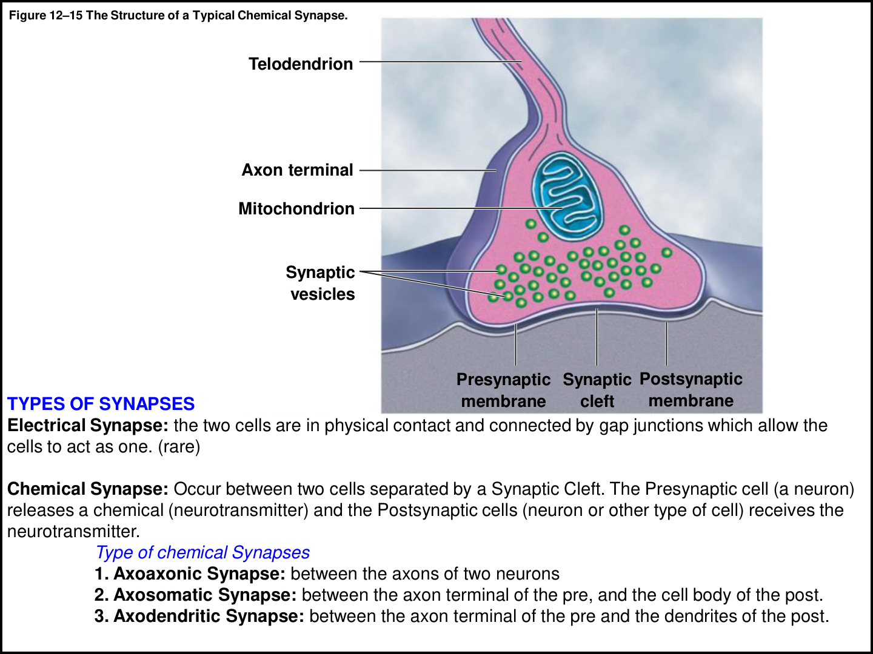
03 • SYNAPSES + INTEGRATION
LECTURE PRIORITY
Name a synapse by where the axon ends
AXODENDRITIC
Axon terminal of one neuron contacts a
dendrite of another.
AXOSOMATIC
Axon terminal contacts another neuron’s cell
body (soma).
AXOAXONIC
An axon contacts another axon; important in
the chapter’s presynaptic regulation
examples.
TERMS TO LABEL
Presynaptic membrane, synaptic vesicles,
synaptic cleft, postsynaptic membrane,
receptor and mitochondrion.
REMEMBER
Read the word in two pieces: axo–dendrite, axo–soma, axo–axon.
Book pp. 393, 417; C12 L3 slide 2; T-B/T-C.
039
Notes:
SOURCE BASIS
Book pp. 393, 417; C12 L3 slide 2; T-B/T-C.
TEACH-BACK
Read the word in two pieces: axo–dendrite, axo–soma, axo–axon.
AXODENDRITIC: Axon terminal of one neuron contacts a dendrite of another.
AXOSOMATIC: Axon terminal contacts another neuron’s cell body (soma).
AXOAXONIC: An axon contacts another axon; important in the chapter’s presynaptic regulation examples.
TERMS TO LABEL: Presynaptic membrane, synaptic vesicles, synaptic cleft, postsynaptic membrane, receptor and mitochondrion.
Memory cues and practice questions are review aids created for this deck, not quotations or actual exam questions. Consult the provided source where a caution is marked.

Slide 40
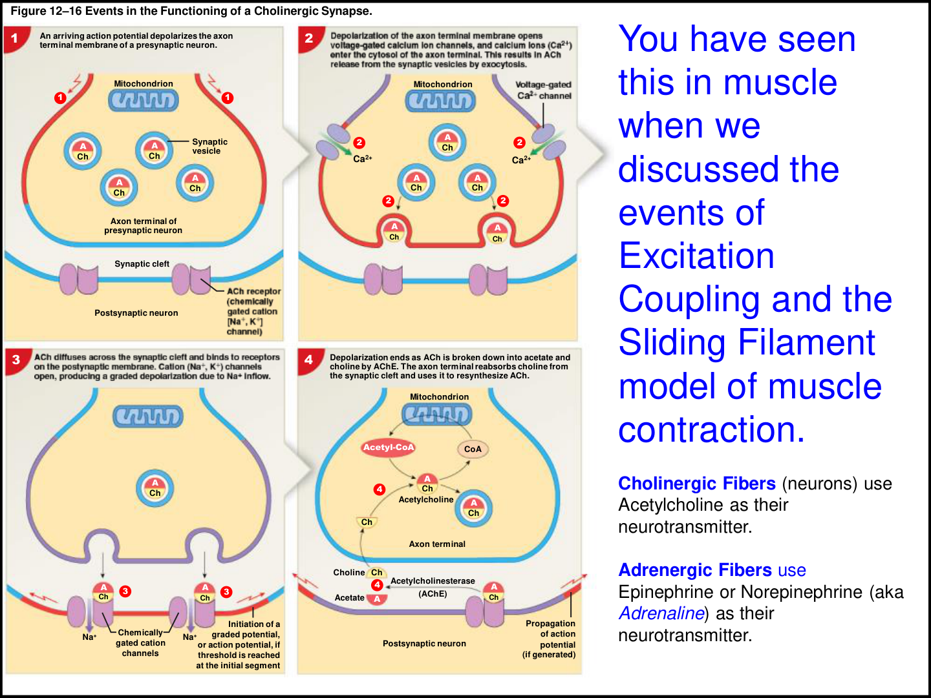
03 • SYNAPSES + INTEGRATION
LECTURE PRIORITY
Cholinergic synapse: the four-event sequence
1 | ARRIVAL
An action potential depolarizes the presynaptic
axon terminal.
2 | RELEASE
Voltage-gated Ca2+ channels open. Ca2+ entry
triggers vesicle exocytosis of acetylcholine (ACh).
3 | RECEPTION
ACh binds postsynaptic chemically gated cation
channels. The example produces net
depolarization; an AP follows only if threshold is
reached.
4 | TERMINATION
Acetylcholinesterase (AChE) breaks ACh into
acetate and choline. Choline is taken back up and
reused.
REMEMBER
Arrival → Calcium → ACh → Receptor → AChE. Calcium triggers release; sodium helps the response.
Book pp. 418–419; C12 L3 slide 3; T-C.
040
Notes:
SOURCE BASIS
Book pp. 418–419; C12 L3 slide 3; T-C.
The book specifies cation channels that can pass Na+ and K+, with net depolarization in this example. Do not confuse presynaptic voltage-gated Ca2+ channels with postsynaptic ligand-gated channels. Acetyl-CoA supplies the acetyl component for ACh resynthesis.
TEACH-BACK
Arrival → Calcium → ACh → Receptor → AChE. Calcium triggers release; sodium helps the response.
1 | ARRIVAL: An action potential depolarizes the presynaptic axon terminal.
2 | RELEASE: Voltage-gated Ca2+ channels open. Ca2+ entry triggers vesicle exocytosis of acetylcholine (ACh).
3 | RECEPTION: ACh binds postsynaptic chemically gated cation channels. The example produces net depolarization; an AP follows only if threshold is reached.
4 | TERMINATION: Acetylcholinesterase (AChE) breaks ACh into acetate and choline. Choline is taken back up and reused.
Memory cues and practice questions are review aids created for this deck, not quotations or actual exam questions. Consult the provided source where a caution is marked.

Slide 41
03 • SYNAPSES + INTEGRATION
CORE
Why signaling can slow down or weaken
SYNAPTIC DELAY
MORE SYNAPSES
The book gives about 0.2–0.5 ms between
presynaptic arrival and postsynaptic effect;
much reflects Ca2+ entry and release
steps.
More successive chemical synapses can
add more delay, even if the axons
themselves are similar.
SYNAPTIC FATIGUE
PREDICT THE BLOCK
Intense stimulation can outpace
transmitter synthesis, transport and
recycling; the response weakens until
supplies recover.
Blocking terminal Ca2+ entry reduces
release. Blocking ACh receptors reduces
the postsynaptic response. Blocking AChE
delays ACh removal.
REMEMBER
Fast axons can still be slowed by many synaptic handoffs.
Book pp. 418–420, 432; C12 L3 slide 3; T-C.
041
Notes:
SOURCE BASIS
Book pp. 418–420, 432; C12 L3 slide 3; T-C.
These are mechanism exercises based on the source, not medication advice. The text’s cholinergic model is an example; not every transmitter is removed by AChE.
TEACH-BACK
Fast axons can still be slowed by many synaptic handoffs.
SYNAPTIC DELAY: The book gives about 0.2–0.5 ms between presynaptic arrival and postsynaptic effect; much reflects Ca2+ entry and release steps.
MORE SYNAPSES: More successive chemical synapses can add more delay, even if the axons themselves are similar.
SYNAPTIC FATIGUE: Intense stimulation can outpace transmitter synthesis, transport and recycling; the response weakens until supplies recover.
PREDICT THE BLOCK: Blocking terminal Ca2+ entry reduces release. Blocking ACh receptors reduces the postsynaptic response. Blocking AChE delays ACh removal.
Memory cues and practice questions are review aids created for this deck, not quotations or actual exam questions. Consult the provided source where a caution is marked.

Slide 42
03 • SYNAPSES + INTEGRATION
LECTURE PRIORITY
Major neurotransmitters: first pass
Transmitter
Class / role in the supplied chapter
Remember
Acetylcholine
(ACh)
Cholinergic signaling; skeletal NMJs and
many other synapses
Cholinergic uses ACh
Norepinephrine
(NE)
Biogenic amine; adrenergic signaling in
CNS/ANS
NE = noradrenaline
Dopamine
Biogenic amine; movement control and
reward-related examples
Dopamine is not an endorphin
Serotonin
Biogenic amine; mood, sleep/wake and
presynaptic facilitation examples
Effect depends on receptor
REMEMBER
A transmitter’s name alone does not tell you every effect it can produce.
Book pp. 420–424, 427; C12 L3 slides 3–4, 7; T-C.
042
Notes:
SOURCE BASIS
Book pp. 420–424, 427; C12 L3 slides 3–4, 7; T-C.
The transcript contains simplified mood explanations and drug lists. This slide does not treat those explanations as a complete cause of mental illness or use them for treatment guidance. The book classifies dopamine separately from opioid peptides.
TEACH-BACK
A transmitter’s name alone does not tell you every effect it can produce.
Acetylcholine (ACh) | Cholinergic signaling; skeletal NMJs and many other synapses | Cholinergic uses ACh
Norepinephrine (NE) | Biogenic amine; adrenergic signaling in CNS/ANS | NE = noradrenaline
Dopamine | Biogenic amine; movement control and reward-related examples | Dopamine is not an endorphin
Serotonin | Biogenic amine; mood, sleep/wake and presynaptic facilitation examples | Effect depends on receptor
Memory cues and practice questions are review aids created for this deck, not quotations or actual exam questions. Consult the provided source where a caution is marked.

Slide 43
03 • SYNAPSES + INTEGRATION
BOOK DETAIL
Amino acids, peptides and other messengers
Group
Examples
Key course point
Excitatory amino
acids
Glutamate, aspartate
Promote excitation in the
chapter’s examples
Inhibitory amino
acids
GABA, glycine
Can increase Cl− conductance or
alter K+/Ca2+ pathways,
depending on receptor
Opioid peptides
Enkephalins, endorphins, dynorphins
Pain modulation; can inhibit
substance P release
Dissolved gases
Nitric oxide (NO), carbon monoxide (CO)
Can diffuse into cells and act
through intracellular enzymes
Other table
examples
ATP/GTP, adenosine, peptide hormones,
anandamide
Recognize as additional chemical
signaling categories
REMEMBER
GABA/glycine brake; glutamate often excites. Receptors still determine the mechanism.
Book pp. 421–424, Table 12–4; T-C.
043
Notes:
SOURCE BASIS
Book pp. 421–424, Table 12–4; T-C.
A neuromodulator changes transmitter release or the target cell’s response, often with slower/longer effects. The transcript conflates nitric oxide with “laughing gas”; that identification is not supported by the supplied book, so it is not taught here. The lecturer explicitly de-emphasized the bottom intracellular-enzyme pathway on the receptor diagram.
TEACH-BACK
GABA/glycine brake; glutamate often excites. Receptors still determine the mechanism.
Excitatory amino acids | Glutamate, aspartate | Promote excitation in the chapter’s examples
Inhibitory amino acids | GABA, glycine | Can increase Cl− conductance or alter K+/Ca2+ pathways, depending on receptor
Opioid peptides | Enkephalins, endorphins, dynorphins | Pain modulation; can inhibit substance P release
Dissolved gases | Nitric oxide (NO), carbon monoxide (CO) | Can diffuse into cells and act through intracellular enzymes
Other table examples | ATP/GTP, adenosine, peptide hormones, anandamide | Recognize as additional chemical signaling categories
Memory cues and practice questions are review aids created for this deck, not quotations or actual exam questions. Consult the provided source where a caution is marked.

Slide 44
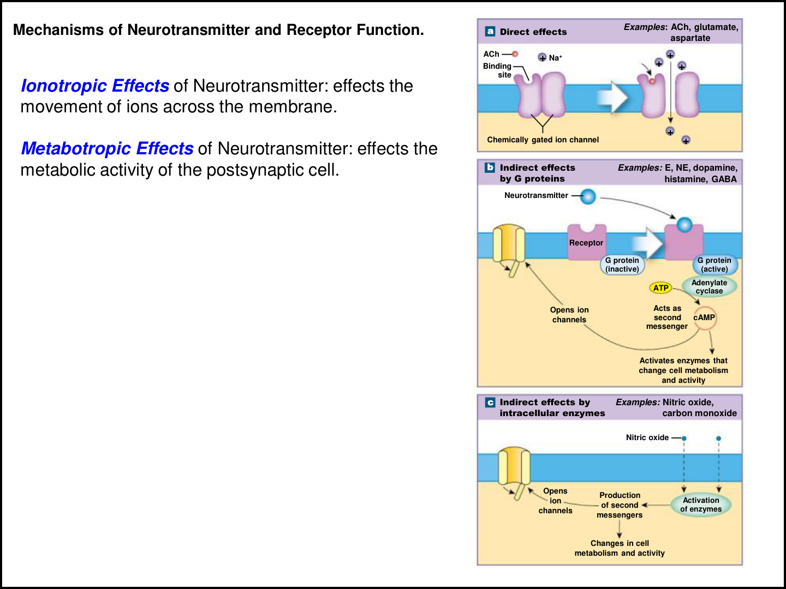
03 • SYNAPSES + INTEGRATION
LECTURE PRIORITY
Receptor type determines the response
DIRECT / IONOTROPIC
Transmitter binding opens or closes an ion channel
directly; membrane permeability changes.
INDIRECT / METABOTROPIC
A receptor activates a G protein and intracellular
signaling steps rather than directly opening the
channel.
SECOND-MESSENGER EXAMPLE
Activated G-protein signaling can activate
adenylate cyclase, which converts ATP into cAMP;
cAMP changes channels or enzyme activity.
FIRST VERSUS SECOND
The extracellular transmitter is the first messenger.
cAMP is an intracellular second messenger.
REMEMBER
Ionotropic: ion gate. Metabotropic: messenger steps.
Book pp. 421–424; C12 L3 slide 4; T-C.
044
Notes:
SOURCE BASIS
Book pp. 421–424; C12 L3 slide 4; T-C.
Source caution: the transcript appears to convert adenylate cyclase itself into cAMP. The textbook says the enzyme converts ATP to cAMP. Keep the enzyme, substrate and product separate. The lecture mentions later activation of protein kinase as an extension of this pathway.
TEACH-BACK
Ionotropic: ion gate. Metabotropic: messenger steps.
DIRECT / IONOTROPIC: Transmitter binding opens or closes an ion channel directly; membrane permeability changes.
INDIRECT / METABOTROPIC: A receptor activates a G protein and intracellular signaling steps rather than directly opening the channel.
SECOND-MESSENGER EXAMPLE: Activated G-protein signaling can activate adenylate cyclase, which converts ATP into cAMP; cAMP changes channels or enzyme activity.
FIRST VERSUS SECOND: The extracellular transmitter is the first messenger. cAMP is an intracellular second messenger.
Memory cues and practice questions are review aids created for this deck, not quotations or actual exam questions. Consult the provided source where a caution is marked.

Slide 45
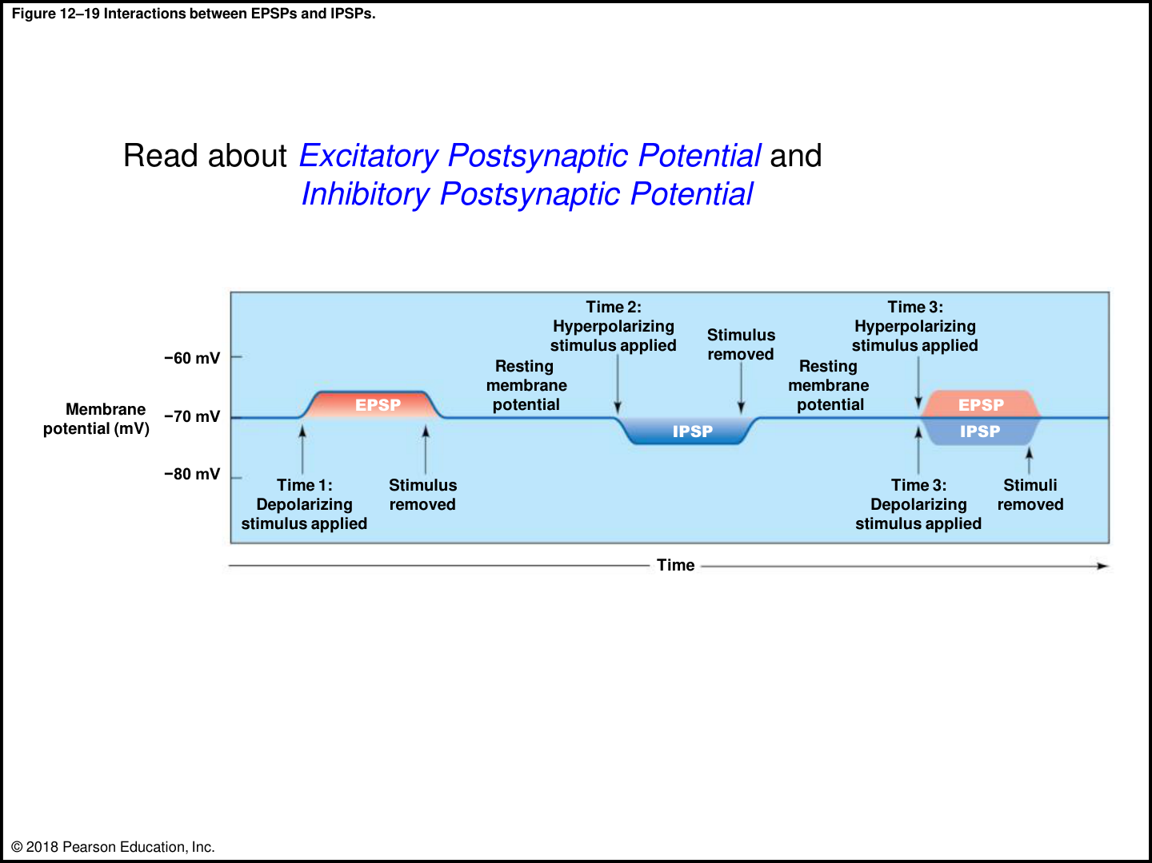
03 • SYNAPSES + INTEGRATION
LECTURE PRIORITY
EPSPs and IPSPs: closer to or farther from firing?
EPSP
Excitatory postsynaptic potential: a graded
depolarization that makes reaching threshold more
likely.
IPSP
Inhibitory postsynaptic potential: the chapter’s
example is graded hyperpolarization, making
threshold harder to reach.
CHANNEL EXAMPLES
Na+ entry can depolarize. K+ exit can
hyperpolarize; the book’s transmitter table also
includes inhibitory Cl− channels.
NET EFFECT
A neuron integrates simultaneous excitatory and
inhibitory input. The balance at the trigger region
matters.
REMEMBER
EPSP = easier. IPSP = inhibited. Neither is itself an axonal AP.
Book pp. 422, 425–427; C12 L3 slide 6; T-C.
045
Notes:
SOURCE BASIS
Book pp. 422, 425–427; C12 L3 slide 6; T-C.
TEACH-BACK
EPSP = easier. IPSP = inhibited. Neither is itself an axonal AP.
EPSP: Excitatory postsynaptic potential: a graded depolarization that makes reaching threshold more likely.
IPSP: Inhibitory postsynaptic potential: the chapter’s example is graded hyperpolarization, making threshold harder to reach.
CHANNEL EXAMPLES: Na+ entry can depolarize. K+ exit can hyperpolarize; the book’s transmitter table also includes inhibitory Cl− channels.
NET EFFECT: A neuron integrates simultaneous excitatory and inhibitory input. The balance at the trigger region matters.
Memory cues and practice questions are review aids created for this deck, not quotations or actual exam questions. Consult the provided source where a caution is marked.

Slide 46
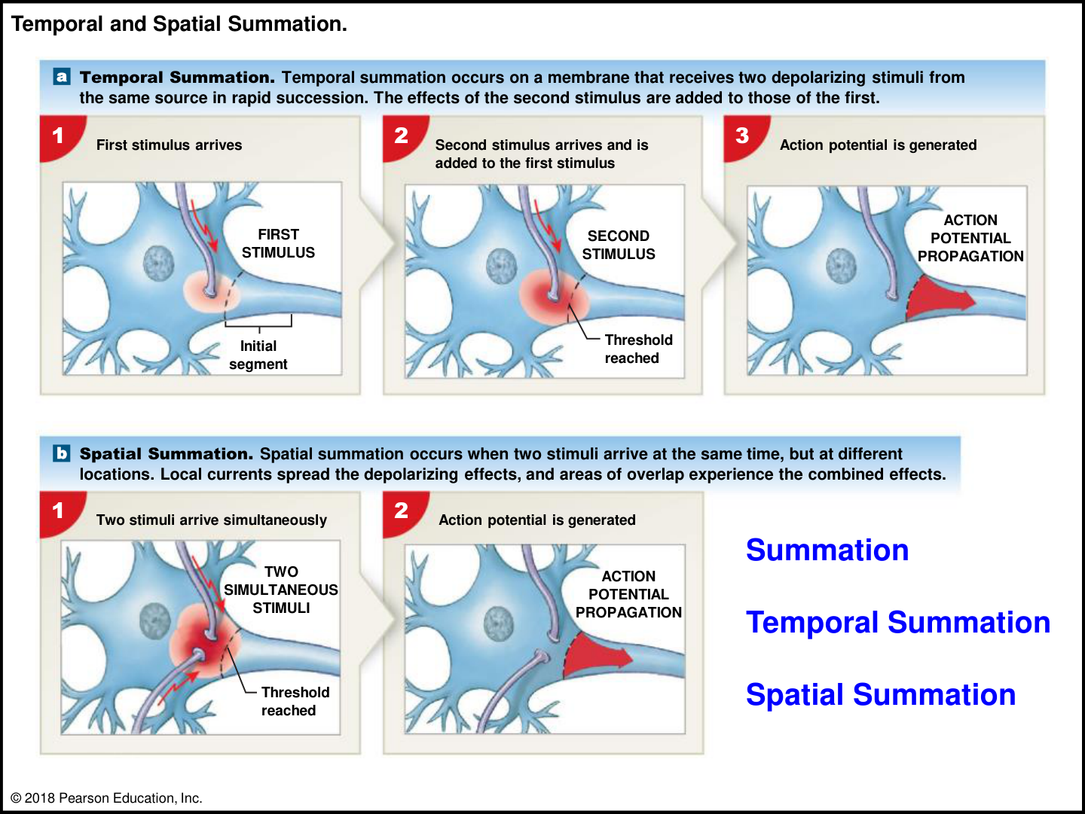
03 • SYNAPSES + INTEGRATION
LECTURE PRIORITY
Temporal versus spatial summation
TEMPORAL
Repeated input at one synapse arrives close
enough in time that a new effect adds to the
previous one.
SPATIAL
Inputs from multiple synapses arrive
together and combine across locations.
WHAT SUMS?
Graded postsynaptic potentials—not the
amplitude of action potentials.
THRESHOLD TEST
The combined effect must sufficiently
depolarize the initial segment; inhibitory
input may cancel some excitation.
REMEMBER
Temporal = time at one place. Spatial = several places at once.
Book pp. 425–427; C12 L3 slides 5–6; T-C.
046
Notes:
SOURCE BASIS
Book pp. 425–427; C12 L3 slides 5–6; T-C.
TEACH-BACK
Temporal = time at one place. Spatial = several places at once.
TEMPORAL: Repeated input at one synapse arrives close enough in time that a new effect adds to the previous one.
SPATIAL: Inputs from multiple synapses arrive together and combine across locations.
WHAT SUMS?: Graded postsynaptic potentials—not the amplitude of action potentials.
THRESHOLD TEST: The combined effect must sufficiently depolarize the initial segment; inhibitory input may cancel some excitation.
Memory cues and practice questions are review aids created for this deck, not quotations or actual exam questions. Consult the provided source where a caution is marked.

Slide 47
03 • SYNAPSES + INTEGRATION
APPLY IT
Do the voltage arithmetic—then interpret it
SETUP
EXAMPLE A
For this simplified exercise, rest is −70
mV, threshold is −55 mV, and the stated
effects reach the trigger region.
Three simultaneous +5 mV EPSPs give
−55 mV: threshold is reached.
EXAMPLE B
EXAMPLE C
Three +5 mV EPSPs plus one −5 mV
IPSP give −60 mV: still below threshold.
Starting at −85 mV, a +15 mV
depolarization gives −70 mV—not an
action potential.
REMEMBER
Calculate the final voltage, not just the size of the change.
Based on Book pp. 425–428 and T-C examples. New simplified practice calculations.
047
Notes:
SOURCE BASIS
Based on Book pp. 425–428 and T-C examples. New simplified practice calculations.
Real synaptic effects depend on time, location and channel properties. Here the problem explicitly supplies a simplified sum at the trigger region. Students should not silently add local synaptic voltages measured at unrelated locations as though attenuation did not exist.
TEACH-BACK
Calculate the final voltage, not just the size of the change.
SETUP: For this simplified exercise, rest is −70 mV, threshold is −55 mV, and the stated effects reach the trigger region.
EXAMPLE A: Three simultaneous +5 mV EPSPs give −55 mV: threshold is reached.
EXAMPLE B: Three +5 mV EPSPs plus one −5 mV IPSP give −60 mV: still below threshold.
EXAMPLE C: Starting at −85 mV, a +15 mV depolarization gives −70 mV—not an action potential.
Memory cues and practice questions are review aids created for this deck, not quotations or actual exam questions. Consult the provided source where a caution is marked.

Slide 48
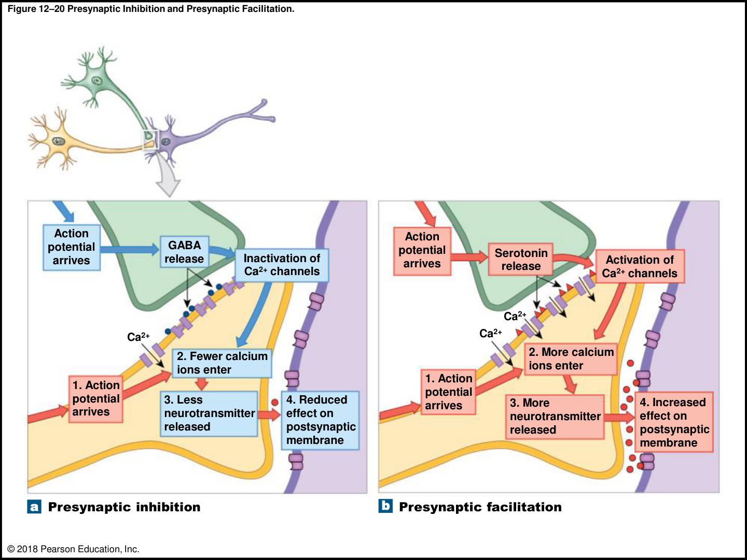
03 • SYNAPSES + INTEGRATION
LECTURE PRIORITY
Presynaptic inhibition versus facilitation
INHIBITION EXAMPLE
An axoaxonic input releases GABA; Ca2+ entry
at the target terminal is reduced, so less
neurotransmitter is released.
FACILITATION EXAMPLE
An axoaxonic input involving serotonin
prolongs/enhances Ca2+ entry, increasing
transmitter release.
WHERE IS THE CHANGE?
At the presynaptic terminal before that terminal
communicates across its main synapse.
COMPARE WITH IPSP
An IPSP describes the target cell’s graded
postsynaptic response. Presynaptic inhibition
changes how much transmitter arrives.
REMEMBER
Less Ca2+ → less release. More Ca2+ → more release.
Book p. 427; C12 L3 slide 7; T-C.
048
Notes:
SOURCE BASIS
Book p. 427; C12 L3 slide 7; T-C.
Presynaptic means the location relative to the regulated synapse; it should not be reduced to the everyday meaning “something happened earlier in time.”
TEACH-BACK
Less Ca2+ → less release. More Ca2+ → more release.
INHIBITION EXAMPLE: An axoaxonic input releases GABA; Ca2+ entry at the target terminal is reduced, so less neurotransmitter is released.
FACILITATION EXAMPLE: An axoaxonic input involving serotonin prolongs/enhances Ca2+ entry, increasing transmitter release.
WHERE IS THE CHANGE?: At the presynaptic terminal before that terminal communicates across its main synapse.
COMPARE WITH IPSP: An IPSP describes the target cell’s graded postsynaptic response. Presynaptic inhibition changes how much transmitter arrives.
Memory cues and practice questions are review aids created for this deck, not quotations or actual exam questions. Consult the provided source where a caution is marked.

Slide 49
03 • SYNAPSES + INTEGRATION
PARTNER CHECK
Checkpoint 3 | synapses
1. Why does blocking terminal Ca2+ channels reduce communication
across a chemical synapse?
2. Five inputs arrive at different synapses at the same time. What kind of
summation is this?
3. In the cAMP example, what is the enzyme, what is its substrate, and
what is the product?
4. How does presynaptic inhibition differ from a postsynaptic IPSP?
REMEMBER
Take turns: answer without looking, explain why, then reveal the next slide.
Book pp. 418–427; C12 L3. Original practice questions.
049
Notes:
SOURCE BASIS
Book pp. 418–427; C12 L3. Original practice questions.
TEACH-BACK
Take turns: answer without looking, explain why, then reveal the next slide.
1. Why does blocking terminal Ca2+ channels reduce communication across a chemical synapse?
2. Five inputs arrive at different synapses at the same time. What kind of summation is this?
3. In the cAMP example, what is the enzyme, what is its substrate, and what is the product?
4. How does presynaptic inhibition differ from a postsynaptic IPSP?
Memory cues and practice questions are review aids created for this deck, not quotations or actual exam questions. Consult the provided source where a caution is marked.

Slide 50
03 • SYNAPSES + INTEGRATION
ANSWER KEY
Checkpoint 3 | synapses | answers
1. Less Ca2+ enters; fewer vesicles release transmitter; the postsynaptic effect
decreases.
2. Spatial summation. Repeated input at one location in rapid succession is
temporal summation.
3. Adenylate cyclase is the enzyme; ATP is converted into the second messenger
cAMP.
4. Presynaptic inhibition reduces release from the sending terminal. An IPSP is an
inhibitory graded response in the receiving membrane.
REMEMBER
A correct label is only half the job. Explain the structure, mechanism, or consequence.
Book pp. 418–427; C12 L3. Original practice questions.
050
Notes:
SOURCE BASIS
Book pp. 418–427; C12 L3. Original practice questions.
TEACH-BACK
A correct label is only half the job. Explain the structure, mechanism, or consequence.
1. Less Ca2+ enters; fewer vesicles release transmitter; the postsynaptic effect decreases.
2. Spatial summation. Repeated input at one location in rapid succession is temporal summation.
3. Adenylate cyclase is the enzyme; ATP is converted into the second messenger cAMP.
4. Presynaptic inhibition reduces release from the sending terminal. An IPSP is an inhibitory graded response in the receiving membrane.
Memory cues and practice questions are review aids created for this deck, not quotations or actual exam questions. Consult the provided source where a caution is marked.

Slide 51
04 • SPINAL CORD ANATOMY
4
Build the spinal cord map
Orient the cord, protect it, locate its nuclei, and trace information through the roots.
Use the memory cues, then explain the mechanism without reading.
051
Notes:
SOURCE BASIS
TEACH-BACK
Orient the cord, protect it, locate its nuclei, and trace information through the roots.
Memory cues and practice questions are review aids created for this deck, not quotations or actual exam questions. Consult the provided source where a caution is marked.

Slide 52
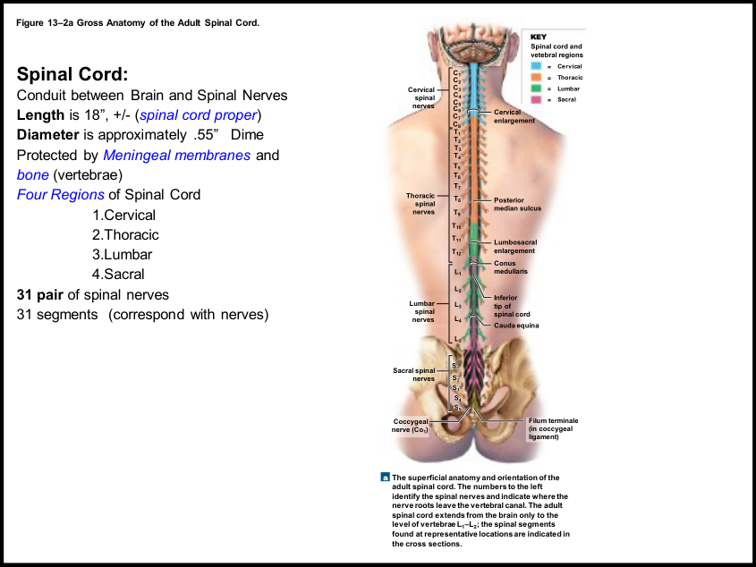
04 • SPINAL CORD ANATOMY
LECTURE PRIORITY
Spinal cord: conduit and reflex center
GENERAL SIZE
The supplied book gives about 45 cm / 18 inches
long and a maximum width near 14 mm / 0.55
inches.
FOUR REGIONS
Cervical, thoracic, lumbar and sacral. Thirty-one
segments correspond to 31 pairs of spinal nerves.
TWO ENLARGEMENTS
Cervical enlargement serves upper limbs;
lumbosacral enlargement serves pelvic structures
and lower limbs.
TWO BIG JOBS
Conduct sensory and motor information between
brain and body; organize spinal reflex responses
locally.
REMEMBER
Two enlargements for two sets of limbs—not a thoracic enlargement.
Book pp. 434–437; C13 L1 slides 1–4; T-C.
052
Notes:
SOURCE BASIS
Book pp. 434–437; C13 L1 slides 1–4; T-C.
TEACH-BACK
Two enlargements for two sets of limbs—not a thoracic enlargement.
GENERAL SIZE: The supplied book gives about 45 cm / 18 inches long and a maximum width near 14 mm / 0.55 inches.
FOUR REGIONS: Cervical, thoracic, lumbar and sacral. Thirty-one segments correspond to 31 pairs of spinal nerves.
TWO ENLARGEMENTS: Cervical enlargement serves upper limbs; lumbosacral enlargement serves pelvic structures and lower limbs.
TWO BIG JOBS: Conduct sensory and motor information between brain and body; organize spinal reflex responses locally.
Memory cues and practice questions are review aids created for this deck, not quotations or actual exam questions. Consult the provided source where a caution is marked.

Slide 53
04 • SPINAL CORD ANATOMY
LECTURE PRIORITY
31 spinal nerve pairs: understand the naming rule
Region
Pairs
Exit / naming detail
Cervical
8 (C1–C8)
C1–C7 exit above their
matching vertebrae; C8 exits
between C7 and T1
Thoracic
12 (T1–T12)
Exit below the matching
vertebra
Lumbar
5 (L1–L5)
Exit below the matching
vertebra
Sacral
5 (S1–S5)
Sacral pairs continue the
regional numbering
Coccygeal
1 (Co1)
Completes the 31-pair total
REMEMBER
8 + 12 + 5 + 5 + 1 = 31. Seven cervical vertebrae, eight cervical nerve pairs.
Book pp. 436–438; C13 L1 slides 3–8; T-C.
053
Notes:
SOURCE BASIS
Book pp. 436–438; C13 L1 slides 3–8; T-C.
Do not confuse spinal nerve numbering, spinal cord segment position and vertebral level. Below the upper cervical region they do not remain aligned point-for-point as the vertebral column grows.
TEACH-BACK
8 + 12 + 5 + 5 + 1 = 31. Seven cervical vertebrae, eight cervical nerve pairs.
Cervical | 8 (C1–C8) | C1–C7 exit above their matching vertebrae; C8 exits between C7 and T1
Thoracic | 12 (T1–T12) | Exit below the matching vertebra
Lumbar | 5 (L1–L5) | Exit below the matching vertebra
Sacral | 5 (S1–S5) | Sacral pairs continue the regional numbering
Coccygeal | 1 (Co1) | Completes the 31-pair total
Memory cues and practice questions are review aids created for this deck, not quotations or actual exam questions. Consult the provided source where a caution is marked.

Slide 54
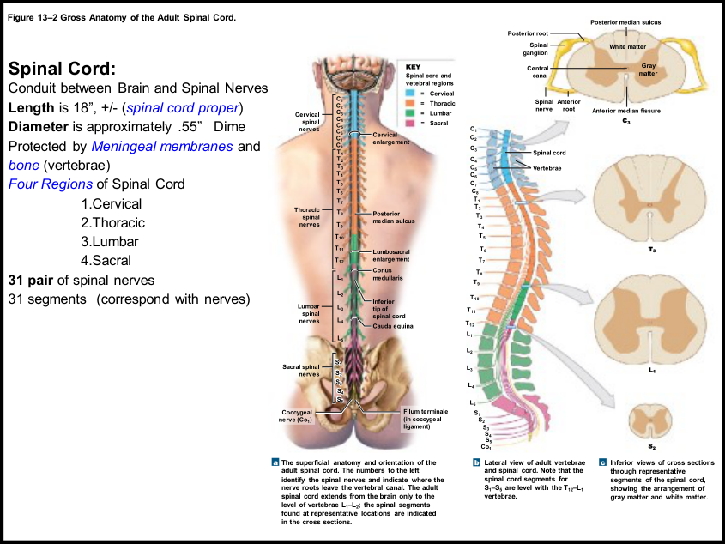
04 • SPINAL CORD ANATOMY
LECTURE PRIORITY
Conus, cauda and filum: three different things
CONUS MEDULLARIS
Tapered inferior end of the spinal cord proper,
near vertebral levels L1–L2 in the adult.
CAUDA EQUINA
Long descending nerve roots below the conus;
the “horse’s tail,” not another solid spinal cord.
FILUM TERMINALE
Slender supporting strand extending from the
conus and contributing to the coccygeal
ligament.
WHY THE LONG ROOTS?
The vertebral column grows longer than the
cord; lower roots travel downward to their
exit sites.
REMEMBER
Conus = cone. Cauda = tail. Filum = thread.
Book pp. 436–438; C13 L1 slides 3–8; T-C.
054
Notes:
SOURCE BASIS
Book pp. 436–438; C13 L1 slides 3–8; T-C.
The source explains growth by saying cord growth largely keeps pace to about age four, after which vertebral elongation creates the mismatch. Learn the adult anatomical consequence rather than treating the lecture’s age estimate as a measurement for an individual.
TEACH-BACK
Conus = cone. Cauda = tail. Filum = thread.
CONUS MEDULLARIS: Tapered inferior end of the spinal cord proper, near vertebral levels L1–L2 in the adult.
CAUDA EQUINA: Long descending nerve roots below the conus; the “horse’s tail,” not another solid spinal cord.
FILUM TERMINALE: Slender supporting strand extending from the conus and contributing to the coccygeal ligament.
WHY THE LONG ROOTS?: The vertebral column grows longer than the cord; lower roots travel downward to their exit sites.
Memory cues and practice questions are review aids created for this deck, not quotations or actual exam questions. Consult the provided source where a caution is marked.

Slide 55
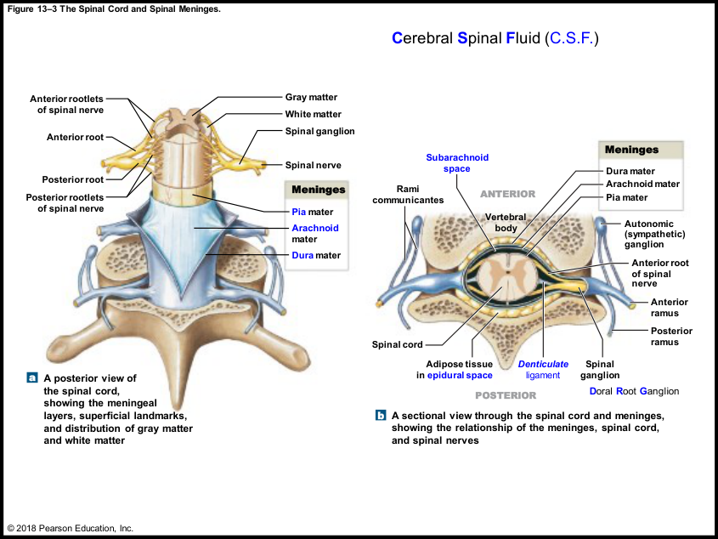
04 • SPINAL CORD ANATOMY
LECTURE PRIORITY
Meninges: three layers from outside inward
DURA MATER
Tough outer fibrous covering. “Hard mother”
is the lecture’s translation cue.
ARACHNOID MATER
Middle layer with web-like trabeculae
spanning toward the pia.
PIA MATER
Delicate inner covering tightly attached to
neural tissue; related to the cord’s surface
blood vessels.
CONTINUITY
Spinal meninges are continuous with cranial
meninges at the foramen magnum.
REMEMBER
D–A–P: Dura, Arachnoid, Pia. Pia is pasted to the cord.
Book pp. 438–439; C13 L1 slides 9–10; T-C.
055
Notes:
SOURCE BASIS
Book pp. 438–439; C13 L1 slides 9–10; T-C.
TEACH-BACK
D–A–P: Dura, Arachnoid, Pia. Pia is pasted to the cord.
DURA MATER: Tough outer fibrous covering. “Hard mother” is the lecture’s translation cue.
ARACHNOID MATER: Middle layer with web-like trabeculae spanning toward the pia.
PIA MATER: Delicate inner covering tightly attached to neural tissue; related to the cord’s surface blood vessels.
CONTINUITY: Spinal meninges are continuous with cranial meninges at the foramen magnum.
Memory cues and practice questions are review aids created for this deck, not quotations or actual exam questions. Consult the provided source where a caution is marked.

Slide 56
04 • SPINAL CORD ANATOMY
LECTURE PRIORITY
The spaces are not interchangeable
Space
Where?
What is important?
Epidural
Between vertebral canal wall and spinal dura
Fat, loose connective tissue and
vessels; epidural anesthetic
location
Subdural
Between dura and arachnoid
Book describes a
potential/artifactual separation,
not a normal open fluid space
Subarachnoid
Between arachnoid and pia
Contains CSF, trabeculae and
vessels
Central canal
Inside the spinal cord
Also contains CSF; not a
meningeal space
REMEMBER
CSF around the cord = SUBARACHNOID, not epidural.
Book pp. 437–440; C13 L1 slide 9; T-C.
056
Notes:
SOURCE BASIS
Book pp. 437–440; C13 L1 slide 9; T-C.
The textbook describes lumbar puncture as accessing the lower lumbar subarachnoid space and contrasts epidural with spinal anesthesia. This is anatomical context, not an instruction for performing a procedure. CSF provides cushioning and a medium for transport of dissolved substances.
TEACH-BACK
CSF around the cord = SUBARACHNOID, not epidural.
Epidural | Between vertebral canal wall and spinal dura | Fat, loose connective tissue and vessels; epidural anesthetic location
Subdural | Between dura and arachnoid | Book describes a potential/artifactual separation, not a normal open fluid space
Subarachnoid | Between arachnoid and pia | Contains CSF, trabeculae and vessels
Central canal | Inside the spinal cord | Also contains CSF; not a meningeal space
Memory cues and practice questions are review aids created for this deck, not quotations or actual exam questions. Consult the provided source where a caution is marked.

Slide 57
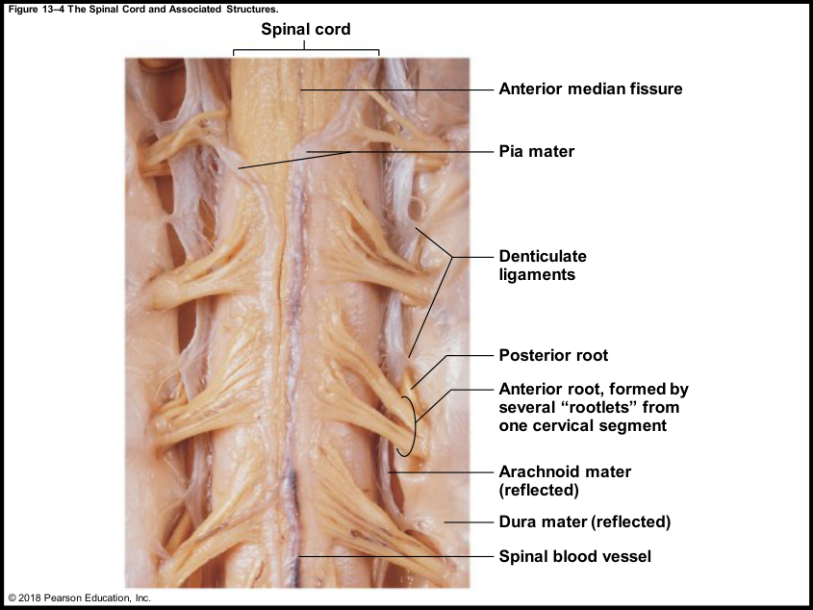
04 • SPINAL CORD ANATOMY
SOURCE CAUTION
Keep the cord stable
DENTICULATE LIGAMENTS
Extensions of pia that pass through the arachnoid
toward dura; resist side-to-side movement.
LONGITUDINAL SUPPORT
Dural attachments at the foramen magnum and
the filum/coccygeal ligament complex resist
superior–inferior shifting.
WHY IT MATTERS
Roots leave through fixed exits. Excessive motion
would stretch or damage neural connections.
SOURCE CAUTION
The transcript/handout mention “cruciform
ligaments” and vertebral attachment. The textbook
describes dural attachment at the foramen
magnum and pia-to-dura denticulate ligaments.
REMEMBER
Denticulate = lateral support. Filum/coccygeal support = lengthwise stability.
Book pp. 438–439; C13 L1 slides 7–10; T-C.
057
Notes:
SOURCE BASIS
Book pp. 438–439; C13 L1 slides 7–10; T-C.
Use the textbook-supported structure/function explanation here. Ask the instructor which attachment terminology he expects if this discrepancy appears in an exam review.
TEACH-BACK
Denticulate = lateral support. Filum/coccygeal support = lengthwise stability.
DENTICULATE LIGAMENTS: Extensions of pia that pass through the arachnoid toward dura; resist side-to-side movement.
LONGITUDINAL SUPPORT: Dural attachments at the foramen magnum and the filum/coccygeal ligament complex resist superior–inferior shifting.
WHY IT MATTERS: Roots leave through fixed exits. Excessive motion would stretch or damage neural connections.
SOURCE CAUTION: The transcript/handout mention “cruciform ligaments” and vertebral attachment. The textbook describes dural attachment at the foramen magnum and pia-to-dura denticulate ligaments.
Memory cues and practice questions are review aids created for this deck, not quotations or actual exam questions. Consult the provided source where a caution is marked.

Slide 58
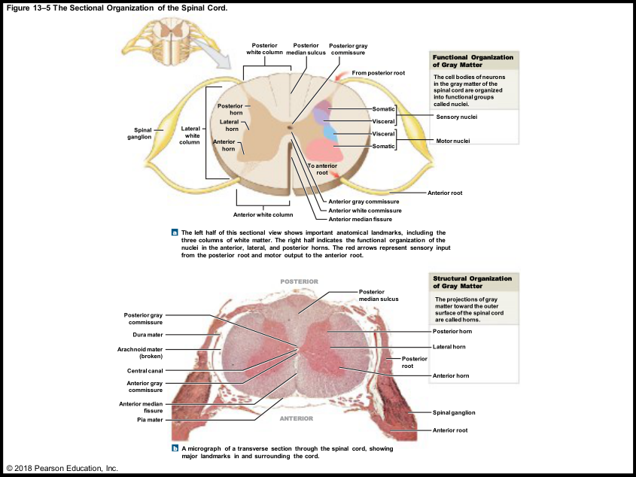
04 • SPINAL CORD ANATOMY
LECTURE PRIORITY
Spinal cord cross-section: orient before labeling
POSTERIOR
Posterior median sulcus is the shallower midline
groove; posterior/dorsal horns lie toward it.
ANTERIOR
Anterior median fissure is the deeper midline
indentation; anterior/ventral horns are on this
side.
GRAY CENTER
Butterfly/H-shaped gray matter surrounds the
central canal. Gray commissures bridge the two
halves.
WHITE OUTSIDE
Posterior, lateral and anterior white columns
surround the gray matter; the anterior white
commissure crosses the midline.
REMEMBER
Find the deep anterior fissure first; then name every other part relative to it.
Book pp. 437, 440–441; C13 L1 slides 11–13; T-C.
058
Notes:
SOURCE BASIS
Book pp. 437, 440–441; C13 L1 slides 11–13; T-C.
TEACH-BACK
Find the deep anterior fissure first; then name every other part relative to it.
POSTERIOR: Posterior median sulcus is the shallower midline groove; posterior/dorsal horns lie toward it.
ANTERIOR: Anterior median fissure is the deeper midline indentation; anterior/ventral horns are on this side.
GRAY CENTER: Butterfly/H-shaped gray matter surrounds the central canal. Gray commissures bridge the two halves.
WHITE OUTSIDE: Posterior, lateral and anterior white columns surround the gray matter; the anterior white commissure crosses the midline.
Memory cues and practice questions are review aids created for this deck, not quotations or actual exam questions. Consult the provided source where a caution is marked.

Slide 59
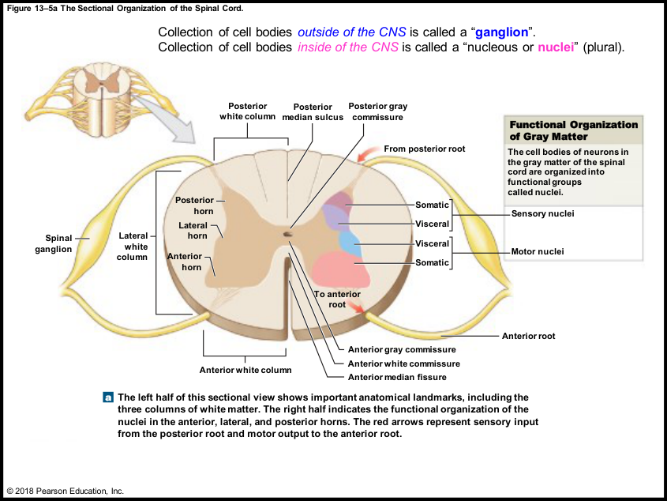
04 • SPINAL CORD ANATOMY
LECTURE PRIORITY
The high-priority nuclei pattern: S–V–V–S
POSTERIOR → ANTERIOR
Somatic sensory; visceral sensory; visceral
motor; somatic motor.
SENSORY HALF
Posterior horn nuclei receive and integrate
incoming information.
MOTOR HALF
Lateral horn nuclei contribute visceral motor
output; anterior horn nuclei contribute
somatic motor output.
EXAM CUE
The professor explicitly flagged the
organization of this diagram as something
students should know.
REMEMBER
S–V–V–S: the outer labels are Somatic; the middle labels are Visceral. Sensory above, motor below in this
figure.
Book pp. 440–441; C13 L1 slides 12–13; T-C.
059
Notes:
SOURCE BASIS
Book pp. 440–441; C13 L1 slides 12–13; T-C.
The book places lateral horns prominently in thoracic/lumbar segments. Use the illustrated orientation rather than assuming “above” always means posterior on every rotated image. Nuclei extend longitudinally and contain subgroups controlling particular muscle regions.
TEACH-BACK
S–V–V–S: the outer labels are Somatic; the middle labels are Visceral. Sensory above, motor below in this figure.
POSTERIOR → ANTERIOR: Somatic sensory; visceral sensory; visceral motor; somatic motor.
SENSORY HALF: Posterior horn nuclei receive and integrate incoming information.
MOTOR HALF: Lateral horn nuclei contribute visceral motor output; anterior horn nuclei contribute somatic motor output.
EXAM CUE: The professor explicitly flagged the organization of this diagram as something students should know.
Memory cues and practice questions are review aids created for this deck, not quotations or actual exam questions. Consult the provided source where a caution is marked.

Slide 60
04 • SPINAL CORD ANATOMY
LECTURE PRIORITY
Dorsal root in; ventral root out; nerve is mixed
DORSAL / POSTERIOR ROOT
Sensory afferent fibers enter the spinal cord. The
dorsal root ganglion contains their cell bodies.
VENTRAL / ANTERIOR ROOT
Motor efferent axons leave. Their cell bodies are
in the CNS, so there is no equivalent ventral root
ganglion.
SPINAL NERVE
After roots join, the spinal nerve contains both
sensory and motor fibers.
RAMI
Posterior and anterior rami also contain mixed
fibers. A posterior ramus is not the same
structure as a posterior root.
REMEMBER
DAVE: Dorsal Afferent; Ventral Efferent. Root ≠ ramus.
Book pp. 437–438, 440–445; C13 L1 slides 9, 12; T-C/T-D.
060
Notes:
SOURCE BASIS
Book pp. 437–438, 440–445; C13 L1 slides 9, 12; T-C/T-D.
TEACH-BACK
DAVE: Dorsal Afferent; Ventral Efferent. Root ≠ ramus.
DORSAL / POSTERIOR ROOT: Sensory afferent fibers enter the spinal cord. The dorsal root ganglion contains their cell bodies.
VENTRAL / ANTERIOR ROOT: Motor efferent axons leave. Their cell bodies are in the CNS, so there is no equivalent ventral root ganglion.
SPINAL NERVE: After roots join, the spinal nerve contains both sensory and motor fibers.
RAMI: Posterior and anterior rami also contain mixed fibers. A posterior ramus is not the same structure as a posterior root.
Memory cues and practice questions are review aids created for this deck, not quotations or actual exam questions. Consult the provided source where a caution is marked.

Slide 61
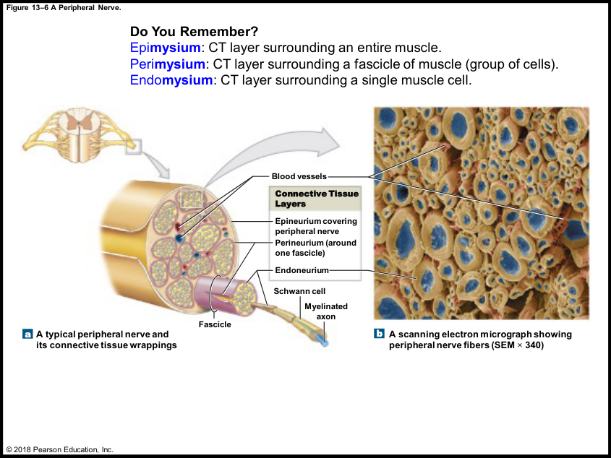
04 • SPINAL CORD ANATOMY
LECTURE PRIORITY
Peripheral nerve coverings: reuse the muscle pattern
ENDONEURIUM
Delicate connective tissue around individual
axons.
PERINEURIUM
Connective tissue around a fascicle—a
bundle of axons.
EPINEURIUM
Outer connective tissue around the whole
nerve.
PURPOSE
Support, protection from mechanical stress,
and routes for vessels supplying the nerve.
REMEMBER
Endo = each axon; peri = packet; epi = entire nerve.
Book p. 442; C13 L1 slide 14; T-A/T-C.
061
Notes:
SOURCE BASIS
Book p. 442; C13 L1 slide 14; T-A/T-C.
The corresponding muscle terms are endomysium, perimysium and epimysium. A nerve fascicle is a group of axons; a skeletal muscle fascicle is a group of muscle fibers.
TEACH-BACK
Endo = each axon; peri = packet; epi = entire nerve.
ENDONEURIUM: Delicate connective tissue around individual axons.
PERINEURIUM: Connective tissue around a fascicle—a bundle of axons.
EPINEURIUM: Outer connective tissue around the whole nerve.
PURPOSE: Support, protection from mechanical stress, and routes for vessels supplying the nerve.
Memory cues and practice questions are review aids created for this deck, not quotations or actual exam questions. Consult the provided source where a caution is marked.

Slide 62
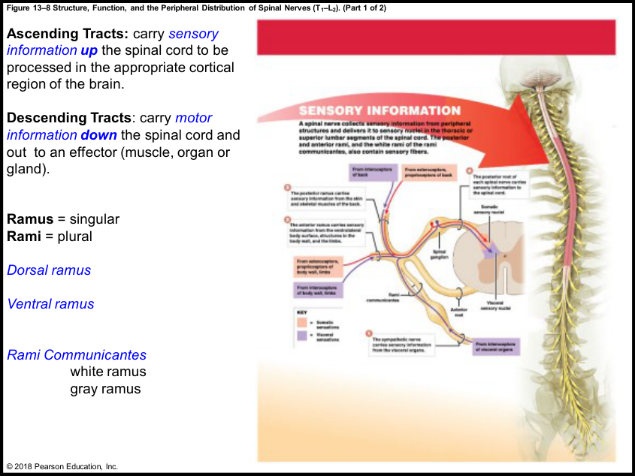
04 • SPINAL CORD ANATOMY
LECTURE PRIORITY
White-matter tracts: direction and destination
ASCENDING
Carry sensory information toward the brain. The
lecture uses spinothalamic as an example.
DESCENDING
Carry motor commands from brain toward spinal
levels. The lecture uses corticospinal as an
example.
NAME CLUE
The prefix often identifies the origin and the
suffix the destination: spino–thalamic;
cortico–spinal.
ORGANIZATION
A tract groups axons with similar
functions/direction. Shorter tracts can link spinal
segments; longer ones connect cord and brain.
REMEMBER
Ascending arrives at the brain; descending delivers motor commands downward.
Book p. 440; C13 L2 slides 3–4; T-D.
062
Notes:
SOURCE BASIS
Book p. 440; C13 L2 slides 3–4; T-D.
The lecture connects these examples to the thalamus and cortical sensory/motor regions. Detailed tract courses belong to later chapters; do not invent additional pathway crossings not provided in this material.
TEACH-BACK
Ascending arrives at the brain; descending delivers motor commands downward.
ASCENDING: Carry sensory information toward the brain. The lecture uses spinothalamic as an example.
DESCENDING: Carry motor commands from brain toward spinal levels. The lecture uses corticospinal as an example.
NAME CLUE: The prefix often identifies the origin and the suffix the destination: spino–thalamic; cortico–spinal.
ORGANIZATION: A tract groups axons with similar functions/direction. Shorter tracts can link spinal segments; longer ones connect cord and brain.
Memory cues and practice questions are review aids created for this deck, not quotations or actual exam questions. Consult the provided source where a caution is marked.

Slide 63
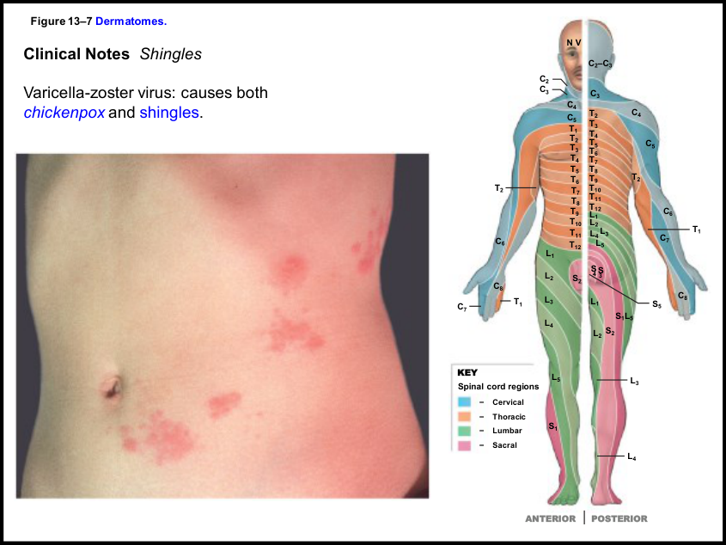
04 • SPINAL CORD ANATOMY
LECTURE PRIORITY
Dermatomes: know the concept, not the whole map
DEFINITION
A skin territory supplied by a particular spinal
nerve/root; the book depicts bilateral territories
for a pair.
OVERLAP
Adjacent territories overlap, so the boundaries
are not isolated hard lines.
APPLICATION
Sensory changes can help localize a nerve/root
problem; the chapter uses shingles as a
recognizable distribution example.
LECTURE LIMIT
The professor says to understand what a
dermatome is, but not to memorize the complete
labeled map for this exam.
REMEMBER
DERM = skin; TOME = territory for this memory aid.
Book pp. 442–443; C13 L1 slide 15; T-C.
063
Notes:
SOURCE BASIS
Book pp. 442–443; C13 L1 slide 15; T-C.
Varicella-zoster is the virus associated with chickenpox and shingles in the handout. The book’s clinical note has internally inconsistent statements about neuron location and older treatment/vaccine details; those are not used for medical advice or added to the exam sheet.
TEACH-BACK
DERM = skin; TOME = territory for this memory aid.
DEFINITION: A skin territory supplied by a particular spinal nerve/root; the book depicts bilateral territories for a pair.
OVERLAP: Adjacent territories overlap, so the boundaries are not isolated hard lines.
APPLICATION: Sensory changes can help localize a nerve/root problem; the chapter uses shingles as a recognizable distribution example.
LECTURE LIMIT: The professor says to understand what a dermatome is, but not to memorize the complete labeled map for this exam.
Memory cues and practice questions are review aids created for this deck, not quotations or actual exam questions. Consult the provided source where a caution is marked.

Slide 64
04 • SPINAL CORD ANATOMY
PARTNER CHECK
Checkpoint 4 | cord anatomy
1. Name the meningeal layers outside-to-inside. Which space contains CSF
around the cord?
2. What changes after dorsal and ventral roots join?
3. Recite the four functional nuclei groups from posterior toward anterior.
4. Distinguish the conus medullaris, cauda equina and filum terminale.
REMEMBER
Take turns: answer without looking, explain why, then reveal the next slide.
Book pp. 435–445; C13 L1; T-C. Original practice questions.
064
Notes:
SOURCE BASIS
Book pp. 435–445; C13 L1; T-C. Original practice questions.
TEACH-BACK
Take turns: answer without looking, explain why, then reveal the next slide.
1. Name the meningeal layers outside-to-inside. Which space contains CSF around the cord?
2. What changes after dorsal and ventral roots join?
3. Recite the four functional nuclei groups from posterior toward anterior.
4. Distinguish the conus medullaris, cauda equina and filum terminale.
Memory cues and practice questions are review aids created for this deck, not quotations or actual exam questions. Consult the provided source where a caution is marked.

Slide 65
04 • SPINAL CORD ANATOMY
ANSWER KEY
Checkpoint 4 | cord anatomy | answers
1. Dura, arachnoid, pia. CSF around the cord is in the subarachnoid space.
2. A mixed spinal nerve forms: it carries sensory and motor fibers. The separate
roots have different directions/functions.
3. Somatic sensory, visceral sensory, visceral motor, somatic motor.
4. Conus: tapered end of cord proper. Cauda: descending roots. Filum: supporting
fibrous strand.
REMEMBER
A correct label is only half the job. Explain the structure, mechanism, or consequence.
Book pp. 435–445; C13 L1; T-C. Original practice questions.
065
Notes:
SOURCE BASIS
Book pp. 435–445; C13 L1; T-C. Original practice questions.
TEACH-BACK
A correct label is only half the job. Explain the structure, mechanism, or consequence.
1. Dura, arachnoid, pia. CSF around the cord is in the subarachnoid space.
2. A mixed spinal nerve forms: it carries sensory and motor fibers. The separate roots have different directions/functions.
3. Somatic sensory, visceral sensory, visceral motor, somatic motor.
4. Conus: tapered end of cord proper. Cauda: descending roots. Filum: supporting fibrous strand.
Memory cues and practice questions are review aids created for this deck, not quotations or actual exam questions. Consult the provided source where a caution is marked.

Slide 66
05 • PATHWAYS + PLEXUSES
5
Trace the route and identify the target
Use the roots, rami and ganglia correctly before memorizing named nerves.
Use the memory cues, then explain the mechanism without reading.
066
Notes:
SOURCE BASIS
TEACH-BACK
Use the roots, rami and ganglia correctly before memorizing named nerves.
Memory cues and practice questions are review aids created for this deck, not quotations or actual exam questions. Consult the provided source where a caution is marked.

Slide 67
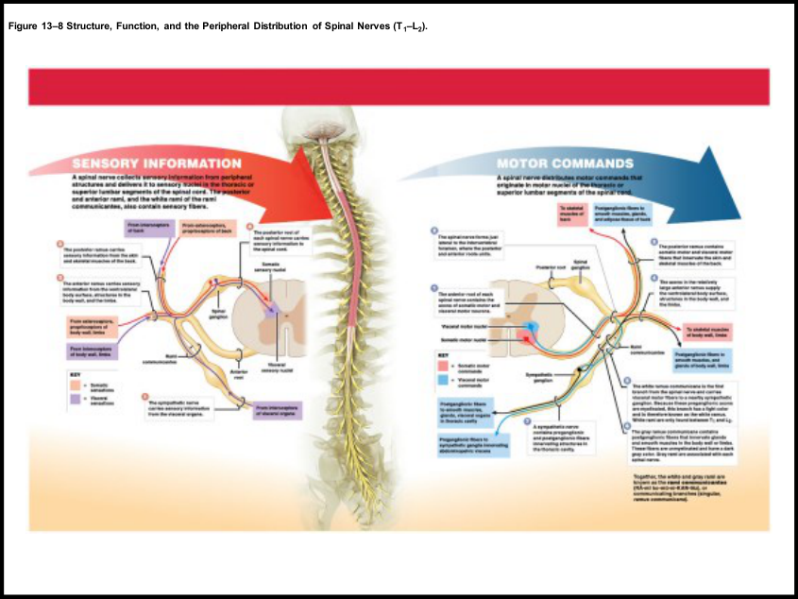
05 • PATHWAYS + PLEXUSES
LECTURE PRIORITY
Rami: branches after the mixed nerve forms
POSTERIOR RAMUS
Supplies sensory and motor fibers to the skin
and muscles of the back.
ANTERIOR RAMUS
Supplies the ventrolateral body wall and limbs;
anterior rami form the major plexuses.
WHITE RAMUS COMMUNICANS
Myelinated preganglionic sympathetic fibers
travel toward a sympathetic ganglion; the
illustrated white ramus also carries visceral
sensory fibers.
GRAY RAMUS COMMUNICANS
Unmyelinated postganglionic fibers return to
spinal-nerve routes for body-wall/limb targets.
REMEMBER
Root = in/out of cord. Ramus = branch to a body region. Communicans = connecting branch.
Book pp. 438, 444–447; C13 L2 slides 1–4; T-D.
067
Notes:
SOURCE BASIS
Book pp. 438, 444–447; C13 L2 slides 1–4; T-D.
Book detail: white rami occur between T1 and L2; gray rami are associated with all spinal nerves. Do not reverse white preganglionic and gray postganglionic routes.
TEACH-BACK
Root = in/out of cord. Ramus = branch to a body region. Communicans = connecting branch.
POSTERIOR RAMUS: Supplies sensory and motor fibers to the skin and muscles of the back.
ANTERIOR RAMUS: Supplies the ventrolateral body wall and limbs; anterior rami form the major plexuses.
WHITE RAMUS COMMUNICANS: Myelinated preganglionic sympathetic fibers travel toward a sympathetic ganglion; the illustrated white ramus also carries visceral sensory fibers.
GRAY RAMUS COMMUNICANS: Unmyelinated postganglionic fibers return to spinal-nerve routes for body-wall/limb targets.
Memory cues and practice questions are review aids created for this deck, not quotations or actual exam questions. Consult the provided source where a caution is marked.

Slide 68
05 • PATHWAYS + PLEXUSES
LECTURE PRIORITY
Trace sensory information inward
BODY WALL / LIMB
Receptor → anterior ramus → mixed spinal nerve
→ dorsal root/DRG → spinal sensory nuclei.
BACK
Receptor → posterior ramus → mixed spinal
nerve → dorsal root/DRG → spinal sensory
nuclei.
VISCERAL EXAMPLE
Visceral receptor → sympathetic-nerve route →
white ramus → spinal nerve → dorsal root/DRG
→ visceral sensory nuclei.
COMMON ENDPOINT
The dorsal root carries sensory information
regardless of whether its source is somatic or
visceral.
REMEMBER
Different origins; same sensory doorway: the dorsal root.
Book p. 444, Fig. 13–8; C13 L2 slide 3; T-D.
068
Notes:
SOURCE BASIS
Book p. 444, Fig. 13–8; C13 L2 slide 3; T-D.
This traces the thoracic/superior lumbar example in the supplied figure, not every possible visceral afferent route in the body. A sensory neuron’s cell body is in the DRG; sensory fibers do not normally synapse there in this model.
TEACH-BACK
Different origins; same sensory doorway: the dorsal root.
BODY WALL / LIMB: Receptor → anterior ramus → mixed spinal nerve → dorsal root/DRG → spinal sensory nuclei.
BACK: Receptor → posterior ramus → mixed spinal nerve → dorsal root/DRG → spinal sensory nuclei.
VISCERAL EXAMPLE: Visceral receptor → sympathetic-nerve route → white ramus → spinal nerve → dorsal root/DRG → visceral sensory nuclei.
COMMON ENDPOINT: The dorsal root carries sensory information regardless of whether its source is somatic or visceral.
Memory cues and practice questions are review aids created for this deck, not quotations or actual exam questions. Consult the provided source where a caution is marked.

Slide 69
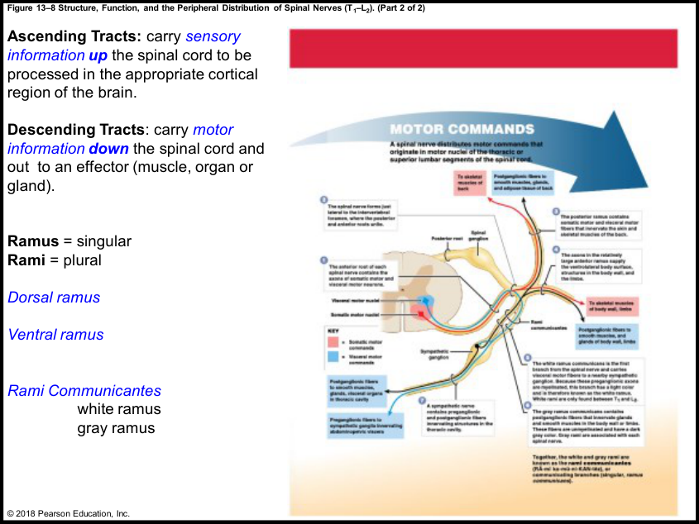
05 • PATHWAYS + PLEXUSES
LECTURE PRIORITY
Trace motor commands outward
SOMATIC ROUTE
CNS somatic motor neuron → ventral root →
spinal nerve → appropriate ramus → skeletal
muscle.
VISCERAL ROUTE
CNS preganglionic neuron → ventral root → spinal
nerve → white ramus → sympathetic ganglion
pathway.
TWO-NEURON CHAIN
Visceral motor signaling in this model uses a
preganglionic neuron, then a postganglionic
neuron to the effector.
TARGETS
Smooth muscle, glands and adipose tissue are not
voluntarily controlled just because their fibers
share a mixed nerve with somatic axons.
REMEMBER
Somatic: one neuron from CNS to muscle. Autonomic example: a ganglion relay.
Book pp. 395, 445; C13 L2 slide 4; T-D.
069
Notes:
SOURCE BASIS
Book pp. 395, 445; C13 L2 slide 4; T-D.
TEACH-BACK
Somatic: one neuron from CNS to muscle. Autonomic example: a ganglion relay.
SOMATIC ROUTE: CNS somatic motor neuron → ventral root → spinal nerve → appropriate ramus → skeletal muscle.
VISCERAL ROUTE: CNS preganglionic neuron → ventral root → spinal nerve → white ramus → sympathetic ganglion pathway.
TWO-NEURON CHAIN: Visceral motor signaling in this model uses a preganglionic neuron, then a postganglionic neuron to the effector.
TARGETS: Smooth muscle, glands and adipose tissue are not voluntarily controlled just because their fibers share a mixed nerve with somatic axons.
Memory cues and practice questions are review aids created for this deck, not quotations or actual exam questions. Consult the provided source where a caution is marked.

Slide 70
05 • PATHWAYS + PLEXUSES
LECTURE PRIORITY
Three sympathetic destinations in the lecture diagram
Destination
What happens at the ganglion?
How to trace it
Body wall / limbs
Preganglionic fiber synapses in chain
ganglion
Postganglionic fiber returns
through gray ramus, then
travels in a spinal nerve/ramus
Thoracic viscera
Relay occurs in a sympathetic ganglion
Postganglionic fibers continue
toward the thoracic organ
Abdominopelvic
viscera
Preganglionic fiber can pass through without
synapsing there
It reaches a more distant
collateral ganglion;
postganglionic fiber then
reaches the organ
REMEMBER
“Pre” and “post” refer to the autonomic ganglion synapse—not distance from the spinal cord.
Book p. 445, Fig. 13–8; C13 L2 slide 4; T-D.
070
Notes:
SOURCE BASIS
Book p. 445, Fig. 13–8; C13 L2 slide 4; T-D.
These three routes are the instructor’s explanation of the diagram. More complete sympathetic anatomy belongs to later chapters. Do not label every fiber passing through a ganglion “postganglionic”; it may not have synapsed yet.
TEACH-BACK
“Pre” and “post” refer to the autonomic ganglion synapse—not distance from the spinal cord.
Body wall / limbs | Preganglionic fiber synapses in chain ganglion | Postganglionic fiber returns through gray ramus, then travels in a spinal nerve/ramus
Thoracic viscera | Relay occurs in a sympathetic ganglion | Postganglionic fibers continue toward the thoracic organ
Abdominopelvic viscera | Preganglionic fiber can pass through without synapsing there | It reaches a more distant collateral ganglion; postganglionic fiber then reaches the organ
Memory cues and practice questions are review aids created for this deck, not quotations or actual exam questions. Consult the provided source where a caution is marked.

Slide 71
05 • PATHWAYS + PLEXUSES
LECTURE PRIORITY
Four plexuses: memorize your course’s ranges
Plexus
Range used in your sources
Broad region
Cervical
C1–C5
Neck and diaphragm
Brachial
C5–T1
Pectoral girdle and upper limb
Lumbar
T12–L4
Pelvic/lower-limb contributions
Sacral
L4–S4
Pelvis and lower limb
REMEMBER
C5 overlaps cervical/brachial; L4 overlaps lumbar/sacral. No separate thoracic plexus in this list.
Book pp. 446–451; C13 L2 slides 5, 9–12; T-D.
071
Notes:
SOURCE BASIS
Book pp. 446–451; C13 L2 slides 5, 9–12; T-D.
A plexus is a sharing/interweaving of fibers from anterior rami. Ranges are explicitly the supplied course/textbook conventions; other references may use different boundary conventions. Do not silently substitute a different range.
TEACH-BACK
C5 overlaps cervical/brachial; L4 overlaps lumbar/sacral. No separate thoracic plexus in this list.
Cervical | C1–C5 | Neck and diaphragm
Brachial | C5–T1 | Pectoral girdle and upper limb
Lumbar | T12–L4 | Pelvic/lower-limb contributions
Sacral | L4–S4 | Pelvis and lower limb
Memory cues and practice questions are review aids created for this deck, not quotations or actual exam questions. Consult the provided source where a caution is marked.

Slide 72
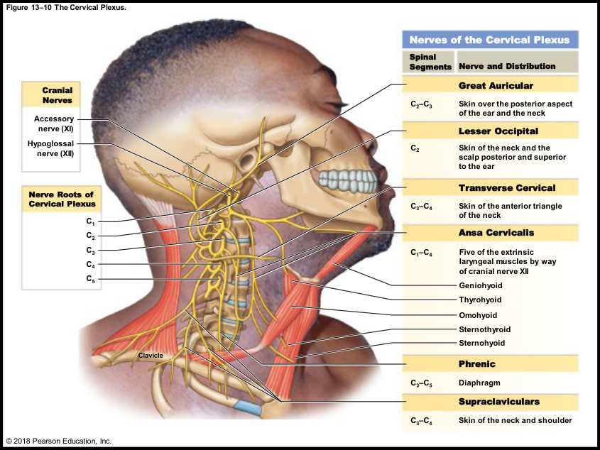
05 • PATHWAYS + PLEXUSES
LECTURE PRIORITY
Cervical plexus: the phrenic nerve is the priority
BOUNDARIES
Know C1–C5 for the plexus in these course
sources.
KEY NERVE
Phrenic nerve receives contributions from
C3, C4 and C5.
KEY TARGET
The diaphragm: a critical breathing muscle.
TEST CUE
The professor specifically says to know this
nerve’s contributing roots, unlike most
detailed individual root lists in the other
plexuses.
REMEMBER
“C3, C4, C5 keep the diaphragm alive.”
Book pp. 447–448; C13 L2 slides 5–6; T-D.
072
Notes:
SOURCE BASIS
Book pp. 447–448; C13 L2 slides 5–6; T-D.
The lecture uses spinal injury levels to illustrate why phrenic innervation matters. Exact clinical consequences depend on the injury; focus on the route and target, not a guaranteed outcome for every lesion.
TEACH-BACK
“C3, C4, C5 keep the diaphragm alive.”
BOUNDARIES: Know C1–C5 for the plexus in these course sources.
KEY NERVE: Phrenic nerve receives contributions from C3, C4 and C5.
KEY TARGET: The diaphragm: a critical breathing muscle.
TEST CUE: The professor specifically says to know this nerve’s contributing roots, unlike most detailed individual root lists in the other plexuses.
Memory cues and practice questions are review aids created for this deck, not quotations or actual exam questions. Consult the provided source where a caution is marked.

Slide 73
05 • PATHWAYS + PLEXUSES
LECTURE PRIORITY
Brachial plexus: four major test targets
Nerve
Lecture-level association
Representative muscles / target
Musculocutaneous
Flexors of the arm
Biceps brachii, brachialis,
coracobrachialis
Median
Forearm/digital flexion; pronation
Flexor carpi radialis, palmaris
longus, pronators; digital flexors
Ulnar
Additional forearm/hand flexors and intrinsic
hand actions
Flexor carpi ulnaris; parts of
deep digital flexors; small hand
muscles
Radial
Extensors of arm and forearm
Triceps brachii and the
wrist/finger extensor group
REMEMBER
Musculocutaneous bends the arm; median/ulnar help flex the forearm/hand; radial extends.
Book p. 448; C13 L2 slides 7–8; T-D.
073
Notes:
SOURCE BASIS
Book p. 448; C13 L2 slides 7–8; T-D.
The professor explicitly de-emphasizes the separate root range for each of these nerves, but wants names and muscle groups. The table summarizes the lecture’s pattern; it is not a claim that every individual muscle supplied by a nerve has the same action.
TEACH-BACK
Musculocutaneous bends the arm; median/ulnar help flex the forearm/hand; radial extends.
Musculocutaneous | Flexors of the arm | Biceps brachii, brachialis, coracobrachialis
Median | Forearm/digital flexion; pronation | Flexor carpi radialis, palmaris longus, pronators; digital flexors
Ulnar | Additional forearm/hand flexors and intrinsic hand actions | Flexor carpi ulnaris; parts of deep digital flexors; small hand muscles
Radial | Extensors of arm and forearm | Triceps brachii and the wrist/finger extensor group
Memory cues and practice questions are review aids created for this deck, not quotations or actual exam questions. Consult the provided source where a caution is marked.

Slide 74
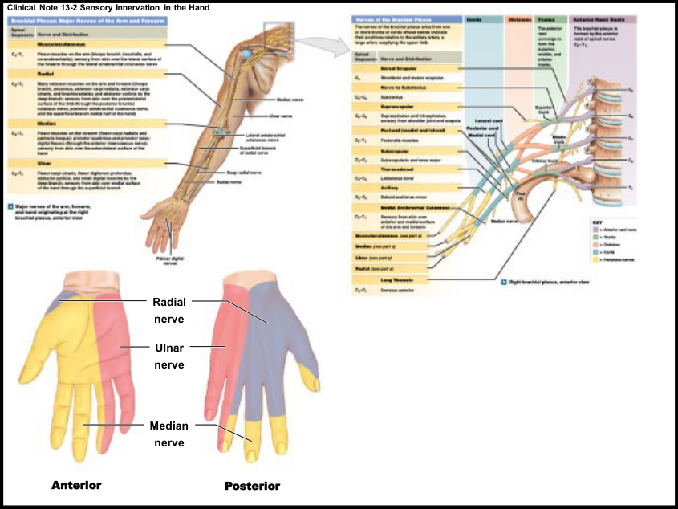
05 • PATHWAYS + PLEXUSES
REFERENCE
Brachial wiring: understand without overmemorizing
SEQUENCE
Anterior rami (“roots” of the plexus) → trunks →
divisions → cords → named peripheral nerves.
TRUNKS + CORDS
The source names superior/middle/inferior
trunks and lateral/posterior/medial cords.
MULTIPLE CONTRIBUTIONS
A peripheral nerve may contain fibers originating
at several spinal levels. A single muscle can
therefore receive overlapping contributions.
SCOPE
Know what a plexus does. The professor does
not ask this class to memorize every
root-to-cord-to-branch detail.
REMEMBER
Roots, Trunks, Divisions, Cords, Branches: “Read The Diagram Carefully, Buddy.”
Book pp. 447–449; C13 L2 slides 7–8; T-D.
074
Notes:
SOURCE BASIS
Book pp. 447–449; C13 L2 slides 7–8; T-D.
Book reference: the lateral cord forms musculocutaneous and contributes to median; the medial cord contributes to median and ulnar; the posterior cord gives rise to axillary and radial. The axillary nerve supplies deltoid and teres minor. These details are included as reference, not elevated above the instructor’s four named priorities.
TEACH-BACK
Roots, Trunks, Divisions, Cords, Branches: “Read The Diagram Carefully, Buddy.”
SEQUENCE: Anterior rami (“roots” of the plexus) → trunks → divisions → cords → named peripheral nerves.
TRUNKS + CORDS: The source names superior/middle/inferior trunks and lateral/posterior/medial cords.
MULTIPLE CONTRIBUTIONS: A peripheral nerve may contain fibers originating at several spinal levels. A single muscle can therefore receive overlapping contributions.
SCOPE: Know what a plexus does. The professor does not ask this class to memorize every root-to-cord-to-branch detail.
Memory cues and practice questions are review aids created for this deck, not quotations or actual exam questions. Consult the provided source where a caution is marked.

Slide 75
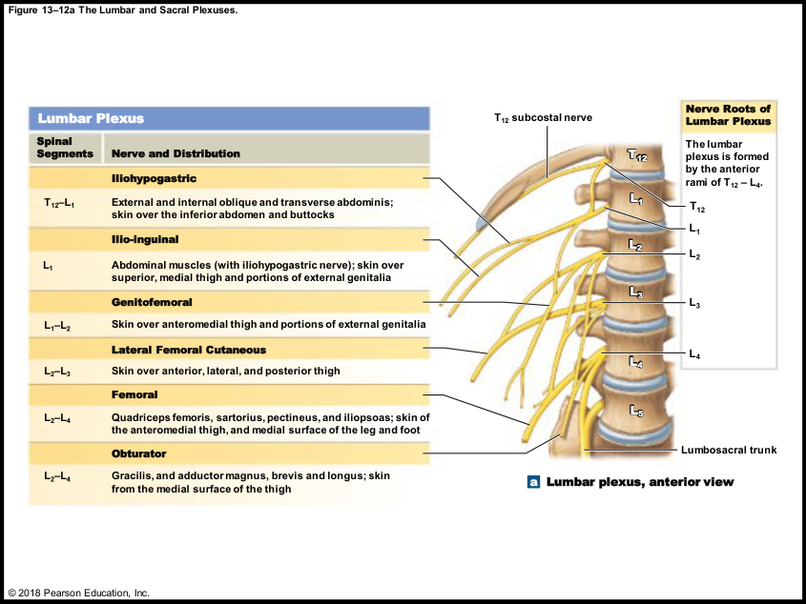
05 • PATHWAYS + PLEXUSES
LECTURE PRIORITY
Lumbar plexus: femoral and obturator
PLEXUS RANGE
T12–L4 in the handout and lecture.
FEMORAL
The supplied table lists quadriceps, sartorius,
pectineus and iliopsoas. The professor
emphasizes the anterior-thigh/hip-flexion group.
OBTURATOR
Gracilis and adductor magnus, brevis and longus:
remember the thigh-adductor association.
DON’T MIX THE ACTION
Adduction moves toward the midline. A
speech-recognition “abduction” near the
adductor list should not replace the slide’s
muscle names.
REMEMBER
Femoral = front-thigh group. Obturator = adductors bring the thighs together.
Book p. 450; C13 L2 slide 11; T-D.
075
Notes:
SOURCE BASIS
Book p. 450; C13 L2 slide 11; T-D.
The professor does not require the individual root ranges beside these nerves. The source’s group descriptions are simplified; avoid treating “hip flexion” as the sole function of every muscle listed under femoral.
TEACH-BACK
Femoral = front-thigh group. Obturator = adductors bring the thighs together.
PLEXUS RANGE: T12–L4 in the handout and lecture.
FEMORAL: The supplied table lists quadriceps, sartorius, pectineus and iliopsoas. The professor emphasizes the anterior-thigh/hip-flexion group.
OBTURATOR: Gracilis and adductor magnus, brevis and longus: remember the thigh-adductor association.
DON’T MIX THE ACTION: Adduction moves toward the midline. A speech-recognition “abduction” near the adductor list should not replace the slide’s muscle names.
Memory cues and practice questions are review aids created for this deck, not quotations or actual exam questions. Consult the provided source where a caution is marked.

Slide 76
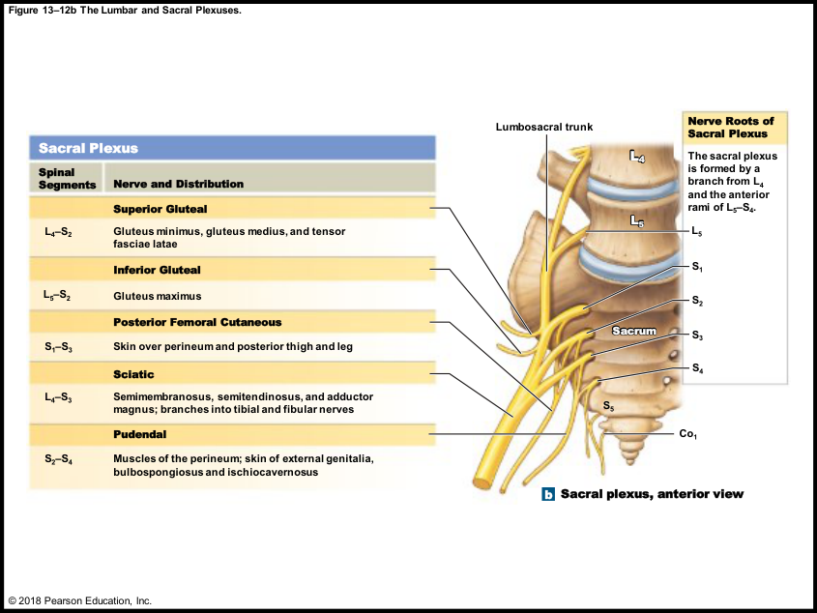
05 • PATHWAYS + PLEXUSES
LECTURE PRIORITY
Sacral plexus: gluteal nerves and sciatic nerve
PLEXUS RANGE
L4–S4 in these sources.
SUPERIOR GLUTEAL
Gluteus medius, gluteus minimus and tensor
fasciae latae in the table.
INFERIOR GLUTEAL
Gluteus maximus. The lecturer especially
wants the gluteal-muscle association.
SCIATIC
The highlighted table includes
semimembranosus, semitendinosus and
adductor magnus; it divides into tibial and
fibular branches.
REMEMBER
Inferior gluteal → maximus. Sciatic → the highlighted hamstring group and major lower-limb branches.
Book pp. 450–451; C13 L2 slides 10, 12; T-D.
076
Notes:
SOURCE BASIS
Book pp. 450–451; C13 L2 slides 10, 12; T-D.
TEACH-BACK
Inferior gluteal → maximus. Sciatic → the highlighted hamstring group and major lower-limb branches.
PLEXUS RANGE: L4–S4 in these sources.
SUPERIOR GLUTEAL: Gluteus medius, gluteus minimus and tensor fasciae latae in the table.
INFERIOR GLUTEAL: Gluteus maximus. The lecturer especially wants the gluteal-muscle association.
SCIATIC: The highlighted table includes semimembranosus, semitendinosus and adductor magnus; it divides into tibial and fibular branches.
Memory cues and practice questions are review aids created for this deck, not quotations or actual exam questions. Consult the provided source where a caution is marked.

Slide 77
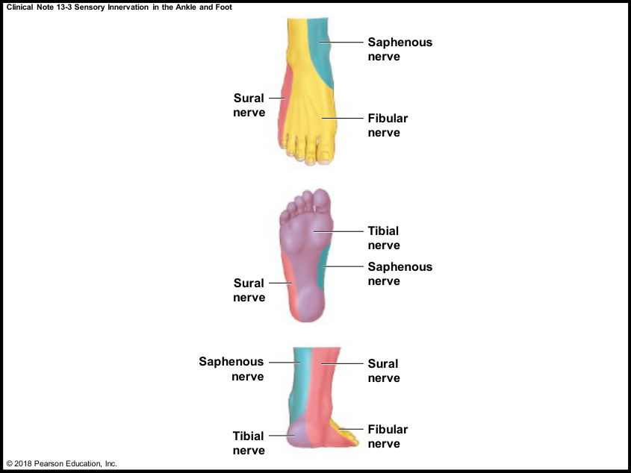
05 • PATHWAYS + PLEXUSES
REFERENCE
Hand and foot sensory maps: recognize the application
HAND
The source image maps median, ulnar and
radial territories.
FOOT
The image distinguishes tibial, fibular, sural
and saphenous territories.
PURPOSE
A pattern of sensory change, combined with
muscle findings, can help identify a nerve
pathway involved.
LECTURE LIMIT
The professor says not to memorize the
detailed foot map. Treat these as localization
examples and reference visuals.
REMEMBER
Map the symptom to a pathway—but do not mistake a peripheral-nerve map for a dermatome map.
Book pp. 448, 451; C13 L2 slides 7, 13; T-D.
077
Notes:
SOURCE BASIS
Book pp. 448, 451; C13 L2 slides 7, 13; T-D.
A dermatome is organized by spinal nerve/root level; a named peripheral nerve may mix contributions from several levels through a plexus. This distinction follows the chapter’s description of plexus formation.
TEACH-BACK
Map the symptom to a pathway—but do not mistake a peripheral-nerve map for a dermatome map.
HAND: The source image maps median, ulnar and radial territories.
FOOT: The image distinguishes tibial, fibular, sural and saphenous territories.
PURPOSE: A pattern of sensory change, combined with muscle findings, can help identify a nerve pathway involved.
LECTURE LIMIT: The professor says not to memorize the detailed foot map. Treat these as localization examples and reference visuals.
Memory cues and practice questions are review aids created for this deck, not quotations or actual exam questions. Consult the provided source where a caution is marked.

Slide 78
05 • PATHWAYS + PLEXUSES
PARTNER CHECK
Checkpoint 5 | pathways and plexuses
1. A sensory impulse from the back enters through which ramus and which
root?
2. Does a preganglionic fiber become postganglionic merely by passing
through a ganglion?
3. Name the phrenic roots and its target. Which plexus contains it in this
course?
4. Match the nerves: arm flexion, arm/forearm extension, thigh adduction,
gluteus maximus.
REMEMBER
Take turns: answer without looking, explain why, then reveal the next slide.
Book pp. 444–451; C13 L2; T-D. Original practice questions.
078
Notes:
SOURCE BASIS
Book pp. 444–451; C13 L2; T-D. Original practice questions.
TEACH-BACK
Take turns: answer without looking, explain why, then reveal the next slide.
1. A sensory impulse from the back enters through which ramus and which root?
2. Does a preganglionic fiber become postganglionic merely by passing through a ganglion?
3. Name the phrenic roots and its target. Which plexus contains it in this course?
4. Match the nerves: arm flexion, arm/forearm extension, thigh adduction, gluteus maximus.
Memory cues and practice questions are review aids created for this deck, not quotations or actual exam questions. Consult the provided source where a caution is marked.

Slide 79
05 • PATHWAYS + PLEXUSES
ANSWER KEY
Checkpoint 5 | pathways and plexuses | answers
1. Posterior ramus, then mixed spinal nerve and dorsal/posterior root.
2. No. The terms refer to the neuron before versus after the ganglionic synapse.
3. C3–C5; diaphragm; cervical plexus (course range C1–C5).
4. Musculocutaneous; radial; obturator; inferior gluteal, respectively.
REMEMBER
A correct label is only half the job. Explain the structure, mechanism, or consequence.
Book pp. 444–451; C13 L2; T-D. Original practice questions.
079
Notes:
SOURCE BASIS
Book pp. 444–451; C13 L2; T-D. Original practice questions.
TEACH-BACK
A correct label is only half the job. Explain the structure, mechanism, or consequence.
1. Posterior ramus, then mixed spinal nerve and dorsal/posterior root.
2. No. The terms refer to the neuron before versus after the ganglionic synapse.
3. C3–C5; diaphragm; cervical plexus (course range C1–C5).
4. Musculocutaneous; radial; obturator; inferior gluteal, respectively.
Memory cues and practice questions are review aids created for this deck, not quotations or actual exam questions. Consult the provided source where a caution is marked.

Slide 80
06 • CIRCUITS + REFLEXES
6
From neuronal pools to automatic responses
Explain how many neurons cooperate—and why a spinal reflex can happen before conscious pain.
Use the memory cues, then explain the mechanism without reading.
080
Notes:
SOURCE BASIS
TEACH-BACK
Explain how many neurons cooperate—and why a spinal reflex can happen before conscious pain.
Memory cues and practice questions are review aids created for this deck, not quotations or actual exam questions. Consult the provided source where a caution is marked.

Slide 81
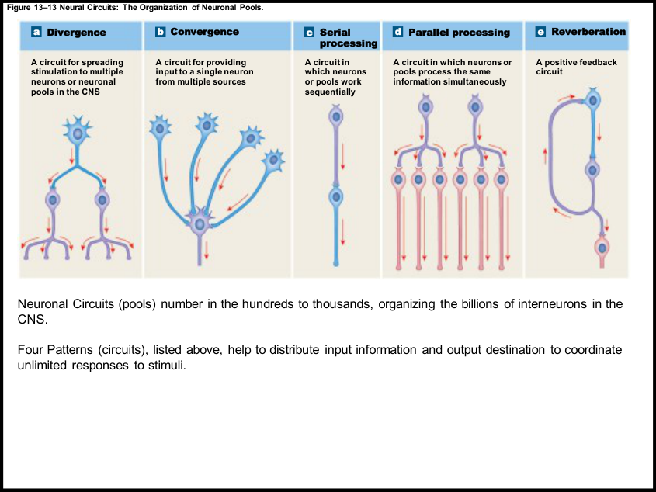
06 • CIRCUITS + REFLEXES
LECTURE PRIORITY
Five patterns of neural circuitry
DIVERGENCE / CONVERGENCE
Divergence distributes one input to many outputs.
Convergence combines many inputs at one target.
SERIAL / PARALLEL
Serial processing is a sequence of relays. Parallel
processing sends information through multiple
simultaneous processing pathways.
REVERBERATION
Feedback connections reactivate earlier neurons;
activity can continue until inhibition or fatigue
ends the loop.
NEURONAL POOL
A functional group of interconnected neurons with
particular input sources and output destinations.
REMEMBER
Diverge = distribute. Converge = collect. Serial = sequence. Parallel = simultaneous. Reverberate = repeat.
Book pp. 452–453; C13 L3 slide 1; T-D.
081
Notes:
SOURCE BASIS
Book pp. 452–453; C13 L3 slide 1; T-D.
The handout text says “Four Patterns” but displays five. The textbook explicitly lists five; all five are included. The lecture uses visual inputs distributed to perception/balance as divergence and multiple balance-related inputs arriving at the cerebellum as convergence.
TEACH-BACK
Diverge = distribute. Converge = collect. Serial = sequence. Parallel = simultaneous. Reverberate = repeat.
DIVERGENCE / CONVERGENCE: Divergence distributes one input to many outputs. Convergence combines many inputs at one target.
SERIAL / PARALLEL: Serial processing is a sequence of relays. Parallel processing sends information through multiple simultaneous processing pathways.
REVERBERATION: Feedback connections reactivate earlier neurons; activity can continue until inhibition or fatigue ends the loop.
NEURONAL POOL: A functional group of interconnected neurons with particular input sources and output destinations.
Memory cues and practice questions are review aids created for this deck, not quotations or actual exam questions. Consult the provided source where a caution is marked.

Slide 82
06 • CIRCUITS + REFLEXES
CORE
Recognize the circuit from a scenario
Scenario
Circuit pattern
Why?
One sensory input informs
several brain regions
Divergence
One source spreads to multiple targets
Several sources influence a
single motor neuron
Convergence
Many inputs collect at one target
Information moves
through relay 1, then 2,
then 3
Serial
Sequential processing
Withdrawal, weight shift
and awareness occur
together
Parallel
Several paths process information at once
A response persists briefly
after its initiating input
Reverberation
Feedback can maintain activity
REMEMBER
Ask “how many inputs, how many paths, and does the circuit loop?”
Book pp. 452–453, 455; C13 L3 slide 1; T-D.
082
Notes:
SOURCE BASIS
Book pp. 452–453, 455; C13 L3 slide 1; T-D.
These are study scenarios built from the source examples. A real response may involve more than one circuit pattern; the question must specify the feature being tested.
TEACH-BACK
Ask “how many inputs, how many paths, and does the circuit loop?”
One sensory input informs several brain regions | Divergence | One source spreads to multiple targets
Several sources influence a single motor neuron | Convergence | Many inputs collect at one target
Information moves through relay 1, then 2, then 3 | Serial | Sequential processing
Withdrawal, weight shift and awareness occur together | Parallel | Several paths process information at once
A response persists briefly after its initiating input | Reverberation | Feedback can maintain activity
Memory cues and practice questions are review aids created for this deck, not quotations or actual exam questions. Consult the provided source where a caution is marked.

Slide 83
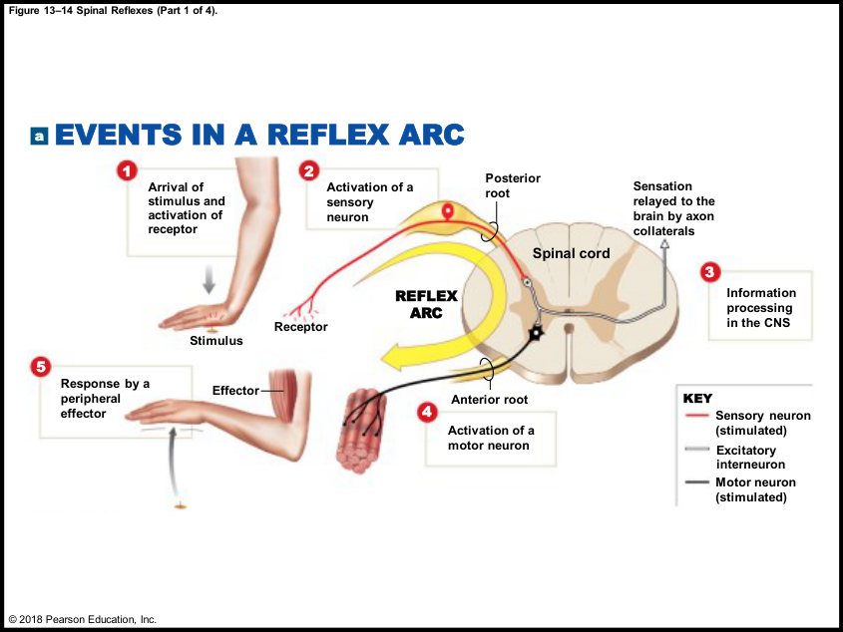
06 • CIRCUITS + REFLEXES
LECTURE PRIORITY
The five steps of a reflex arc
1 + 2 | INPUT
A stimulus activates a receptor; a sensory neuron
carries the signal toward the CNS.
3 | INTEGRATION
Information is processed in the CNS. A
polysynaptic arc uses interneurons; a
monosynaptic arc can connect sensory directly to
motor.
4 + 5 | OUTPUT
A motor neuron carries the command to a
peripheral effector, which produces the response.
FAST PROTECTION
A spinal withdrawal response can start before
conscious awareness of pain; collateral pathways
also relay information to the brain.
REMEMBER
Receptor → Sensory → Integration → Motor → Effector. “Receive, Send, Integrate, Move, Execute.”
Book pp. 453–456; C13 L3 slides 2–4; T-D.
083
Notes:
SOURCE BASIS
Book pp. 453–456; C13 L3 slides 2–4; T-D.
TEACH-BACK
Receptor → Sensory → Integration → Motor → Effector. “Receive, Send, Integrate, Move, Execute.”
1 + 2 | INPUT: A stimulus activates a receptor; a sensory neuron carries the signal toward the CNS.
3 | INTEGRATION: Information is processed in the CNS. A polysynaptic arc uses interneurons; a monosynaptic arc can connect sensory directly to motor.
4 + 5 | OUTPUT: A motor neuron carries the command to a peripheral effector, which produces the response.
FAST PROTECTION: A spinal withdrawal response can start before conscious awareness of pain; collateral pathways also relay information to the brain.
Memory cues and practice questions are review aids created for this deck, not quotations or actual exam questions. Consult the provided source where a caution is marked.

Slide 84
06 • CIRCUITS + REFLEXES
LECTURE PRIORITY
Classify one reflex four different ways
Question
Two categories
What separates them?
How did it
develop?
Innate / acquired
Inborn circuitry versus learned
motor pattern
What is the
effector?
Somatic / visceral
Skeletal muscle versus visceral
effectors
How many
synapses?
Monosynaptic / polysynaptic
One versus more than one
synapse
Where is it
processed?
Spinal / cranial
Spinal cord versus brain
REMEMBER
Development, response, complexity, site: one reflex can have a label in all four categories.
Book pp. 456–457; C13 L3 slide 7; T-D.
084
Notes:
SOURCE BASIS
Book pp. 456–457; C13 L3 slide 7; T-D.
Source caution: the lecture says innate reflexes cannot be improved with practice. The textbook adds that many innate or acquired reflexes can be modified or suppressed. Learn innate = not learned; do not overextend that to “the brain can never influence it.”
TEACH-BACK
Development, response, complexity, site: one reflex can have a label in all four categories.
How did it develop? | Innate / acquired | Inborn circuitry versus learned motor pattern
What is the effector? | Somatic / visceral | Skeletal muscle versus visceral effectors
How many synapses? | Monosynaptic / polysynaptic | One versus more than one synapse
Where is it processed? | Spinal / cranial | Spinal cord versus brain
Memory cues and practice questions are review aids created for this deck, not quotations or actual exam questions. Consult the provided source where a caution is marked.

Slide 85
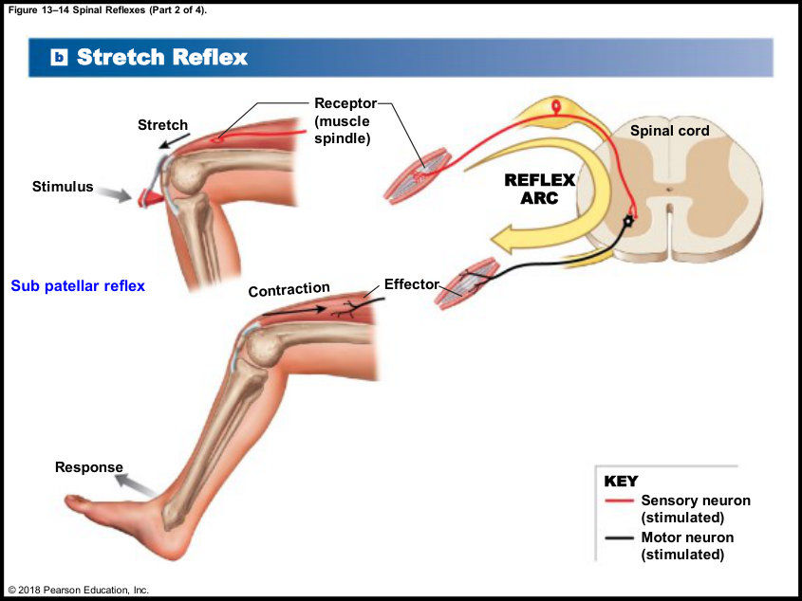
06 • CIRCUITS + REFLEXES
LECTURE PRIORITY
Monosynaptic versus polysynaptic
MONOSYNAPTIC
Sensory neuron synapses directly on a motor
neuron. Minimum two neurons, one CNS
synapse.
POLYSYNAPTIC
One or more interneurons participate; multiple
synapses enable excitation/inhibition of
multiple muscle groups.
SPEED TRADEOFF
Fewer synapses minimize delay. More synapses
allow more complex and adjustable responses.
COMMON TRAP
Five steps in a reflex arc do not mean five
neurons or five synapses.
REMEMBER
Mono counts synapses—not neurons, muscles or steps.
Book pp. 454–458; C13 L3 slides 3–5; T-D.
085
Notes:
SOURCE BASIS
Book pp. 454–458; C13 L3 slides 3–5; T-D.
TEACH-BACK
Mono counts synapses—not neurons, muscles or steps.
MONOSYNAPTIC: Sensory neuron synapses directly on a motor neuron. Minimum two neurons, one CNS synapse.
POLYSYNAPTIC: One or more interneurons participate; multiple synapses enable excitation/inhibition of multiple muscle groups.
SPEED TRADEOFF: Fewer synapses minimize delay. More synapses allow more complex and adjustable responses.
COMMON TRAP: Five steps in a reflex arc do not mean five neurons or five synapses.
Memory cues and practice questions are review aids created for this deck, not quotations or actual exam questions. Consult the provided source where a caution is marked.

Slide 86
06 • CIRCUITS + REFLEXES
CORE
Stretch reflex: the patellar example
STIMULUS
A patellar-tendon tap briefly stretches
quadriceps and its muscle spindles.
SENSORY ARM
The spindle’s sensory neuron enters through
the dorsal root and excites a motor neuron.
MOTOR ARM
Motor output returns to the stretched
muscle; quadriceps contraction extends the
knee.
FUNCTION
Automatic opposition to stretch helps
regulate muscle length and posture. The core
excitatory arc is monosynaptic.
REMEMBER
Stretch a muscle → that muscle contracts. The receptor is the muscle spindle.
Book pp. 454, 457–458; C13 L3 slide 5.
086
Notes:
SOURCE BASIS
Book pp. 454, 457–458; C13 L3 slide 5.
The professor calls this the knee-jerk or subpatellar reflex. The book describes 20–40 ms for the example and emphasizes large, myelinated Type A fibers. Antagonist inhibition can involve additional circuitry even though the core stretch-reflex arc is monosynaptic.
TEACH-BACK
Stretch a muscle → that muscle contracts. The receptor is the muscle spindle.
STIMULUS: A patellar-tendon tap briefly stretches quadriceps and its muscle spindles.
SENSORY ARM: The spindle’s sensory neuron enters through the dorsal root and excites a motor neuron.
MOTOR ARM: Motor output returns to the stretched muscle; quadriceps contraction extends the knee.
FUNCTION: Automatic opposition to stretch helps regulate muscle length and posture. The core excitatory arc is monosynaptic.
Memory cues and practice questions are review aids created for this deck, not quotations or actual exam questions. Consult the provided source where a caution is marked.

Slide 87
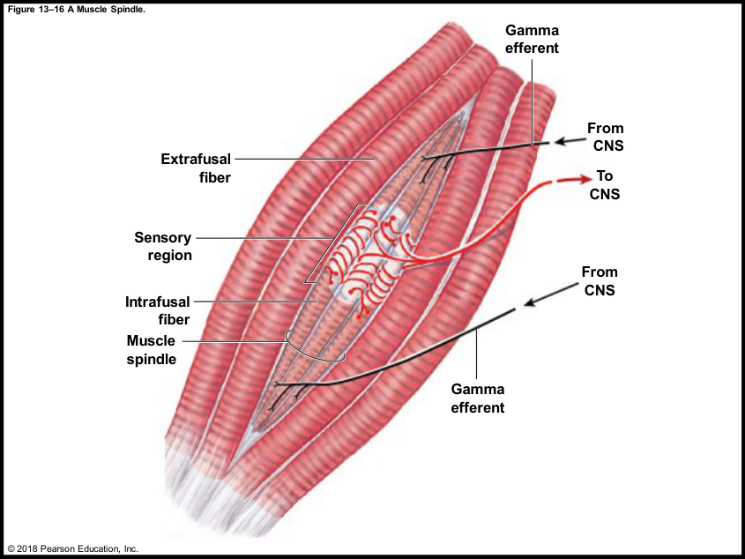
06 • CIRCUITS + REFLEXES
BOOK + HANDOUT
Muscle spindle: intrafusal, extrafusal and gamma
INTRAFUSAL
Specialized small fibers inside the spindle; a
central sensory region is monitored by
sensory endings.
EXTRAFUSAL
The surrounding ordinary skeletal muscle
fibers that generate most muscle force.
GAMMA EFFERENTS
Motor axons to the contractile ends of
intrafusal fibers; adjust spindle sensitivity.
WHY ADJUST?
As a muscle shortens, gamma activity helps
keep the sensory region responsive to a
newly imposed stretch or load.
REMEMBER
INTRA is IN the spindle; EXTRA is the external working muscle.
Book p. 458; C13 L3 slide 8.
087
Notes:
SOURCE BASIS
Book p. 458; C13 L3 slide 8.
Stretching the spindle increases sensory firing and increases stimulation of motor neurons to the same muscle’s extrafusal fibers. Reduced stretch lowers this input. The source uses the example of adding a ball to a partially flexed arm to show adjustment to a new load.
TEACH-BACK
INTRA is IN the spindle; EXTRA is the external working muscle.
INTRAFUSAL: Specialized small fibers inside the spindle; a central sensory region is monitored by sensory endings.
EXTRAFUSAL: The surrounding ordinary skeletal muscle fibers that generate most muscle force.
GAMMA EFFERENTS: Motor axons to the contractile ends of intrafusal fibers; adjust spindle sensitivity.
WHY ADJUST?: As a muscle shortens, gamma activity helps keep the sensory region responsive to a newly imposed stretch or load.
Memory cues and practice questions are review aids created for this deck, not quotations or actual exam questions. Consult the provided source where a caution is marked.

Slide 88
06 • CIRCUITS + REFLEXES
BOOK DETAIL
Postural reflexes: small corrections all the time
UPRIGHT STANCE
Multiple muscle groups continually make small
adjustments to keep the body balanced.
FORWARD LEAN
Stretching postural muscles can increase their
contraction and counter the change in position.
COORDINATION
If correction overshoots, different muscle
groups adjust; this is not one isolated,
permanent contraction.
CONNECTION
The lecture connects proprioceptive input,
neural pools and subconscious balance control
to these ongoing responses.
REMEMBER
Standing still is active control—not the absence of nervous-system activity.
Book p. 459; T-D.
088
Notes:
SOURCE BASIS
Book p. 459; T-D.
TEACH-BACK
Standing still is active control—not the absence of nervous-system activity.
UPRIGHT STANCE: Multiple muscle groups continually make small adjustments to keep the body balanced.
FORWARD LEAN: Stretching postural muscles can increase their contraction and counter the change in position.
COORDINATION: If correction overshoots, different muscle groups adjust; this is not one isolated, permanent contraction.
CONNECTION: The lecture connects proprioceptive input, neural pools and subconscious balance control to these ongoing responses.
Memory cues and practice questions are review aids created for this deck, not quotations or actual exam questions. Consult the provided source where a caution is marked.

Slide 89
06 • CIRCUITS + REFLEXES
BOOK DETAIL
Stretch reflex versus Golgi tendon reflex
Feature
Stretch reflex
Tendon reflex
Monitored feature
Muscle length/stretch
Tension in the tendon
Receptor
Muscle spindle
Golgi tendon organ
Typical source
response
Contract the stretched muscle
Inhibit the muscle generating
excessive tension
Core circuit
Monosynaptic excitation
Polysynaptic; inhibitory
interneuron
Purpose
emphasized
Control length, tone and posture
Limit excessive tension /
tendon damage
REMEMBER
Spindle senses stretch; tendon organ senses tension.
Book pp. 457–459.
089
Notes:
SOURCE BASIS
Book pp. 457–459.
The supplied transcript stops before all late-chapter details. The tendon reflex is included because it is in assigned section 13-7, even though it is less prominent in the supplied handouts.
TEACH-BACK
Spindle senses stretch; tendon organ senses tension.
Monitored feature | Muscle length/stretch | Tension in the tendon
Receptor | Muscle spindle | Golgi tendon organ
Typical source response | Contract the stretched muscle | Inhibit the muscle generating excessive tension
Core circuit | Monosynaptic excitation | Polysynaptic; inhibitory interneuron
Purpose emphasized | Control length, tone and posture | Limit excessive tension / tendon damage
Memory cues and practice questions are review aids created for this deck, not quotations or actual exam questions. Consult the provided source where a caution is marked.

Slide 90
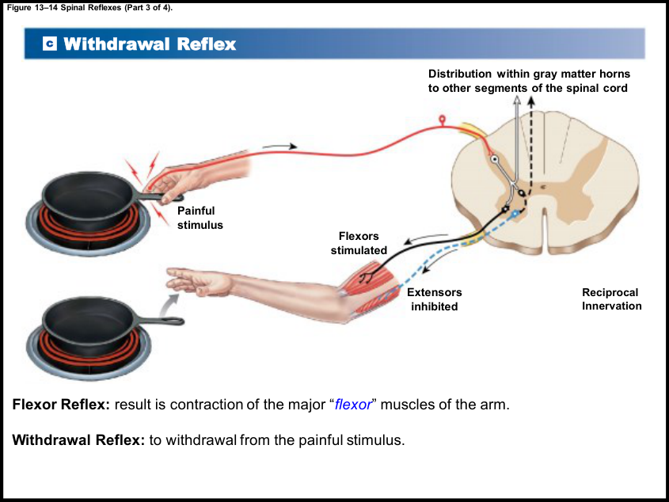
06 • CIRCUITS + REFLEXES
LECTURE PRIORITY
Withdrawal reflex: flexors on, extensors off
TRIGGER
A painful or otherwise threatening stimulus
activates sensory input.
FLEXION
Spinal interneurons stimulate motor neurons
to the appropriate flexor muscles, pulling the
affected part away.
RECIPROCAL INHIBITION
Interneurons inhibit antagonistic extensors
so they do not fight the withdrawal.
COORDINATION
Stronger stimuli can recruit additional
segments and muscles. Signals also ascend
toward conscious perception.
REMEMBER
Pull away with flexors; let go with extensors.
Book pp. 455, 459–460; C13 L3 slide 4; T-D.
090
Notes:
SOURCE BASIS
Book pp. 455, 459–460; C13 L3 slide 4; T-D.
The reflex is polysynaptic. “Reciprocal” means the coordination can work in either direction: activating a muscle group is paired with inhibiting its antagonist. The source calls the limb withdrawal example a flexor reflex.
TEACH-BACK
Pull away with flexors; let go with extensors.
TRIGGER: A painful or otherwise threatening stimulus activates sensory input.
FLEXION: Spinal interneurons stimulate motor neurons to the appropriate flexor muscles, pulling the affected part away.
RECIPROCAL INHIBITION: Interneurons inhibit antagonistic extensors so they do not fight the withdrawal.
COORDINATION: Stronger stimuli can recruit additional segments and muscles. Signals also ascend toward conscious perception.
Memory cues and practice questions are review aids created for this deck, not quotations or actual exam questions. Consult the provided source where a caution is marked.

Slide 91
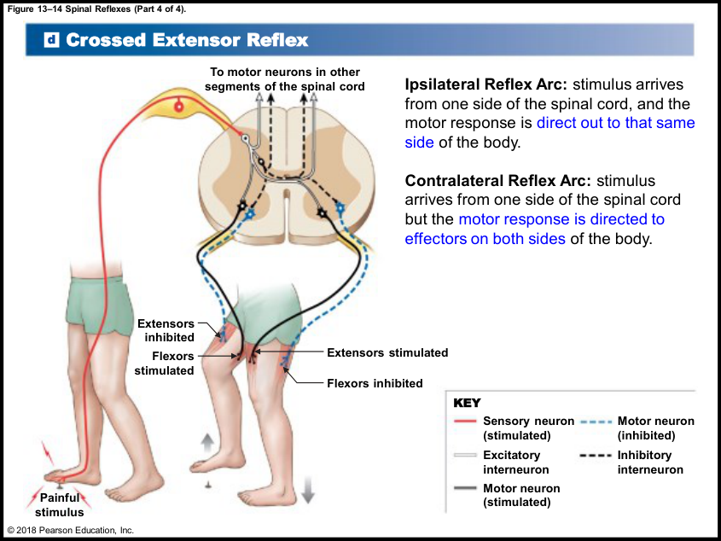
06 • CIRCUITS + REFLEXES
CORE
Crossed extensor reflex: withdraw and stay standing
STIMULATED SIDE
Flexors contract and extensors are inhibited,
withdrawing the foot from the painful stimulus.
OPPOSITE SIDE
Extensors contract and flexors are inhibited,
supporting body weight on the other leg.
CROSSING
Interneurons cross the spinal midline to
coordinate the contralateral response.
TERMS
Ipsilateral = same side as the stimulus.
Contralateral = opposite side. The combined
withdrawal/crossed-extensor behavior involves
both sides.
REMEMBER
One leg lifts; the other leg holds.
Book pp. 455, 459; C13 L3 slide 6.
091
Notes:
SOURCE BASIS
Book pp. 455, 459; C13 L3 slide 6.
Source caution: the handout describes contralateral as a response on both sides. The book defines contralateral as the opposite side; both sides participate when ipsilateral withdrawal and contralateral extension occur together.
TEACH-BACK
One leg lifts; the other leg holds.
STIMULATED SIDE: Flexors contract and extensors are inhibited, withdrawing the foot from the painful stimulus.
OPPOSITE SIDE: Extensors contract and flexors are inhibited, supporting body weight on the other leg.
CROSSING: Interneurons cross the spinal midline to coordinate the contralateral response.
TERMS: Ipsilateral = same side as the stimulus. Contralateral = opposite side. The combined withdrawal/crossed-extensor behavior involves both sides.
Memory cues and practice questions are review aids created for this deck, not quotations or actual exam questions. Consult the provided source where a caution is marked.

Slide 92
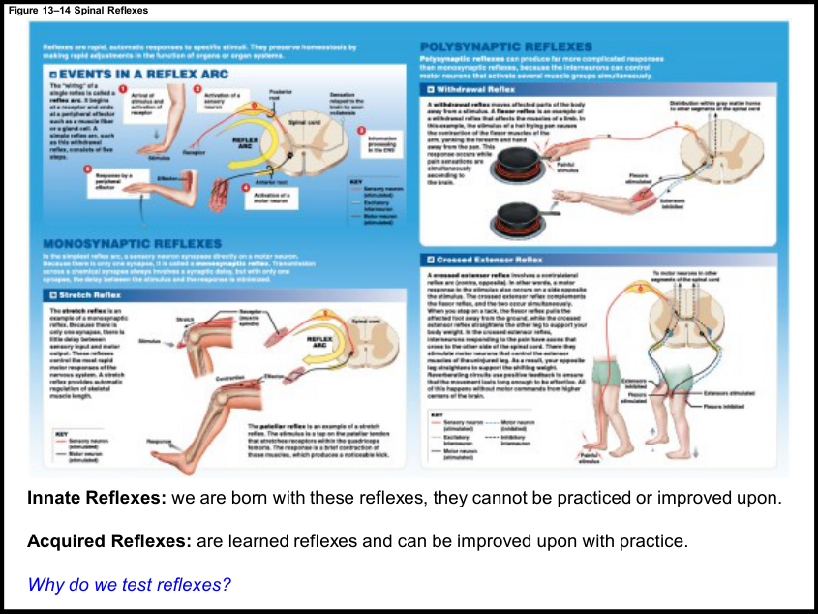
06 • CIRCUITS + REFLEXES
BOOK DETAIL
Polysynaptic responses: the textbook’s five features
INTERNEURON POOLS
Processing can excite one set of motor
neurons and inhibit another.
MULTIPLE SEGMENTS
Intersegmental connections distribute
responses to additional muscle groups.
RECIPROCAL INHIBITION
Opposing muscles are coordinated rather
than simply contracting together.
REVERBERATION + COOPERATION
Feedback can prolong a response; several
reflexes cooperate to produce coordinated
movement.
REMEMBER
Pools, segments, opposites, persistence, cooperation.
Book pp. 459–460, 462.
092
Notes:
SOURCE BASIS
Book pp. 459–460, 462.
The assigned text lists these as five general characteristics: pools of interneurons, more than one segment, reciprocal inhibition, reverberating circuits, and cooperation among reflexes. The slide combines the last two visually but retains all five for recall.
TEACH-BACK
Pools, segments, opposites, persistence, cooperation.
INTERNEURON POOLS: Processing can excite one set of motor neurons and inhibit another.
MULTIPLE SEGMENTS: Intersegmental connections distribute responses to additional muscle groups.
RECIPROCAL INHIBITION: Opposing muscles are coordinated rather than simply contracting together.
REVERBERATION + COOPERATION: Feedback can prolong a response; several reflexes cooperate to produce coordinated movement.
Memory cues and practice questions are review aids created for this deck, not quotations or actual exam questions. Consult the provided source where a caution is marked.

Slide 93
06 • CIRCUITS + REFLEXES
BOOK + HANDOUT
The brain can tune a spinal reflex
LOCAL INITIATION
DESCENDING INFLUENCE
A spinal reflex does not need a new
conscious command before it begins.
Brain pathways can facilitate or inhibit
spinal interneurons and motor neurons
through EPSPs and IPSPs.
REINFORCEMENT
PATTERN REUSE
Generalized facilitation enhances a
reflex; the book uses the Jendrassik
maneuver as an example.
Higher centers can recruit and adjust
existing spinal motor patterns instead of
specifying every individual muscle
contraction.
REMEMBER
A spinal reflex is locally organized—not disconnected from the brain.
Book pp. 460–461; C13 L3 slide 9.
093
Notes:
SOURCE BASIS
Book pp. 460–461; C13 L3 slide 9.
The book’s Jendrassik example involves interlocking the hands and trying to pull them apart while testing the knee reflex. Learn the concept of reinforcement; reflex interpretation is not a standalone self-diagnosis.
TEACH-BACK
A spinal reflex is locally organized—not disconnected from the brain.
LOCAL INITIATION: A spinal reflex does not need a new conscious command before it begins.
DESCENDING INFLUENCE: Brain pathways can facilitate or inhibit spinal interneurons and motor neurons through EPSPs and IPSPs.
REINFORCEMENT: Generalized facilitation enhances a reflex; the book uses the Jendrassik maneuver as an example.
PATTERN REUSE: Higher centers can recruit and adjust existing spinal motor patterns instead of specifying every individual muscle contraction.
Memory cues and practice questions are review aids created for this deck, not quotations or actual exam questions. Consult the provided source where a caution is marked.

Slide 94
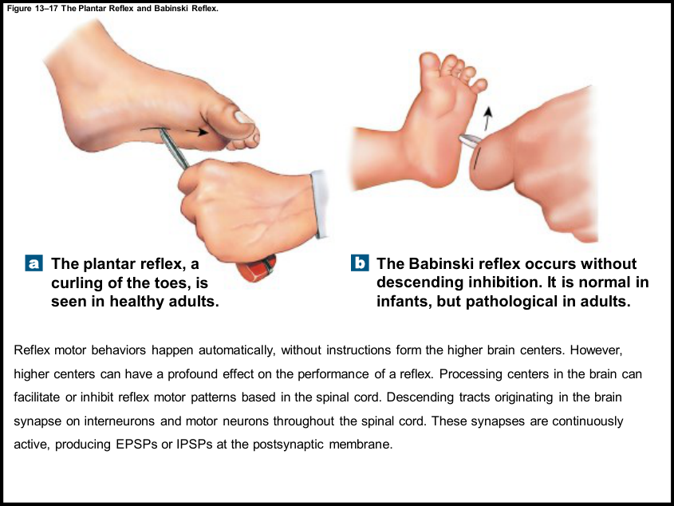
06 • CIRCUITS + REFLEXES
BOOK + HANDOUT
Plantar versus Babinski response
ADULT PLANTAR RESPONSE
In the chapter’s description, stroking the
lateral sole normally produces toe curling.
INFANT BABINSKI RESPONSE
Toe fanning/extension is normal early in
development while descending pathways are
immature.
ADULT BABINSKI SIGN
Its presence can indicate impaired
descending inhibition from CNS disease or
injury.
WHY THIS IS HERE
It demonstrates how higher centers change
the expression of a spinal reflex.
REMEMBER
Babinski belongs in the baby example; its reappearance in an adult is a CNS warning sign in this chapter.
Book p. 461; C13 L3 slide 9.
094
Notes:
SOURCE BASIS
Book p. 461; C13 L3 slide 9.
The source says the infant response disappears around age two. This is a teaching example, not a diagnostic rule to apply without clinical context. Do not conclude the cause of an abnormal reflex from one observation.
TEACH-BACK
Babinski belongs in the baby example; its reappearance in an adult is a CNS warning sign in this chapter.
ADULT PLANTAR RESPONSE: In the chapter’s description, stroking the lateral sole normally produces toe curling.
INFANT BABINSKI RESPONSE: Toe fanning/extension is normal early in development while descending pathways are immature.
ADULT BABINSKI SIGN: Its presence can indicate impaired descending inhibition from CNS disease or injury.
WHY THIS IS HERE: It demonstrates how higher centers change the expression of a spinal reflex.
Memory cues and practice questions are review aids created for this deck, not quotations or actual exam questions. Consult the provided source where a caution is marked.

Slide 95
06 • CIRCUITS + REFLEXES
PARTNER CHECK
Checkpoint 6 | circuits and reflexes
1. List the five reflex-arc steps. Must every reflex have an interneuron?
2. A muscle suddenly stretches. Which receptor starts the stretch reflex,
and what is the response?
3. What happens to flexors and extensors on each side during a
crossed-extensor response?
4. How can a spinal reflex occur without a conscious command yet still be
affected by the brain?
REMEMBER
Take turns: answer without looking, explain why, then reveal the next slide.
Book pp. 453–461; C13 L3. Original practice questions.
095
Notes:
SOURCE BASIS
Book pp. 453–461; C13 L3. Original practice questions.
TEACH-BACK
Take turns: answer without looking, explain why, then reveal the next slide.
1. List the five reflex-arc steps. Must every reflex have an interneuron?
2. A muscle suddenly stretches. Which receptor starts the stretch reflex, and what is the response?
3. What happens to flexors and extensors on each side during a crossed-extensor response?
4. How can a spinal reflex occur without a conscious command yet still be affected by the brain?
Memory cues and practice questions are review aids created for this deck, not quotations or actual exam questions. Consult the provided source where a caution is marked.

Slide 96
06 • CIRCUITS + REFLEXES
ANSWER KEY
Checkpoint 6 | circuits and reflexes | answers
1. Receptor, sensory neuron, CNS integration, motor neuron, effector. No: a
monosynaptic arc connects sensory directly to motor.
2. Muscle spindle; the stretched muscle contracts. Contrast a Golgi tendon
organ’s tension-monitoring role.
3. Stimulated side: flexors on, extensors off. Opposite side: extensors on, flexors
off.
4. Spinal circuitry can initiate the response locally while descending pathways
facilitate or inhibit that circuitry.
REMEMBER
A correct label is only half the job. Explain the structure, mechanism, or consequence.
Book pp. 453–461; C13 L3. Original practice questions.
096
Notes:
SOURCE BASIS
Book pp. 453–461; C13 L3. Original practice questions.
TEACH-BACK
A correct label is only half the job. Explain the structure, mechanism, or consequence.
1. Receptor, sensory neuron, CNS integration, motor neuron, effector. No: a monosynaptic arc connects sensory directly to motor.
2. Muscle spindle; the stretched muscle contracts. Contrast a Golgi tendon organ’s tension-monitoring role.
3. Stimulated side: flexors on, extensors off. Opposite side: extensors on, flexors off.
4. Spinal circuitry can initiate the response locally while descending pathways facilitate or inhibit that circuitry.
Memory cues and practice questions are review aids created for this deck, not quotations or actual exam questions. Consult the provided source where a caution is marked.

Slide 97
07 • FINAL REVIEW + EXAM SHEET
7
Turn understanding into recall
Finish with mixed cases, drawing rehearsal, a precise glossary, and a one-sided exam sheet.
Use the memory cues, then explain the mechanism without reading.
097
Notes:
SOURCE BASIS
TEACH-BACK
Finish with mixed cases, drawing rehearsal, a precise glossary, and a one-sided exam sheet.
Memory cues and practice questions are review aids created for this deck, not quotations or actual exam questions. Consult the provided source where a caution is marked.

Slide 98
07 • FINAL REVIEW + EXAM SHEET
PARTNER CHECK
Mixed cases | connect the chapters
1. Terminal Ca2+ entry is reduced, but the presynaptic AP still arrives.
Predict transmitter release and the postsynaptic effect.
2. A ventral root is selectively damaged. Would you first expect a
sensory-input or motor-output deficit?
3. An injured neuron cannot conduct through a badly damaged myelinated
segment. Why is “all-or-none means nothing can stop it” misleading?
4. An image shows a gray butterfly with a central canal. Name the anterior
motor region and the adjacent outward route.
REMEMBER
Take turns: answer without looking, explain why, then reveal the next slide.
Book pp. 399–401, 409–419, 437–441. Original practice questions.
098
Notes:
SOURCE BASIS
Book pp. 399–401, 409–419, 437–441. Original practice questions.
TEACH-BACK
Take turns: answer without looking, explain why, then reveal the next slide.
1. Terminal Ca2+ entry is reduced, but the presynaptic AP still arrives. Predict transmitter release and the postsynaptic effect.
2. A ventral root is selectively damaged. Would you first expect a sensory-input or motor-output deficit?
3. An injured neuron cannot conduct through a badly damaged myelinated segment. Why is “all-or-none means nothing can stop it” misleading?
4. An image shows a gray butterfly with a central canal. Name the anterior motor region and the adjacent outward route.
Memory cues and practice questions are review aids created for this deck, not quotations or actual exam questions. Consult the provided source where a caution is marked.

Slide 99
07 • FINAL REVIEW + EXAM SHEET
ANSWER KEY
Mixed cases | connect the chapters | answers
1. Less vesicle release and a smaller postsynaptic effect are expected in the
chapter’s synapse model.
2. Motor-output deficit: ventral roots carry efferent axons. Dorsal roots carry
sensory input.
3. All-or-none describes firing once threshold is reached in excitable membrane.
Successful propagation still requires a functioning pathway.
4. Anterior/ventral horn contains somatic motor nuclei; their axons leave through
the ventral/anterior root.
REMEMBER
A correct label is only half the job. Explain the structure, mechanism, or consequence.
Book pp. 399–401, 409–419, 437–441. Original practice questions.
099
Notes:
SOURCE BASIS
Book pp. 399–401, 409–419, 437–441. Original practice questions.
TEACH-BACK
A correct label is only half the job. Explain the structure, mechanism, or consequence.
1. Less vesicle release and a smaller postsynaptic effect are expected in the chapter’s synapse model.
2. Motor-output deficit: ventral roots carry efferent axons. Dorsal roots carry sensory input.
3. All-or-none describes firing once threshold is reached in excitable membrane. Successful propagation still requires a functioning pathway.
4. Anterior/ventral horn contains somatic motor nuclei; their axons leave through the ventral/anterior root.
Memory cues and practice questions are review aids created for this deck, not quotations or actual exam questions. Consult the provided source where a caution is marked.

Slide 100
07 • FINAL REVIEW + EXAM SHEET
DRAW BY HAND
Hand-draw practice 1: neuron and action potential
NEURON
Sketch soma, dendrites, axon hillock, initial
segment, myelinated axon, nodes and
terminals. Add the direction of signaling.
LOCAL VS LONG DISTANCE
Label graded potentials near the receiving
region and AP propagation along the axon.
VOLTAGE CURVE
Draw −70 mV rest, −55 mV lecture threshold,
+30 mV peak, falling phase and undershoot.
GATES
Write Na+ in on the rise and K+ out on the
fall. Mark absolute versus relative refractory
intervals.
REMEMBER
Draw it from memory first; compare afterward. This slide is for practice—not an image to print on your exam
sheet.
Book Figs. 12–2, 12–13; C12 L1/L2.
100
Notes:
SOURCE BASIS
Book Figs. 12–2, 12–13; C12 L1/L2.
TEACH-BACK
Draw it from memory first; compare afterward. This slide is for practice—not an image to print on your exam sheet.
NEURON: Sketch soma, dendrites, axon hillock, initial segment, myelinated axon, nodes and terminals. Add the direction of signaling.
LOCAL VS LONG DISTANCE: Label graded potentials near the receiving region and AP propagation along the axon.
VOLTAGE CURVE: Draw −70 mV rest, −55 mV lecture threshold, +30 mV peak, falling phase and undershoot.
GATES: Write Na+ in on the rise and K+ out on the fall. Mark absolute versus relative refractory intervals.
Memory cues and practice questions are review aids created for this deck, not quotations or actual exam questions. Consult the provided source where a caution is marked.

Slide 101
07 • FINAL REVIEW + EXAM SHEET
DRAW BY HAND
Hand-draw practice 2: cord and reflex arc
CORD
Draw a circle with a gray butterfly and central
canal. Mark posterior sulcus and anterior fissure.
PATHWAYS
Add dorsal root + DRG, ventral root, mixed spinal
nerve and two mixed rami.
FUNCTIONS
Place the S–V–V–S nuclei order and label
sensory in / motor out.
REFLEX
Draw receptor, sensory neuron, integration,
motor neuron and effector. Add antagonist
inhibition or a crossing branch for a more
complex reflex.
REMEMBER
A simple, correct sketch beats a tiny copied picture—and printed pictures are not allowed.
Book Figs. 13–5, 13–14; C13 L1/L3; T-C exam rule.
101
Notes:
SOURCE BASIS
Book Figs. 13–5, 13–14; C13 L1/L3; T-C exam rule.
TEACH-BACK
A simple, correct sketch beats a tiny copied picture—and printed pictures are not allowed.
CORD: Draw a circle with a gray butterfly and central canal. Mark posterior sulcus and anterior fissure.
PATHWAYS: Add dorsal root + DRG, ventral root, mixed spinal nerve and two mixed rami.
FUNCTIONS: Place the S–V–V–S nuclei order and label sensory in / motor out.
REFLEX: Draw receptor, sensory neuron, integration, motor neuron and effector. Add antagonist inhibition or a crossing branch for a more complex reflex.
Memory cues and practice questions are review aids created for this deck, not quotations or actual exam questions. Consult the provided source where a caution is marked.

Slide 102
07 • FINAL REVIEW + EXAM SHEET
EXAM RULE
Study Assistance Sheet: the recorded rule
PAPER
TEXT
One side of a standard sheet of paper;
do not use the reverse side.
Typed or handwritten text is permitted
in the recording.
VISUALS
USE IT WELL
Any image must be hand-drawn. Do not
print, photocopy or shrink a diagram
onto the sheet.
The professor recommends a few
hard-to-retain items—not an unreadable ocean
of text. The supplied PDF is text-only and
leaves a blank area for your own sketches.
REMEMBER
Print one side only, at actual size. Add any desired diagrams by hand.
T-C: Pasted text (3).txt, closing exam instructions.
102
Notes:
SOURCE BASIS
T-C: Pasted text (3).txt, closing exam instructions.
No absolute exam date is established by the relative “next week” statements in these undated transcripts. Confirm any later classroom update to the note-sheet rule. The sheet is US Letter landscape, still one standard sheet.
TEACH-BACK
Print one side only, at actual size. Add any desired diagrams by hand.
PAPER: One side of a standard sheet of paper; do not use the reverse side.
TEXT: Typed or handwritten text is permitted in the recording.
VISUALS: Any image must be hand-drawn. Do not print, photocopy or shrink a diagram onto the sheet.
USE IT WELL: The professor recommends a few hard-to-retain items—not an unreadable ocean of text. The supplied PDF is text-only and leaves a blank area for your own sketches.
Memory cues and practice questions are review aids created for this deck, not quotations or actual exam questions. Consult the provided source where a caution is marked.

Slide 103
07 • FINAL REVIEW + EXAM SHEET
LECTURE PRIORITY
What the professor explicitly prioritizes
Memorize / explain
De-emphasized details
Keep in the review
Graded vs AP; ion
gates; pump; glia;
synapses
Not a license to skip spoken explanations
Statements made in class can be
testable
S–V–V–S, roots,
mixed nerves,
pathway routes
Complete dermatome map memorization
Definition and localization purpose
Four plexus ranges;
phrenic C3–C5;
named nerve targets
Every individual nerve’s root range; full PT-level
wiring
Phrenic roots are the explicit
exception
Reflex steps,
circuitry and
classification
Detailed foot sensory-map memorization
Later handout/book reflexes still
included
REMEMBER
A priority marker is evidence from the recording—not a promise that other assigned material is excluded.
T-B, T-C, T-D; all six handouts.
103
Notes:
SOURCE BASIS
T-B, T-C, T-D; all six handouts.
TEACH-BACK
A priority marker is evidence from the recording—not a promise that other assigned material is excluded.
Graded vs AP; ion gates; pump; glia; synapses | Not a license to skip spoken explanations | Statements made in class can be testable
S–V–V–S, roots, mixed nerves, pathway routes | Complete dermatome map memorization | Definition and localization purpose
Four plexus ranges; phrenic C3–C5; named nerve targets | Every individual nerve’s root range; full PT-level wiring | Phrenic roots are the explicit exception
Reflex steps, circuitry and classification | Detailed foot sensory-map memorization | Later handout/book reflexes still included
Memory cues and practice questions are review aids created for this deck, not quotations or actual exam questions. Consult the provided source where a caution is marked.

Slide 104
07 • FINAL REVIEW + EXAM SHEET
SOURCE CAUTION
Source cautions 1 | do not memorize transcription errors
Issue
Safer source-grounded distinction
Multipolar = always
motor
Motor examples are multipolar, but interneurons can be multipolar too
(Book pp. 394–395).
Perikaryon includes
nucleus
Book p. 392: perikaryon is cytoplasm around the nucleus; soma is the cell
body.
Pump off = always −90
mV
The book’s −90 mV example requires K+-selective permeability
assumptions (pp. 402–405).
Adenylate cyclase
turns into cAMP
Adenylate cyclase catalyzes ATP conversion to cAMP (p. 424).
Dopamine is an
endorphin
Book separates dopamine (amine) from opioid peptides such as endorphins
(pp. 420–423).
REMEMBER
Where sources differ, learn the mechanism and retain the source distinction.
Book pp. 392–395, 402–405, 420–424; T-A–T-C.
104
Notes:
SOURCE BASIS
Book pp. 392–395, 402–405, 420–424; T-A–T-C.
TEACH-BACK
Where sources differ, learn the mechanism and retain the source distinction.
Multipolar = always motor | Motor examples are multipolar, but interneurons can be multipolar too (Book pp. 394–395).
Perikaryon includes nucleus | Book p. 392: perikaryon is cytoplasm around the nucleus; soma is the cell body.
Pump off = always −90 mV | The book’s −90 mV example requires K+-selective permeability assumptions (pp. 402–405).
Adenylate cyclase turns into cAMP | Adenylate cyclase catalyzes ATP conversion to cAMP (p. 424).
Dopamine is an endorphin | Book separates dopamine (amine) from opioid peptides such as endorphins (pp. 420–423).
Memory cues and practice questions are review aids created for this deck, not quotations or actual exam questions. Consult the provided source where a caution is marked.

Slide 105
07 • FINAL REVIEW + EXAM SHEET
SOURCE CAUTION
Source cautions 2 | preserve the limits of the evidence
Issue
How this deck handles it
Innate reflexes can never
change
Innate means inborn. Book p. 457 and section 13-8 allow
modulation/suppression.
Contralateral means
both sides
Contralateral means opposite side. The combined reflex behavior involves both
sides (pp. 455, 459).
Four neural circuit
patterns
The diagram and textbook actually list five (pp. 452–453).
Expanded antidepressant
list / “laughing gas”
Those transcript identifications are not established by the supplied book; do not
use them as pharmacology facts.
Cruciform / vertebral
attachment wording
Book pp. 438–439 describes pia-to-dura denticulate ligaments and
dural/coccygeal longitudinal support.
REMEMBER
The transcript is evidence of class emphasis, not an error-free scientific reference.
Book pp. 438–439, 452–461; C13 L3; T-C/T-D.
105
Notes:
SOURCE BASIS
Book pp. 438–439, 452–461; C13 L3; T-C/T-D.
TEACH-BACK
The transcript is evidence of class emphasis, not an error-free scientific reference.
Innate reflexes can never change | Innate means inborn. Book p. 457 and section 13-8 allow modulation/suppression.
Contralateral means both sides | Contralateral means opposite side. The combined reflex behavior involves both sides (pp. 455, 459).
Four neural circuit patterns | The diagram and textbook actually list five (pp. 452–453).
Expanded antidepressant list / “laughing gas” | Those transcript identifications are not established by the supplied book; do not use them as pharmacology facts.
Cruciform / vertebral attachment wording | Book pp. 438–439 describes pia-to-dura denticulate ligaments and dural/coccygeal longitudinal support.
Memory cues and practice questions are review aids created for this deck, not quotations or actual exam questions. Consult the provided source where a caution is marked.

Slide 106
REFERENCE • KEY TERMS + EXTRA DETAILS
GLOSSARY
Key terms | cells and signaling structures
Term
Definition to be able to say aloud
Soma / perikaryon
Cell body / cytoplasm of the cell body around its nucleus
Nissl bodies
Clusters of rough ER and free ribosomes involved in protein synthesis
Axolemma / axoplasm
Axon plasma membrane / axon cytoplasm
Collateral / telodendria
Side branch of an axon / fine terminal branches
Neurolemma /
internode / node
Outer Schwann-cell covering / myelinated segment / gap between
segments
Synapse / effector
Communication junction / target that produces a response
REMEMBER
Pair the word with a location on a drawing—not just another word.
Book pp. 390–400, 416–417.
106
Notes:
SOURCE BASIS
Book pp. 390–400, 416–417.
TEACH-BACK
Pair the word with a location on a drawing—not just another word.
Soma / perikaryon | Cell body / cytoplasm of the cell body around its nucleus
Nissl bodies | Clusters of rough ER and free ribosomes involved in protein synthesis
Axolemma / axoplasm | Axon plasma membrane / axon cytoplasm
Collateral / telodendria | Side branch of an axon / fine terminal branches
Neurolemma / internode / node | Outer Schwann-cell covering / myelinated segment / gap between segments
Synapse / effector | Communication junction / target that produces a response
Memory cues and practice questions are review aids created for this deck, not quotations or actual exam questions. Consult the provided source where a caution is marked.

Slide 107
REFERENCE • KEY TERMS + EXTRA DETAILS
GLOSSARY
Key terms | electrical and chemical mechanisms
Term
Meaning
Electrochemical
gradient
Combined electrical and concentration forces acting on an ion
Threshold
Membrane voltage at which an AP is initiated in the excitable region
Refractory period
Interval of absent or reduced responsiveness after AP initiation
Summation
Combination of graded potentials across time and/or space
Cholinergic /
adrenergic
ACh signaling / NE or related adrenergic signaling in the lecture
Neuromodulator /
second messenger
Chemical altering synaptic activity / intracellular signal generated after
receptor activation
REMEMBER
For every mechanism, identify the ion, the channel, and the membrane location.
Book pp. 402–427.
107
Notes:
SOURCE BASIS
Book pp. 402–427.
TEACH-BACK
For every mechanism, identify the ion, the channel, and the membrane location.
Electrochemical gradient | Combined electrical and concentration forces acting on an ion
Threshold | Membrane voltage at which an AP is initiated in the excitable region
Refractory period | Interval of absent or reduced responsiveness after AP initiation
Summation | Combination of graded potentials across time and/or space
Cholinergic / adrenergic | ACh signaling / NE or related adrenergic signaling in the lecture
Neuromodulator / second messenger | Chemical altering synaptic activity / intracellular signal generated after receptor activation
Memory cues and practice questions are review aids created for this deck, not quotations or actual exam questions. Consult the provided source where a caution is marked.

Slide 108
REFERENCE • KEY TERMS + EXTRA DETAILS
GLOSSARY
Key terms | spinal structures and pathways
Term
Meaning
Nucleus / ganglion
CNS / PNS collection of neuronal cell bodies
Horn / column / tract
Gray projection / white-matter region / functionally related axon bundle
Commissure
Connection crossing the spinal midline
Rootlet / root / ramus
Small root contribution / cord connection / nerve branch
Plexus / dermatome
Interwoven nerve network / spinal-nerve skin territory
Preganglionic /
postganglionic
Before / after the autonomic ganglion relay
REMEMBER
Structure names tell you location, scale, or the path a signal takes.
Book pp. 437–453.
108
Notes:
SOURCE BASIS
Book pp. 437–453.
TEACH-BACK
Structure names tell you location, scale, or the path a signal takes.
Nucleus / ganglion | CNS / PNS collection of neuronal cell bodies
Horn / column / tract | Gray projection / white-matter region / functionally related axon bundle
Commissure | Connection crossing the spinal midline
Rootlet / root / ramus | Small root contribution / cord connection / nerve branch
Plexus / dermatome | Interwoven nerve network / spinal-nerve skin territory
Preganglionic / postganglionic | Before / after the autonomic ganglion relay
Memory cues and practice questions are review aids created for this deck, not quotations or actual exam questions. Consult the provided source where a caution is marked.

Slide 109
REFERENCE • KEY TERMS + EXTRA DETAILS
GLOSSARY
Key terms | reflex vocabulary
Term
Meaning
Neuronal pool
Functional group of interconnected neurons
Reflex arc
Neural pathway producing a reflex response
Reciprocal inhibition
Excitation of one muscle group paired with inhibition of its antagonist
Ipsilateral /
contralateral
Same side / opposite side relative to the stimulus
Intrafusal / extrafusal
Within the muscle spindle / surrounding force-producing muscle fibers
Reinforcement
Facilitation that enhances a reflex response
REMEMBER
Never answer “mono” or “poly” without saying what you are counting.
Book pp. 452–461.
109
Notes:
SOURCE BASIS
Book pp. 452–461.
TEACH-BACK
Never answer “mono” or “poly” without saying what you are counting.
Neuronal pool | Functional group of interconnected neurons
Reflex arc | Neural pathway producing a reflex response
Reciprocal inhibition | Excitation of one muscle group paired with inhibition of its antagonist
Ipsilateral / contralateral | Same side / opposite side relative to the stimulus
Intrafusal / extrafusal | Within the muscle spindle / surrounding force-producing muscle fibers
Reinforcement | Facilitation that enhances a reflex response
Memory cues and practice questions are review aids created for this deck, not quotations or actual exam questions. Consult the provided source where a caution is marked.

Slide 110
REFERENCE • KEY TERMS + EXTRA DETAILS
REFERENCE
Additional branch names | cervical and brachial
Branch(es)
Associated region or muscle in the textbook
Great auricular, lesser
occipital
Skin around ear, neck and posterior/superior scalp
Transverse cervical,
supraclavicular
Anterior neck; neck/shoulder skin
Ansa cervicalis
Listed neck/hyoid-associated muscles
Axillary; suprascapular
Deltoid/teres minor; supraspinatus/infraspinatus
Dorsal scapular; long
thoracic
Rhomboids/levator scapulae; serratus anterior
Pectoral; subscapular;
thoracodorsal
Pectoral muscles; subscapularis/teres major; latissimus dorsi
REMEMBER
Reference only: the lecture does not require every branch or its individual root range.
Book pp. 447–449; C13 L2.
110
Notes:
SOURCE BASIS
Book pp. 447–449; C13 L2.
The book also names nerve to subclavius and medial antebrachial cutaneous branches. The original full branch/root table is on textbook p. 449. Branches are retained here to cover assigned-reading terminology without moving them into the high-priority exam list.
TEACH-BACK
Reference only: the lecture does not require every branch or its individual root range.
Great auricular, lesser occipital | Skin around ear, neck and posterior/superior scalp
Transverse cervical, supraclavicular | Anterior neck; neck/shoulder skin
Ansa cervicalis | Listed neck/hyoid-associated muscles
Axillary; suprascapular | Deltoid/teres minor; supraspinatus/infraspinatus
Dorsal scapular; long thoracic | Rhomboids/levator scapulae; serratus anterior
Pectoral; subscapular; thoracodorsal | Pectoral muscles; subscapularis/teres major; latissimus dorsi
Memory cues and practice questions are review aids created for this deck, not quotations or actual exam questions. Consult the provided source where a caution is marked.

Slide 111
REFERENCE • KEY TERMS + EXTRA DETAILS
REFERENCE
Additional branch names | lumbar and sacral
Branch(es)
Associated region or role in the textbook
Iliohypogastric /
ilio-inguinal
Abdominal-wall muscles and selected lower-abdominal/groin skin
Genitofemoral
Anteromedial thigh and parts of external genital skin
Lateral femoral
cutaneous
Cutaneous territory of the thigh
Posterior femoral
cutaneous
Posterior thigh/perineal cutaneous territory
Pudendal
Perineal muscles and external genital skin
Tibial / fibular / sural /
saphenous
Named lower-limb branches shown in the sensory distribution figures
REMEMBER
Recognize these names; prioritize femoral, obturator, gluteal and sciatic targets first.
Book pp. 450–451; C13 L2 slides 10–13.
111
Notes:
SOURCE BASIS
Book pp. 450–451; C13 L2 slides 10–13.
TEACH-BACK
Recognize these names; prioritize femoral, obturator, gluteal and sciatic targets first.
Iliohypogastric / ilio-inguinal | Abdominal-wall muscles and selected lower-abdominal/groin skin
Genitofemoral | Anteromedial thigh and parts of external genital skin
Lateral femoral cutaneous | Cutaneous territory of the thigh
Posterior femoral cutaneous | Posterior thigh/perineal cutaneous territory
Pudendal | Perineal muscles and external genital skin
Tibial / fibular / sural / saphenous | Named lower-limb branches shown in the sensory distribution figures
Memory cues and practice questions are review aids created for this deck, not quotations or actual exam questions. Consult the provided source where a caution is marked.

Slide 112
REFERENCE • KEY TERMS + EXTRA DETAILS
BOOK DETAIL
Clinical vocabulary | Chapter 12
Term
Source-based meaning
Anesthetic / neurotoxin
Agent reducing sensation / compound interfering with nervous function
Anticholinesterase
Blocks ACh breakdown by AChE
Atropine /
d-tubocurarine
The text’s examples of interfering with ACh receptor actions in different
target tissues
Excitotoxicity
Excessive neurotransmitter stimulation that can damage neurons
Neuropathy /
neuroblastoma
Peripheral sensory symptoms / malignant tumor of neuroblasts
Tay–Sachs / dysthymia
The chapter’s lipid-metabolism/neuron-deterioration example / persistent
depressive-condition term
REMEMBER
These are assigned-text vocabulary, not treatment instructions or confirmed exam emphasis.
Book p. 432.
112
Notes:
SOURCE BASIS
Book p. 432.
The source’s clinical vocabulary and older diagnostic framing are retained as course-reading context. No doses, treatment recommendations or contemporary diagnostic criteria are inferred.
TEACH-BACK
These are assigned-text vocabulary, not treatment instructions or confirmed exam emphasis.
Anesthetic / neurotoxin | Agent reducing sensation / compound interfering with nervous function
Anticholinesterase | Blocks ACh breakdown by AChE
Atropine / d-tubocurarine | The text’s examples of interfering with ACh receptor actions in different target tissues
Excitotoxicity | Excessive neurotransmitter stimulation that can damage neurons
Neuropathy / neuroblastoma | Peripheral sensory symptoms / malignant tumor of neuroblasts
Tay–Sachs / dysthymia | The chapter’s lipid-metabolism/neuron-deterioration example / persistent depressive-condition term
Memory cues and practice questions are review aids created for this deck, not quotations or actual exam questions. Consult the provided source where a caution is marked.

Slide 113
REFERENCE • KEY TERMS + EXTRA DETAILS
BOOK DETAIL
Clinical vocabulary | Chapter 13
Term
Source-based meaning
Areflexia / spinal shock
Absent reflexes / transient depressed reflex activity below a cord injury
Paraplegia / quadriplegia
Lower-limb paralysis / upper- and lower-limb involvement
Hemiparesis
Weakness affecting one side
Brown-Séquard
syndrome
Unilateral cord lesion pattern: source describes same-side
weakness/proprioceptive loss and opposite-side pain/temperature loss
Erb palsy / Kernig sign
Brachial-plexus stretch injury example / meningeal irritation sign described in
the text
Myelography / nerve
conduction study
Contrast imaging of spinal structures / testing conduction through a nerve
pathway
REMEMBER
Match the term to the structure or function affected; do not turn a single sign into a diagnosis.
Book p. 464.
113
Notes:
SOURCE BASIS
Book p. 464.
The page also lists nerve growth factor, tabes dorsalis and equinovarus. Tabes dorsalis is described as degenerative sensory-pathway disease with diminished reflexes. Equinovarus is described as plantar flexion, inversion and adduction; the printed alternate-name wording is inconsistent, so do not memorize that synonym. Nerve growth factor supports neuron growth/maintenance.
TEACH-BACK
Match the term to the structure or function affected; do not turn a single sign into a diagnosis.
Areflexia / spinal shock | Absent reflexes / transient depressed reflex activity below a cord injury
Paraplegia / quadriplegia | Lower-limb paralysis / upper- and lower-limb involvement
Hemiparesis | Weakness affecting one side
Brown-Séquard syndrome | Unilateral cord lesion pattern: source describes same-side weakness/proprioceptive loss and opposite-side pain/temperature loss
Erb palsy / Kernig sign | Brachial-plexus stretch injury example / meningeal irritation sign described in the text
Myelography / nerve conduction study | Contrast imaging of spinal structures / testing conduction through a nerve pathway
Memory cues and practice questions are review aids created for this deck, not quotations or actual exam questions. Consult the provided source where a caution is marked.

Slide 114
REFERENCE • KEY TERMS + EXTRA DETAILS
FINAL CHECK
Final teach-back: can you explain the whole route?
FROM STIMULUS
THROUGH THE CORD
Describe a receptor, a graded potential,
threshold and the resulting sensory AP.
Trace the mixed nerve, dorsal root and
spinal integration; distinguish a local
reflex from an ascending pathway.
TO THE RESPONSE
IF SOMETHING CHANGES
Trace motor output through a ventral root,
identify an appropriate nerve/effector, and
describe the chemical synapse.
Predict the effect of blocked Na+ channels,
reduced Ca2+ entry, myelin damage, a root
lesion or loss of descending inhibition.
REMEMBER
The goal is a connected explanation—not a stack of disconnected definitions.
Synthesis of Book Chapters 12–13; all six handouts and available transcripts.
114
Notes:
SOURCE BASIS
Synthesis of Book Chapters 12–13; all six handouts and available transcripts.
TEACH-BACK
The goal is a connected explanation—not a stack of disconnected definitions.
FROM STIMULUS: Describe a receptor, a graded potential, threshold and the resulting sensory AP.
THROUGH THE CORD: Trace the mixed nerve, dorsal root and spinal integration; distinguish a local reflex from an ascending pathway.
TO THE RESPONSE: Trace motor output through a ventral root, identify an appropriate nerve/effector, and describe the chemical synapse.
IF SOMETHING CHANGES: Predict the effect of blocked Na+ channels, reduced Ca2+ entry, myelin damage, a root lesion or loss of descending inhibition.
Memory cues and practice questions are review aids created for this deck, not quotations or actual exam questions. Consult the provided source where a caution is marked.

Slide 115
REFERENCE • KEY TERMS + EXTRA DETAILS
SOURCE INDEX
Coverage map | every learning-outcome section
CHAPTER 12
CHAPTER 13
12-1 Divisions
5–7
13-1 Organization
52
12-2 Neurons
8–12
13-2 Cord + meninges
52–57
12-3 Neuroglia
13–17
13-3 Gray/white matter
58–62
12-4 Membrane potential
21–27
13-4 Nerves + plexuses
60–77
12-5 Action potentials
28–34
13-5 Neuronal pools
81–82
12-6 Synapses
38–41
13-6 Reflex arc / categories
83–85
12-7 Transmitters / receptors
42–44
13-7 Reflex mechanisms
86–92
12-8 Integration
45–48
13-8 Brain influence
93–94
REMEMBER
Use chapter sections to find any concept you need to revisit.
Book learning outcomes on pp. 389 and 433.
115
Notes:
SOURCE BASIS
Book learning outcomes on pp. 389 and 433.
TEACH-BACK
Use chapter sections to find any concept you need to revisit.
Memory cues and practice questions are review aids created for this deck, not quotations or actual exam questions. Consult the provided source where a caution is marked.

Slide 116
REFERENCE • KEY TERMS + EXTRA DETAILS
SOURCE INDEX
Source index | the exact files used
TEXTBOOK
CHAPTER 12 HANDOUTS
chapters12-13.pdf: Chapter 12, pp.
389–432 (PDF pages 1–44); Chapter
13, pp. 433–464 (PDF pages 45–76).
233 Ch12_Lecture_01_Student HO.pdf
(11 slides); _02_ (15 slides); _03_ (7
slides).
CHAPTER 13 HANDOUTS
FIGURES
233 Ch13_Lecture 01 Handout.pdf (15
slides); Lecture 02 (13 slides); Lecture
03 (10 slides).
Figures in this private study deck are
reproduced/cropped from your supplied course
PDFs. Pearson attribution remains in the sources;
this is not a public republication package.
REMEMBER
Source footers use printed textbook page numbers and original handout slide numbers.
The seven uploaded PDFs.
116
Notes:
SOURCE BASIS
The seven uploaded PDFs.
TEACH-BACK
Source footers use printed textbook page numbers and original handout slide numbers.
TEXTBOOK: chapters12-13.pdf: Chapter 12, pp. 389–432 (PDF pages 1–44); Chapter 13, pp. 433–464 (PDF pages 45–76).
CHAPTER 12 HANDOUTS: 233 Ch12_Lecture_01_Student HO.pdf (11 slides); _02_ (15 slides); _03_ (7 slides).
CHAPTER 13 HANDOUTS: 233 Ch13_Lecture 01 Handout.pdf (15 slides); Lecture 02 (13 slides); Lecture 03 (10 slides).
FIGURES: Figures in this private study deck are reproduced/cropped from your supplied course PDFs. Pearson attribution remains in the sources; this is not a public republication package.
Memory cues and practice questions are review aids created for this deck, not quotations or actual exam questions. Consult the provided source where a caution is marked.

Slide 117
REFERENCE • KEY TERMS + EXTRA DETAILS
SOURCE INDEX
Transcript index | distinguish the similarly named files
T-A | ORGANIZED SUMMARY
T-B | RAW TRANSCRIPT
Pasted text (4).txt — Chapter 12
foundations, glia, membrane potentials,
propagation and synaptic overview. Not a
verbatim transcript.
Pasted text (2).txt — Chapter 12 recap,
ion gradients, gated channels and
graded/action potentials.
T-C | RAW TRANSCRIPT
T-D | RAW TRANSCRIPT
Pasted text (3).txt — Synapses and
integration, early spinal-cord anatomy,
plus the one-sided note-sheet rule.
Pasted text(2).txt — Spinal pathways,
plexuses, neural circuits and the beginning
of reflexes. Note the missing space before
“(2)”.
REMEMBER
No claim is made that these files contain every class session or the complete actual exam scope.
The four uploaded text files; exact filenames preserved.
117
Notes:
SOURCE BASIS
The four uploaded text files; exact filenames preserved.
TEACH-BACK
No claim is made that these files contain every class session or the complete actual exam scope.
T-A | ORGANIZED SUMMARY: Pasted text (4).txt — Chapter 12 foundations, glia, membrane potentials, propagation and synaptic overview. Not a verbatim transcript.
T-B | RAW TRANSCRIPT: Pasted text (2).txt — Chapter 12 recap, ion gradients, gated channels and graded/action potentials.
T-C | RAW TRANSCRIPT: Pasted text (3).txt — Synapses and integration, early spinal-cord anatomy, plus the one-sided note-sheet rule.
T-D | RAW TRANSCRIPT: Pasted text(2).txt — Spinal pathways, plexuses, neural circuits and the beginning of reflexes. Note the missing space before “(2)”.
Memory cues and practice questions are review aids created for this deck, not quotations or actual exam questions. Consult the provided source where a caution is marked.

