Slide 1
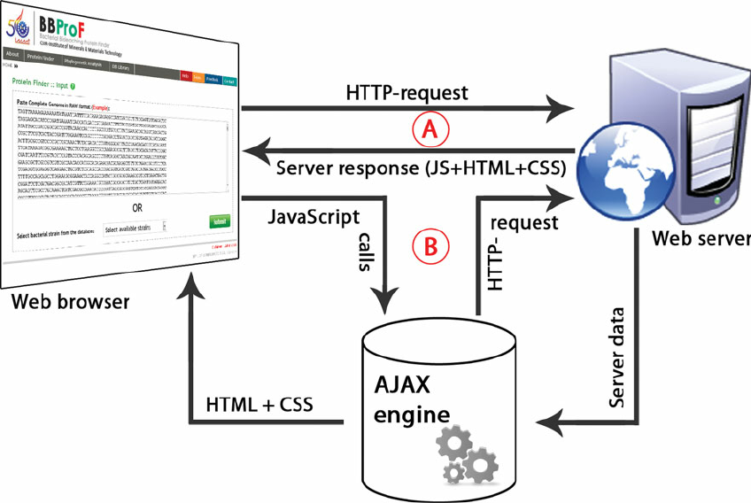
HOW DOES THE WEB WORK?
what happens when you view a webpage in a web browser on your computer or phone…?

Slide 2
HOW DOES THE WEB WORK?
The user types or clicks a URL into their browser, which sends a request to their Internet Service Provider (ISP).
The ISP communicates with the Domain Name System (DNS), which checks the IP address of the server that hosts the website.
The ISP sends the IP address of the server to the browser, which then connects to the server and requests the web page.
The server responds by sending the web page and any additional resources to the browser.
The browser displays the web page by translating the codes on the page.

Slide 3
WHAT DO YOU NEED TO BE A WEB DEVELOPER?
Simply put, a web developer is a person who does web development. He/she works with the back-end, front-end, and sometimes both to ensure the seamless working of a website.
Here are the basics steps to becoming a web developer:
Learn the basics of HTML, CSS, and Javascript.
Go through wordpress tutorials.
Learn the basics of UI and UX.
Learn SQL and Python/PHP/React/ any other programming language.
Learn the basics of SEO.
Make sure your site is responsive.

Slide 4
WHY DID I CHOOSE TO LEARN WEB DEVELOPMENT?
To develop my problem solving skills.
To enhance my designing skills using codes.
Open source contribution.
Teamwork skills.
Self learning.
Earn well.

