Slide 1

Climate Impact Modelling
Hazard–Exposure–Impact framework applied to climate risk analysis William Alfonso Leon Rueda

Slide 2


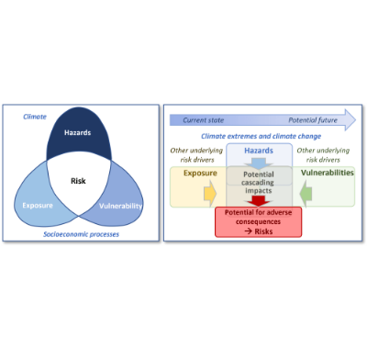

Climate Risk Modelling
The Risk Equation
This strictly defined mathematical interaction is essential for isolating the primary physical and socioeconomic drivers of risk.
It provides an indispensable framework for climate change impact studies, disaster risk mitigation analysis, and long-term decision support.

Slide 3

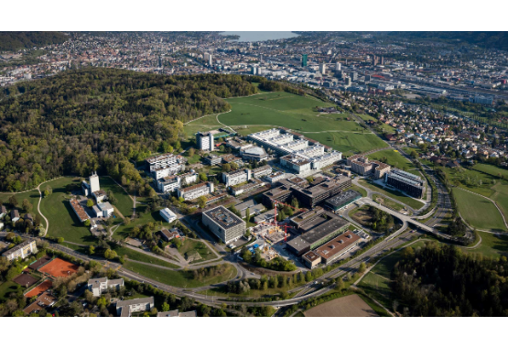
What is CLIMADA?
CLIMate ADAptation Platform
•
An advanced, open-source climate risk modelling platform initially developed by researchers at ETH Zurich.
•
Features a highly modular architecture explicitly designed for probabilistic impact modelling and adaptation analysis.
•
Seamlessly integrates physical hazard dynamics with spatial exposure assets and empirical vulnerability functions.
https://github.com/CLIMADA-project

Slide 4






CLIMADA Architecture
Hazard Intensity → Asset Exposure → Impact Functions → Engine Calculation
Hazard
Exposure
Impact Function
The physical severity and probability of a climate extreme event, such as high-resolution flood depth or regional drought index.
The exact geographical location of critical infrastructure, assets, or populations intersecting with designated hazard zones.
The core mathematical relationship translating measured hazard intensity into an expected degree of socioeconomic damage.

Slide 5
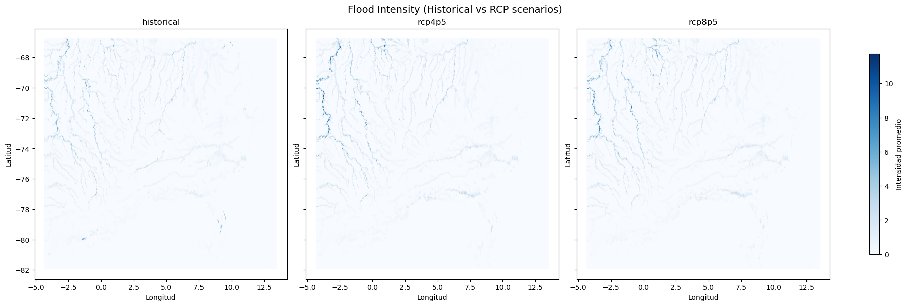
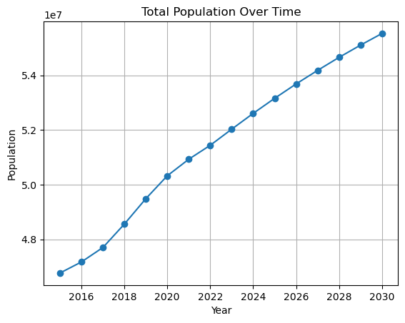
Data Sources Used
•
Climate Hazards: High-resolution physical flood rasters and SPEI drought severity data provided via NetCDF files.
•
Exposure Maps: Granular, gridded population datasets and detailed spatial asset distributions.
•
Spatial Analytics: Dynamically processed raster layers and integrated climate indicator matrices.
•
Computational Tools: Executed entirely via Python, utilizing CLIMADA, Google Earth Engine, Xarray, and GeoPandas.

Slide 6




Workflow Overview
2. Generation
4. Computation
Convert raw rasters to compliant CLIMADA Hazards and map geographic Exposure objects.
Execute impact calculations, perform localized event analysis, and aggregate final metrics.
1. Initialization
3. Vulnerability
Setup the computational environment and load all raw climate datasets.
Define precise Impact Functions linking physical intensity to population or structural damage.

Slide 7


Hazard Construction
Goal: Transform raw climatic geospatial data into CLIMADA-compatible hazard events.
Flood Hazard
Drought Hazard
High-resolution raster flood intensity layers are parsed and dynamically converted into specific CLIMADA Hazard objects using the custom tif_to_hazard() function, ensuring strict retention of original spatial resolution.
Standardized Precipitation Evapotranspiration Index (SPEI) matrices from NetCDF are meticulously processed into discrete hazard events via spei_nc_to_hazard() and programmatically structured with fix_hazard_events().

Slide 8
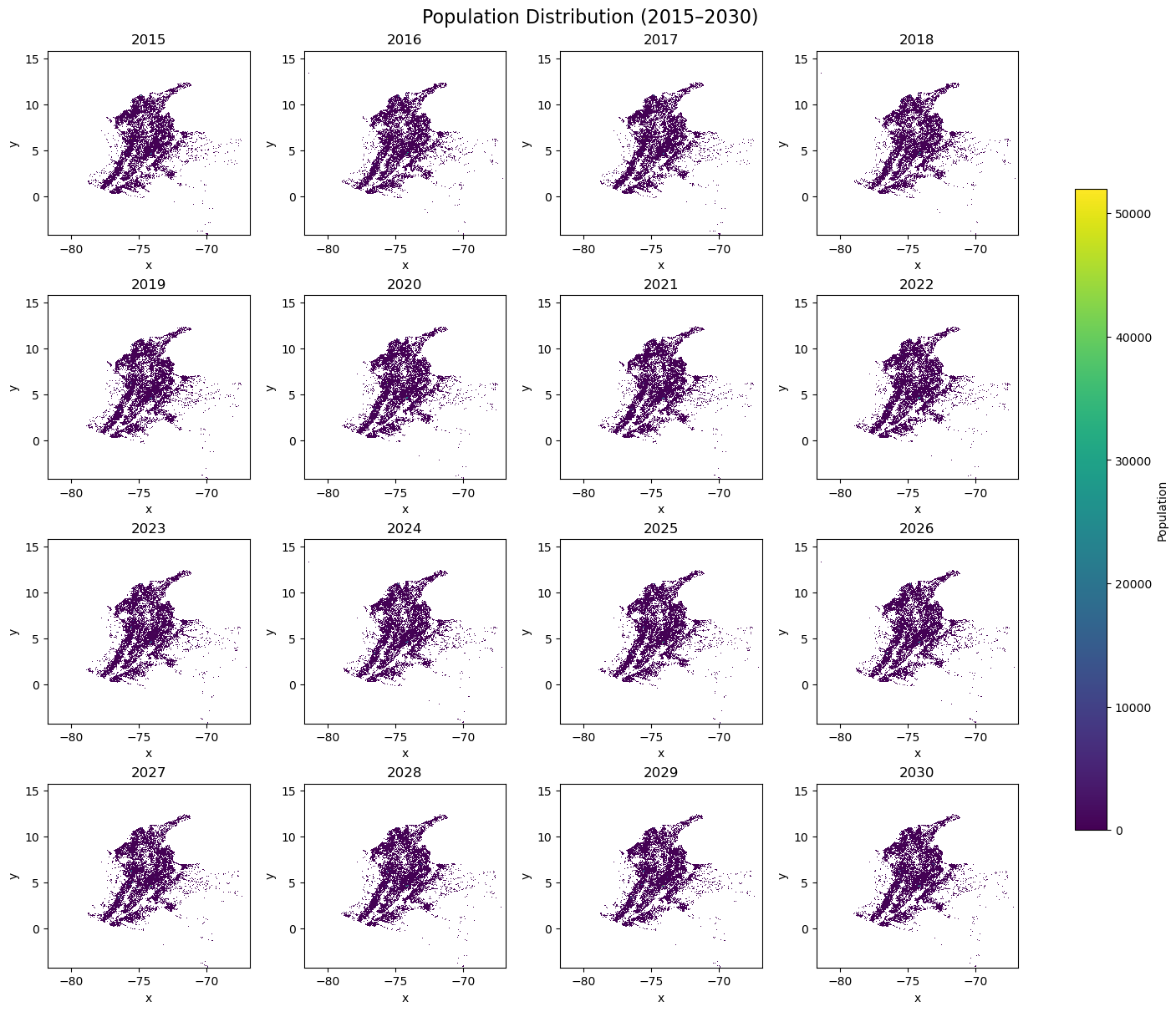
Exposure Modelling
Population Exposure
•
Exposure modelling creates the direct spatial link between vulnerable demographics and localized hazard footprints.
•
Extensive raster population datasets are programmatically mapped to CLIMADA Exposure objects.
•
The pop_to_exposures() function accurately interprets geographical coordinate bounds.
•
The final resulting objects contain exact longitude/latitude pairs explicitly mapped to population counts.

Slide 9
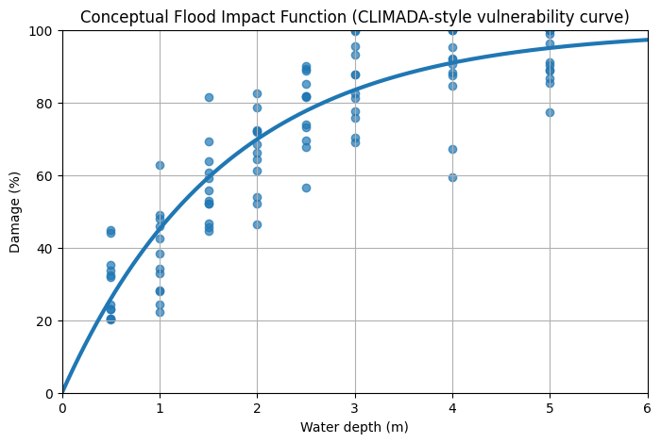
Impact Functions
Vulnerability Modelling
•
Impact functions embody the critical threshold relationship between environmental extremes and resulting socioeconomic damage.
•
They are absolutely necessary to translate pure physical hazard magnitudes into actionable impact metrics.
•
In CLIMADA, they explicitly define three core parameters:
•
Intensity: The absolute magnitude of the specific hazard.
•
Mean Damage Degree: The expected severity of the physical loss.
•
Probability: The likelihood of an exposed asset sustaining damage.

Slide 10






Impact Calculation
Impact Engine
The Process
Generated Outputs
The core computational module of CLIMADA designed to orchestrate the vast spatial intersection of massive hazard matrices and exposure arrays.
Algorithmically extracts local hazard intensity at specific exposure coordinates, applies the assigned impact function, and computes the mathematically expected damage.
Yields highly detailed analytic metrics including explicit impact per temporal event, aggregated overall impacts, and exhaustive spatial distribution grids.

Slide 11


Event Processing
Refinement Steps
Methodology & Purpose
Crucial supplementary processing steps within the analytical notebook ensure unparalleled modelling robustness:
Dedicated functions such as mean_hazard() and parse_hazard_key() are actively utilized to rigorously standardize chaotic inputs.
•
Automated hazard event corrections to mitigate missing or erratic sensory data.
Primary Purpose: To dramatically improve the spatial consistency and absolute reliability of hazard datasets prior to initiating the heavy computational impact calculations.
•
Targeted event averaging over specific temporal windows to analyze prolonged hazards.
•
Thorough event aggregation for comprehensive, cumulative risk profiling.

Slide 12
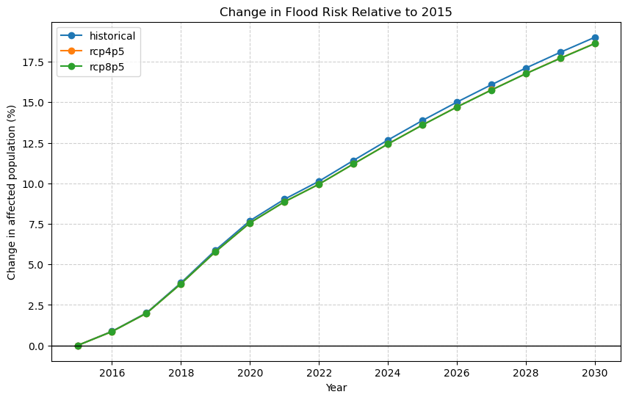



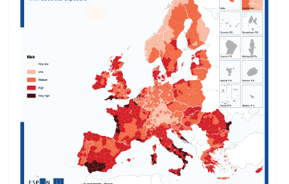
Impact Outputs
Affected Population: Expected demographic impacts and displacements mapped precisely across highly exposed geographic regions.
Event-Based Impacts: Rigorous statistical breakdowns of financial or structural loss per discrete climate catastrophe.
Spatial Distribution: High-resolution cartographic plotting indicating exactly where the most severe climate damages will manifest.

Slide 13
Workflow Applications
Climate Risk Assessment: Methodically quantifying expected damages across varied climate projection scenarios to accurately pinpoint highly vulnerable regions and demographics.
Adaptation Planning: Stress-testing the efficacy of theoretical adaptation measures by systematically modifying their effect on established vulnerability and exposure curves.
Disaster Risk Management: Demonstrably effective for rapid, comprehensive flood risk analysis and prolonged drought severity mapping to dictate mitigation strategies.
Climate Policy Support: Yielding mathematically robust, irrefutable data evidence directly to national policymakers and stakeholders to guide long-term resilience investments.

Slide 14






Approach Advantages
The fully Pythonic implementation offers significant advantages to researchers:
Reproducible Pipeline
Data Integration
Highly Scalable
The entirely scripted methodology guarantees that every sequential operation, from initial data loading to terminal output generation, is perfectly repeatable and transparent.
The framework seamlessly marries diverse, complex physical climate indicators with multi-dimensional socioeconomic data layers allowing for infinitely flexible hazard modelling.
The underlying architecture ensures the exact same analytical code can scale flawlessly from extremely localized city models to vast, multi-regional continental studies.

Slide 15

Conclusions
A Robust Framework
CLIMADA provides a highly robust, open-source framework for holistic climate impact modelling.
The Hazard–Exposure–Impact approach allows for a granular, integrated risk analysis that accounts for all drivers of damage.
Our developed Python workflow enables fully automated impact calculations directly from raw climate datasets.
Ultimately, this approach delivers actionable insights to support strategic climate resilience planning.
https://github.com/waleonr/CLIMADACOL

Slide 16






Image Sources
https://www.adaptationcommunity.net/wp-content/uploads/2023/08/CR_SB_website_Overview_page_Conceptual_framework_figure_rev28Aug2023-3.png
Source: www.adaptationcommunity.net
https://ethz.ch/en/campus/development/hoenggerberg/_jcr_content/par/fullwidthimage_26897405/image.imageformat.1286.333617114.jpg
Source: ethz.ch
https://images-provider.frontiersin.org/api/ipx/w=1200&f=png/https://www.frontiersin.org/files/Articles/1309629/feart-12-1309629-HTML/image_m/feart-12-1309629-g001.jpg
Source: www.frontiersin.org
https://www.kontur.io/wp-content/uploads/2022/08/kontur_population.png
Source: www.kontur.io
https://www.cdema.org/virtuallibrary/images/description/Flood_empirical.jpg
Source: www.cdema.org
https://skepticalscience.com/graphics/Vulnerable_Countries_500.jpg
Source: skepticalscience.com

Slide 17



Image Sources
https://assets.visme.co/templates/banners/thumbnails/i_Social-Media-Bar-Graph_full.jpg
Source: www.visme.co
http://www.espon.eu/sites/default/files/2024-05/illustration_aggregated-risk-europe-map.png
Source: www.espon.eu
https://cop30.br/en/news-about-cop30/global-adaptation-efforts-advance-as-countries-move-from-planning-to-action-unfccc-report-shows/@@images/image-1280-aadb507844f180658e24b4dc740e9198.jpeg
Source: cop30.br

