Slide 1





7 Sentiment Analysis

Slide 2

Prepare Data

Slide 3
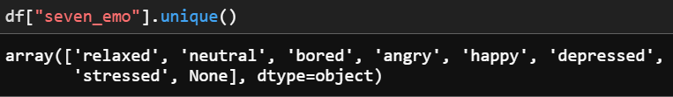
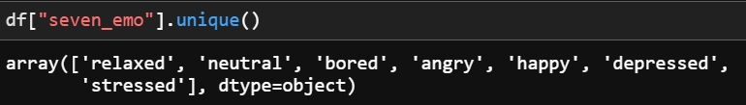

Slide 4
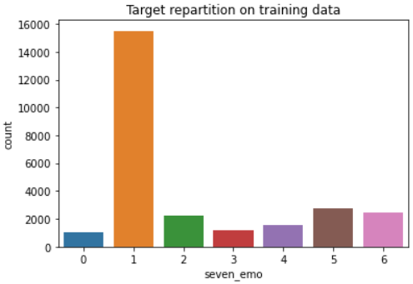
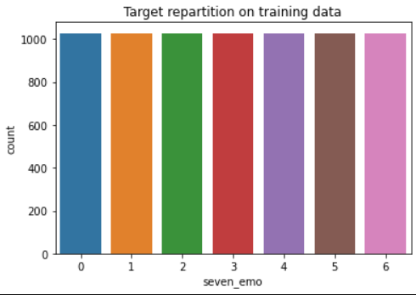
Min count =1028

Slide 5

Embedding
&
Tokenizer

Slide 6

01
newmm
Fasttext
02
TF-IDF
Deepcut
Train positive model for positive emotion
Train negative model for negative emotion
Train negative+positive

Slide 7

Model
&
Algorithm

Slide 8

01
SVM
02
KNN
03
04
BERT
LSTM
Try hard but not success

Slide 9
01
SVM
Newmm
TF-IDF
Kernel | Linear | Poly nomial | Radial Basis | Sigmoid
Accuracy | 53.95 | 53.40 | 55.06 | 53.95
F1 score | 53.95 | 53.40 | 55.06 | 53.95

Slide 10
02
KNN
Newmm
TF-IDF
K | K=1 | K=3 | K=5 | K=7
Accuracy | 45.07 | 43.19 | 46.32 | 47.08
F1 score | 45.06 | 43.19 | 46.31 | 47.08

Slide 11
03
LSTM
Fasttext
Epochs | 20 | 50 | 100
Accuracy | 43.95 | 43.35 | 45.20
F1 score | 43.95 | 43.35 | 45.20

Slide 12
04
BERT
Bert-base-multilingual-cased
Epochs | 20 | 50
Accuracy | 21.03 | 28.24
F1 score | 21.03 | 28.24
****Try to tune Thai language very hard but not success****
Github Ref :
khmer-text-data/Train-BERT-Khmer-Doc.ipynb at master · phylypo/khmer-text-data (github.com)

Slide 13

Conclusion

Slide 14



SVM
Kernel : Radial Basis
KNN
Accuracy : 55.06
F1 score : 55.06
K=7
LSTM
Accuracy : 47.08
F1 score : 47.08
Content Here
Epochs = 100
Accuracy : 45.20
F1 score : 45.20

Slide 15
THANK YOU
Peeranut Piyrattanachai 6013296
Weerapath Ruenrurngdee 6013126
https://github.com/waleweewe12/NLP-emotion-prediction

