Slide 1
SPREAD THE SMILE- DONATION PLATFORM
Presented By:
Ms. Banshika Gupta (240310120004)
Ms. Jyoti Choudhary (240310120017)
Mr. Uday Walia(240310120014)
Guide
Mr. Prashant Kumar
Project Engineer, CDAC Delhi

Slide 2
Problem Statement
The charitable sector in India is hindered by fragmentation, inefficiencies, and a lack of coordination among NGOs, donors, and recipients.
This leads to inconsistent donation processes, difficulties in tracking contributions, and uncertainty for donors regarding the effective use of their donations.
Additionally, the absence of reliable verification systems for recipient needs results in misallocation or delays in aid delivery, further exacerbated by limited transparency, reducing accountability and trust in the sector.

Slide 3
INTRODUCTION
The charitable sector in India plays a vital role in addressing social challenges, but it faces significant hurdles that hinder its effectiveness.
Fragmentation among NGOs, donors, and recipients leads to inefficiencies and a lack of coordination, making it difficult to standardize donation processes and ensure proper tracking of contributions.
Donors often experience uncertainty about the impact of their contributions, while recipients may suffer from delayed or misallocated aid.
Spread the Smile: Donation Platform is designed to bridge these gaps by providing a unified, transparent and efficient solution that fosters collaboration, verifies recipient needs, and enhances the overall trust and effectiveness of the charitable ecosystem.

Slide 4
Software Requirements
Designing End: React.js
Development End: Spring Boot.
Data Base : MySQL.
Tools : MySQL Workbench 8.0 CE, Browser, Spring ToolSuit

Slide 5
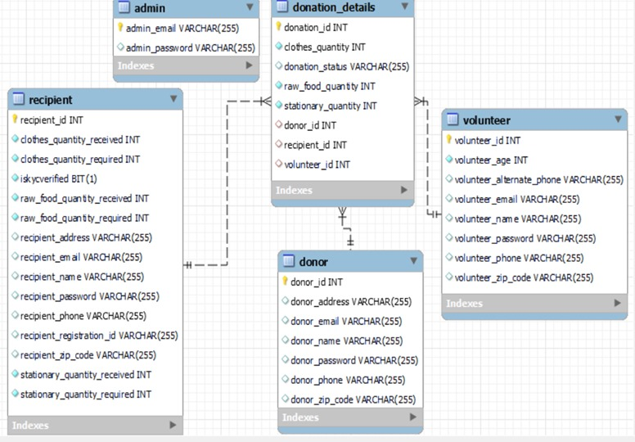
ER Diagram:

Slide 6
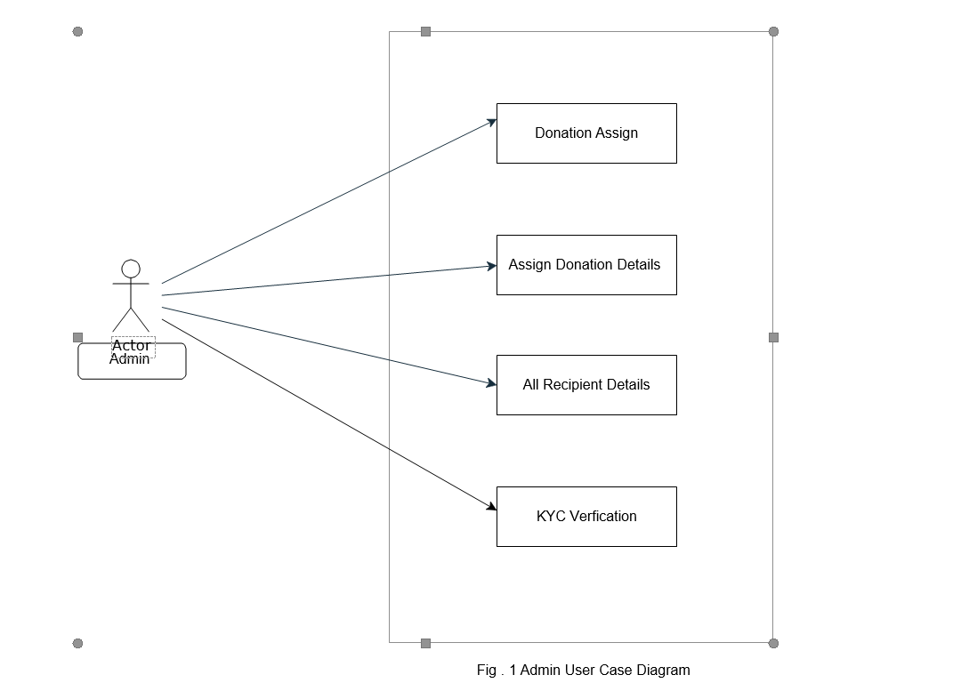
Use-case Model
Admin Use-case

Slide 7
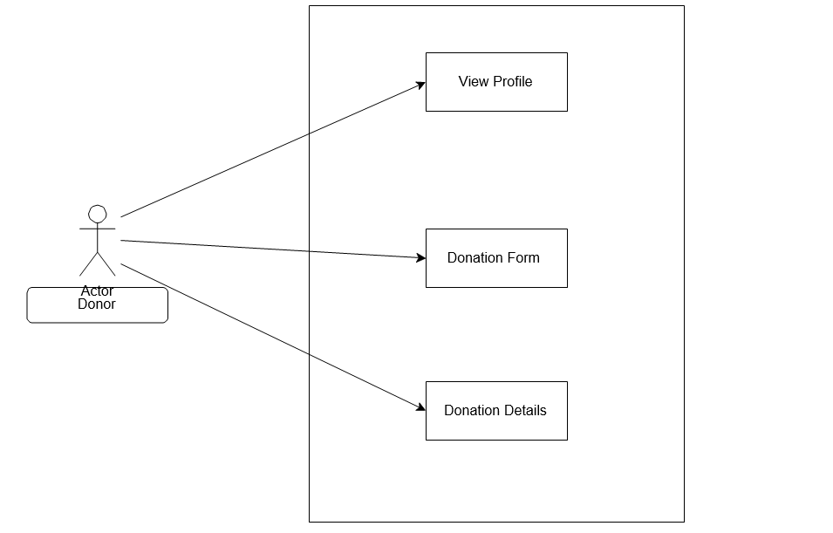
Donor use-case

Slide 8
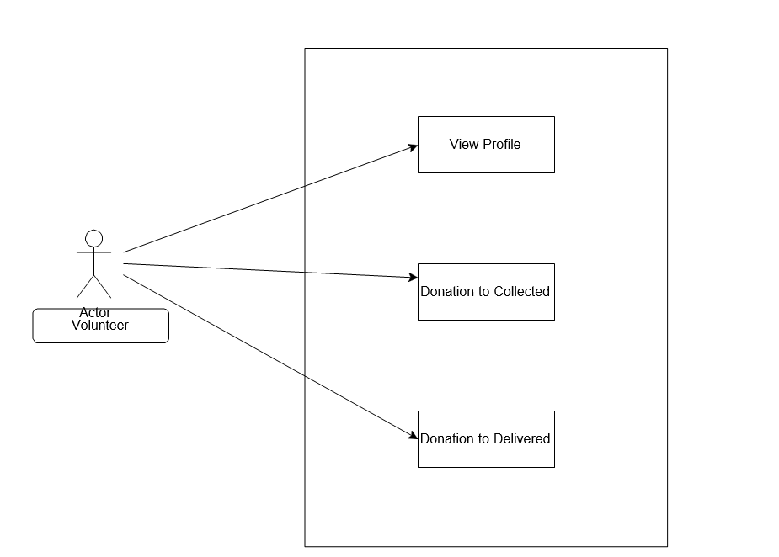
Volunteer use-case

Slide 9
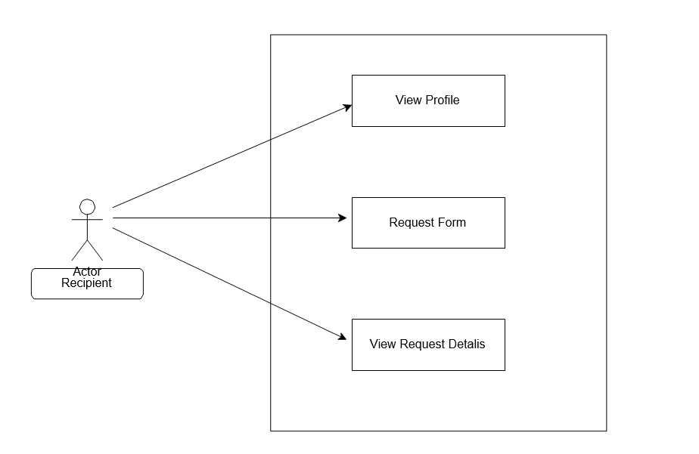
Recipient use-case

Slide 10
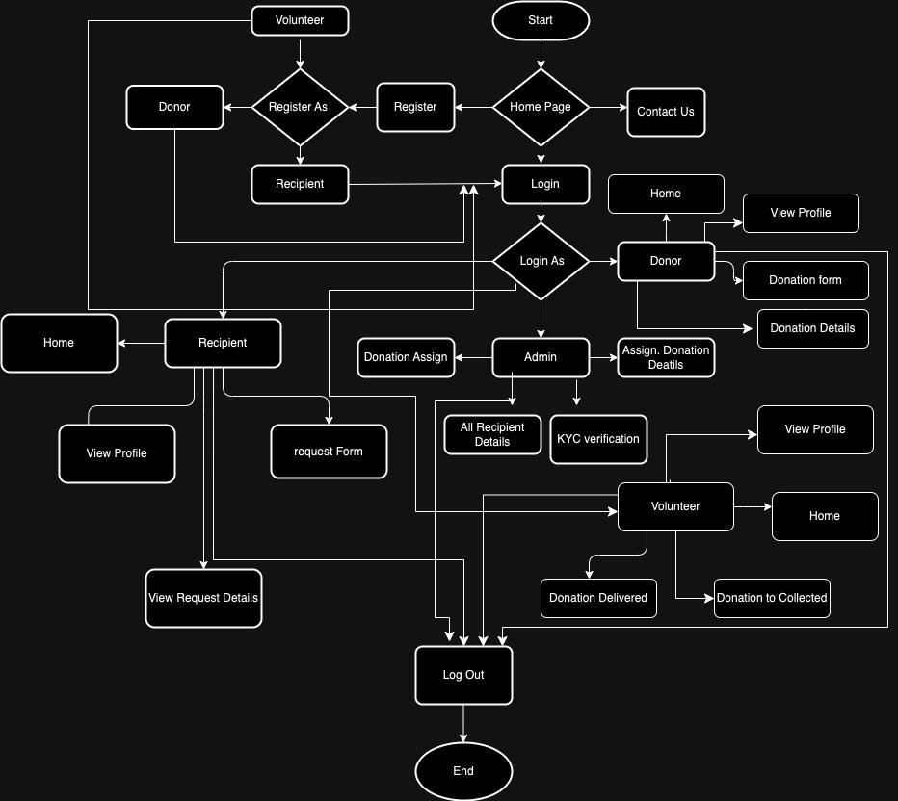
Flow Chart

Slide 11
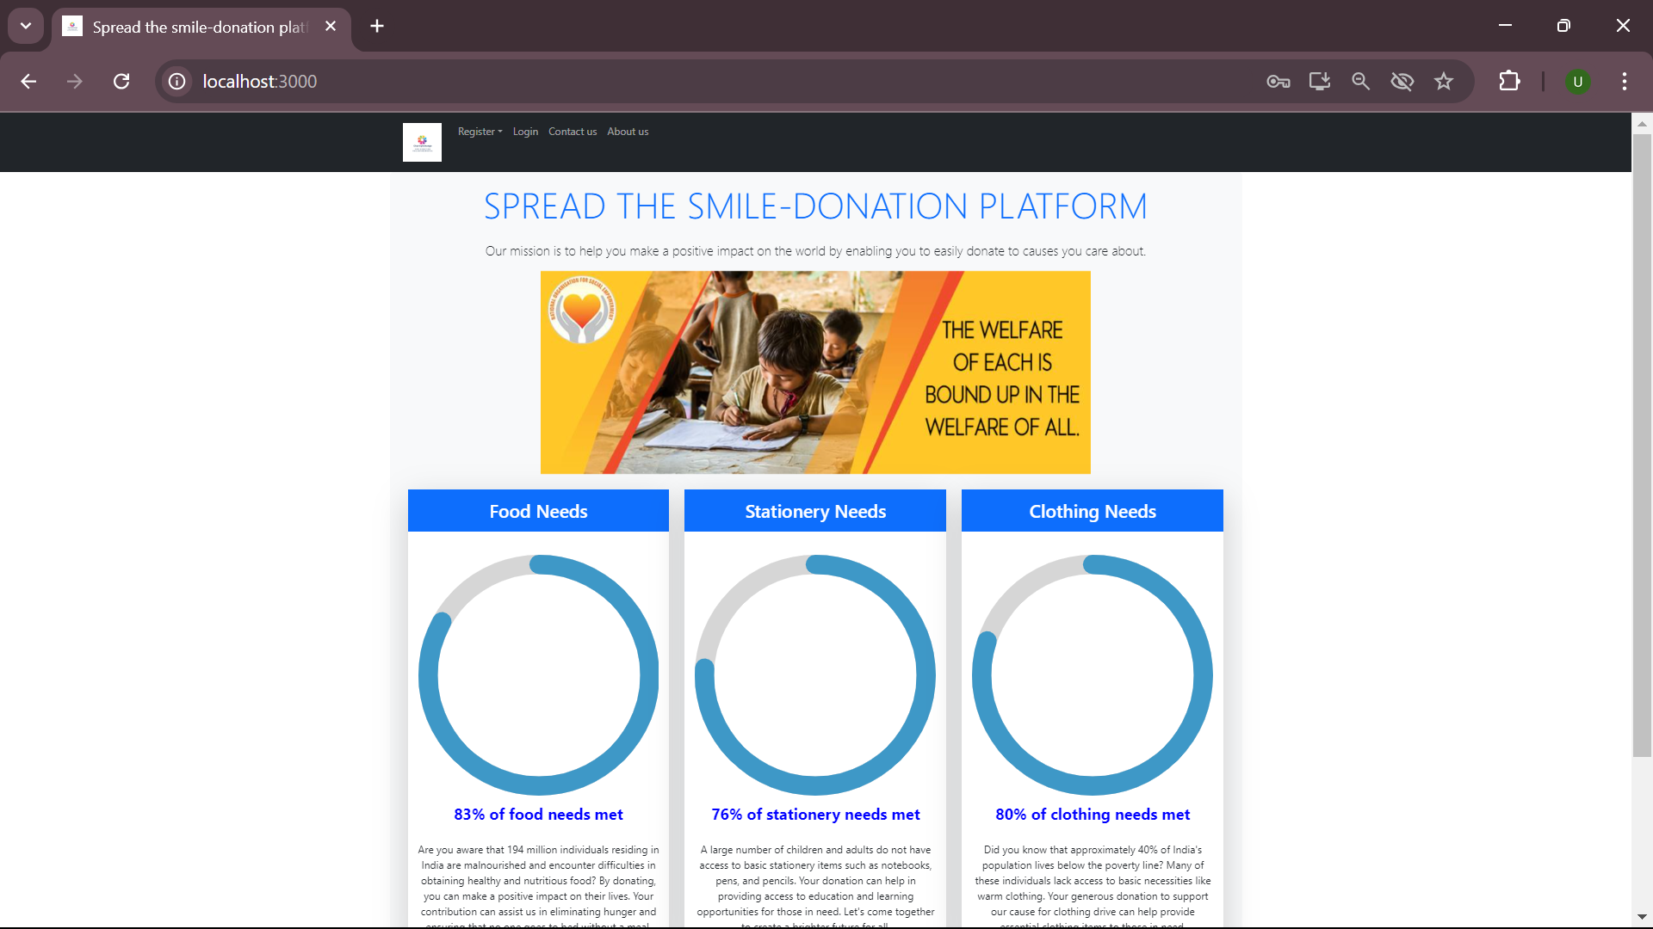
Implementation
Home page:

Slide 12
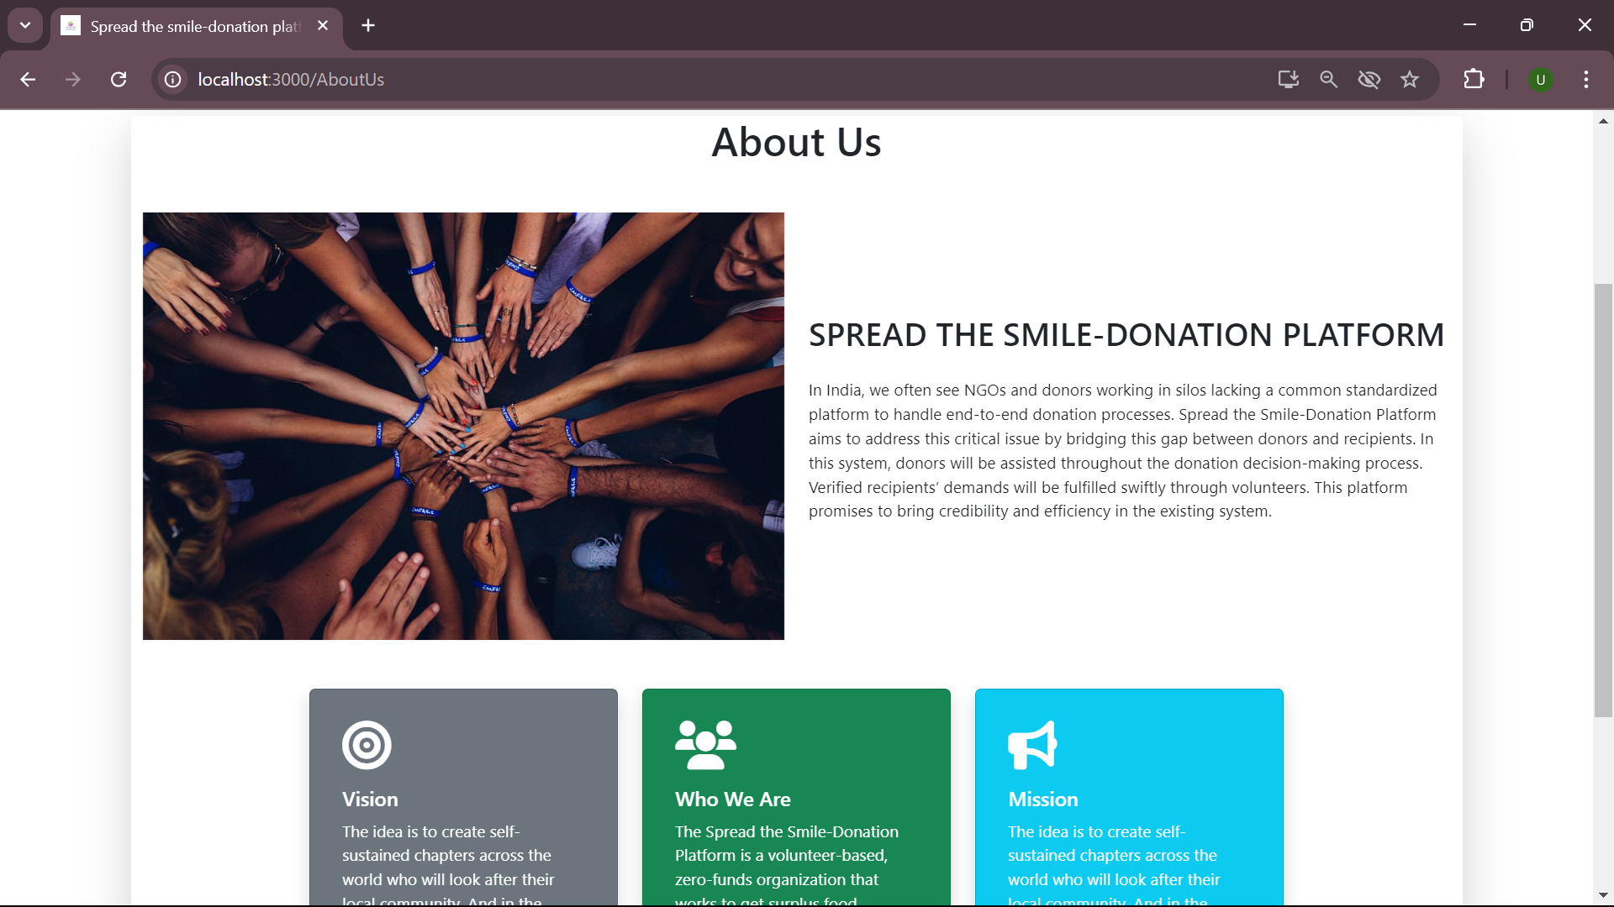

Slide 13
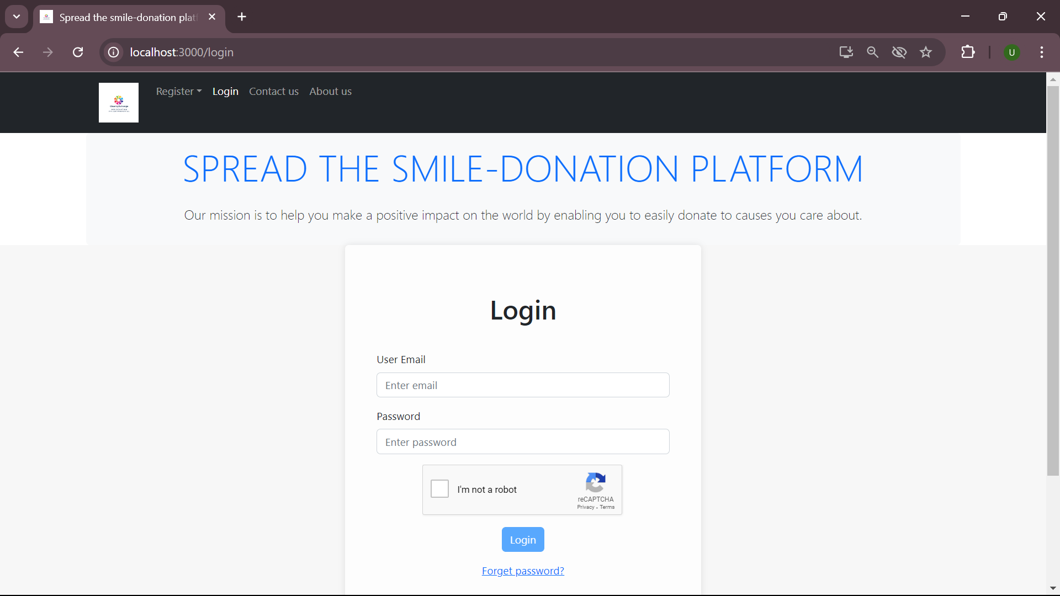

Slide 14
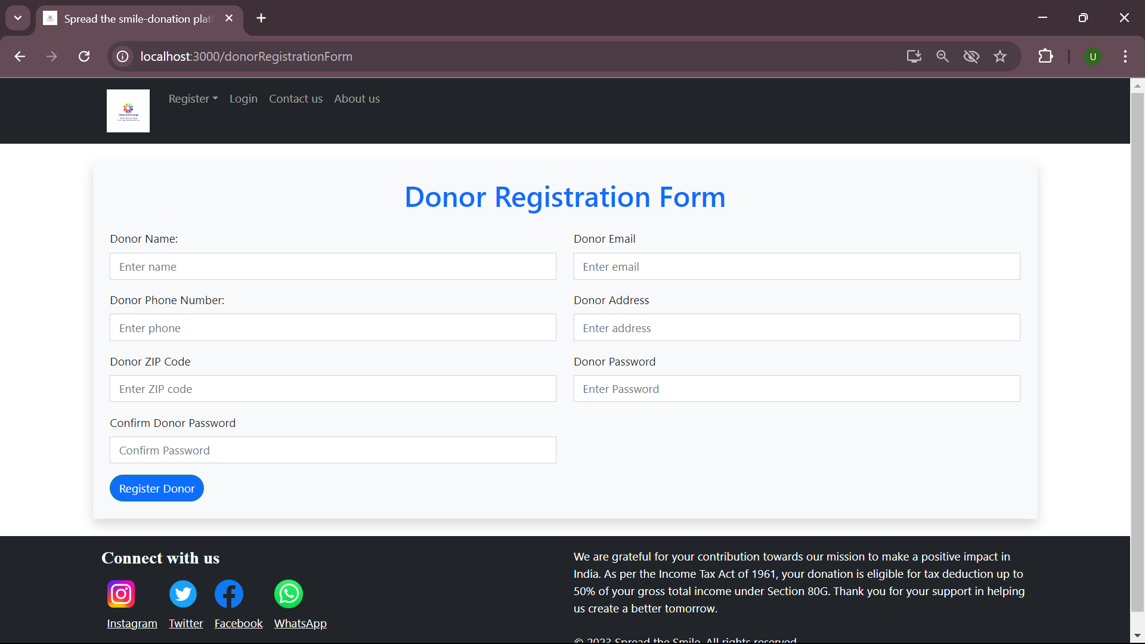

Slide 15
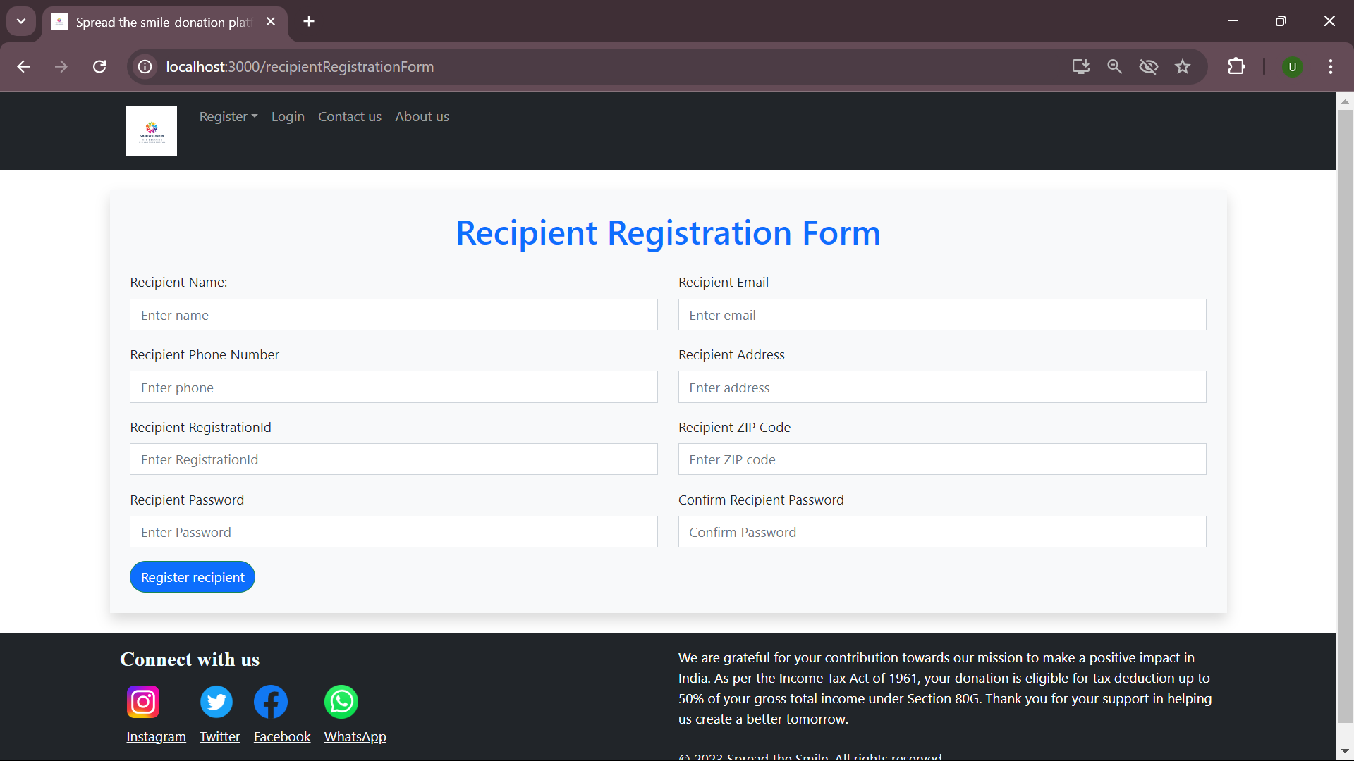

Slide 16


Slide 17
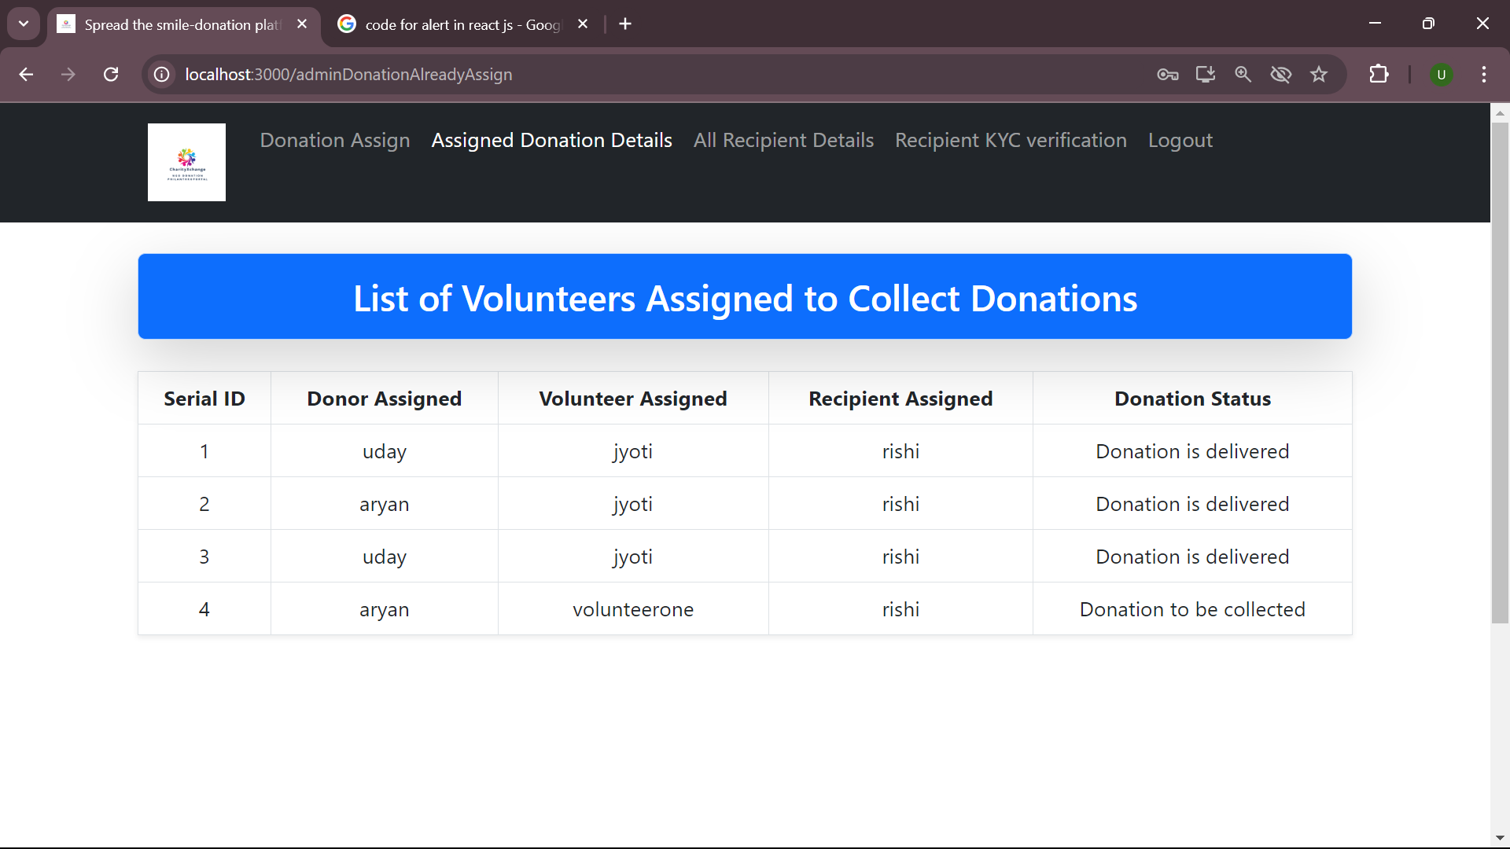

Slide 18
FUTURE SCOPE
Enhanced Mobile Features: Develop dedicated mobile apps for iOS and Android to offer a more optimized user experience on mobile devices.
Multi-Language Support: Add support for multiple languages to cater to a broader audience across different regions in India.
Advanced KYC Verification System: Allow recipients to upload essential documents (e.g., government-issued ID, proof of address, and income certificate). Use AI to automatically verify these documents for authenticity and flag any discrepancies.

Slide 19
CONCLUSION
We define the problem on which we are working in this project.
We designed the simple user interface and resolved security issues of the system.
Finally, system is implemented and tested accordingly to the test cases.
At personal level we learned to work with team, implement software development technology and principles and good programing practice.

Slide 20
THANK YOU…

