Slide 1

Multi-Factor Authentication System
This presentation explores a secure login system designed to protect user accounts using two-factor authentication, combining both email and SMS verification for added security.

Slide 2
Introduction
What is This?
Purpose
A secure login system that implements two-factor authentication, requiring both an email-based OTP and an SMS-based OTP.
To enhance account security by adding an extra layer of verification to prevent unauthorized access.

Slide 3

Features
1
User Registration
2
User Login
Users provide their email, password, and phone number. The password is securely encrypted and stored.
Users enter their email and password. The system verifies the credentials. Both email and SMS OTPs are required for authentication.
3
Security
The system utilizes bcrypt for secure password encryption, and OTP verification ensures only authorized users can access accounts.

Slide 4
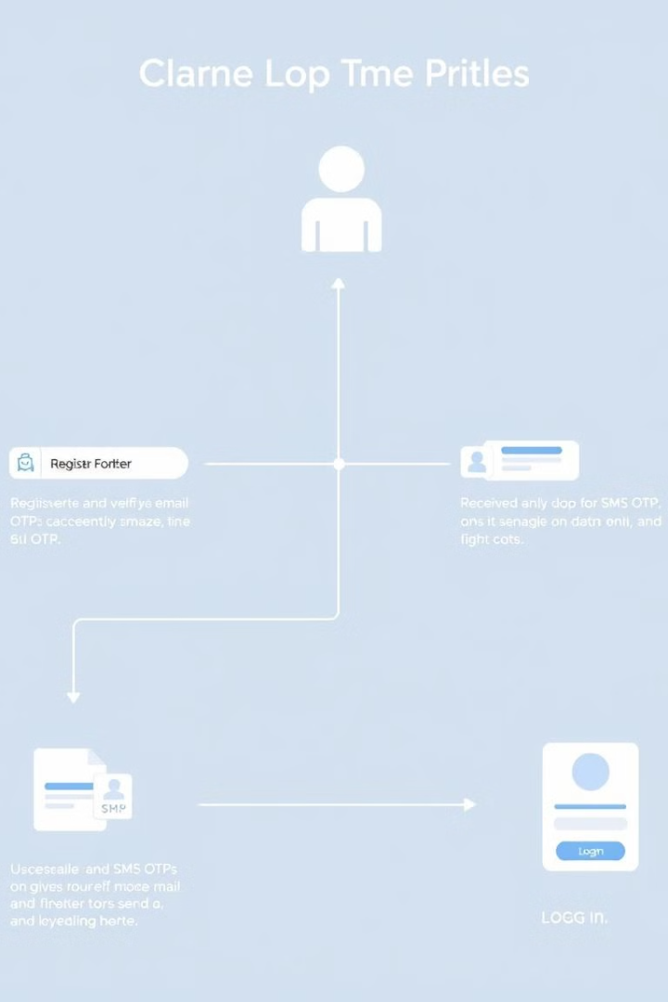
How It Works
1
Registration
Users enter their details, password is hashed, and a success message confirms registration.
2
Login
Email and password are verified. If correct, OTP verification proceeds. A 6-digit code is sent to the registered email and phone number.
3
OTP Verification
Users enter the OTPs received by email and SMS. If both are correct, login is successful.

Slide 5
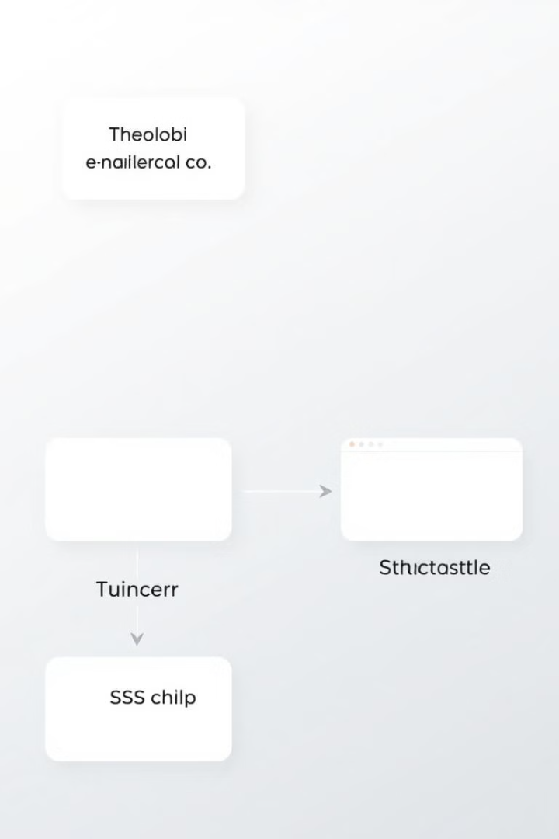
Key Components
Python Backend Code
MailHog
Handles registration, login, and OTP verification, providing the core logic of the system.
A local email testing tool used for sending and viewing emails for development and debugging purposes.
GUI
SMS Simulation
Built using Tkinter, providing a user-friendly interface for registration and login interactions.
Simulates SMS functionality by printing OTPs on the console during development, providing a convenient testing method.

Slide 6
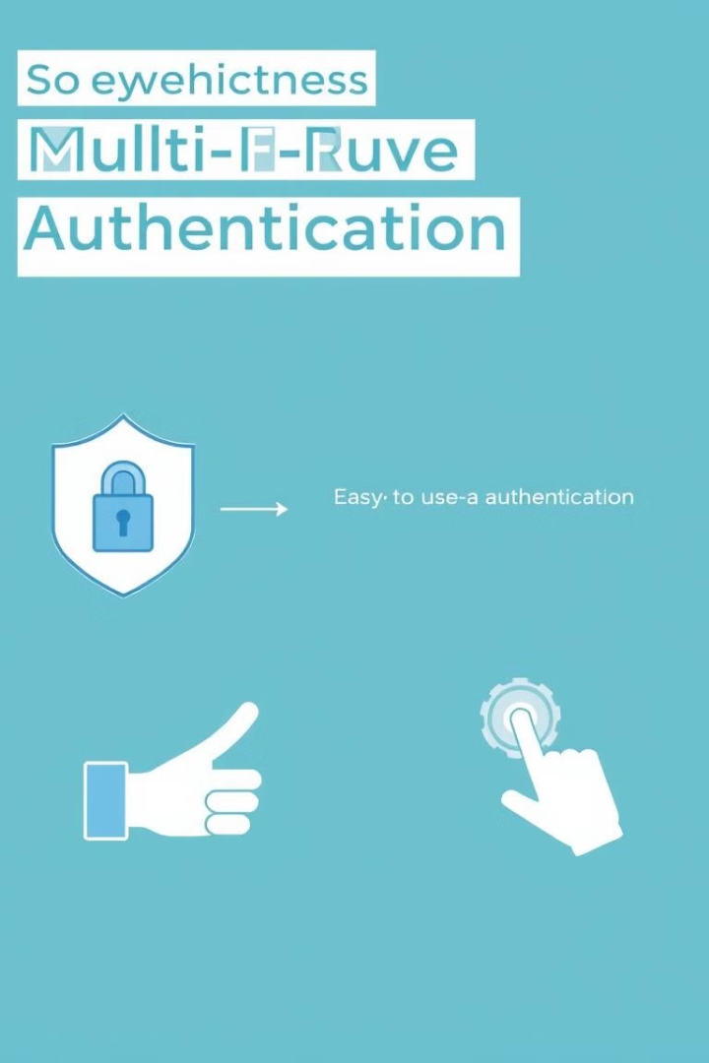
Benefits
High Security
User-Friendly
Combining password and OTPs for login provides a robust defense against unauthorized access.
The system offers an intuitive interface with clear steps, making it easy for users to register and log in.
Flexible Development
This system can be readily integrated into various real-world systems and adapted to different platforms and applications.

Slide 7
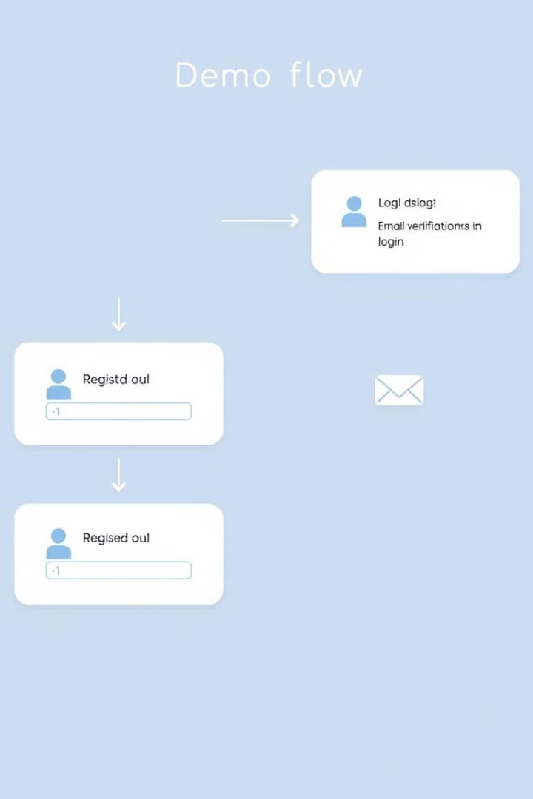




Demo Flow
Step 1
User registers with email, password, and phone number.
Step 2
User logs in with their email and password.
Step 3
User verifies email and SMS OTPs.
Step 4
Successful login message is displayed.

Slide 8
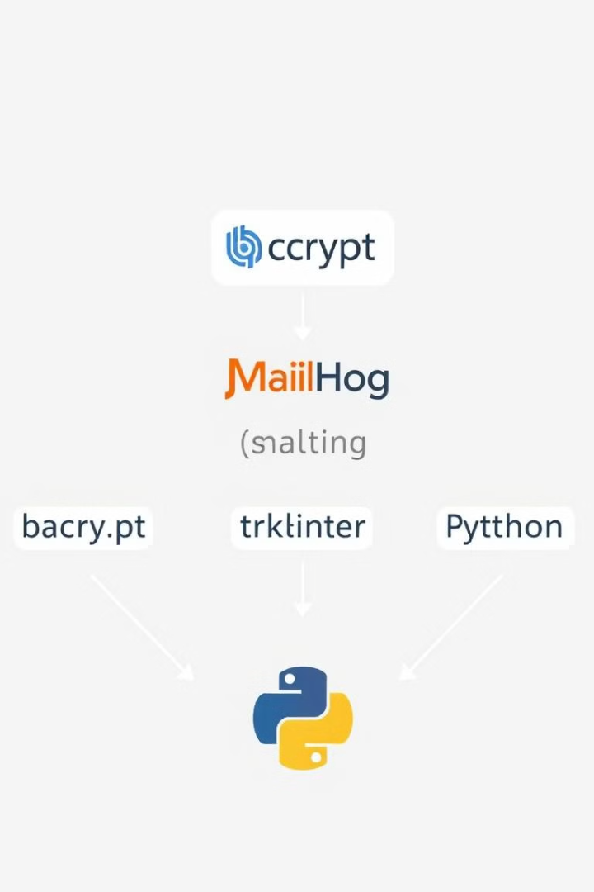



Tools Used
bcrypt
MailHog
Secure password hashing for robust security.
Local email testing tool for development.
Tkinter
Python Modules
GUI for user interaction and a streamlined experience.
Core backend functionality for the system.

Slide 9
Conclusion
Why Use This System?
Key Takeaways
This system offers a secure, reliable, and user-friendly multi-factor authentication approach.
The system protects users from unauthorized access, is easy to implement, and can be scaled for real-world applications.

