Slide 1
GPU‑Accelerated Lattice‑Boltzmann in PyTorch
Walid Abdul Hakim

Slide 2
Goal
Build a trustworthy PyTorch‑based LBM solver
Have acceptable results
Decrease the dev-time.

Slide 3
Verification

Slide 4
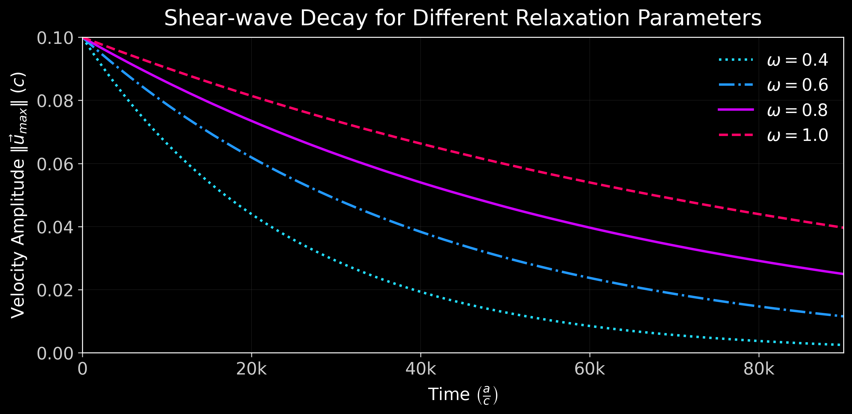
Verification I: Shear‑Wave Decay

Slide 5
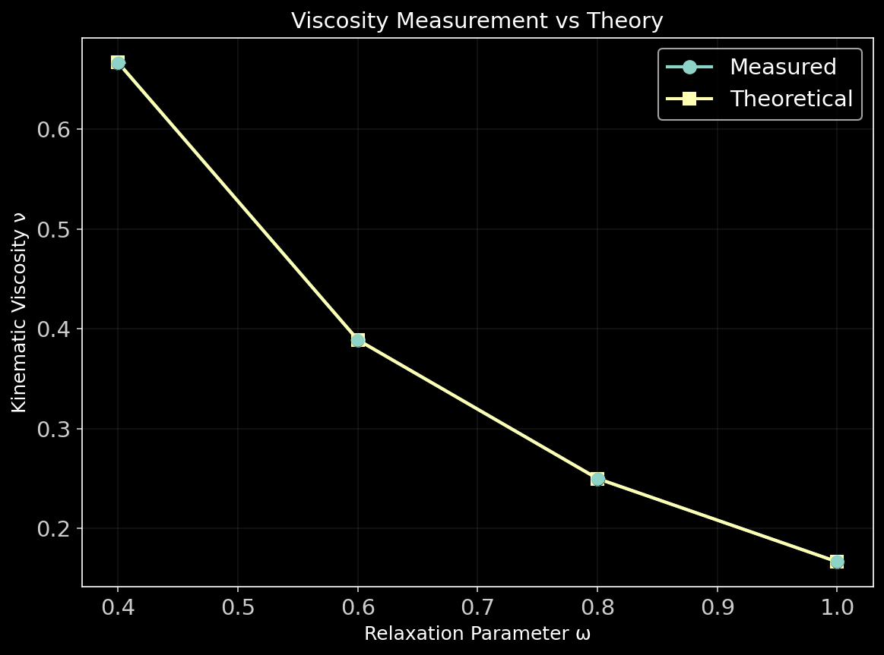
Verification II: Viscosity

Slide 6
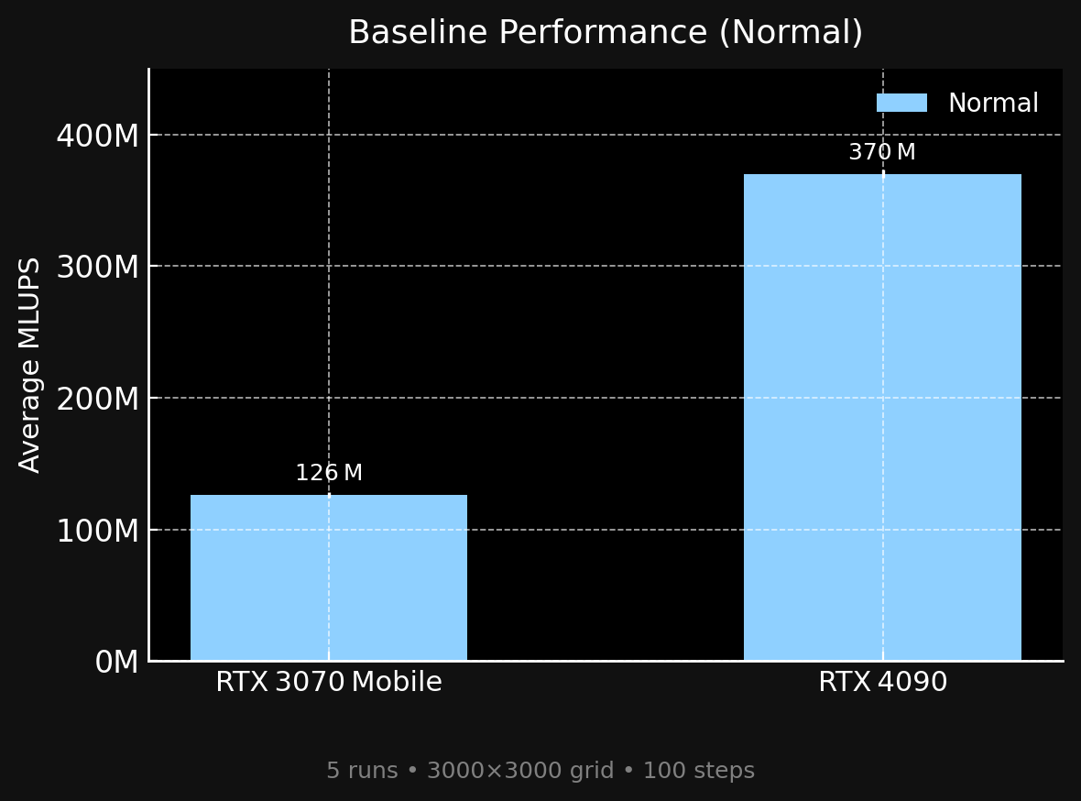

Slide 7
Improvements
Fusing collision + streaming + BC
Micro-tuning
Mixed precisions
Memory format-channels_last
Switching torch,compile modes
no significant increase in performance

Slide 8
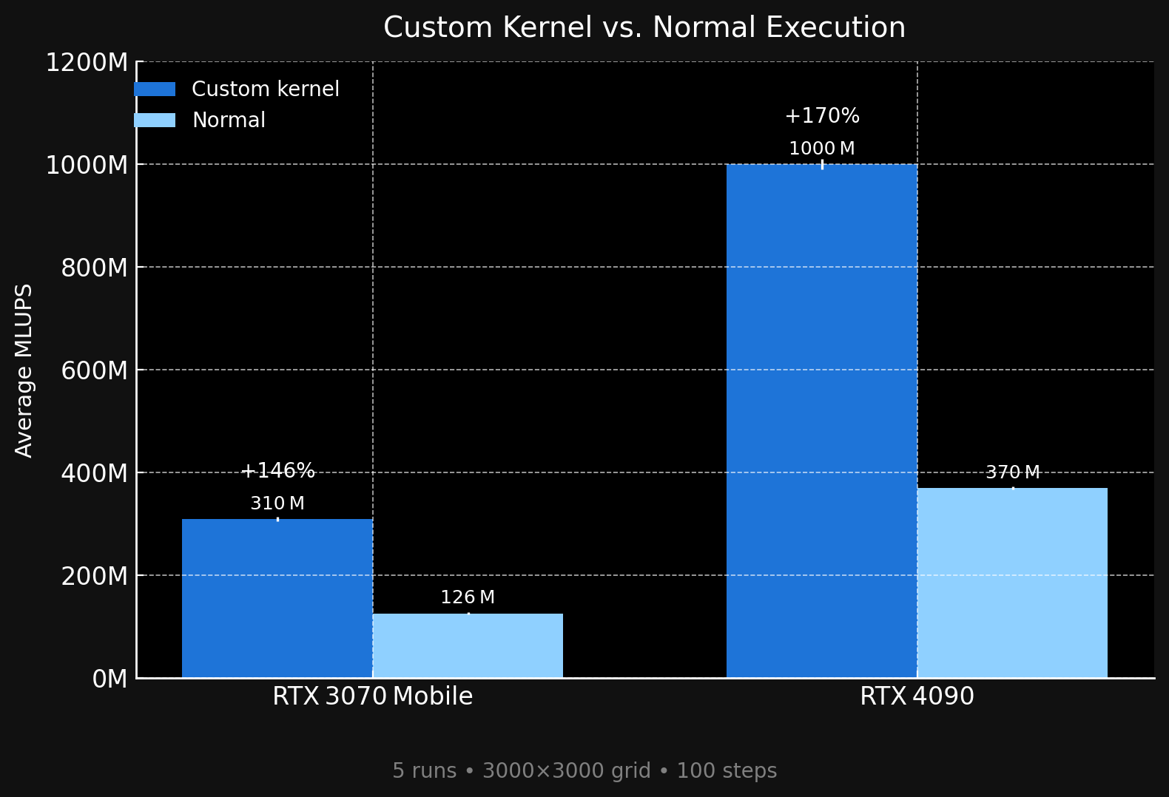

Slide 9
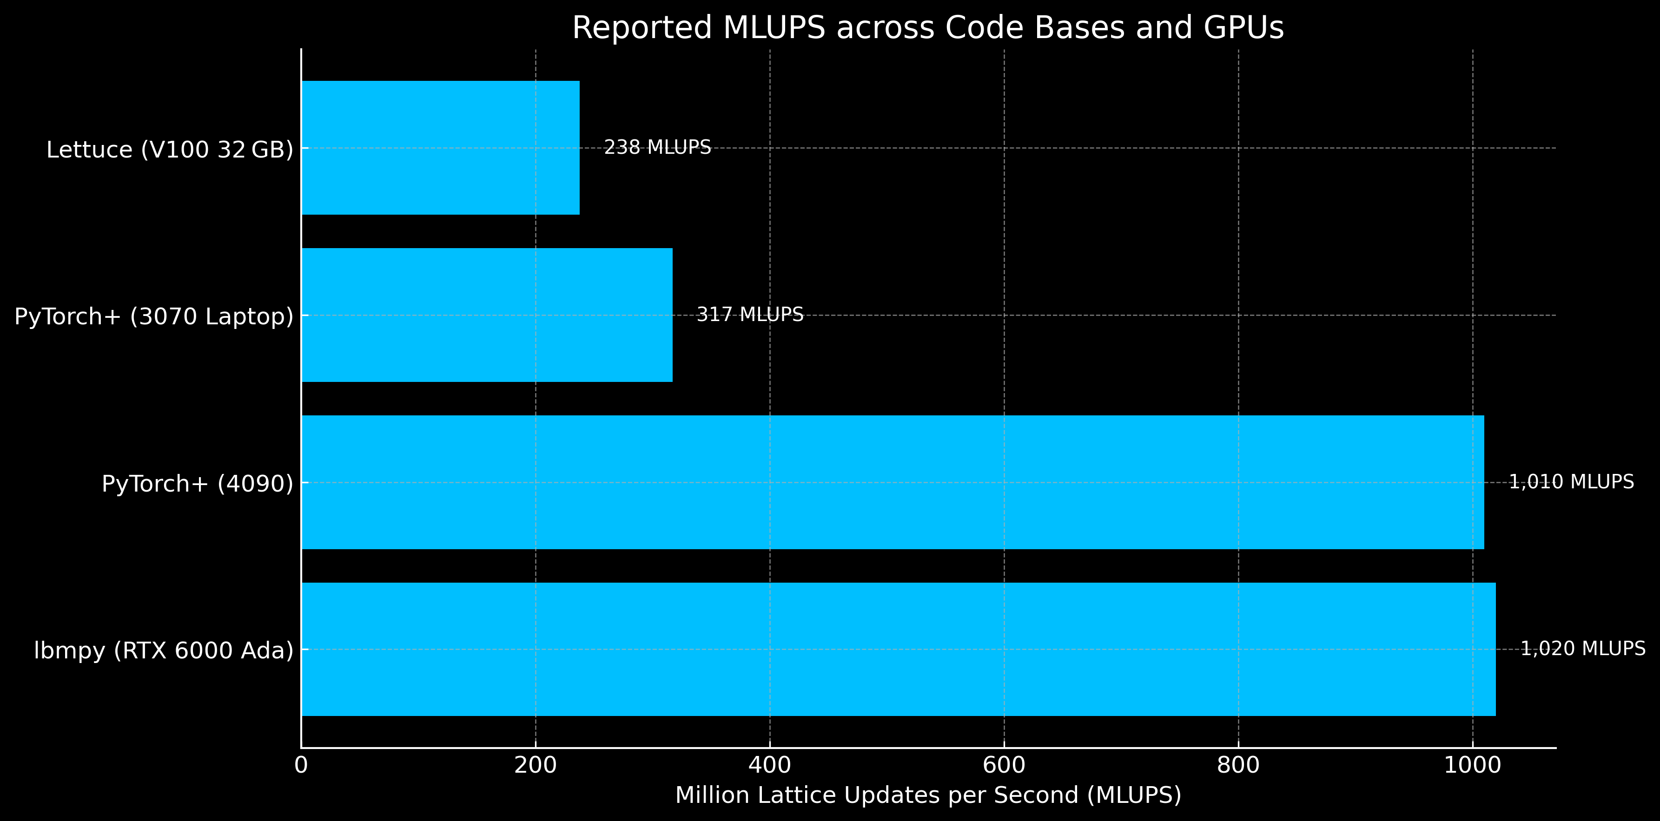
arXiv:2106.12929v2 [physics.comp-ph] 17 Nov 2021 https://pycodegen.pages.i10git.cs.fau.de/lbmpy/notebooks/00_tutorial_lbmpy_walberla_overview.html?utm_source=chatgpt.com

Slide 10
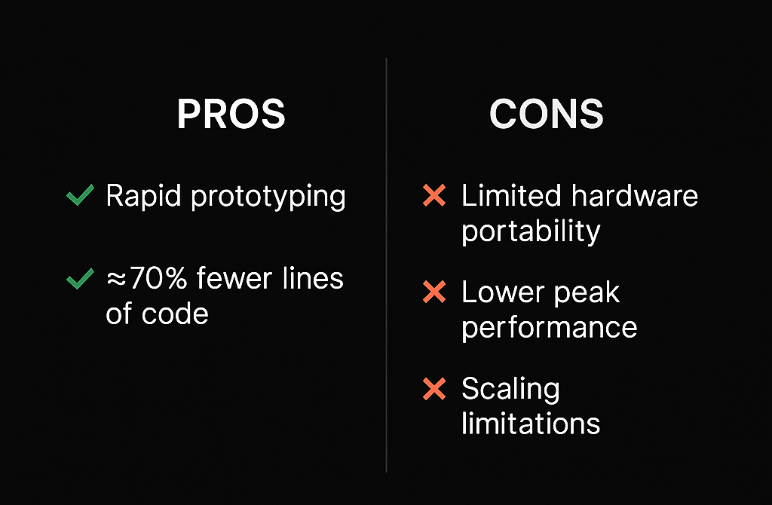

Slide 11

Demo

Slide 12
Thank you for your attention

