Slide 1

Evolution

Slide 2

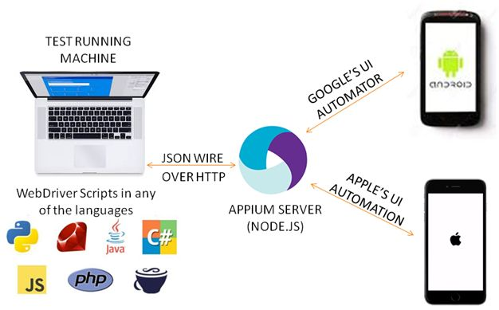

Slide 3




Appium & Selenium Testing Practice

Slide 4
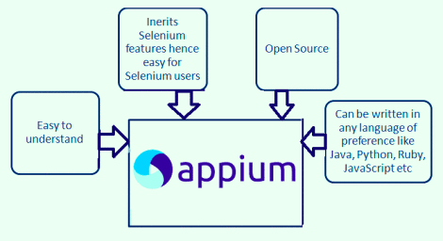

Slide 5
Appium Introduction
APPIUM :
Selenium Web driver + Mobile Features = Appium
Appium is an open source, cross-platform test automation tool for native, hybrid and mobile web apps, tested on simulators (iOS, FirefoxOS), emulators (Android), and real devices (iOS, Android, FirefoxOS).

Slide 6
Appium Introduction
Supported Platforms
iOS
Android
FirefoxOS

Slide 7
Appium Introduction
Why Appium?
You don't have to recompile your app or modify it in any way, due to use of standard automation APIs on all platforms.
You can use any testing framework.
You can write the code in any language Supported by Webdriver (Java, C#, Python, JavaScript and etc.)
If you use Apple's UIAutomation library without Appium you can only write tests using JavaScript and you can only run tests through the Instruments application. Similarly, with Google's UiAutomator you can only write tests in Java. Appium opens up the possibility of true cross-platform native mobile automation.

Slide 8
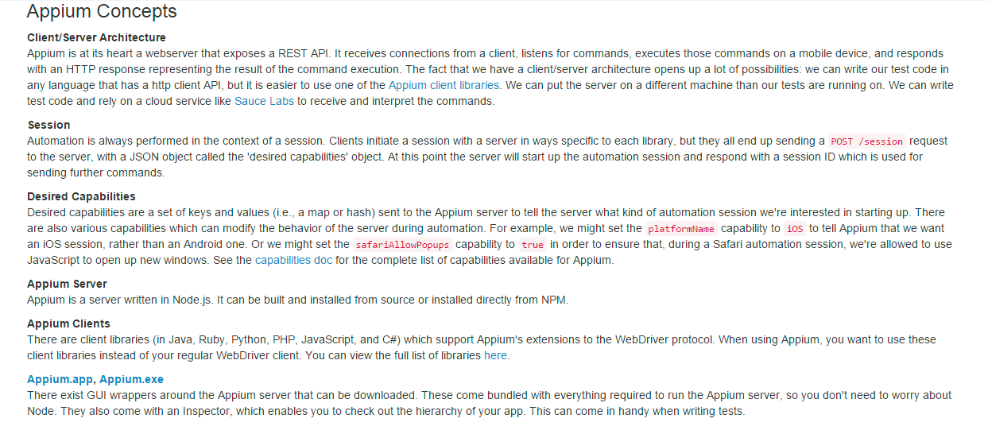
Appium Concept

