Slide 1





Appium & Selenium Testing Practice

Slide 2
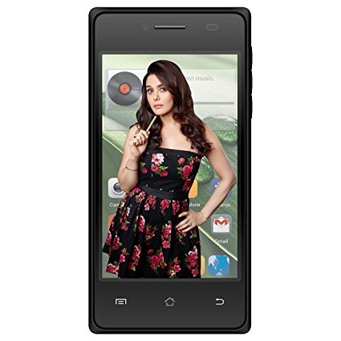
Device Shortcut:

Slide 3
Device Shortcut:
driver.pressKeyCode(AndroidKeyCode.BACK);
driver.pressKeyCode(AndroidKeyCode.HOME);

