Slide 1



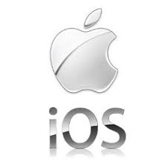
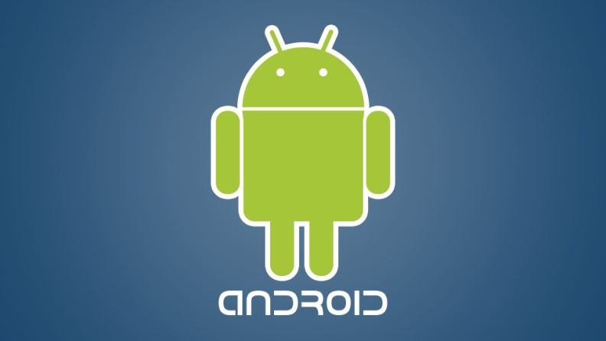
Appium & Selenium Testing Practice

Slide 2
Types of Application or Testing methods
Mobile devices: This includes smartphones, phablets, and tablets.
Mobile devices run one of two operating systems: iOS and Android.

Slide 3
OS on Mobile
iOS is developed and supported by Apple and is used on only on their own iPhones and iPads

Slide 4
OS on Mobile
Android is developed and supported by Google, often considered a more open platform compared to Apple.
Android is an open source operating system.
Google sells a few devices of its own, but Android normally runs on devices built by other companies like Samsung, Huawei, LG, HTC, etc.

Slide 5
OS Mobile: Android vs. iOS
As of Q3 2016, Android controls about 88% of the mobile device market worldwide, and Apple owns most of the rest.

Slide 6
OS Testing: Web App
Web apps don’t need to be downloaded like mobile apps do. Web apps load in browsers like Chrome, Safari, or Firefox and they don’t take up any memory or storage on the user’s device.

Slide 7
OS Testing: Native and Hybrid
There are two kinds of mobile apps: native and hybrid. When we talk about mobile apps in this article, we’re talking about apps you download from an app store.
Most of the most popular apps out there like Pokemon Go, Twitter, and Waze, are fully native.
If a native app and a web app got married and had a kid, it would be a hybrid app.

