Slide 1





Appium & Selenium Testing Practice

Slide 2
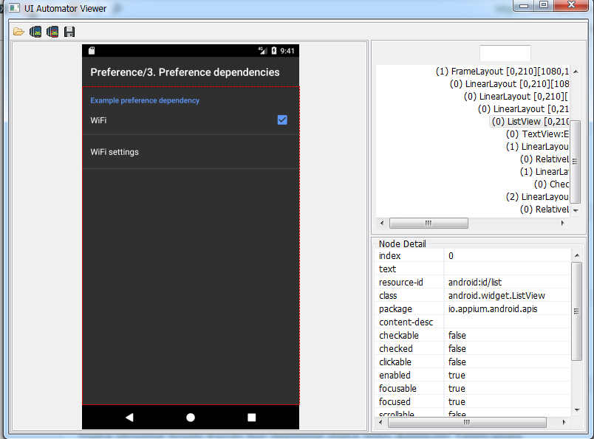
Inspect WebElement using UI Automator Viewer

Slide 3
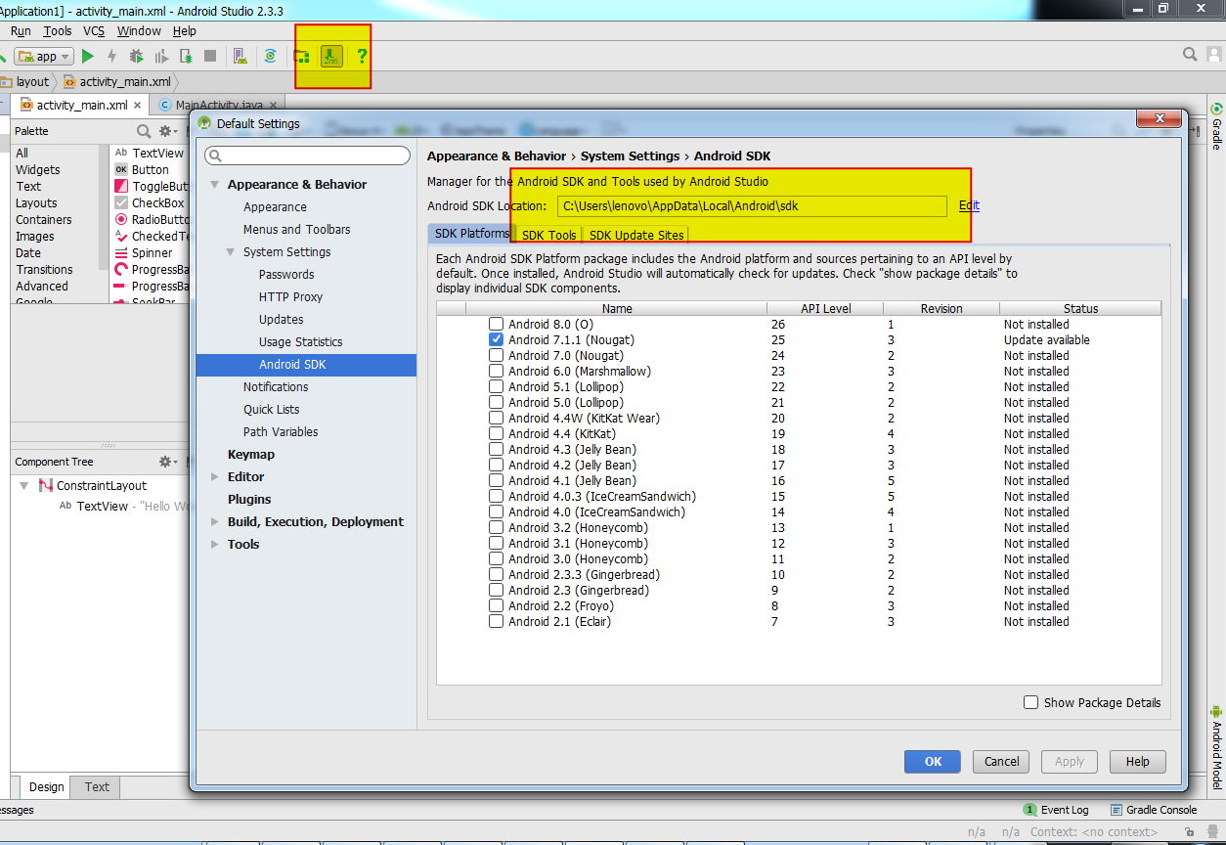
Starting the UI Automator

Slide 4
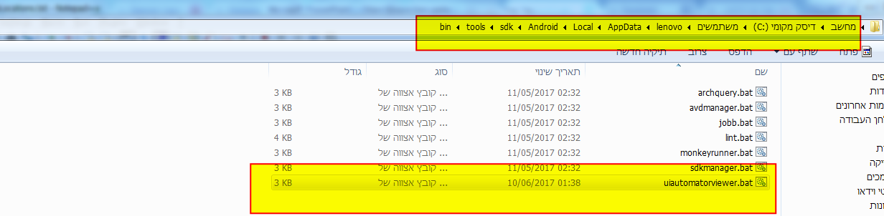
Starting the UI Automator

Slide 5
Finding and Executed Methods
driver.findElementBy…
Id
Xpath
findElementByClassName
AndroidUIAutomator

Slide 6
Finding in WebDriver object DOM
.findElementById("android:id/title").getText()
.findElementByXPath("//android.widget.TextView[@text='Preference']").click();
.findElementByClassName("android.widget.EditText").sendKeys("Hagai_WifiSetting1");
.findElementByAndroidUIAutomator("text(\"Views\")").click();

Slide 7
Set WebElemen Object
AndroidElement aeExpandList = driver.findElementByAndroidUIAutomator("text(\"Expandable Lists\")");
aeExpandList.click();

Slide 8
Find Elements List
.findElementsByAndroidUIAutomator("new UiSelector().clickable(true)");
List<AndroidElement> aeClickableElementList = …

