Slide 1





Appium & Selenium Testing Practice

Slide 2
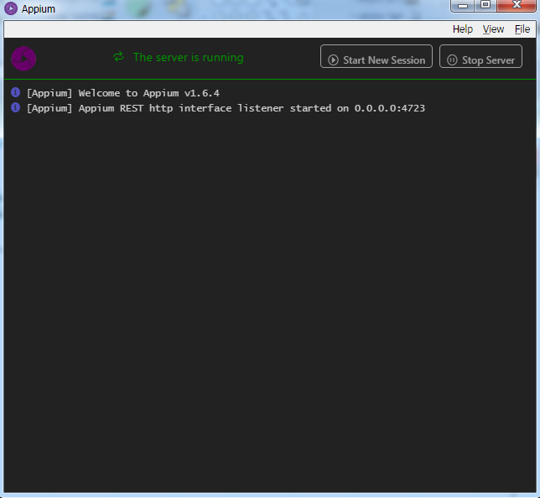
Install & Start Appium Desktop Server

Slide 3
Start Emulator
From Android Studio
From Batch: C:\Users\lenovo\AppData\Local\Android\sdk\tools\emulator.exe -avd demo1

Slide 4
Start UI Automator Viewer for identify DOM elements
From SDK: ..\Android\sdk\tools\bin
Start Batch: C:\Users\lenovo\AppData\Local\Android\sdk\tools\emulator.exe -avd demo1

Slide 5
Creating our Capability Instant
DesiredCapabilities cap = new DesiredCapabilities();
Using Selenium Remote library.
cap.setCapability(MobileCapabilityType.DEVICE_NAME, "demo1");
cap.setCapability(MobileCapabilityType.NEW_COMMAND_TIMEOUT, "100");
cap.setCapability(MobileCapabilityType.APP, fs.getAbsolutePath());
Sending cap to the Android Driver object:
AndroidDriver<AndroidElement> driver = new AndroidDriver<>(new URL("http://127.0.0.1:4723/wd/hub"),cap);
//Setting General wait if element is not exist in first attempt
driver.manage().timeouts().implicitlyWait(10, TimeUnit.SECONDS);

Slide 6
Use Base Class for reusable Code
static Capabilities()
Return AndroidDriver<AndroidElement>

Slide 7
Why to use APK in our Application test ?
Stability: in case app is not installed.
Best Practice.

