Slide 1




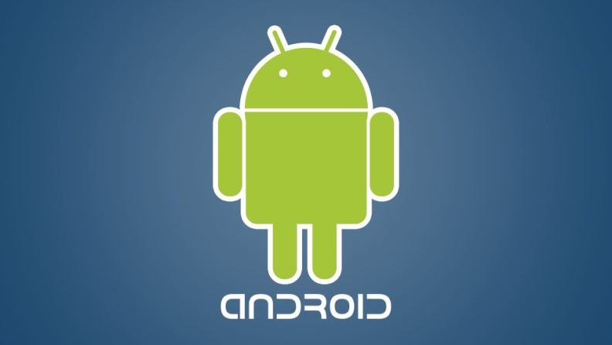
Appium & Selenium Testing Practice

Slide 2
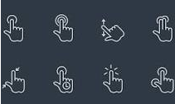
Most common user gestures on Mobile Devices:

