Slide 1
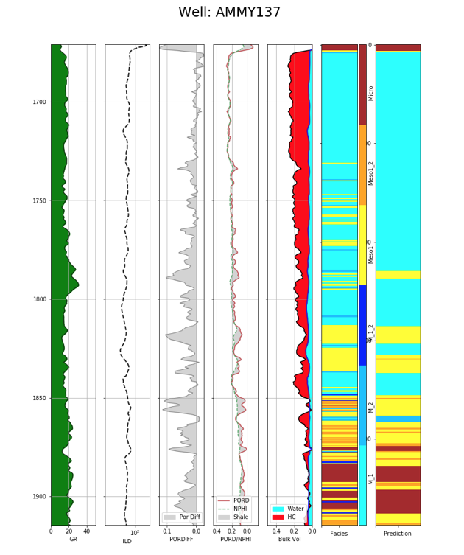
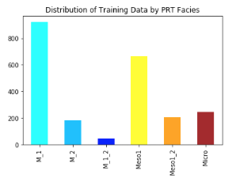
Distribution of PRTs in Training Data

Slide 2
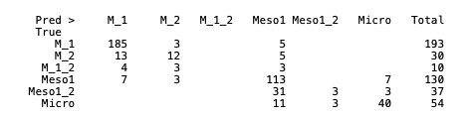
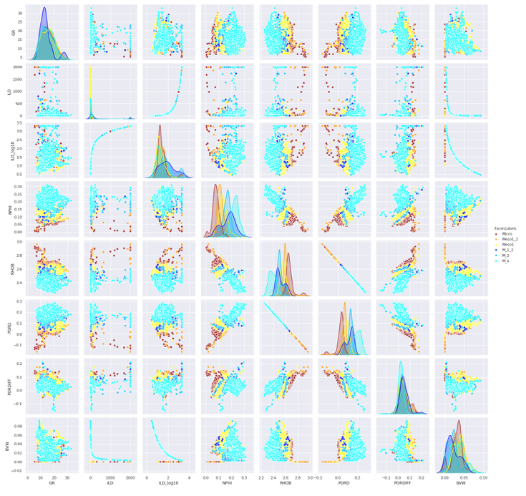
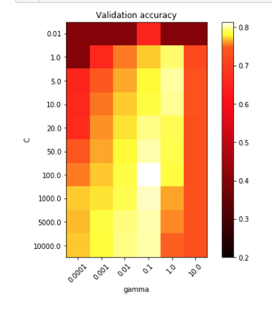
Seaborn Matrix Plot
Confusion Matrix
Model parameter selection of C and gamma
Highest Accuracy:
C = 100
Gamma = 0.1

Slide 3
