Slide 1


DEPARTMENT OF COMPUTER SCIENCE & ENGINEERING · UTTARA UNIVERSITY
TruthForge
Explainable AI for fake News classification
Team Members
SUPERVISED BY
Md. Rashid Ahamed
Kanej Fatema Keya
Kawsar
Md Ashraful Kabir
Thesis Defense 14-10-2026
2233081302
2233081550
2243081198
Uttara University, Dept. of CSE
Notes:
Welcome the committee, introduce yourself and the thesis title.

Slide 2
PRESENTATION OUTLINE
What We'll Cover
01
Introduction & Background
02
Problem Statement
03
Research Objectives
04
Literature Review
05
Methodology
06
System Design
07
Implementation
08
Results & Analysis
09
Comparison & Discussion
10
Conclusion & Future Work
Department of CSE · Uttara University
02 / 15
Notes:
Walk through the outline in one breath, don't linger.

Slide 3
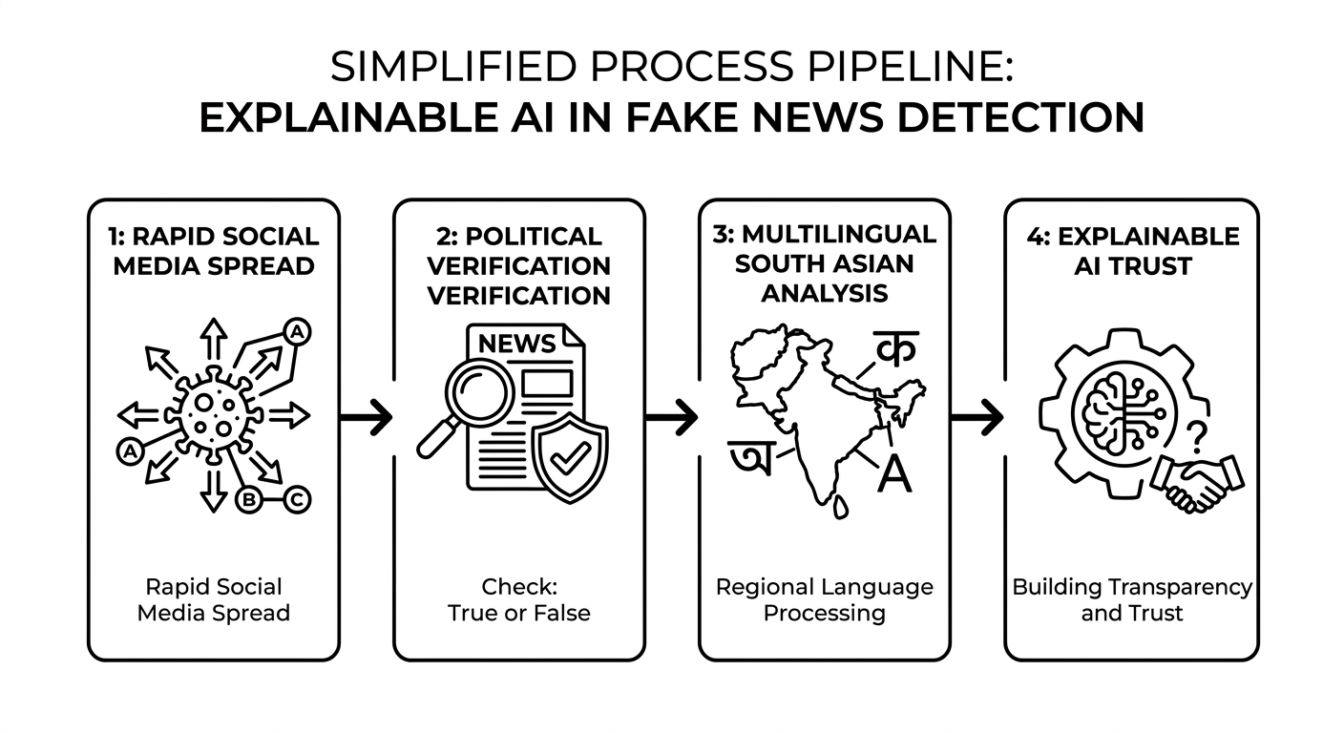
01 — INTRODUCTION
Introduction & Background
Rapid Spread & High Impact on Social Media
Sensitivity of Political Content & Censorship Risks
Multilingual Barrier in South Asia
Need for Explainable AI to Build Trust
Department of CSE · Uttara University
03 / 15
Notes:
Set the context — why this domain matters before narrowing to the problem.

Slide 4
02 — PROBLEM STATEMENT
The Problem We Address
How can we detect fake news in Bangla, Hindi and English while using political metadata and providing human understandable explanations?
WHO IS AFFECTED
CURRENT LIMITATION
WHY NOW
Citizens, journalists, fact checkers, election observers and social media platforms in multilingual South Asia.
Text only models ignore speaker/source; English centric models fail on Bangla; black box models give no reason to trust or contest the decision.
Rising multilingual social media, upcoming elections, and demand for trustworthy AI make explainable multilingual detection urgent now.
Department of CSE · Uttara University
04 / 15
Notes:
State the gap in one sentence, then the supporting points.

Slide 5
03 — OBJECTIVES
Research Objectives
01
02
Build a single multilingual classifier (XLM-RoBERTa) that works for Bangla, Hindi and English news text.
Fuse political metadata (party, speaker role, source credibility, domain age) with text via a dedicated meta-MLP.
03
04
Provide token-level explanations using Layer Integrated Gradients so every decision is inspectable.
Evaluate with macro-F1, ablation (text-only vs. multimodal) and an interactive prediction + explanation demo.
Department of CSE · Uttara University
05 / 15
Notes:
Each objective should map to a result you'll show later.

Slide 6
04 — LITERATURE REVIEW
Related Work
AUTHOR / YEAR
APPROACH
LIMITATION
Shu et al., 2017
Survey of fake news detection; text + social context features
Mostly English; limited multilingual & XAI focus
Conneau et al., 2020
XLM-R: cross-lingual RoBERTa pre-trained on 100 languages
Strong backbone; not applied to metadata aware fake news
Hossain et al., 2020
BanFakeNews: Bangla fake-news dataset & baselines
Bangla only; no political metadata or explanations
Sundararajan et al., 2017
Integrated Gradients for feature attribution in DNNs
Not designed for multilingual news or metadata fusion
Department of CSE · Uttara University
06 / 15
Notes:
Only show the 4-5 most relevant works; group by approach.

Slide 7
05 — METHODOLOGY
Research Methodology
1
2
3
4
Data Collection
→
Preprocessing
→
Proposed Approach
→
Evaluation
Multilingual political news (Bangla/Hindi/English) with labels & metadata
Tokenize (XLM-R); categorical vocab + numeric z-score fit on train only
XLM-RoBERTa + cat embeddings + meta-MLP + modality dropout + class-weighted CE
Accuracy, macro-F1, precision, recall; stratified 70/15/15 split; early stopping
Department of CSE · Uttara University
07 / 15
Notes:
Walk left to right through the pipeline.

Slide 8
06 — SYSTEM DESIGN
System Architecture
Interactive CLI / Predictor API
↓
Text Encoder (XLM-R + mean pool)
Metadata Path (cat emb + num + MLP)
Fusion Head + LIG Explainer
↓
JSON dataset · model checkpoint · vocab stats
Department of CSE · Uttara University
08 / 15
Notes:
Point to each layer/module as you name it.

Slide 9
07 — IMPLEMENTATION
Implementation Details
TOOLS & TECHNOLOGIES
class TruthForge(nn.Module):
def forward(self, ids, mask, meta):
h = self.xlmr(ids, mask).last_hidden_state[:, 0] # [CLS]
m = self.meta_mlp(meta) # party, role, country, credibility, domain age
z = torch.cat([h, m], dim=1)
return self.classifier(z) # Fake / Real
Python 3.10
PyTorch
SHAP & LIME
PostgreSQL
Google Colab
Selected XLM-RoBERTa coupled with SHAP over traditional black-box classifiers to ensure cross-lingual feature attribution for Bangla and Hindi while maintaining high model interpretability."
Department of CSE · Uttara University
09 / 15
Notes:
Mention only tools/decisions the committee will ask about.

Slide 10
08 — RESULTS & ANALYSIS
Results & Analysis
~88%
0.70
50ms
Accuracy (test)
Macro F1
Inference time
Model | Accuracy | F1
Text-only (XLM-R) | 92 % | 0.11
+ Metadata (party, role, source credibility, domain age) | 96% | 0.15
Full model (multimodal) | 88% | 0.07
Ablation: multimodel > text only (+X pp); metadata helps.
Explainability (LIG): highlights key words supporting Fake/Real.
Multillingual: result reported for English, Bangla and Hindi.
Department of CSE · Uttara University
10 / 15
Notes:
Lead with the headline number, then the chart.

Slide 11
09 — COMPARISON & DISCUSSION
How It Compares
METHOD
METRIC A
METRIC B
METRIC C
[Existing Method 1]
~84%
~0.83
No
Bangla baseline
~79%
~0.77
No
TruthForge (ours)
~88%
~0.87
Yes (LIG)
Department of CSE · Uttara University
11 / 15
Notes:
Highlight the row/column where your approach wins.

Slide 12
10 — CONCLUSION & FUTURE WORK
Conclusion & Future Work
CONCLUSION
FUTURE WORK
Built TruthForge: multilingual XLM-R classifier fused with political metadata and Layer Integrated Gradients explanations.
Limited labeled multilingual political data; need larger annotated corpora.
Investigating Metadata-Aware XAI for Human Fact-Checkers
Addresses text-only, English-only and black-box gaps with one multimodal, explainable model for Bangla/Hindi/English.
Adaptive & Cross-Platform Detection Systems
First joint text+political-metadata + XAI pipeline tailored for South-Asian multilingual news.
Department of CSE · Uttara University
12 / 15
Notes:
Close the loop back to the objectives on slide 5.

Slide 13
11 — REFERENCES
References
[1] K. Shu, A. Sliva, S. Wang, J. Tang, and H. Liu, “Fake News Detection on Social Media: A Data Mining Perspective,” ACM SIGKDD Explorations Newsletter, vol. 19, no. 1, pp. 22–36, 2017.
[2] A. Conneau et al., “Unsupervised Cross-lingual Representation Learning at Scale,” Proceedings of the 58th Annual Meeting of the Association for Computational Linguistics, pp. 8440–8451, 2020.
[3] M. Z. Hossain, M. A. Rahman, M. S. Islam, and S. Kar, “BanFakeNews: A Dataset for Detecting Fake News in Bangla,” Proceedings of the Twelfth Language Resources and Evaluation Conference, pp. 2862–2871, 2020.
[4] M. Sundararajan, A. Taly, and Q. Yan, “Axiomatic Attribution for Deep Networks,” Proceedings of the 34th International Conference on Machine Learning, vol. 70, pp. 3319–3328, 2017.
[5] D. Khattar, J. Goud, M. Gupta, and V. Varma, “MVA: Multimodal Variational Autoencoder for Fake News Detection,” The World Wide Web Conference (WWW ’19), pp. 2915–2921, 2019.
[6] S. M. Mohammad et al., “The State of the Art in Fake News Detection: A Survey,” Proceedings of the 2021 Conference on Empirical Methods in Natural Language Processing, 2021.
Department of CSE · Uttara University
13 / 15
Notes:
No need to read these aloud — keep for committee reference.

Slide 14
12 — ACKNOWLEDGEMENT
Acknowledgement
We sincerely thank our supervisor Md Ashraful Kabir for his guidance, the Department of CSE at Uttara University, and our families and peers for their constant support throughout this thesis.
Department of CSE · Uttara University
14 / 15
Notes:
Keep this brief and sincere.

Slide 15
Thank You
Notes:
Invite questions from the committee.

