Slide 1

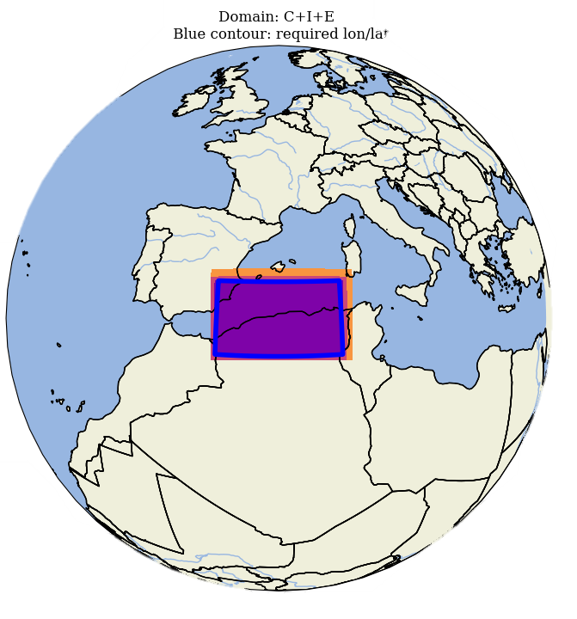
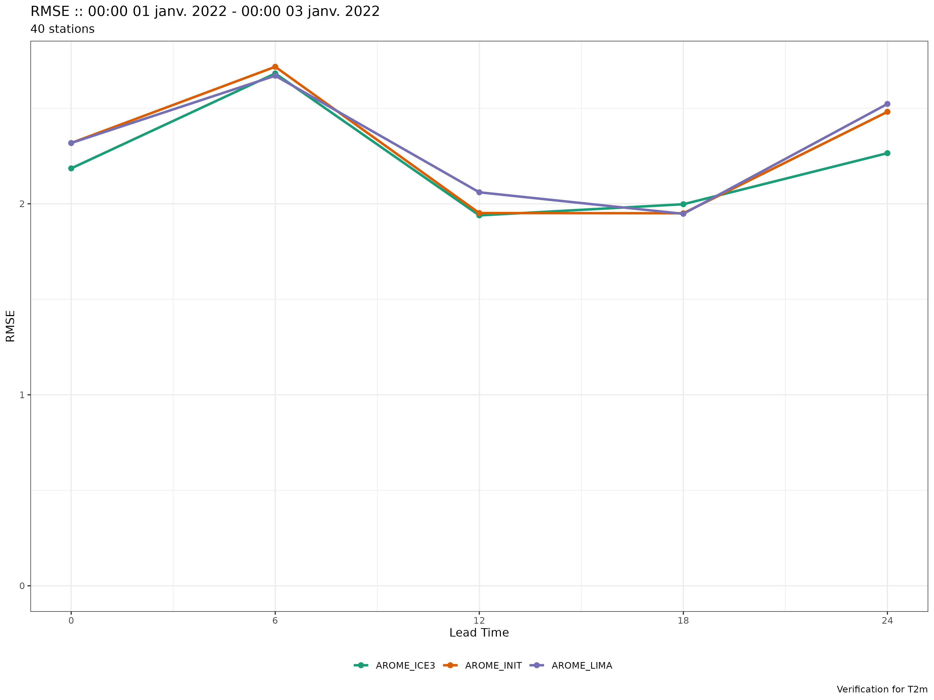
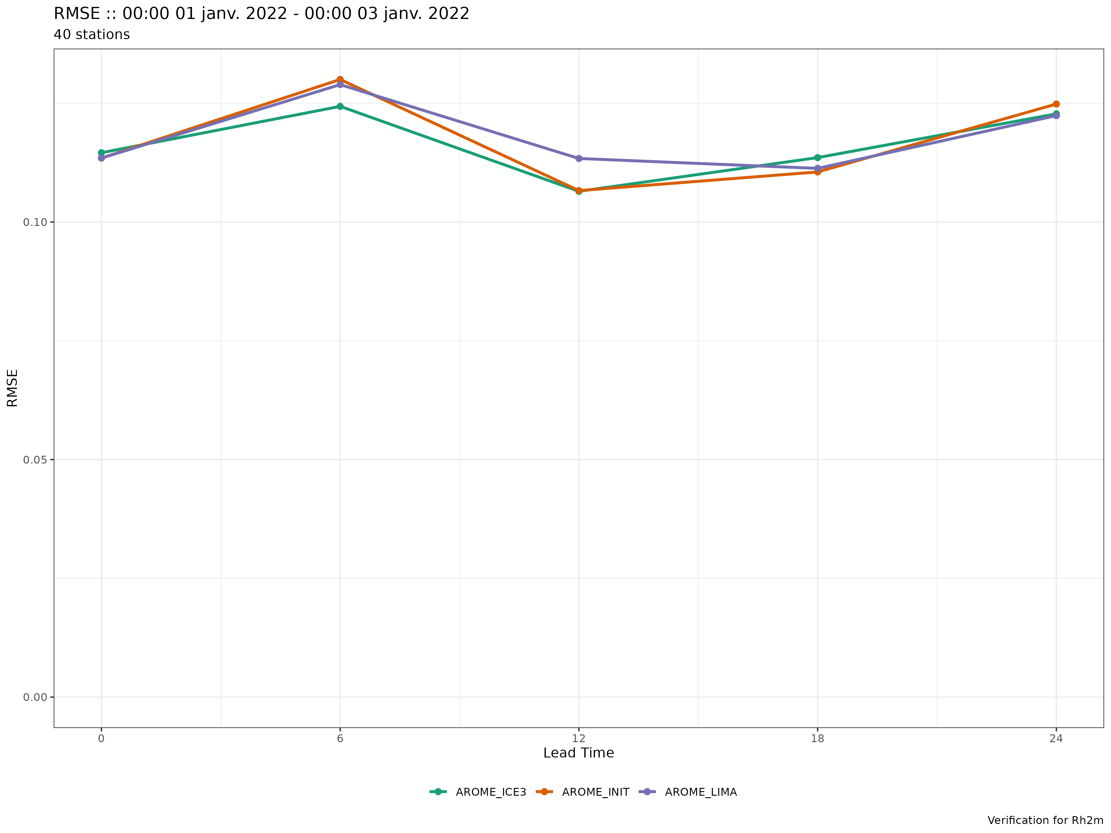
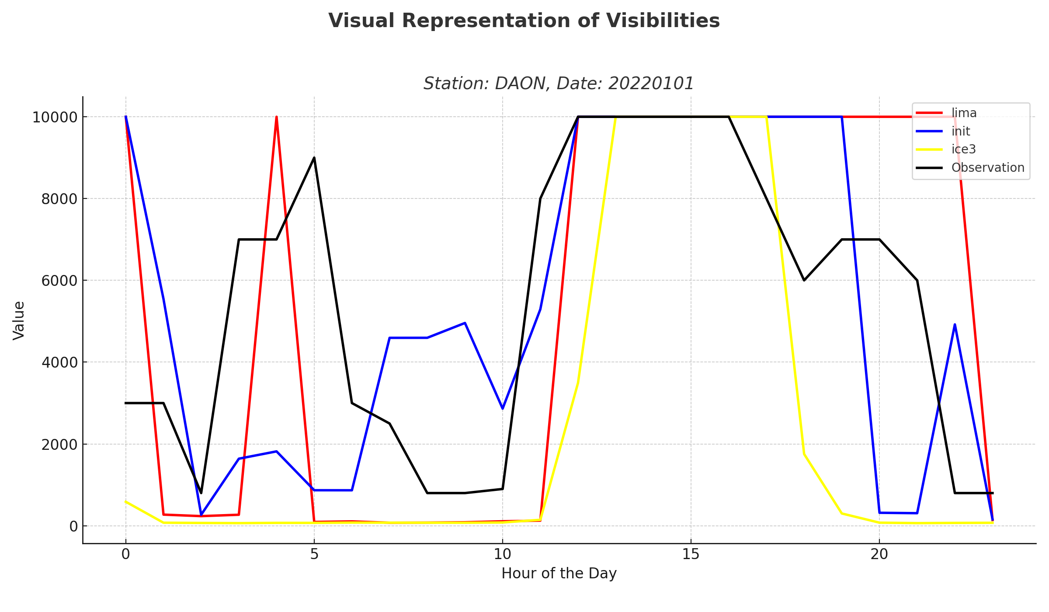
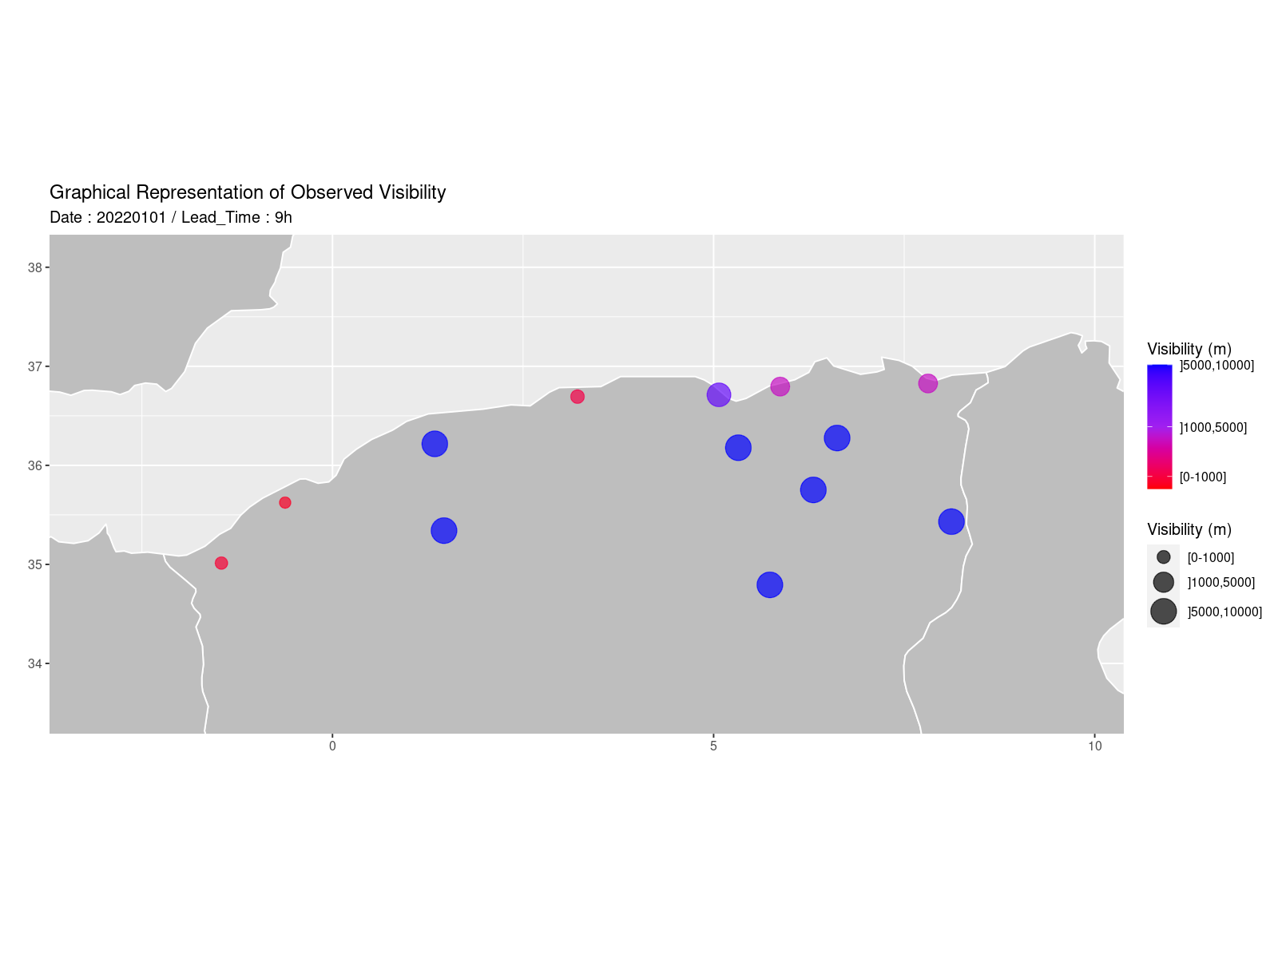
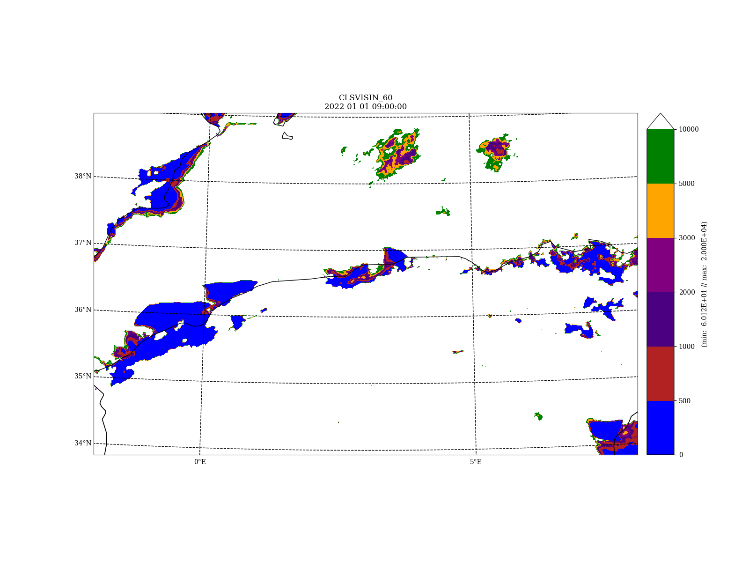
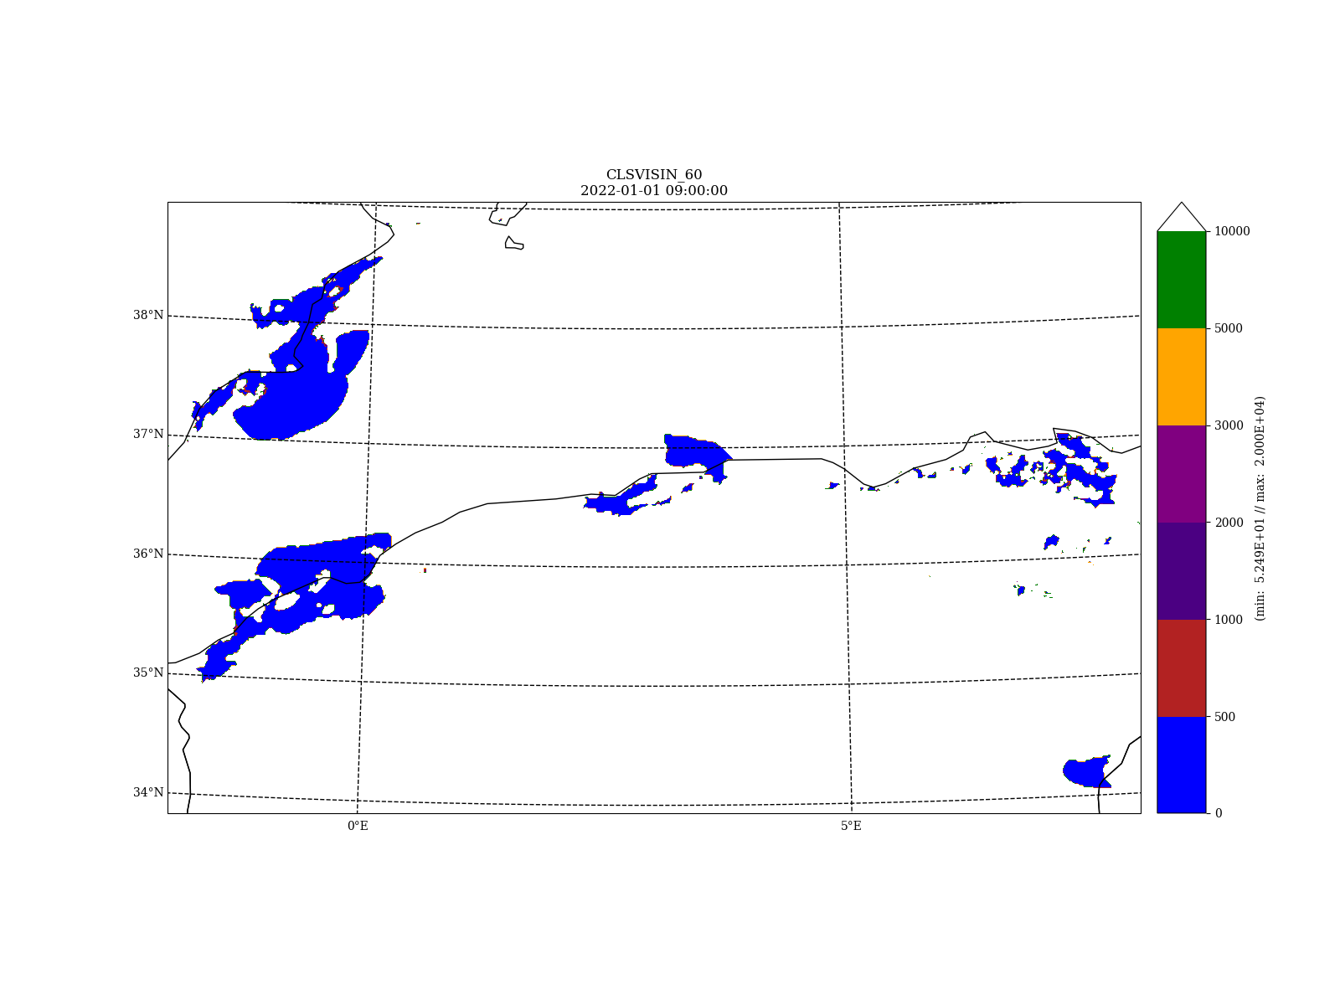
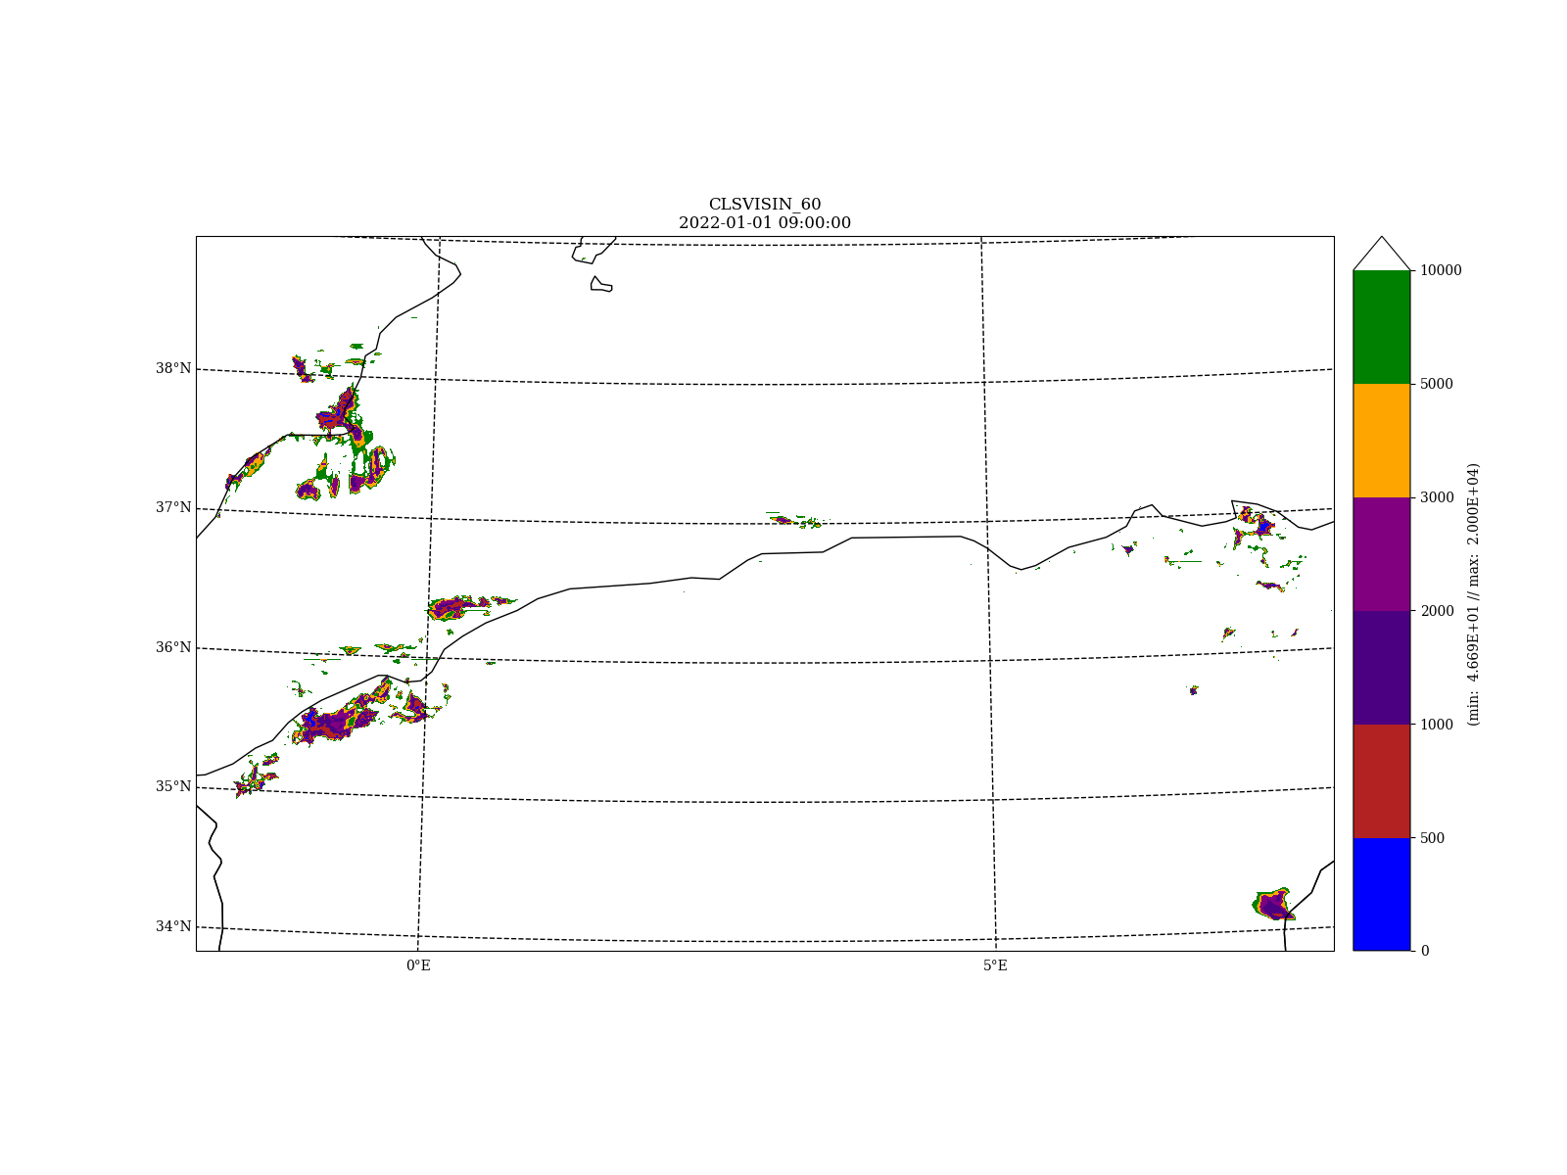
4th All Staff Workshop, 15-19 April 2024, Norrköping & hybrid
Evaluation of visibility with LIMA
Walid CHIKHI
E-mail : w.chikhi@meteo.dz
National Office of Meteorology - ALGERIA
Department of Numerical Weather Prediction
ABSTRACT:
This study presents the incorporation of the double moment LIMA scheme into visibility calculations for foggy conditions, in addition to the existing acvisih scheme in AROME. Traditional visibility calculations rely on the Koschmieder formula, but research by Gultepe et al. (2007) suggests that considering both liquid water content (LWC) and droplet number concentration (Nd) can enhance visibility predictions. By utilizing the LIMA scheme and advancements in microphysical modeling, significant improvements in visibility forecasting, especially for warm fog, can be achieved.
To assess this contribution, a selected fog event occurring between January 1st and January 3rd, 2022, is examined. This event was characterized by exceptional and persistent fog along the coastal regions from the Northwest to the North-central areas of Algeria.
1. Background & Motivation
2. AROME Configurations & Pre-Processing
AROME successfully forecasts low cloud fog, as demonstrated in a study published in the ACCORD Newsletter No.1.(1) However, there's potential to enhance its accuracy. This research explores the LIMA scheme, which considers both liquid water content and concentration. Current methods based on the Koschmieder formula have limitations. Previous research (Gultepe et al , 2007)(2). suggests that including both LWC (Liquid Water Content) and Nd (Number Concentrations of Liquid Water Droplets) can significantly improve visibility predictions up to 20 –50% , especially for warm fog :
Tab.1: AROME configuration characteristics
- Three distinct configurations were prepared for the purpose of comparison :
1. AROME_ICE3 : No Aerosols Initialization + ICE3 Scheme + Default formula .
2. AROME_LIMA : No Aerosols Initialization + LIMA scheme + Default formula
3. AROME_INIT : Aerosols Initialization using CAMS + LIMA scheme + New Formula ( 01 )
- From CAMS , we identify 11 types of aerosols that can be grouped into five major modes between CCN and IFN. (The characteristics of each group have been extracted from old work of: Y.Seity, B.Vié , D.Martin , and M.Mokhtari) :
Characteristics | AROME 1.3
Cycle | CY48T1
Initial conditions | ARPÉGE
Coupling frequency | 3H
Horizontal resolution | 1.3 km
levels | 90 levels
First level from ground | 5 meters
Time-step | 45 s
Grid | C+I | 720 x 440
 | C+I+E | 740 x 480
Cams Aerosols | Group in LIMA | Rho | md | sigma
Sea Salt {0,03-20} um | CCN_F1 | 2160 | 0,8 | 1,89
Sulphate | CCN_F2 | 2000 | 0,5 | 1,6
Hydrophobic Organic Matter | CCN_F3 | 1750 | 0,2 | 1,6
Hydrophobic Black Carbon
Dust {0,03 – 20} um | IFN_F1 | 2300 | 0,8 | 1,9
Hydrophilic Organic Matter | IFN_F2 | 1700 | 0,2 | 1,6
Hydrophilic Black Carbon
$$vis=\frac{1,13}{{\left(Nd∗LWC\right)}^{0.51}}$$
4.Conslusions & Perspectives
Fig .1: AROME domain
The results for the selected scenario show :
Visibility values lower at all forecast times compared to visibilities simulated by the ICE3 or LIMA schemes without aerosol initialization.
The scores of T2m and Rh2m for the LIMA_INIT configuration demonstrates a fluctuation and even behavior similar to the other two configurations.
Further work is planned :
Evaluate results against observations over an extended period and different seasons, including LWC, T2m, Rh2m and visibilities.
Investigate physical processes in the LIMA to improve fog forecasting.
Implement direct LWC calculated by the LIMA scheme.
3. Results
Fig. 2: RMSE temperature
Fig. 3: RMSE Rh2m
Fig. 4: Representation of Vis with 3 configurations
 | OBSERVATIONS | AROME_ICE3 | AROME_LIMA | AROME_INIT
2022 /01/01 09h
Acknowledgment
"I'd like to express my gratitude to Météo-Algerie for providing the observations, and extend my thanks to Ingrid Etchevers and Salomé Antoine for their guidance."
Fig. 5: Visual comparaison of Visibiility for the 3 configurations (2022-01-01 ; leadtime : 09h )

