Slide 1
Social Media Is Changing Our Relationships

Slide 2
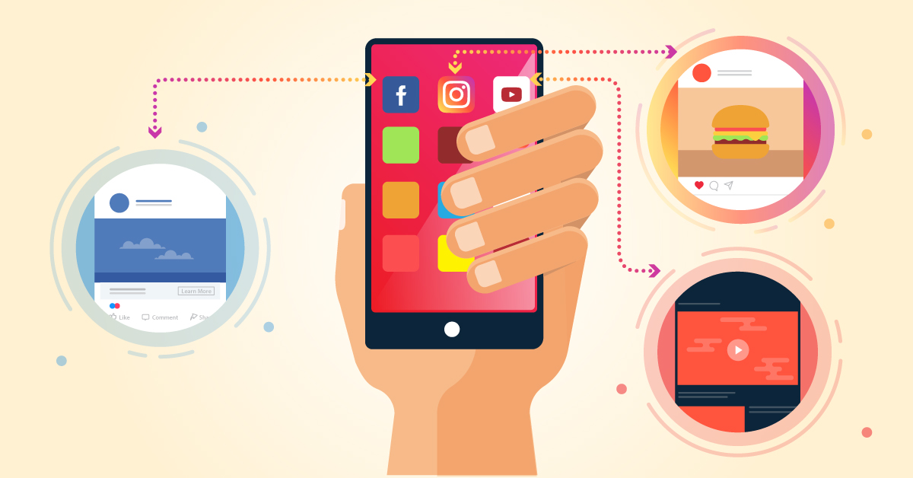
it’s allowing us to connect
with more people more rapidly

Slide 3
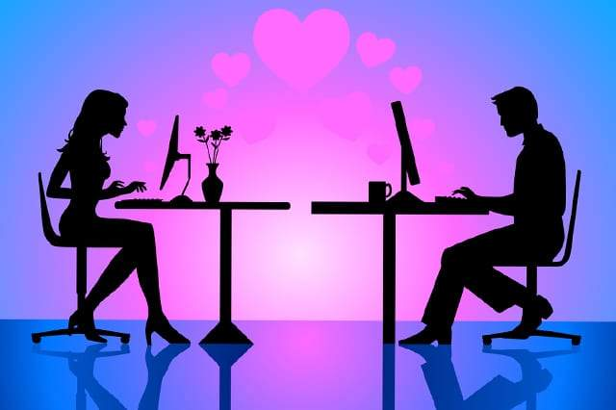
it’s easy to overestimate the level
of intimacy of our online relationships.

Slide 4
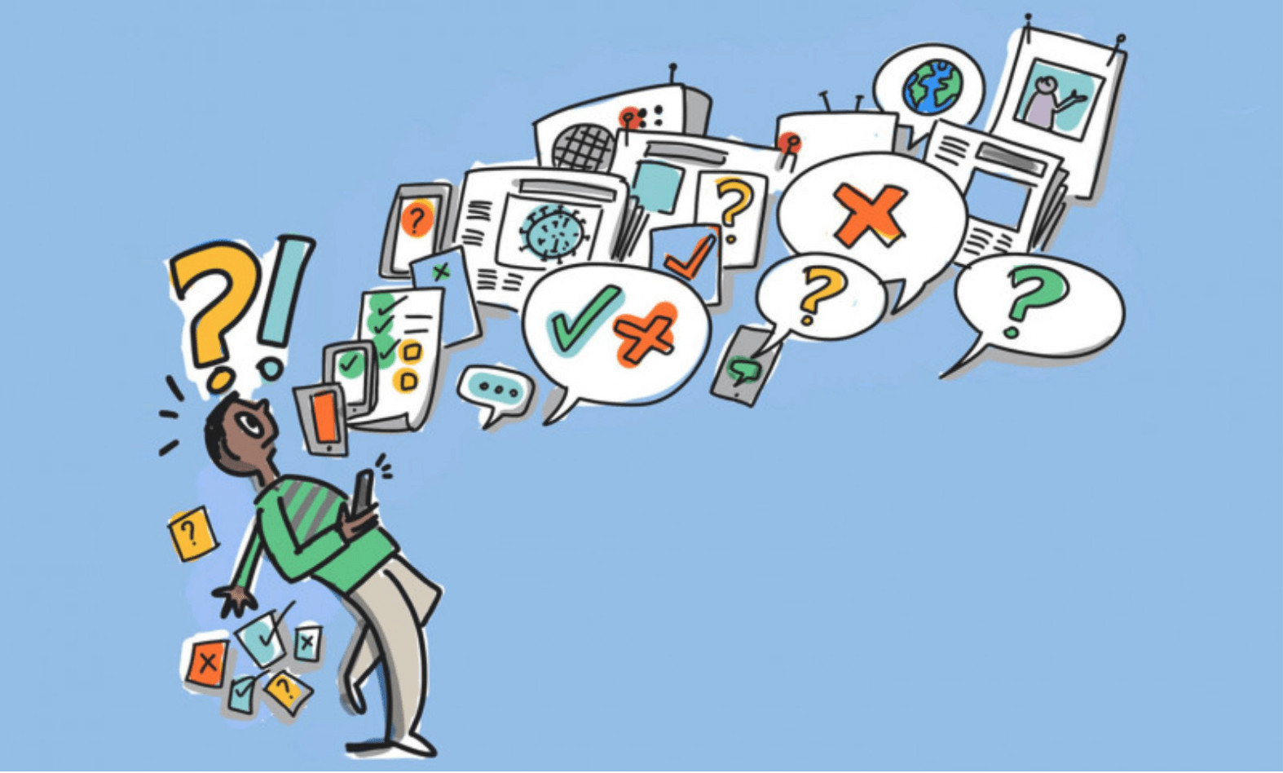
it makes us more susceptible to a sort of social media contagion effect, which means you may possibly start adopting behaviors, attitudes, and beliefs from those within our social network.

Slide 5
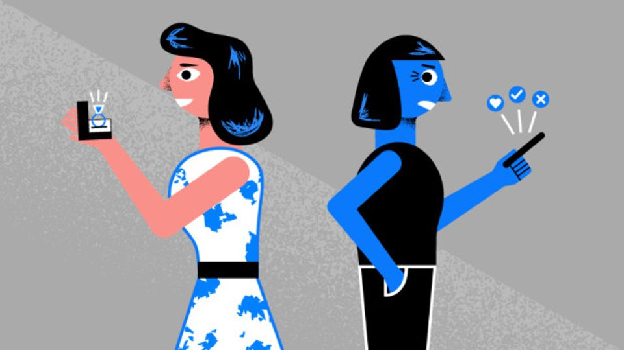
Social media facilitates comparing ourselves with others, which may have positive or negative effects.

Slide 6
Thank You

