Slide 1
GPU‑Accelerated Lattice‑Boltzmann in PyTorch
Walid Abdul Hakim

Slide 2
Motivation
Leverage existing expertise
Benchmark an “unusual” use‑case
Accelerate iteration cycles

Slide 3
Verification

Slide 4
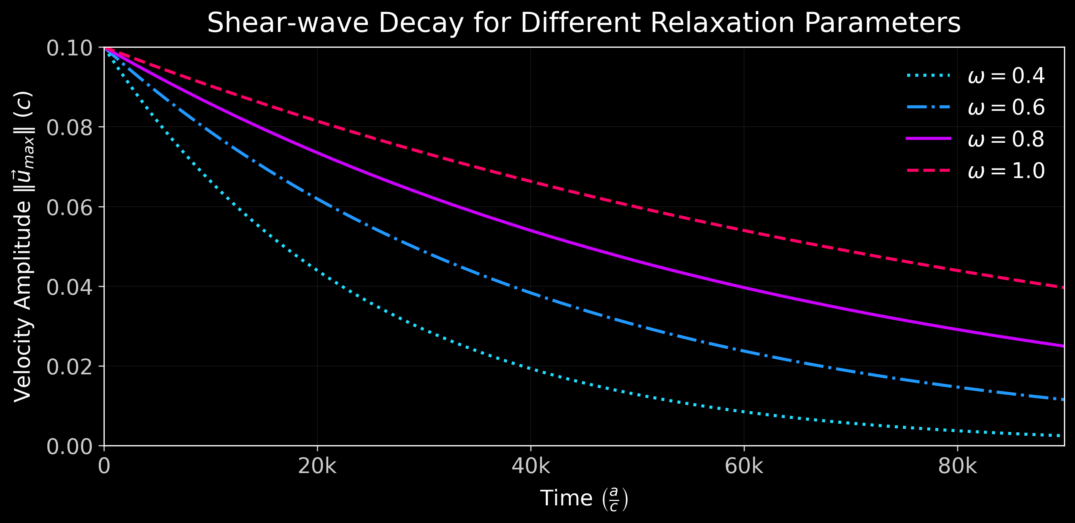
Verification I: Shear‑Wave Decay

Slide 5
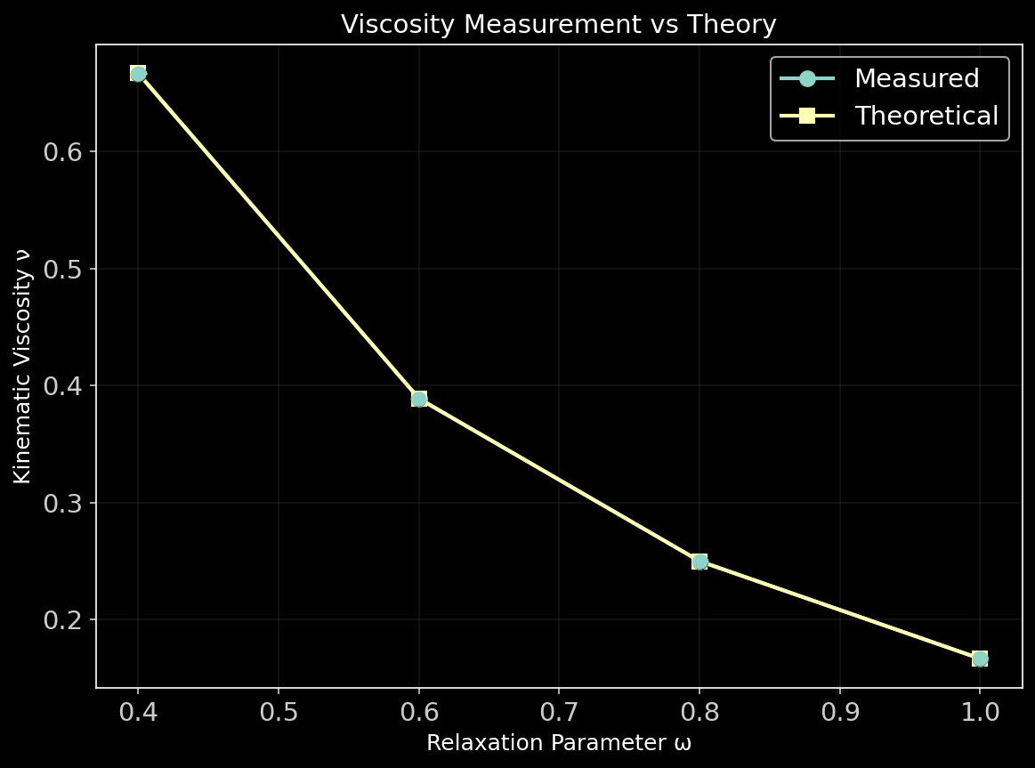
Verification II: Viscosity

Slide 6
Key Improvements
Selective torch.compile for certain functions
Manual Optimisations & Unrolling
A few other micro-tunings

Slide 7
Selective `torch.compile`
Compile only pure math/high‑arithmetic‑intensity parts:
• `collision_streaming_step` – fused collision & rolls
• `apply_boundary_conditions`
• `compute_macroscopic` – vectorised sums
Control flow, allocation, logging, visualization remain ordinary Python so iteration is quick and debugging is friendly.

Slide 8
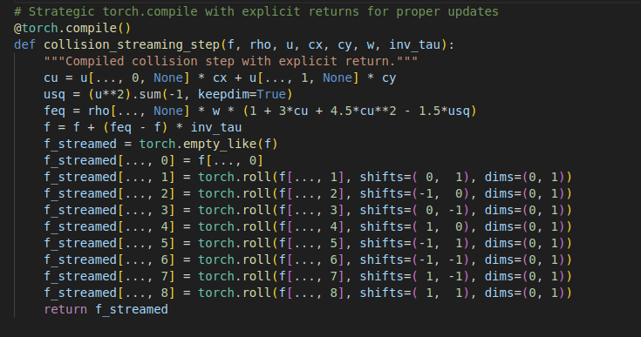

Slide 9
Other Optimizations
Unrolled sum and stack functions.
Warming up gpu.
Other micro-tunings like avoiding creating new tensords, pre allocating, manual bounce back logic.

Slide 10
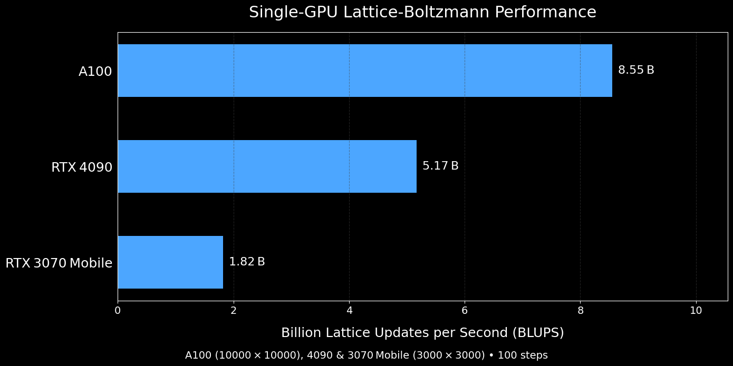

Slide 11
Conclusion
Pros
  Rapid Iteration
  Compact and readable
  Rich tooling
Cons
  Fine-grained control & portability
  Memory overhead
  Determinism and long run stability

Slide 12

Demo

Slide 13
Thank you for your attention

