Slide 1
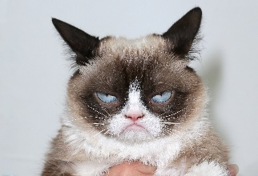

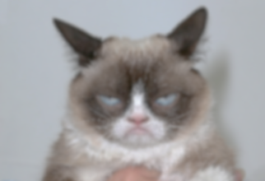
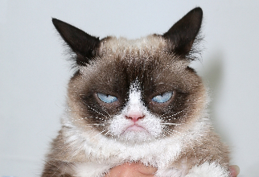
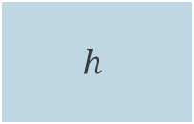
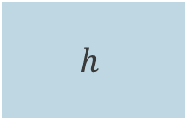

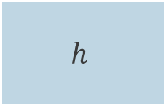
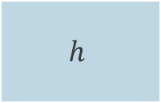
$$h$$
cat
$$h$$
$$h$$
$$h$$
« A grumpy cat held in hands »
« A grumpy cat held in hands »
$$h$$

Slide 2



$$E=noise\left(x\right)+bias^{2}\left(x\right)+variance\left(x\right)$$
$$variance(x)$$
$$bias^{2}(x)$$
$$noise(x)$$
Trade-off
Complexity/capacity

