Slide 1

Wellcome to our Presentation
Project Title : Wireless Power Transmission Circuit
Course Title:Mobile and wireless communication sessional
Course code:CSE 416
Submitted by:
Name ID
Arifur Rahman 1802034
Sumi kayser 1902003
Asha Roy 1902021
Walima khatun 1902026

Slide 2
Introduction :
What is WPT ?
The Transmission of energy from one place to another without using wires.
Conventional energy transfer is using wires
But, the wireless transmission is made possible by using various technologies

Slide 3
Components Required :
2N2222A transistor
LED light
27k resistors
Insulated copper wires
9v battery
Battery clip

Slide 4
Why WPT
Reliable
Efficient
Fast
Low maintenance cost
Can be used for short range or long range

Slide 5
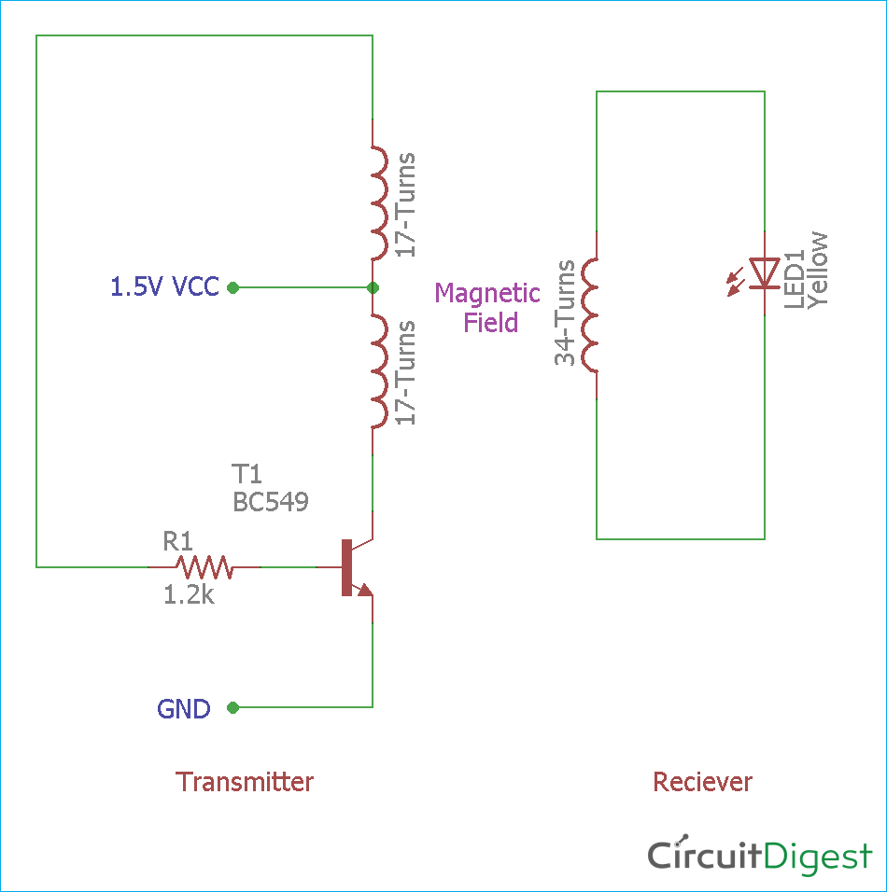
Circuit Diagram :
It has two parts, Transmitter, and the receiver.
Figure : Circuit Diagram

Slide 6
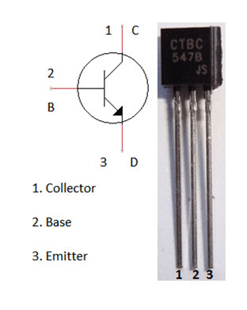
Construction of the Wireless Power Transmission Circuit :
The transistor is NPN Transistor, any basic NPN transistor can be used BC547.
Figure : NPN Transistor

Slide 7
Working of the Wireless Power Transmission Circuit :
Both the circuits are constructed on the breadboard and powered using a 9V battery. The circuit can’t be used for more than 1.5 volt power supply as transistor may heat up for excessive power dissipation. However, for more rating, additional driving circuits are needed.
This wireless electricity transmission is based on the Inductive coupling technique. The circuit consists of two parts- Transmitter and Receiver.

Slide 8
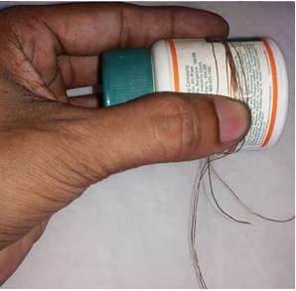
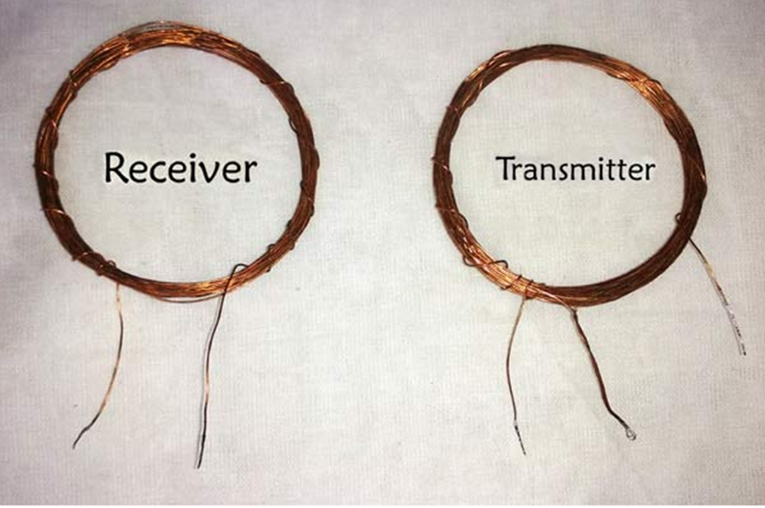
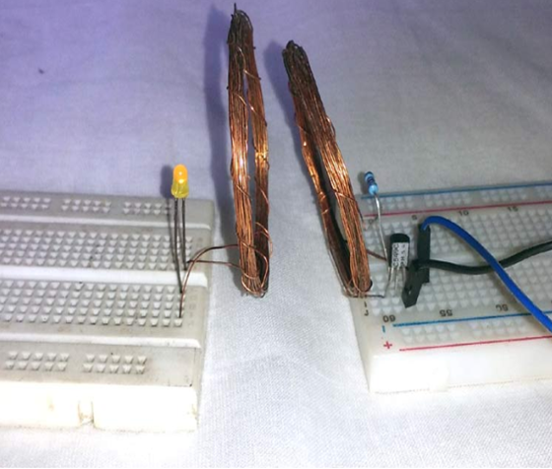
How it Works :
Figure : working Process

Slide 9
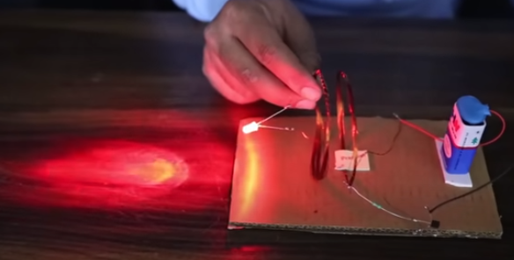
Output of the Project :
Figure : OutPut of Project

Slide 10
Applications of Wireless Power Transmission :
Consumer Electronics
Medical Devices
Electric Vehicles
Robotics
Wireless Sensors
Smart Home Devices
IoT Devices
Smartphones
Laptops and Tablets

Slide 11
Advantages of WPT:
Wireless Power Transmission (WPT) offers several advantages across various applications, contributing to enhanced convenience, efficiency, and flexibility. Some of the key advantages include:
No Physical Connections
Flexibility in Placement
Less Mechanical Stress
Increased Safety
Efficiency and Scalability
Environmental Impact
Increased Design Flexibility
User-Friendly

Slide 12
Limitation of wireless power transmission:
Energy Losses
Limited Range
Environmental Factors
Power Limitations
Safety Concerns

Slide 13
Conclusion of WPT:
The basic aim of this project is to transmit electric power wirelessly. Wireless Power Transfer (WPT) or wireless energy transmission is the transmission of electrical power from a power source to a consuming device without using solid wires or conductors.

Slide 14
Thank you

