Slide 1

Analysis of Biosignal Data AI4PH

Slide 2
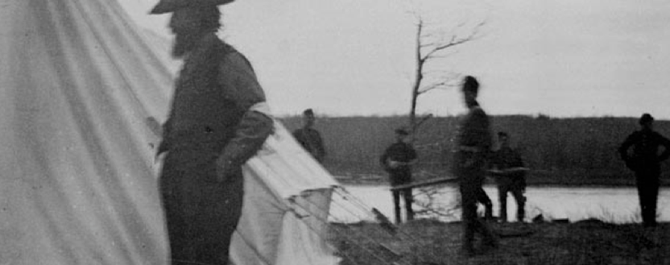
I acknowledge our shared connection to the land and recognize that Indigenous and Métis peoples on Treaty 6 Territory and all Indigenous peoples have been and continue to be stewards for social justice, equity, and land-based education. In the spirit of reconciliation may we all strive to learn and support the work of Indigenous communities as allies and return their land.

Slide 3
Ground Rules
Be proactive
Listen Actively
Speak from experience and relate this to published research
Be respectful
The goal is to learn
We will all fail to follow the ground rules at some point… that’s ok

Slide 4
Please
Ask questions
Tell me to slow down
Sorry for
Typos
Going too fast

Slide 5
There is no geek gene
“Competence at programming is not innate but is rather a learned skill that can be acquired and improved with practice.”
https://journals.plos.org/ploscompbiol/article?id=10.1371/journal.pcbi.1006023

Slide 6
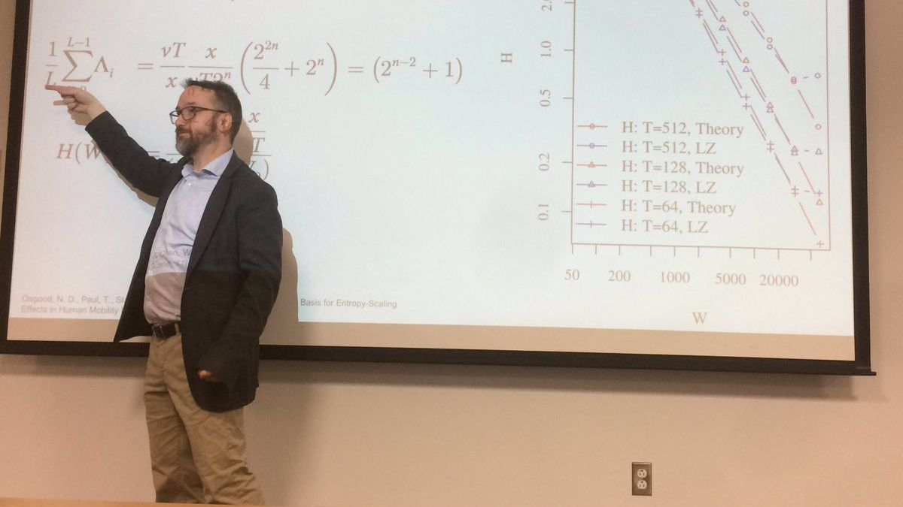
My ML Journey

Slide 7
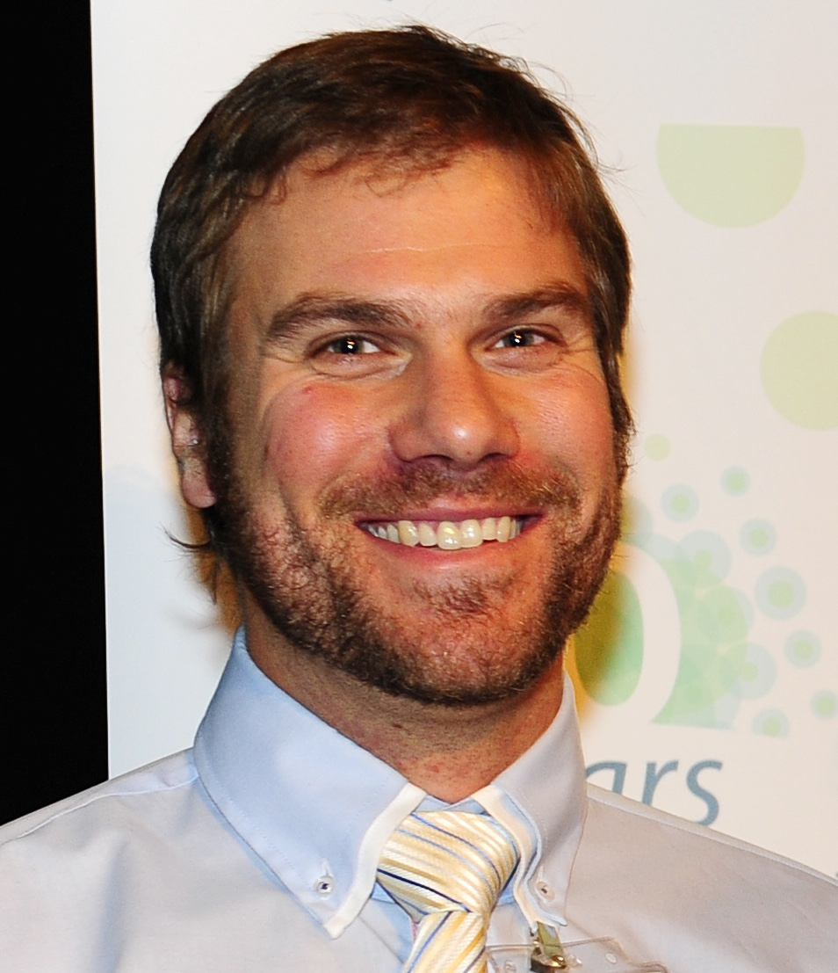
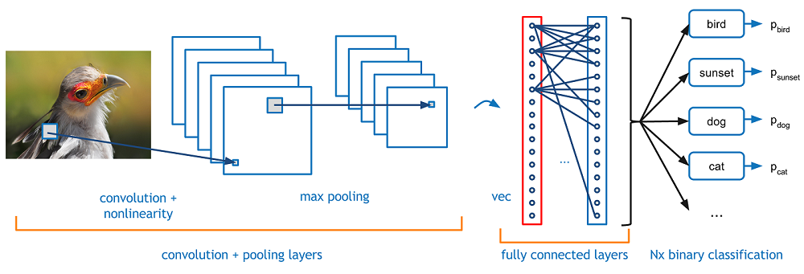

My ML Journey
https://www.kdnuggets.com/2016/09/beginners-guide-understanding-convolutional-neural-networks-part-1.html

Slide 8
Biosignal Data
A biosignal is any signal that can be measured and recorded from biological beings.
Common biosignals
Electroencephalography (EEG): brain signal recordings
Electromyography (EMG): muscle signal recordings
Electrocardiography (ECG): heart signal recordings
Biosignal analysis requires a mix of skills
Health: Knowledge of the functioning of the physical feature you are measuring
Engineering: Understanding and collecting measurements
Data science: Conducting analysis
https://shop.elsevier.com/books/introduction-to-biomedical-instrumentation-and-its-applications/paul/978-0-12-821674-3

Slide 9
Overview
Measurand
A physical quantity.
The body is a source for measurands, which generate biosignals
Design criteria of a measurand are signal, environmental, medical, and economic
Biomedical measurands
biopotential, pressure, flow, dimensions (imaging), displacement (velocity, acceleration, and force), impedance, temperature, and chemical concentration.
https://shop.elsevier.com/books/introduction-to-biomedical-instrumentation-and-its-applications/paul/978-0-12-821674-3

Slide 10
Overview
Transducer
Converts one form of energy to another (mostly electrical).
The transducer produces a usable output of the measurand.
Signal conditioner
Converts the output from the transducer into a digital value sent storage or a display.
Signal conditioning comprises amplication, filtering, and analog-to-digital and digital-to-analog conversions.
https://shop.elsevier.com/books/introduction-to-biomedical-instrumentation-and-its-applications/paul/978-0-12-821674-3

Slide 11
Signals
Biosignals
Biosignals themselves don’t necessarily have inherent meaning
A key goal of biosignal analysis is to define and understand meaning coming from the signals we are interested in.
We are typically looking for specific patterns within the signal that have a specific pattern or that deviate from some pattern.

Slide 12
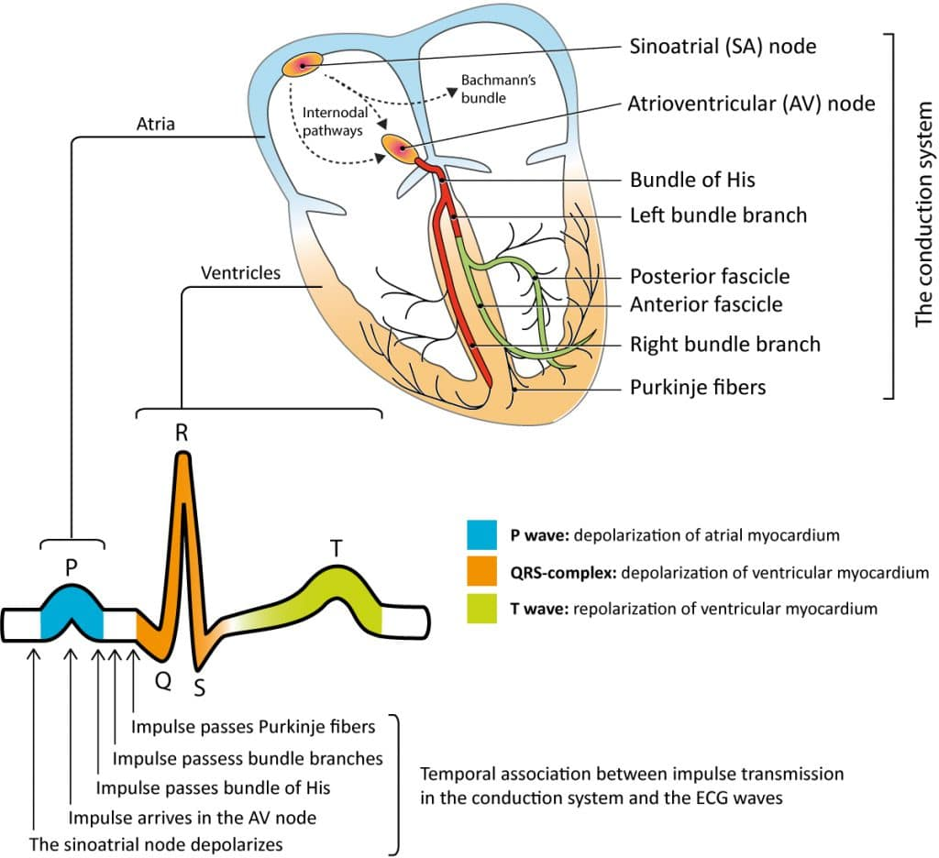
Heart
https://ecgwaves.com/

Slide 13
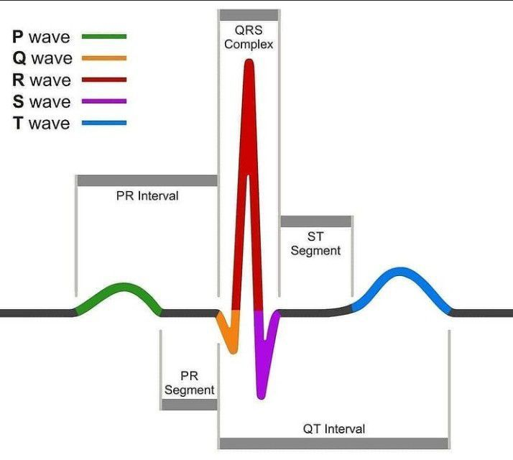
https://cdn.medizzy.com/0OuyL7MmK6b6GeJFuPlXyQ1icO8=/714x640/img/posts/6dfdba11-2675-4b1f-bdba-1126757b1f89

Slide 14
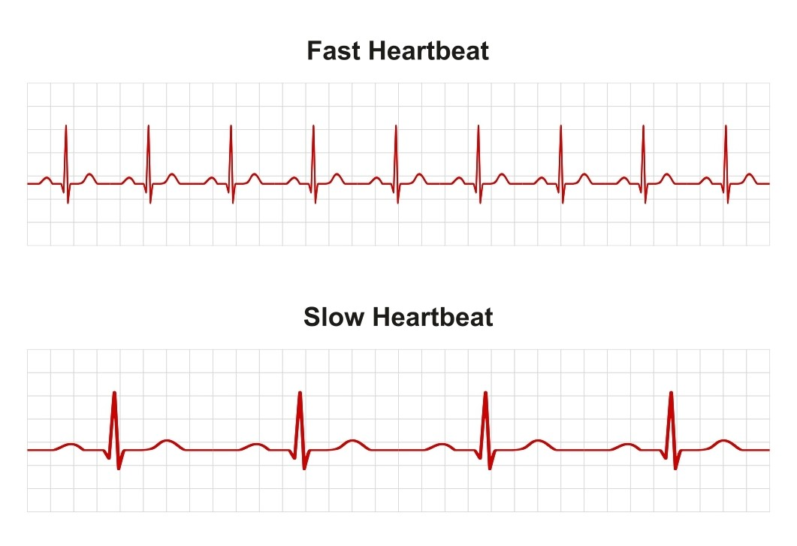
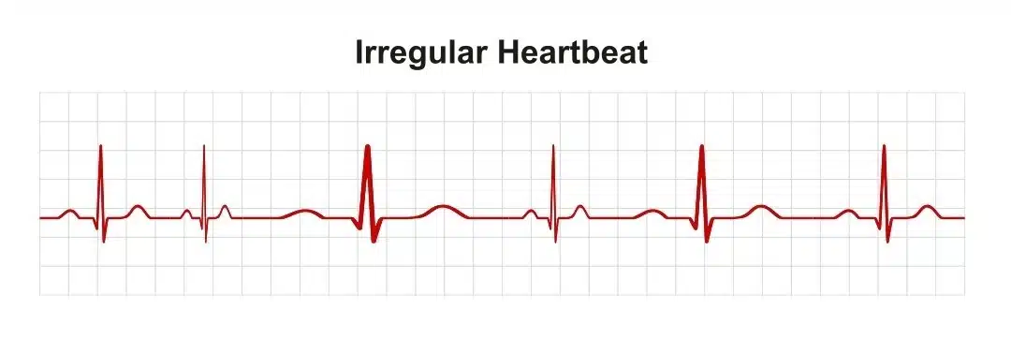
An abnormal ECG result could mean anything from an abnormal heart rate, irregular rhythm, abnormal waveforms or abnormal intervals.

Slide 15
Critical Concept 1
Biosignals are biological bound
If you are looking at your data and getting results that do not make sense, there is probably measurement error or some other bias.
Heart rate: 500 BPM
Acceleration: 5 G or 49 m/s²
ECG: QRS complex > 1s
Very important to understand the physiology of the signal and measurement accuracy of the tool that is being used to collect the data.

Slide 16
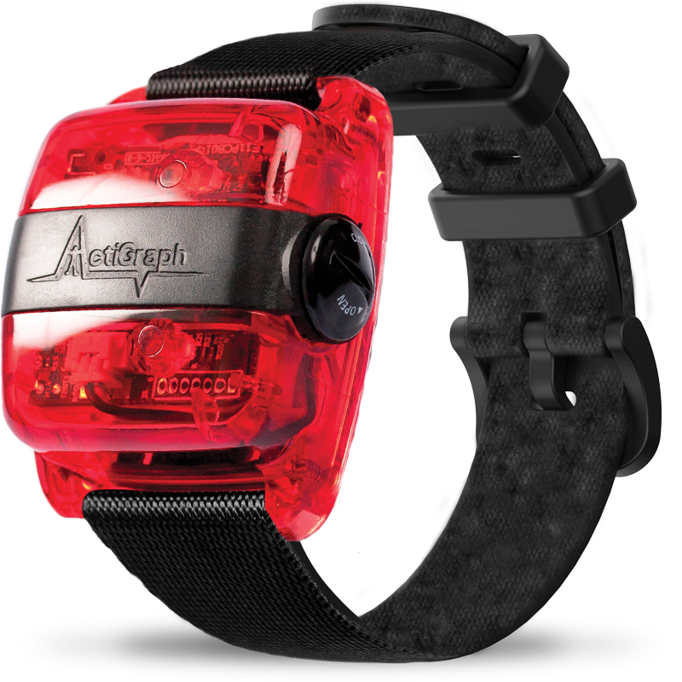
Data Break
Actigraph GT3-X acceleromter
Sample Rate: 30-100 Hertz
Accelerometer: +/- 8G
ADXL345 (Analog Devices, Inc)
~ $3
32 healthy participants
13 men and 19 women
Wore device on left wrist
Our data
10 participants (5 men, 5 women)
https://doi.org/10.13026/51h0-a262

Slide 17
Data Break
Let’s take a look at the data and see what we have.

Slide 18
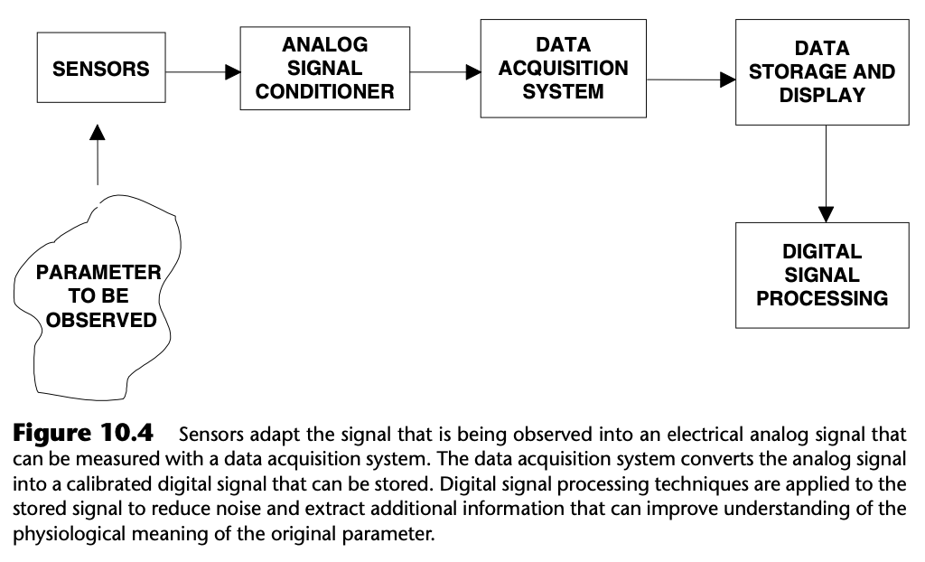
Workflow

Slide 19
DATA
LABELLED?
RULE BASED
IMPLEMENT
RULES
ALGORITHM
TYPE
MACHINE LEARNING
FEATURE ENGINEERING
MODEL TRAINING / TESTING

Slide 20
Signal Processing
Signal processing methods will need to applied to prepare the data
This will depend on the type of signal
Resampling
Get the signals to the same frequency
Clean unruly signals
Band pass filters
Butterworth filter

Slide 21
Rule based algorithms
Rule-based systems follow explicit rules created by human experts.
They're like a set of instructions given to a computer that follows to make decisions.
These systems are good for problems with clear rules and paths.
Counting steps?
One-size fits most
https://www.nature.com/articles/s41746-022-00745-z
https://github.com/muschellij2/walking
https://lilykoff.github.io/step_algorithms

Slide 22
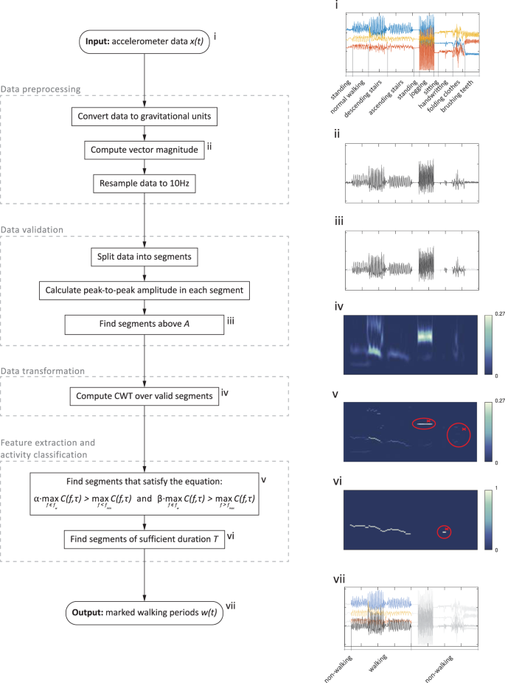
Rule based algorithms

Slide 23
Rule based algorithms

Slide 24
Rule based algorithms
Rule-based systems follow explicit rules created by human experts.
They're like a set of instructions given to a computer that follows to make decisions.
These systems are good for problems with clear rules and paths.
Counting steps?
Peak-to-Peak amplitude
One-size fits most
https://www.nature.com/articles/s41746-022-00745-z
https://github.com/muschellij2/walking
https://lilykoff.github.io/step_algorithms

Slide 25
ML based algorithms
ML based algorithms use some labelled data to train a model and predict future unknown data
More on this in class 2

Slide 26
Features
Regardless of rule-based or ML algorithms, we need features to be able to detect outcomes in our data
Biosignal data are long (lots of observations per time)
Different from genomic data (wide)
Need methods to create features that will explain the outcome we are trying to predict
Summaries of variables

Slide 27
Time and Frequency domain
Time domain
Signals are represented as a function of time, showing how the signal changes over time.
Understanding the temporal characteristics of a signal, such as its amplitude, duration, and timing
Frequency domain
Signals are represented as a function of frequency, showing the different frequency components that make up the signal.
Understanding the spectral characteristics of a signal, such as its frequency content, harmonics, and noise

Slide 28
Time and Frequency domain
Attribute | Frequency Domain | Time Domain
Representation | Signal represented as a sum of sinusoidal components | Signal represented as a function of time
Analysis | Focuses on the frequency content of a signal | Focuses on the amplitude and phase of a signal at specific points in time
Transform | Fourier Transform, Discrete Fourier Transform (DFT) | None, as the time domain is the original representation
Units | Hertz (Hz) | Seconds (s)
Periodicity | Periodic signals have discrete frequency components | Periodic signals have a repeating pattern in time
Phase | Phase information is preserved | Phase information is inherent in the time domain representation
Amplitude | Amplitude information is preserved | Amplitude information is inherent in the time domain representation
Filters | Frequency-based filters (e.g., low-pass, high-pass) | Time-based filters (e.g., moving average, median filter)

Slide 29
Fourier Transform
The Fourier transform converts the function's time-domain representation, shown in red, to the function's frequency-domain representation, shown in blue. The component frequencies, spread across the frequency spectrum, are represented as peaks in the frequency domain.
https://en.wikipedia.org/wiki/Frequency_domain

Slide 30
Data break

Slide 31
Assignment 1
Read in the data and examine the data using summary statistics.
Conduct feature engineering to create 4 new features and describe why you think would would be relevant for classifying the labels in the __activities__ variables
Hint. You could calculate the euclidean norm or peak-to-peak amplitude for example.
Hint. Provide a written justification for why you think the features are important.
Examine whether your new features by gender or weight status to see if there is potential interaction between these features and the two effect modification variables of interest
Hint. Create a visualization or calculate the summary statistics or your new variables by gender and weight.

Slide 32
Additional ML Slides if needed

Slide 33
Machine Learning
Big Data
You can analyse “big data” with traditional approaches we have learned in this class like linear and logistic regression
But often to get more out of the data you need methods more suited to the data
Machine Learning
“A computer program is said to learn from experience E with respect to some class of tasks T and performance measure P, if its performance at tasks in T, as measured by P, improves with experience E’)”
https://doi.org/10.1136/jech-2017-209608

Slide 34
Artificial Intelligence
Artificial Intelligence
“Describe machines that perform human-like activities such as learning, perception, problem solving and playing games.”
AI’s often combine multiple different types of machine learning models to do different tasks and product an output.
Generate Christmas music from a picture
http://www.cs.toronto.edu/songfrompi/
Extract information from picture (one model)
Produce text (another model)
Produce music (another model)
Put it all together (maybe another model)
https://doi.org/10.1136/jech-2017-209608

Slide 35
Types of Machine Learning
Supervised learning
Supervised learning is akin to the type of model-fitting that is standard in epidemiologic practice: The value of the outcome (i.e., the dependent variable), often called its “label” in machine learning, is known for each observation. Data with specified outcome values are called “labeled data.” Common supervised learning techniques include standard epidemiologic approaches such as linear and logistic regression, as well as many of the most popular machine learning algorithms (e.g., decision trees, support vector machines).
Unsupervised learning
The algorithm attempts to identify natural relationships and groupings within the data without reference to any outcome or the “right answer”. Unsupervised learning approaches share similarities in goals and structure with statistical approaches that attempt to identify unspecified subgroups with similar characteristics (e.g., “latent” variables or classes). Clustering algorithms, which group observations on the basis of similar data characteristics (e.g., both oranges and beach balls are round), are common unsupervised learning implementations.
https://towardsdatascience.com/all-machine-learning-models-explained-in-6-minutes-9fe30ff6776a

Slide 36
Types of Machine Learning
Semi-Supervised learning
Semisupervised learning fits models to both labeled and unlabeled data. Labeling data (outcomes) is often time-consuming and expensive, particularly for large data sets. Semisupervised learning supplements limited labeled data with an abundance of unlabeled data with the goal of improving model performance (studies show that unlabeled data can help build a better classifier, but appropriate model selection is critical)
https://towardsdatascience.com/all-machine-learning-models-explained-in-6-minutes-9fe30ff6776a

Slide 37
Types of Machine Learning
Classification
Identifying the category where an observation belongs, given known category labels. Logistic regression is an example of a classifier from statistics.
Regression
Predicting a continuous outcome. Linear regression is an example of a classifier from statistics.
https://towardsdatascience.com/all-machine-learning-models-explained-in-6-minutes-9fe30ff6776a

Slide 38
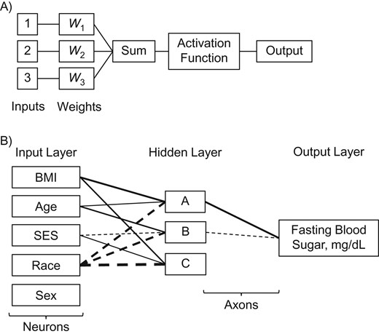
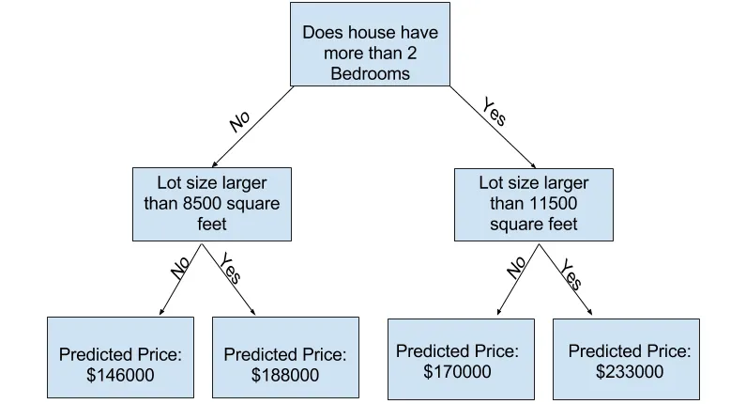
Supervised Learning - Regression
Linear Regression
Wait what?
Decision Tree
Combination of a bunch of logistic regressions (basically)
Random Forest
Ensemble (combination of) a bunch of decision trees
Artificial Neural Network

Slide 39
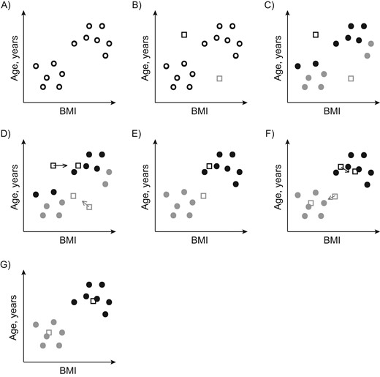
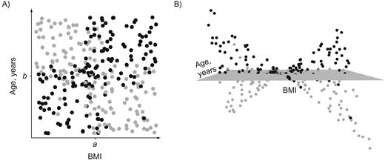
Supervised Learning - Classification
Logistic Regression
Wait what?
Support Vector Machine
Naïve Bayes
Random Forest
Artificial Neural Network
https://towardsdatascience.com/all-machine-learning-models-explained-in-6-minutes-9fe30ff6776a

Slide 40
Unsupervised Learning
Principal Component Analysis
K Nearest Neighbour
t-distributed Stochastic Neighbor Embedding (t-SNE)
Natural Language Processing (NLP)
https://towardsdatascience.com/all-machine-learning-models-explained-in-6-minutes-9fe30ff6776a

Slide 41
Models
Within supervised and unsupervised there are LOTS (hundreds) of different model types. These might have slightly different names or variations for specific tasks or to address different types of data.
There are many flavours (variations) of Random Forest and Artificial Neural Network type models.
It can be hard to keep up.
Pet Peeve!!!
Saying “using machine learning” is like saying “using statistics” it’s nearly completely uninformative in terms of describing what you actual did for your analysis.

Slide 42
Quick Glossary
Machine Learning Term(s) | Epidemiology Term(s) | Definition and Notes
Attribute, feature, predictor, or field | Independent variable | Machine learning uses various terms to reference what epidemiologists would consider an “independent variable,” including attribute, feature, predictor, and field.
Domain | Range of possible variable values | The domain is the set of possible values of an attribute. It can be continuous or categorical/binary.
Input and output | Independent (exposure) and dependent (outcome) variables | In machine learning, “input” refers to all of the predictors or independent variables that enter the model, and “output” generally refers to the predicted value (whether a number, classification, etc.) of the dependent variable or outcome.
https://academic.oup.com/aje/article/188/12/2222/5567515?login=true

Slide 43
Quick Glossary
Machine Learning Term(s) | Epidemiology Term(s) | Definition and Notes
Classifier, estimator | Model | “Classifiers” or “estimators” are used generally in the machine learning literature to refer to algorithms that perform a prediction or classification of interest. Their less common, though more technical, usage specifically refers to fully parameterized models that are used to predict or classify.
Learner | Model-fitting algorithm | A learner inputs a training set and outputs a classifier. Usually, but not always, learner refers to the fitting algorithm, while classifier refers to the fitted model.
Dimensionality | No. of covariates | No. of independent variables under consideration in a model.
https://academic.oup.com/aje/article/188/12/2222/5567515?login=true

Slide 44
Quick Glossary
Machine Learning Term(s) | Epidemiology Term(s) | Definition and Notes
Label | Value of dependent variables, outcomes | A variable’s label is its value for each observation (e.g., 0 or 1). Although labels can technically describe any variable, common shorthand is that “labeled data” refers to data in which the dependent variable assumes a value for all observations.
Imbalanced data | Data set in which some cases or risk categories occur much less frequently than the others | In imbalanced machine learning data sets, the outcome or another risk category of interest occurs much less frequently, either because of the intrinsic nature of the problem (e.g., a rare disease in a database of medical records) or because of the sampling strategy (e.g., prevalence of cases in the study population is much lower than that in the target/source population).
Loss function | Error measure | In machine learning, a loss function is generally considered a penalty for misclassification when assessing a model’s predictive performance.
https://academic.oup.com/aje/article/188/12/2222/5567515?login=true

