Slide 1

R for data analysis
Clinical Research Support Unit

Slide 2

1 Objectives
2 R interface
3 Installation
4 Enter data
5 Create dataset
6 Import dataset
7 Save/export dataset
8 Select variables
9 Data Visualization
Contents

Slide 3



Objectives
R Introduction
Data Management
Statistical
Analysis
Visualization

Slide 4
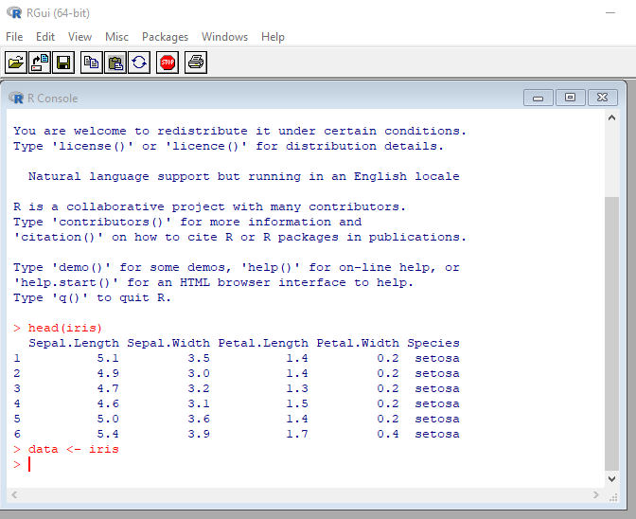
R interface – R GUIs (Graphical User Interfaces)

Slide 5
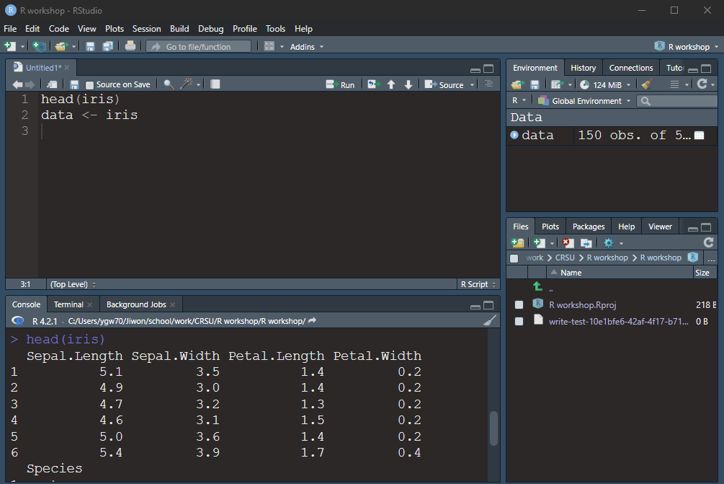
R interface – RStudio
Environment, History
R Script
Console
Files, Plots, Packages, Help

Slide 6
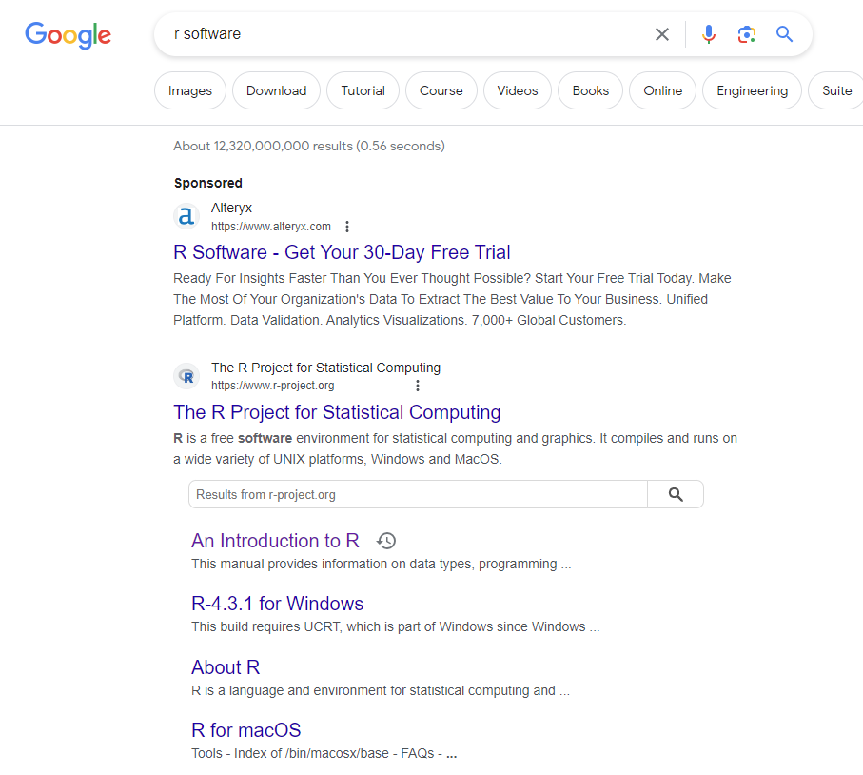
Installation
1. Search R
2. Click Windows or macOS
depending on your OS

Slide 7
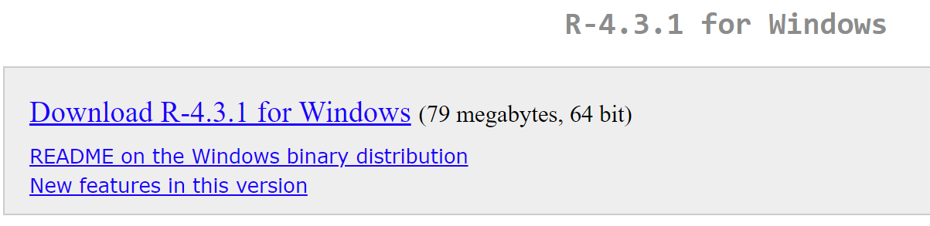
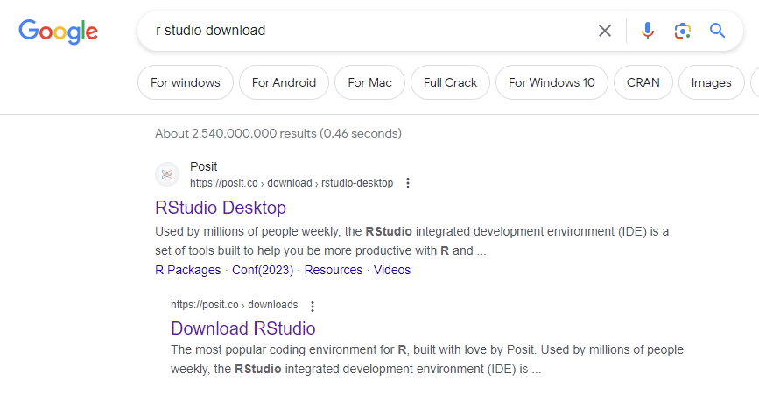
Installation
2. Click download
3. Click download RStudio

Slide 8
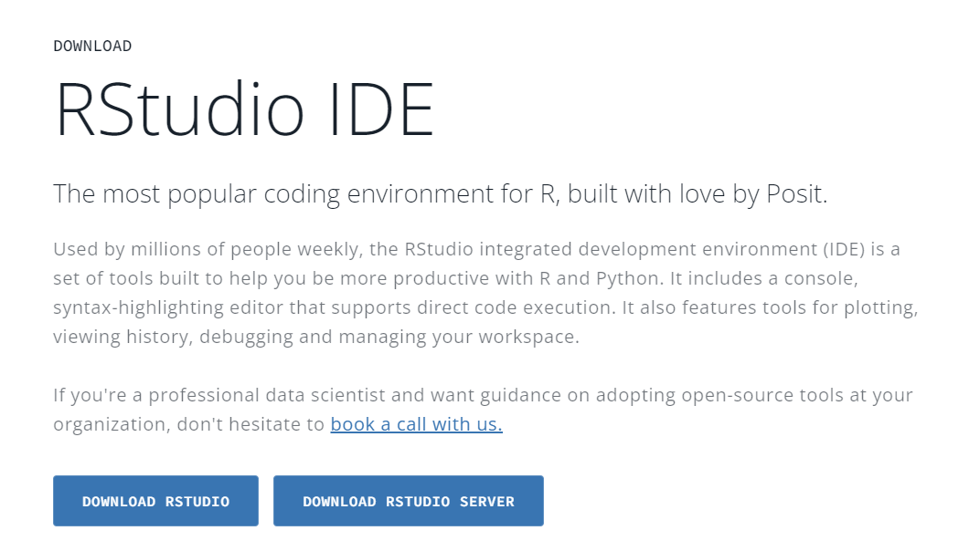
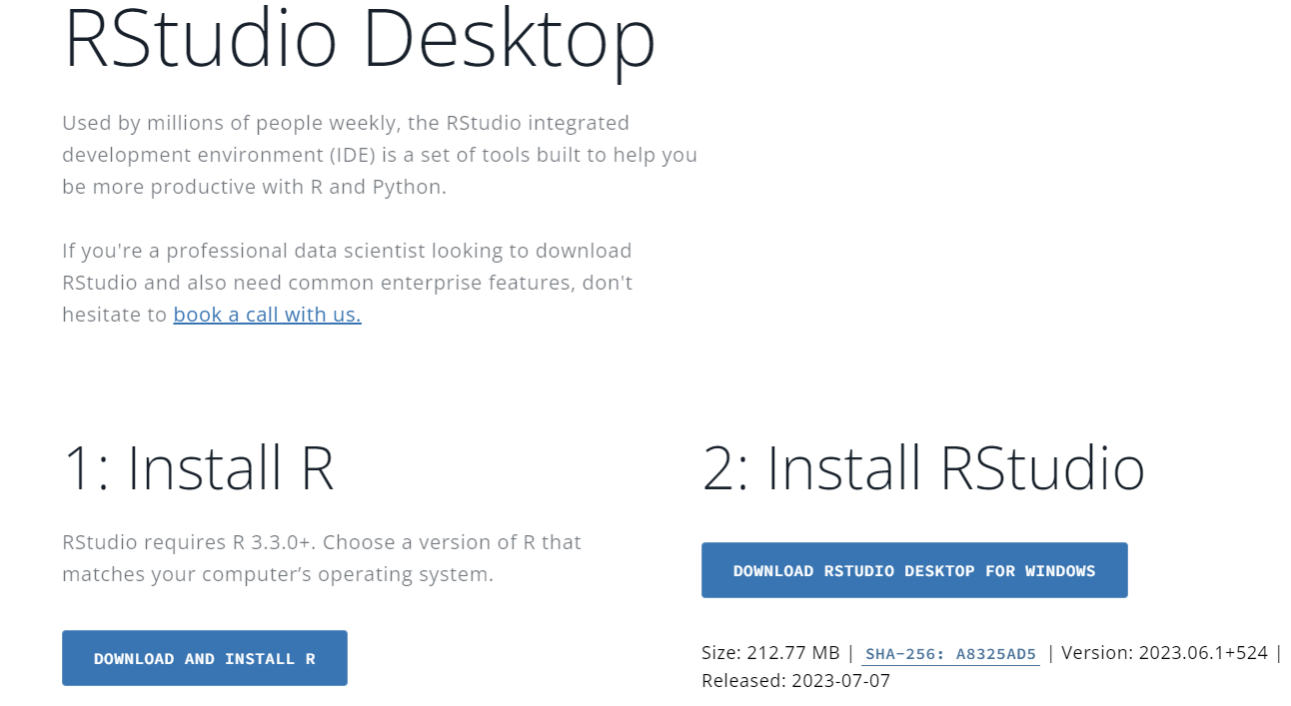
Installation
4. Click download RStudio
5. Click download RStudio

Slide 9
R works via USER made packages
R works via USER make packages
  There are 20066 packages
  https://cran.r-project.org/web/packages/available_packages_by_name.html
  Submission and general verification is done by volunteers with CRAN
  Fundamentally different than Stata and SAS
Two general frameworks for working with data
  Base R
  Tidyverse (Developed by RStudio)
  If you google around know which one you are looking for

Slide 10
Good coding practices
Good idea to follow
  https://google.github.io/styleguide/Rguide.html
  https://www.r-bloggers.com/2018/09/r-code-best-practices/
    There are 5 naming conventions to choose from:
      alllowercase: e.g. adjustcolor
      period.separated: e.g. plot.new
      underscore_separated: e.g. numeric_version
      lowerCamelCase: e.g. addTaskCallback
      UpperCamelCase: e.g. SignatureMethod
    Pick one naming convention and stick to it. My suggestion:
      Files: underscore_separated, all lower case: e.g. numeric_version
      Functions: UpperCamelCase, all lower case: e.g. MyFunction
      Variables: underscore_separated, all lower case: e.g. numeric_version

Slide 11
Entering data (vector)
# if we put # sign, R will not recognize it
# entering numeric data/value 1 into environment (named as a)
a <- 1
# to see data
a
# entering hello world into environment (named as b)
# hello is character data, use single or double quote
b <- "hello world"
b
# Given names such a, b are not case sensitive

Slide 12
Entering data (vector)
# entering multiple numeric data into environment (named as a_1)
a_1 <- c(22, 55, 26, 30, 42, 24)
a_1
# capital C will not work
# no space or unequal space between values will work
# entering multiple character data into environment (named as b_1)
b_1 <- c("m", "f", "m", "m", "f", "m")
b_1

Slide 13
Entering data, Creating dataset
c.1 <- c(1, 2, 3, 4, 5, 6)
c.1
# creating data set named ‘practice’ using variable a_1, b_1, c_1
practice <- data.frame(age=a_1, sex=b_1, id=c_1)
# length of a_1, b_1, c_1 should be same
# giving name as ‘age’ using a_1
# giving name as ‘sex’ using b_1
# giving name as ‘id’ using c_1
# data.frame is a function and should be typed as it is

Slide 14
Exploring dataset
# to know about the data
str(practice)
# to get summary statistics
summary(practice)
# to get summary statistics only for age
summary(practice$age)

Slide 15
Exploring dataset
# to see frequency distribution of variables
# we need to install a package called ‘dplyr’
install.packages(‘dplyr')
library(dplyr)
# to see frequency distribution of age
dplyr::count(practice, age)
# to see frequency distribution of sex
dplyr::count(practice, sex)

Slide 16
Exploring dataset
#to see summary data
install.packages(“vtable”)
library(vtable)
st(practice)
#individual function can be used to get certain descriptives
sd(practice$age)
#sd is a function

Slide 17
Saving data set
# Export/save data ‘practice’ in csv format
# Where is the data going to go?
getwd()
setwd()
write.csv(practice, file = “location/practice.csv”)

Slide 18
Importing data named ‘test’
test <- read.csv(“location of the data/test.csv", header = TRUE)
head(test,10)
tail(test,10)
# To know about data
str(test)
summary(test)

Slide 19
Creating sub data set
# keep selected variables age, gender, id in a new data set named ‘newdata’
newdata <- dplyr::select(test, age, gender, id)
str(newdata)
# creating sub data set named ‘newdata1’ with female only
newdata_female <- dplyr:: filter(test, gender == "f")
str(newdata_female)

Slide 20
Data visualization
# to see histogram
hist_age <- hist(test$age)
plot(hist_age)
#visualize your data using scatter plots
install.packages("ggplot2")
library(ggplot2)
## histogram for age
hist_age_ggplot <- ggplot(test, aes(age)) +
geom_histogram()
plot(hist_age_ggplot)

Slide 21
Data visualization
## scatter plot ldl1 and ldl2
# ldl1 and ldl2 are continuous variables
scatter_ldl <- ggplot(test, aes(x = ldl1, y = ldl2)) +
geom_point()
plot(scatter_ldl)
## scatter plot ldl1 and ldl2 with a regression line
scatter_ldl_lm <- ggplot(test, aes(x = ldl1, y = ldl2)) +
geom_point() +
geom_smooth(method = "lm")
plot(scatter_ldl_lm )

Slide 22
Data visualization
## save your image
ggsave(scatter_lm.pdf, plot = scatter_ldl_lm, dpi = 300)

Slide 23
Acknowledgment
Jiwon Yoon
Prosanta Mondal

