Slide 1

R for data analysis
Clinical Research Support Unit

Slide 2

1 Data import
2 R Markdown
3 Data merging
4 Creating variables
5 Chi-square test
6 T-test
7 Correlation Analysis
8 Linear Regression
9 Logistic Regression
10 ANOVA
Contents

Slide 3
Importing dataset (csv file)
# Importing data set in CSV file named ‘data1’
# Check your file extensions!! What type of file do you have?
getwd()
data1 <- read.csv(“location of the data/data1.csv", header = TRUE)
Install.packages(“readxl”)
library(readxl)
data1 <- read_excel location of the data/data1.xlsx")

Slide 4
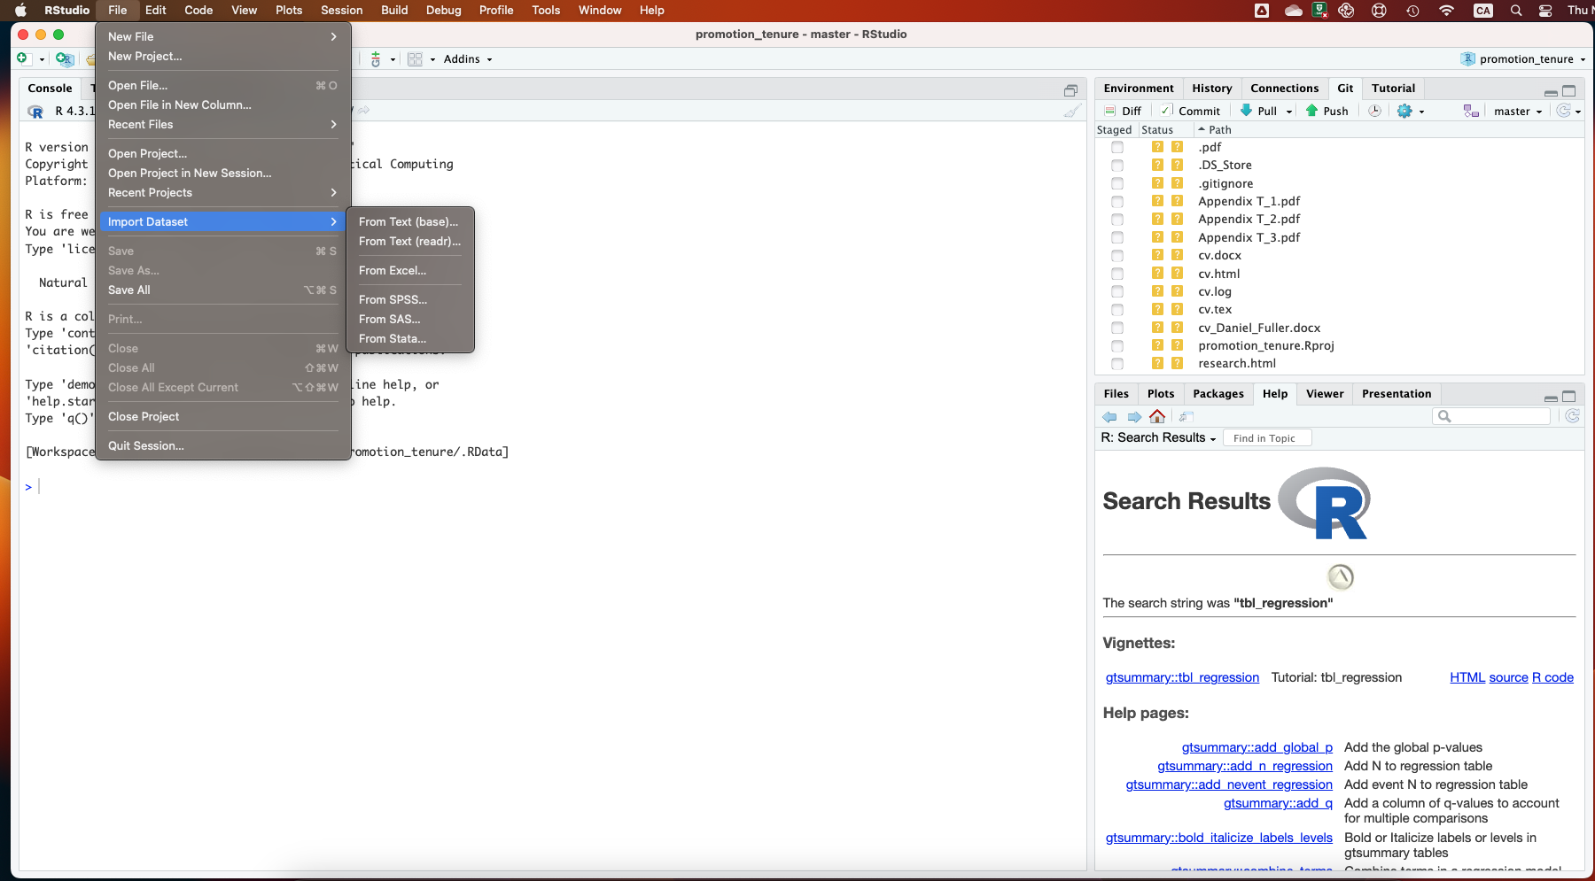

Slide 5
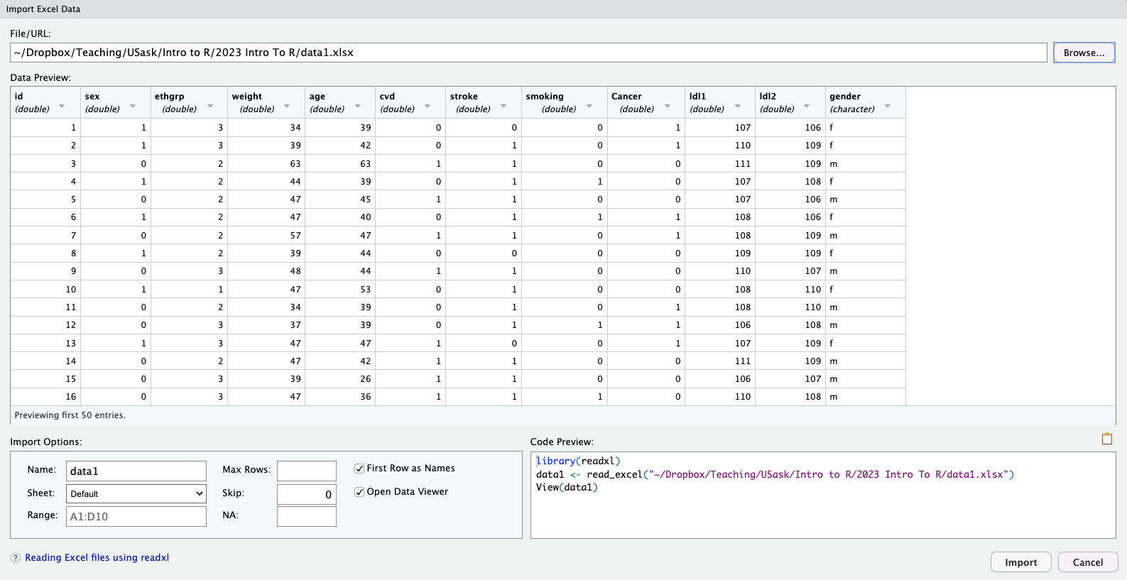

Slide 6

R Markdown – Killer feature
# User created things are amazing
# https://rmarkdown.rstudio.com/
# Basic idea of R Markdown is to integrate statistical code, output, and interpretation into one generic, reproducible, and transferable file format
# If you use it people will think you are magic
# Default standard for R users doing exploratory data analysis
https://yihui.org/

Slide 7
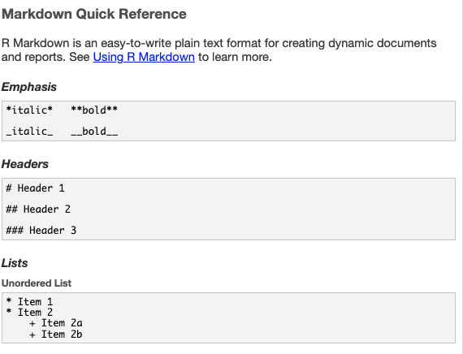
R Markdown – Killer feature
# Based on generic Markdown
# Very simple document formatting language

Slide 8
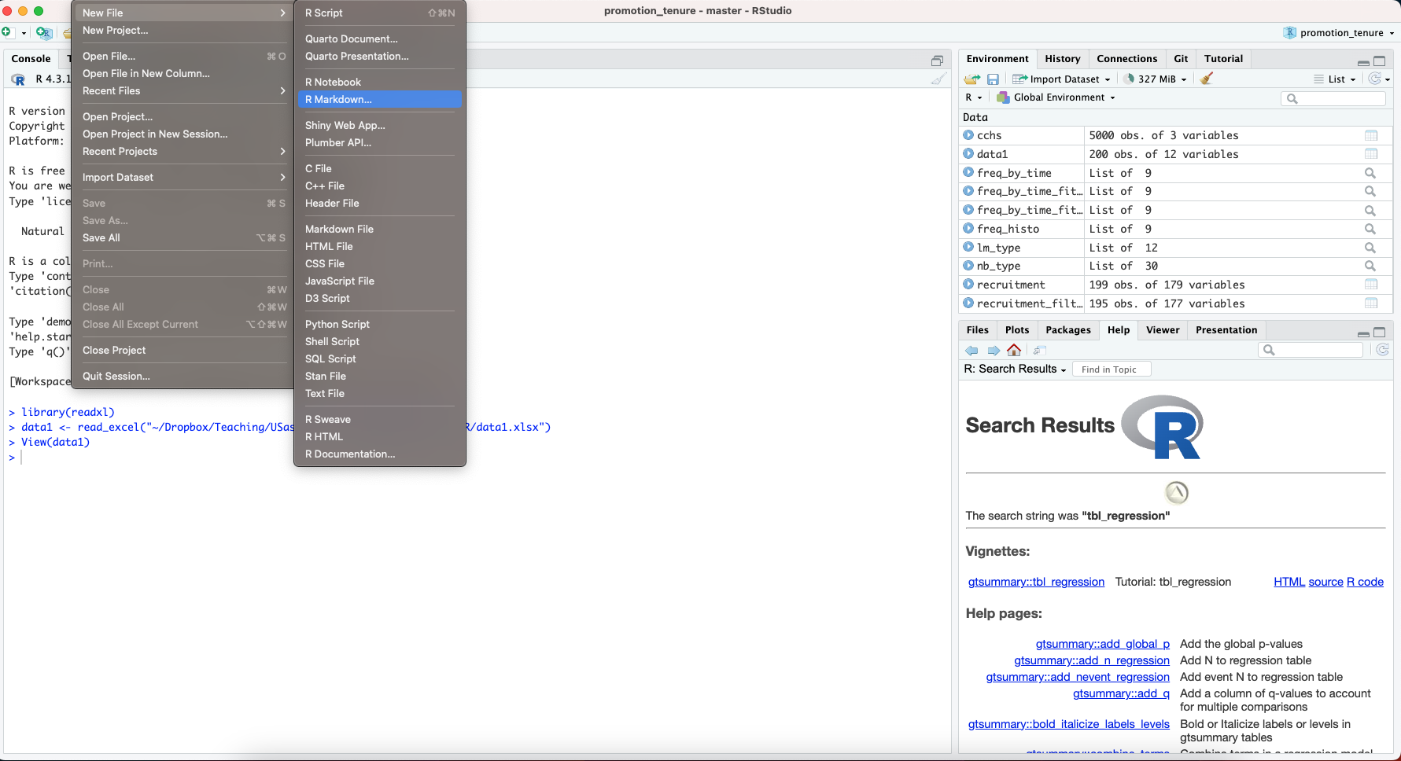
R Markdown – Killer feature

Slide 9
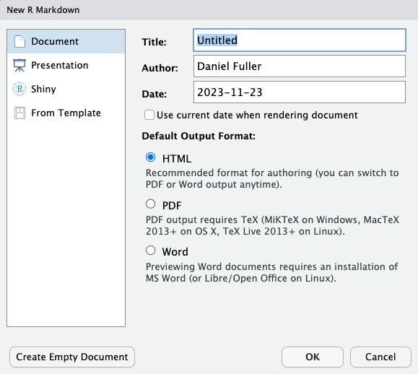

Slide 10
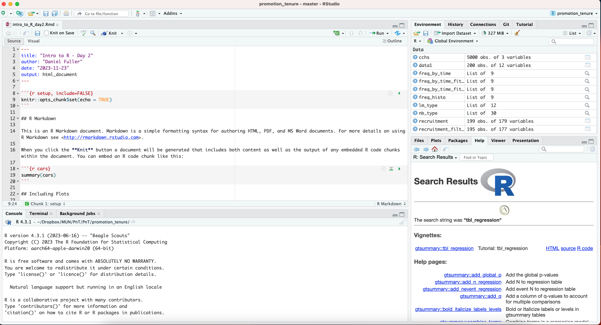

Slide 11
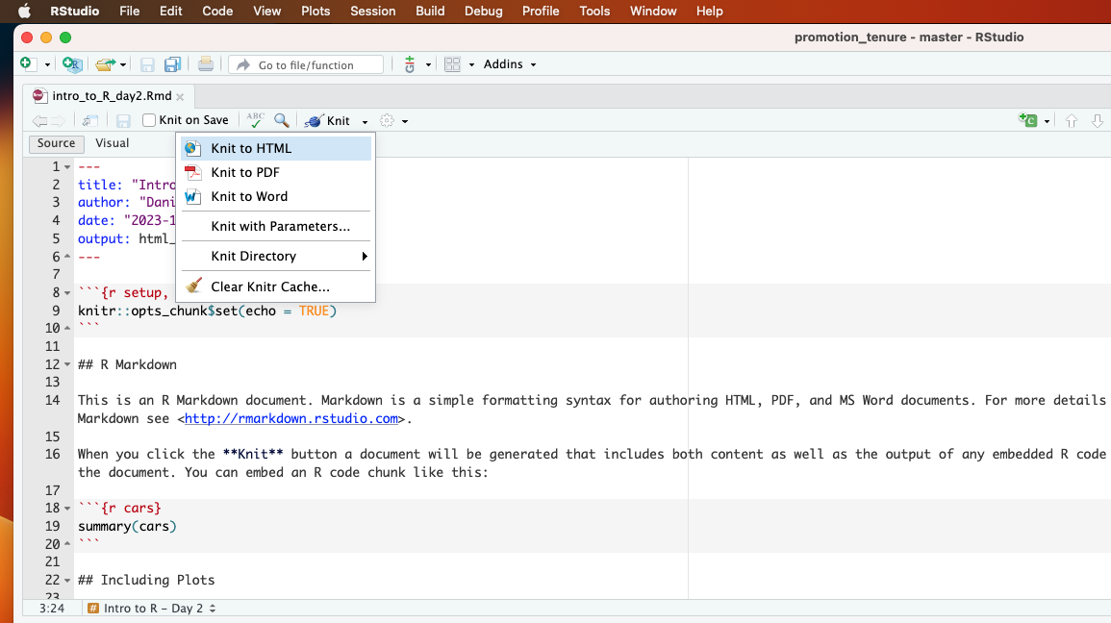

Slide 12
Setup a new Markdown File
# Importing data set in CSV file named ‘data2’
data2 <- read.csv(“location of the data/data2.csv", header = TRUE)
# merging data1 and data2
data1 <- dplyr::select(data1, id, sex, ethgrp, weight, age, cvd)
data2 <- dplyr::select(data2, id, stroke, smoking, Cancer, ldl1, ldl2, gender)
### joining/merging data
data_merge <- dplyr::full_join(data1, data2)
data_merge1 <- dplyr::full_join(data1, data2, by = join_by(id))
data_merge2 <- dplyr::full_join(data1, data2,by = join_by(id == id))

Slide 13
Importing dataset, Data merging
# Importing data set in CSV file named ‘data2’
data2 <- read.csv(“location of the data/data2.csv", header = TRUE)
# merging data1 and data2
data1 <- dplyr::select(data1, id, sex, ethgrp, weight, age, cvd)
data2 <- dplyr::select(data2, id, stroke, smoking, Cancer, ldl1, ldl2, gender)
### joining/merging data
data_merge <- dplyr::full_join(data1, data2)
data_merge1 <- dplyr::full_join(data1, data2, by = join_by(id))
data_merge2 <- dplyr::full_join(data1, data2,by = join_by(id == id))

Slide 14
Importing data named ‘test’
test <- read.csv("location of the data/test.csv", header = TRUE)
##test
head(test,10)
tail(test,10)

Slide 15
Summary statistics
# Need package vtable to describe summary statistics
# if vtable is already installed, need to run library only
library(vtable)
st(test)

Slide 16
Creating categorical variables
# to create categorial variable ‘agecat’ using age
summary(test$age)
test <- test %>%
mutate(age_cat = case_when(
age < 45 ~ "<45",
age >= 45 & age < 50 ~ "45-49",
age >= 50 & age < 59 ~ "50-59",
age >= 60 & age < 65 ~ "60-64",
TRUE ~ "65+"
))
count(test, age_cat)
table(test$age, test$age_cat)

Slide 17
Chi-square test
# Check frequency distribution of a categorical variable
# Cross tabulation
# Chi-square test
# Check frequency distribution of gender
table(test$gender)
# Output:
# gender
# f m
# 117 103

Slide 18
Chi-square test
# Cross tabulation of gender and stroke
table(test$gender, test$stroke)
# Output
# stroke
# gender 0 1
# f 50 67
# m 24 79

Slide 19
Chi-square test
# Chi-square test between gender and stroke
chisq.test(test$gender, test$stroke)
# Output
# Pearson's Chi-squared test with Yates' continuity correction
# data: gender and stroke
# X-squared = 8.4179, df = 1, p-value = 0.003715

Slide 20
Fisher’s exact test
fisher.test(test$gender, test$stroke)
# Output
# Fisher's Exact Test for Count Data
# data: gender and stroke
# p-value = 0.002674
# alternative hypothesis: true odds ratio is not equal to 1
# 95 percent confidence interval:
# 1.318319 4.628560
# sample estimates:
# odds ratio
# 2.446347

Slide 21
T-test (for two independent samples)
# First, we check if data follow Normal distribution
# Normality test (if p>0.05: data are normally distributed)
# Want to compare mean ages between male and female
test_data_female <- filter(test, gender == "f")
shapiro.test(test_data_female$age)
test_data_male <- filter(test, gender == "m")
shapiro.test(test_data_male$age)
# Also check histogtam
hist_age_gender <- ggplot(test, aes(age)) +
geom_histogram() +
facet_wrap(~ gender)
plot(hist_age_gender)

Slide 22
T-test (for two independent samples)
help(t.test)
t.test(age ~ gender, data = test)
Welch Two Sample t-test
data: age by gender
t = -1.9624, df = 200.25, p-value = 0.05111
alternative hypothesis: true difference in means between group f and group m is not equal to 0
95 percent confidence interval:
-5.26625331 0.01274738
sample estimates:
mean in group f mean in group m
51.11111 53.73786
#by default, unequal variance

Slide 23
T-test (for two independent samples)
#check variance
var.test(age ~ gender, data = test)
F test to compare two variances
data: age by gender
F = 0.70681, num df = 116, denom df = 102, p-value = 0.07034
alternative hypothesis: true ratio of variances is not equal to 1
95 percent confidence interval:
0.4830964 1.0293364
sample estimates:
ratio of variances
0.7068141

Slide 24
T-test (for two independent samples
# variances are equal based on the test
t.test(age ~ gender, data = test, var.equal = TRUE)
Two Sample t-test
data: age by gender
t = -1.984, df = 218, p-value = 0.04851
alternative hypothesis: true difference in means between group f and group m is not equal to 0
95 percent confidence interval:
-5.23613291 -0.01737302
sample estimates:
mean in group f mean in group m
51.11111 53.73786

Slide 25
Wilcoxon non-parametric test for independent samples
#non-parametric test if data are not normally distributed
wilcox.test(age ~ gender, data = test)
Wilcoxon rank sum test with continuity correction
data: age by gender
W = 5020, p-value = 0.03246
alternative hypothesis: true location shift is not equal to 0

Slide 26
Paired t-test for two dependent samples test
#paired t-test for two dependent samples
t.test(test$ldl1, test$ldl2, paired = TRUE)
Paired t-test
data: test$ldl1 and test$ldl2
t = -0.5298, df = 219, p-value = 0.5968
alternative hypothesis: true mean difference is not equal to 0
95 percent confidence interval:
-0.3003634 0.1730907
sample estimates:
mean difference
-0.06363636

Slide 27
Correlation analysis
# Pearson correlation coefficient
cor.test(test$ldl1, test$ldl2, method = "pearson")
Pearson's product-moment correlation
data: test$ldl1 and test$ldl2
t = 4.1684, df = 218, p-value = 4.425e-05
alternative hypothesis: true correlation is not equal to 0
95 percent confidence interval:
0.1446265 0.3899574
sample estimates:
cor
0.2717003

Slide 28
Correlation Analysis
#Spearman correlation coefficient
cor.test(test$ldl1, test$ldl2, method = "spearman")
Spearman's rank correlation rho
data: test$ldl1 and test$ldl2
S = 1339899, p-value = 0.0002436
alternative hypothesis: true rho is not equal to 0
sample estimates:
rho
0.2449701

Slide 29
Linear Regression
# Conduct linear regression model between dependent and independent variables
# age is continuous, gender is categorical, ldl is continuous variable
linear_model <- lm(age ~ as.factor(gender) + ldl1, data = test)
summary(linear_model) ### Old School Way
install.packages("gtsummary")
library(gtsummary)
tbl_regression(linear_model)

Slide 30
Logistic regression model
logistic_model <- glm(Cancer ~ as.factor(gender) + ldl1 + smoking, data = test, family = "binomial")
summary(logistic_model)
## odds ratios and 95% CI (Old School Way)
exp(cbind(OR = coef(logistic_model), confint(logistic_model)))
## odds ratios and 95% CI (New School way)
tbl_regression(logistic_model, exponentiate = TRUE)

Slide 31
Analysis of variance (ANOVA)
# One-way ANOVA
# Pass arguments to aov() function for an ANOVA test
one.anova <- aov(age ~ ethgrp, data = test)
summary(one.anova)

Slide 32
Analysis of variance (ANOVA)
# Non-parametric ANOVA
kruskal.test(age ~ ethgrp, data = test)
Kruskal-Wallis rank sum test
data: age by ethgrp
Kruskal-Wallis chi-squared = 15.426, df = 2, p-value = 0.000447

Slide 33
Acknowledgment
Jiwon Yoon
Prosanta Mondal

