Slide 1


GroundwatCh Internship Presentation
Jack Walker

Slide 2
Internship task
Build an Aquifer Storage and Recovery (ASR) model to enhance Vitens’ water supply system
Vitens’ model goals:
  Keep treatment constant (QTreatment) and as low as possible
  Balance ASR infiltration and extraction on a yearly basis to absorb peak demands
How to accomplish these goals?
Deltares’ RTC-Tools
Strategic Heart conceptual model

Slide 3
WHAT IS RTC-TOOLS?

Slide 4


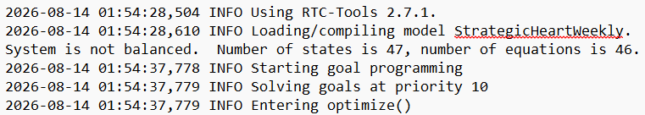
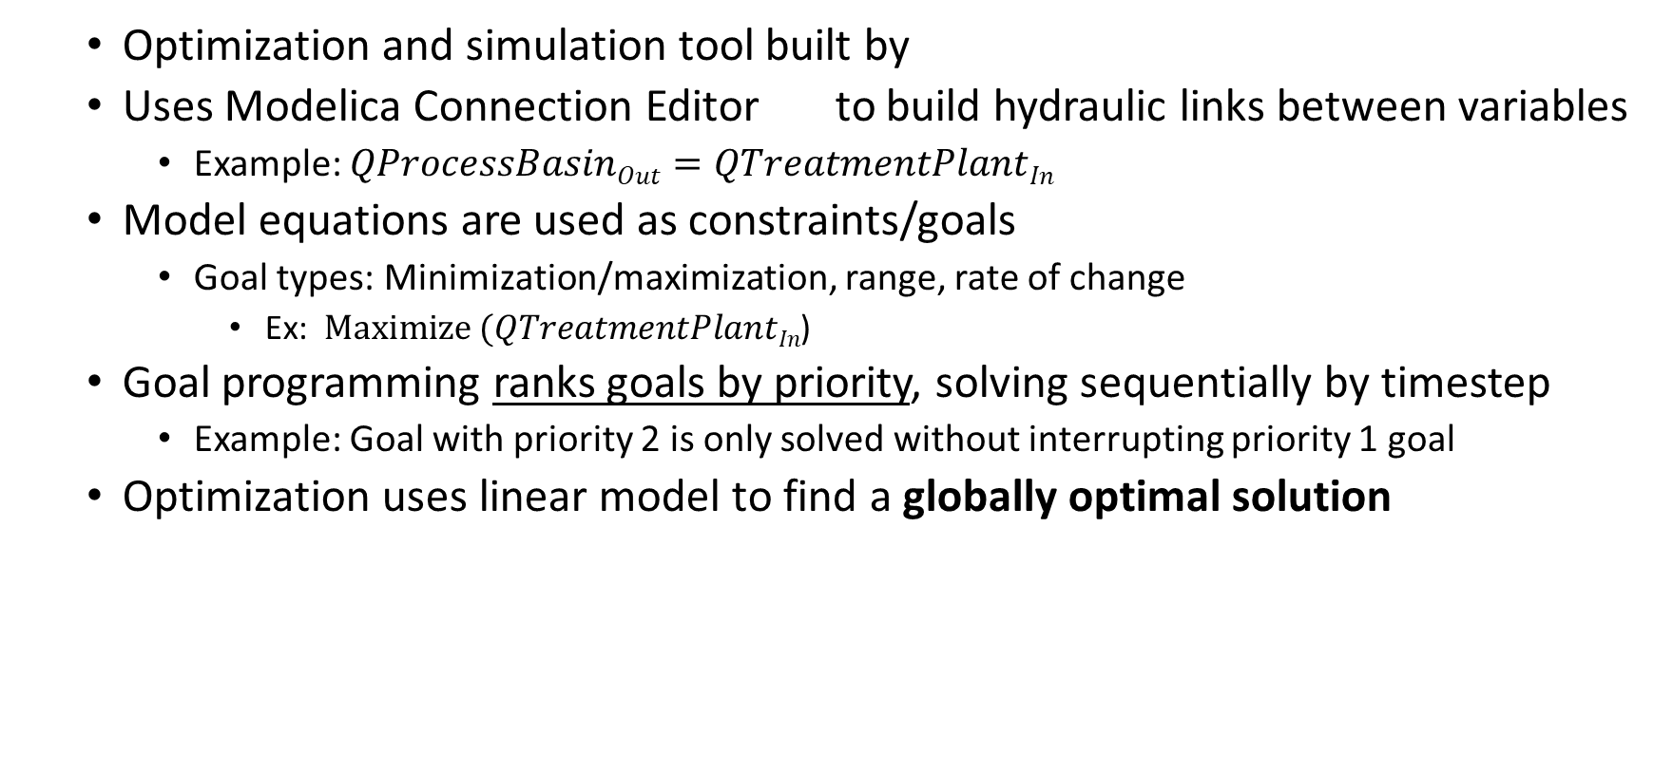
RTC-Tools
  Optimization and simulation tool built by
  Uses Modelica Connection Editor to build hydraulic links between variables
    Example: $QProcessBasinOut=QTreatmentPlantIn$
  Model equations are used as constraints/goals
    Goal types: Minimization/maximization, range, rate of change
      Ex: $Maximize (QTreatmentPlantIn$)
  Goal programming ranks goals by priority, solving sequentially by timestep
    Example: Goal with priority 2 is only solved without interrupting priority 1 goal
  Optimization uses linear model to find a globally optimal solution
  Information source: RTC-Tools documentation (RTC-Tools 2.8.0 documentation)

Slide 5
HOW DOES RTC TOOLS WORK?

Slide 6

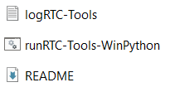

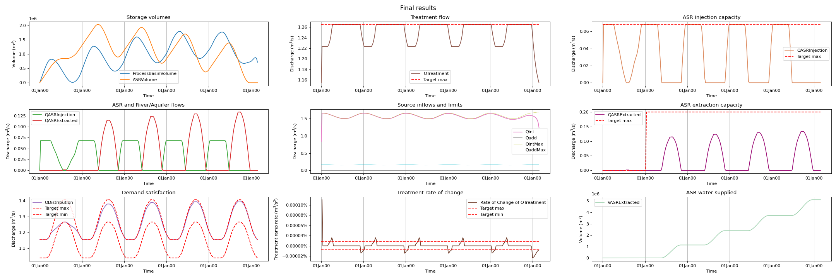
RTC Tools workflow
  3. Construct goal table and input timeseries using variables defined in .mo file
  4. Run RTC-Tools using input files and Modelica model
  1. Download RTC-Tools
state | priority
QDistribution | 10
QTreatment | 20
Qint | 20
Qadd | 20
ASRVolume | 30
ProcessBasinVolume | 30
QASRInjection | 40
QASRExtracted | 40
QShortage | 50
QTreatment | 60
QASRThroughput | 70
Qadd | 80
Qint | 90
Date | Qdem
01/01 | 1.155
08/01 | 1.155
15/01 | 1.155
22/01 | 1.155
29/01 | 1.155
05/02 | 1.155
12/02 | 1.155
19/02 | 1.155
26/02 | 1.155
04/03 | 1.158
11/03 | 1.162
18/03 | 1.168
  5. Load output graphs, compare by priority and final results
  2. Build model in Modelica, save as .mo file

Slide 7
STUDY AREA

Slide 8
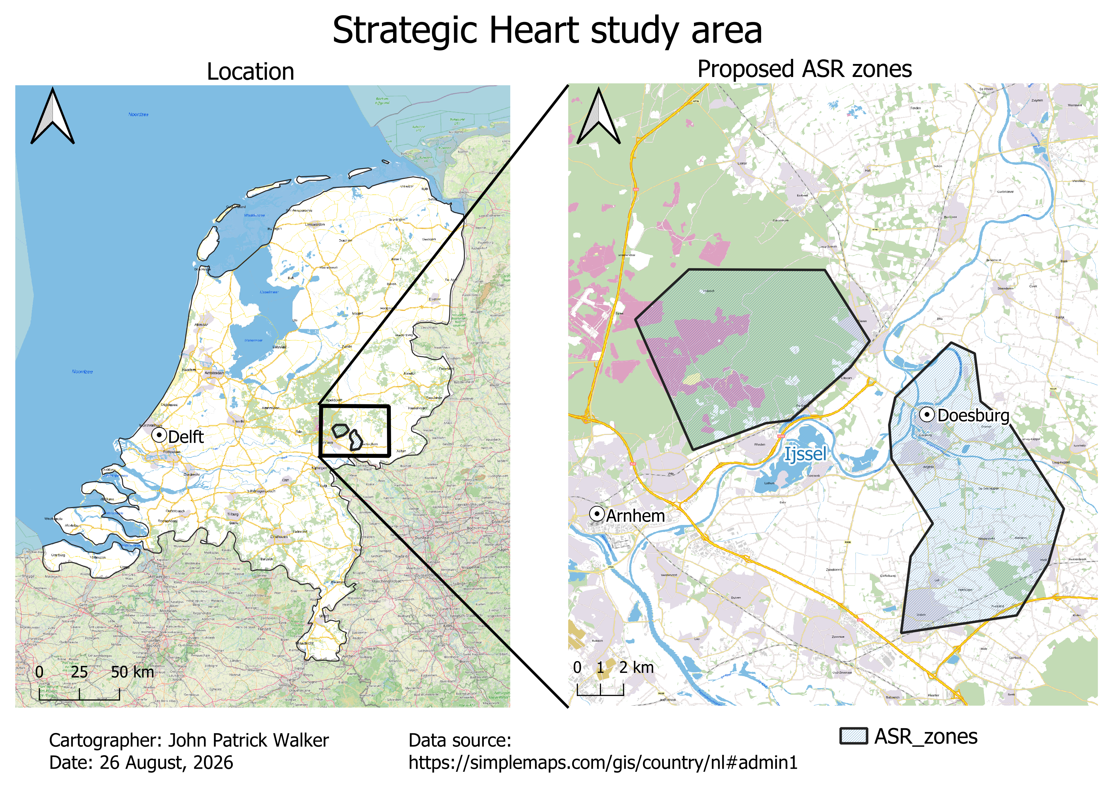
Strategic Heart study area
Located in Gelderland (pop. 2,173,425)
Intake from Ijssel river
Two different ASR zones
Vitens’ demands:
  > 100,000 new homes will be built in Gelderland by 2030
  Natura 2000 areas in the Veluwe NP complicate GW extraction
  Injection into (semi-) confined aquifers
Source: (https://www.vitens.nl/over-water/projecten/gelderland)
Waalre
Twello
Ijssel

Slide 9
CLAY LAYERS AND AQUIFERS

Slide 10
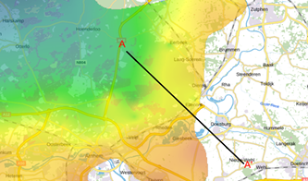
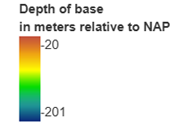

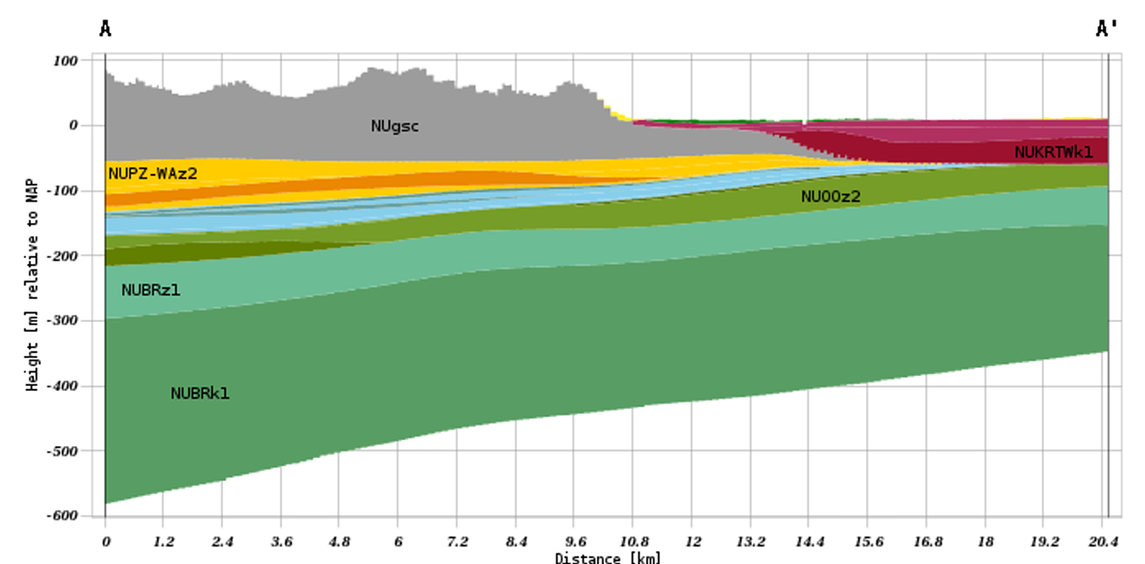
Waalre Formation, third clayey unit
Deposition age: late Pliocene - early Pleistocene
Lithology: fine to coarse sand, bluish grey to brownish grey clay beds
Depth to base: 90 – 140 m
Average thickness: 25 m
Vertical hydraulic conductivity (k_{v}): 0.005 – 0.05 m/d
Waalre Formation, clay
Source: BRO REGIS II v2.2.3 (www.dinoloket.nl)

Slide 11
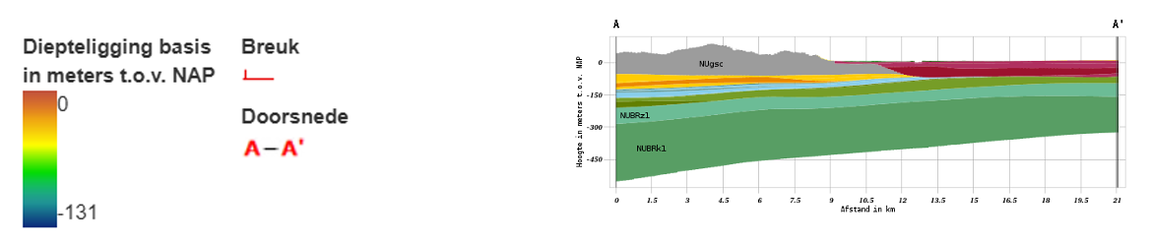
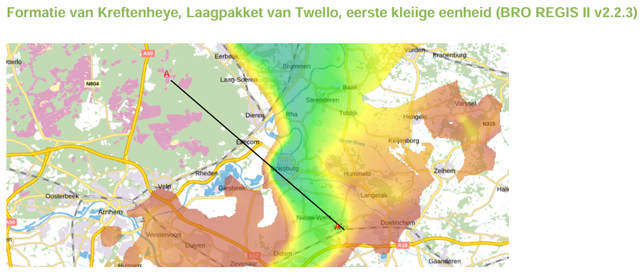


Kreftenheye Formation, Twello Member, first clayey unit
Deposition age: Middle - Late Pleistocene
Lithology: fine to medium sand, locally clayey
Depth to base: 60 – 75 m
Average thickness: up to 75 m
Vertical hydraulic conductivity (k_{v}): 0.0005 – 0.001 m/d
Twello Member
Source: BRO REGIS II v2.2.3 (www.dinoloket.nl)

Slide 12
AQUIFERS

Slide 13
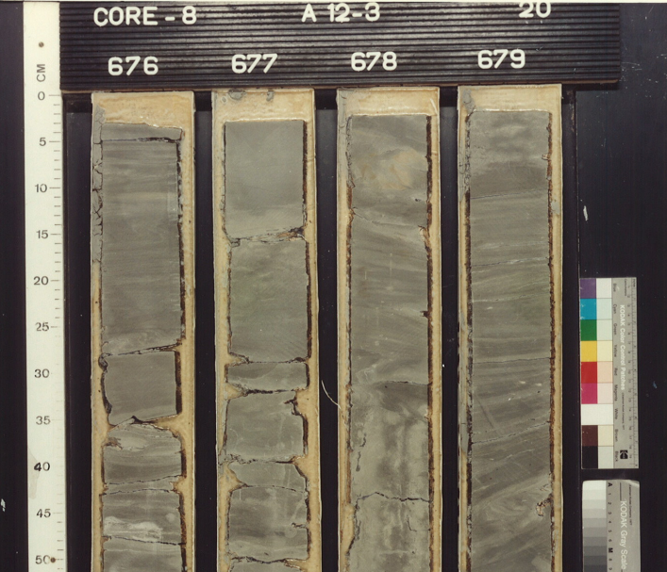
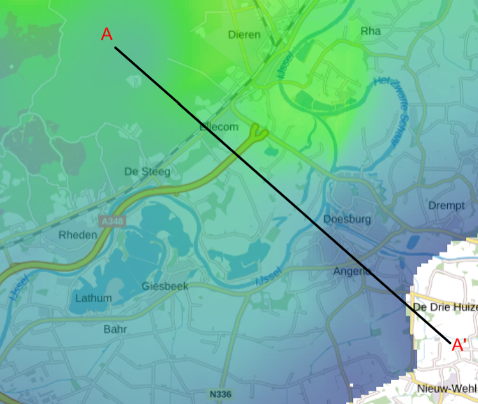
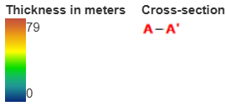
Maasluis Formation
Principal aquifer underlying Waalre
Age: early Pleistocene
Lithology: grey very fine to fine sand, micaceous and calcareous
Average thickness: 25 m
Transmissivity (T):
50 - 100 m²/d
Maasluis Formation
Source: BRO REGIS II v2.2.3 (www.dinoloket.nl)

Slide 14
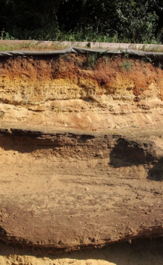
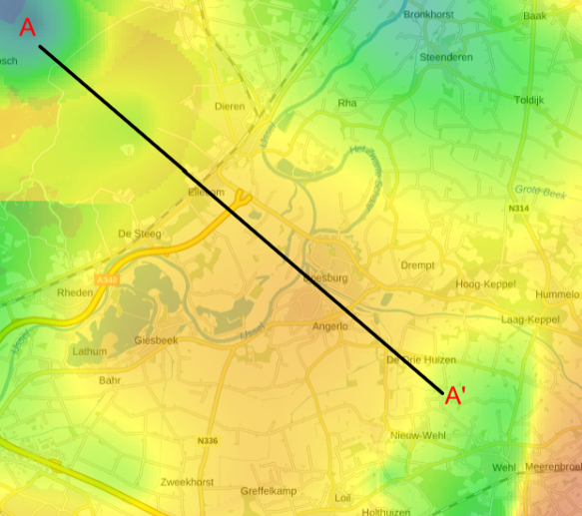
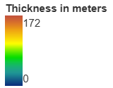
Oosterhout Formation
Principal aquifer underlying Twello
Age: late Miocene to Pliocene
Lithology: Light grey to greyish green very fine to medium sand
Average thickness: 90 m
Transmissivity: 250 - 500 m²/d
Stronger candidate for injection
(photo by André Slupik)
Oosterhout Formation
Source: BRO REGIS II v2.2.3 (www.dinoloket.nl)

Slide 15
MODEL

Slide 16



Modelica file
Boundary inflow
Boundary outflow
Connecting node
Storage node
Model built in OMEdit to create hydraulic/volumetric connections between nodes
Water input from Qint and Qadd, flows to process basin
Treated water can either go to ASRwell or straight to distribution network
  Treatment plant has 20% losses
ASRwell acts as storage

Slide 17
Goal table structure
state | goal_type | priority
QDistribution | range | 10
QTreatment | range | 20
Qint | range | 20
Qadd | range | 20
ASRVolume | range | 30
ProcessBasinVolume | range | 30
QASRInjection | range | 40
QASRExtracted | range | 40
QShortage | minimization_path | 50
QTreatment | range_rate_of_change | 60
QASRThroughput | minimization_path | 70
Qadd | minimization_path | 80
Qint | range_rate_of_change | 90
Physical volumes, injection and extraction maximums, treatment capacity, and distribution ≤ demand
Structural system constraints
Minimize (Qdemand – Qdistribution):
Try to meet demand. Highest priority non-structural goal
Penalize high rate of change between timesteps for Qtreatment and Qint
Minimize QASRInjection + QASRExtracted:
no unnecessary injection/abstraction
Distribution network goals

Slide 18
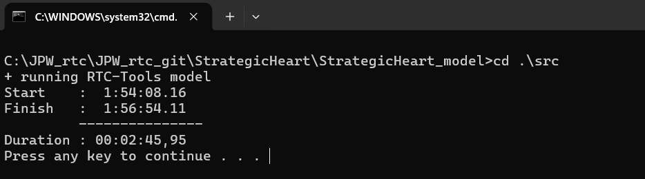
RESULTS

Slide 19
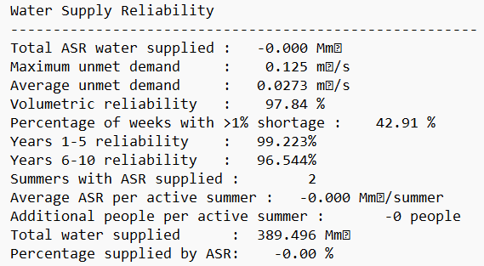
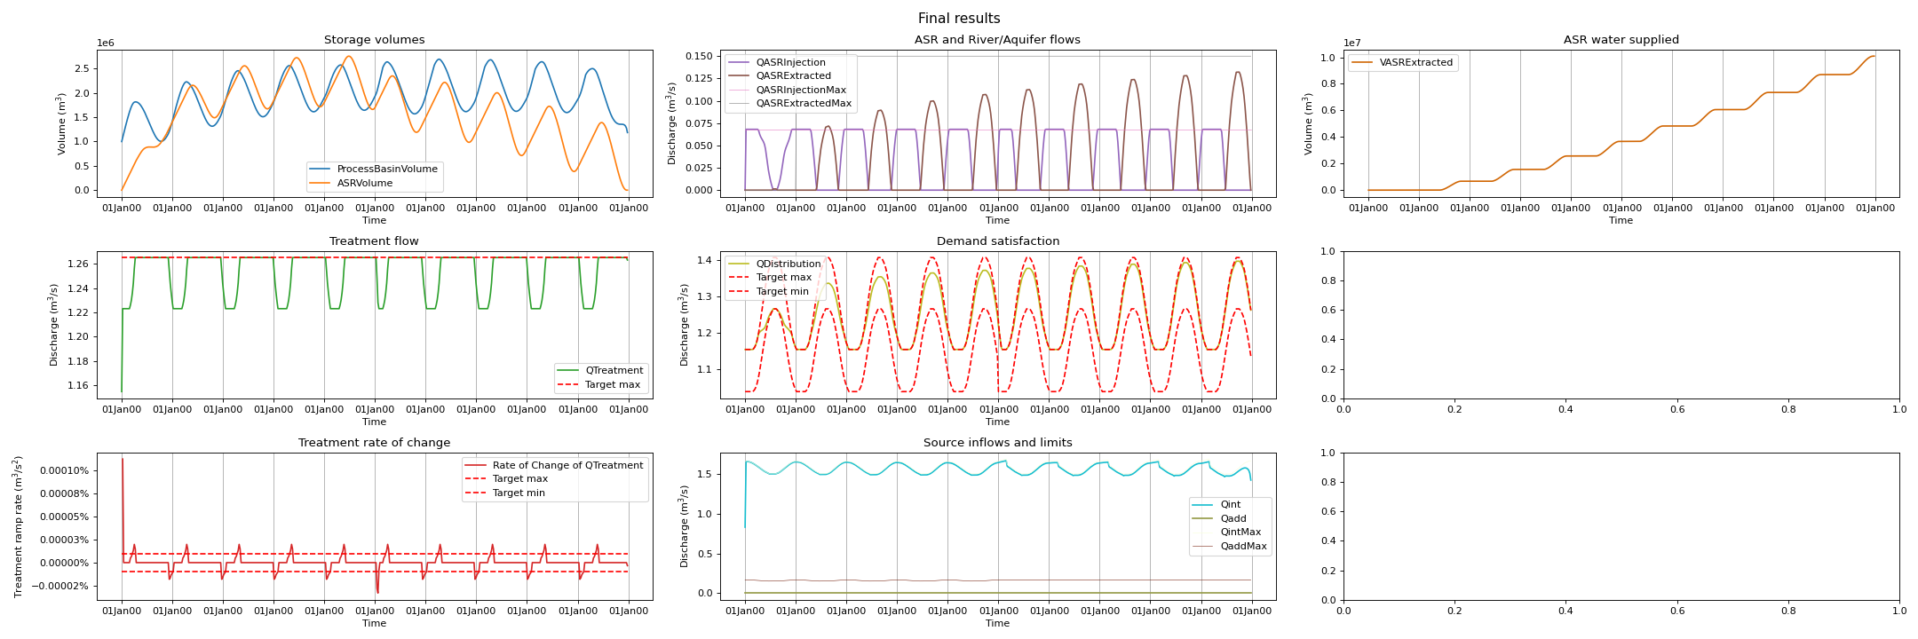
Available results for analysis
Reliability statistics
Total ASR water supplied
Volumetric reliability and % of weeks with shortage
People supported by ASR water
Graphs
Storage volumes
Treatment flow and rate of change
ASR flows and river intake
Demand satisfaction

Slide 20
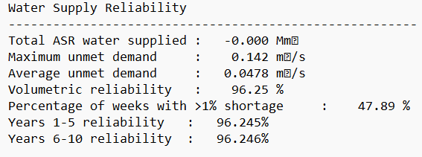
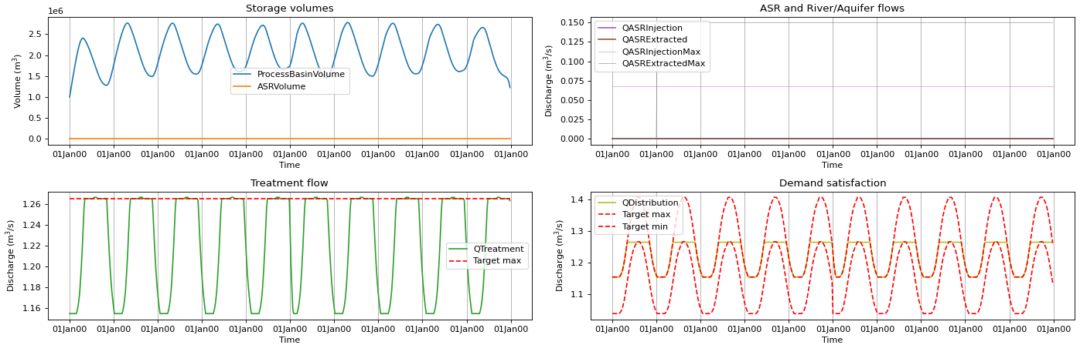
Results #1: 10 yr baseline
QASRInjectionMax | QASRExtractionMax
0.00 m3/s | 0.00 m3/s
0 ASR water supplied
47% of weeks with shortage
96.25% volumetric reliability

Slide 21
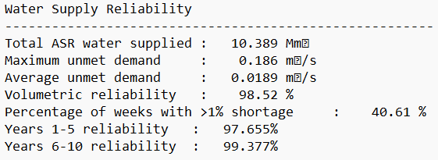
Results #2: ASR 10 year
QASRInjectionMax | QASRExtractionMax
0.068 m3/s | 0.15 m3/s (beginning year 2)
10.39 Mm³ of ASR water supplied
2.27% reliability increase
Max injection reached

Slide 22
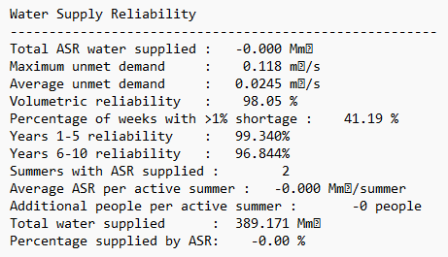
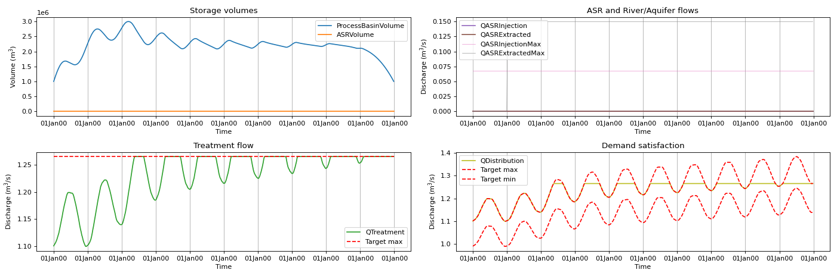
Results #3: Rising demand
QASRInjectionMax | QASRExtractionMax
0.00 m³/s | 0.00 m³/s
41% of weeks have >1% shortage
Qtreatment can’t meet rising demand
Variation in treatment

Slide 23
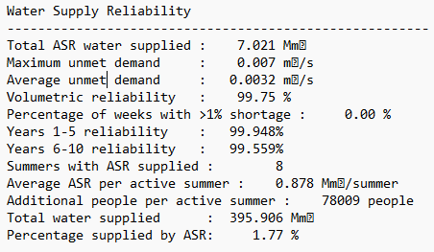
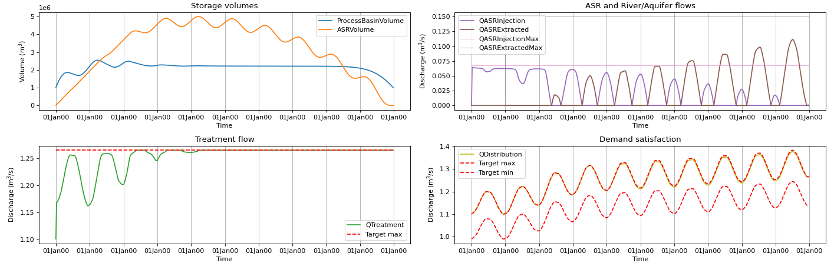
Results #4: ASR rising demand
QASRInjectionMax | QASRExtractionMax
0.068 m³/s | 0.15 m³/s (beginning year 2)
7Mm³ ASR water, shortage weeks reduced to 0%
888,000 m³ of ASR extracted per cycle → water for an additional 78,000 people per cycle
Treatment flow variation reduced

Slide 24
HOW VITENS CAN USE THIS MODEL

Slide 25
Strategic Heart model applications
Establishes reliability parameters for evaluation of ASR system
Demonstrates operating policy for river intake, treatment plant, and ASR
Strategic Heart model meets Vitens’ goal of absorbing peak demands with ASR

Slide 26
NEXT STEPS

Slide 27
Next steps
Adjust model for Vitens’ needs
System functionalities
Real demand/pop. figures
Investigate injection & extraction capacities, explore hourly/temperature model
Cost-benefit analysis of additional water from ASR system
Use model to make informed decision on Strategic Heart project

Slide 28
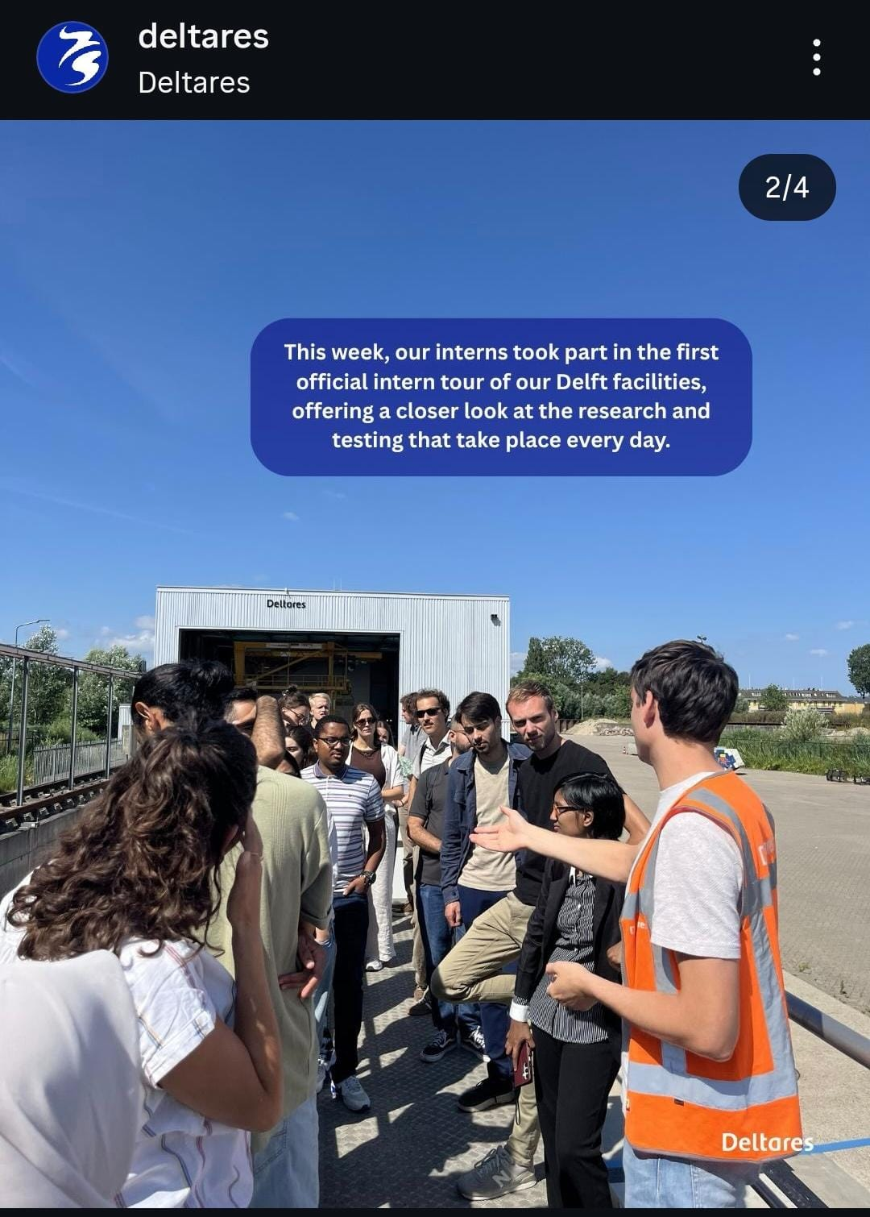
What I learned during this internship
  Enhanced python coding skills
  Learned new software: Modelica Connection Editor
  Investigated ASR system design and capabilities
  Increased understanding of optimization → many many test runs…
  Built connections with RTC-Tools team in Delft and Groundwater Security Department in Utrecht
  Tour of Deltares

Slide 29
THANK YOU BERNHARD AND MARTA

